Slide 1
Summary table (RMSE vs obs)
Variable | Season | DECKv1_451-500 | v2rc3c | v2rc3c-compiler | v2rc3c-GWD
SST | ANN | 1.12 | 1.30 | 1.24 | 1.28
PRECT | ANN | 1.14 | 1.00 | 1.00 | 0.99
PRECT | DJF | 1.44 | 1.38 | 1.39 | 1.37
PRECT | MAM | 1.56 | 1.26 | 1.26 | 1.25
PRECT | JJA | 1.53 | 1.37 | 1.37 | 1.38
PRECT | SON | 1.30 | 1.30 | 1.27 | 1.27
RESTOM | ANN | 9.37 | 8.43 | 8.40 | 8.36
SWCF | ANN | 10.66 | 9.94 | 9.88 | 9.90
LWCF | ANN | 5.39 | 5.31 | 5.31 | 5.28
u850 | ANN | 1.30 | 1.18 | 1.19 | 1.19
u200 | ANN | 2.20 | 2.93 | 2.88 | 2.93
T200 | ANN | 2.60 | 2.65 | 2.62 | 2.65
TREFHT | ANN | 2.57 | 2.90 | 2.80 | 2.88
TREFHT | JJA | 2.85 | 3.04 | 3.00 | 3.06
AODVIS | ANN | 0.07 | 0.06 | 0.06 | 0.06
TAUXY | ANN | 0.02 | 0.02 | 0.02 | 0.02

Slide 2
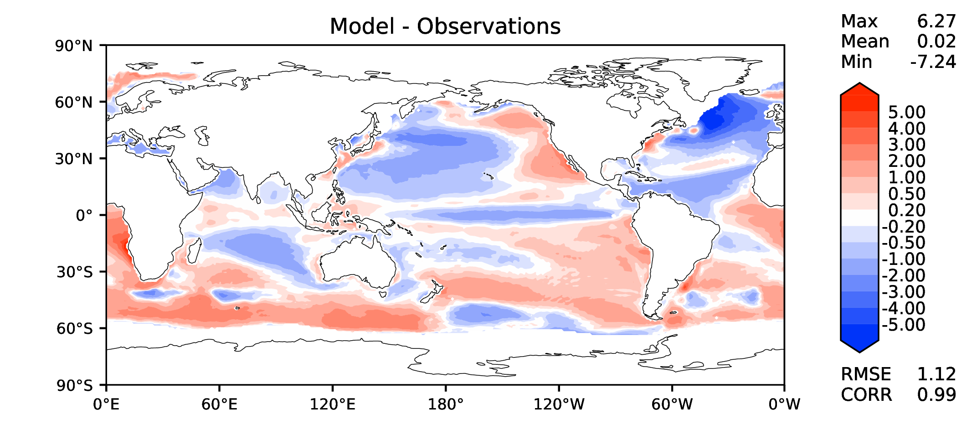
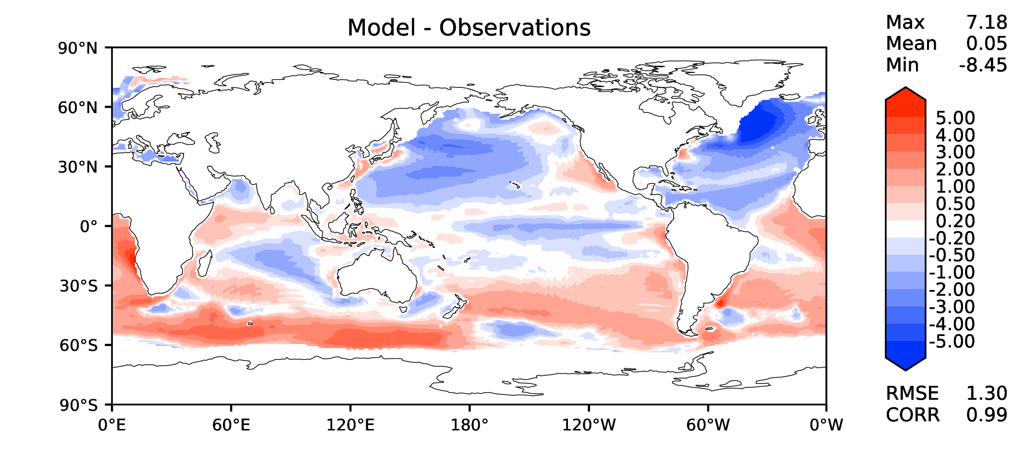
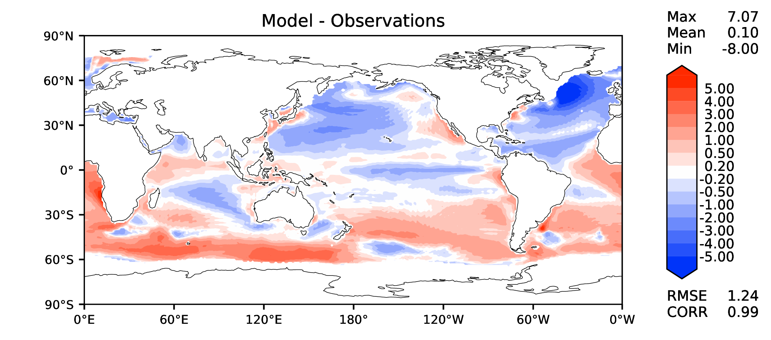

Annual SST (pre-industrial)
DECKv1_451-500
v2rc3c
v2rc3c-compiler
v2rc3c-GWD

Slide 3
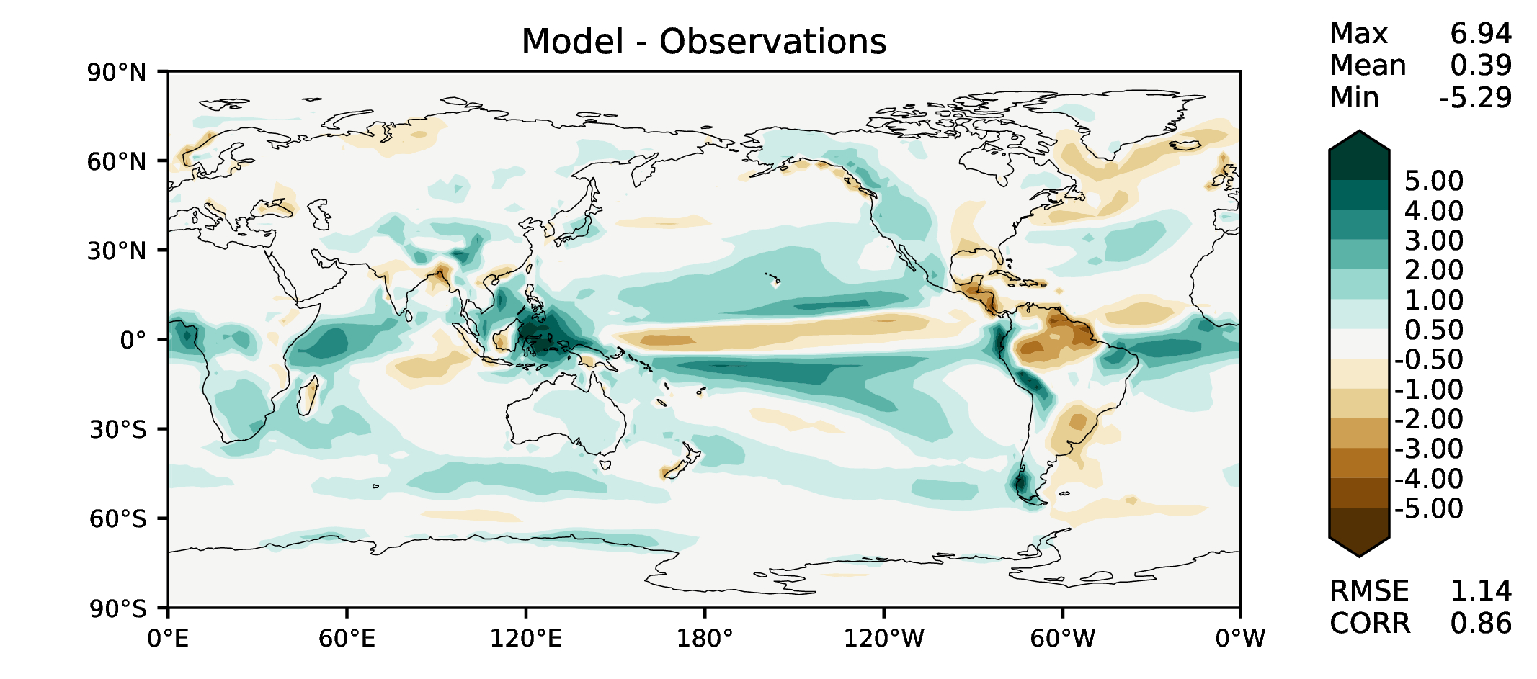
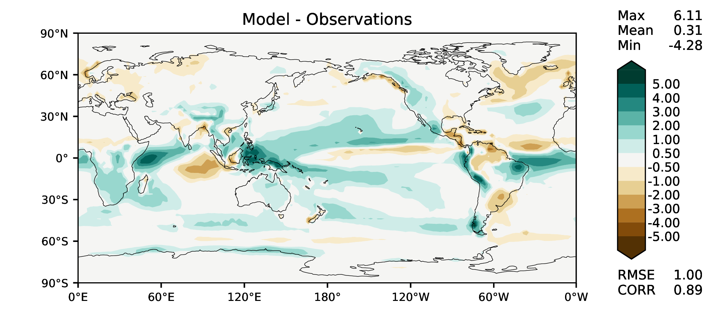

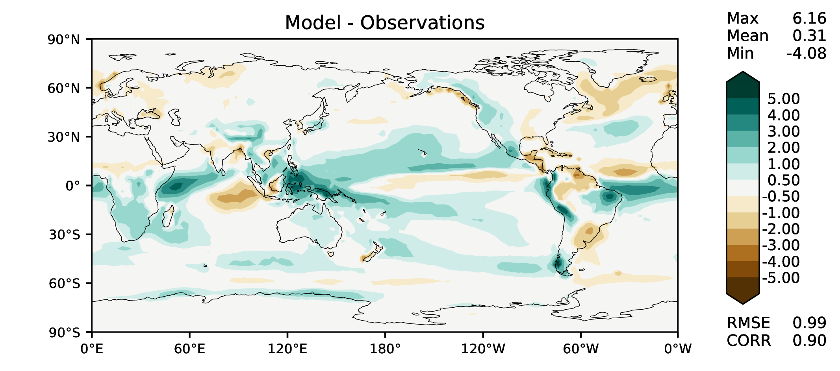
Annual total precipitation
DECKv1_451-500
v2rc3c
v2rc3c-compiler
v2rc3c-GWD

Slide 4
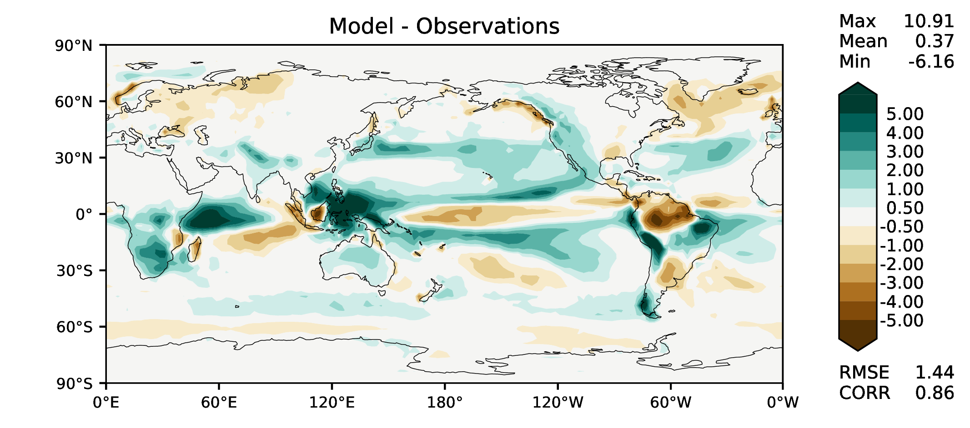
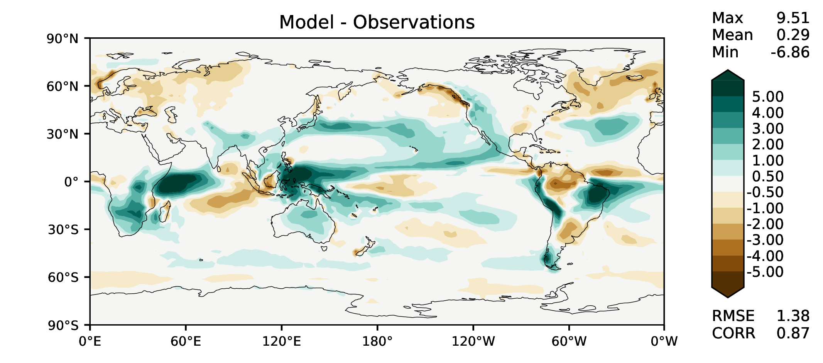


DJF total precipitation
DECKv1_451-500
v2rc3c
v2rc3c-compiler
v2rc3c-GWD

Slide 5
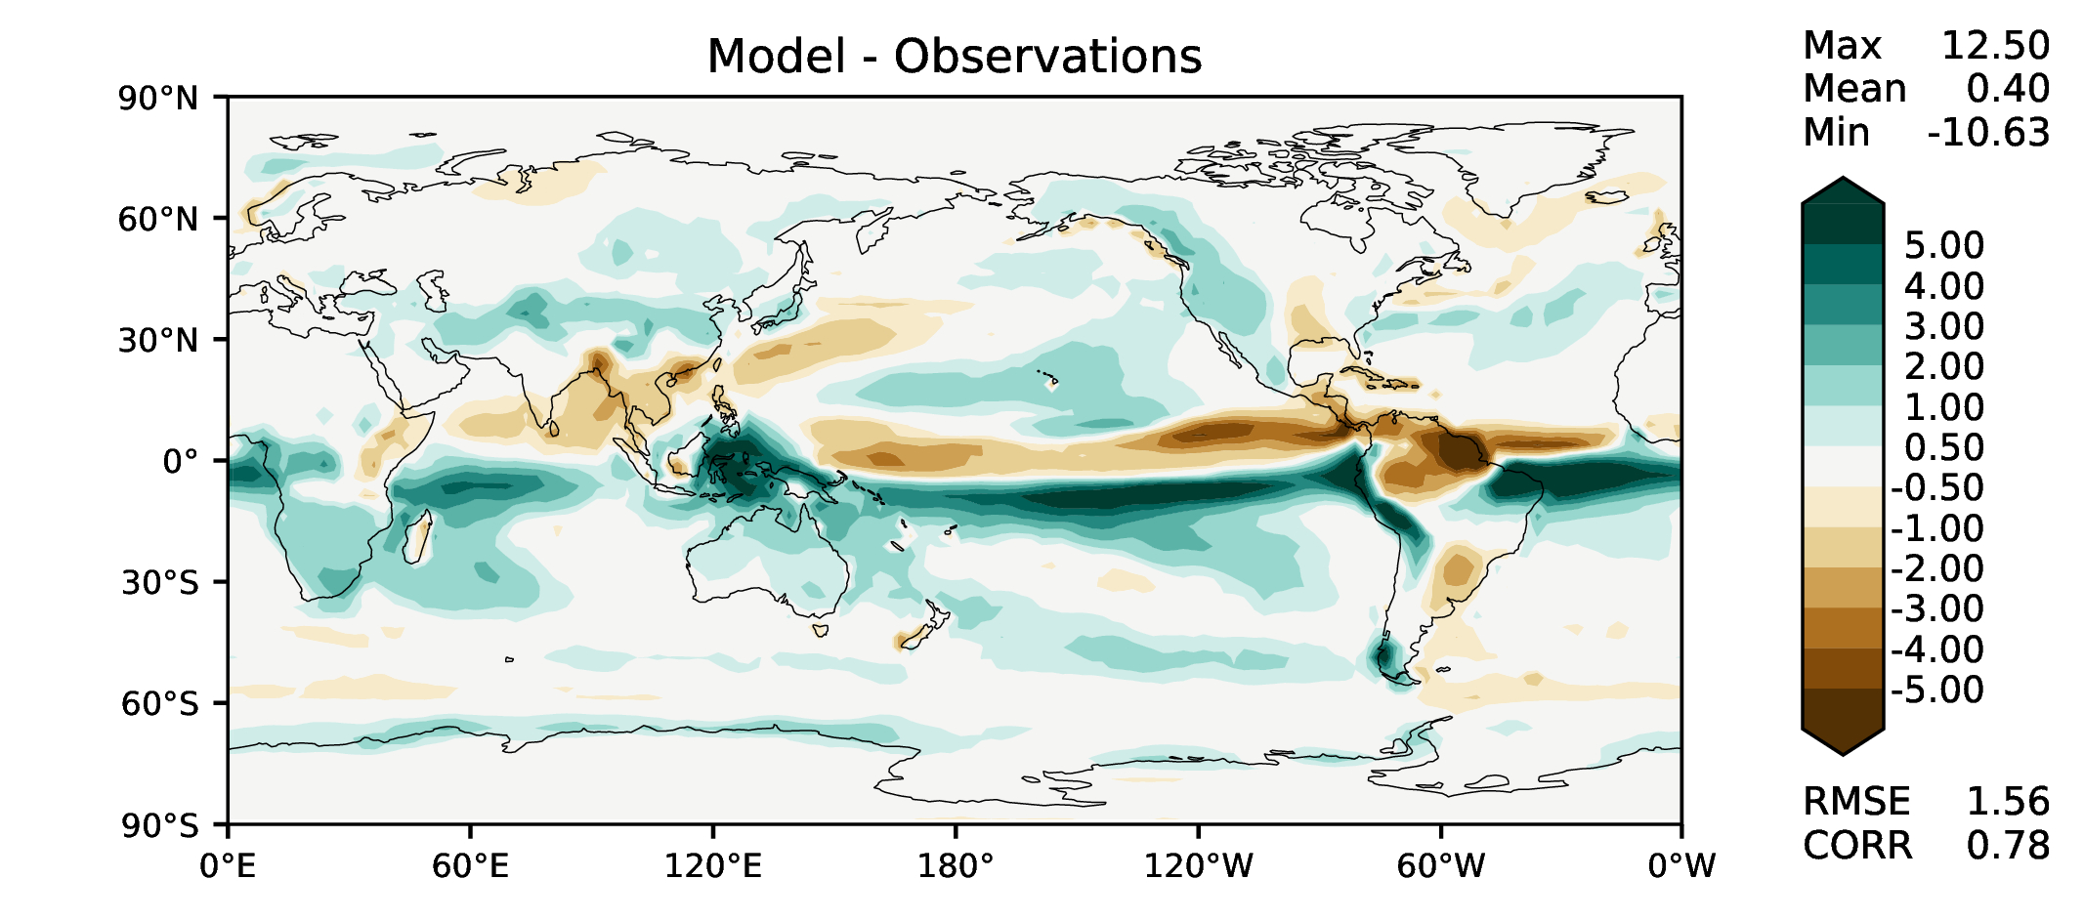
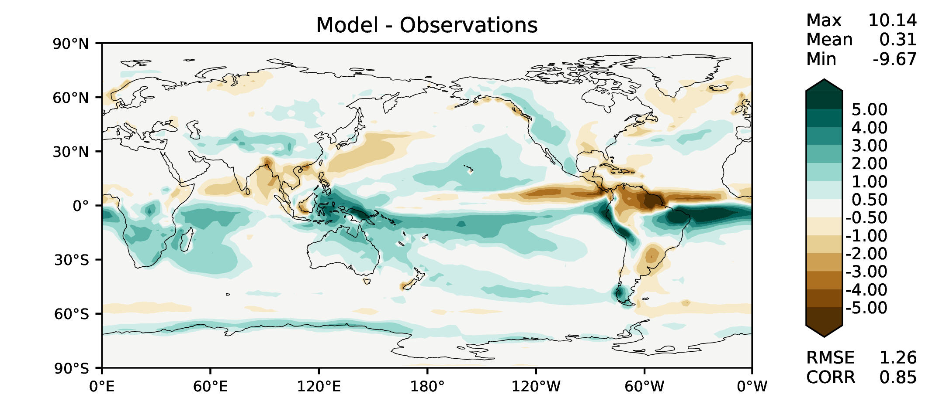
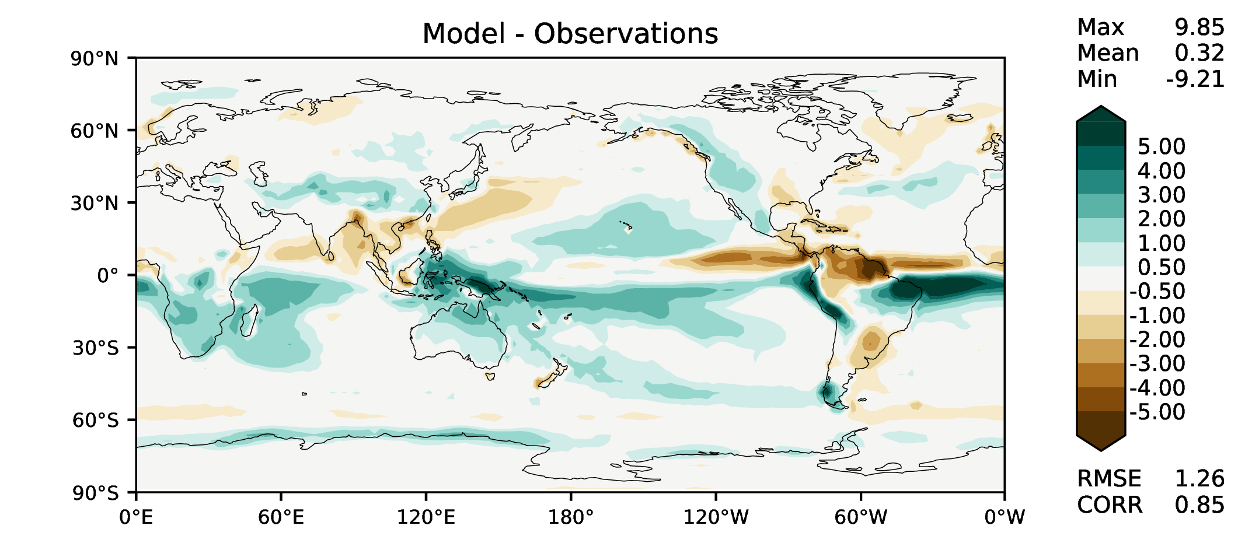
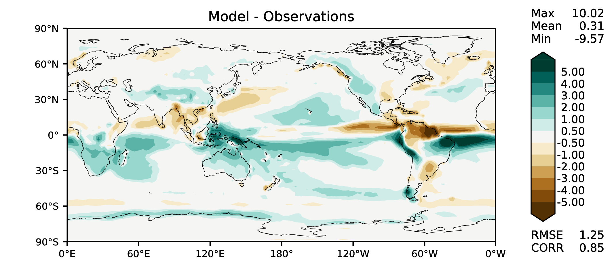
MAM total precipitation
DECKv1_451-500
v2rc3c
v2rc3c-compiler
v2rc3c-GWD

Slide 6
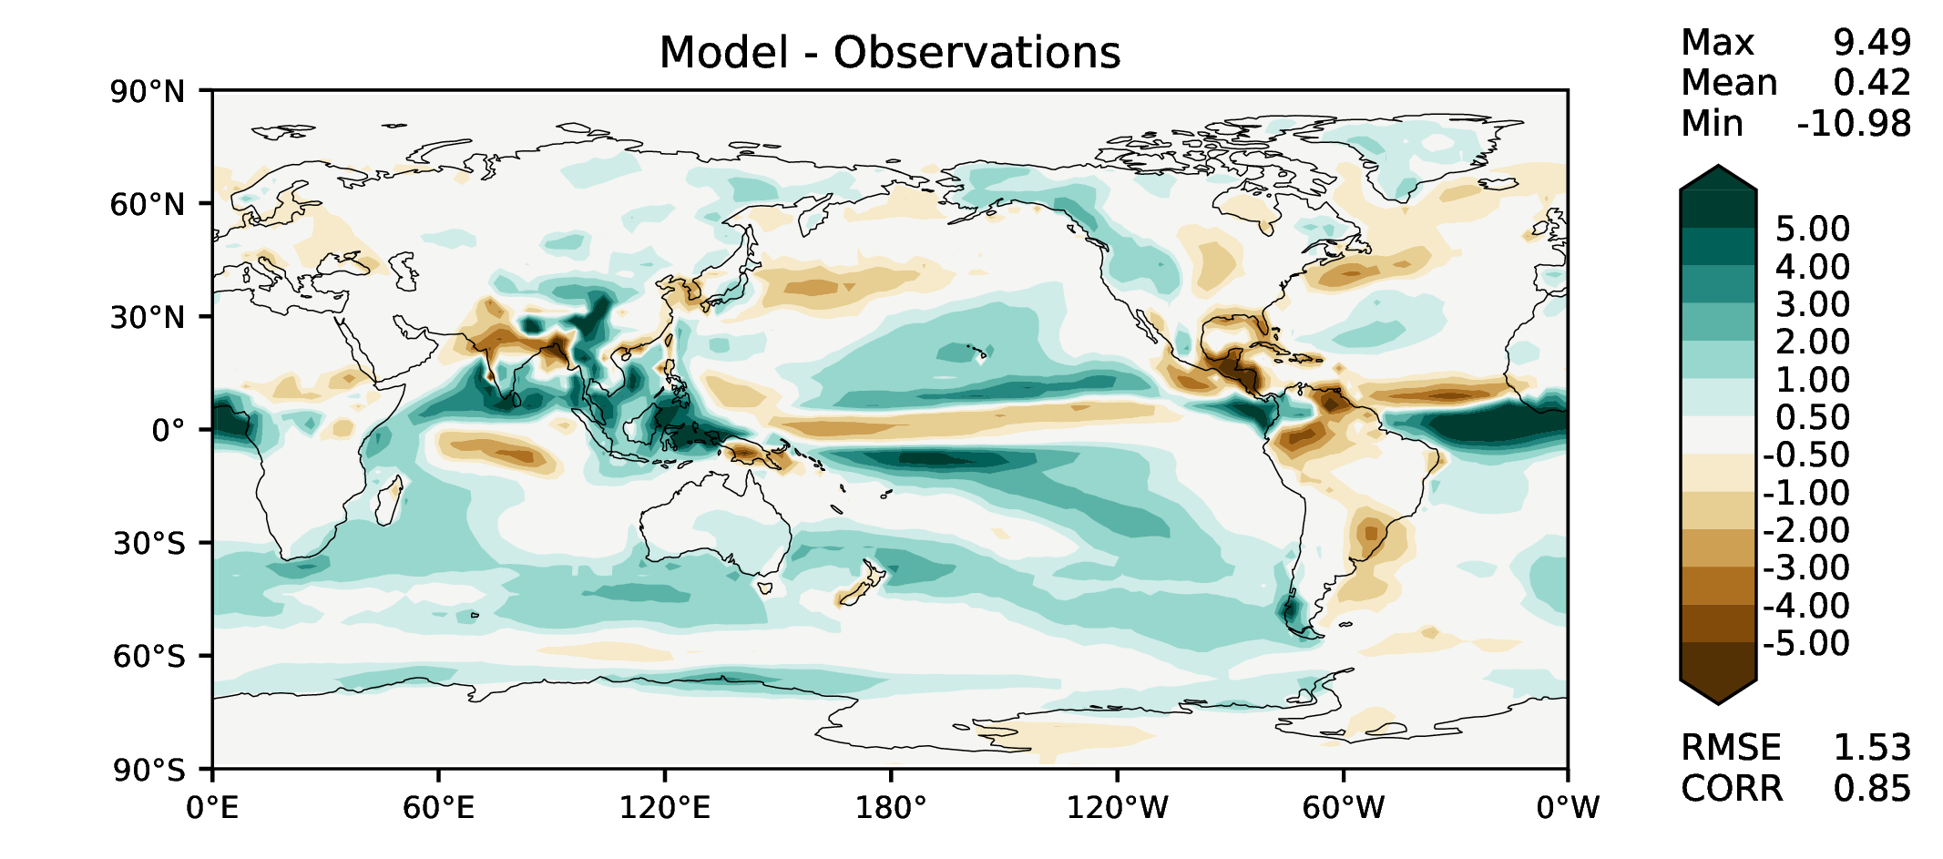
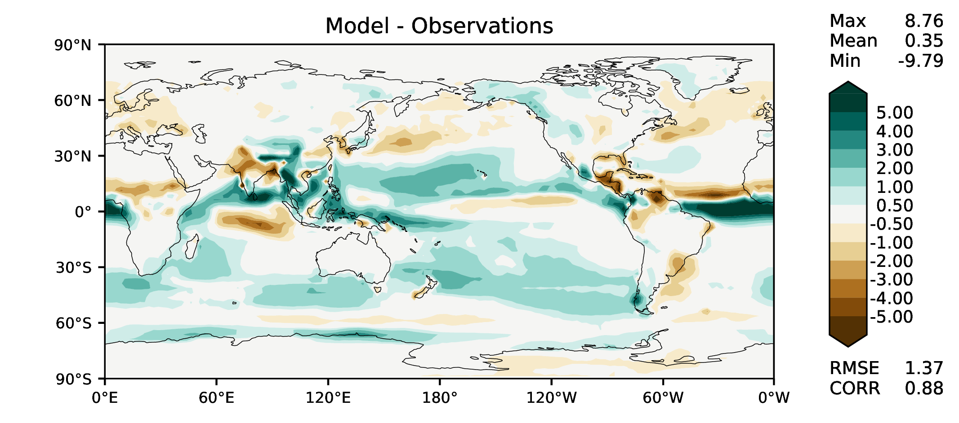
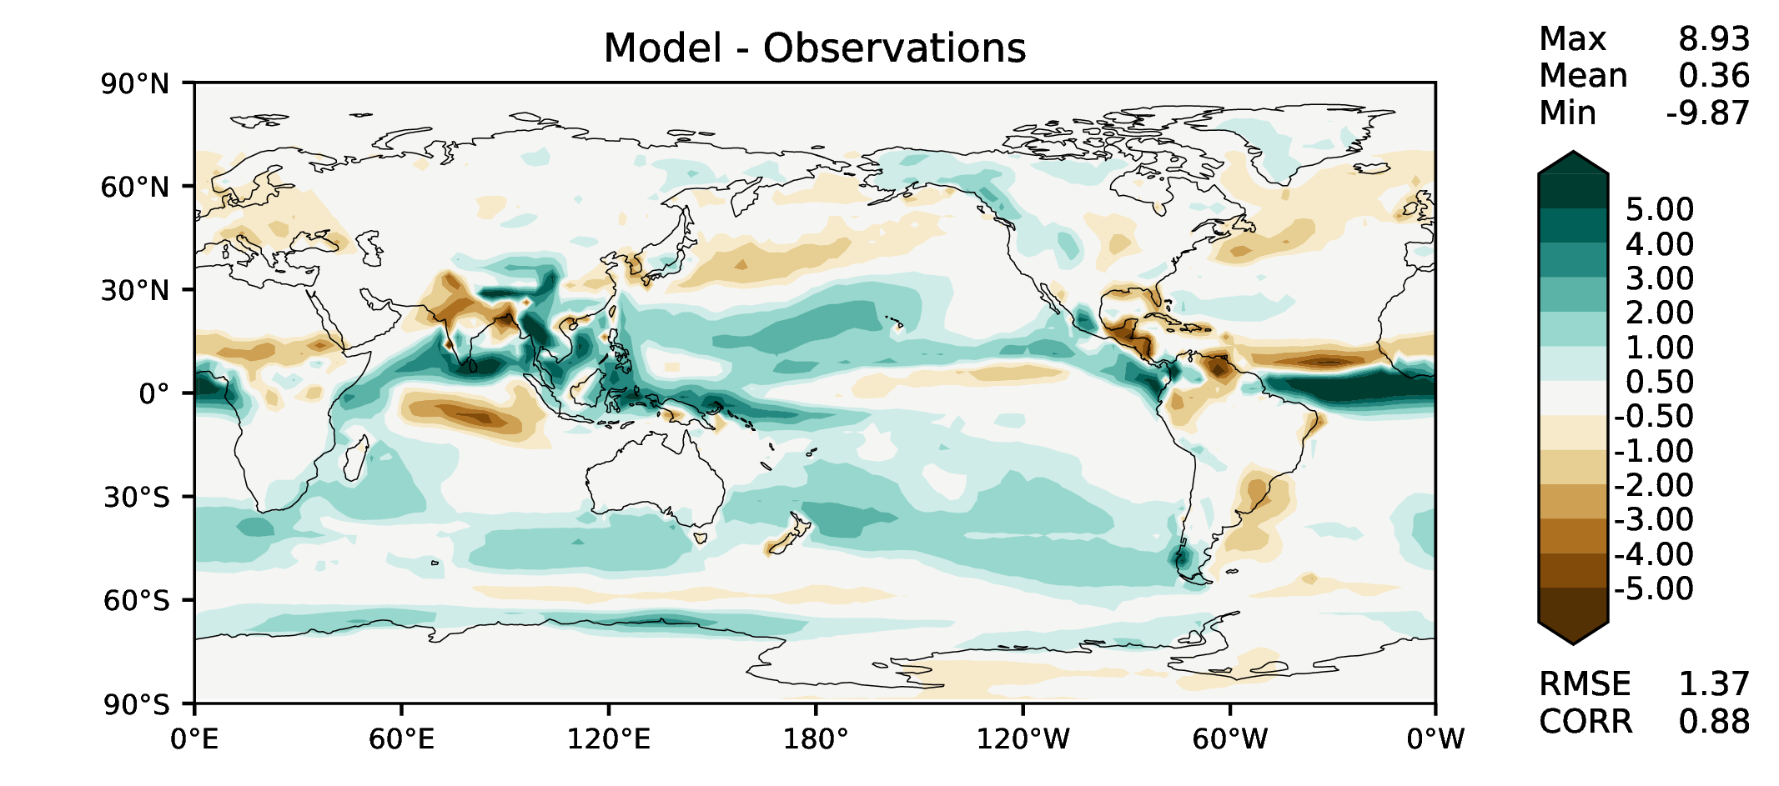

JJA total precipitation
DECKv1_451-500
v2rc3c
v2rc3c-compiler
v2rc3c-GWD

Slide 7
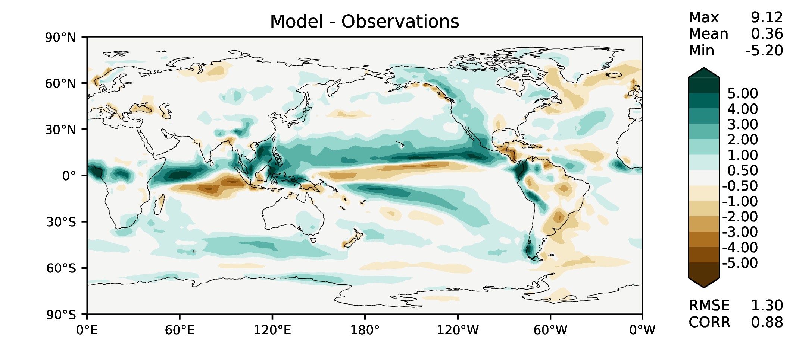
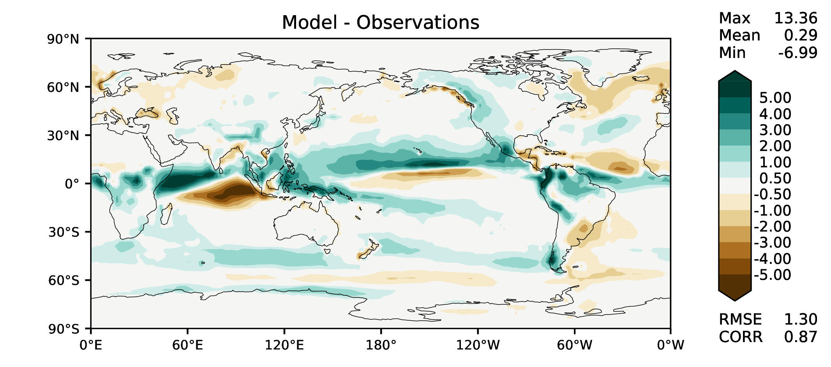
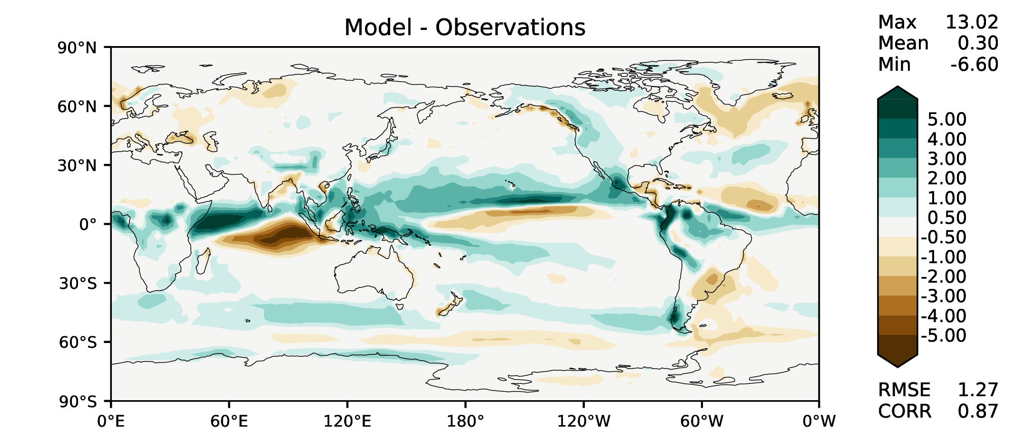

SON total precipitation
DECKv1_451-500
v2rc3c
v2rc3c-compiler
v2rc3c-GWD

Slide 8
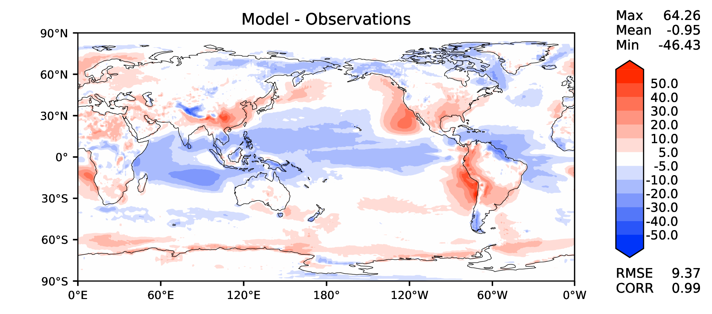
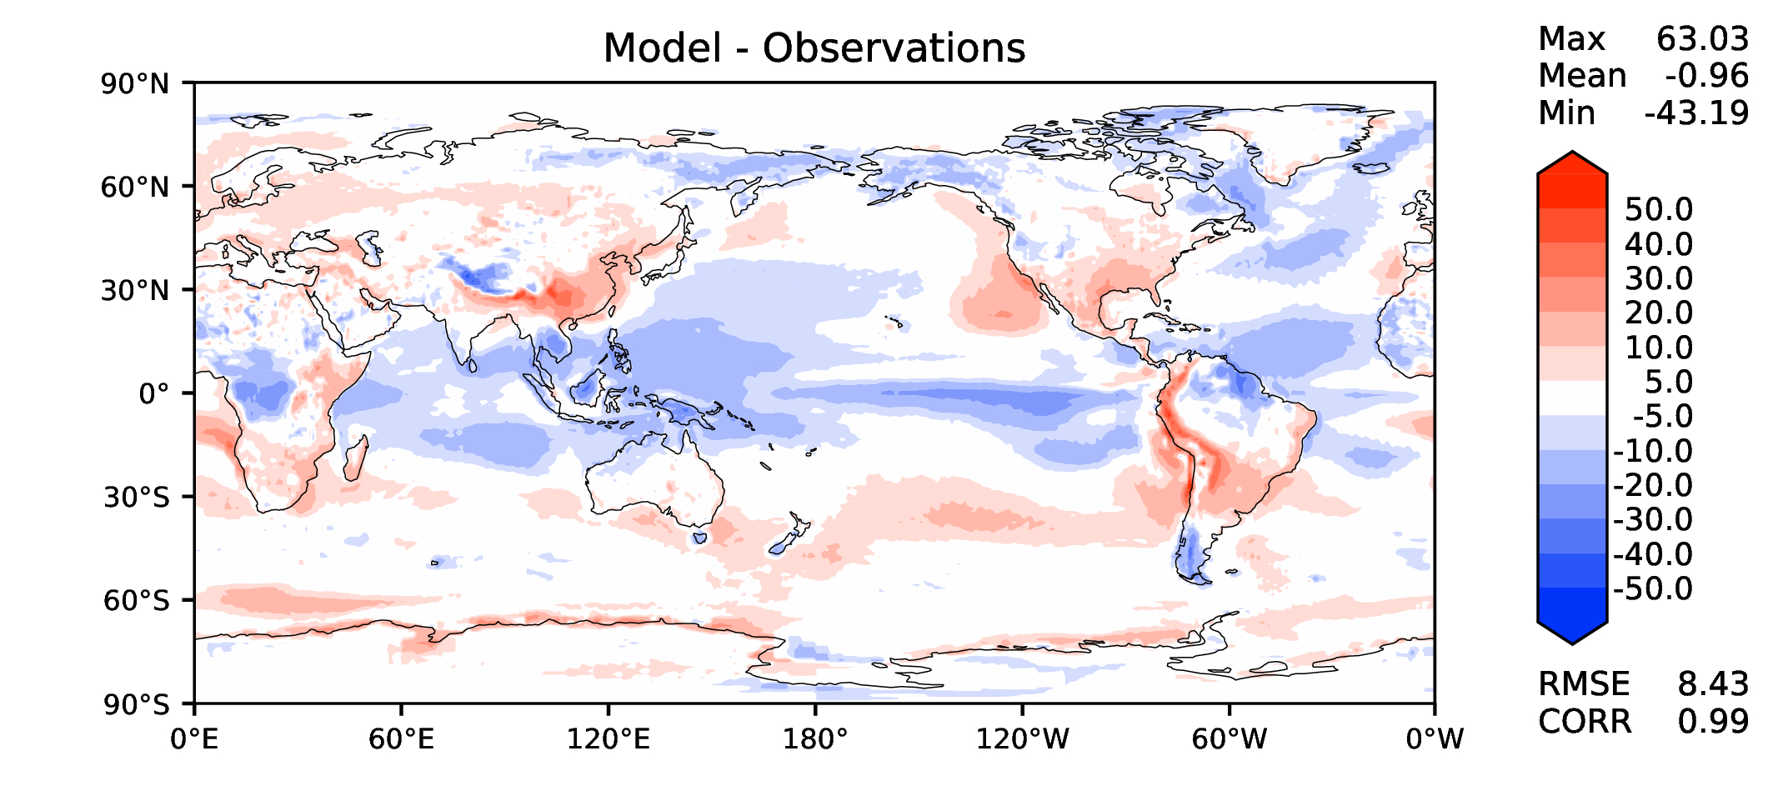
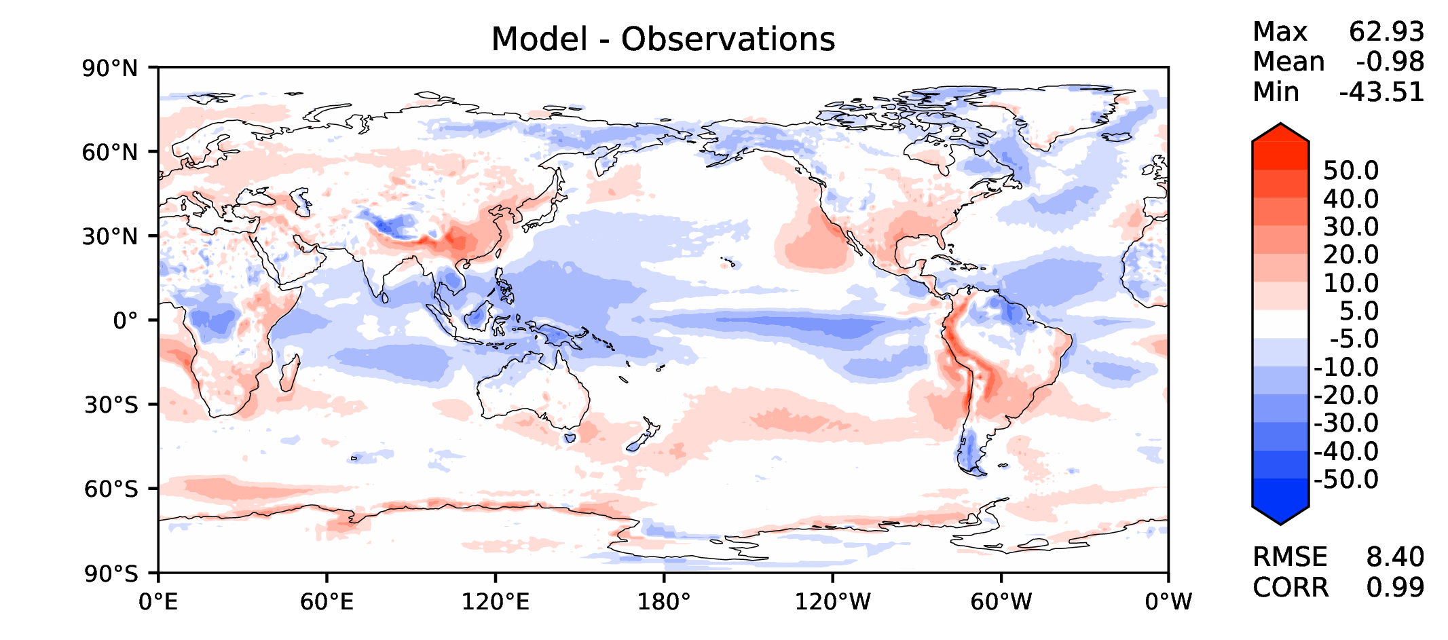
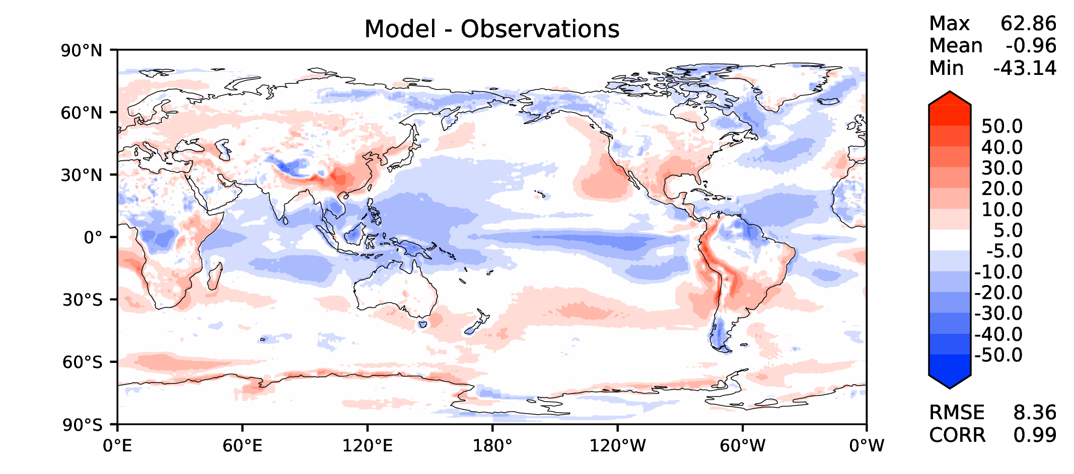
Annual TOA net radiation
DECKv1_451-500
v2rc3c
v2rc3c-compiler
v2rc3c-GWD

Slide 9
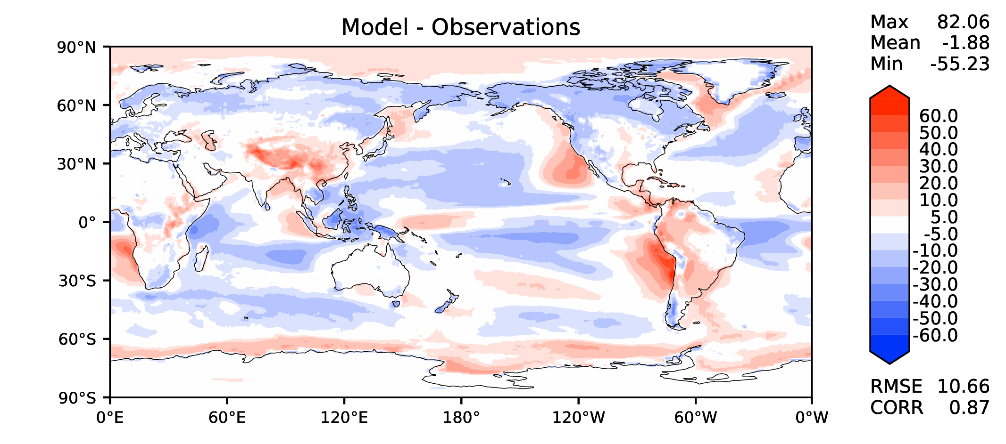
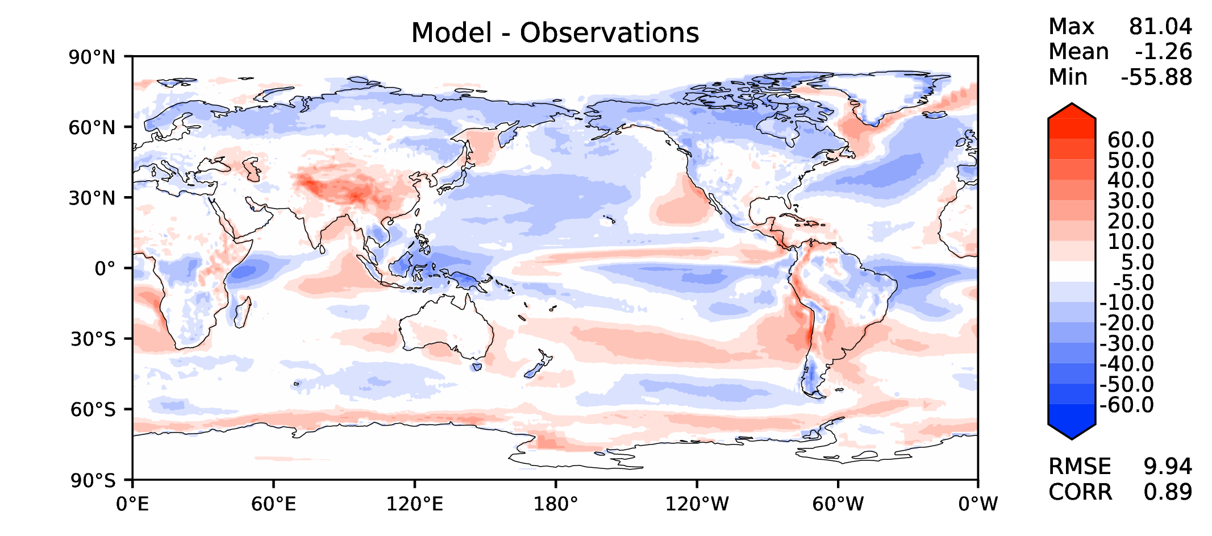
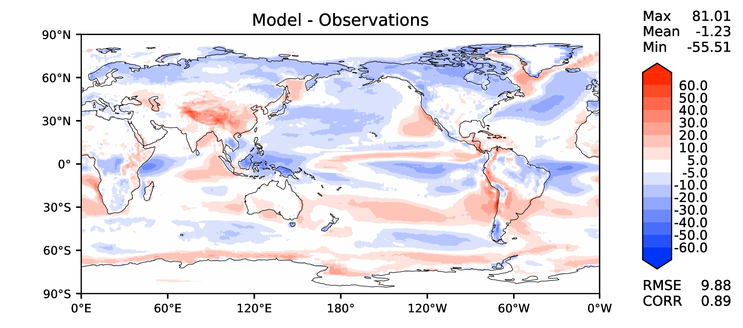
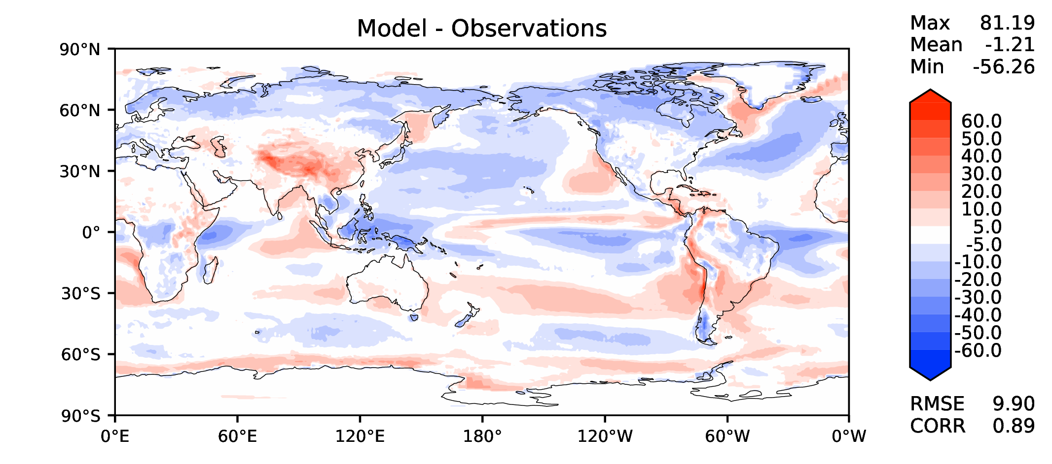
Annual TOA SW CRE
DECKv1_451-500
v2rc3c
v2rc3c-compiler
v2rc3c-GWD

Slide 10
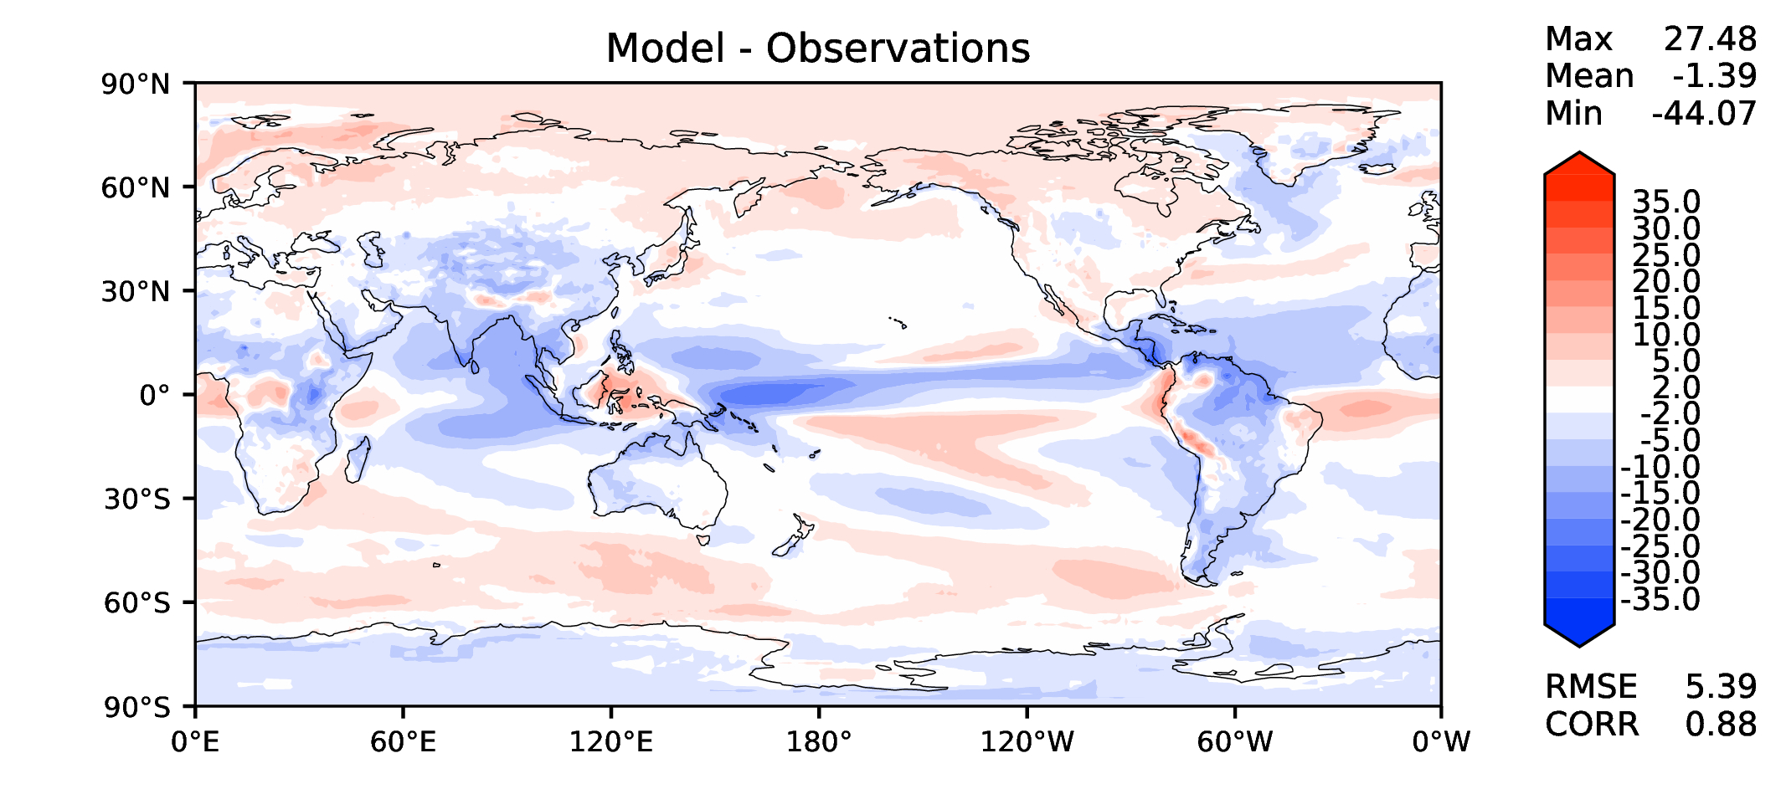
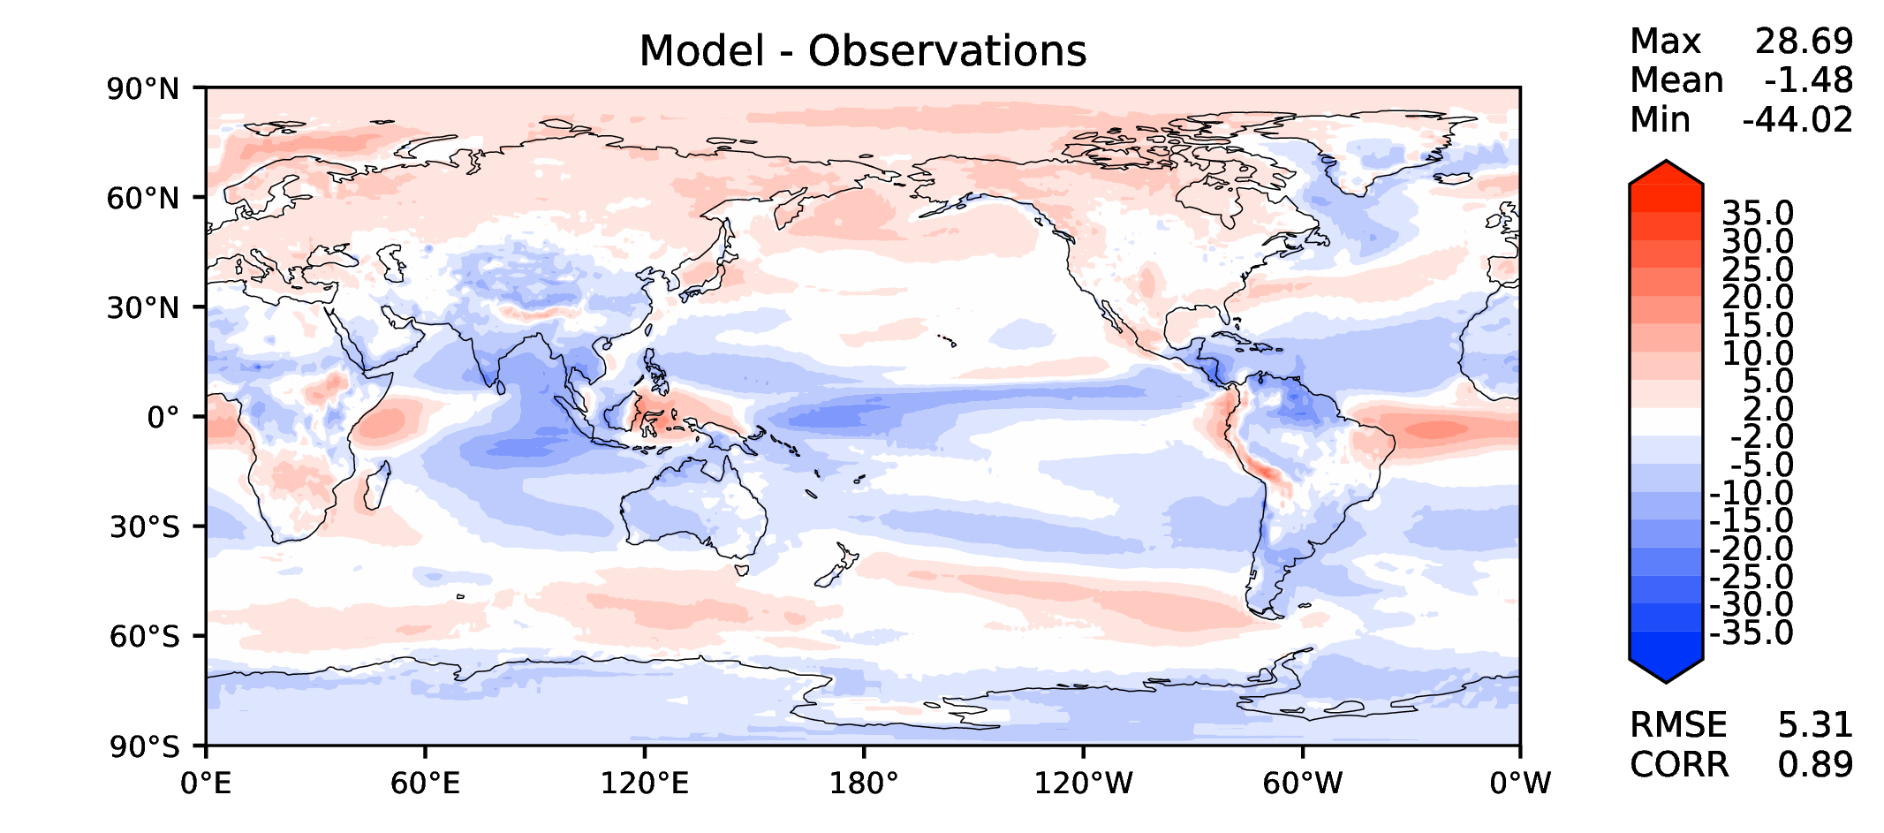
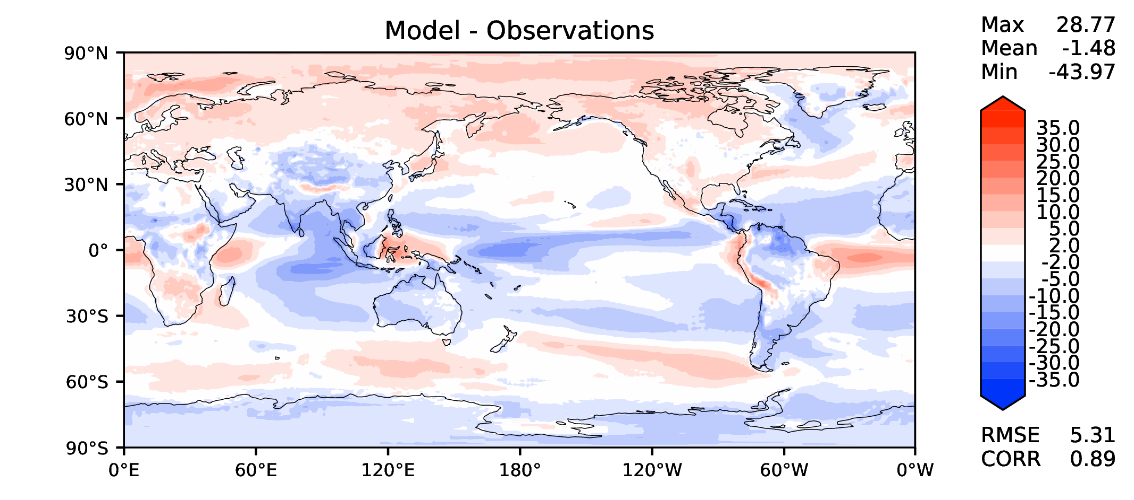
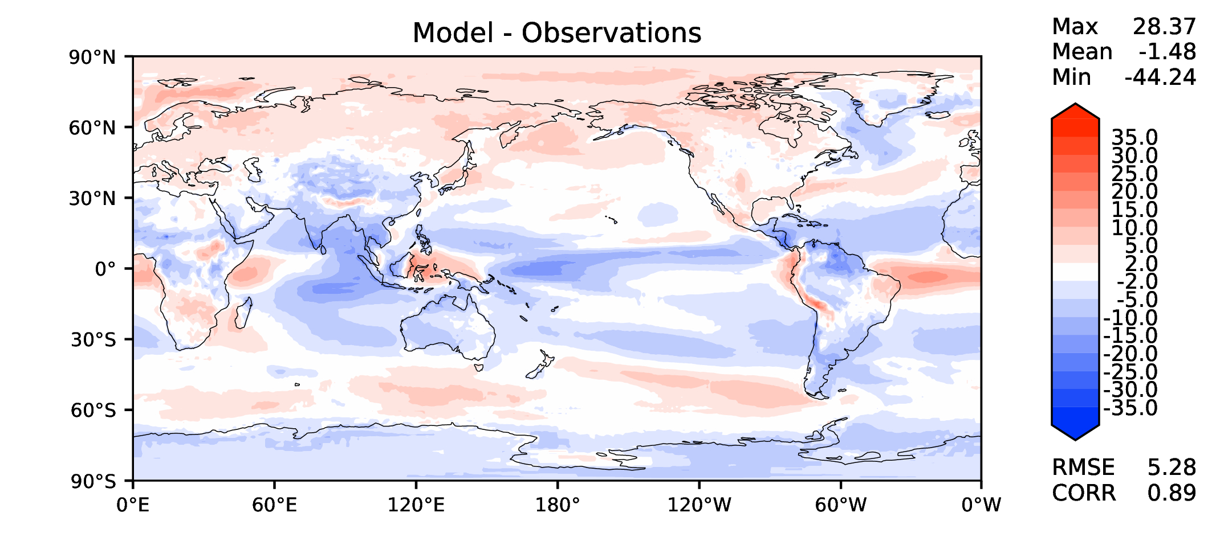
Annual TOA LW CRE
DECKv1_451-500
v2rc3c
v2rc3c-compiler
v2rc3c-GWD

Slide 11
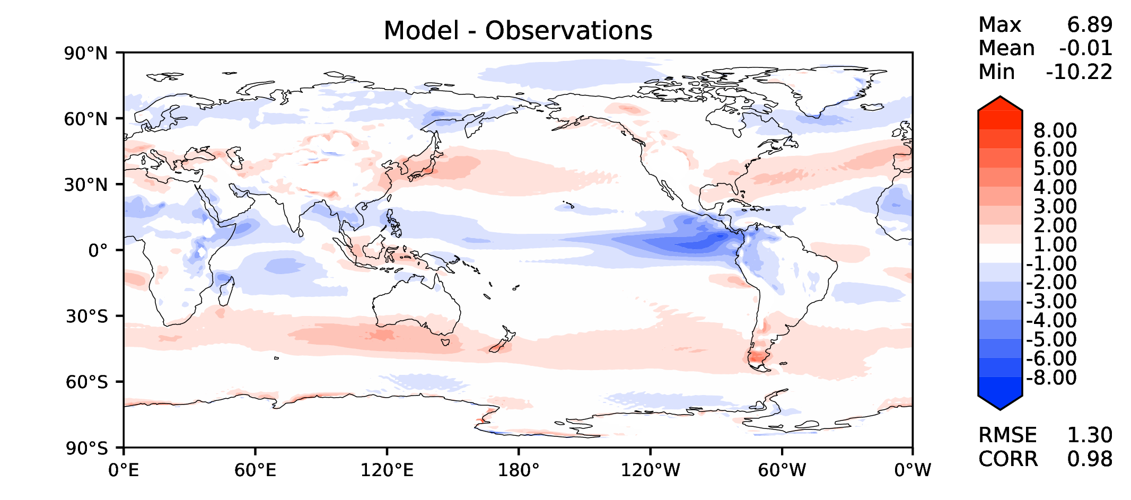
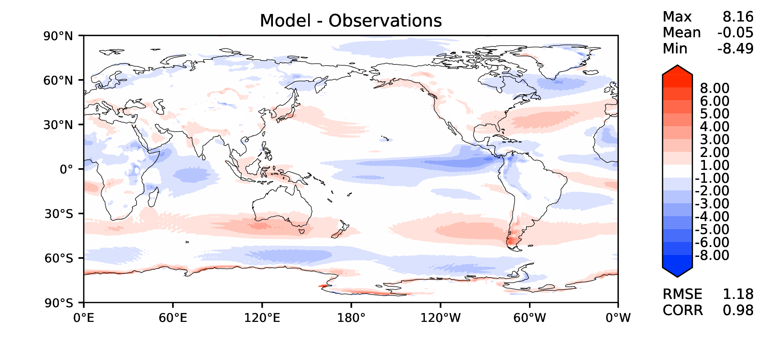
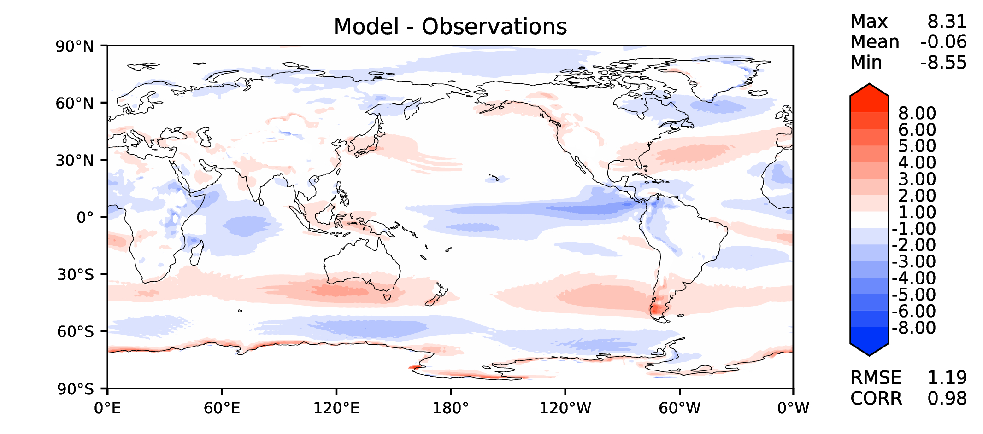
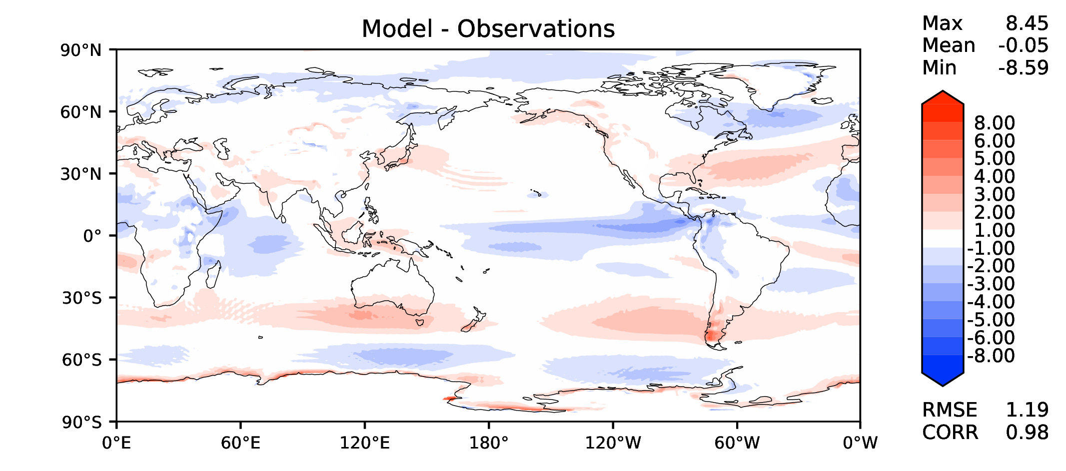
Annual u wind at 850 hPa
DECKv1_451-500
v2rc3c
v2rc3c-compiler
v2rc3c-GWD

Slide 12
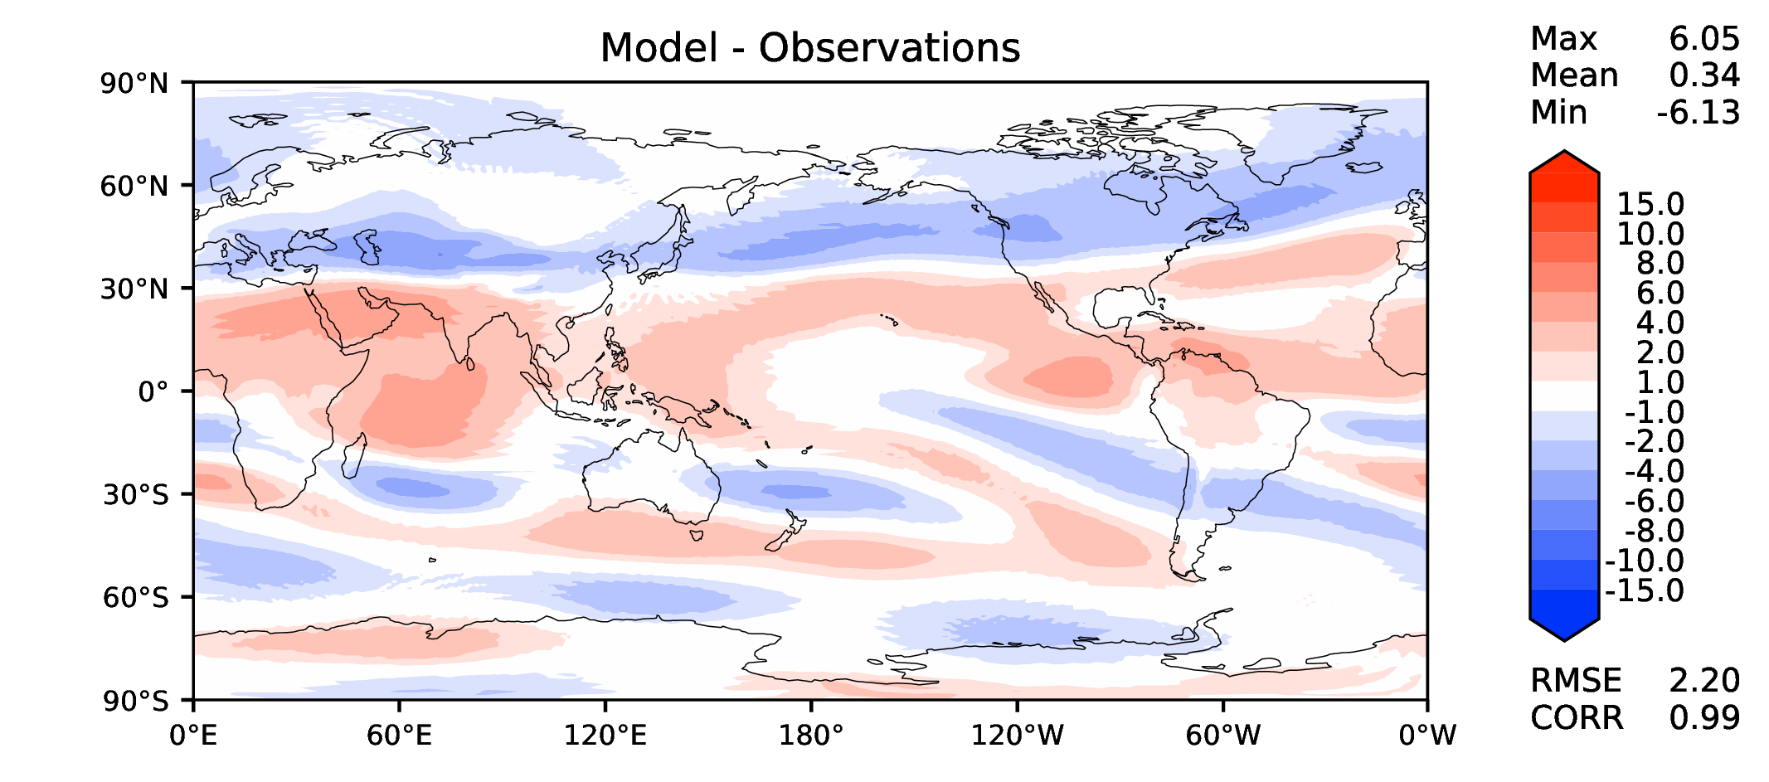
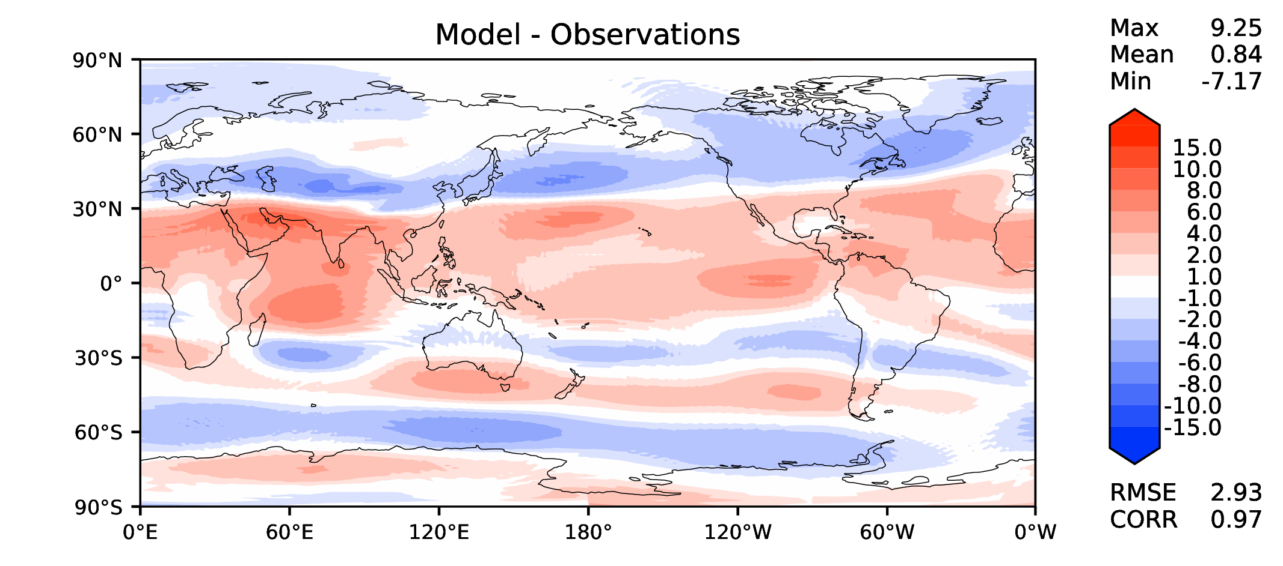
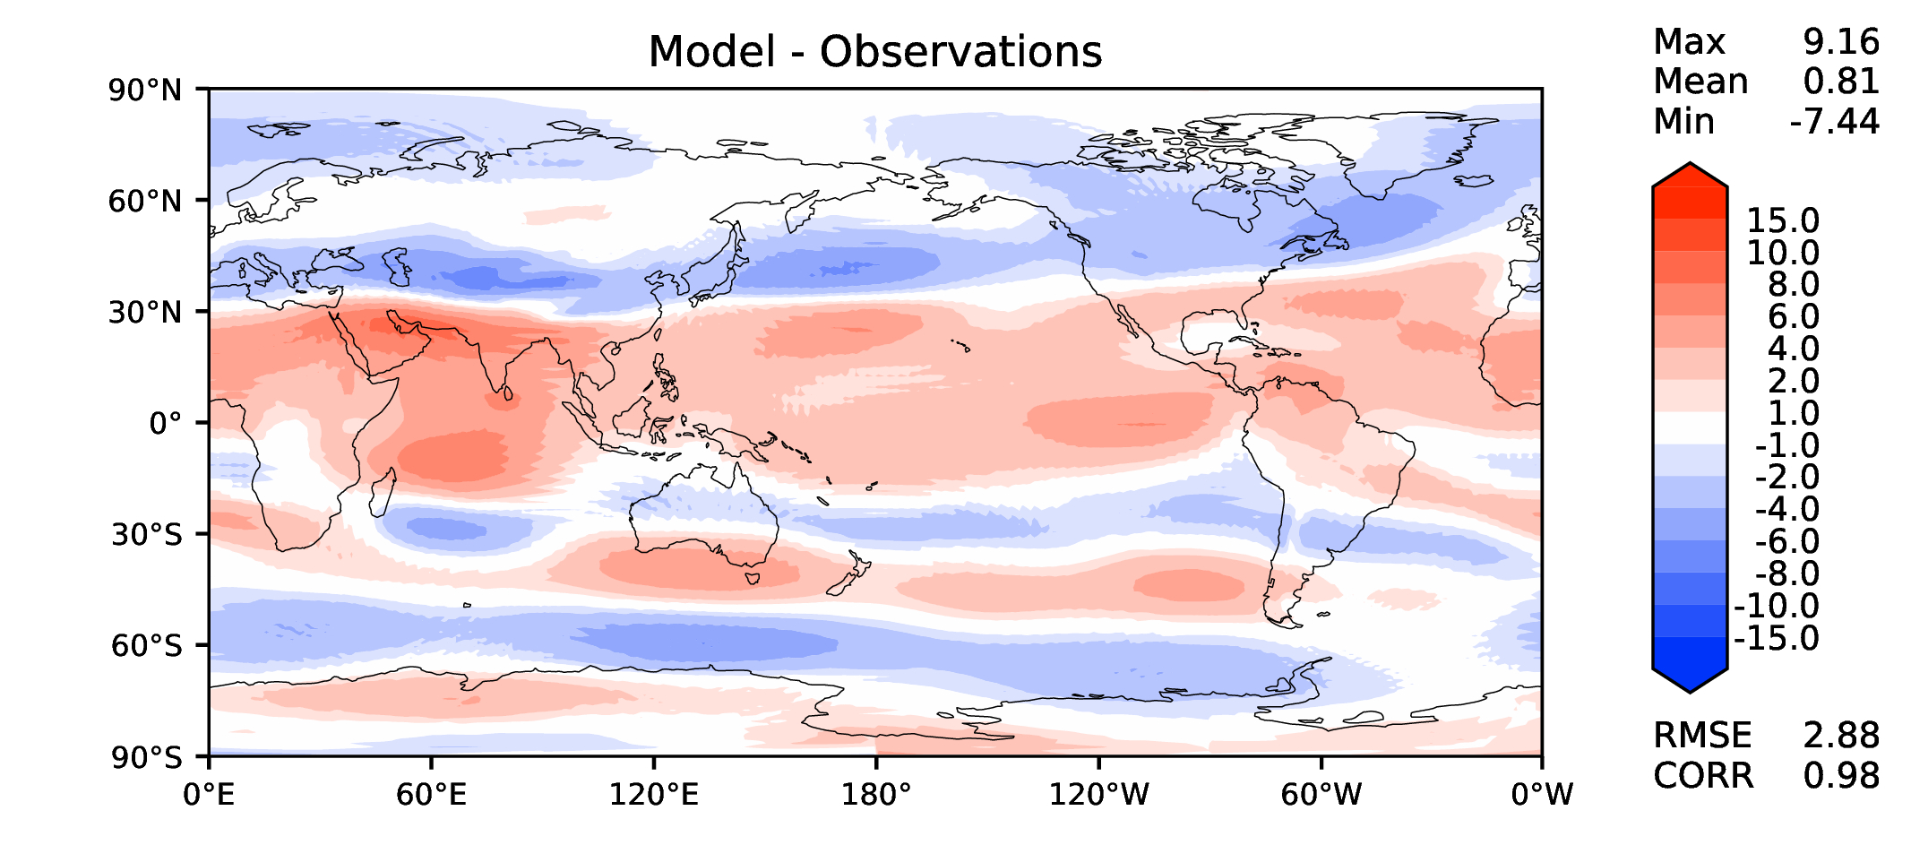
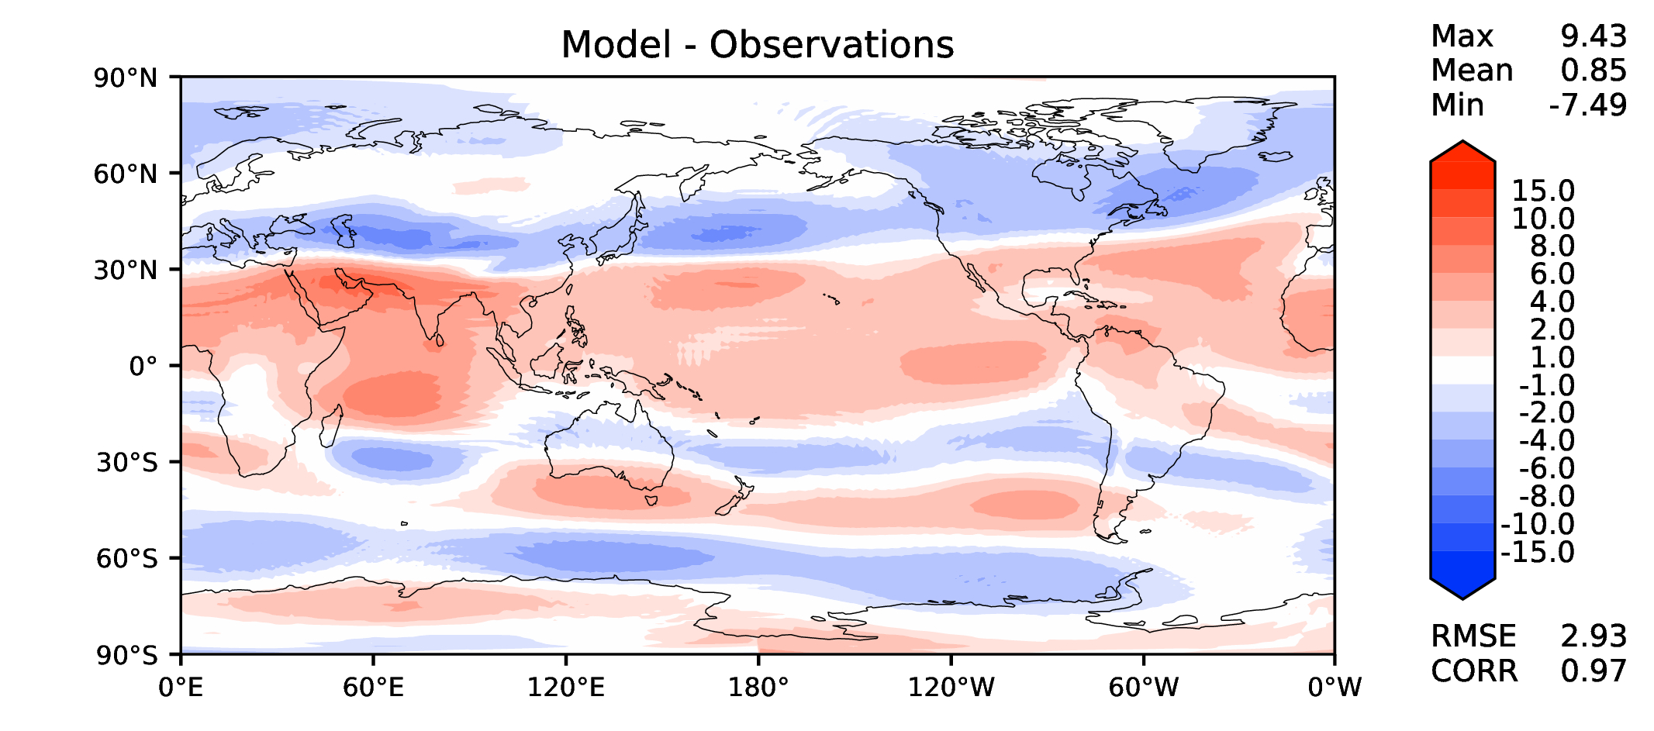
Annual u wind at 200 hPa
DECKv1_451-500
v2rc3c
v2rc3c-compiler
v2rc3c-GWD

Slide 13
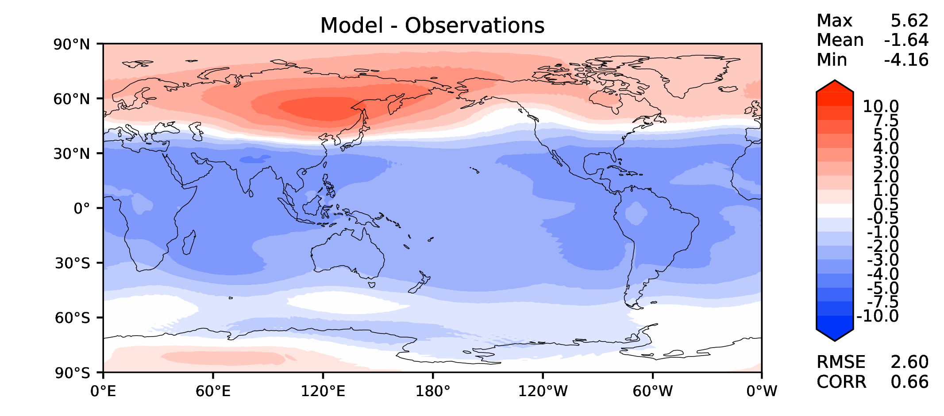
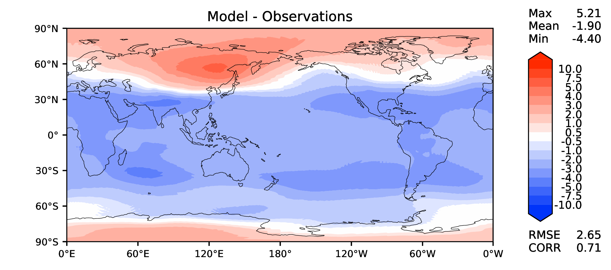


Annual T at 200 hPa
DECKv1_451-500
v2rc3c
v2rc3c-compiler
v2rc3c-GWD

Slide 14
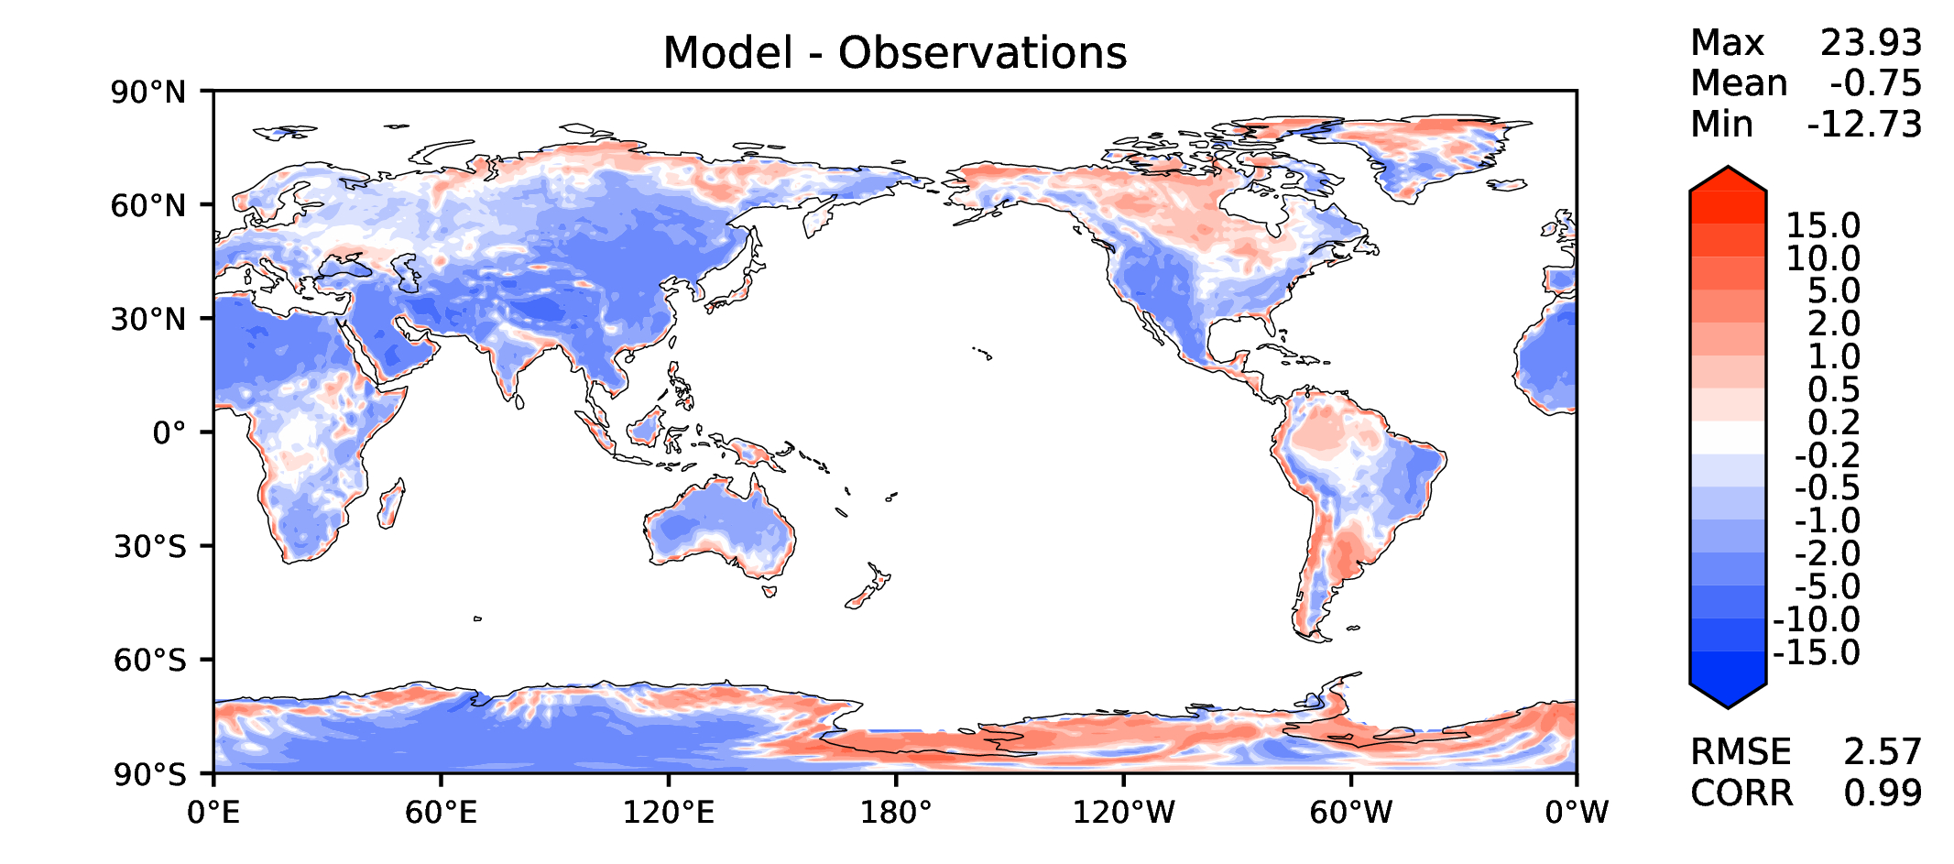
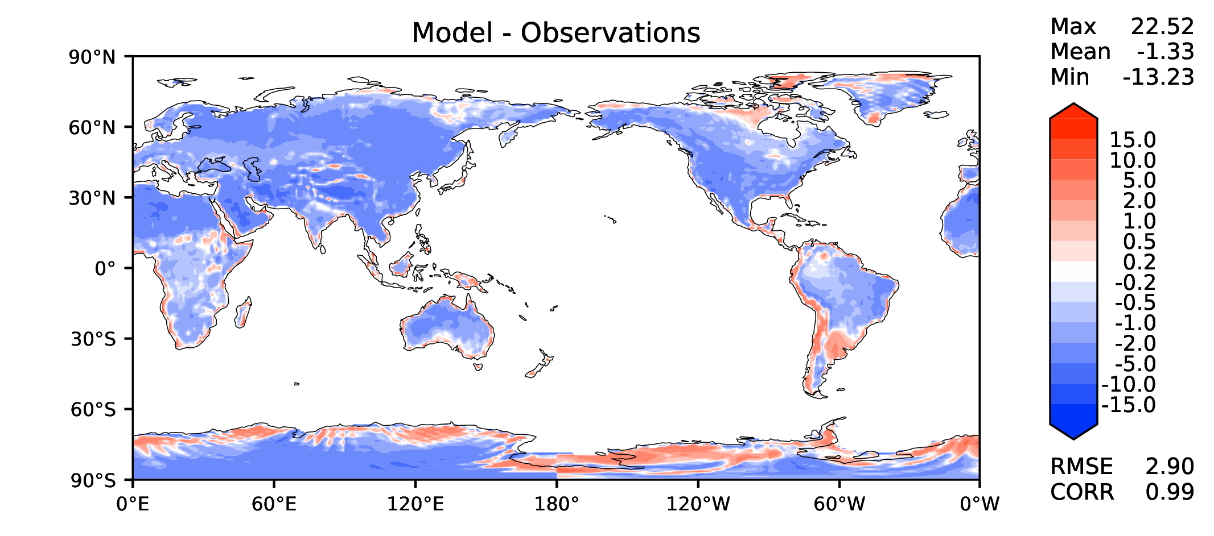
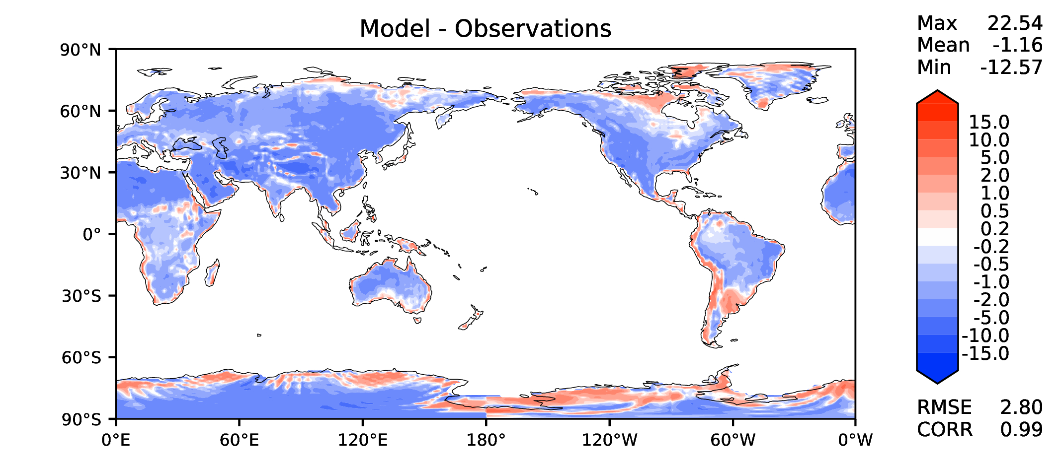
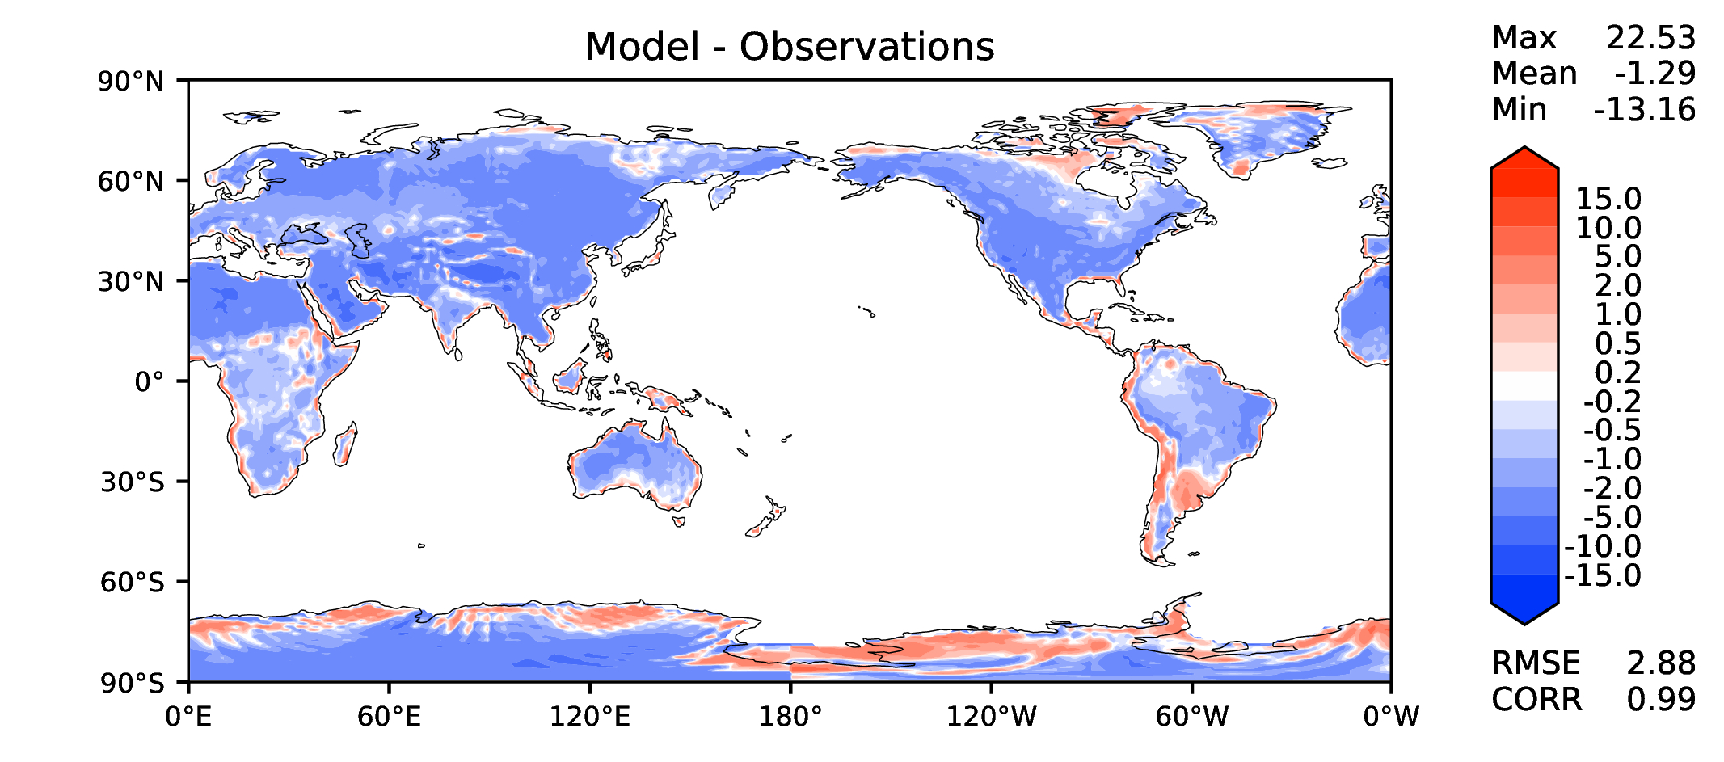
Annual surface air T (land)
DECKv1_451-500
v2rc3c
v2rc3c-compiler
v2rc3c-GWD

Slide 15
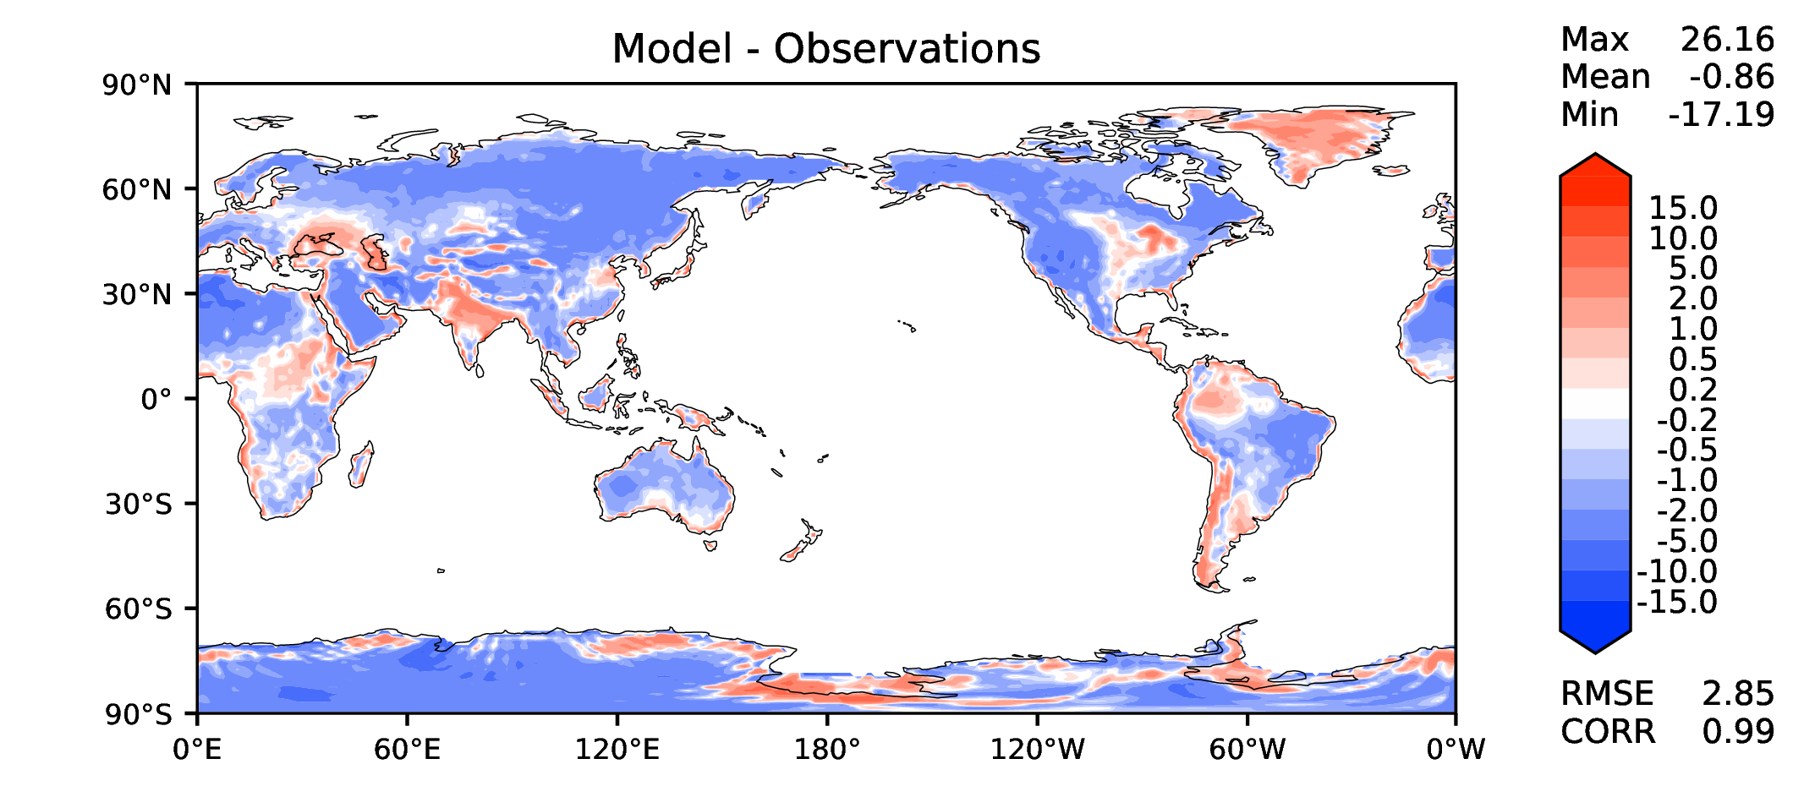
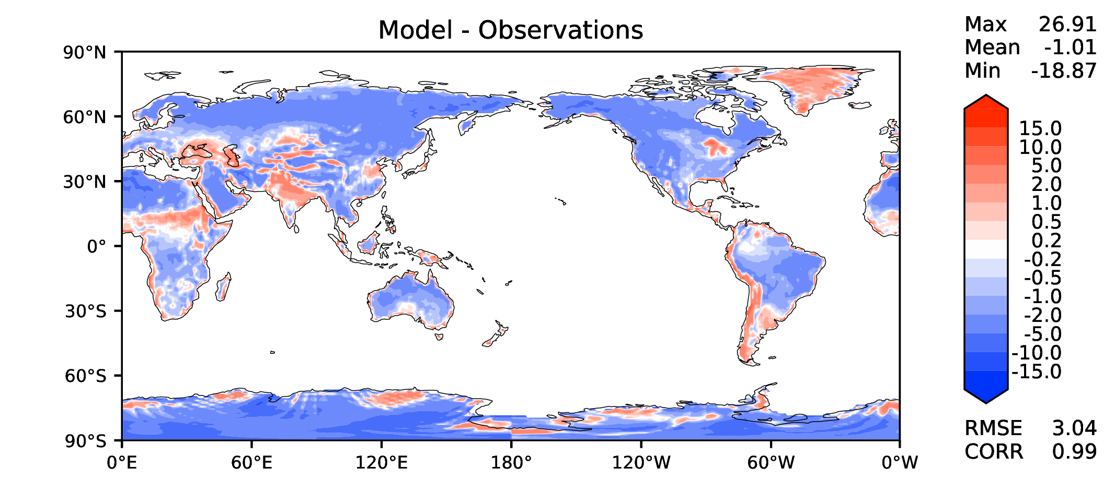
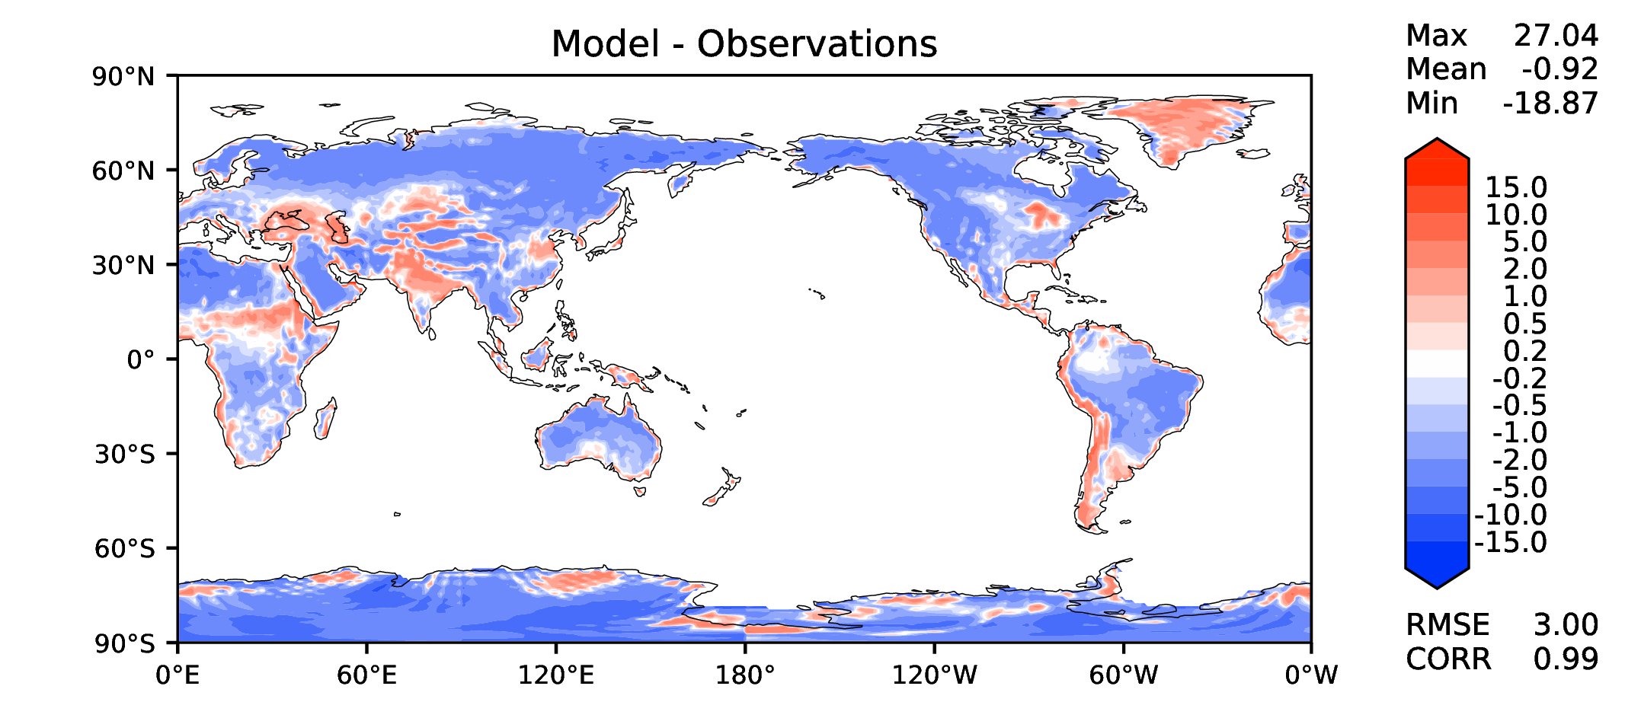

JJA surface air T (land)
DECKv1_451-500
v2rc3c
v2rc3c-compiler
v2rc3c-GWD

Slide 16
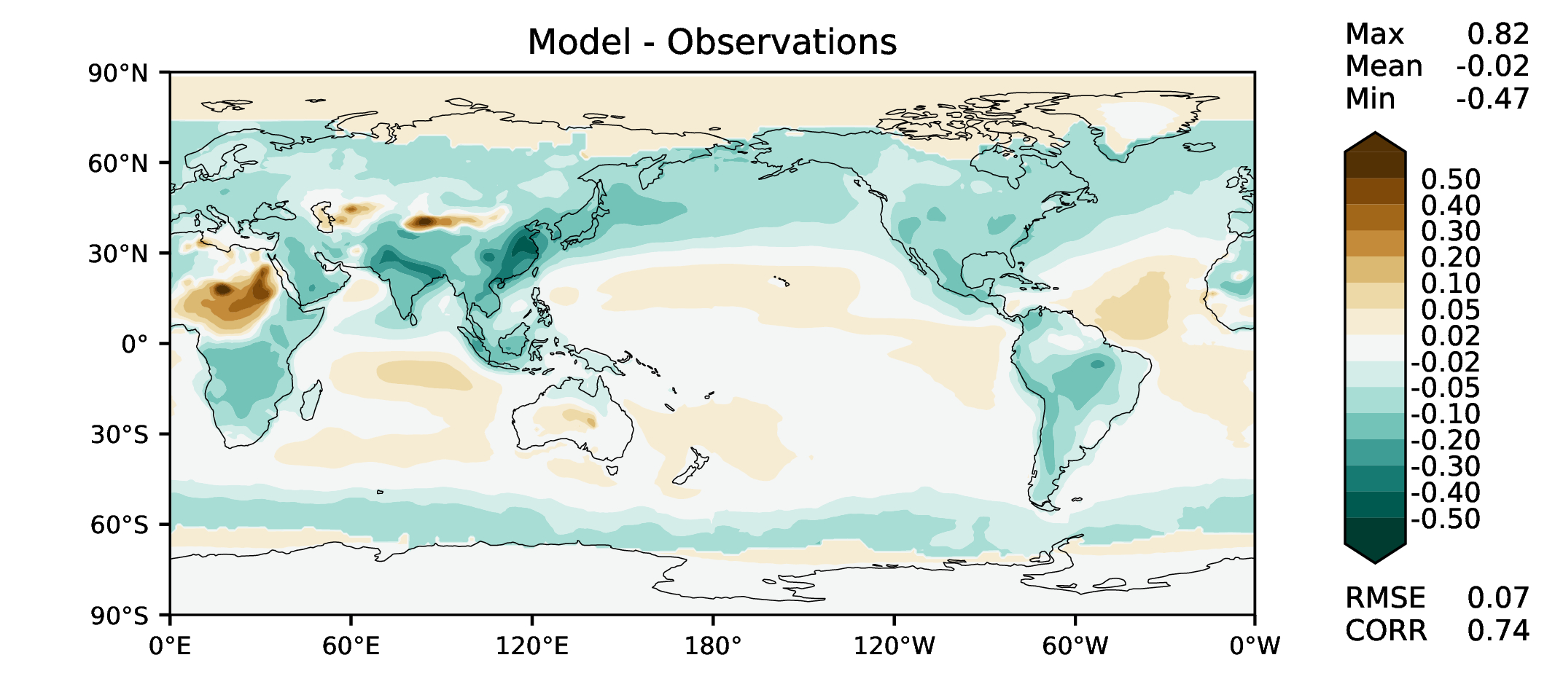
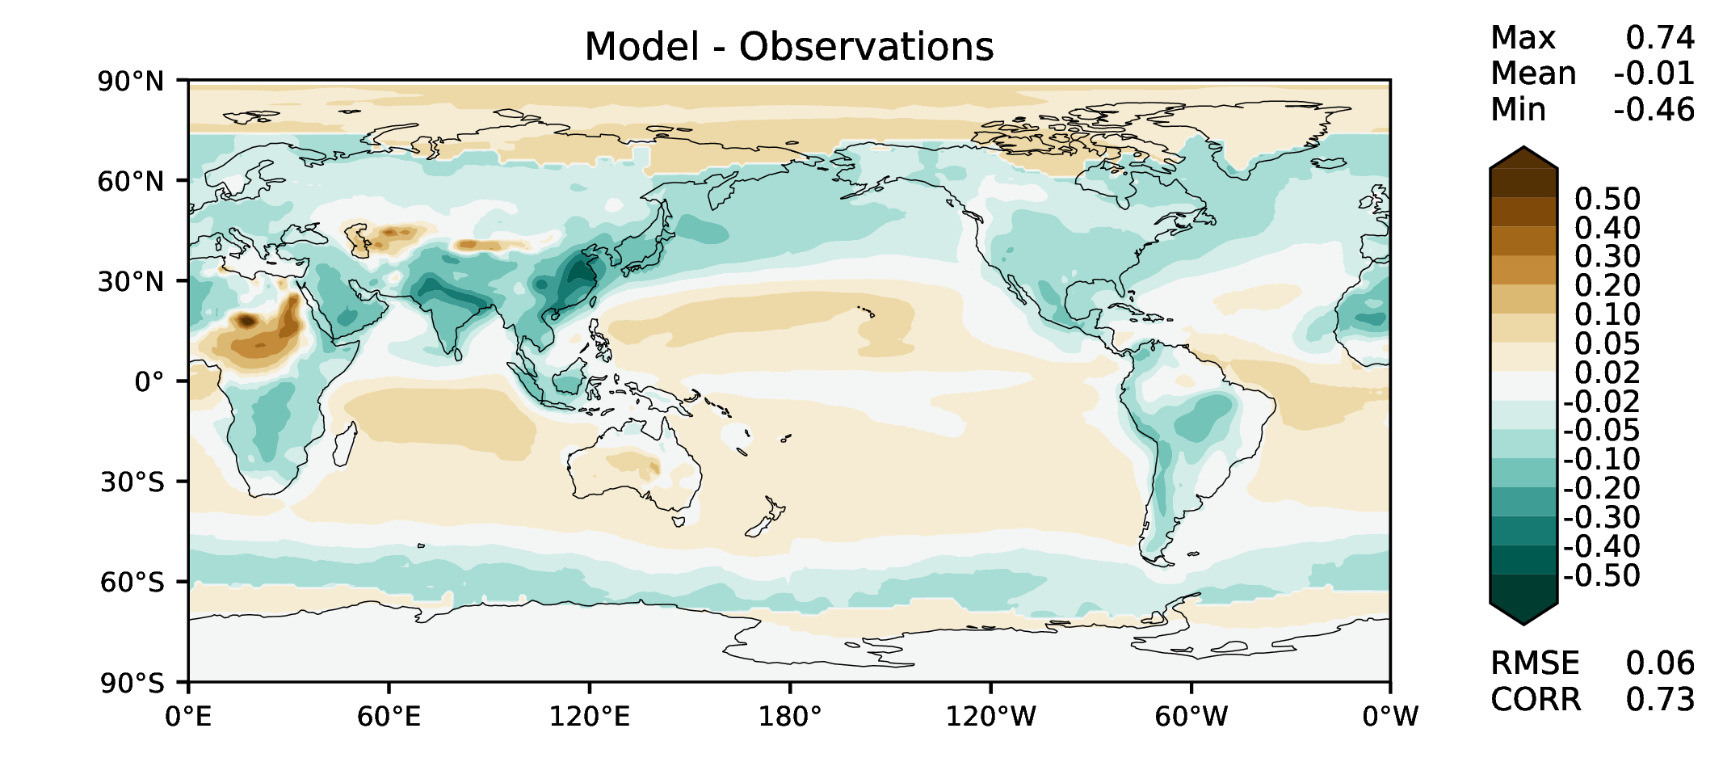

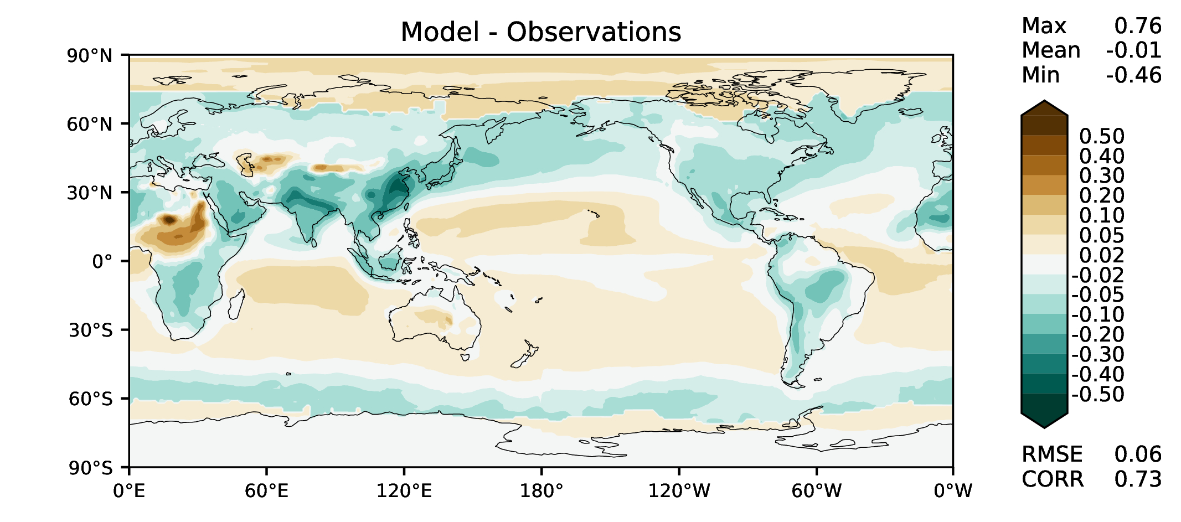
Aerosol optical depth
DECKv1_451-500
v2rc3c
v2rc3c-compiler
v2rc3c-GWD

Slide 17




TAUXY ANN ocean
DECKv1_451-500
v2rc3c
v2rc3c-compiler
v2rc3c-GWD

