Slide 1
Summary table (RMSE vs obs)
Variable | Season | DECKv1b | v2rc1c
SST | ANN | 1.08 | 1.09 | 1.13 | 1.26
PRECT | ANN | 1.11 | 0.98 | 0.96 | 0.94
PRECT | DJF | 1.42 | 1.37 | 1.35 | 1.34
PRECT | MAM | 1.52 | 1.19 | 1.16 | 1.16
PRECT | JJA | 1.48 | 1.34 | 1.32 | 1.30
PRECT | SON | 1.28 | 1.26 | 1.25 | 1.20
RESTOM | ANN | 9.26 | 8.35 | 8.28 | 8.46
SWCF | ANN | 10.52 | 9.83 | 9.86 | 10.36
LWCF | ANN | 5.28 | 5.21 | 5.16 | 5.06
u850 | ANN | 1.28 | 1.22 | 1.18 | 1.20
u200 | ANN | 2.11 | 2.86 | 2.77 | 2.72
T200 | ANN | 2.61 | 2.82 | 2.95 | 3.40
TREFHT | ANN | 2.59 | 2.90 | 3.06 | 3.36
TREFHT | JJA | 2.83 | 3.11 | 3.21 | 3.39
AODVIS | ANN | 0.07 | 0.06 | 0.06 | 0.06
TAUXY | ANN | 0.02 | 0.02 | 0.02 | 0.02

Slide 2
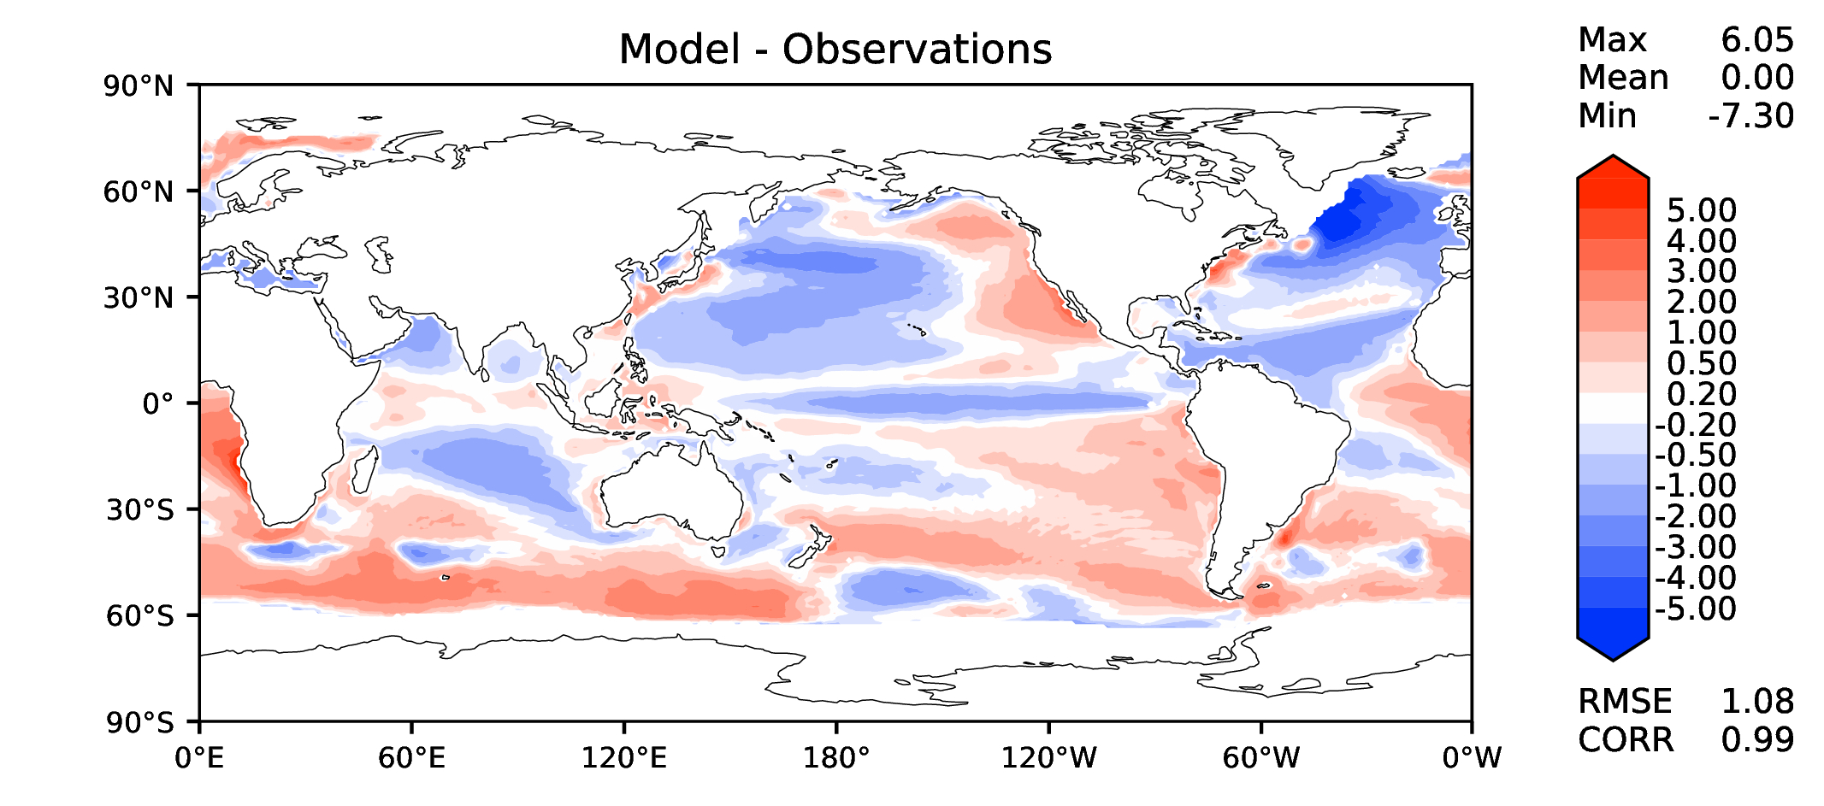
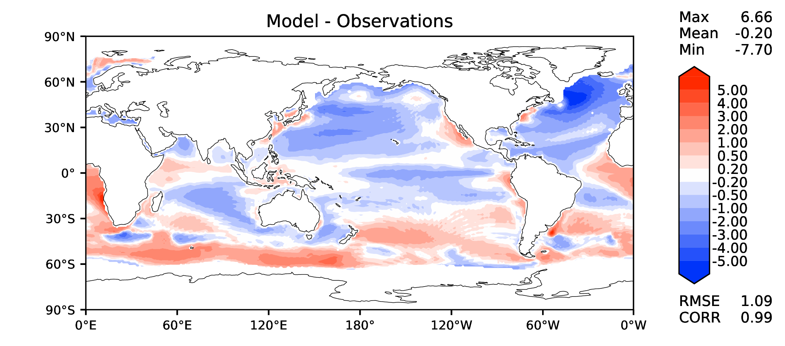
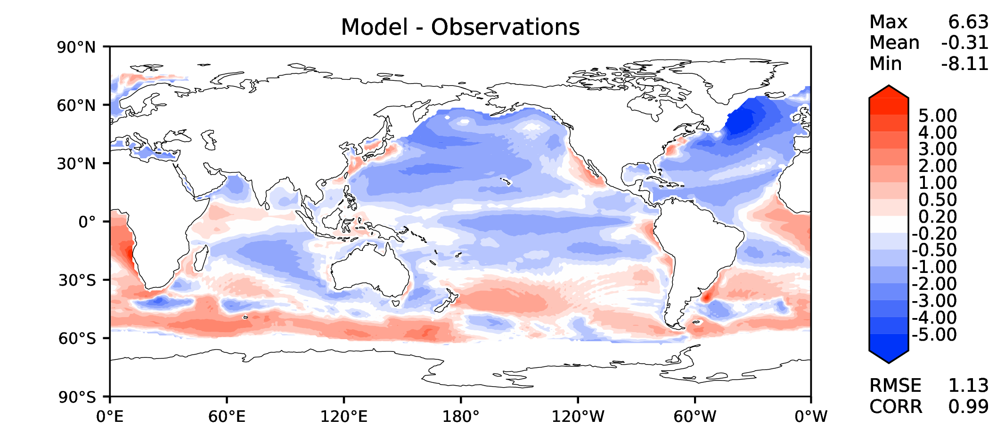
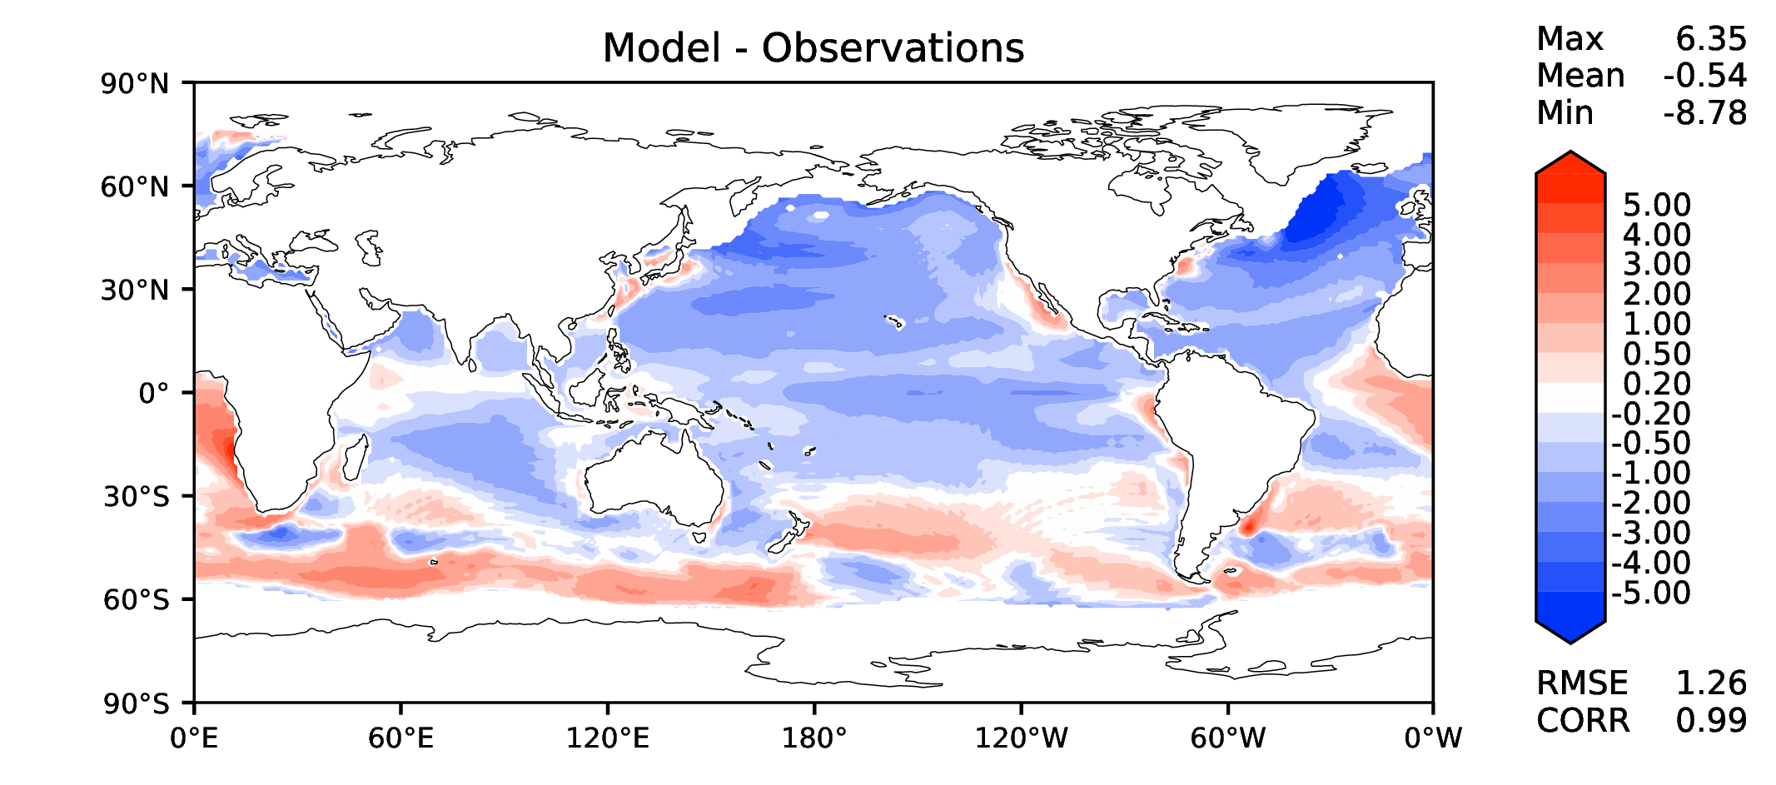
Annual SST (pre-industrial)
DECKv1b
v2rc1c
v2rc3c
v2rc3e

Slide 3
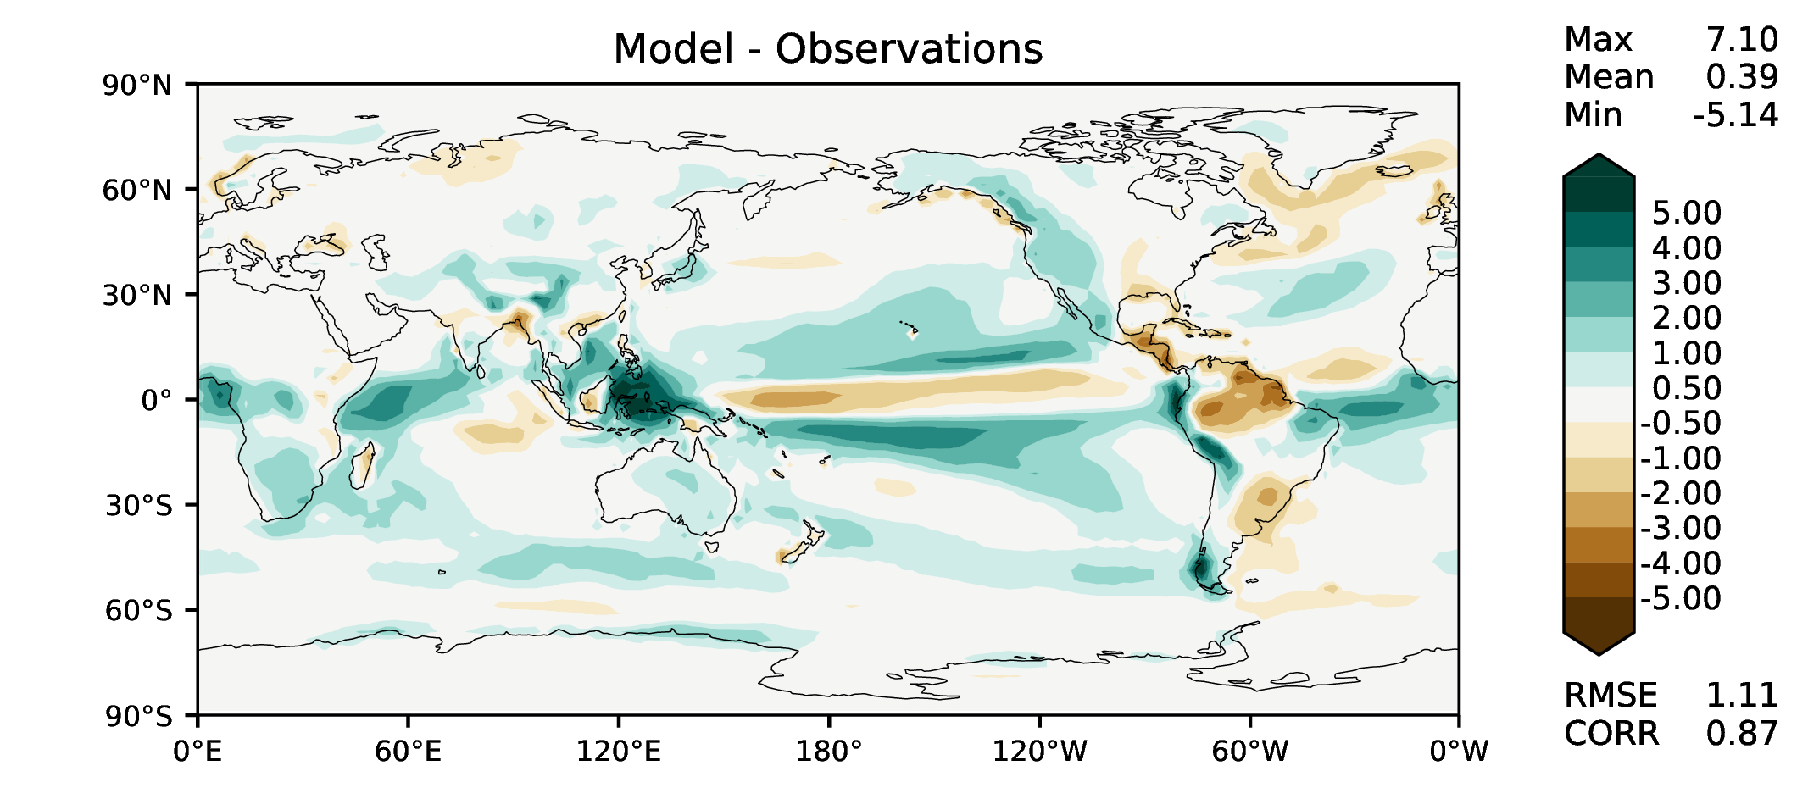
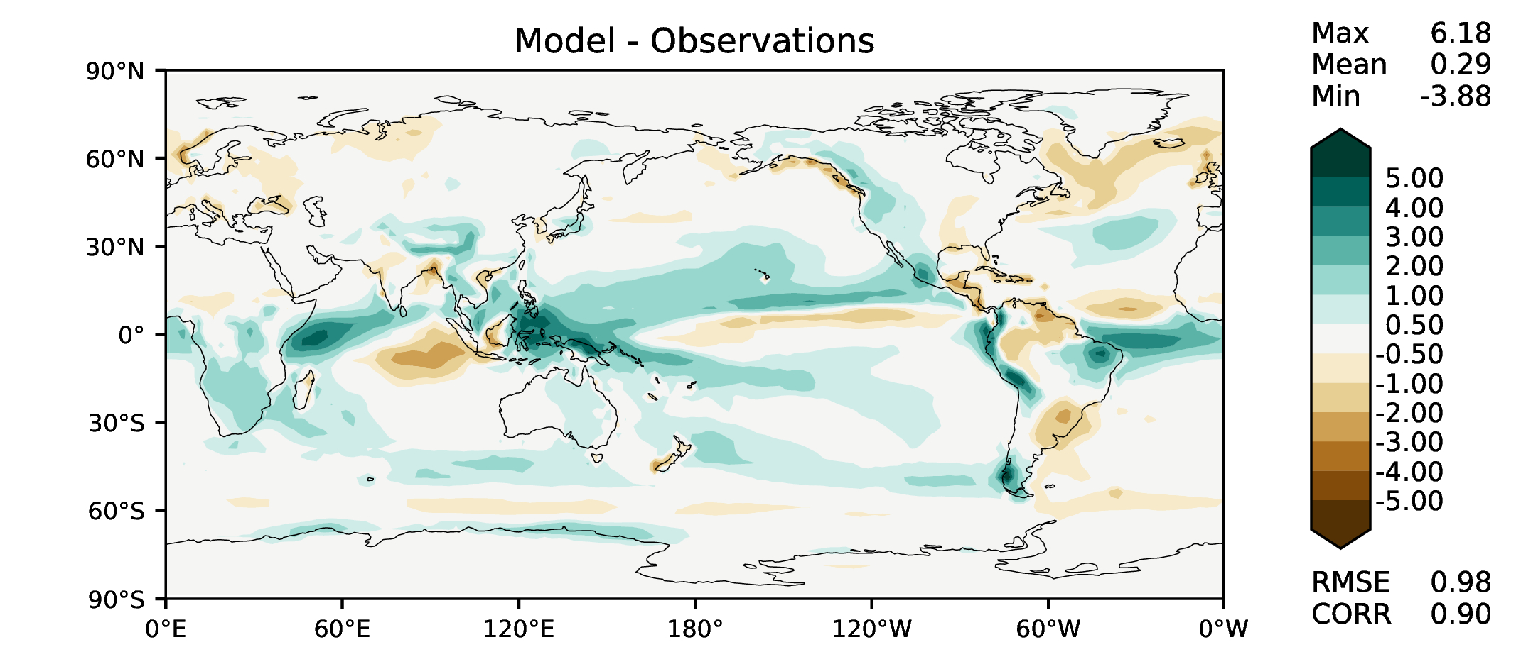
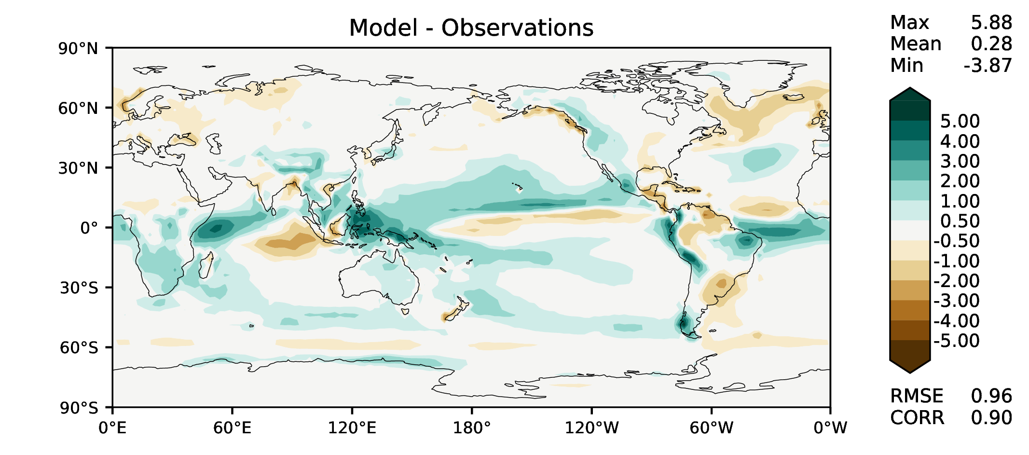
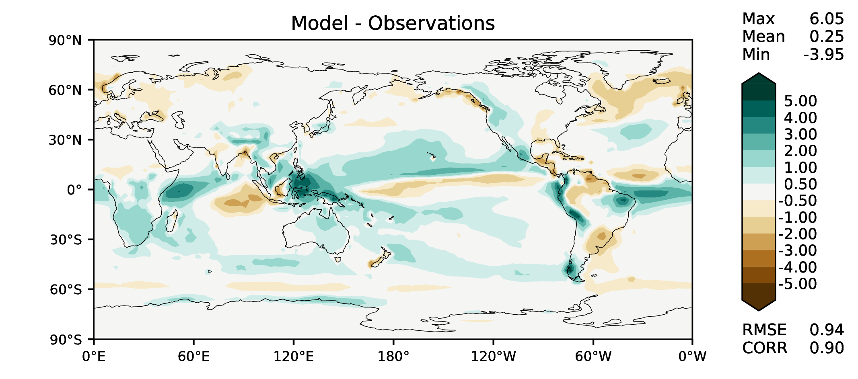
Annual total precipitation
DECKv1b
v2rc1c
v2rc3c
v2rc3e

Slide 4
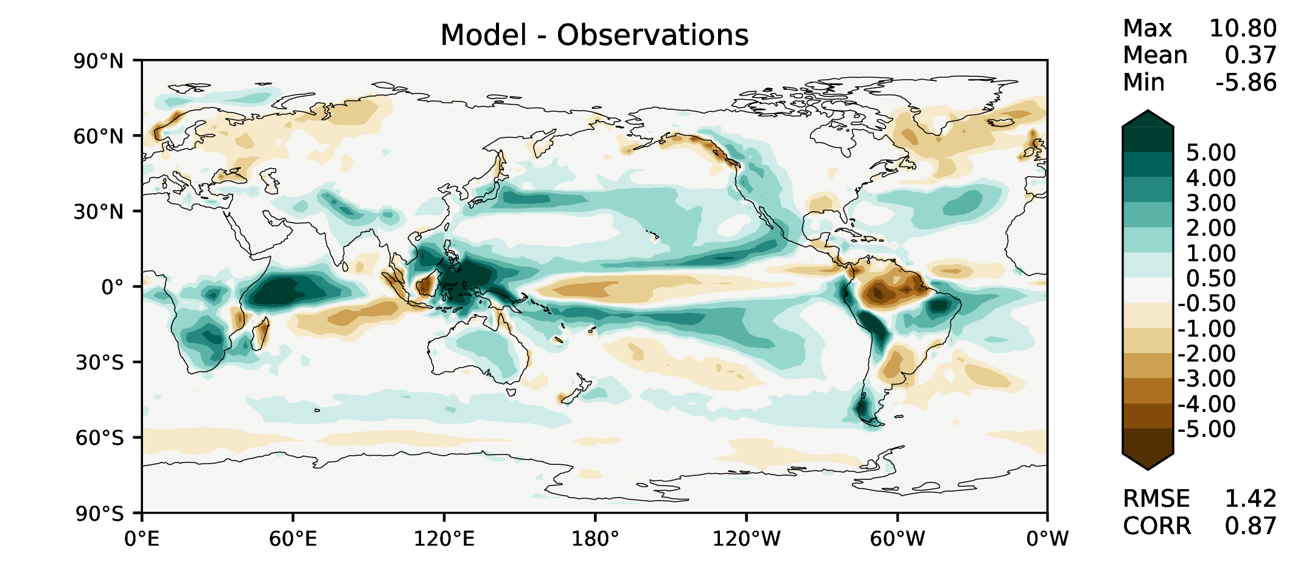
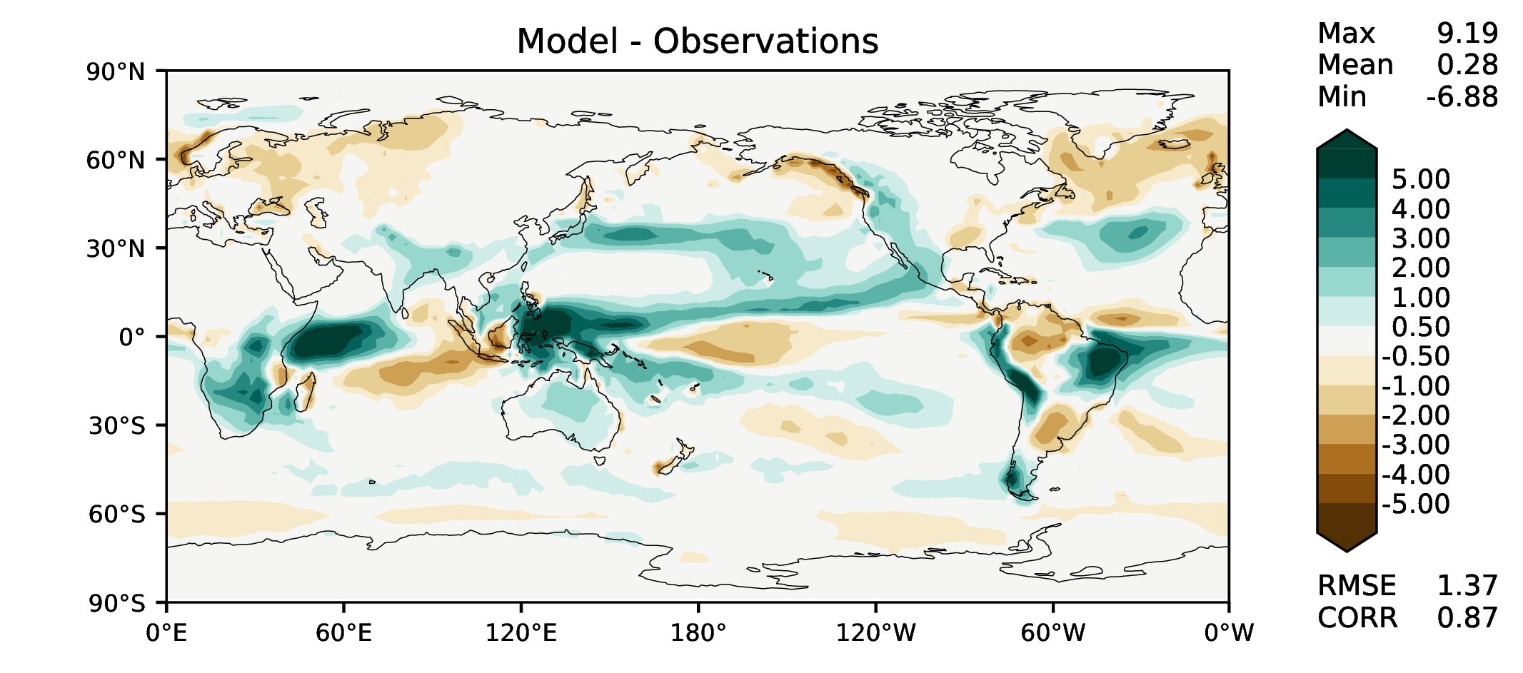
DJF total precipitation
DECKv1b
v2rc1c
v2rc3c
v2rc3e

Slide 5
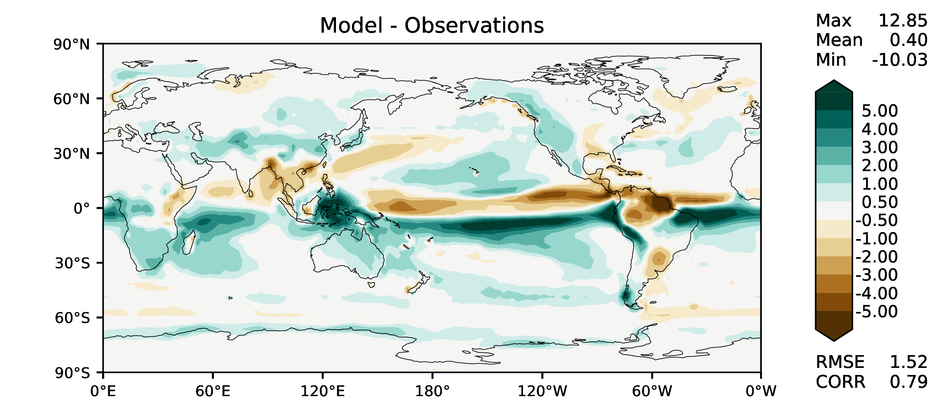
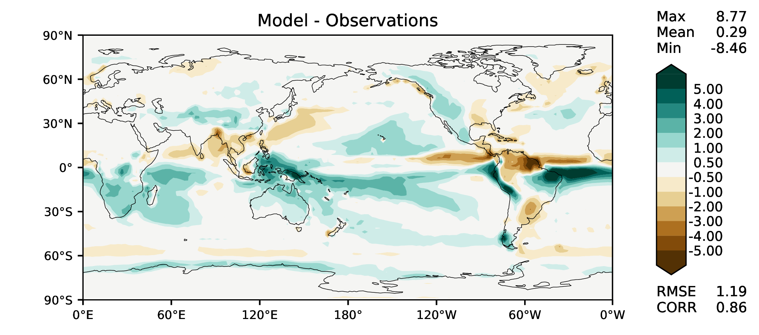
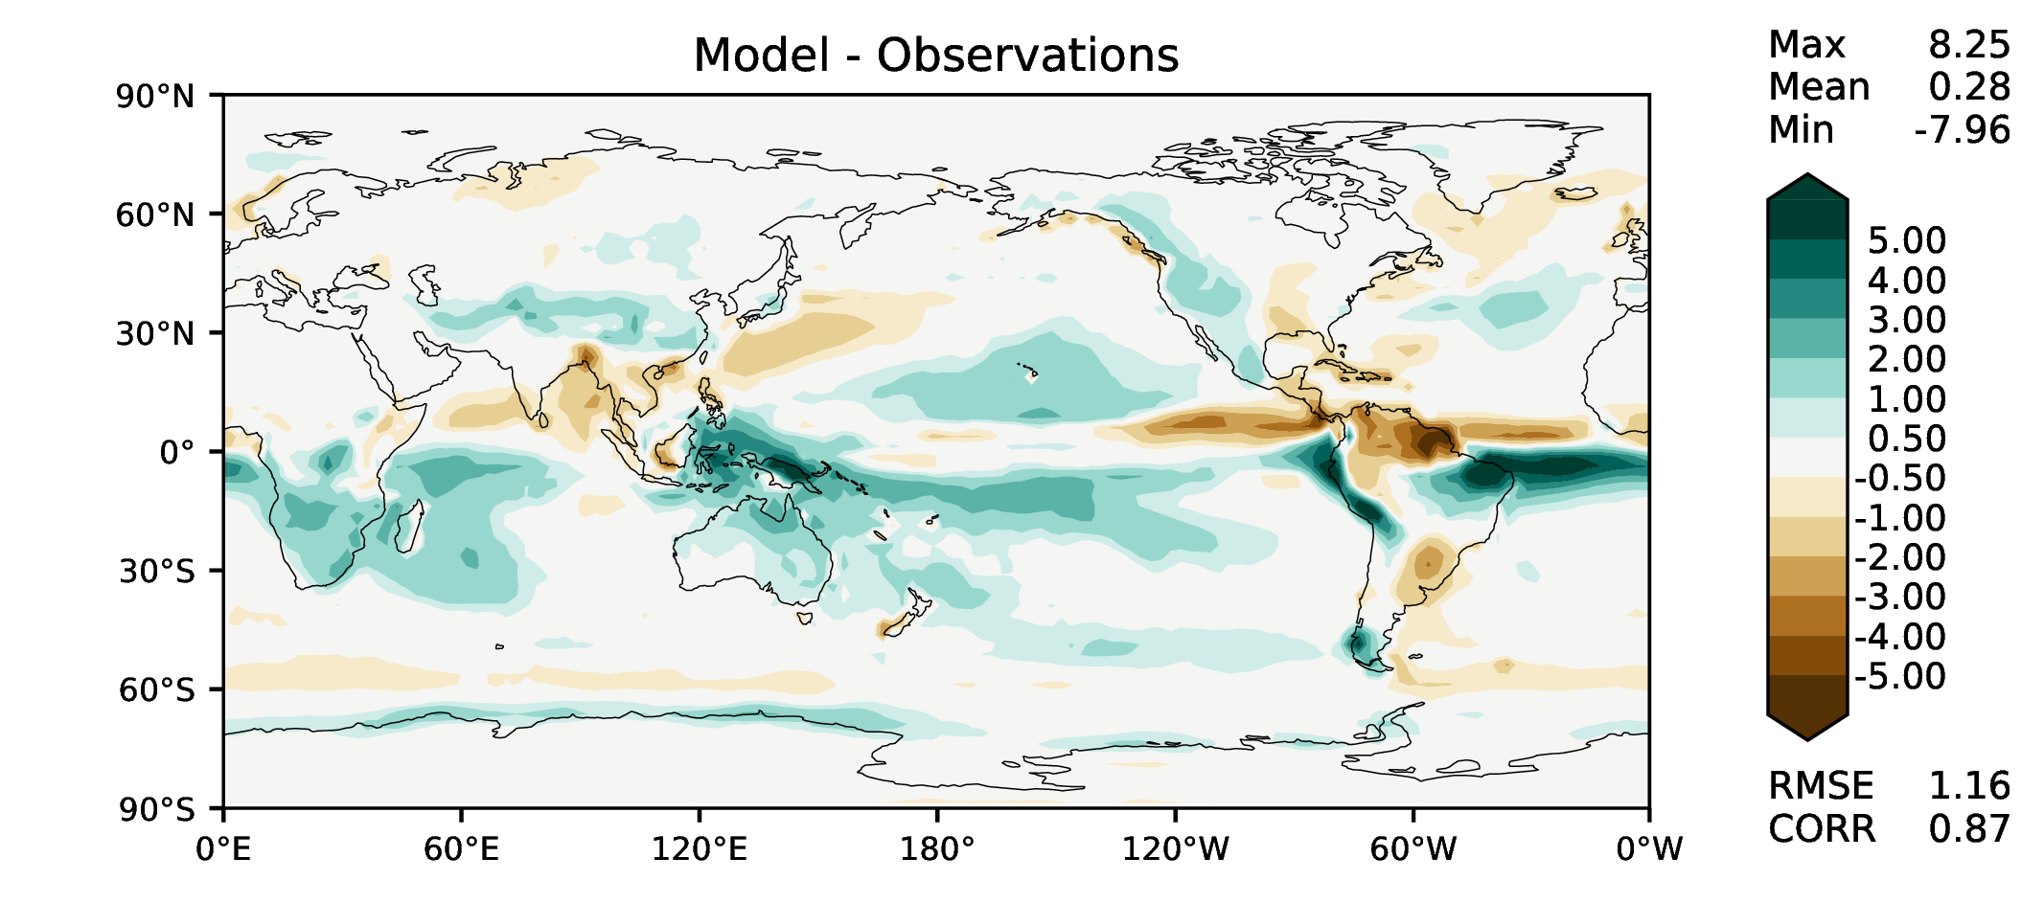
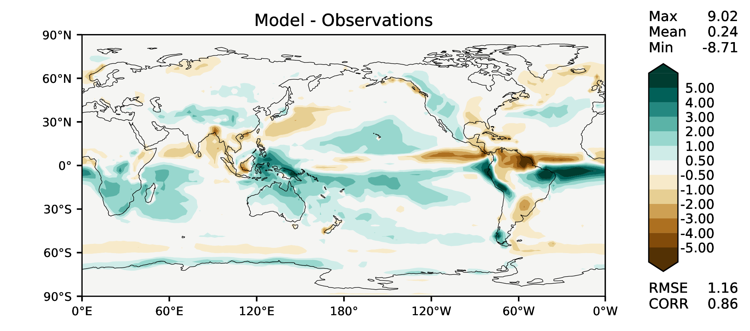
MAM total precipitation
DECKv1b
v2rc1c
v2rc3c
v2rc3e

Slide 6
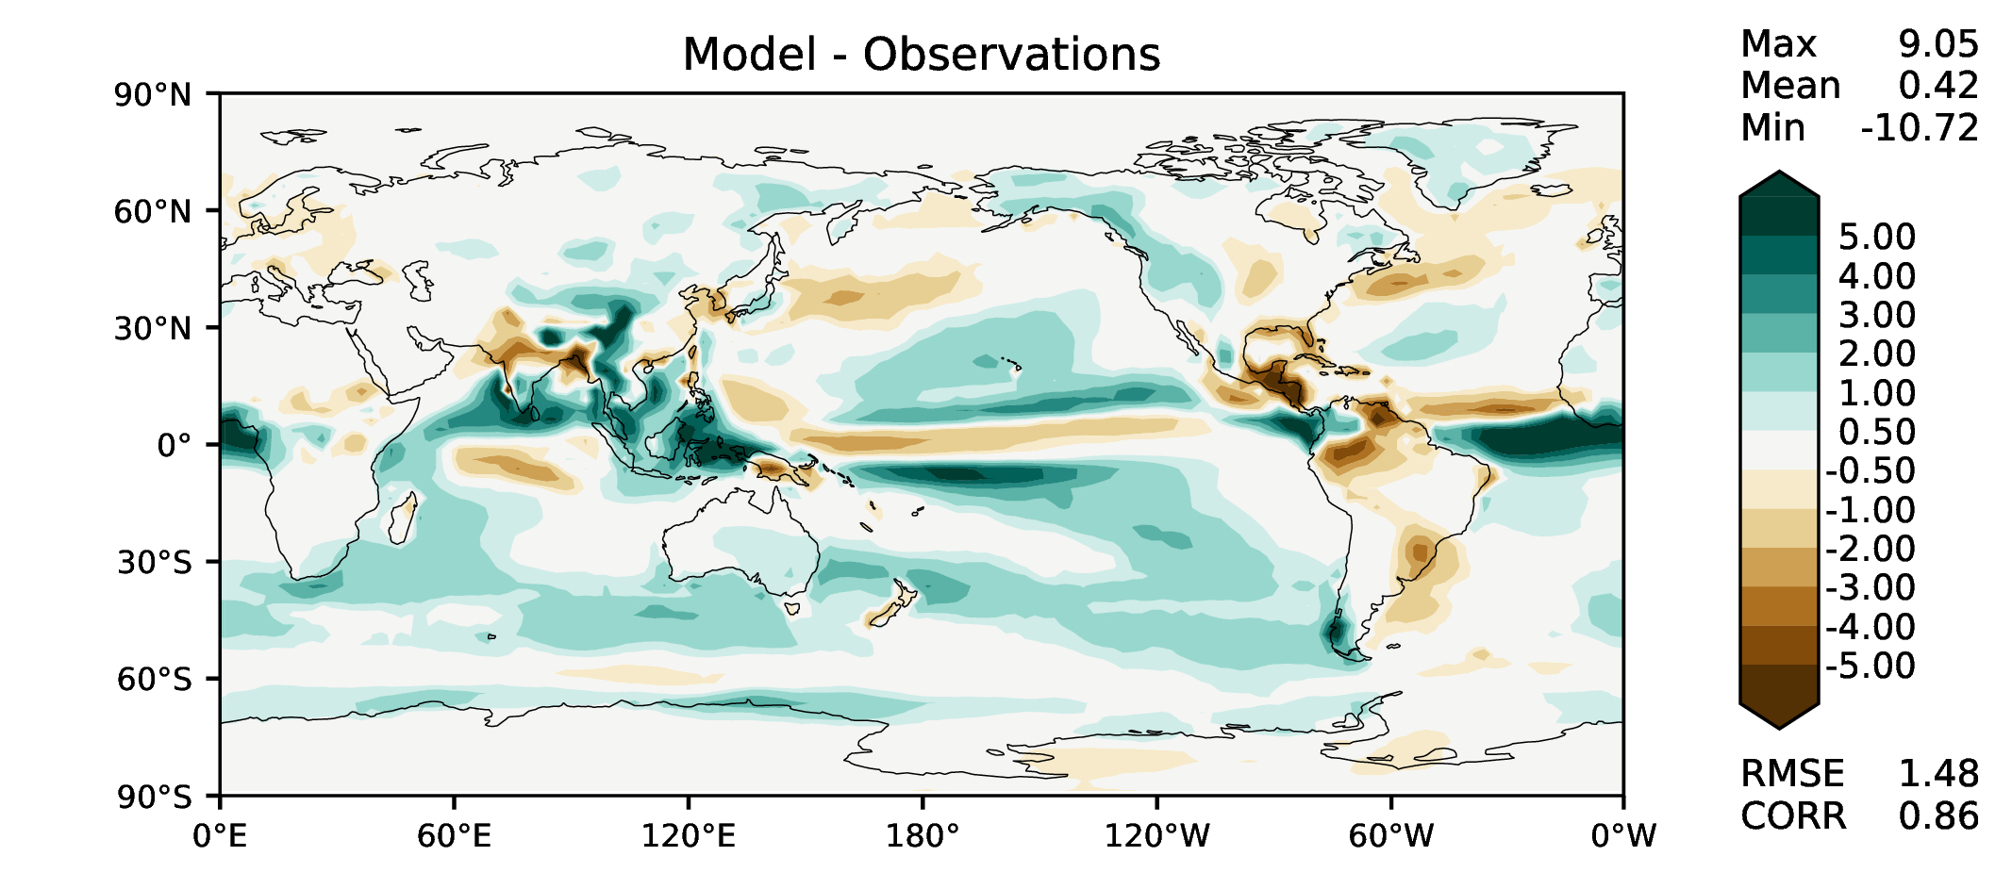
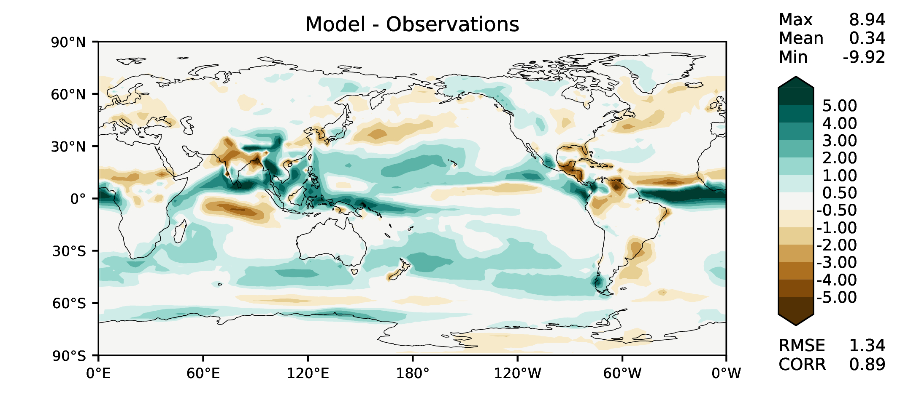
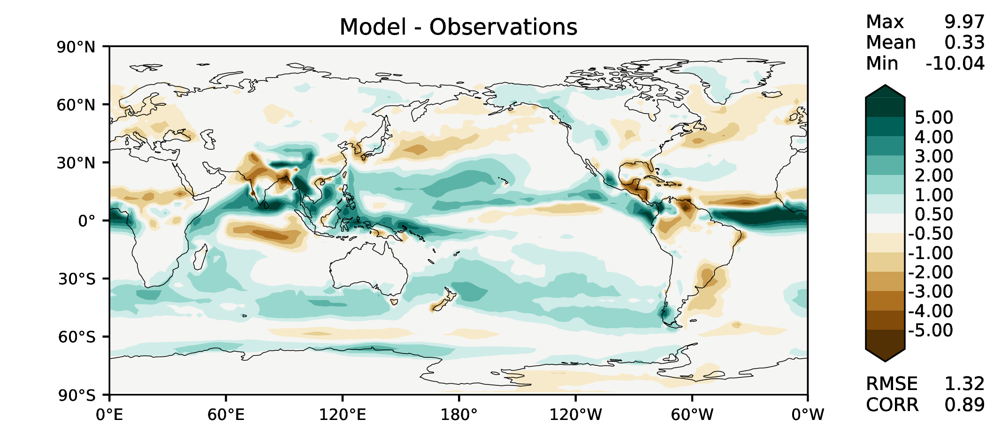
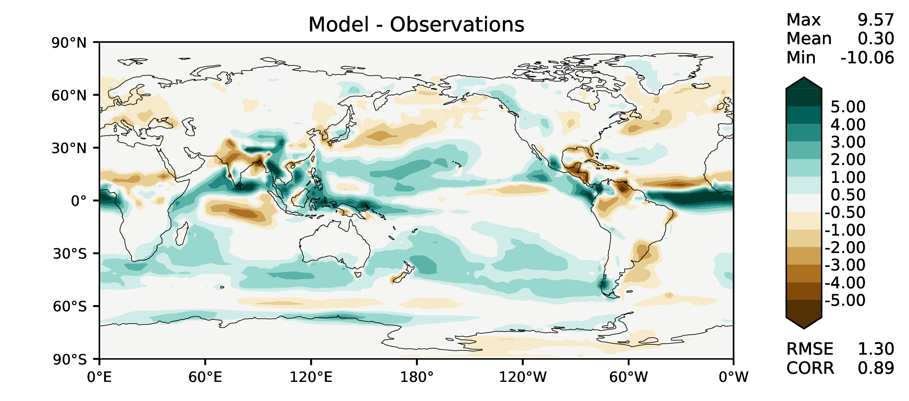
JJA total precipitation
DECKv1b
v2rc1c
v2rc3c
v2rc3e

Slide 7
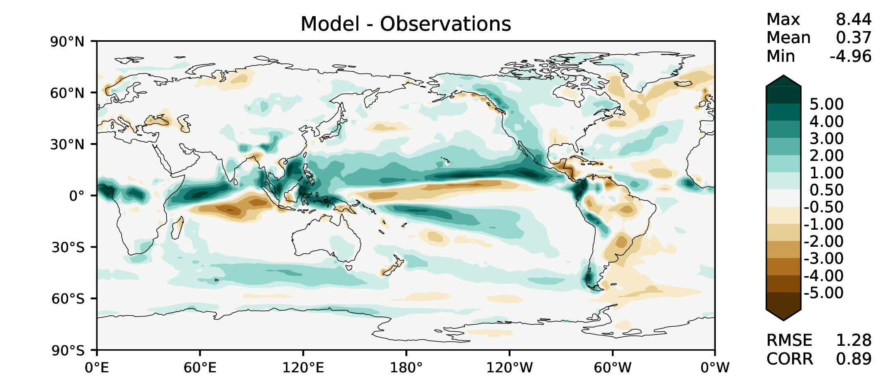
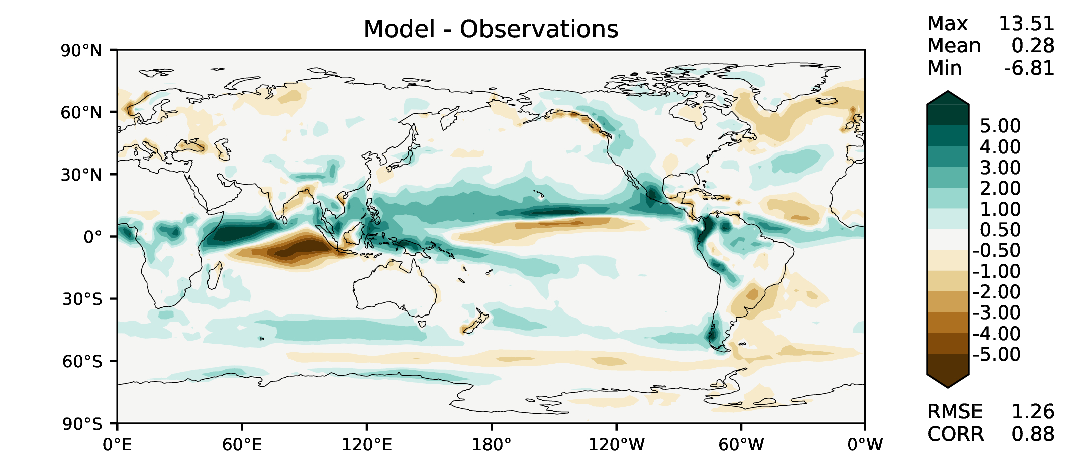
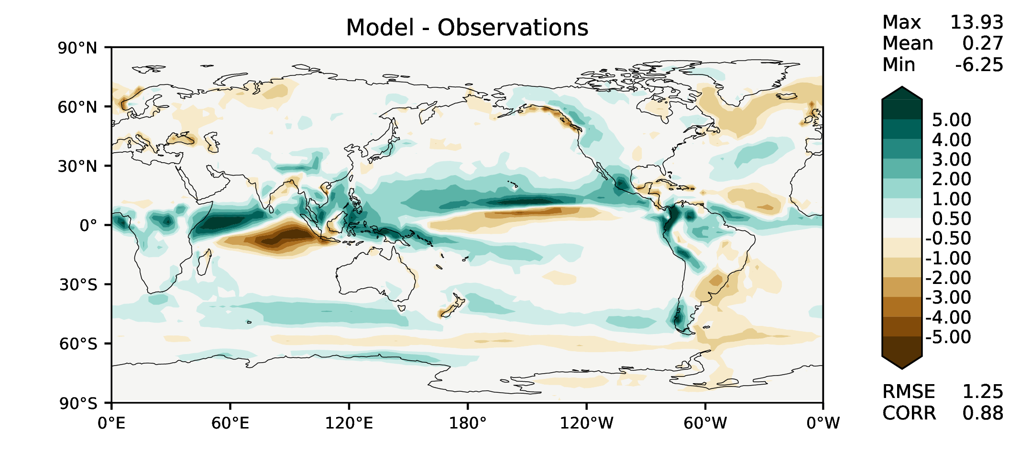
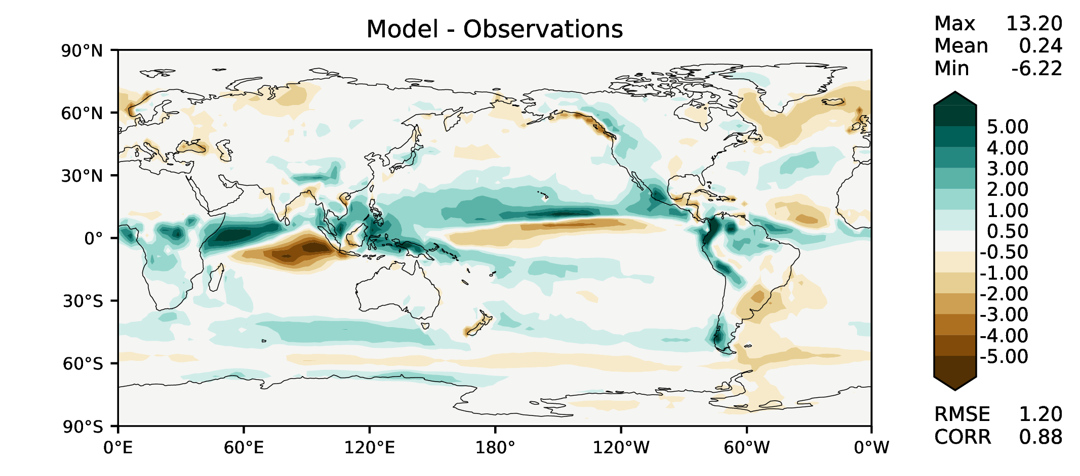
SON total precipitation
DECKv1b
v2rc1c
v2rc3c
v2rc3e

Slide 8
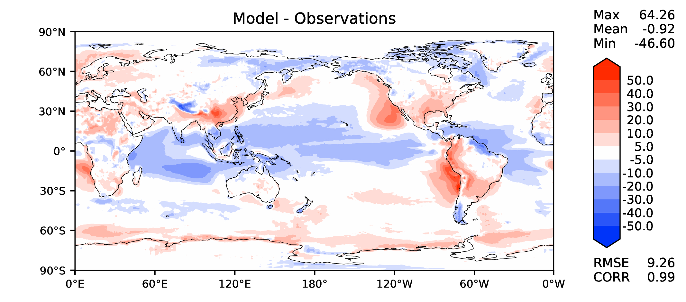
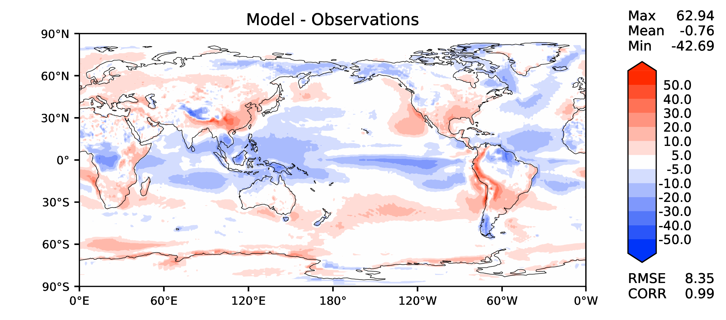
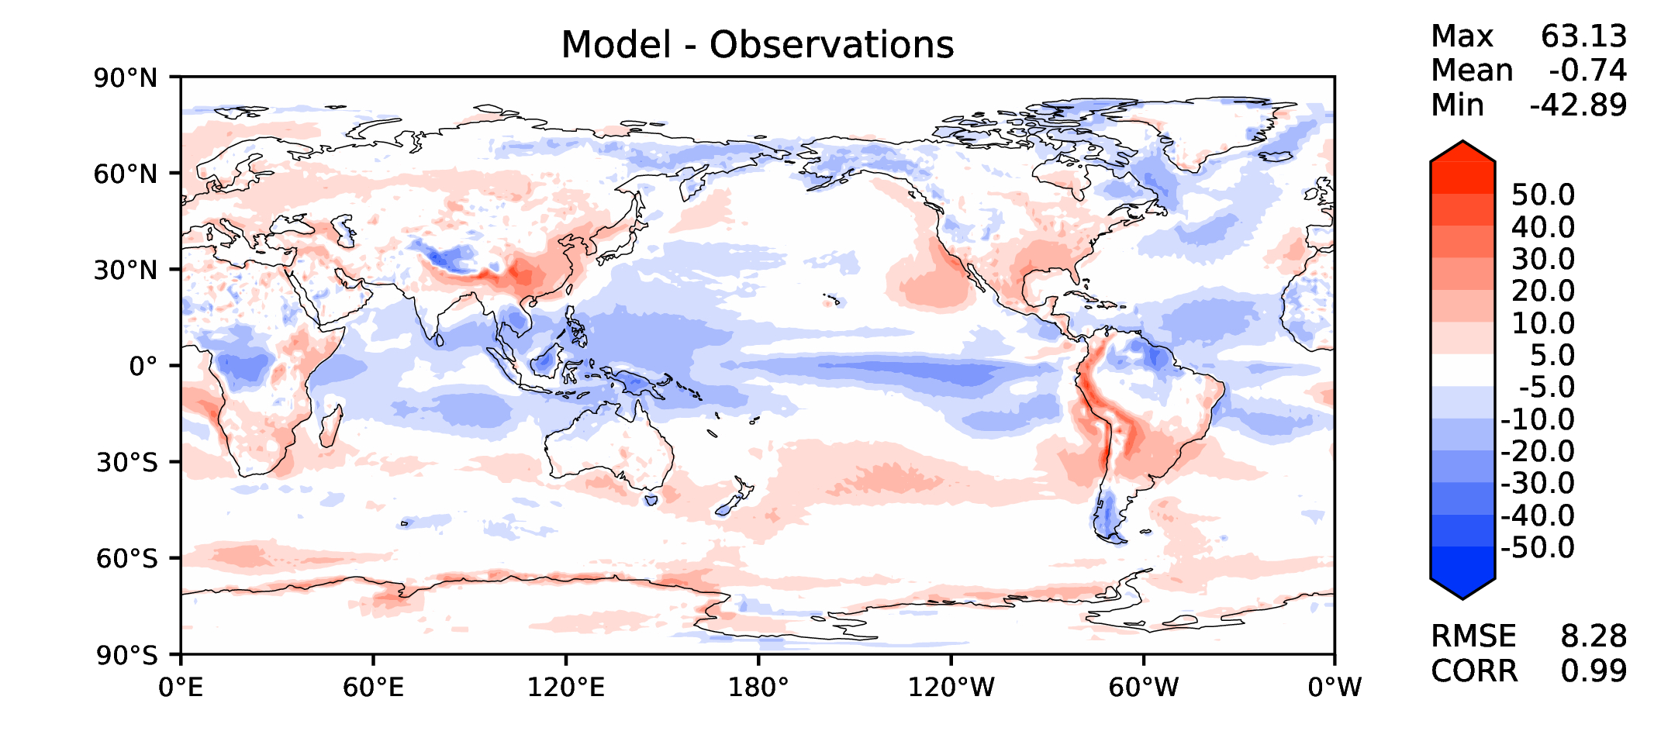
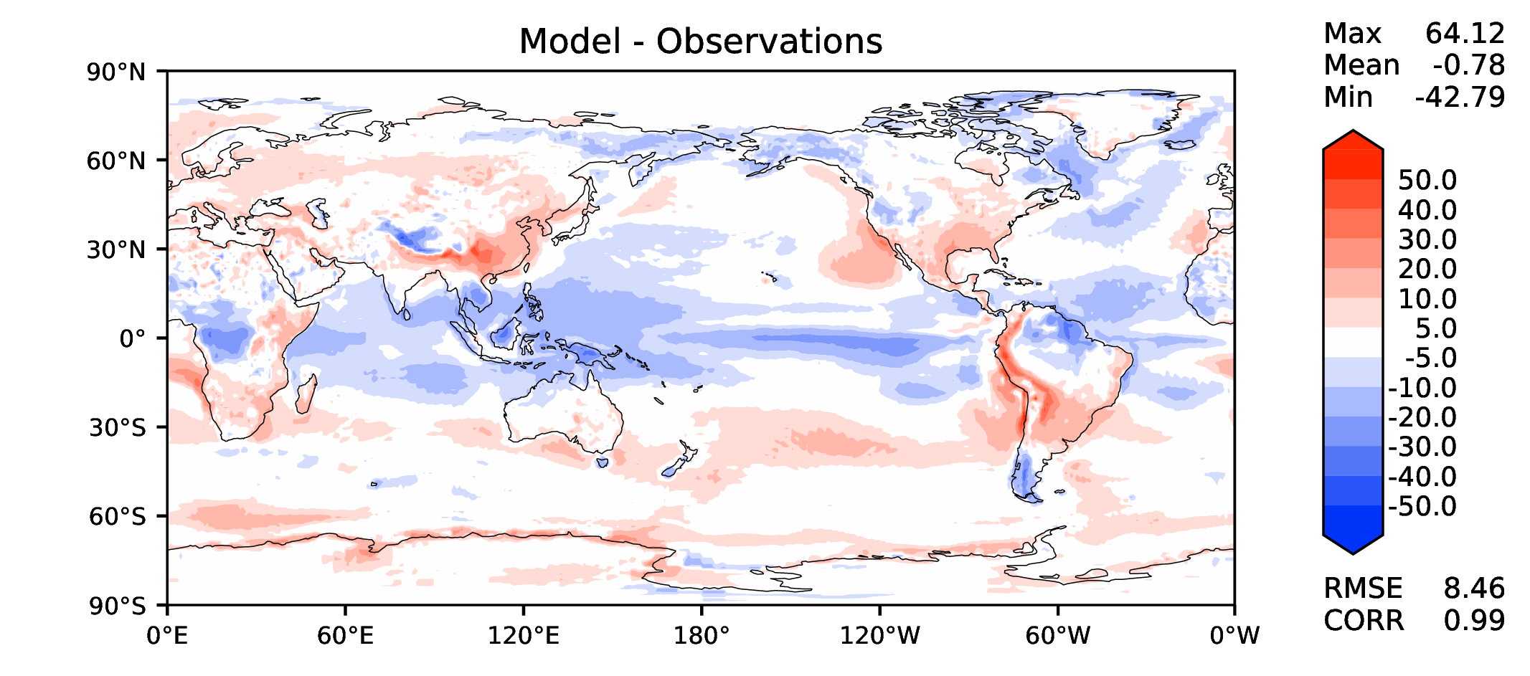
Annual TOA net radiation
DECKv1b
v2rc1c
v2rc3c
v2rc3e

Slide 9
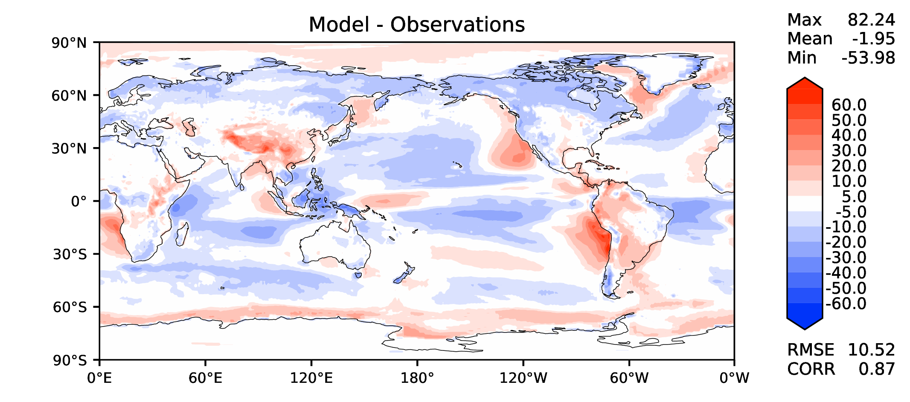
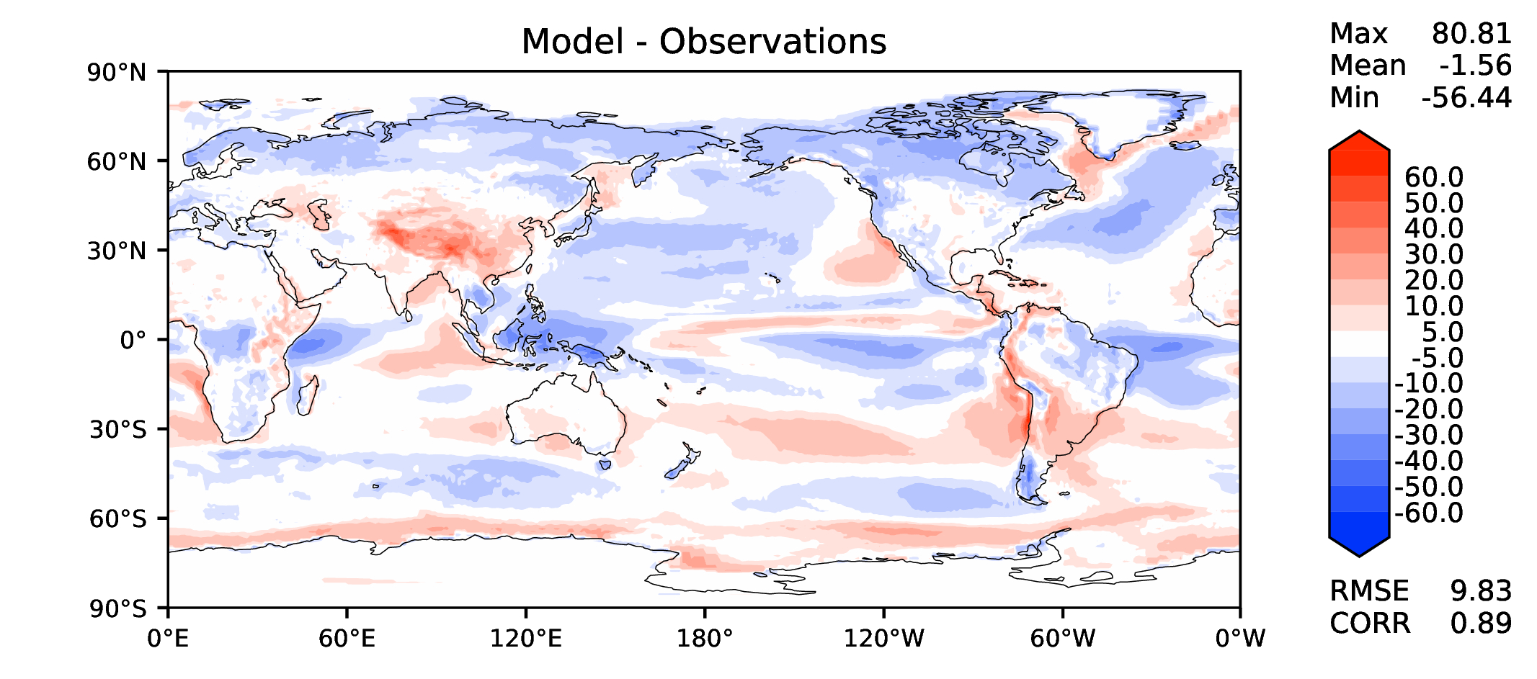
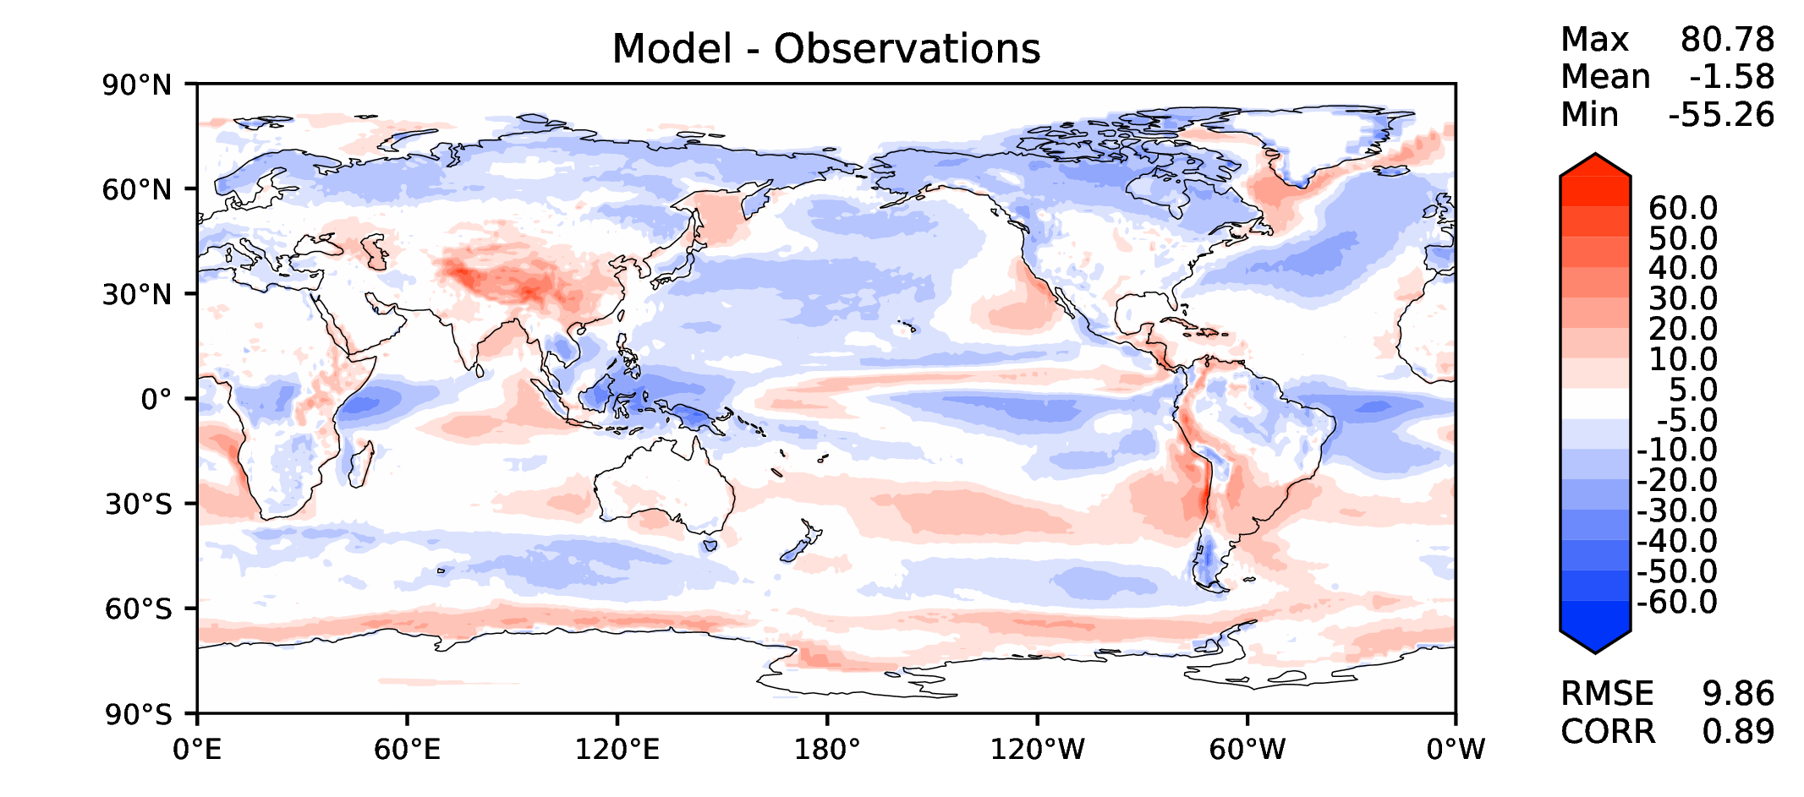
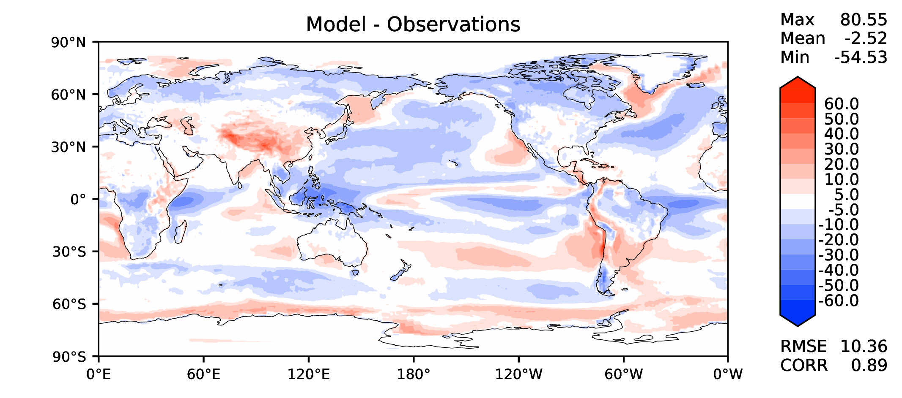
Annual TOA SW CRE
DECKv1b
v2rc1c
v2rc3c
v2rc3e

Slide 10
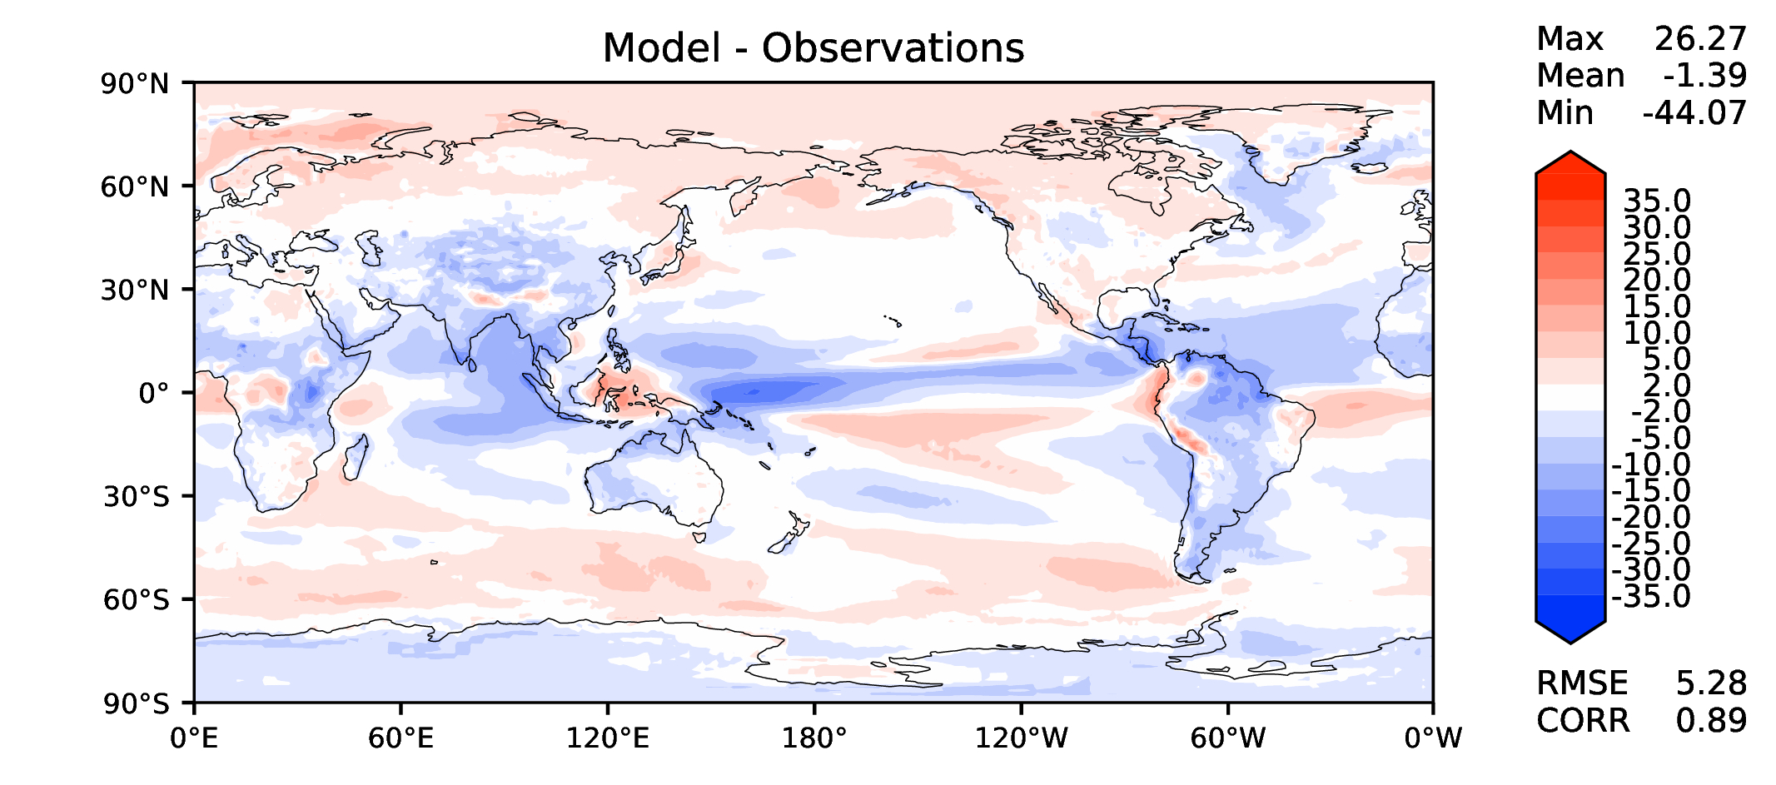
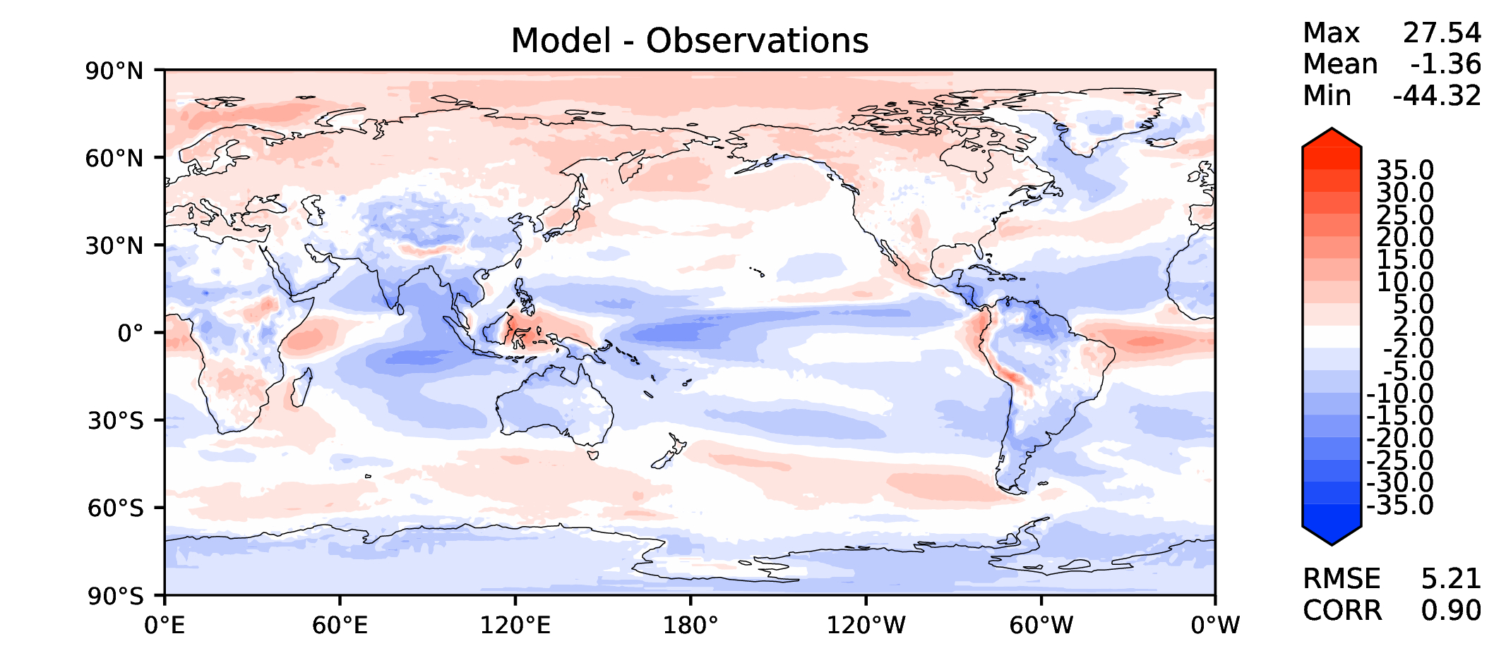
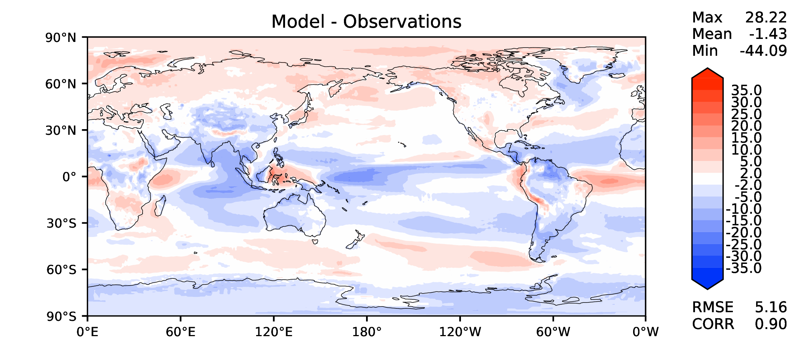
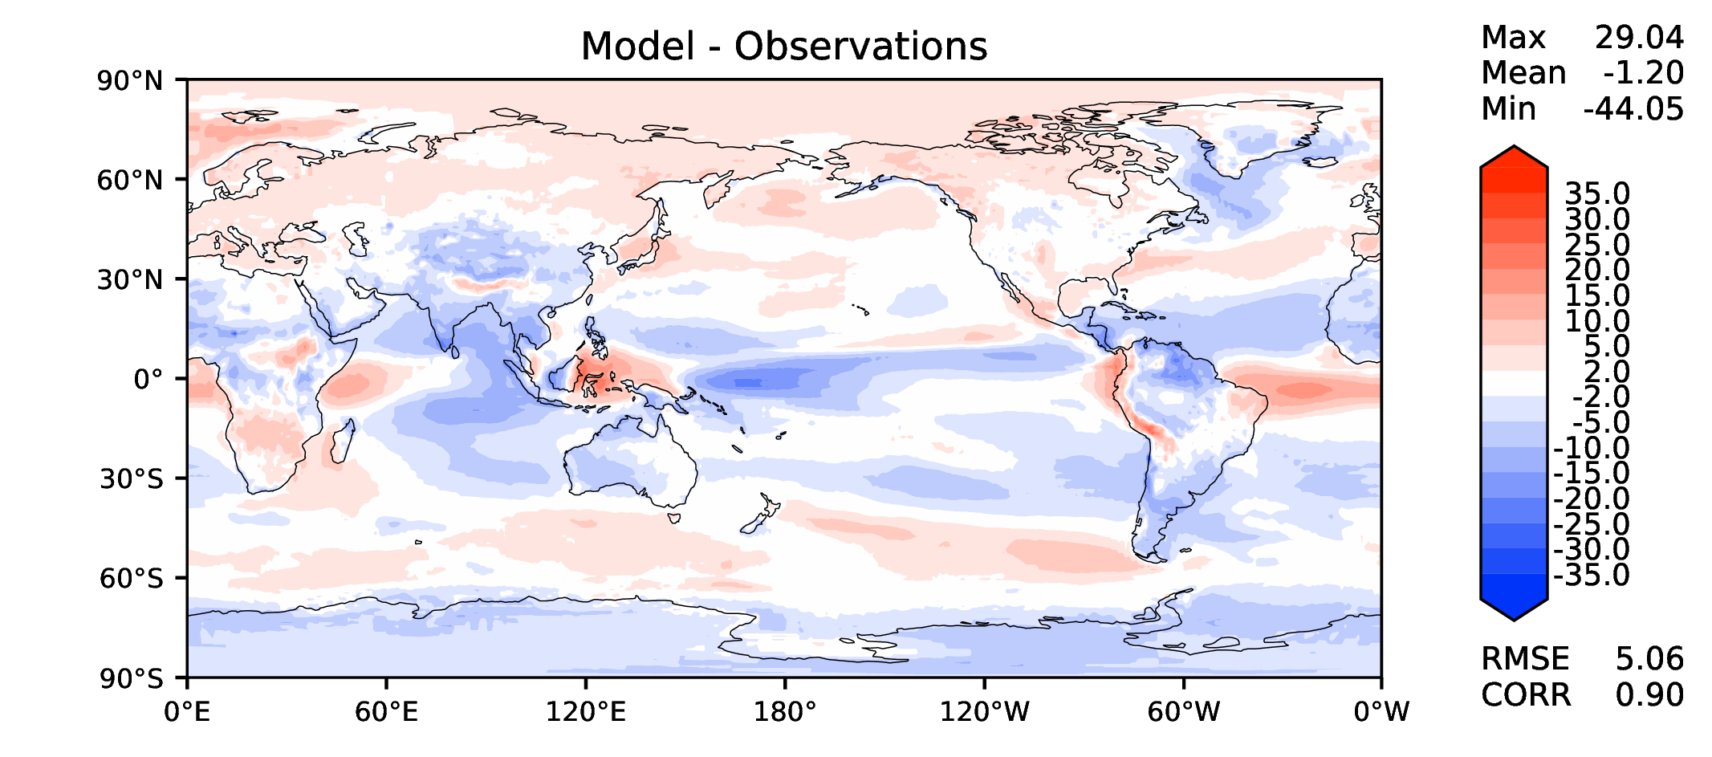
Annual TOA LW CRE
DECKv1b
v2rc1c
v2rc3c
v2rc3e

Slide 11
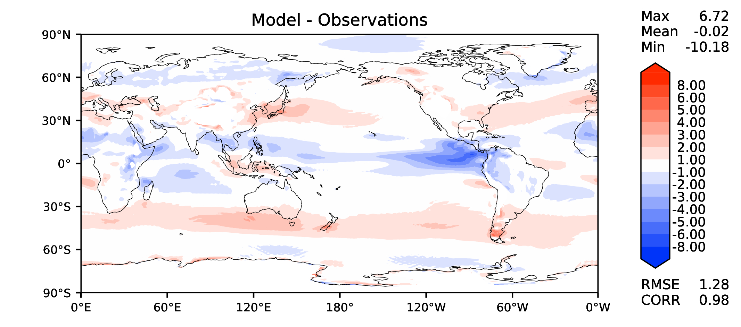
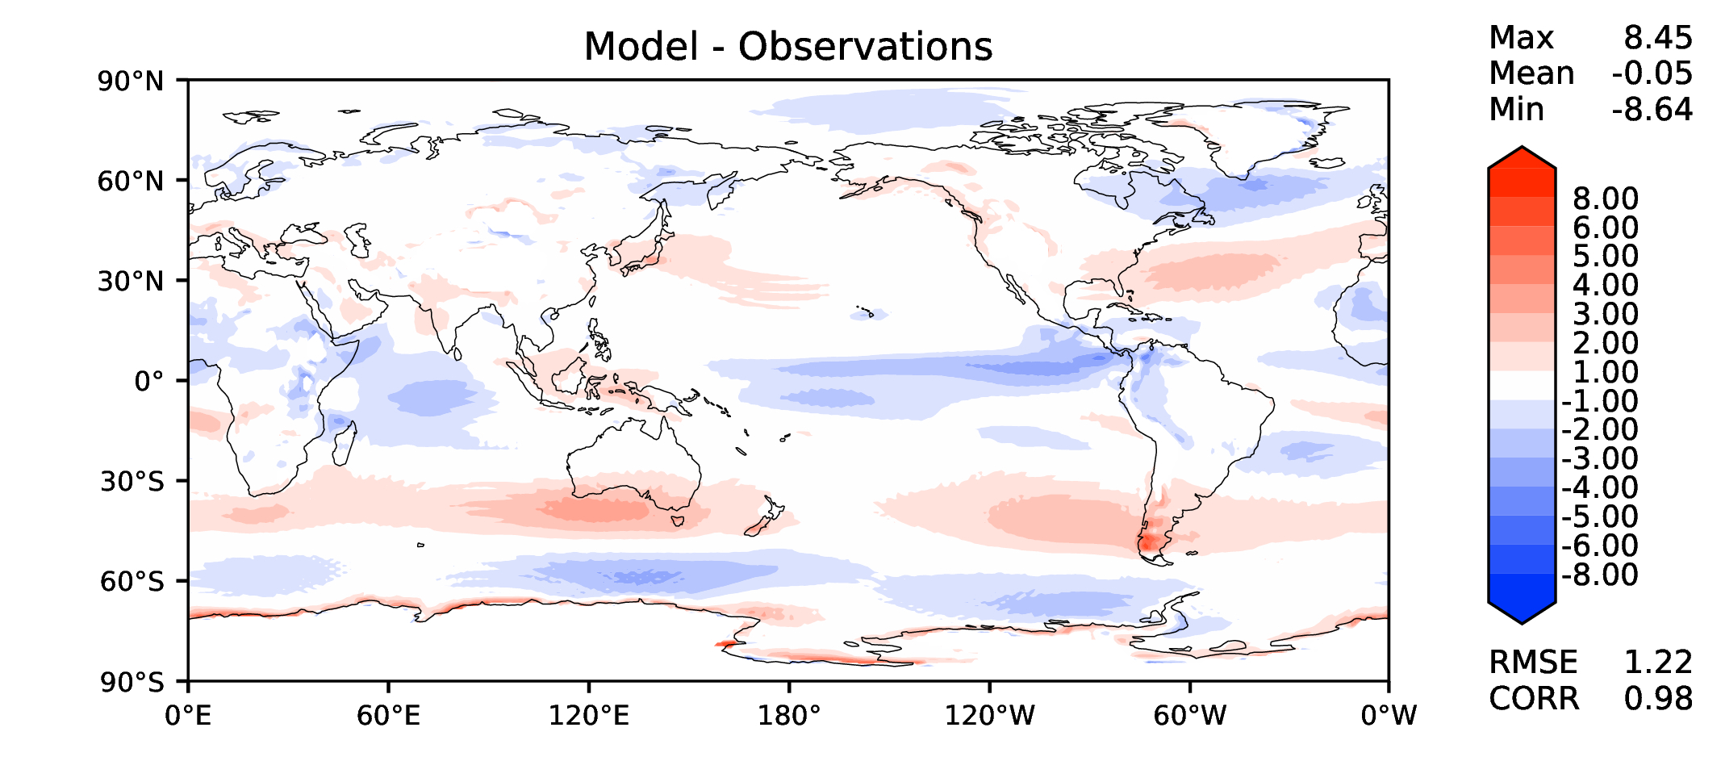
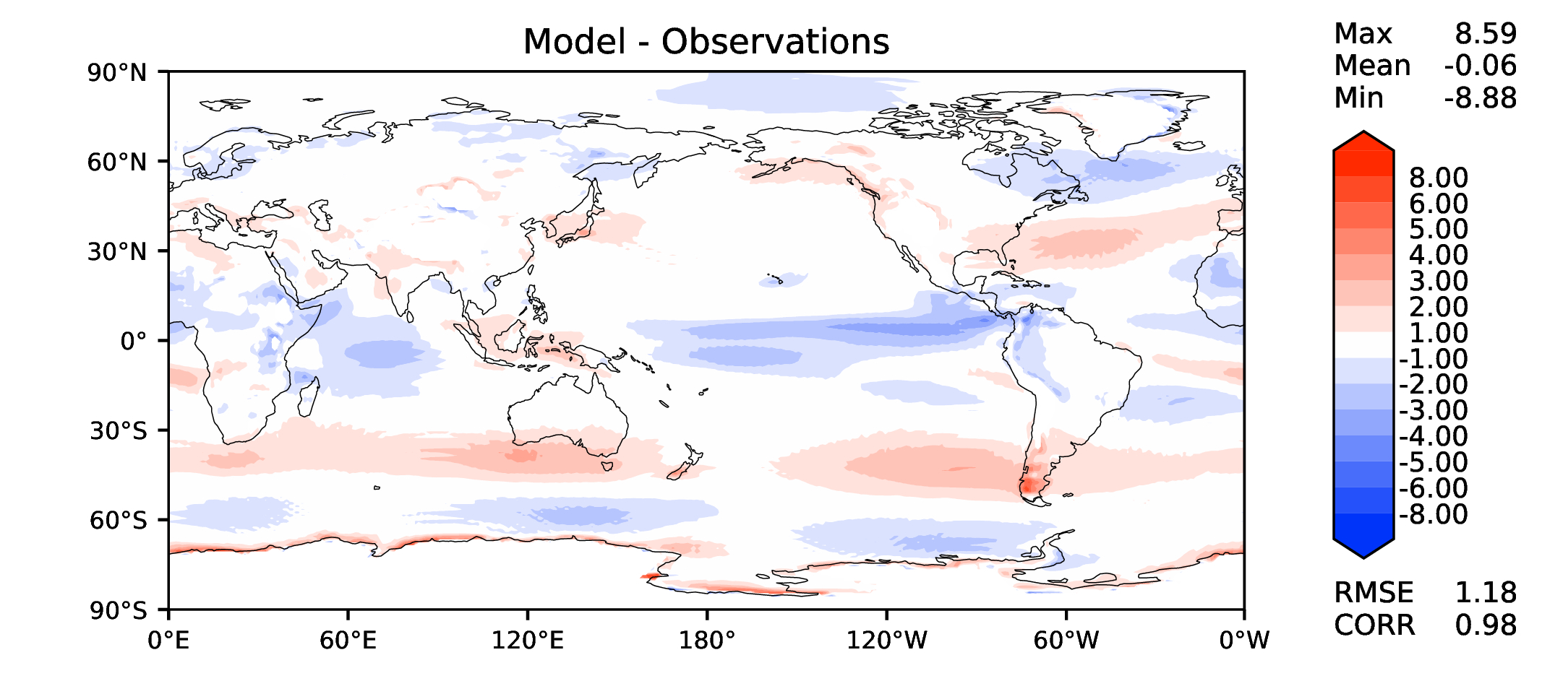
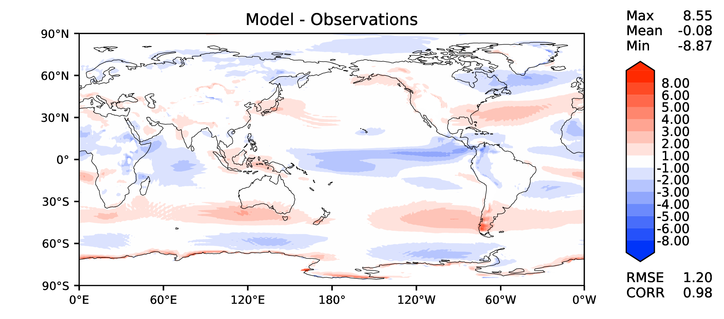
Annual u wind at 850 hPa
DECKv1b
v2rc1c
v2rc3c
v2rc3e

Slide 12
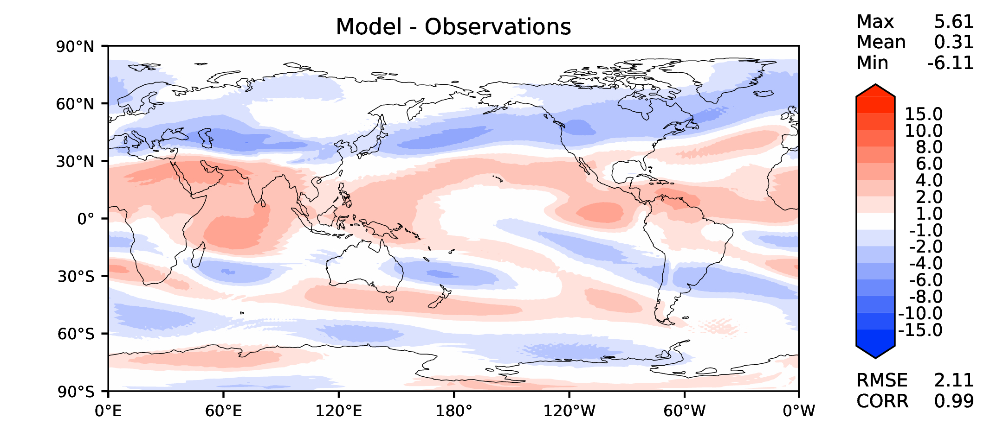
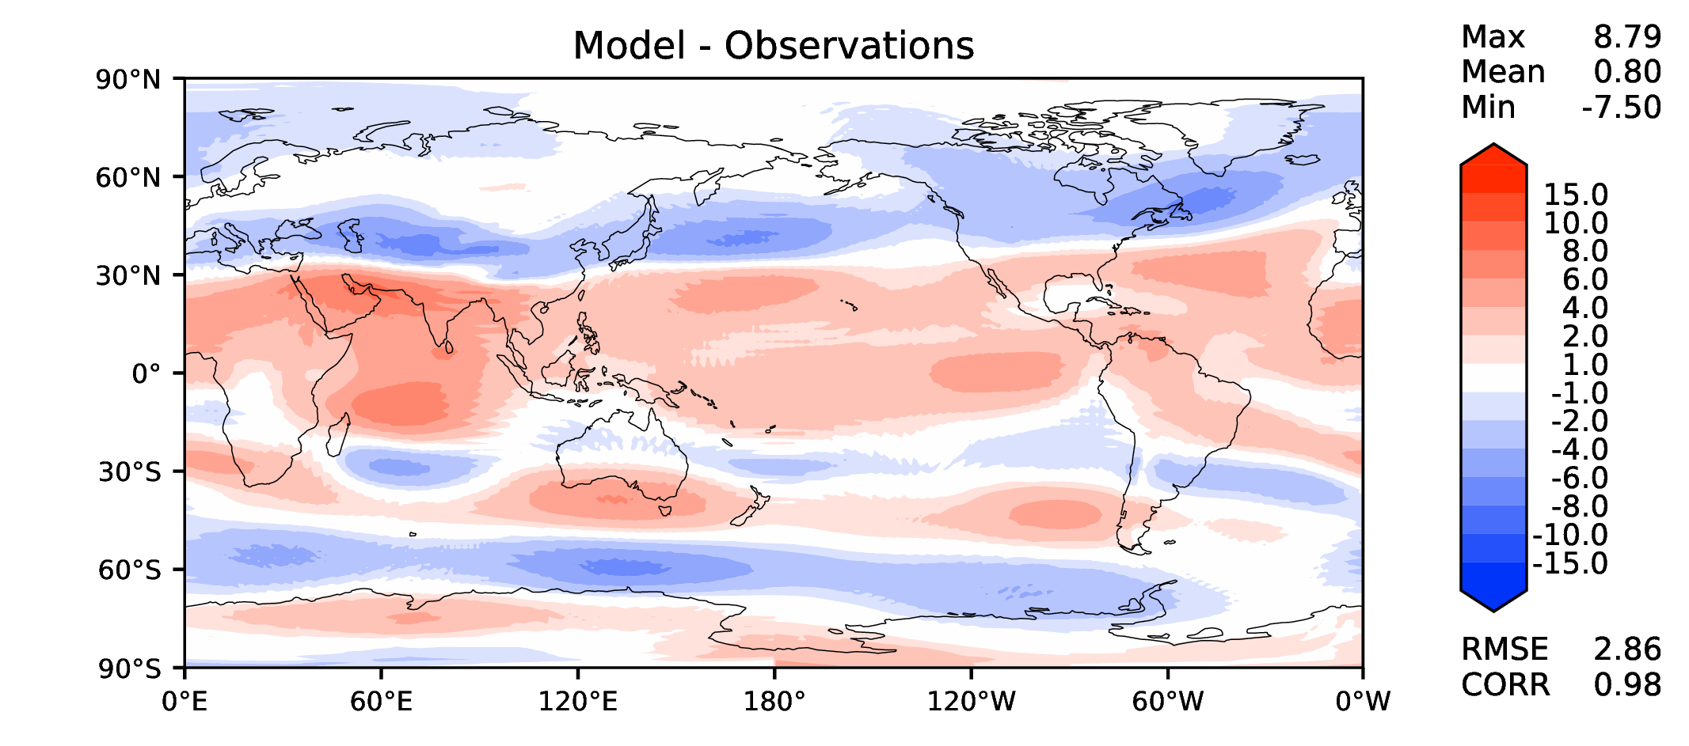
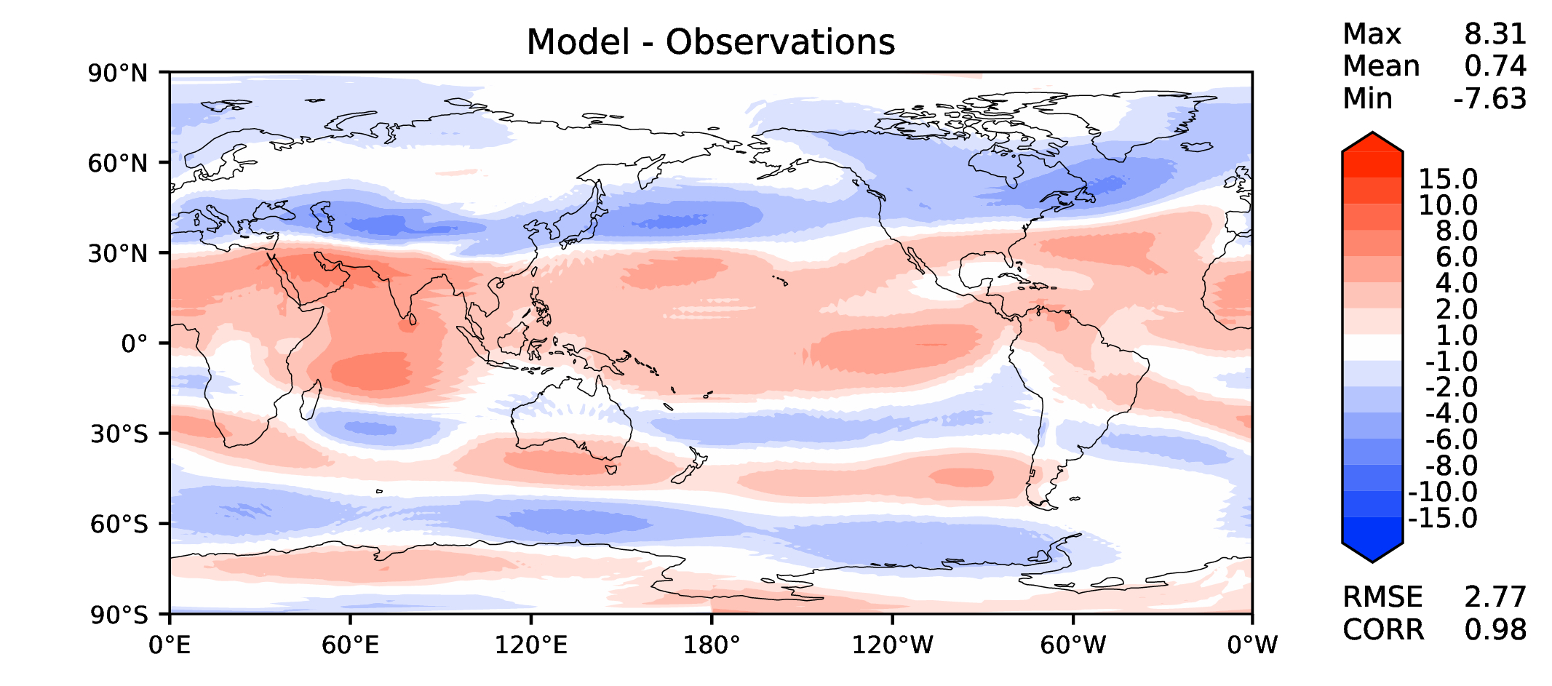
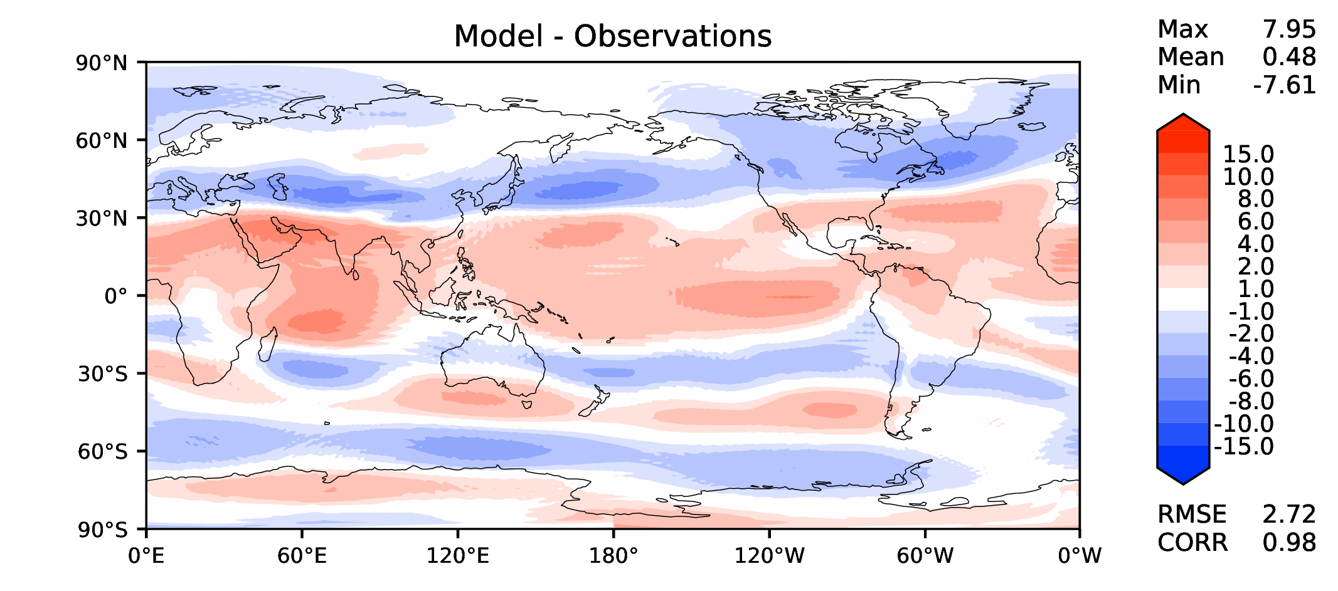
Annual u wind at 200 hPa
DECKv1b
v2rc1c
v2rc3c
v2rc3e

Slide 13
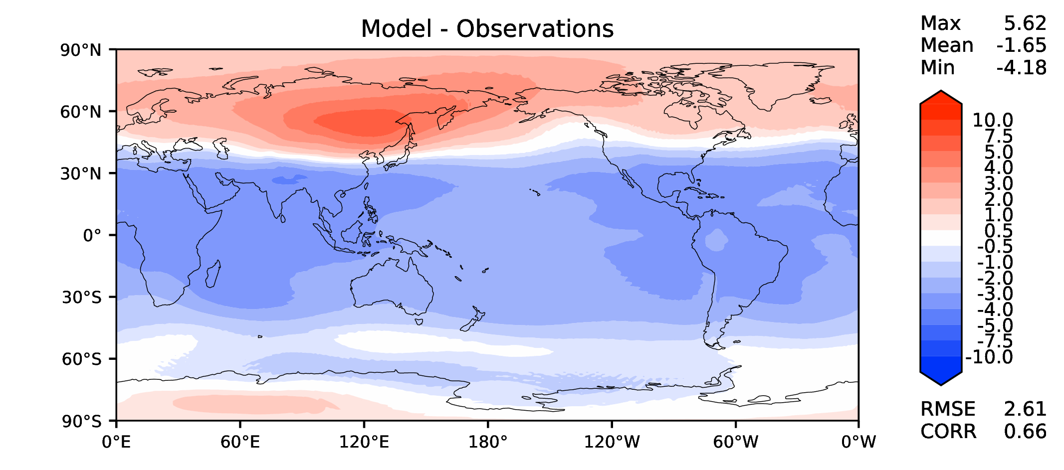
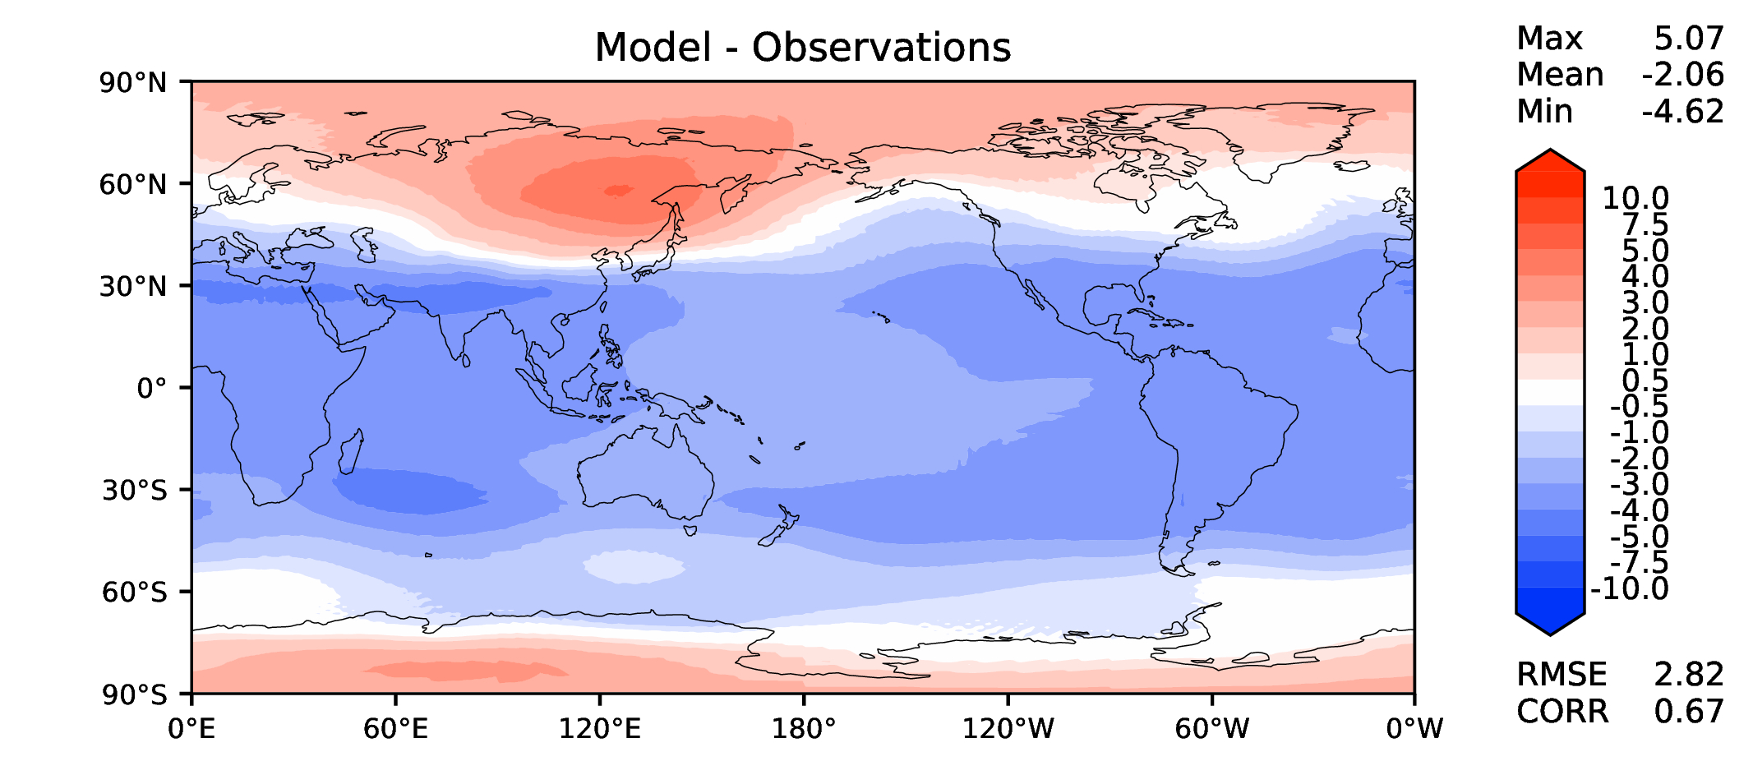
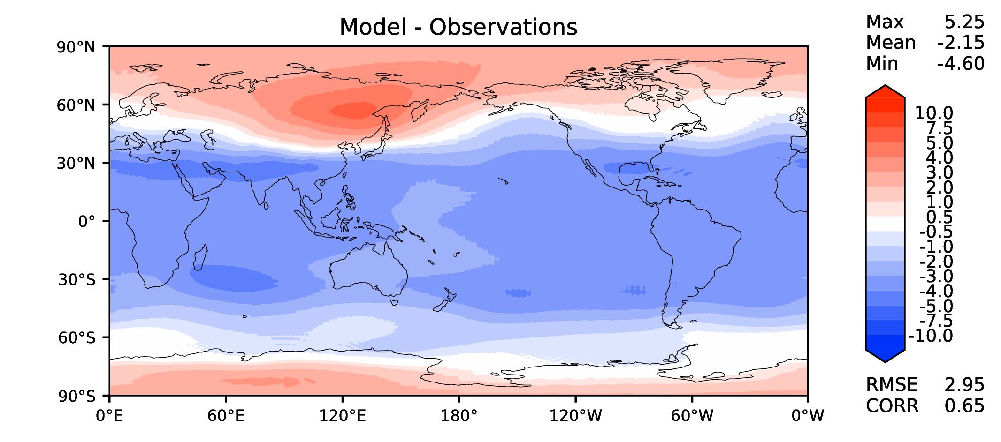
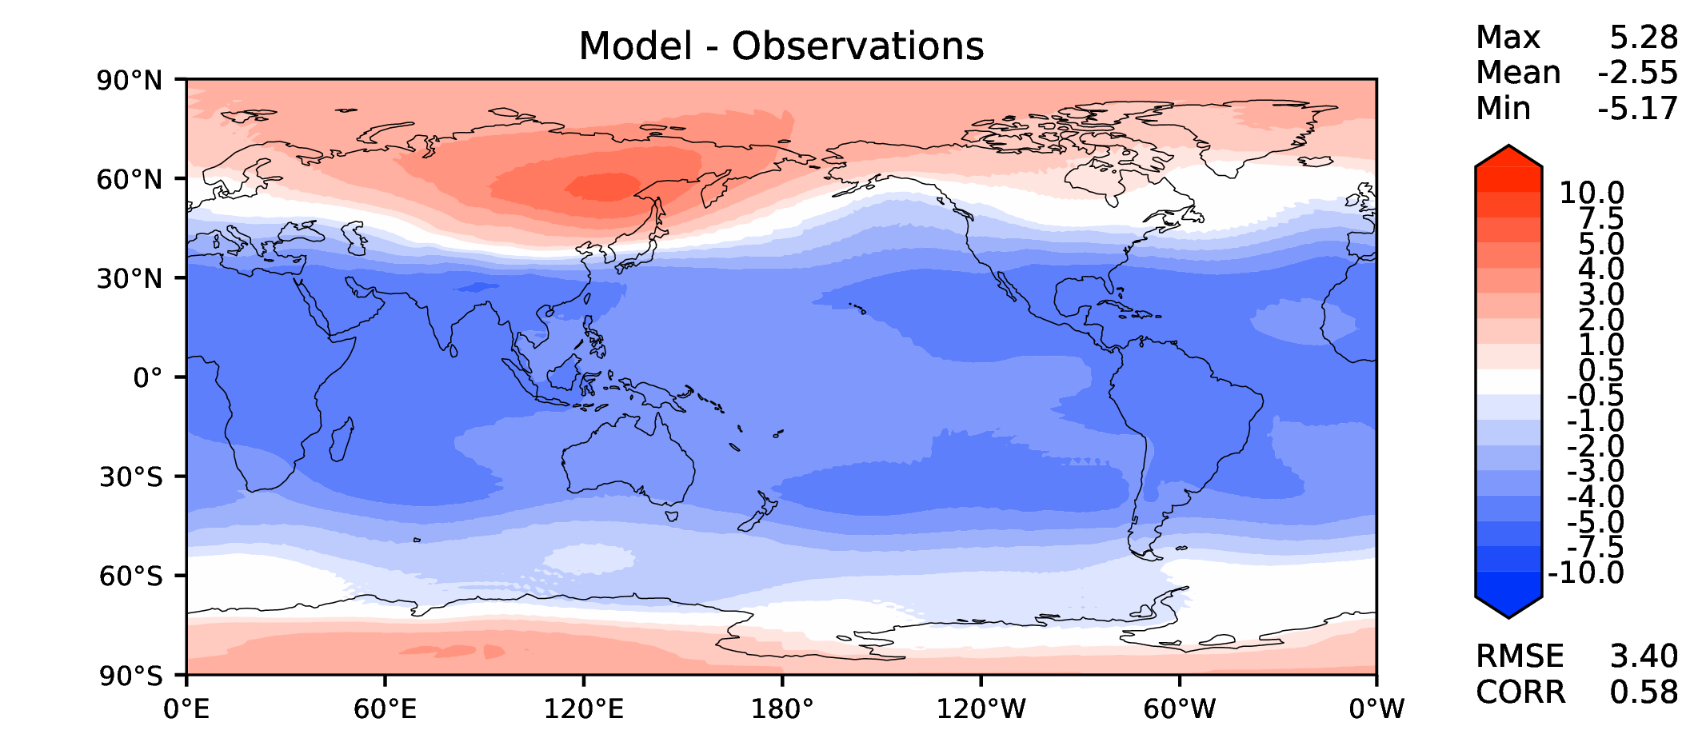
Annual T at 200 hPa
DECKv1b
v2rc1c
v2rc3c
v2rc3e

Slide 14
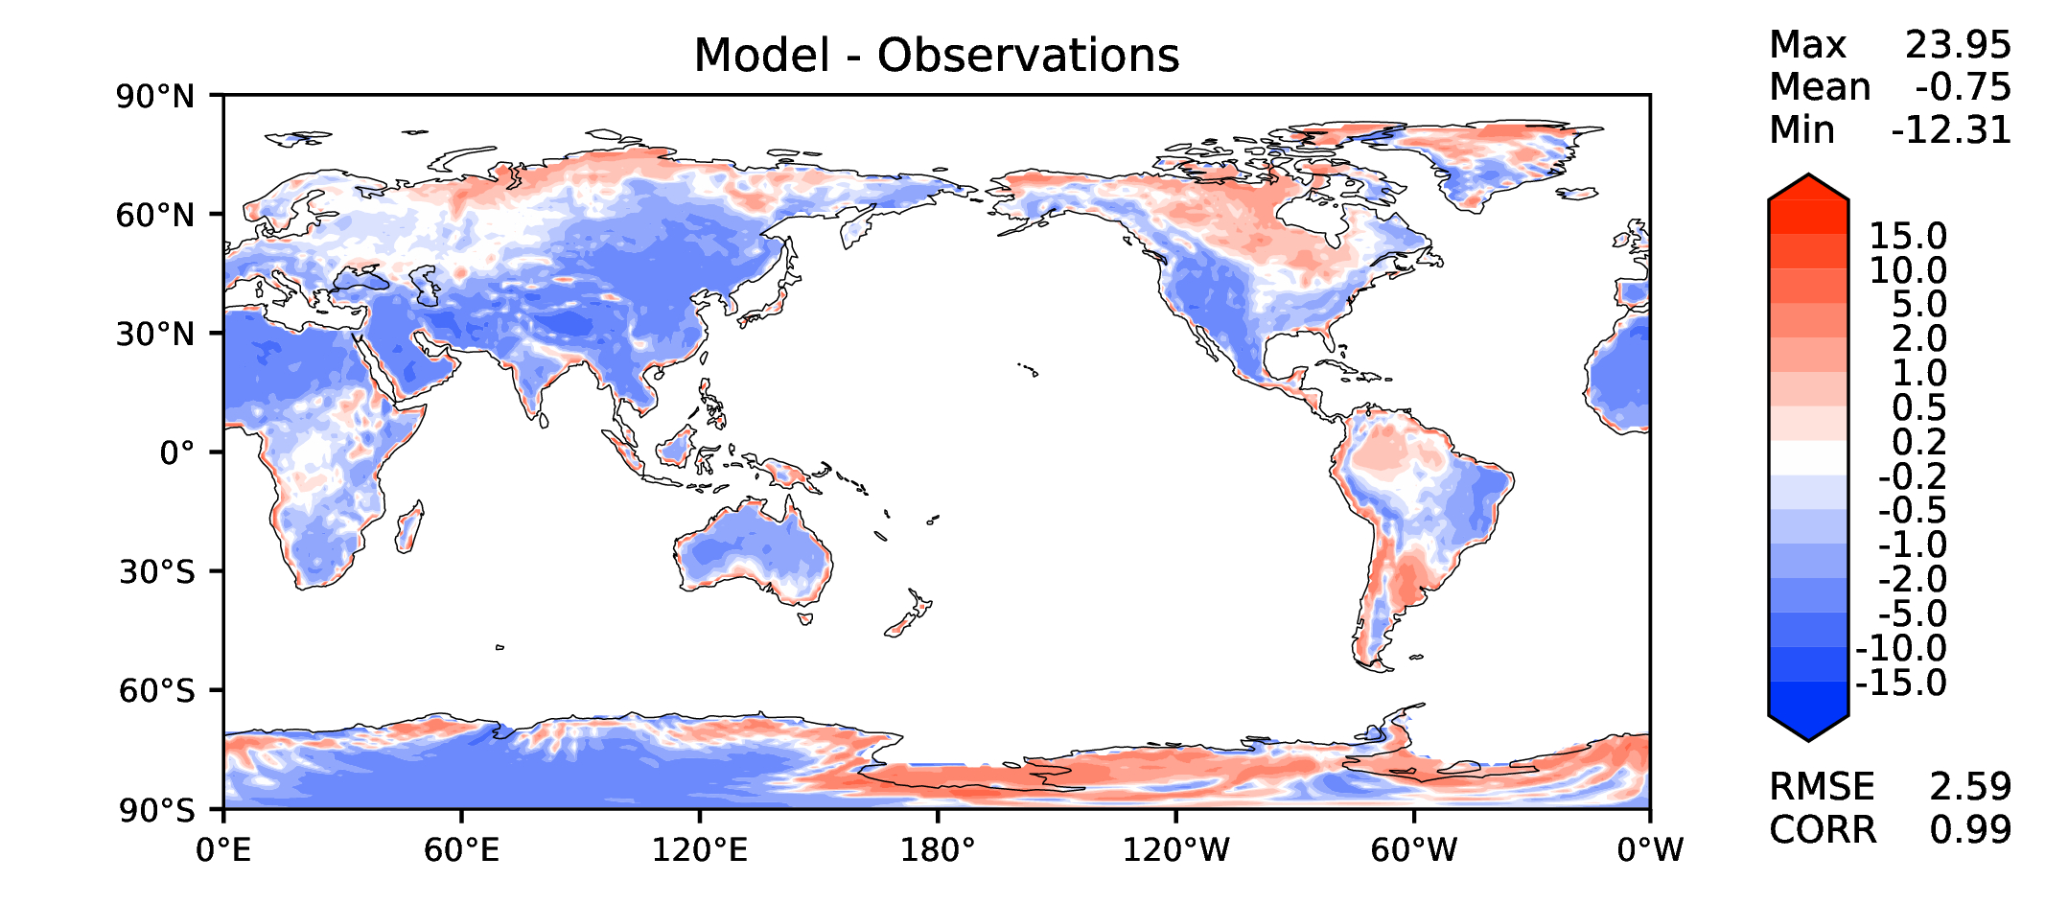
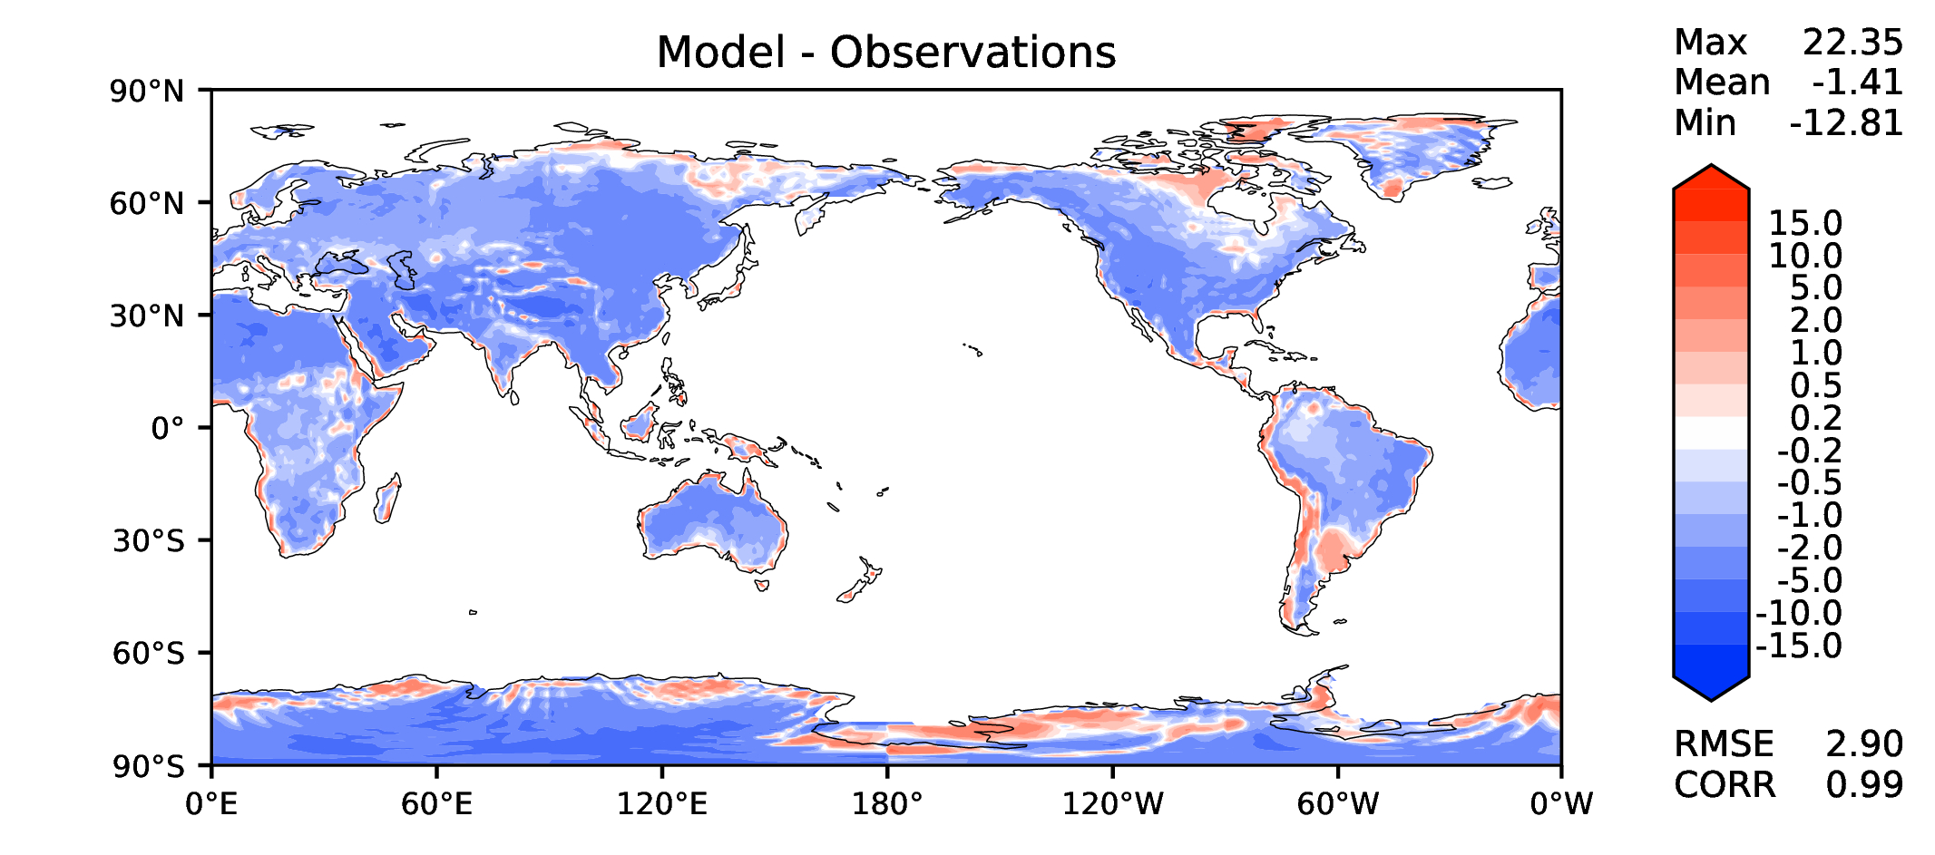
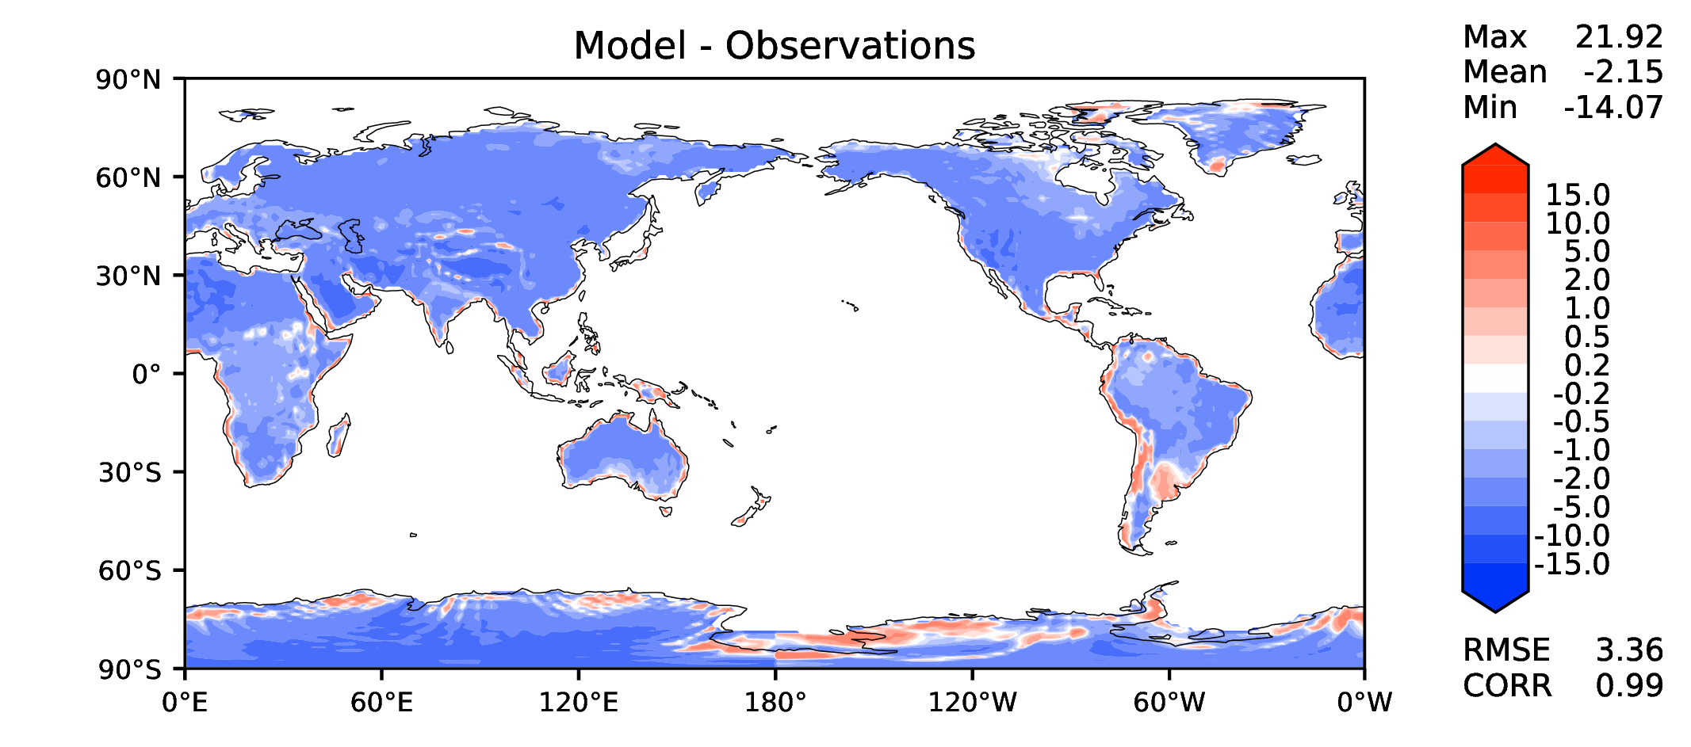
Annual surface air T (land)
DECKv1b
v2rc1c
v2rc3c
v2rc3e

Slide 15
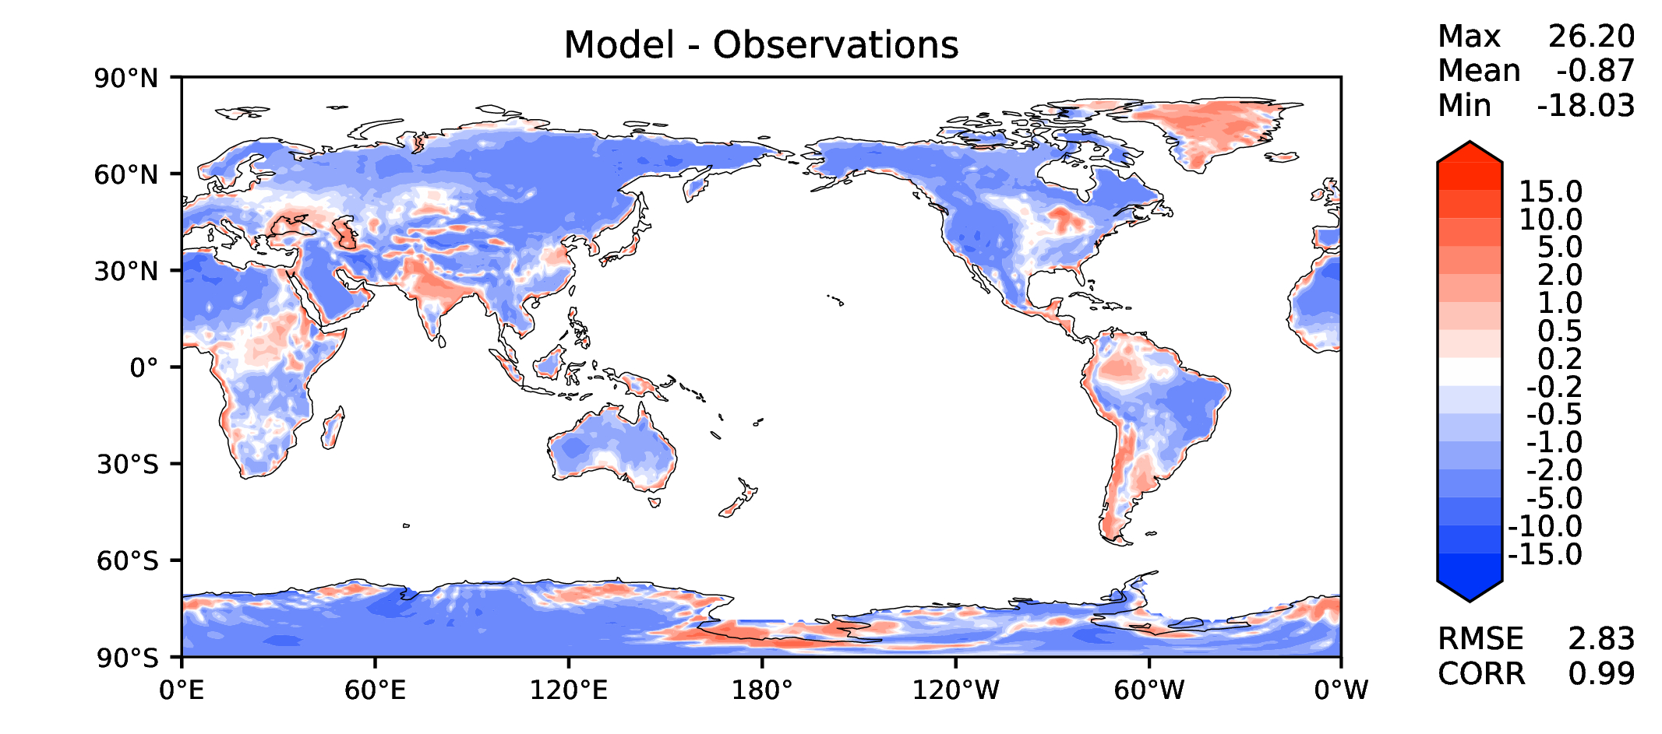
JJA surface air T (land)
DECKv1b
v2rc1c
v2rc3c
v2rc3e

Slide 16
Aerosol optical depth
DECKv1b
v2rc1c
v2rc3c
v2rc3e

Slide 17
TAUXY ANN ocean
DECKv1b
v2rc1c
v2rc3c
v2rc3e

