Slide 1
Summary table (RMSE vs obs)
Variable | Season | DECKv1b | v2rc3c
SST | ANN | 1.12 | 1.35 | 1.38
PRECT | ANN | 1.14 | 1.02 | 0.97
PRECT | DJF | 1.44 | 1.39 | 1.35
PRECT | MAM | 1.56 | 1.31 | 1.24
PRECT | JJA | 1.53 | 1.40 | 1.35
PRECT | SON | 1.30 | 1.31 | 1.22
RESTOM | ANN | 9.37 | 8.50 | 8.59
SWCF | ANN | 10.66 | 10.10 | 10.43
LWCF | ANN | 5.39 | 5.36 | 5.10
u850 | ANN | 1.30 | 1.20 | 1.20
u200 | ANN | 2.20 | 2.90 | 2.97
T200 | ANN | 2.60 | 2.76 | 3.20
TREFHT | ANN | 2.57 | 3.01 | 3.36
TREFHT | JJA | 2.85 | 3.11 | 3.32
AODVIS | ANN | 0.07 | 0.06 | 0.06
TAUXY | ANN | 0.02 | 0.02 | 0.02

Slide 2
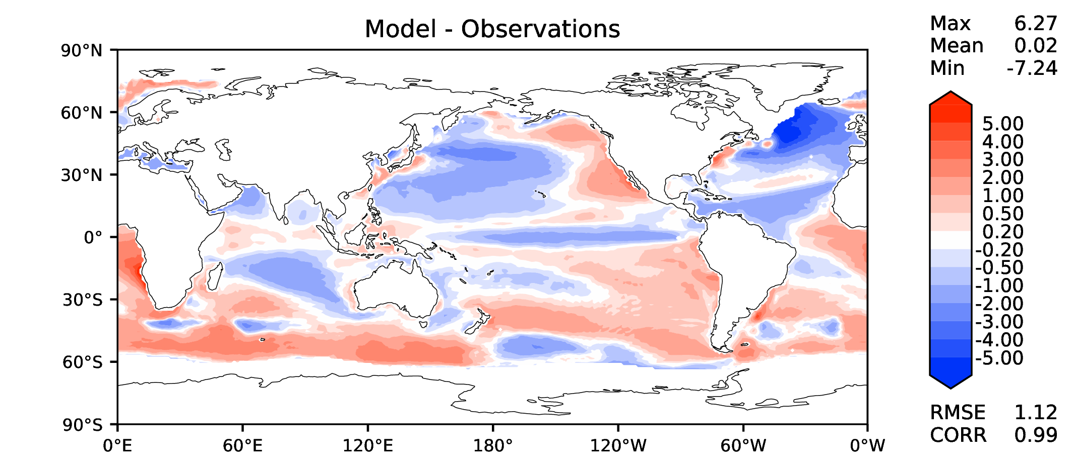
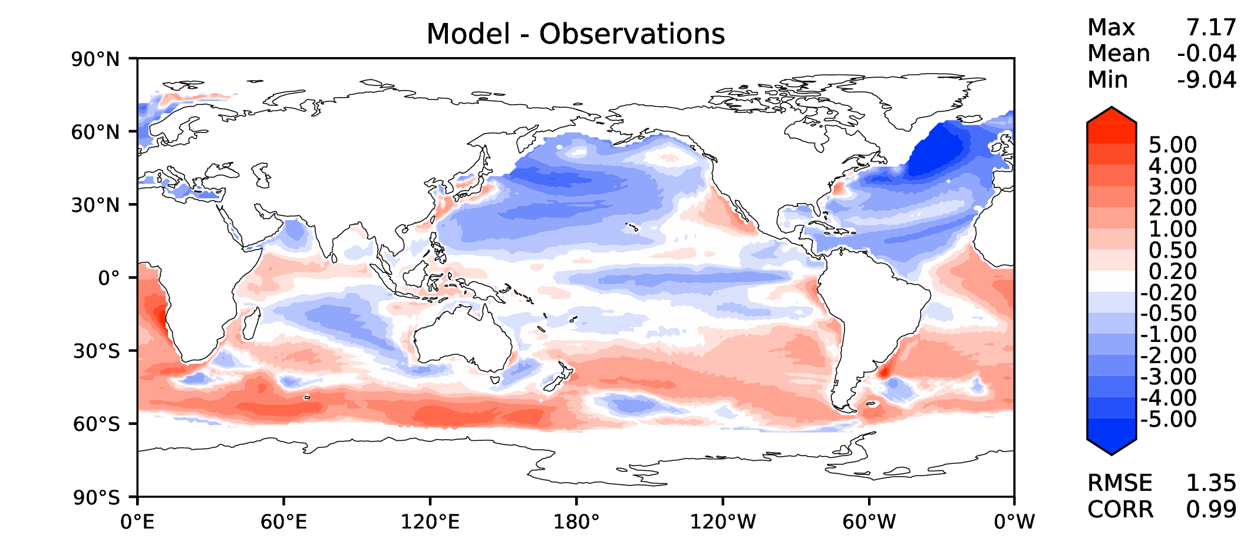
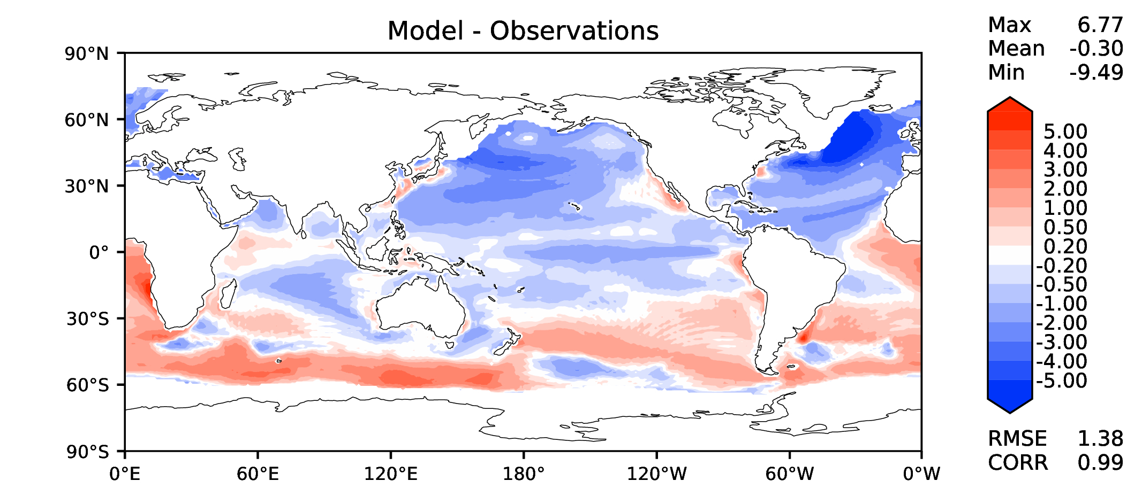
Annual SST (pre-industrial)
DECKv1b
v2rc3c
v2rc3e

Slide 3
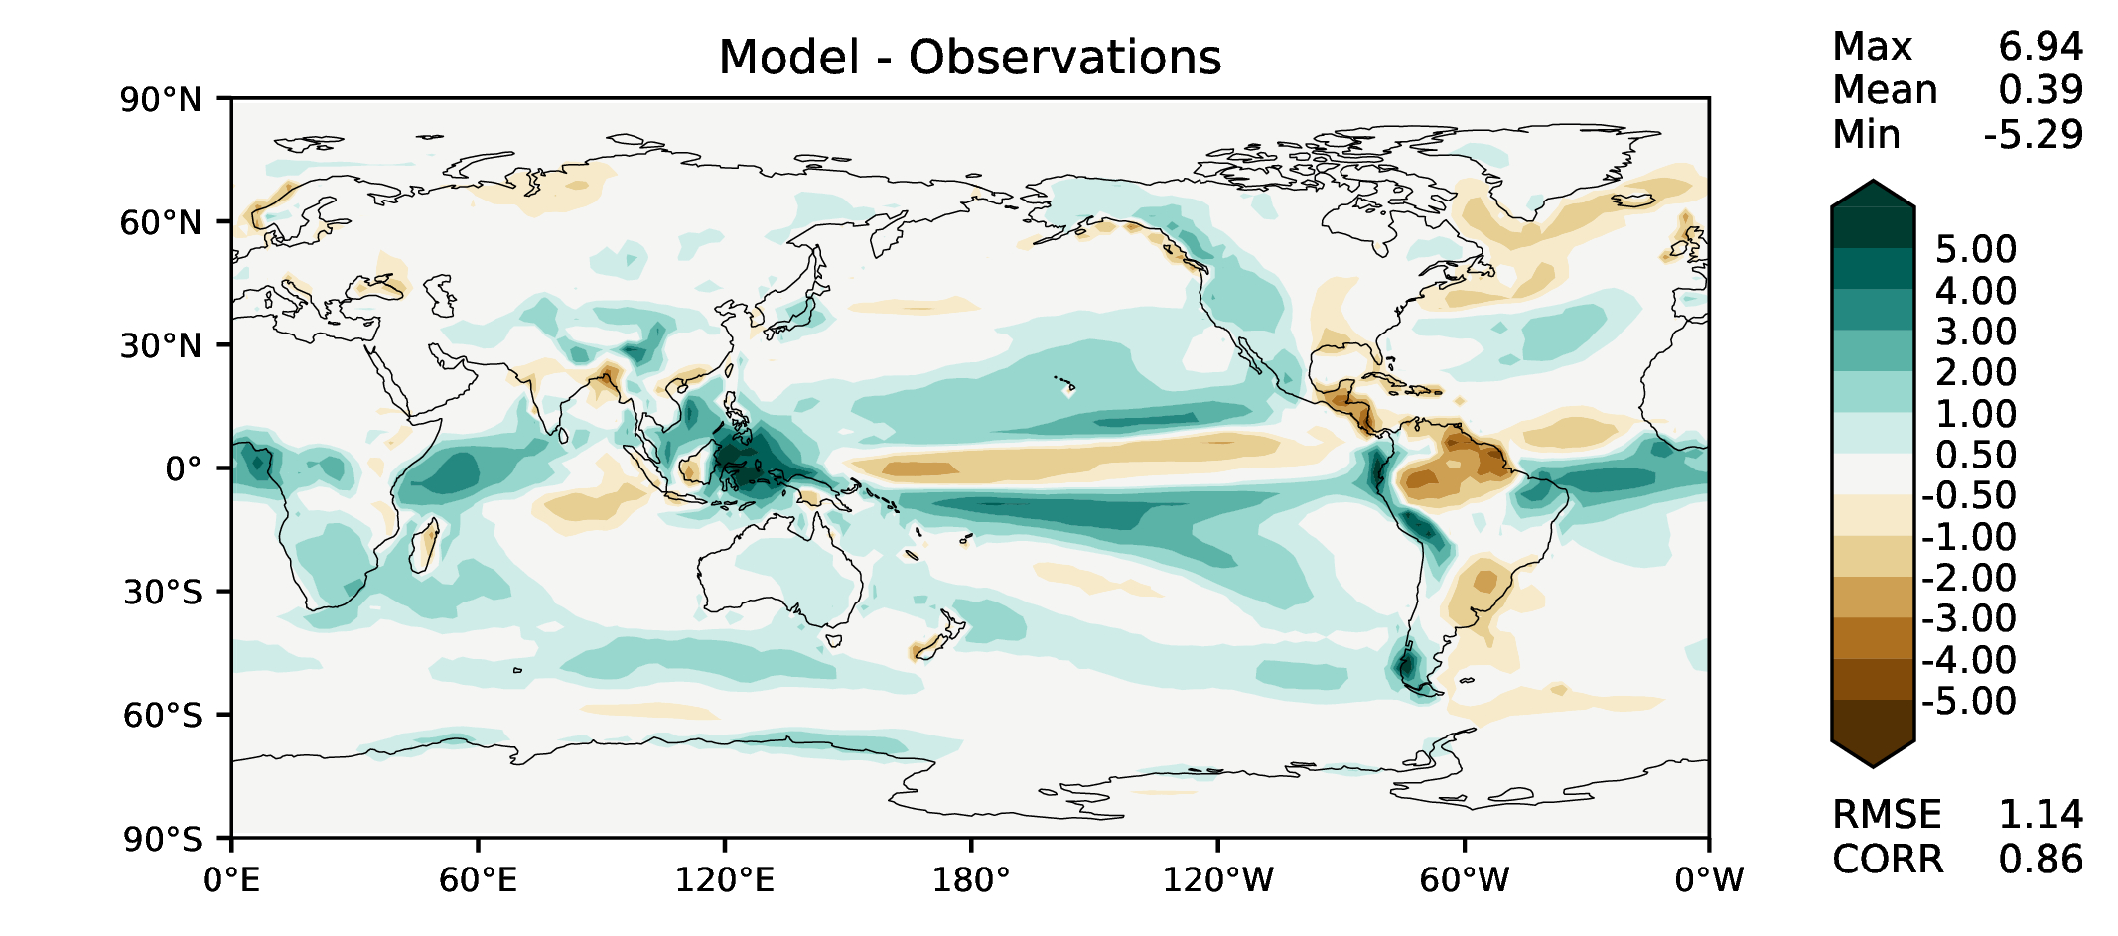
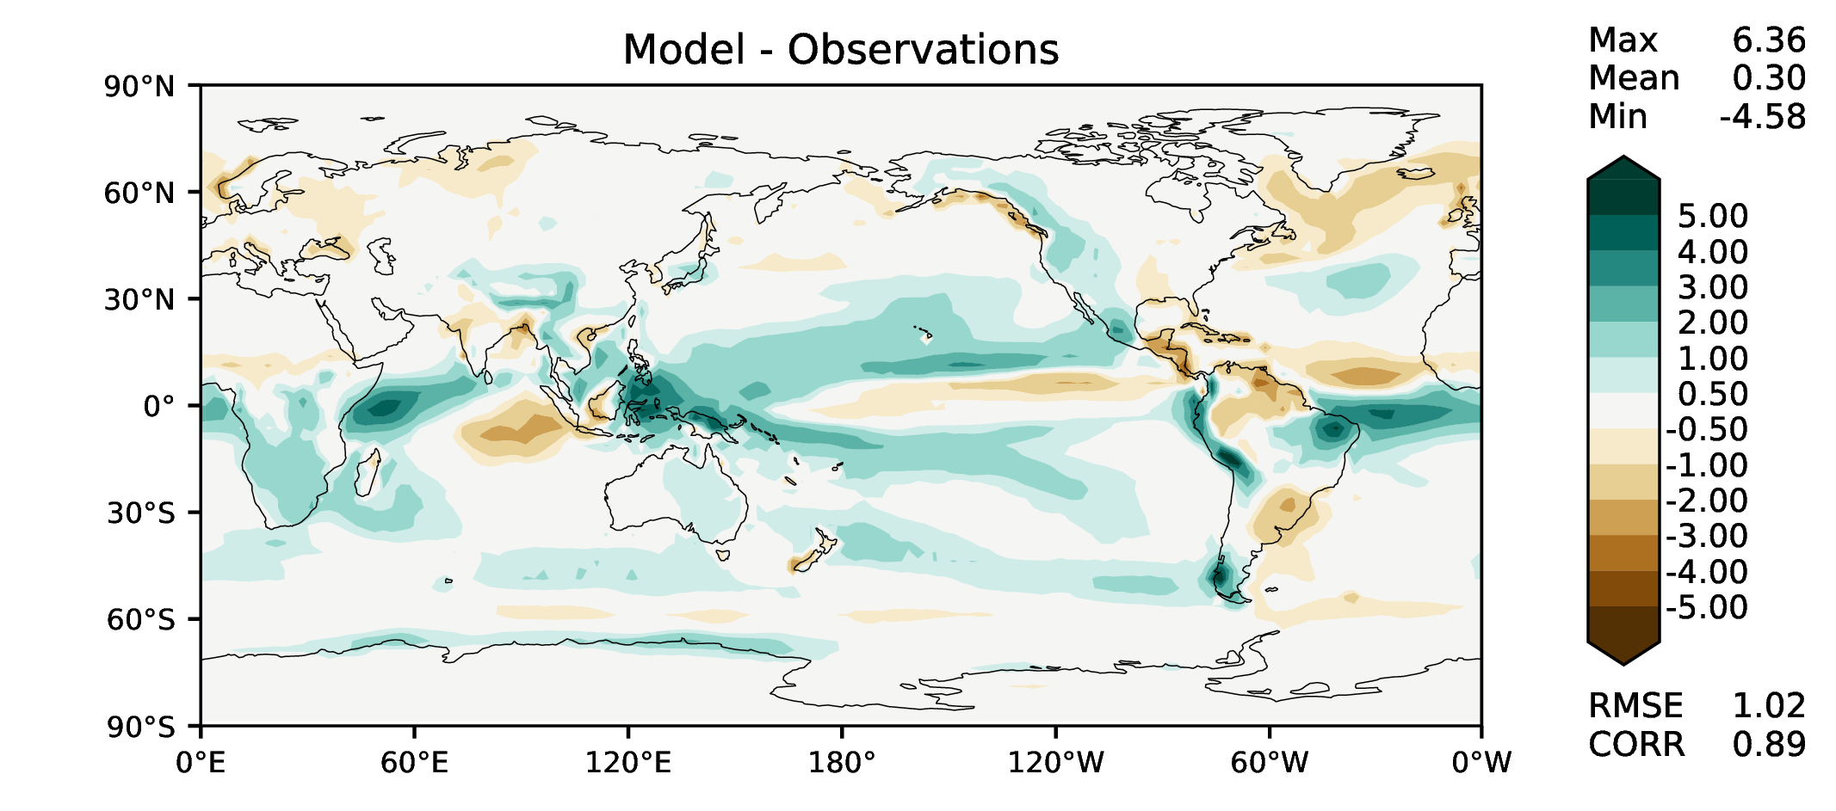
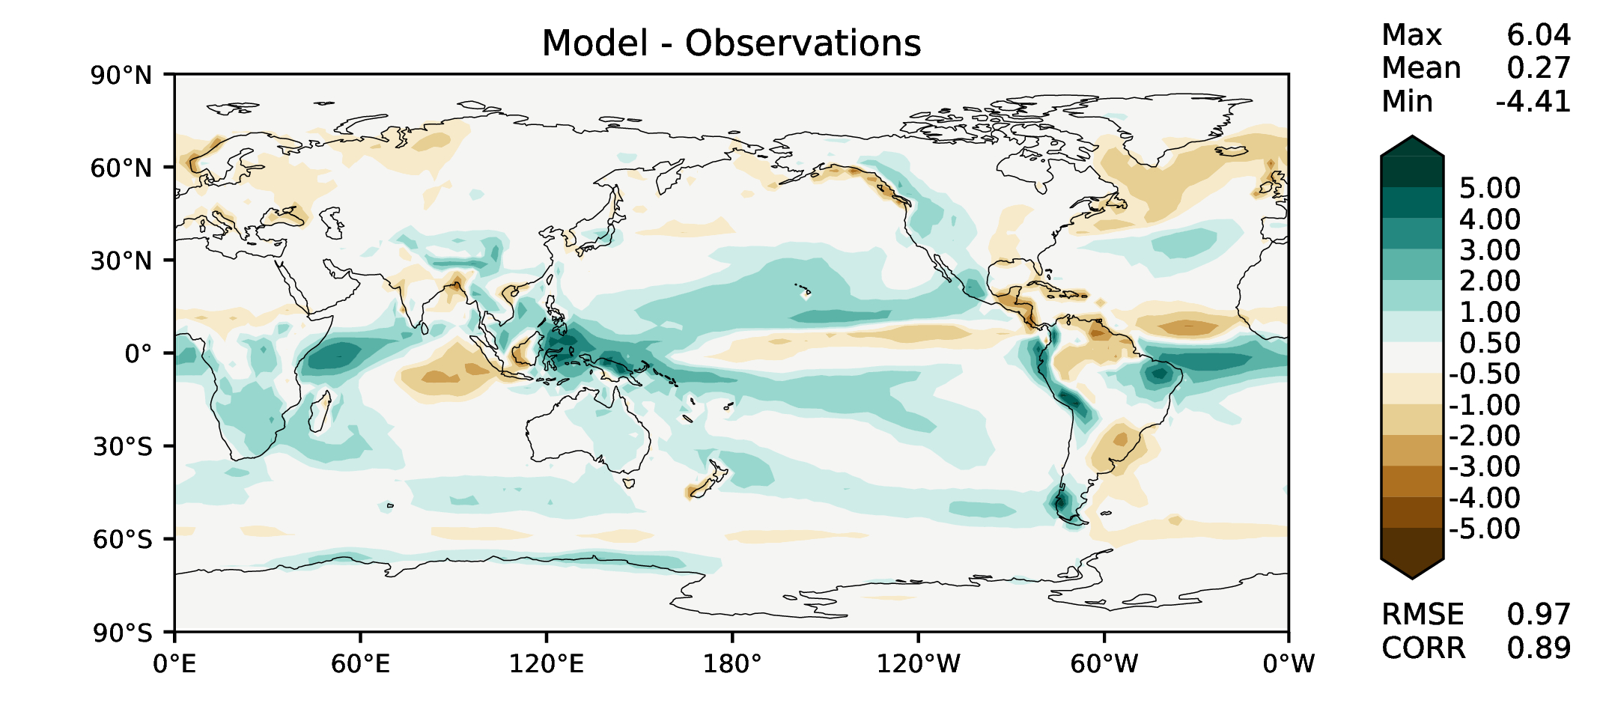
Annual total precipitation
DECKv1b
v2rc3c
v2rc3e

Slide 4
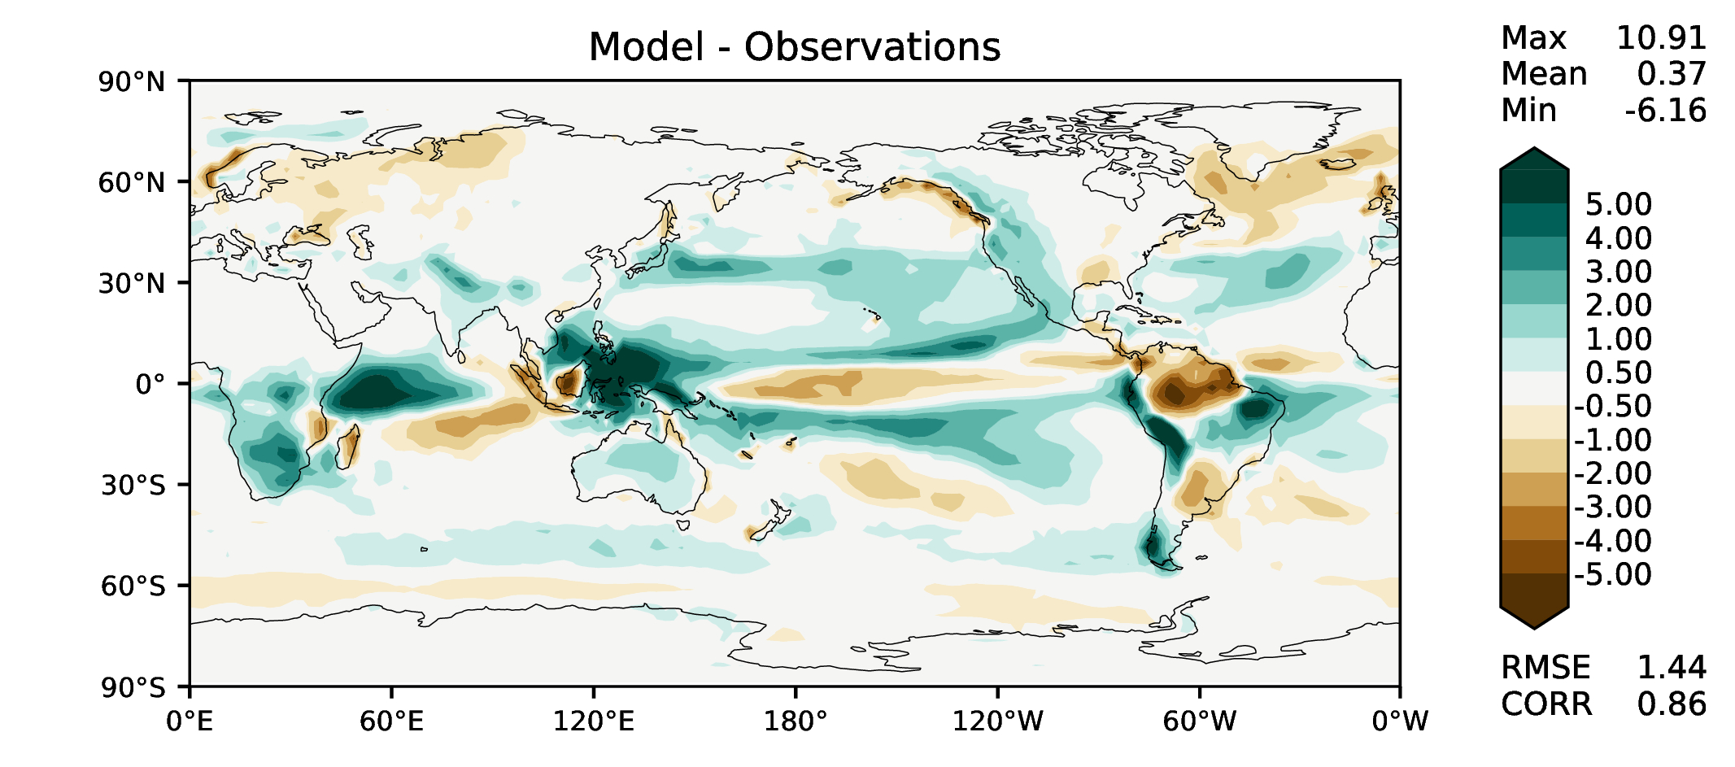
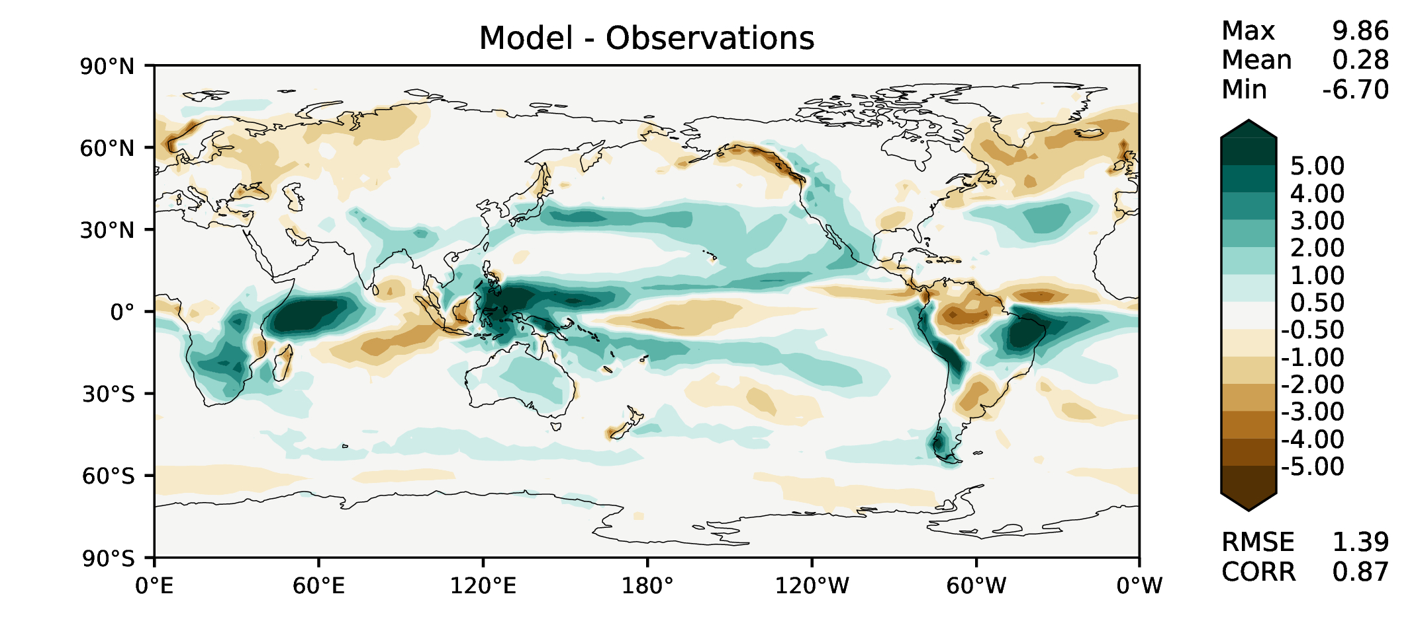

DJF total precipitation
DECKv1b
v2rc3c
v2rc3e

Slide 5
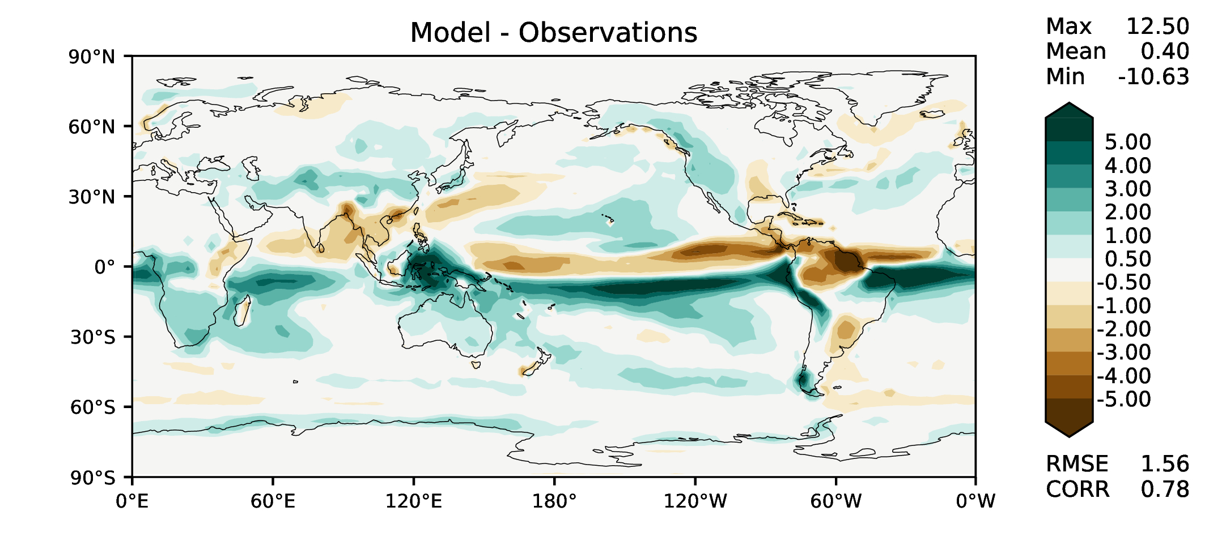
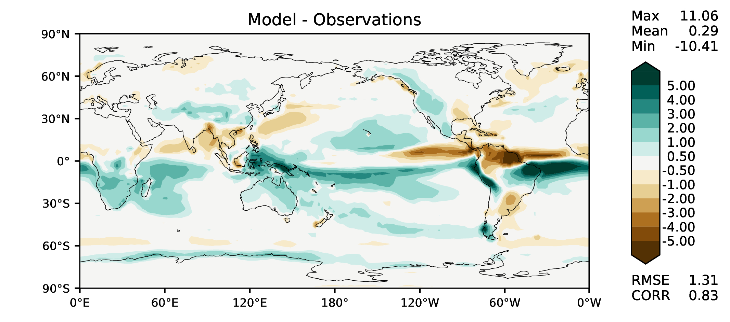
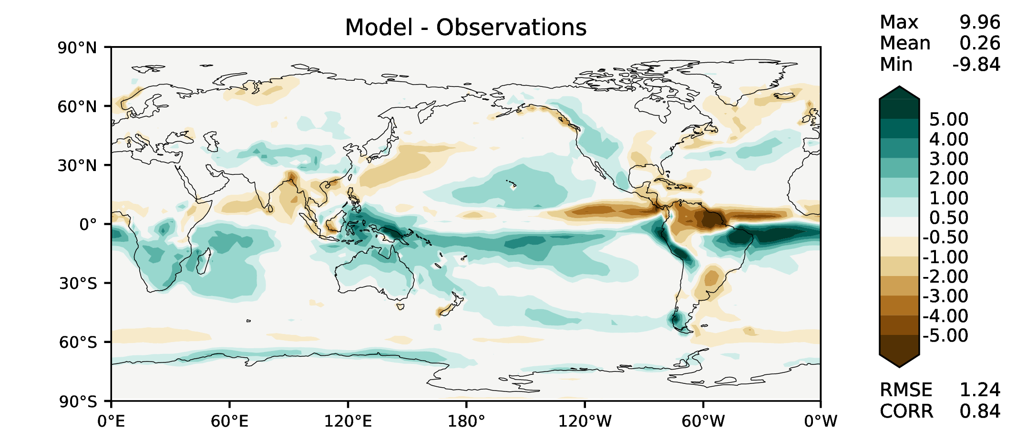
MAM total precipitation
DECKv1b
v2rc3c
v2rc3e

Slide 6
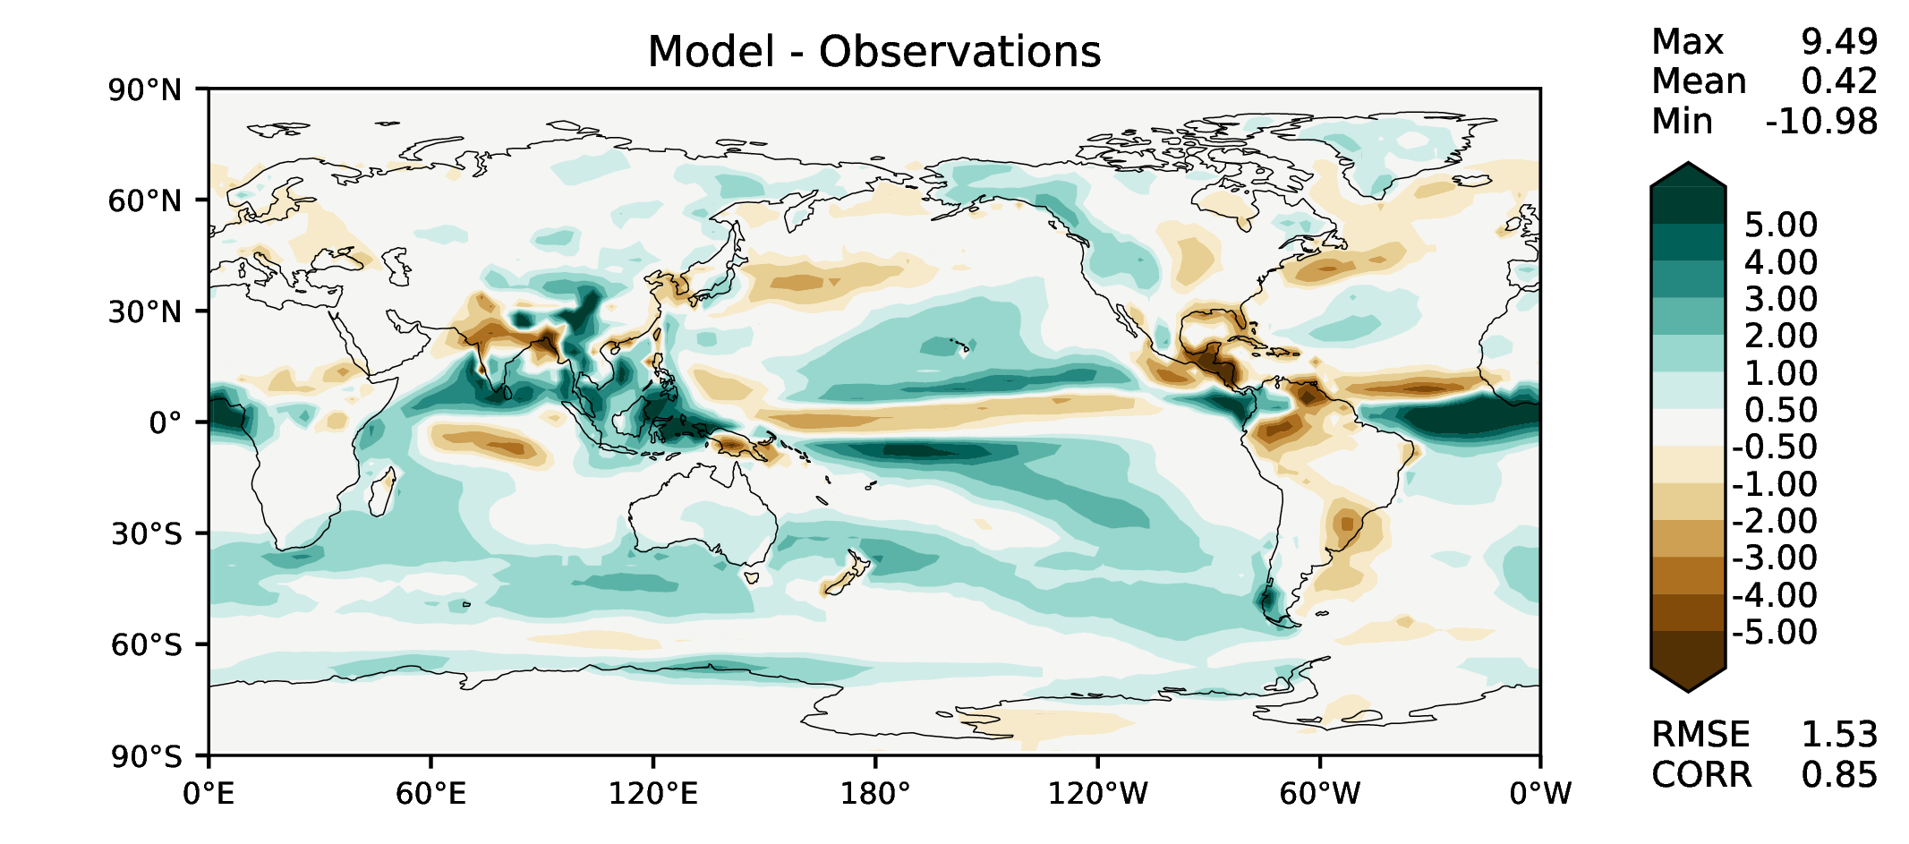
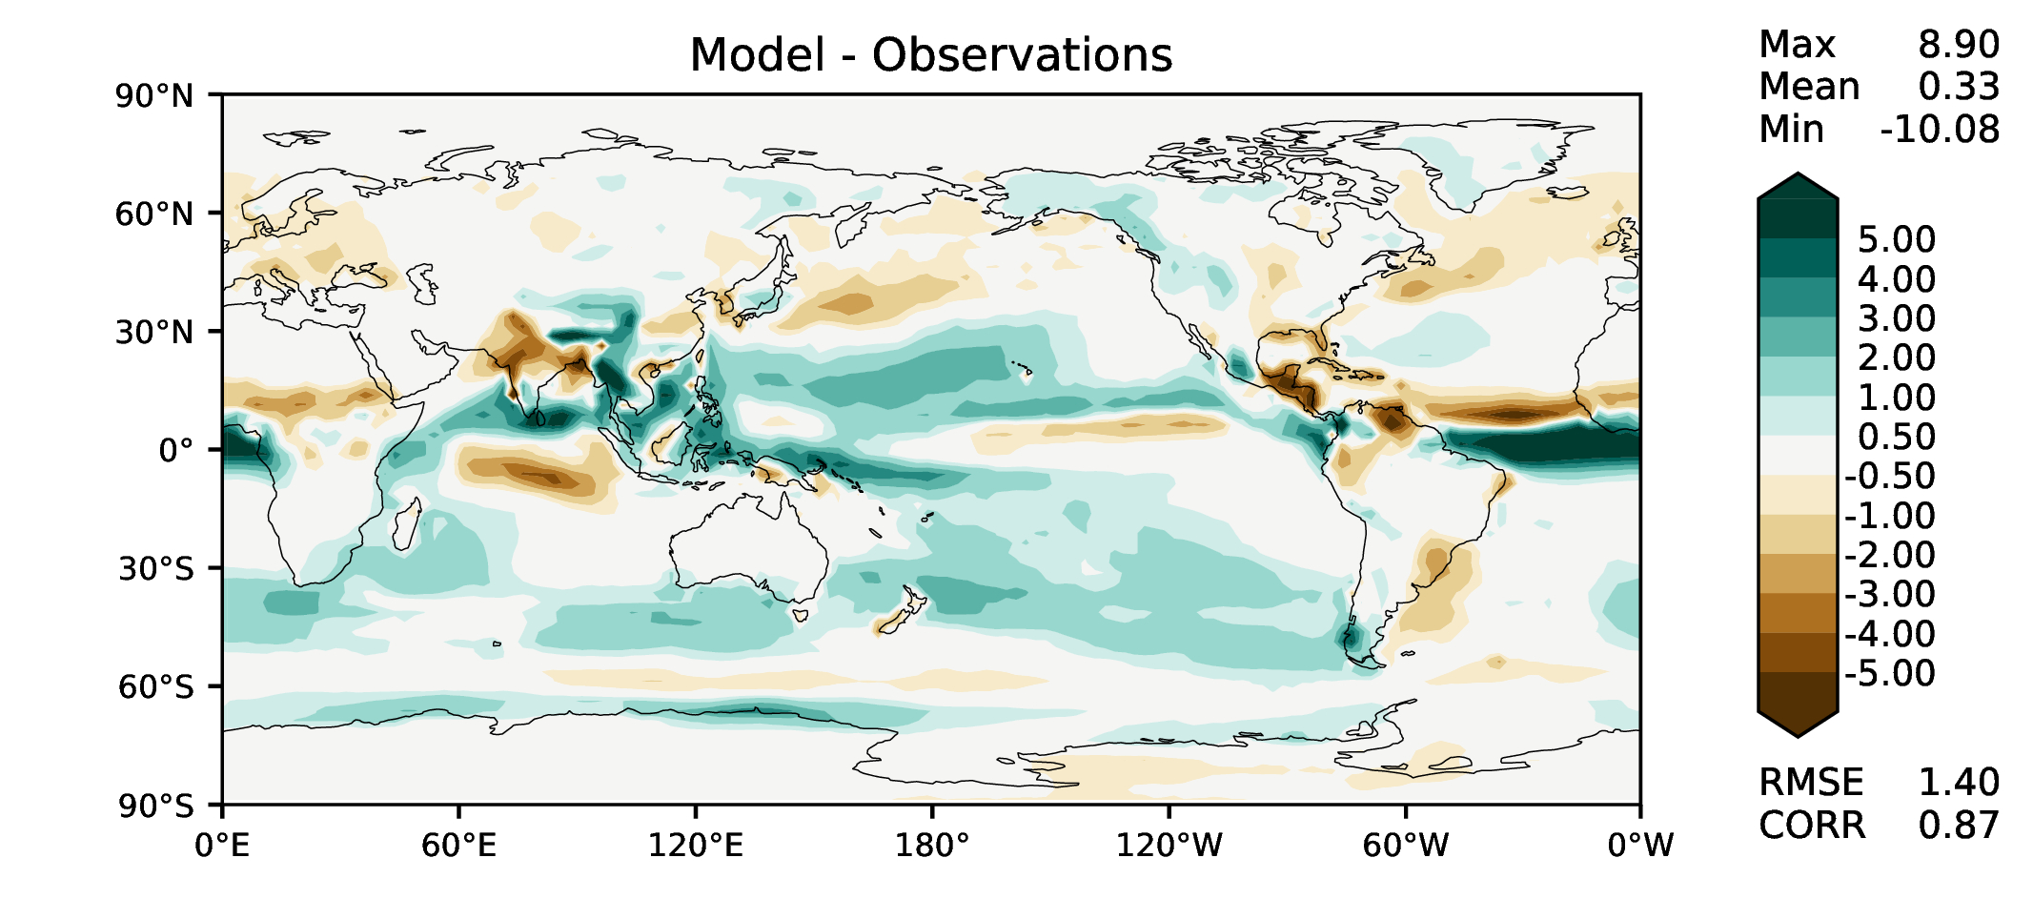
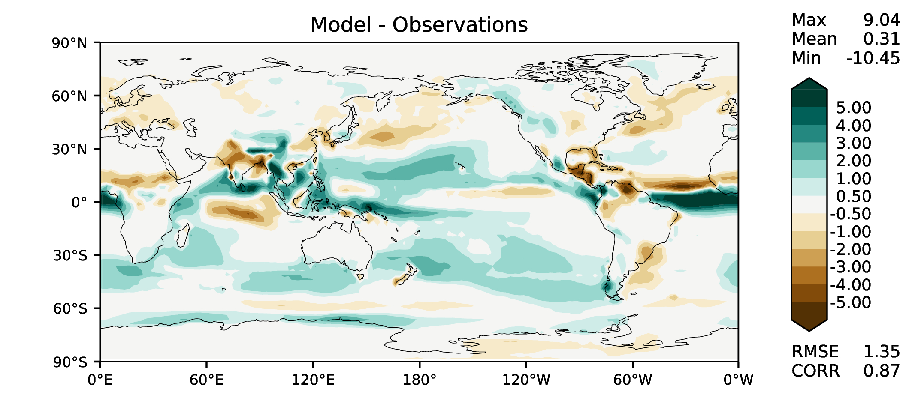
JJA total precipitation
DECKv1b
v2rc3c
v2rc3e

Slide 7
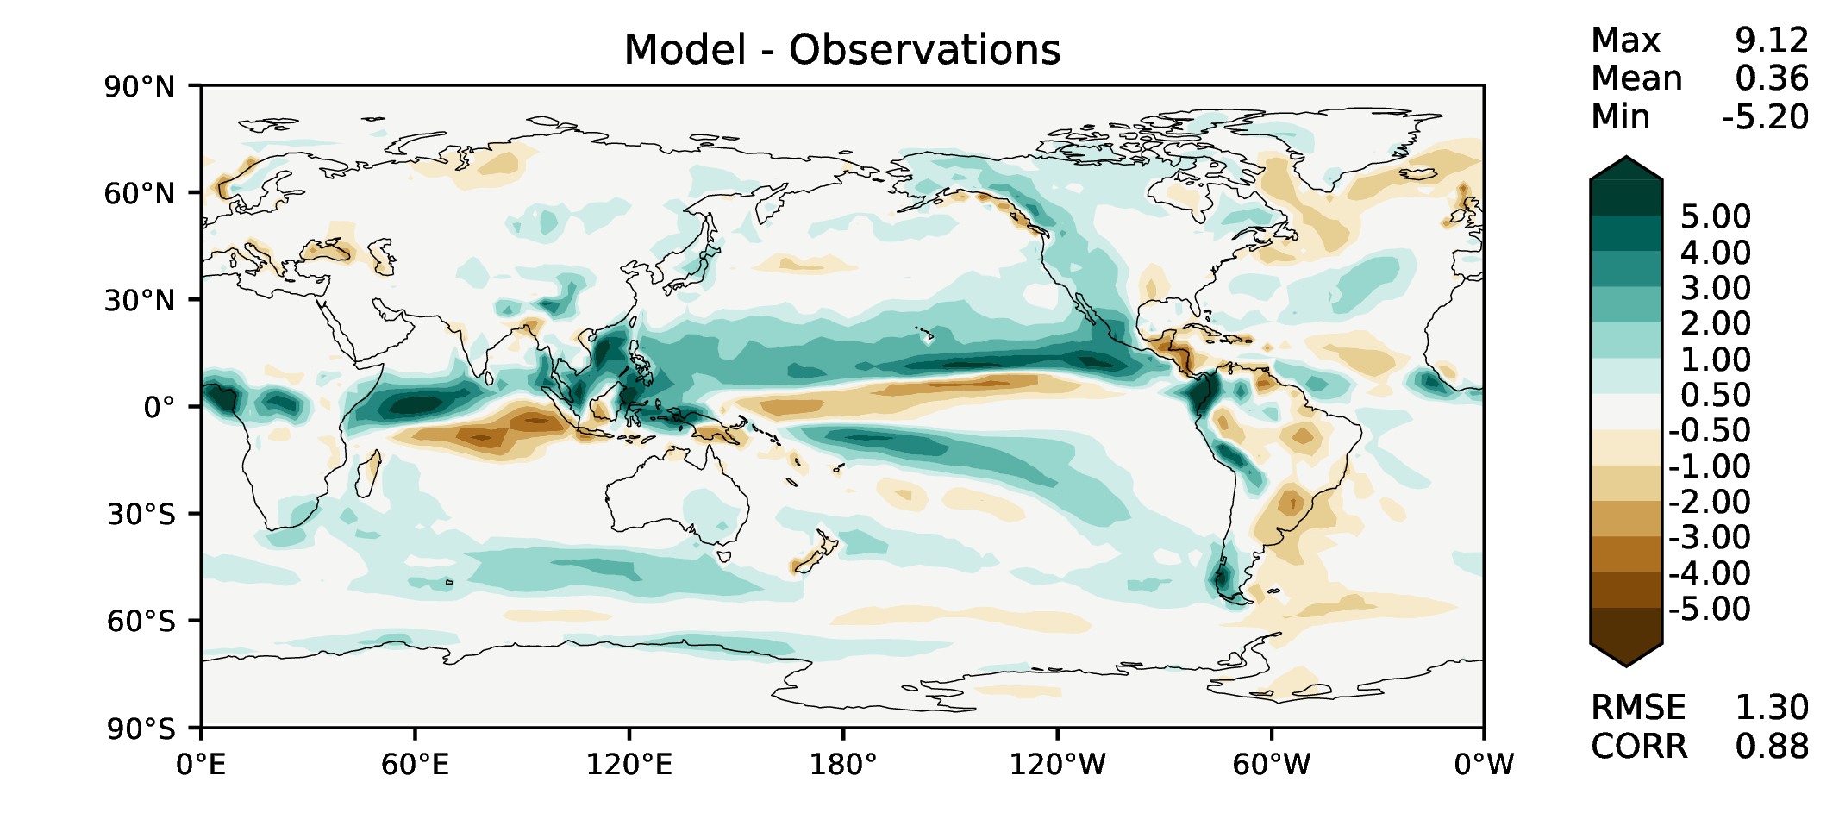
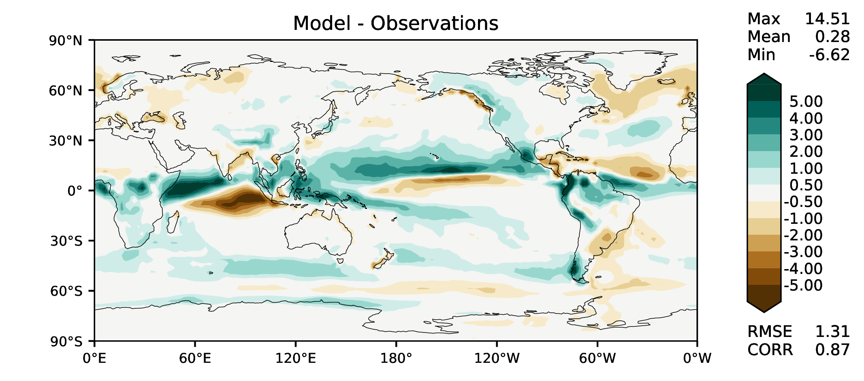
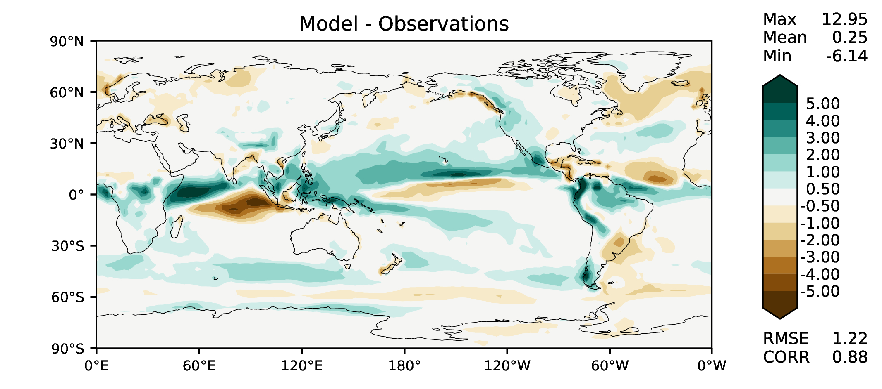
SON total precipitation
DECKv1b
v2rc3c
v2rc3e

Slide 8
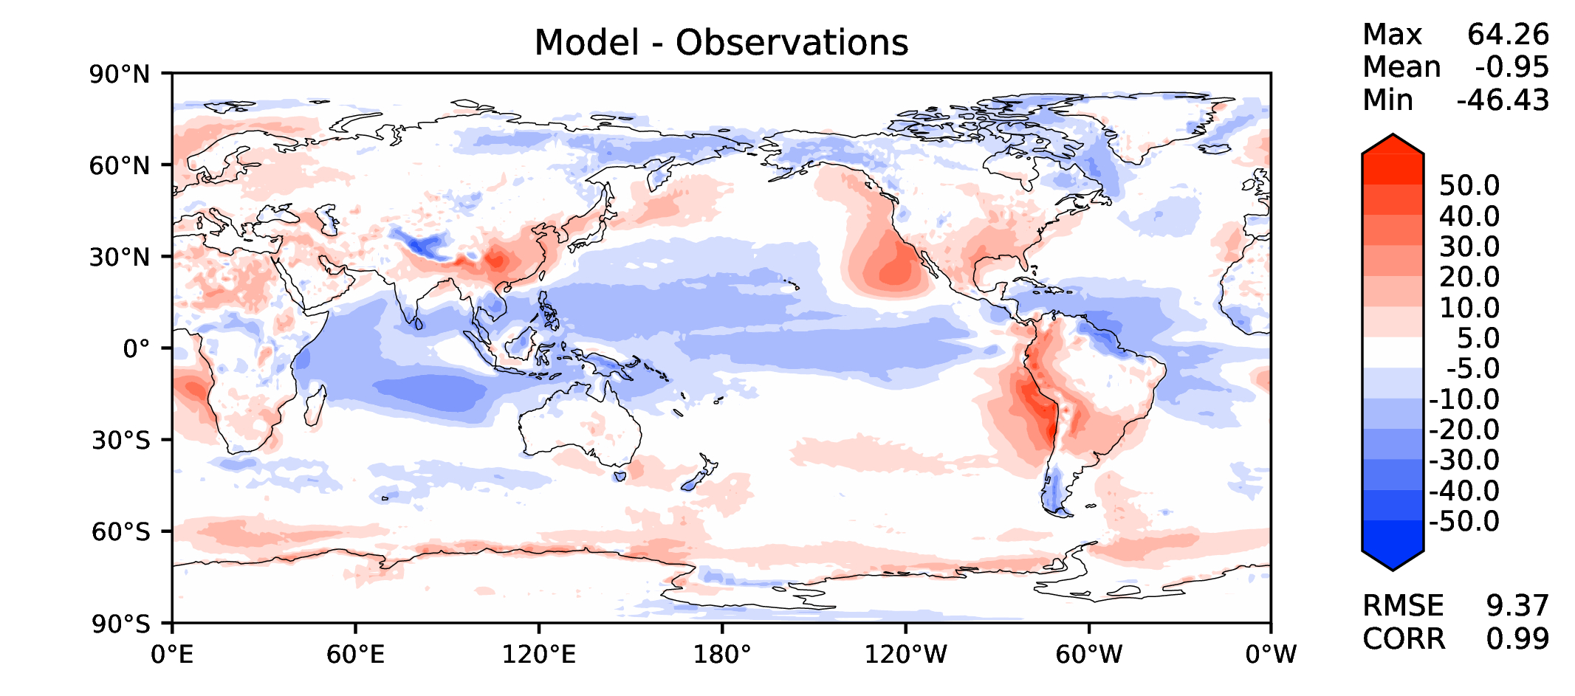
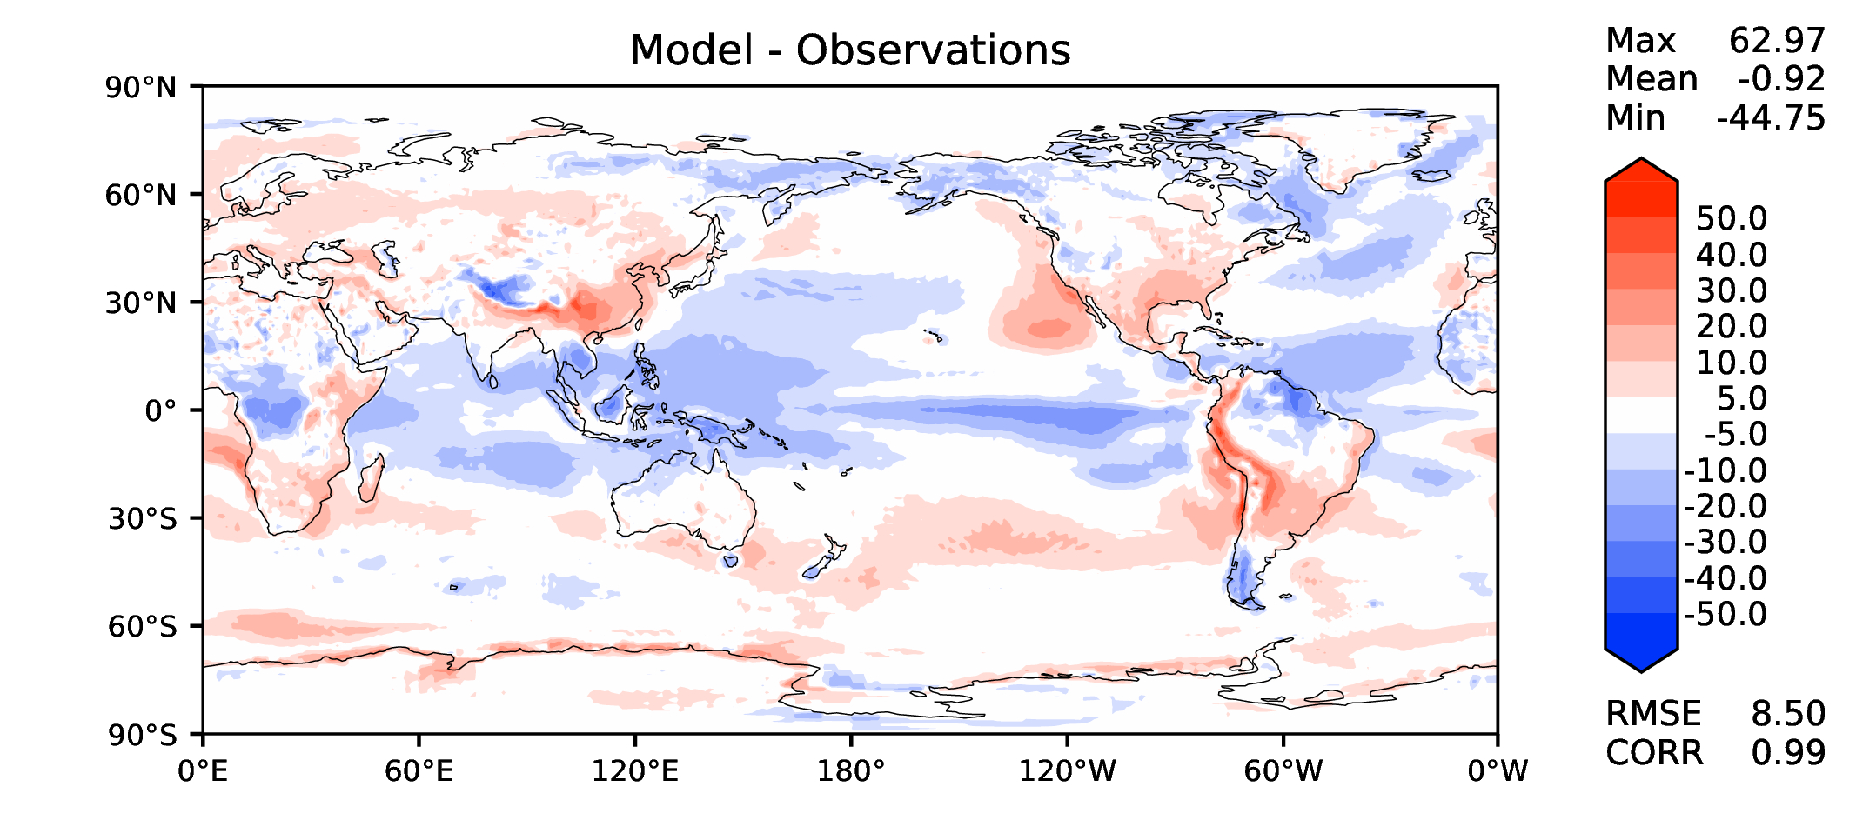
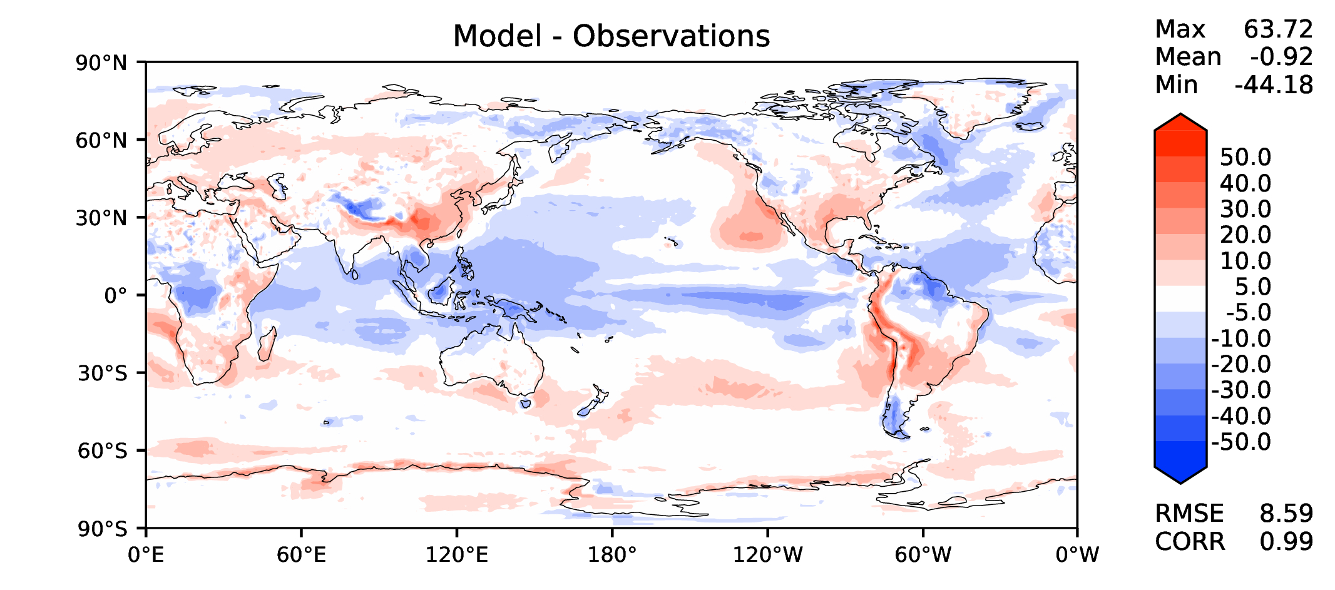
Annual TOA net radiation
DECKv1b
v2rc3c
v2rc3e

Slide 9
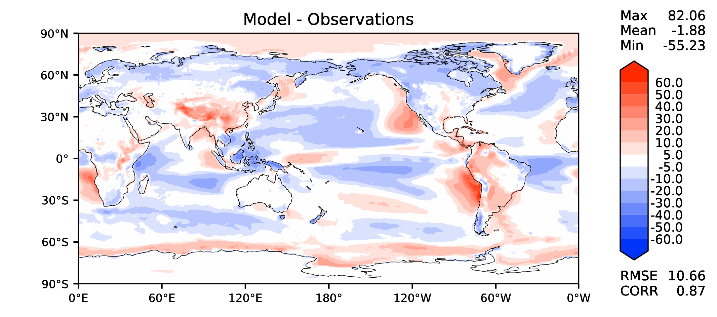
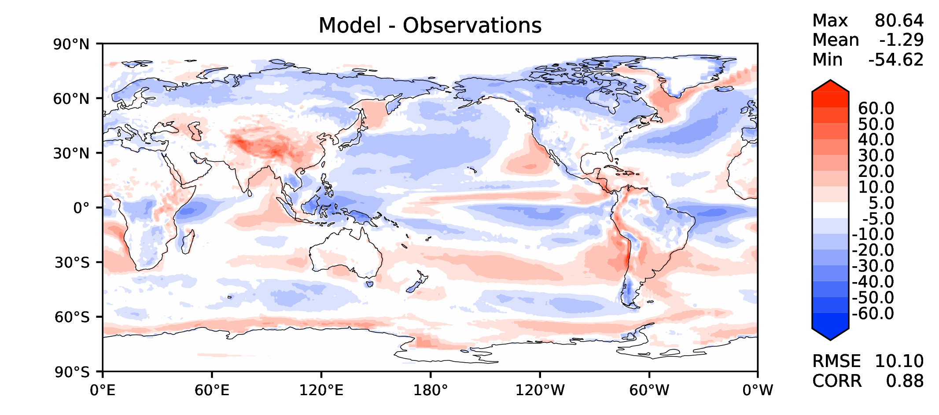
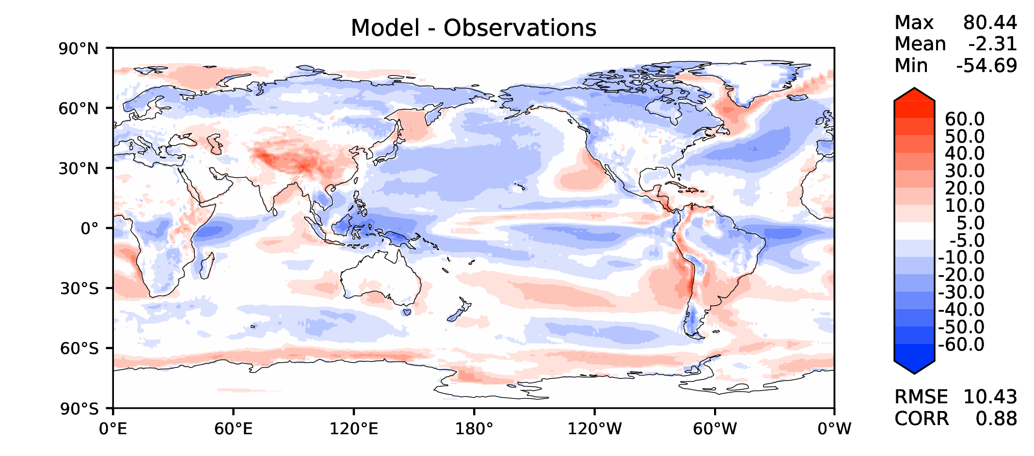
Annual TOA SW CRE
DECKv1b
v2rc3c
v2rc3e

Slide 10
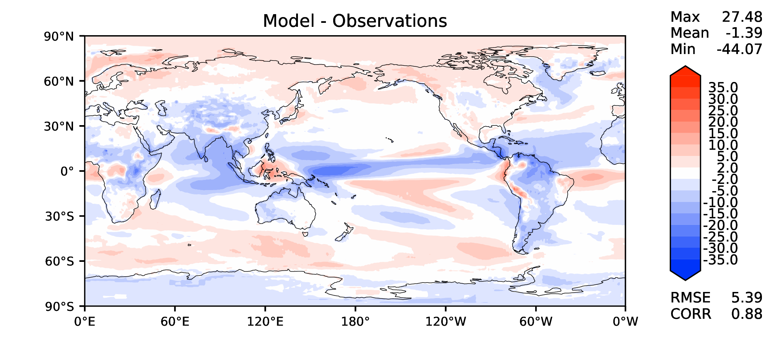
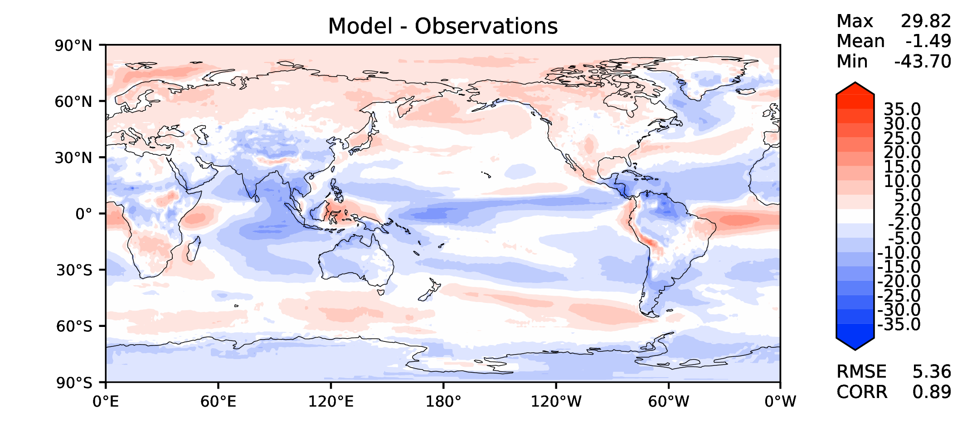
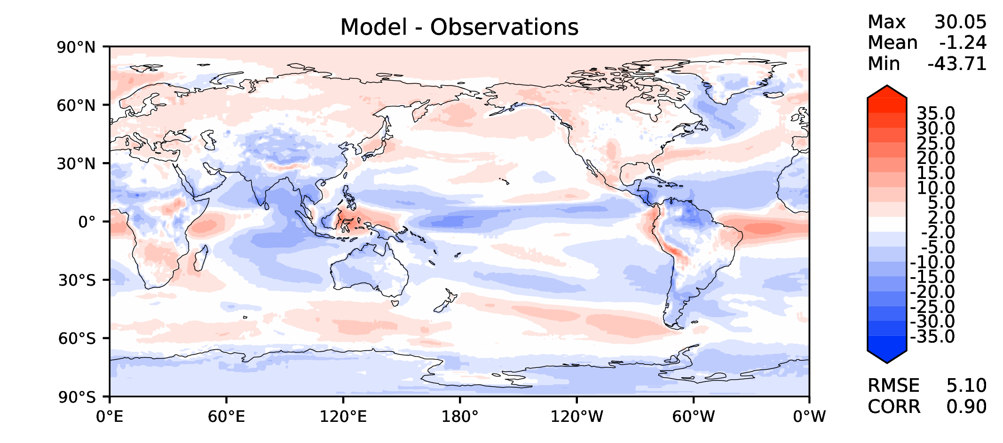
Annual TOA LW CRE
DECKv1b
v2rc3c
v2rc3e

Slide 11
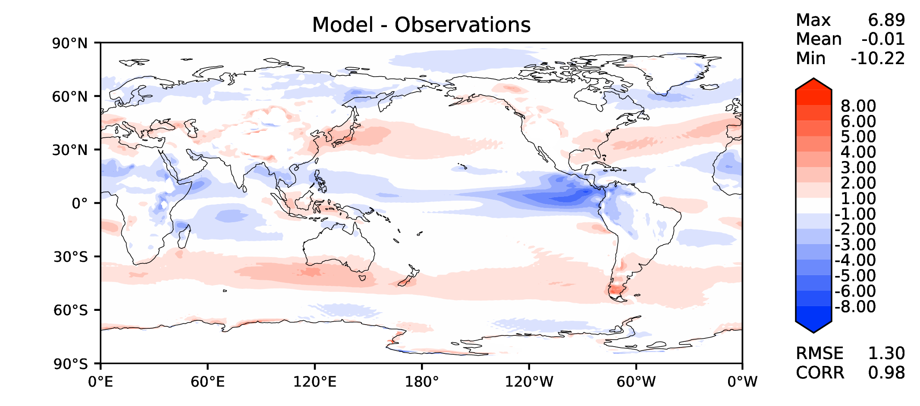
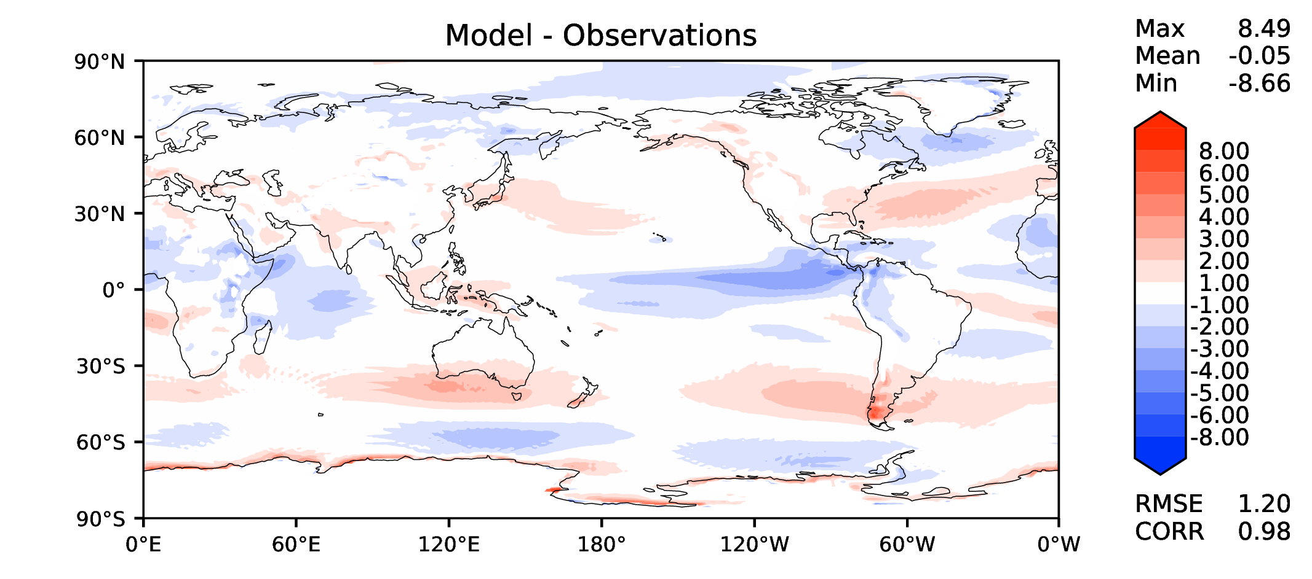
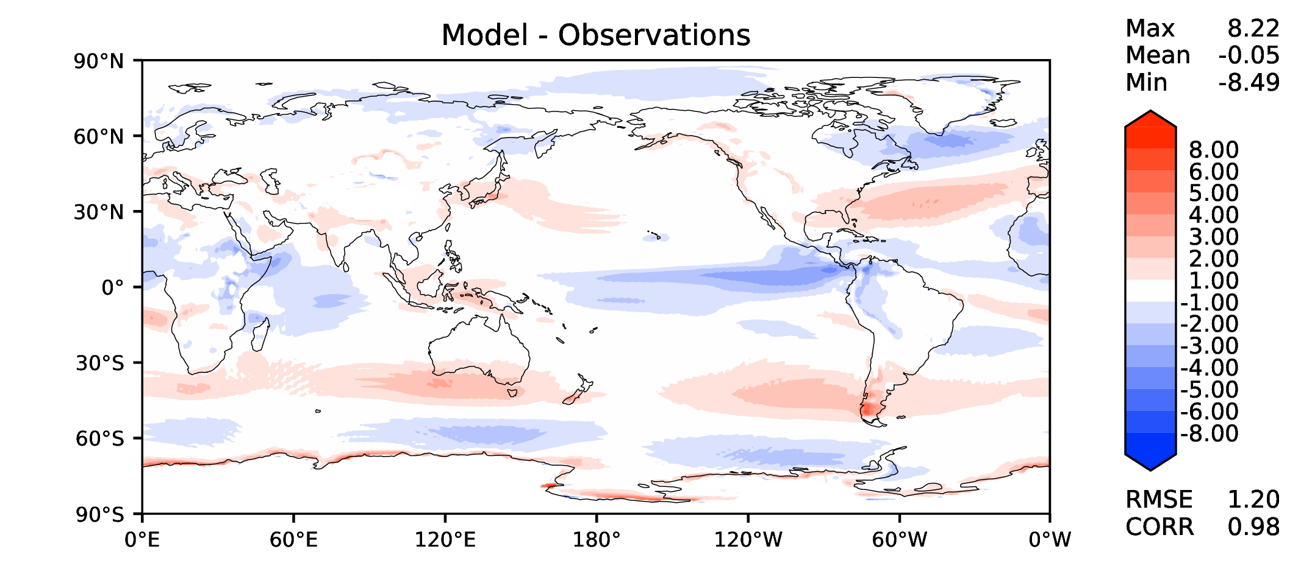
Annual u wind at 850 hPa
DECKv1b
v2rc3c
v2rc3e

Slide 12
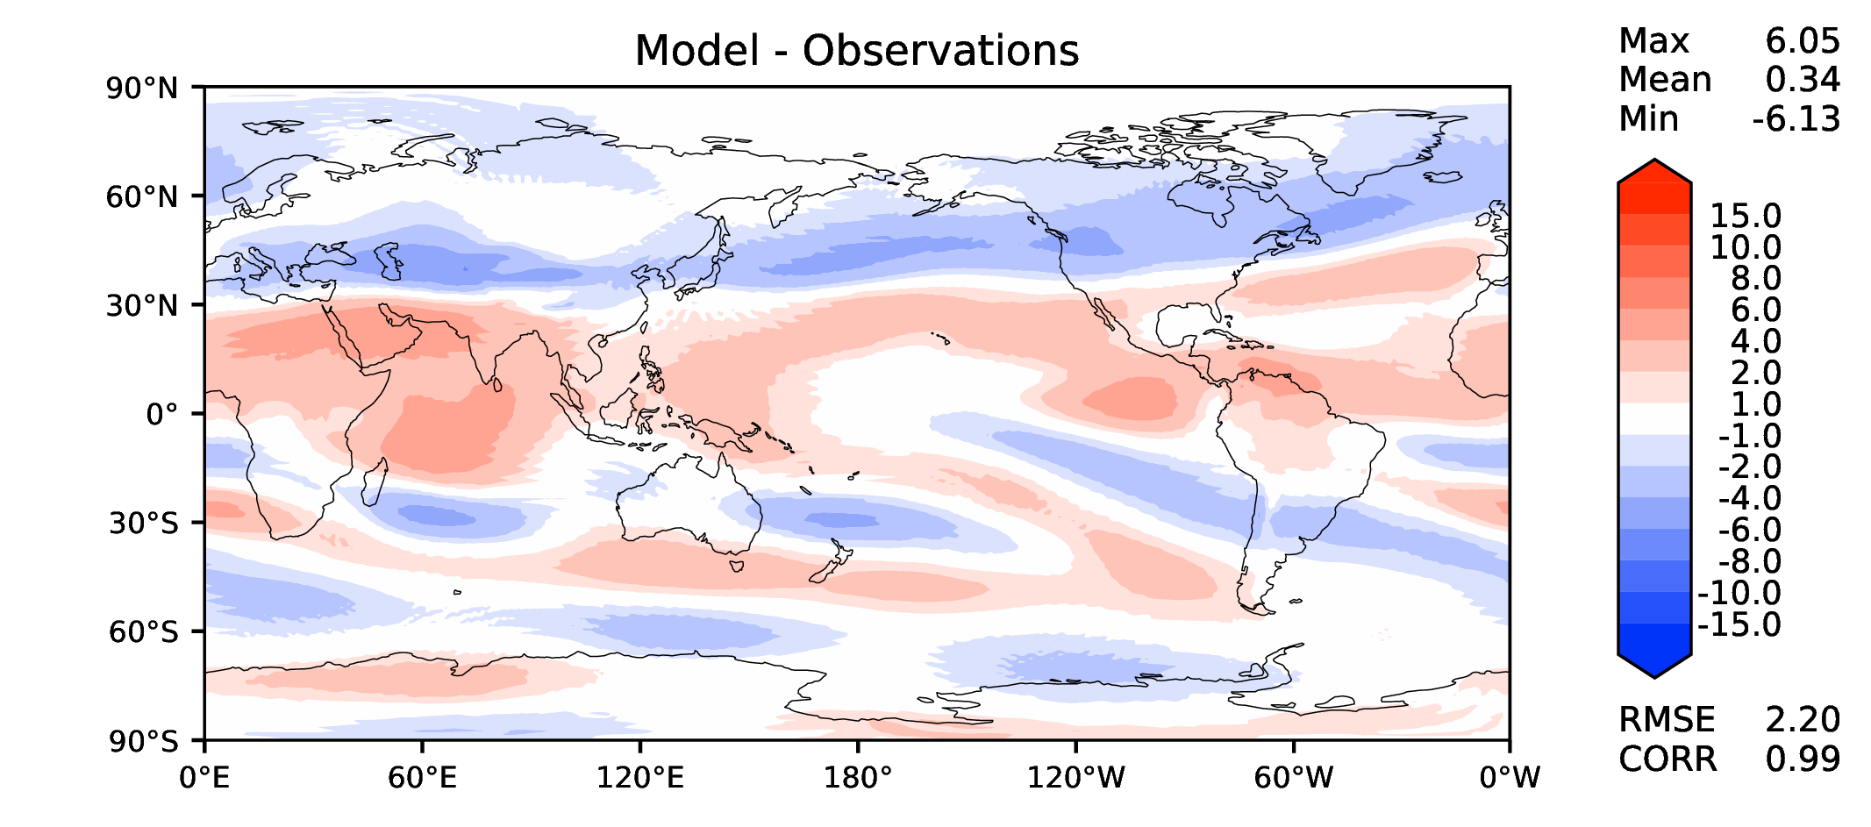
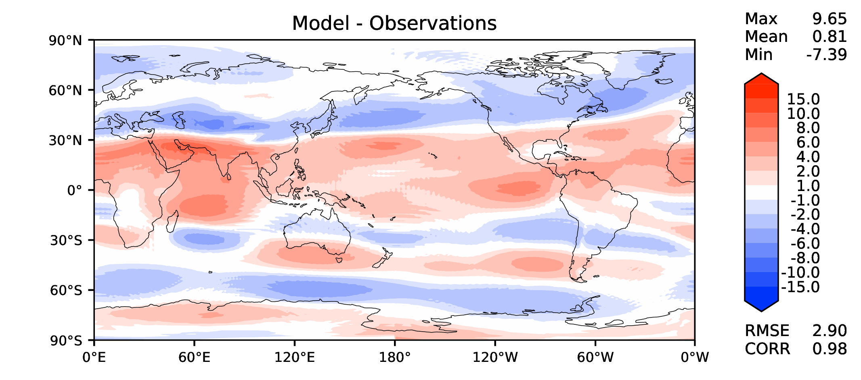
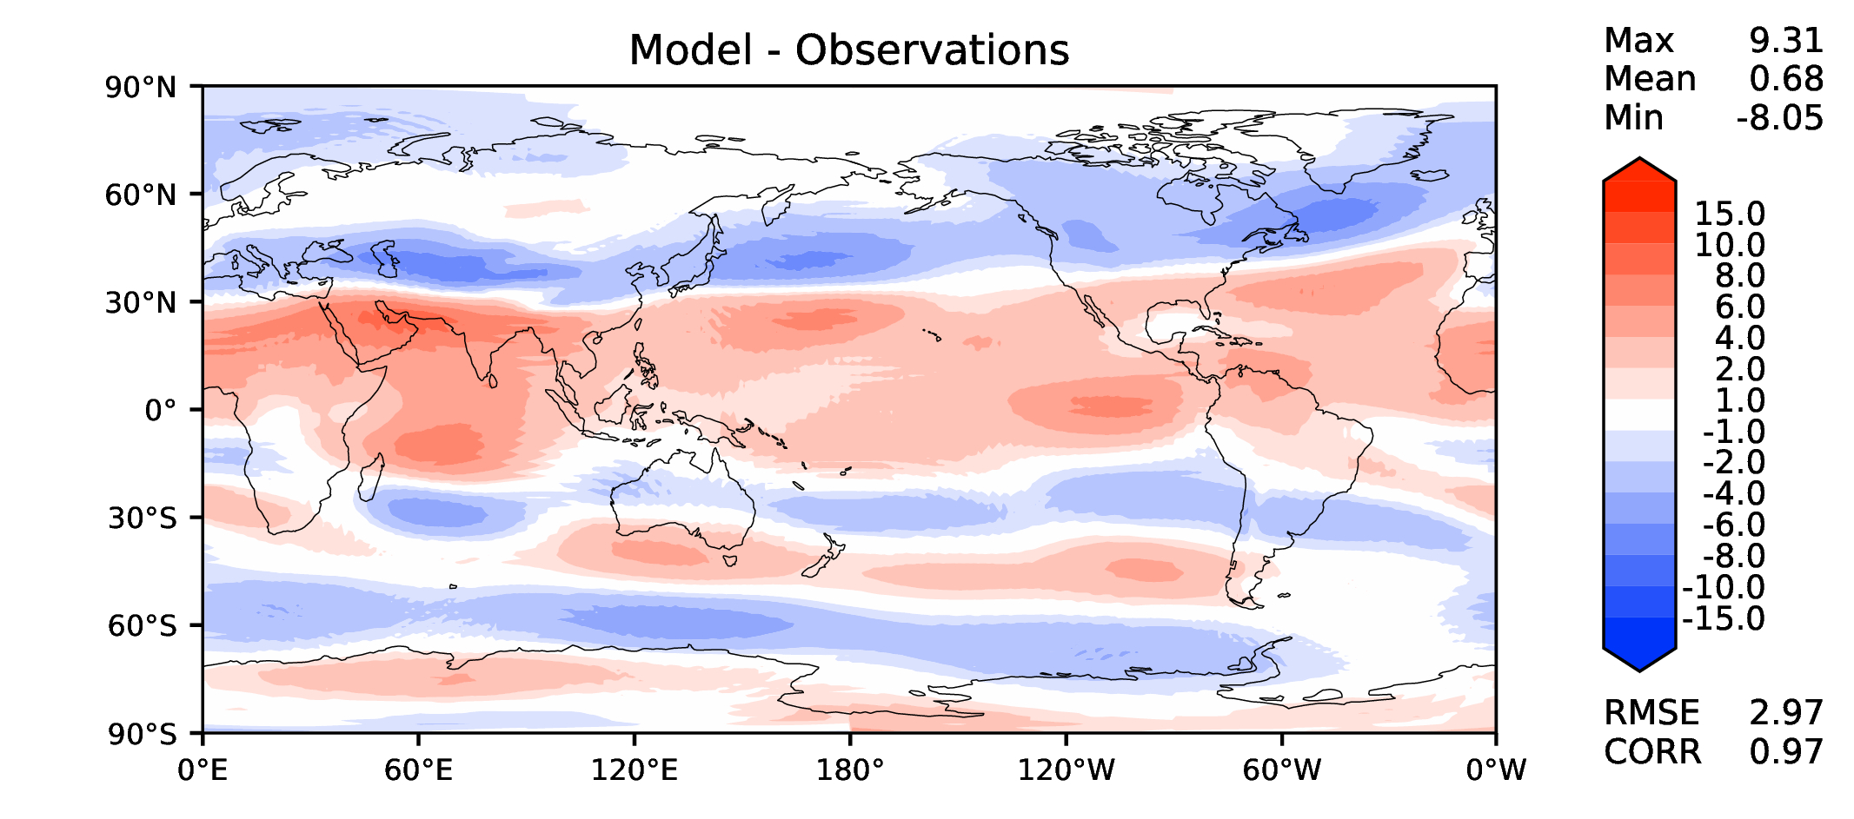
Annual u wind at 200 hPa
DECKv1b
v2rc3c
v2rc3e

Slide 13
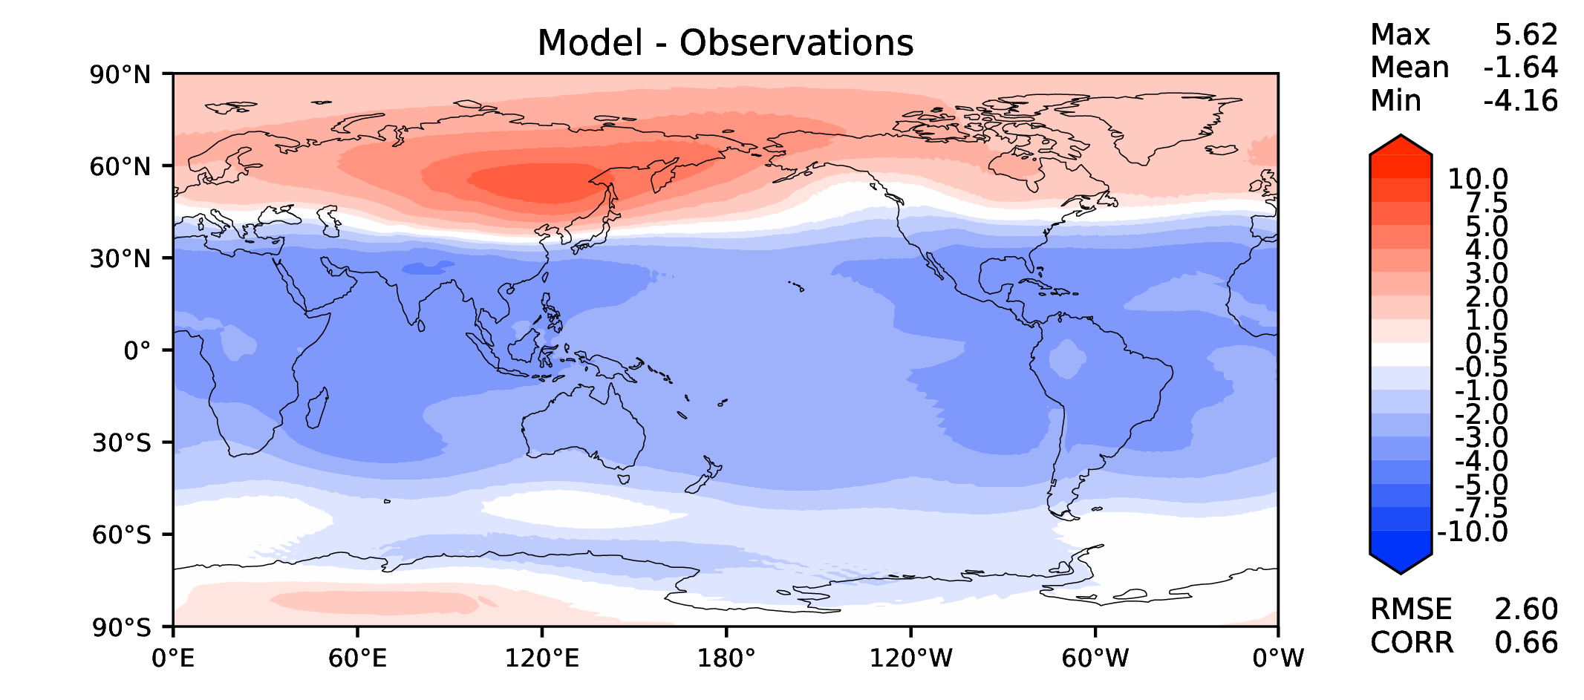
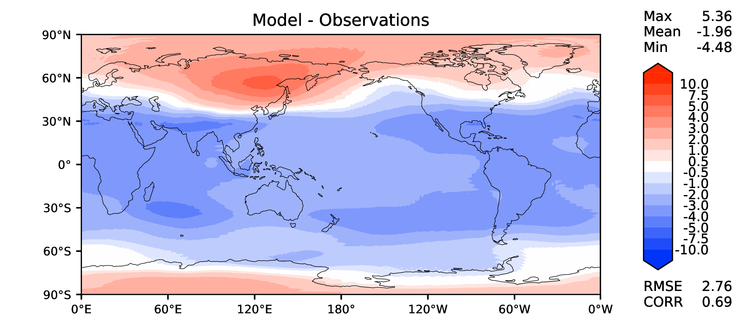
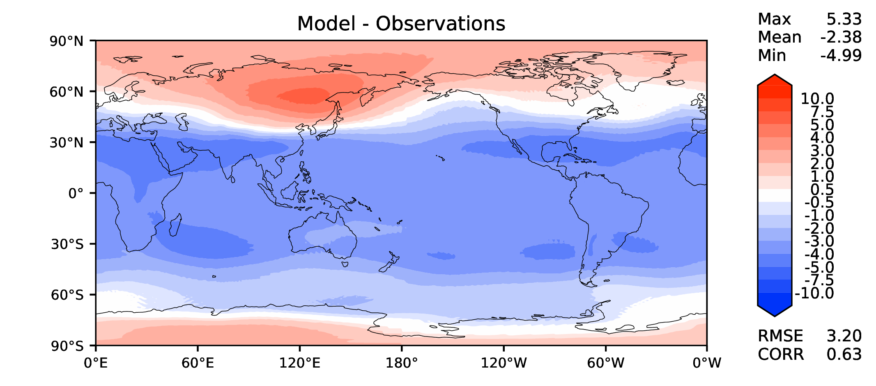
Annual T at 200 hPa
DECKv1b
v2rc3c
v2rc3e

Slide 14
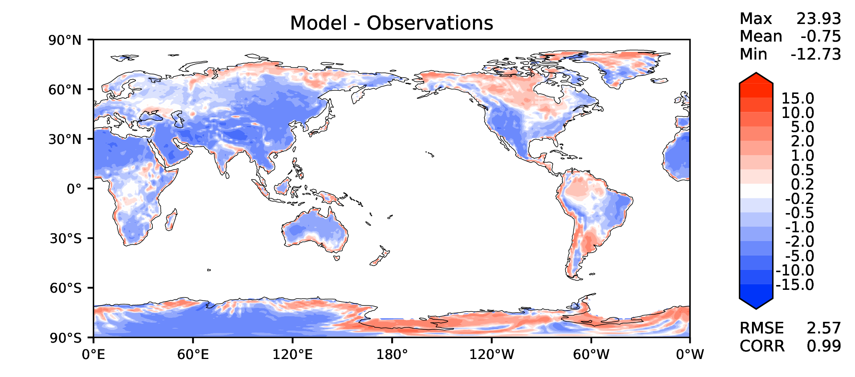
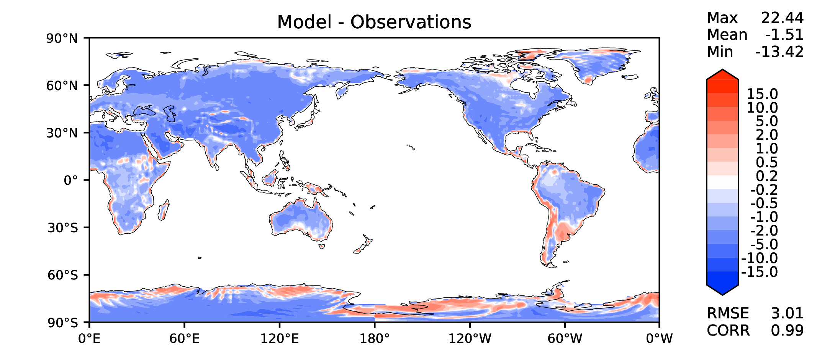
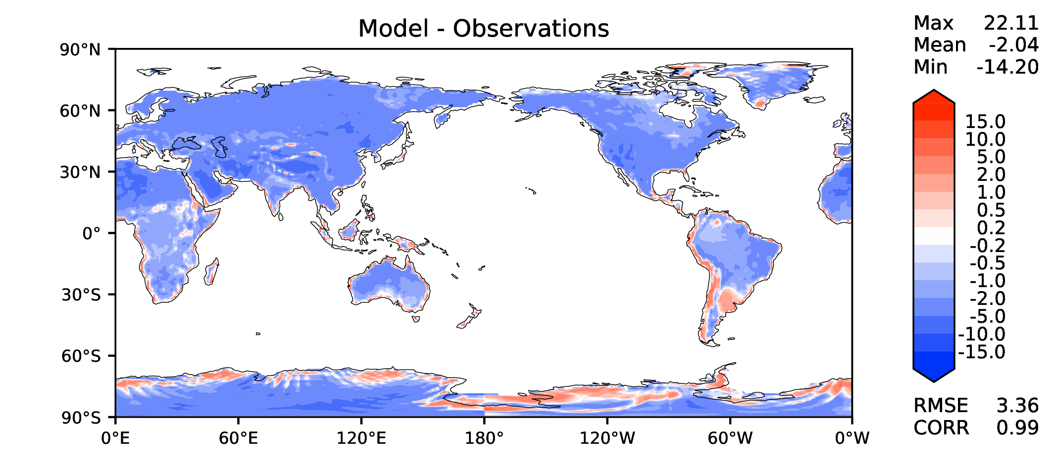
Annual surface air T (land)
DECKv1b
v2rc3c
v2rc3e

Slide 15
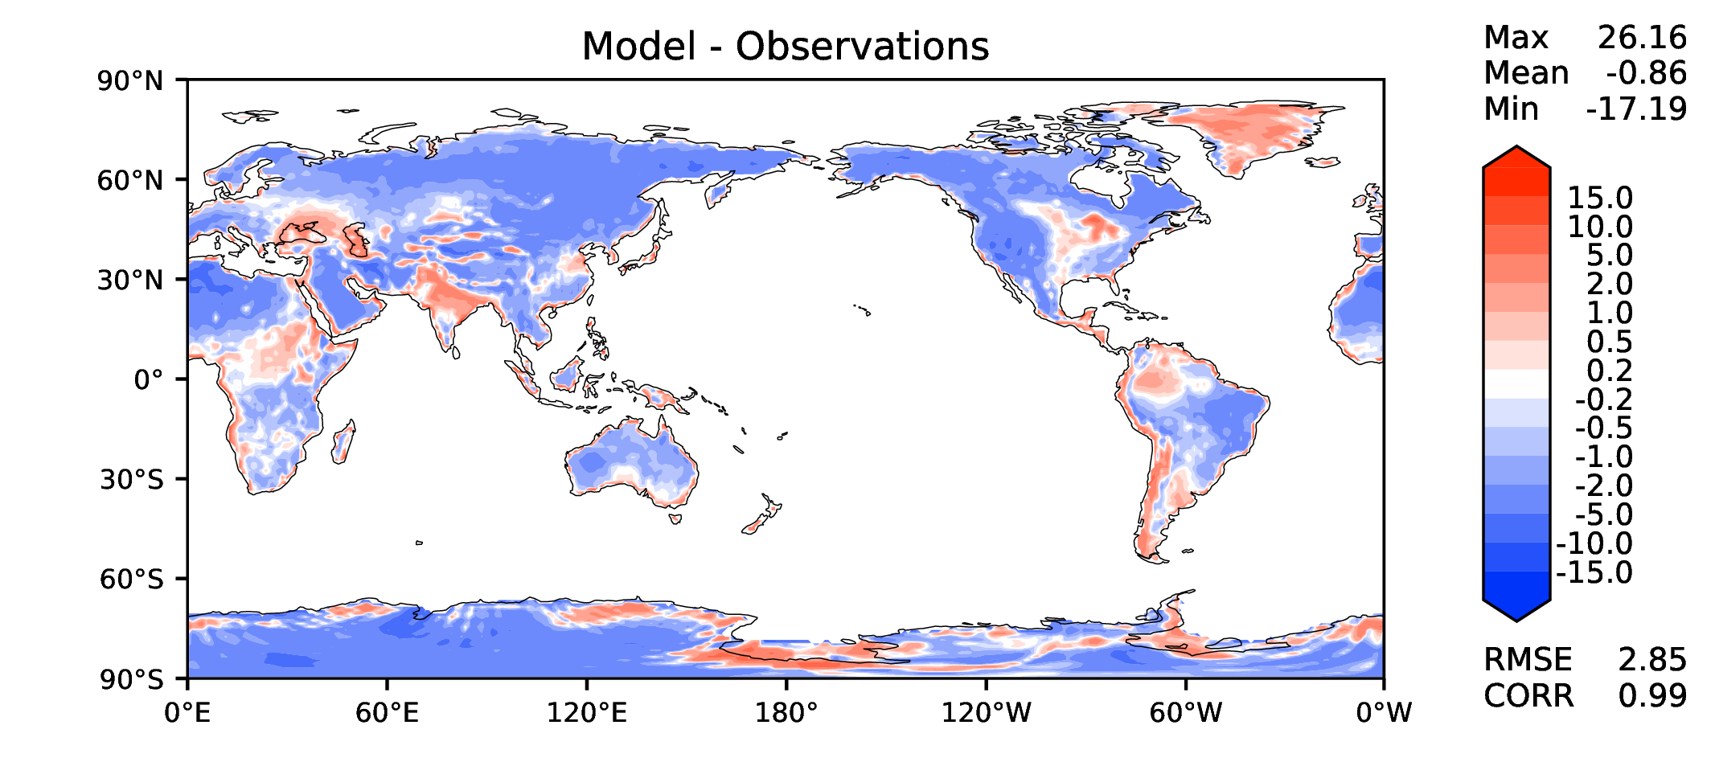
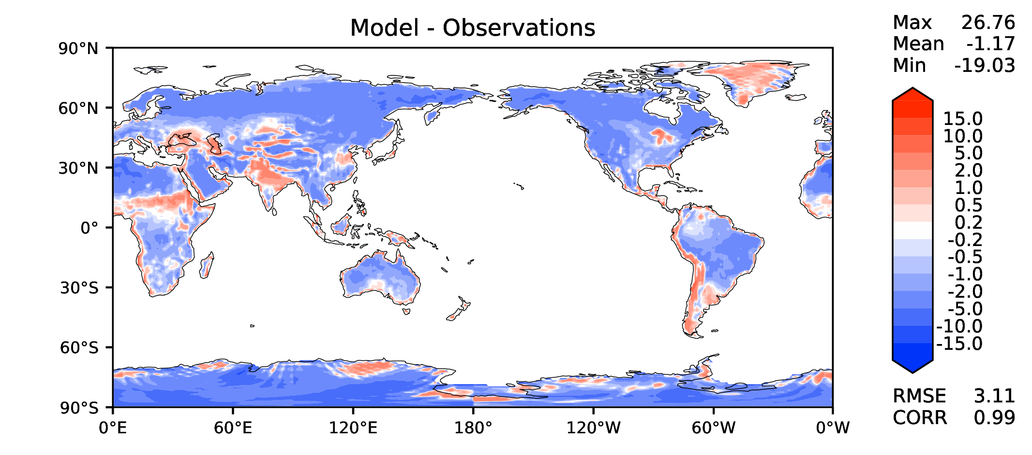
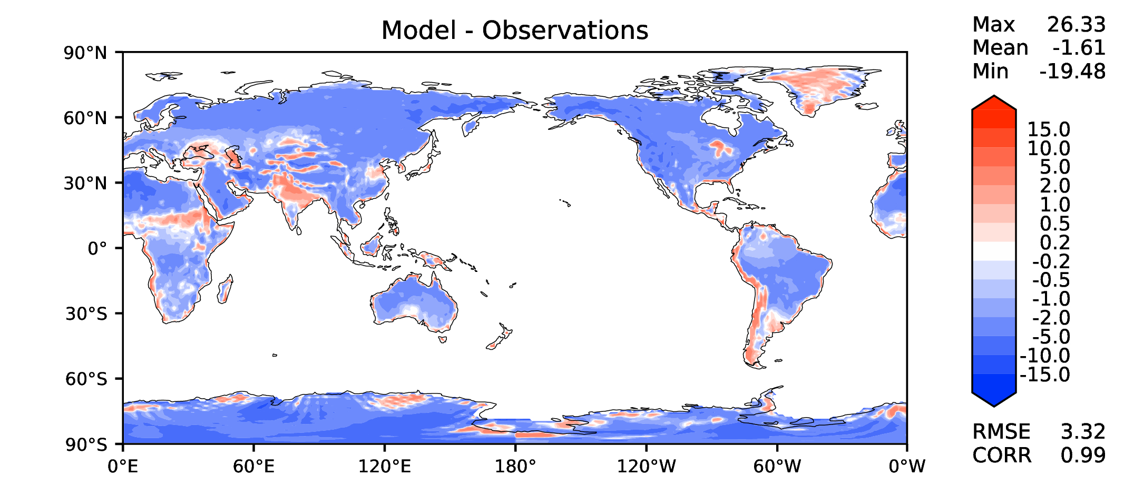
JJA surface air T (land)
DECKv1b
v2rc3c
v2rc3e

Slide 16
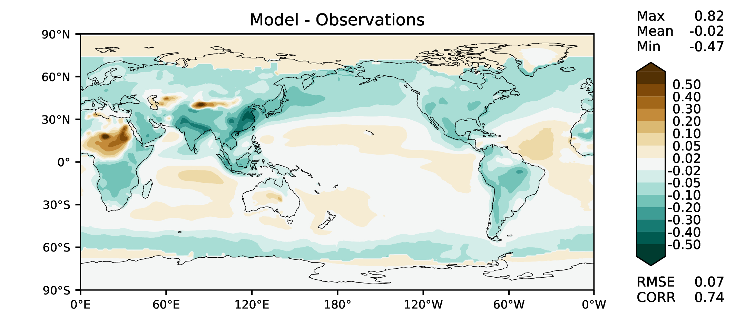
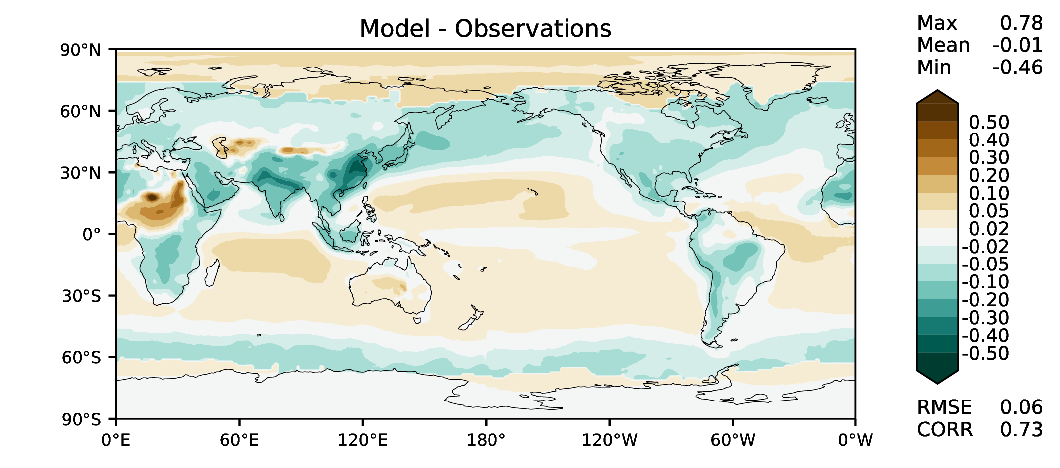
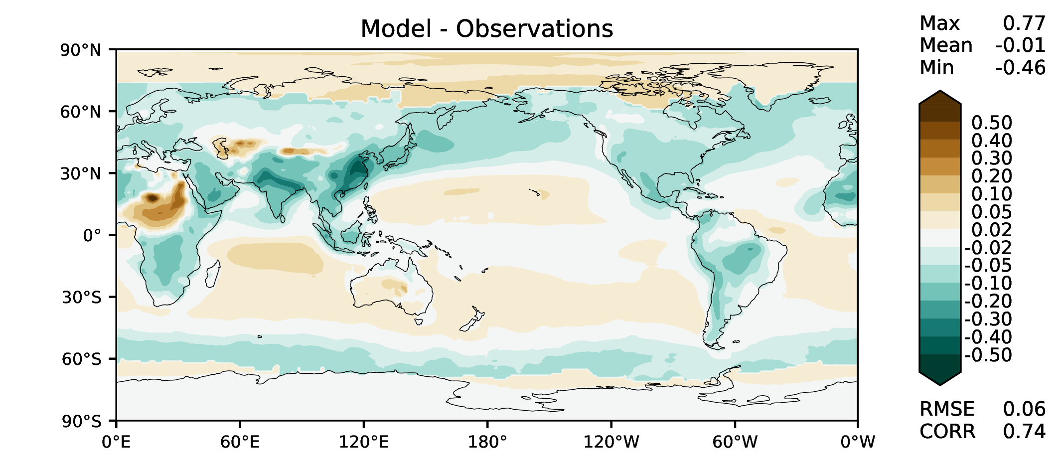
Aerosol optical depth
DECKv1b
v2rc3c
v2rc3e

Slide 17
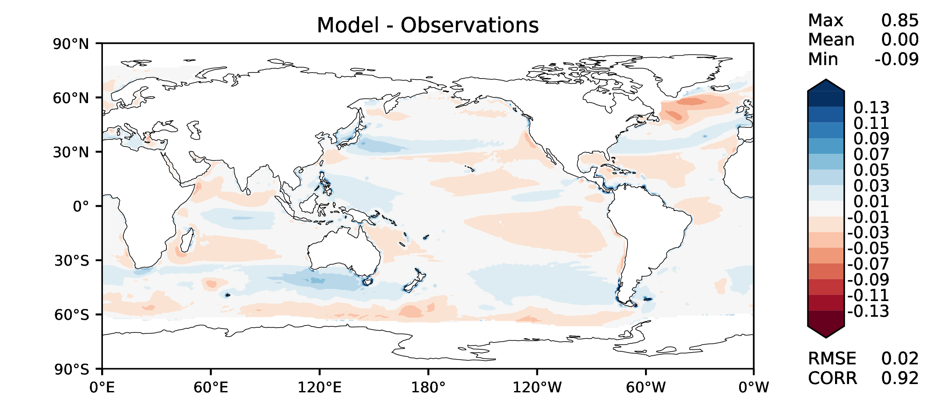
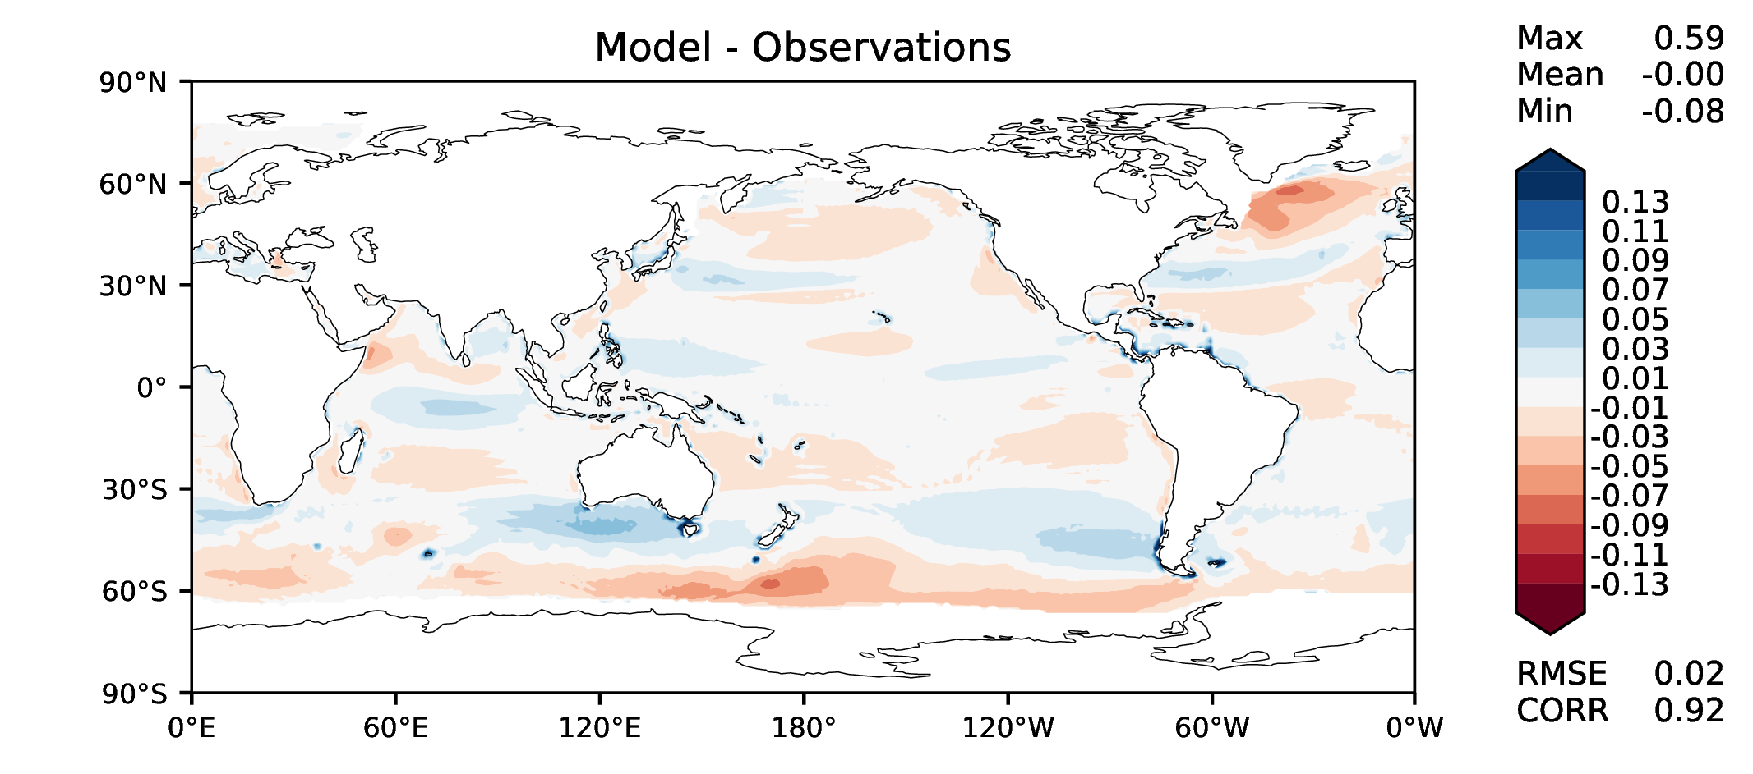
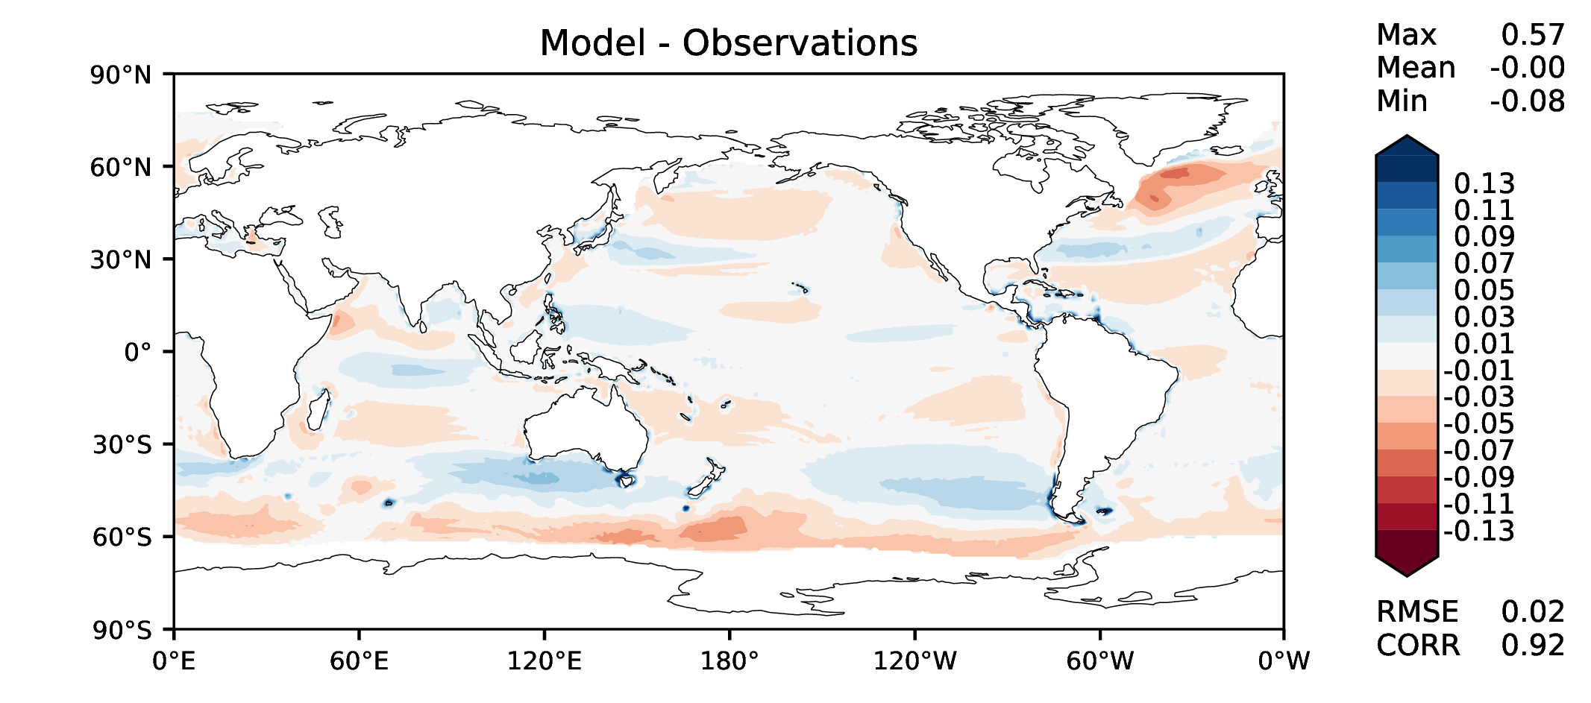
TAUXY ANN ocean
DECKv1b
v2rc3c
v2rc3e

