Slide 1
Summary table (RMSE vs obs)
Variable | Season | DECKv1b | v2rc2c
SST | ANN | 1.08 | 1.10 | 1.04 | 0.97
PRECT | ANN | 1.11 | 0.94 | 0.95 | 1.00
PRECT | DJF | 1.40 | 1.36 | 1.36 | 1.41
PRECT | MAM | 1.52 | 1.10 | 1.08 | 1.17
PRECT | JJA | 1.51 | 1.28 | 1.30 | 1.36
PRECT | SON | 1.28 | 1.22 | 1.24 | 1.32
RESTOM | ANN | 9.34 | 8.21 | 8.25 | 8.23
SWCF | ANN | 10.56 | 9.91 | 9.86 | 9.92
LWCF | ANN | 5.25 | 5.08 | 5.12 | 5.29
u850 | ANN | 1.26 | 1.21 | 1.26 | 1.24
u200 | ANN | 2.22 | 2.61 | 2.75 | 2.80
T200 | ANN | 2.66 | 3.12 | 2.99 | 2.68
TREFHT | ANN | 2.61 | 3.09 | 2.96 | 2.81
TREFHT | JJA | 2.88 | 3.28 | 3.20 | 3.11
AODVIS | ANN | 0.07 | 0.06 | 0.06 | 0.06
TAUXY | ANN | 0.02 | 0.02 | 0.02 | 0.02

Slide 2
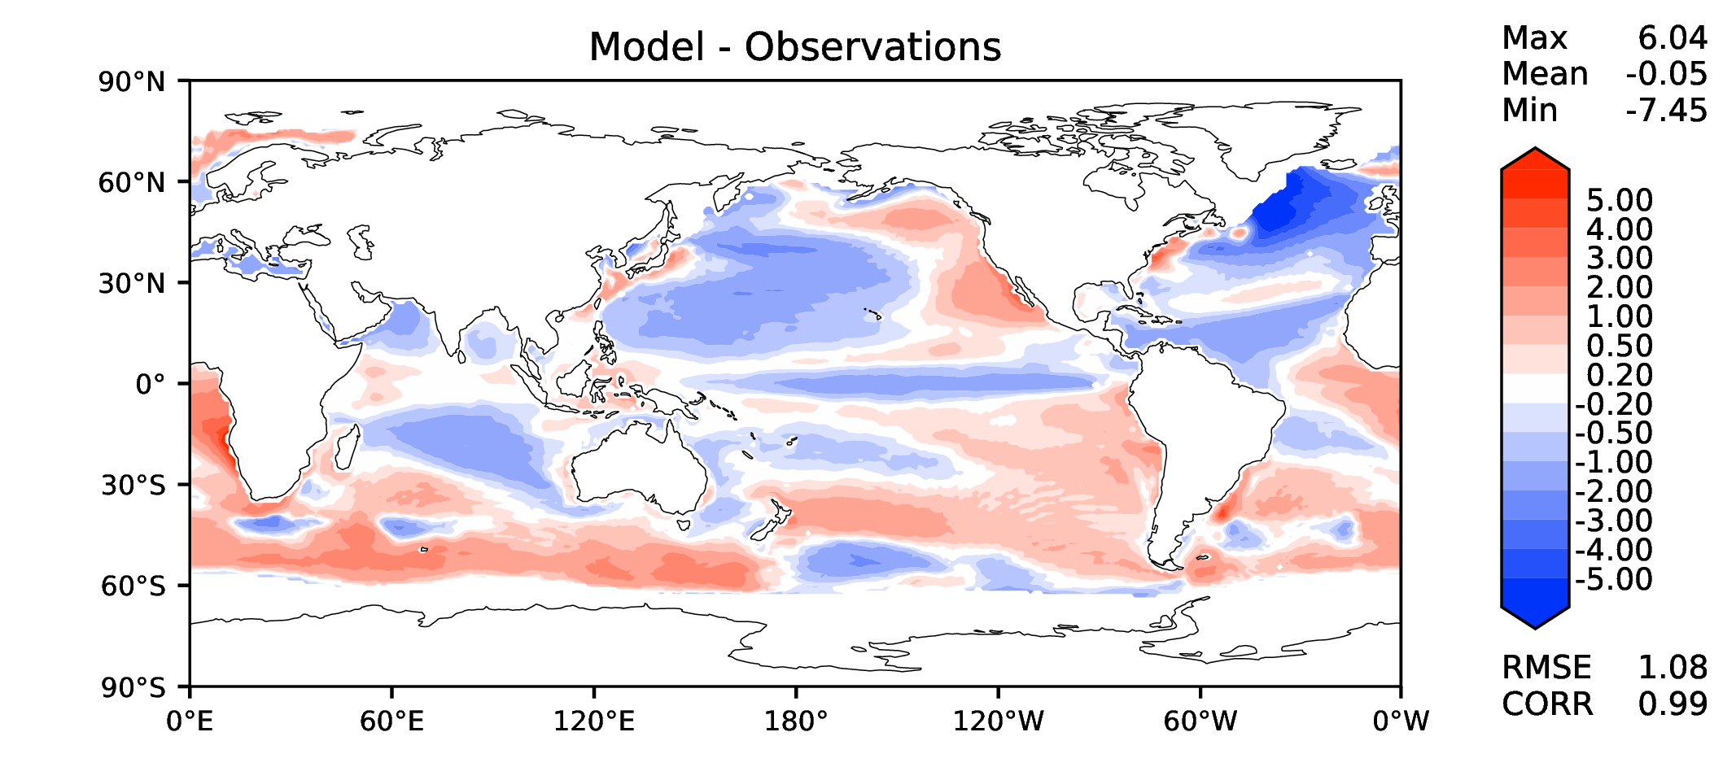
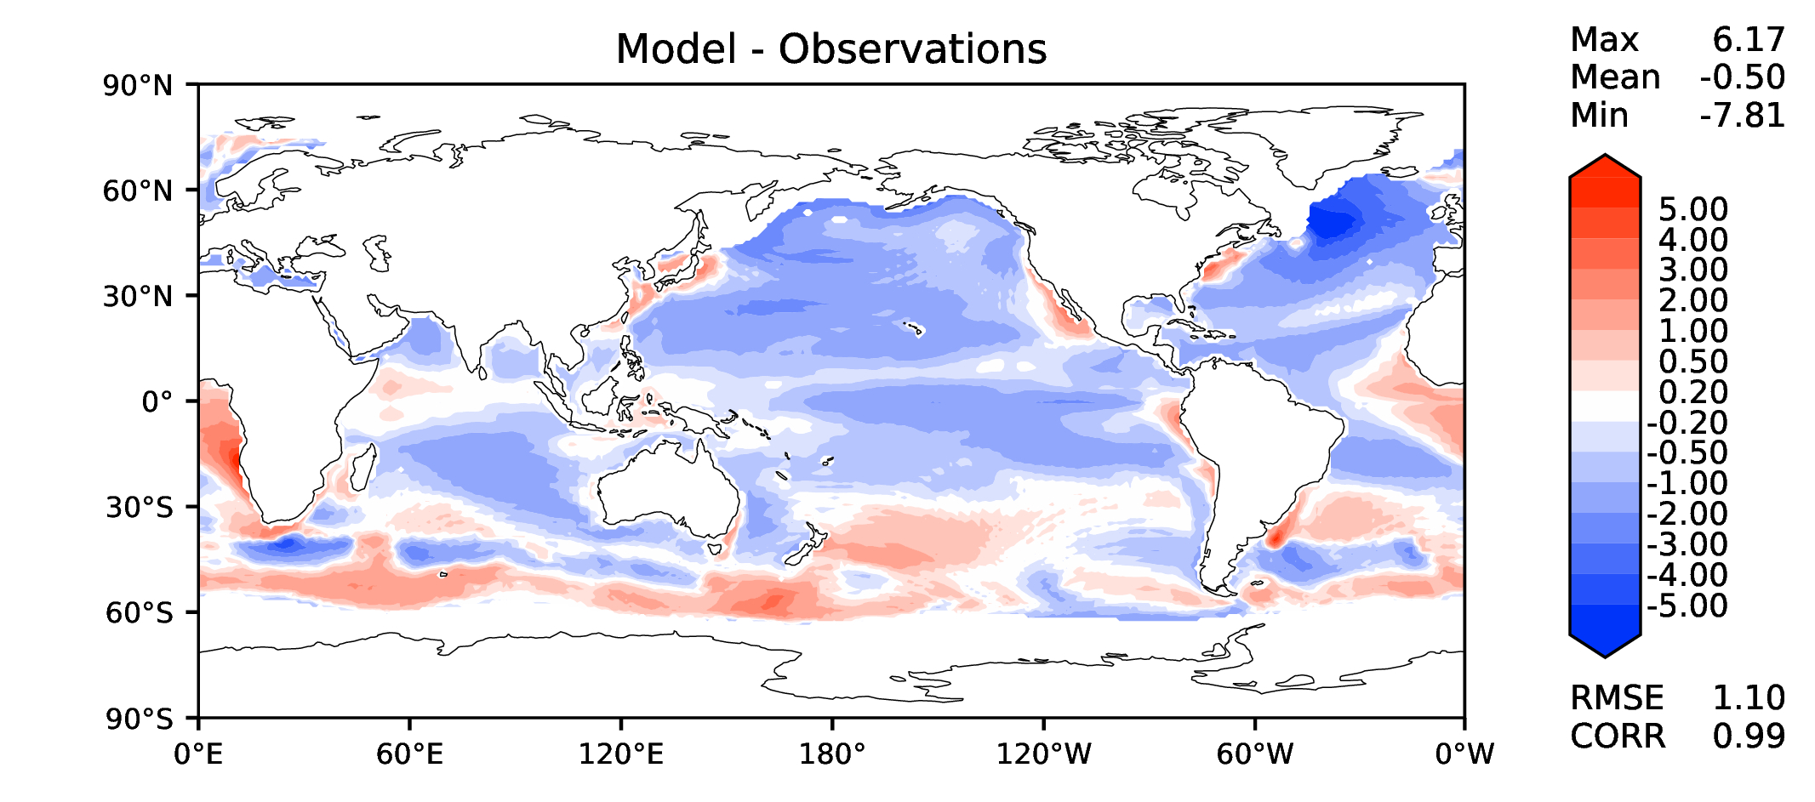
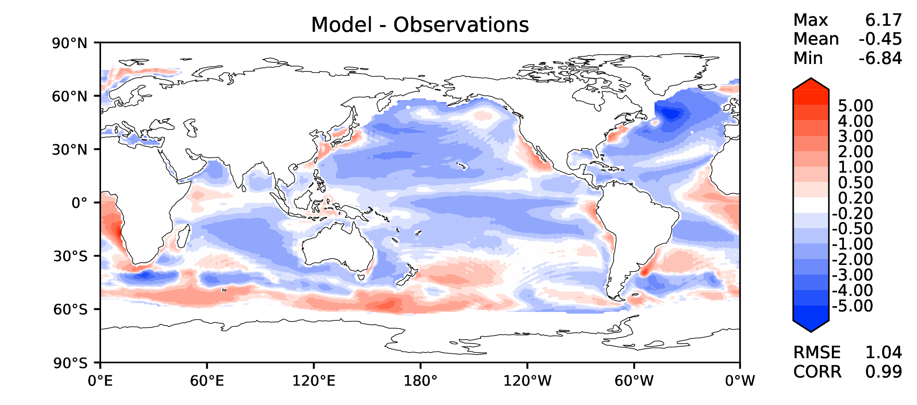
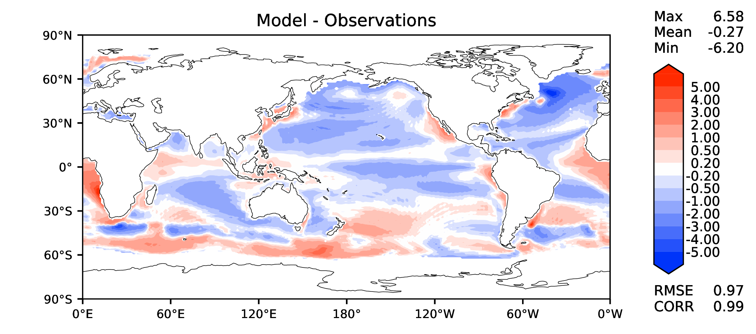
Annual SST (pre-industrial)
DECKv1b
v2rc2c
v2rc1c
v2beta4

Slide 3
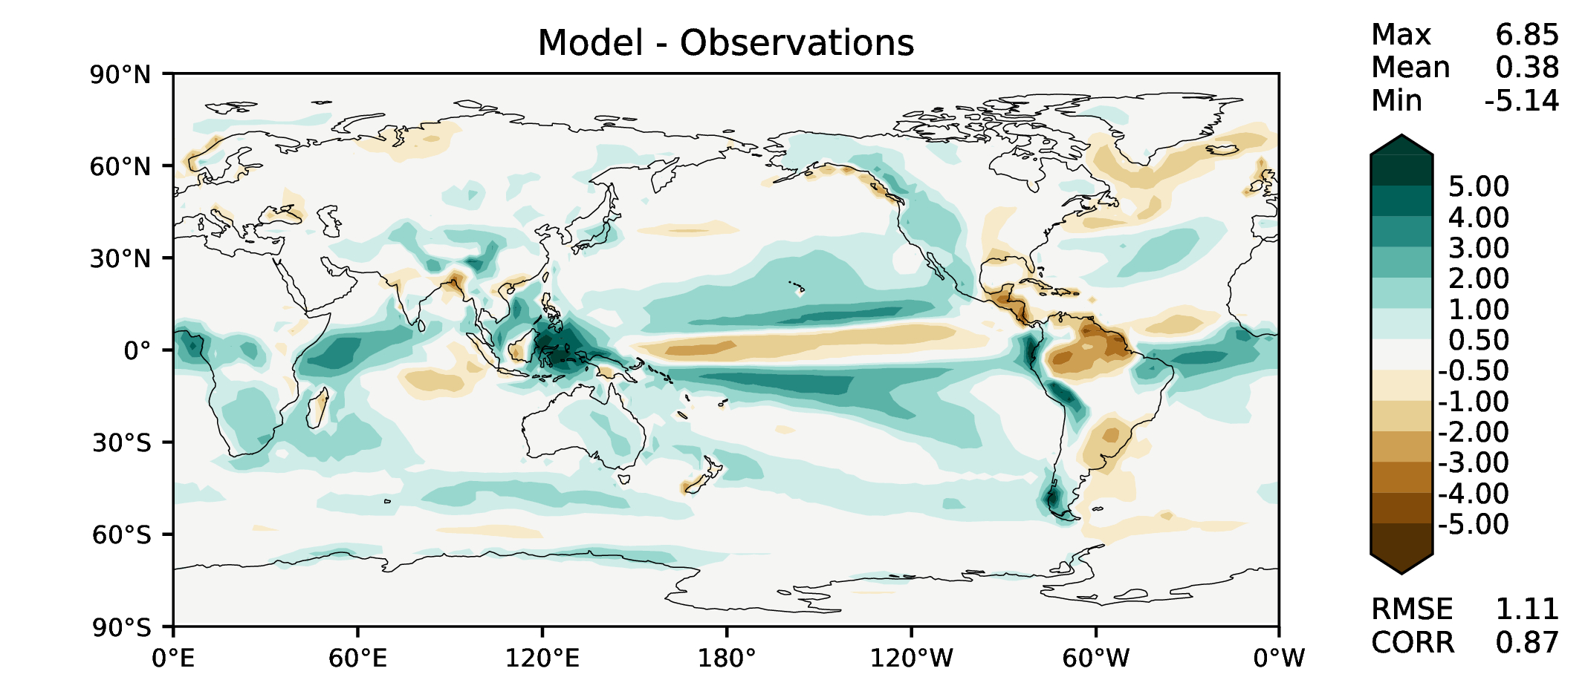
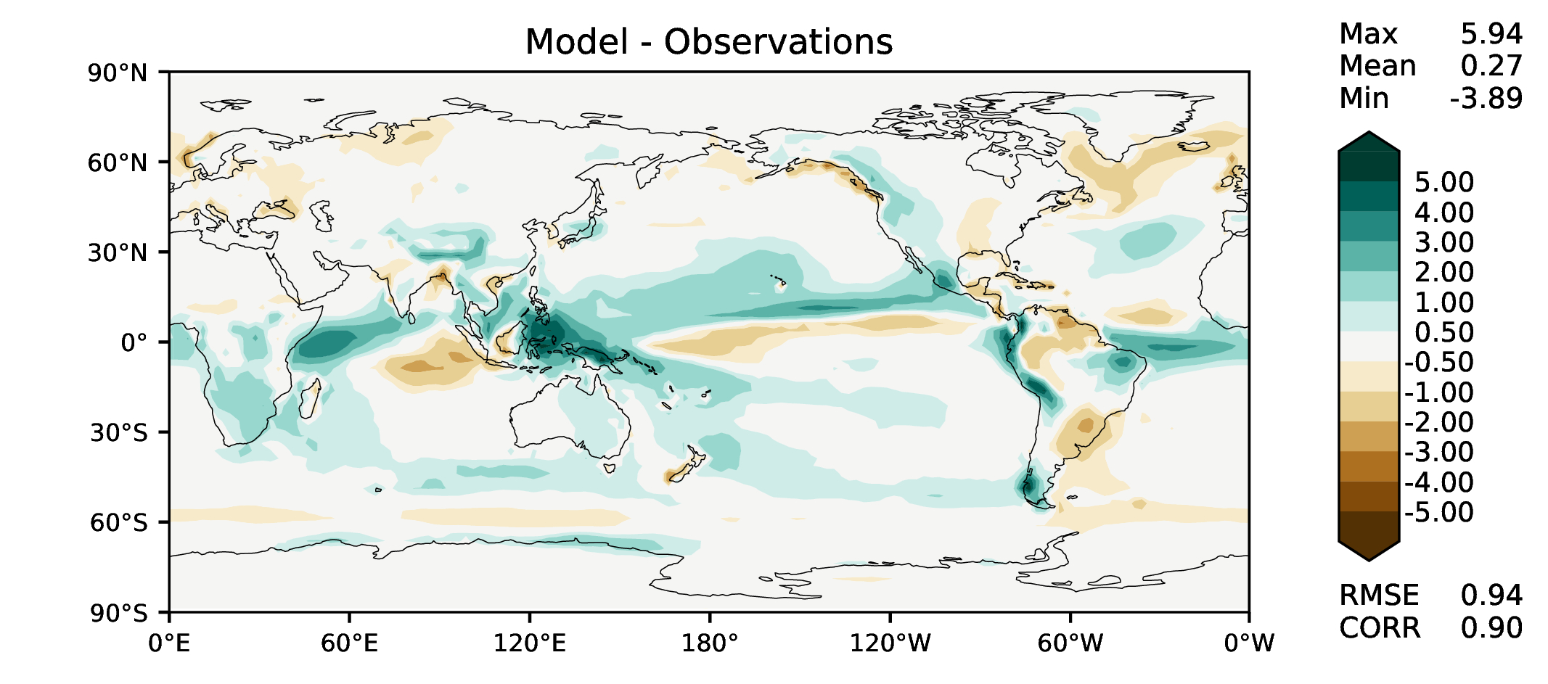
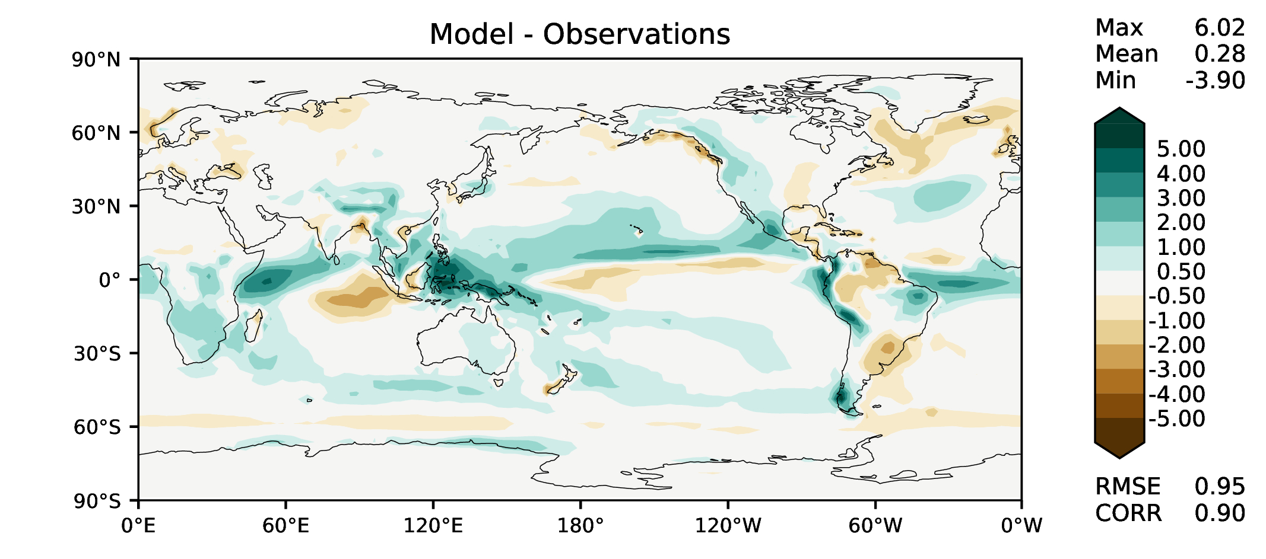
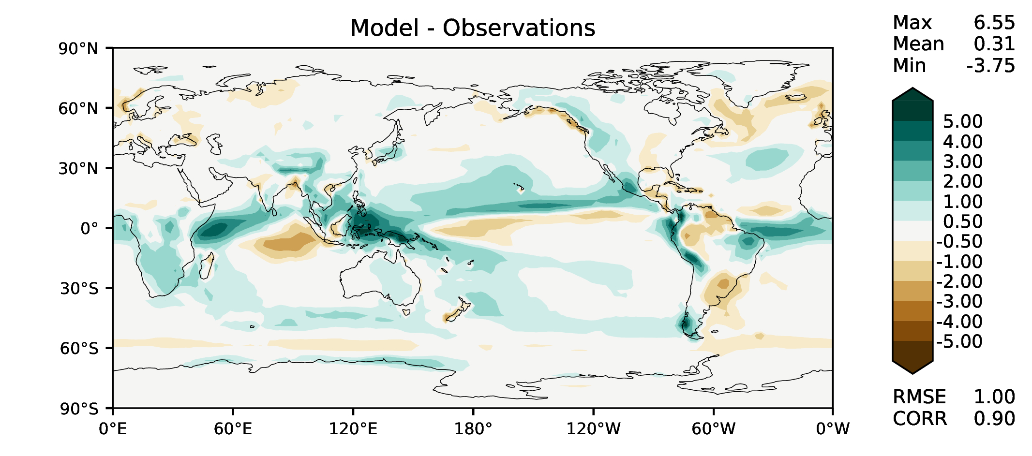
Annual total precipitation
DECKv1b
v2rc2c
v2rc1c
v2beta4

Slide 4
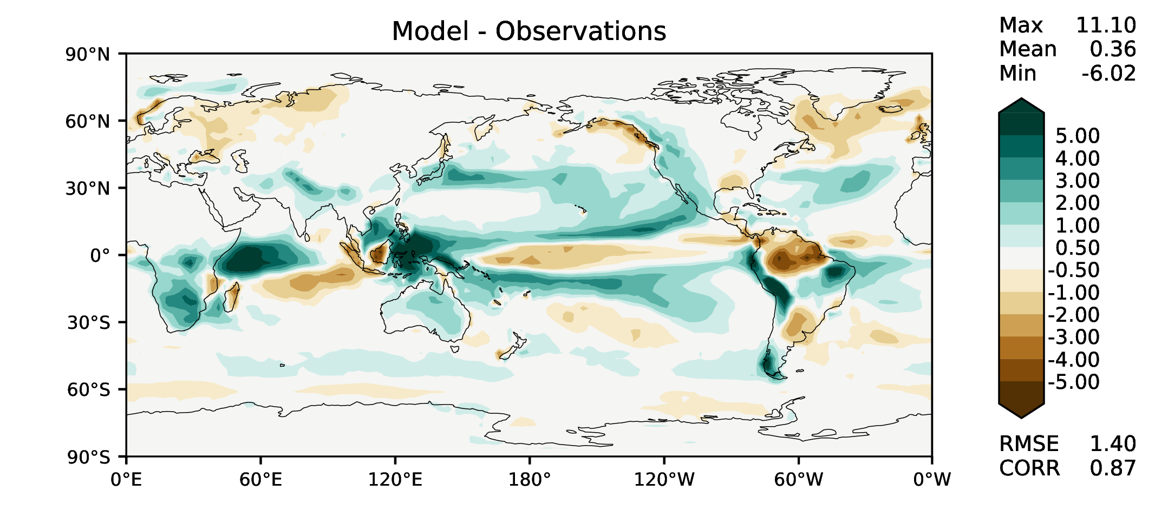
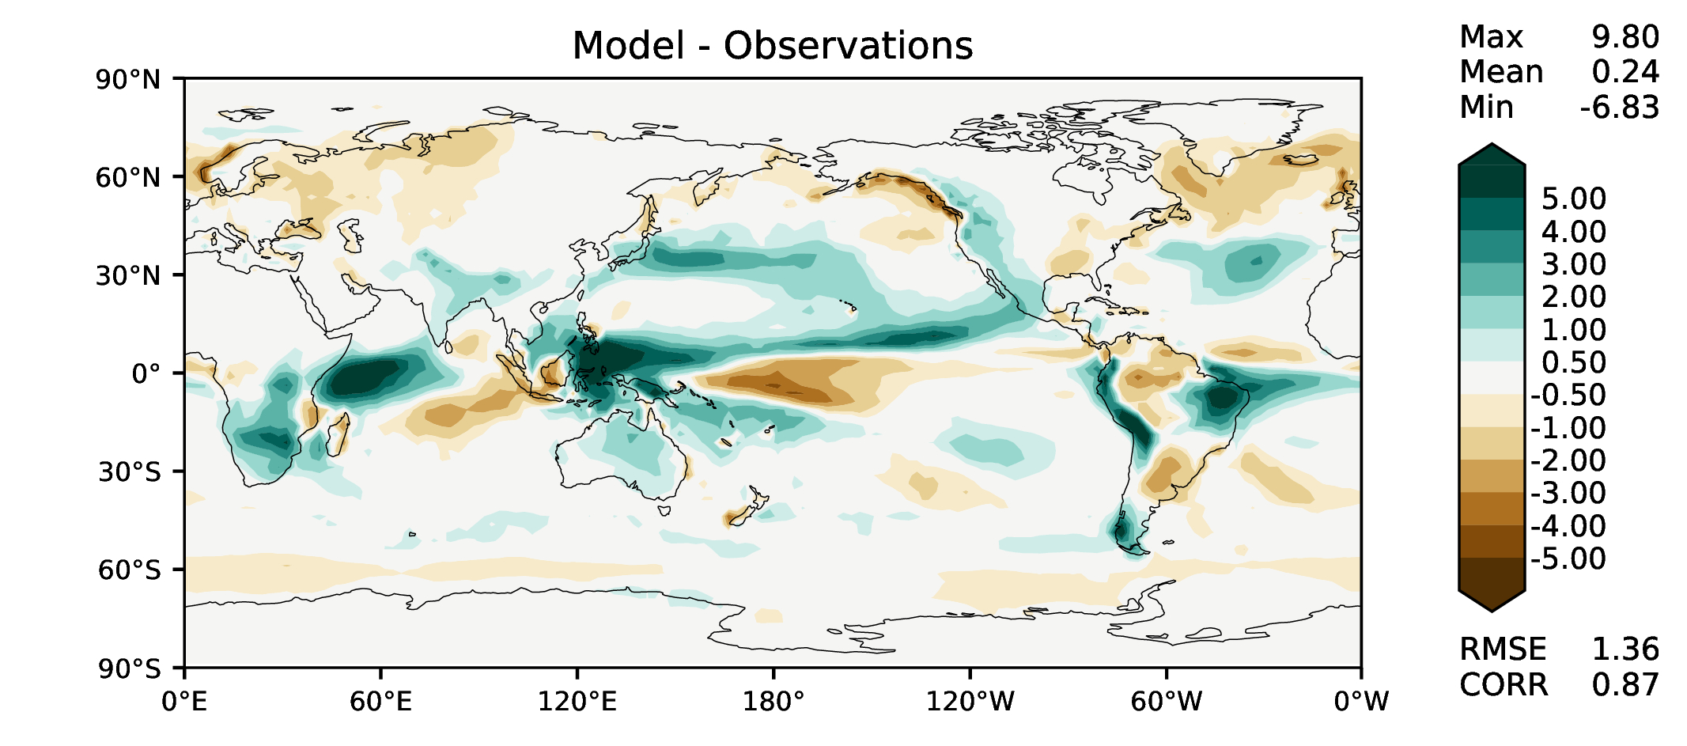
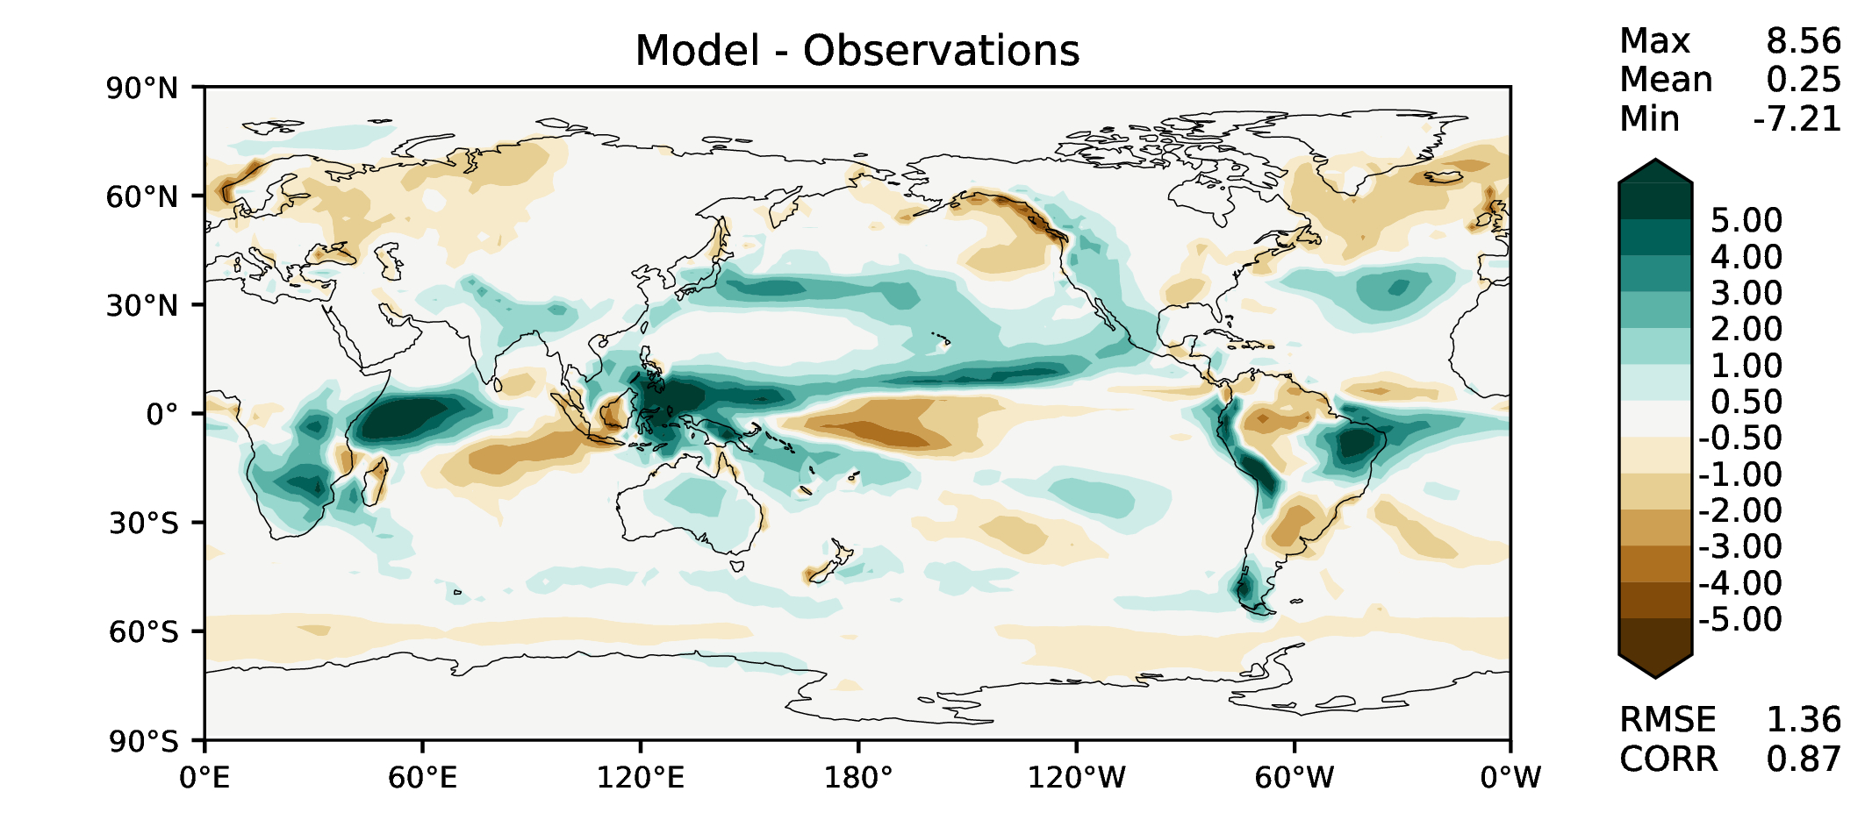

DJF total precipitation
DECKv1b
v2rc2c
v2rc1c
v2beta4

Slide 5
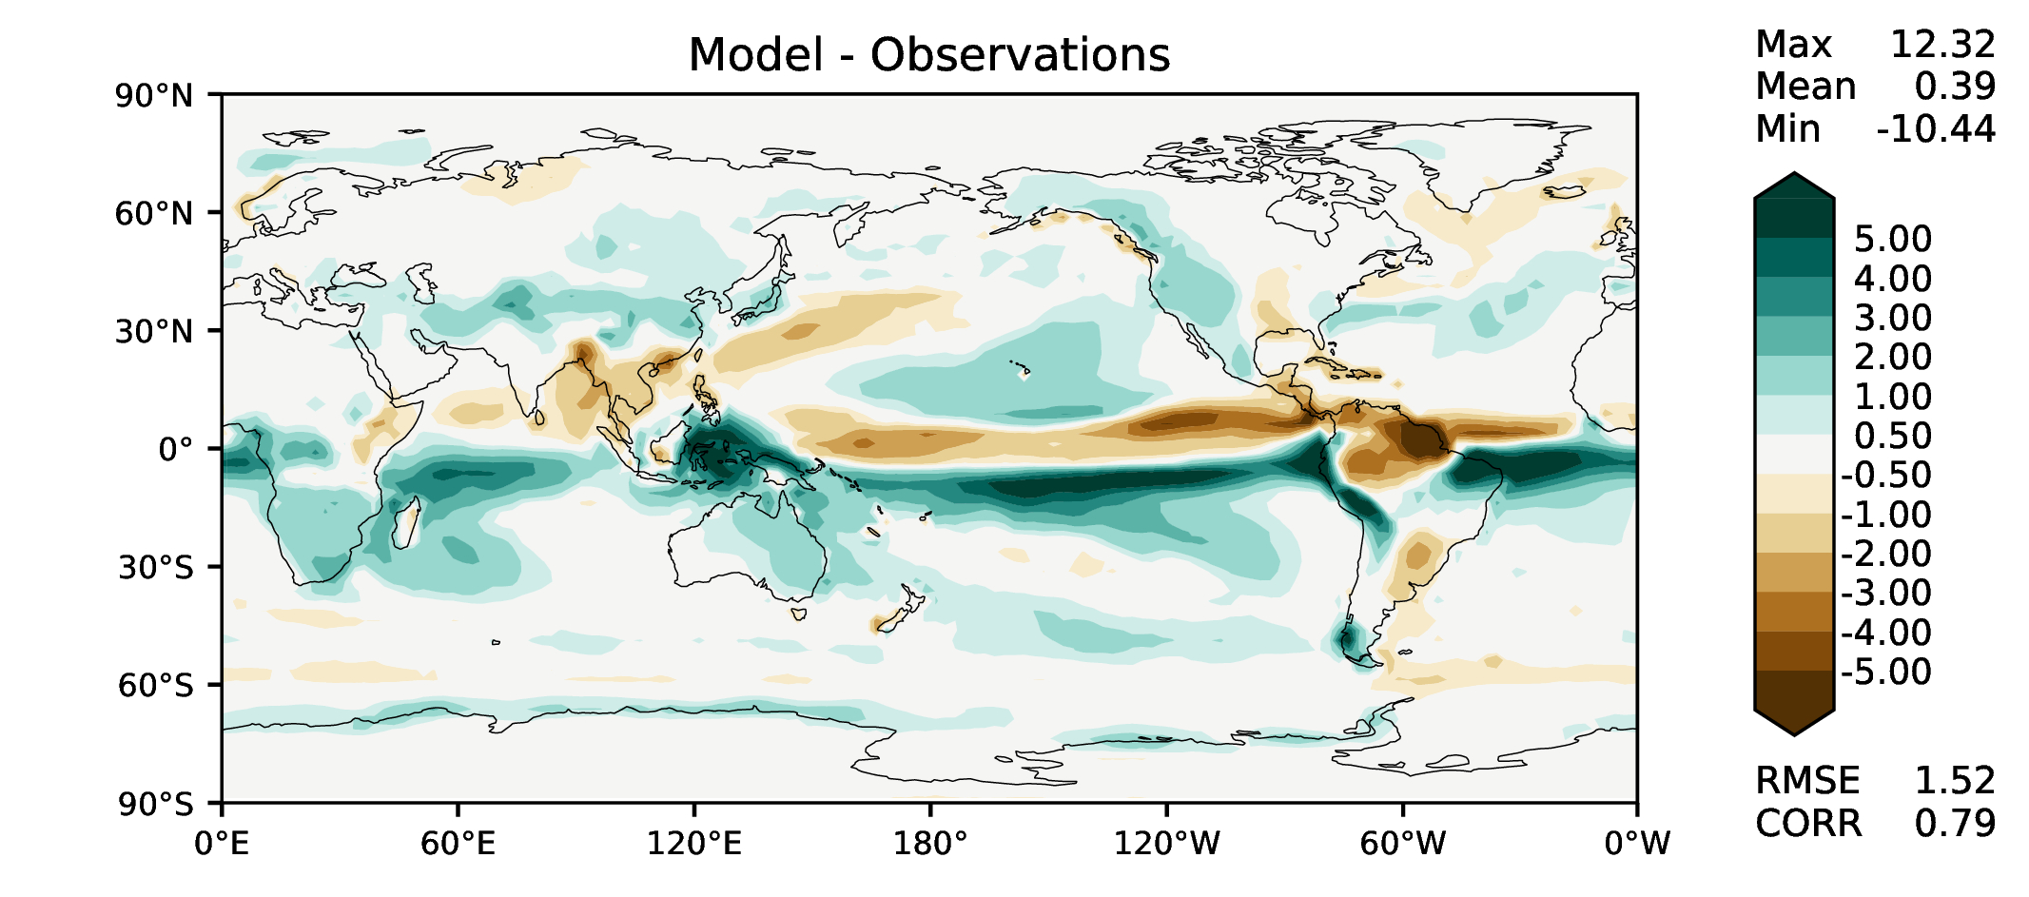
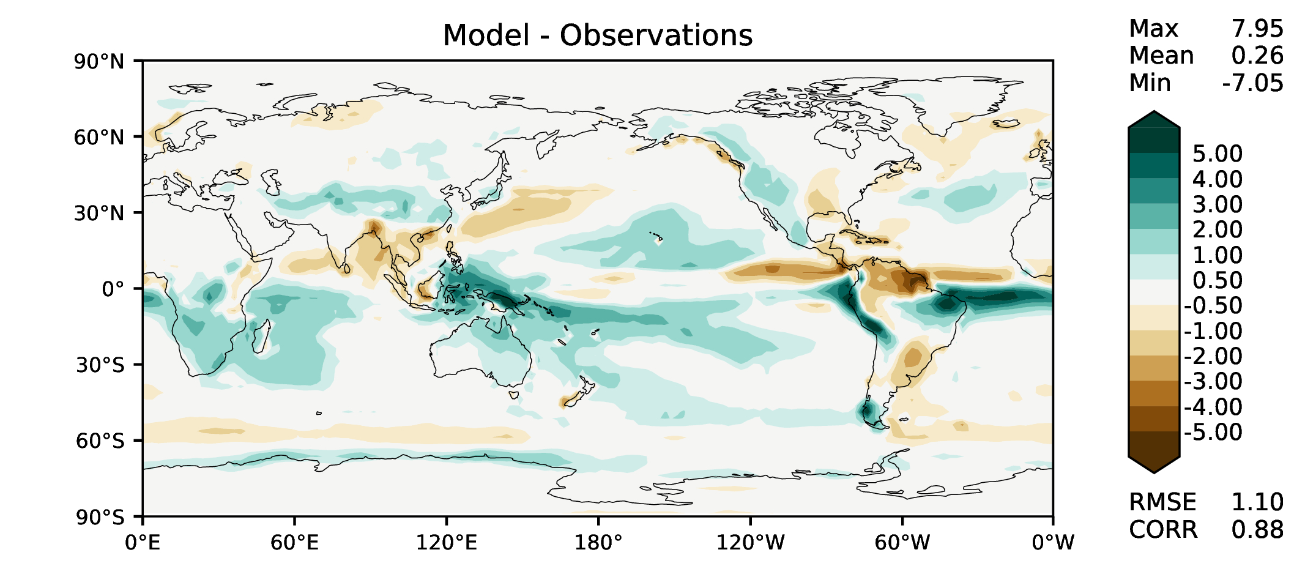
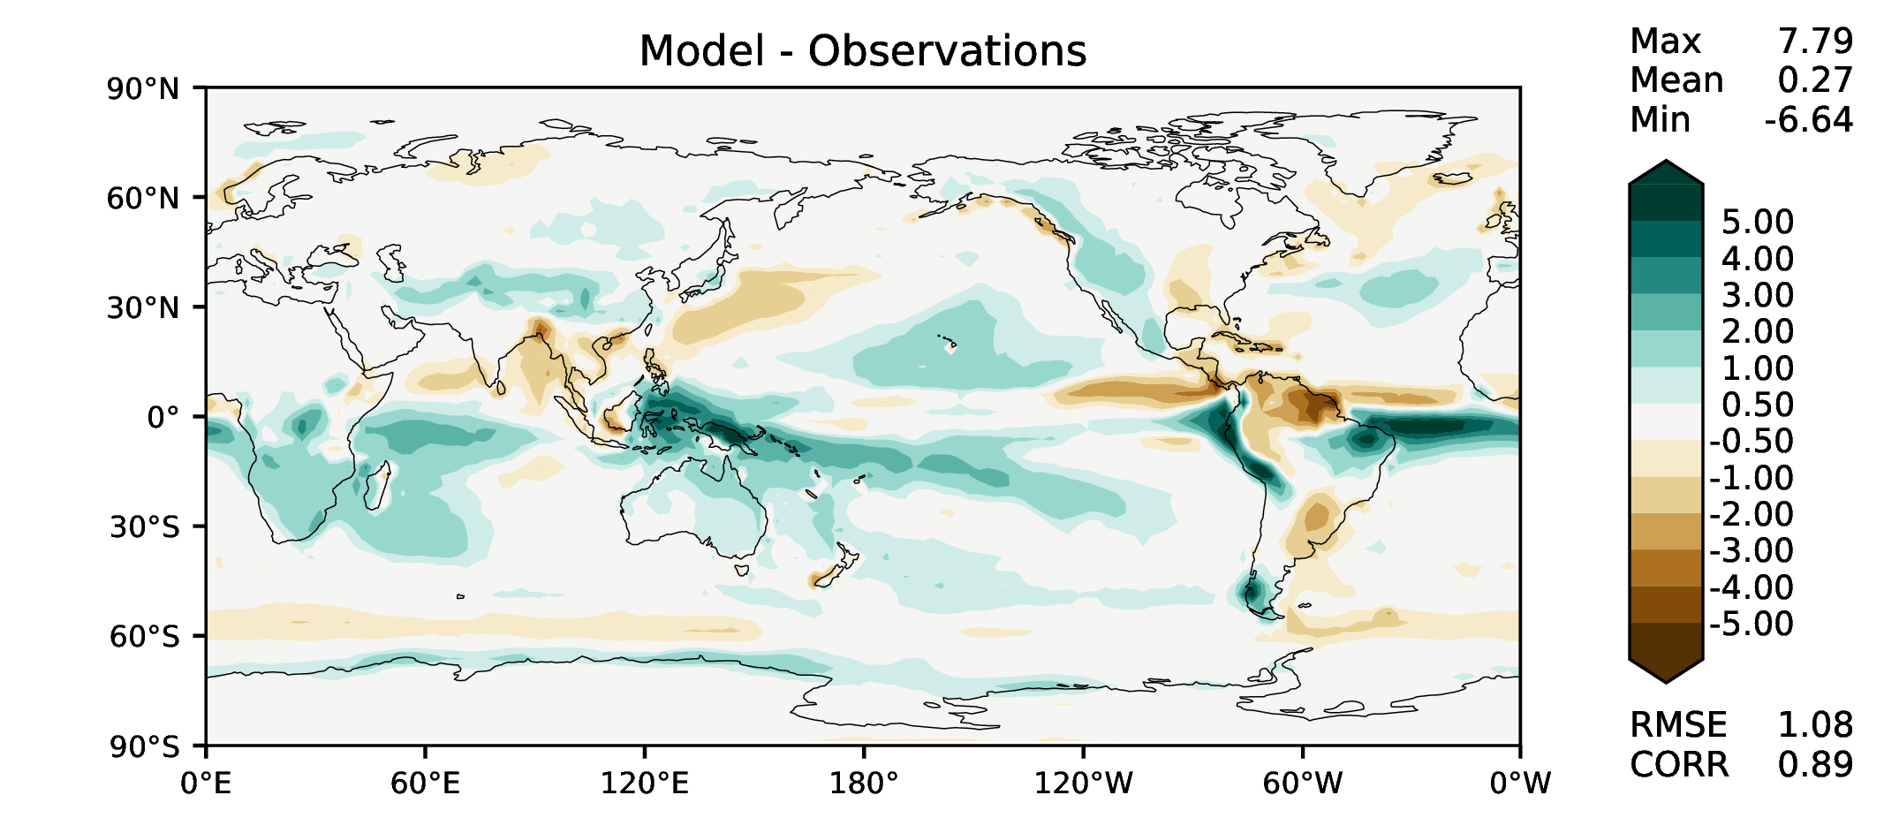
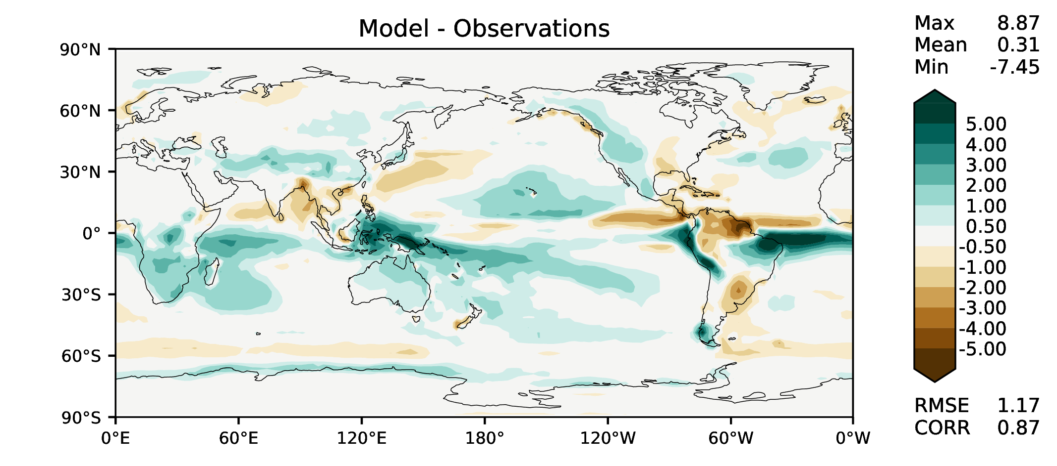
MAM total precipitation
DECKv1b
v2rc2c
v2rc1c
v2beta4

Slide 6
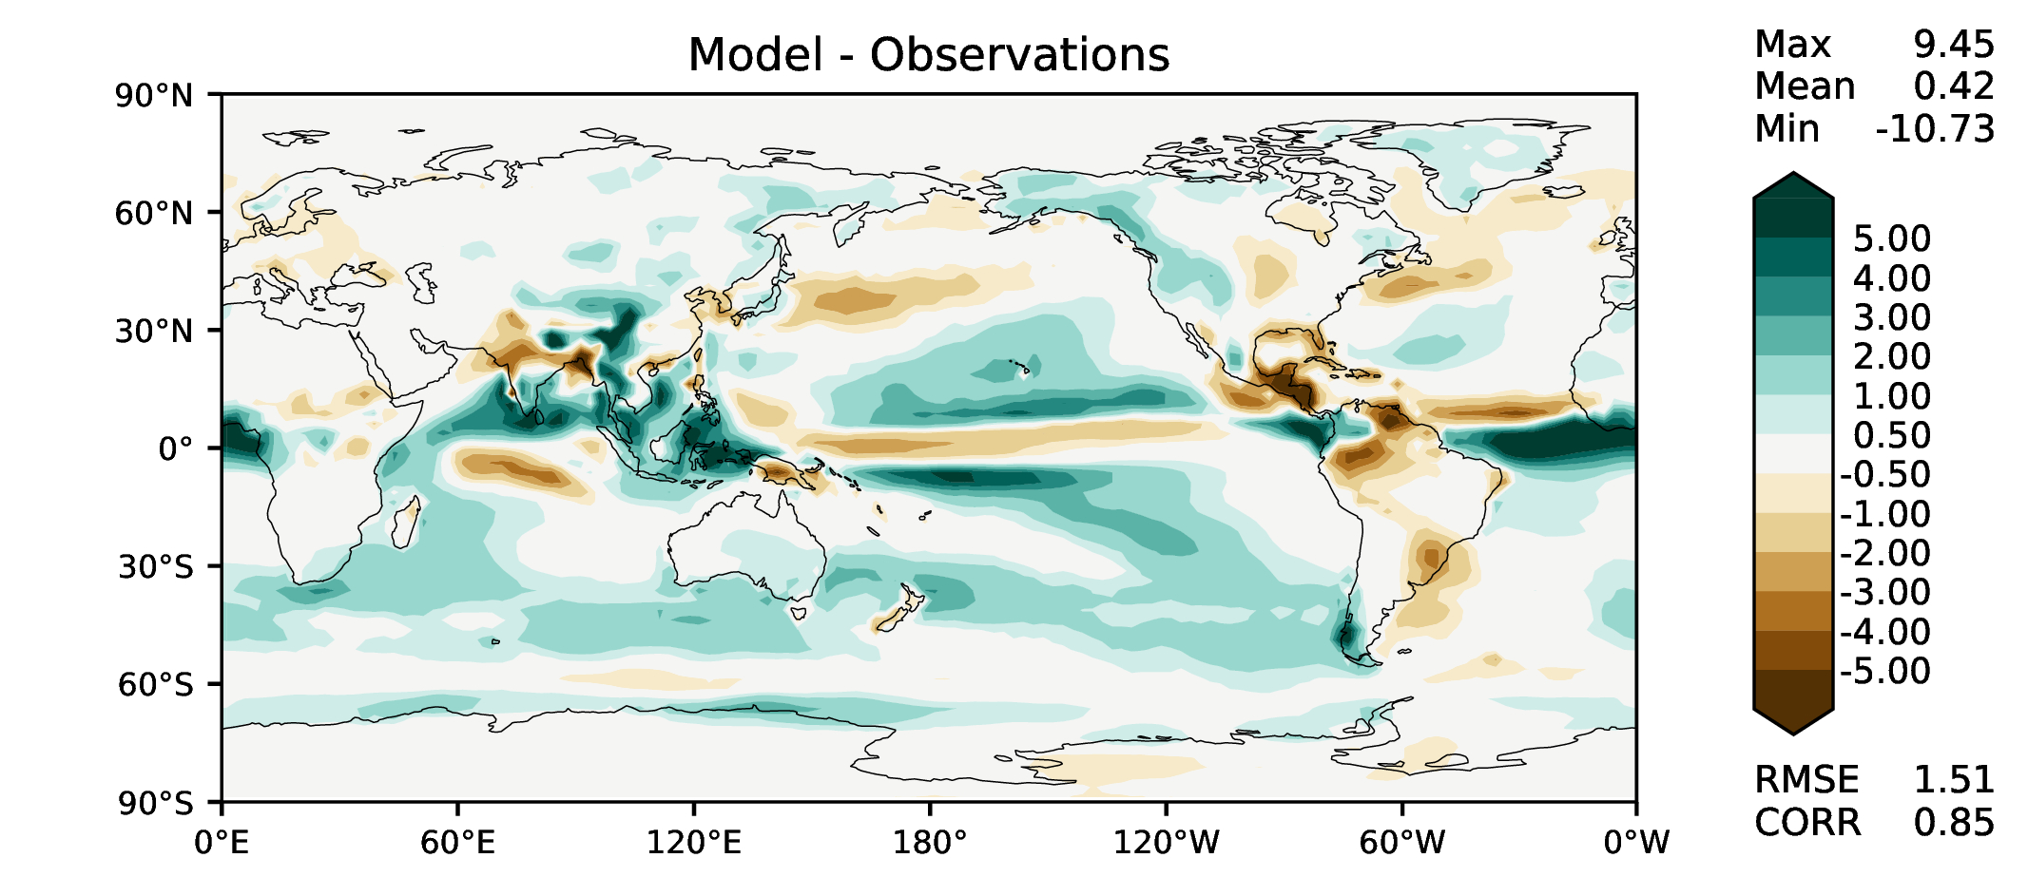
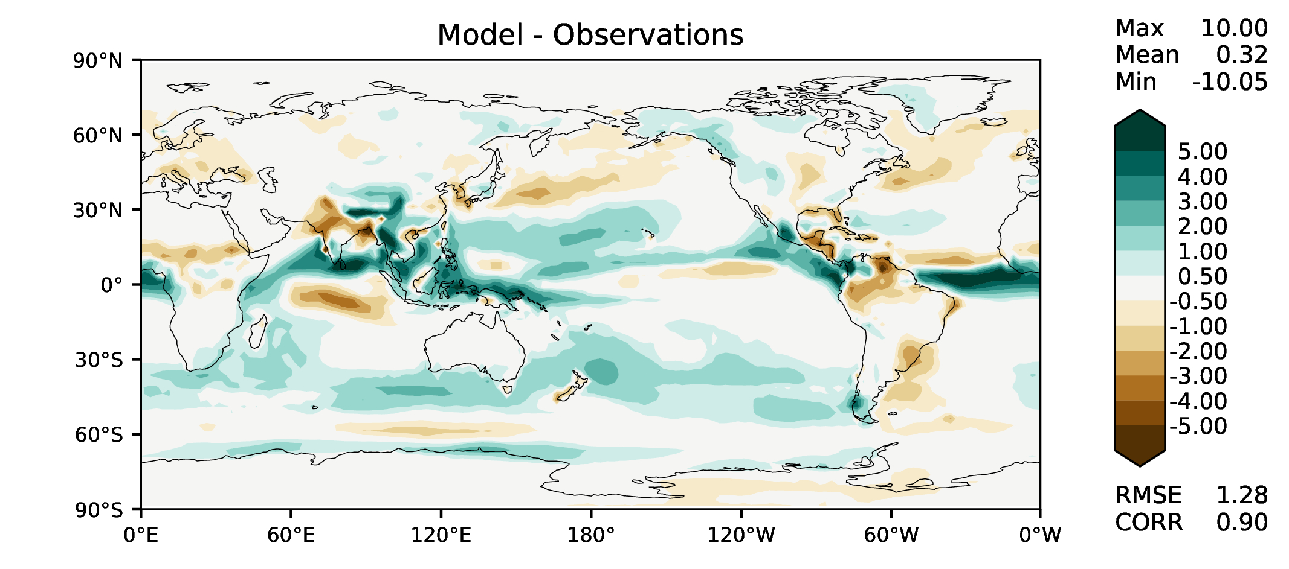
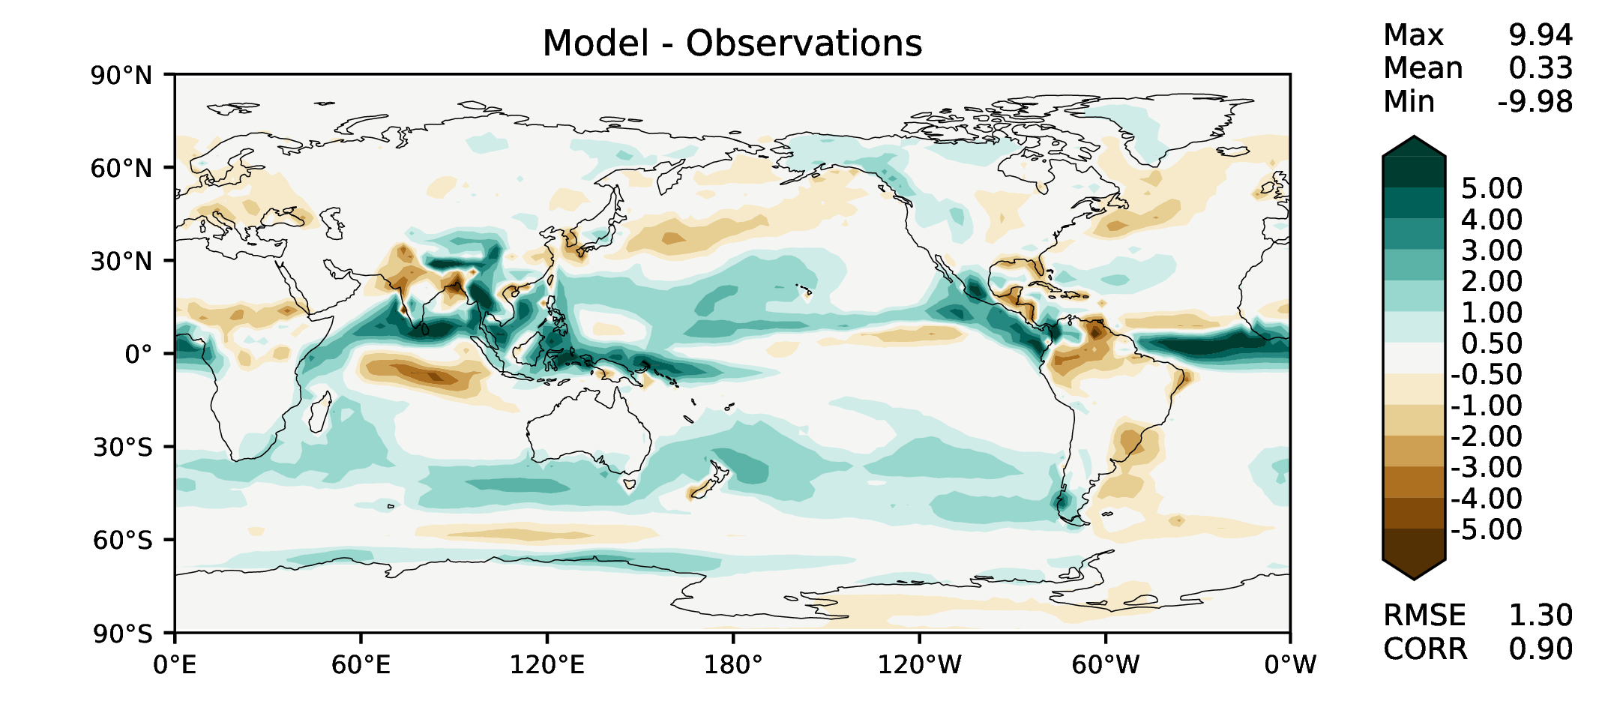
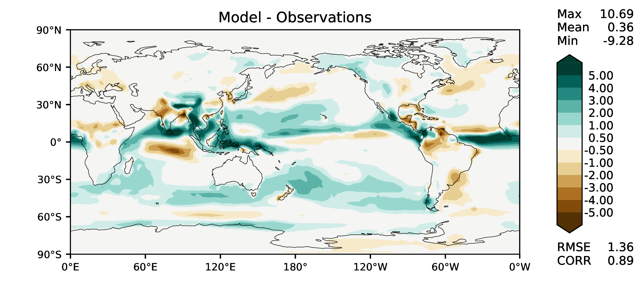
JJA total precipitation
DECKv1b
v2rc2c
v2rc1c
v2beta4

Slide 7
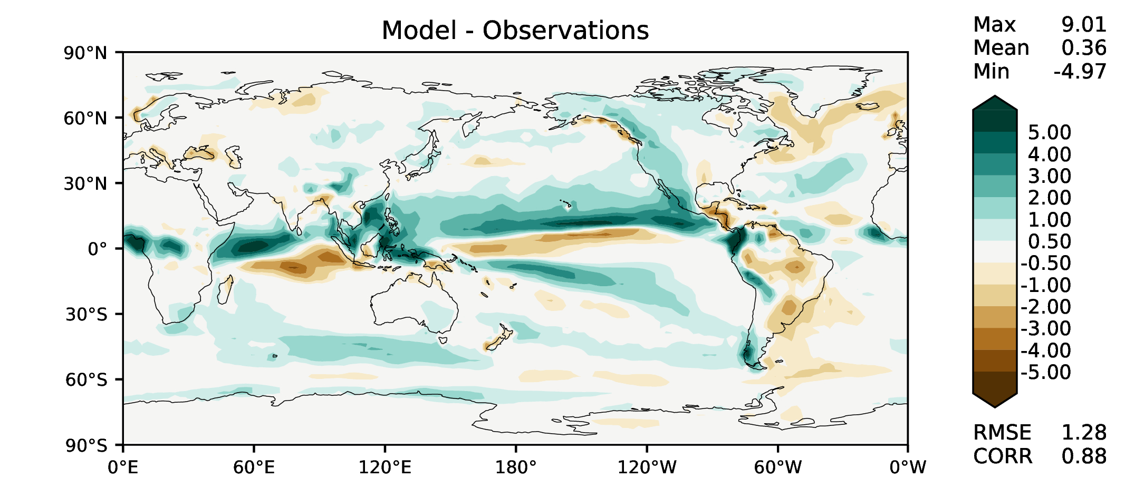
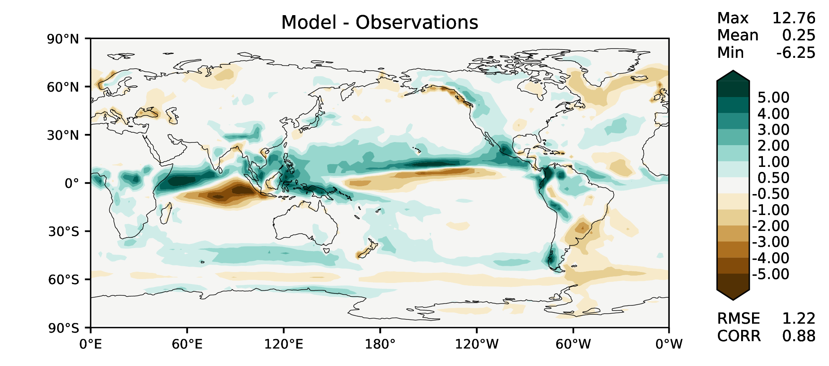
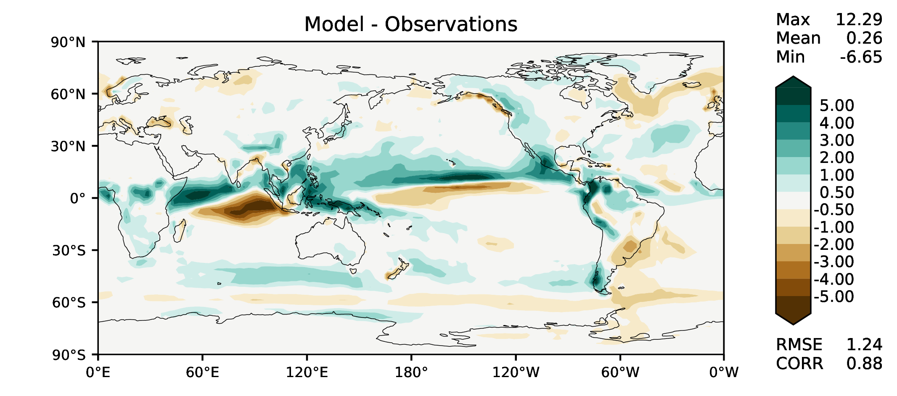
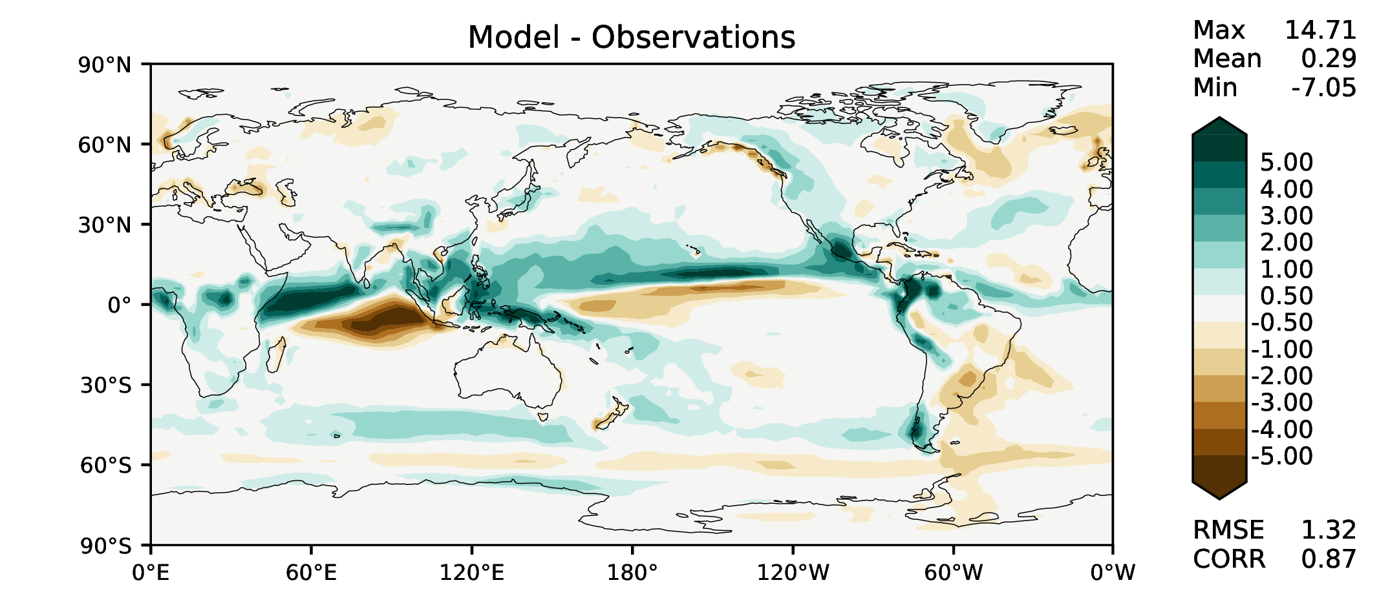
SON total precipitation
DECKv1b
v2rc2c
v2rc1c
v2beta4

Slide 8
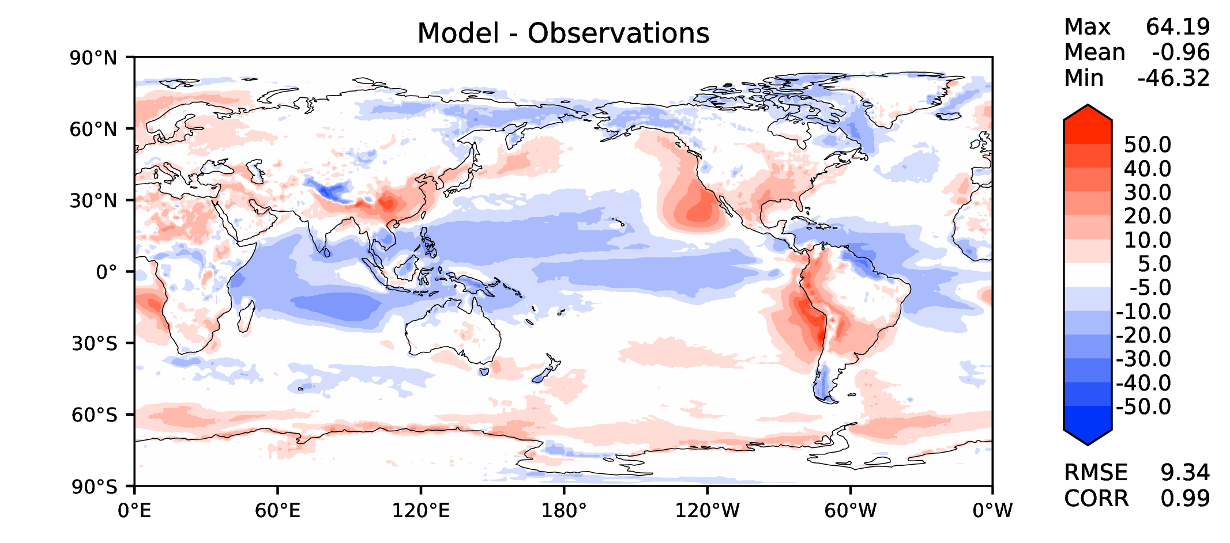
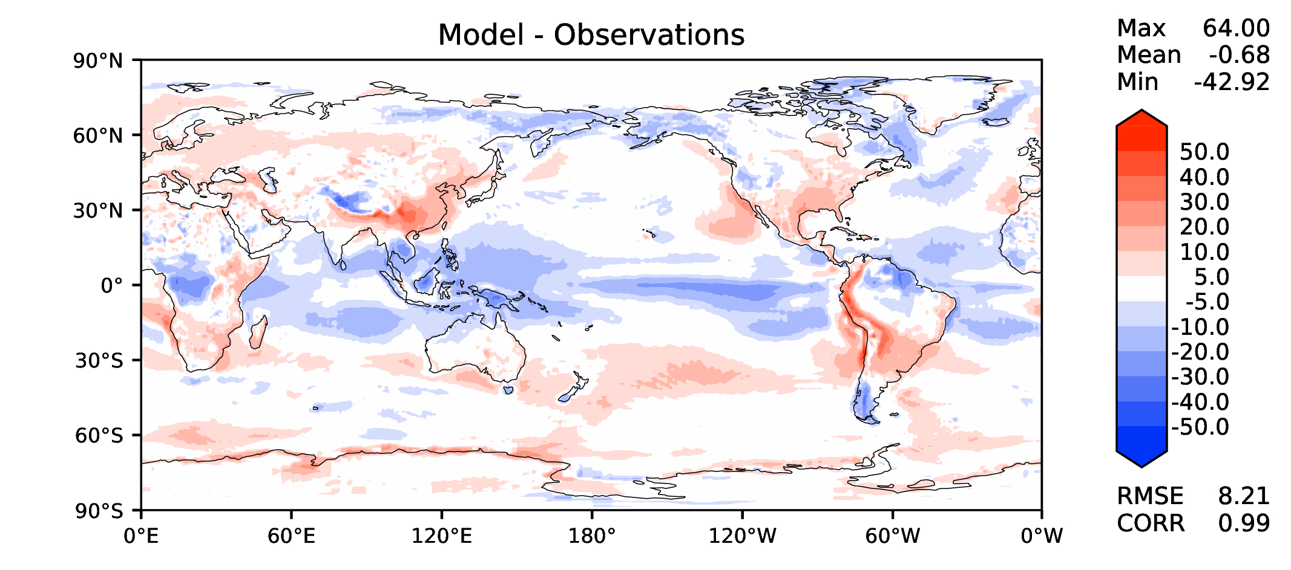
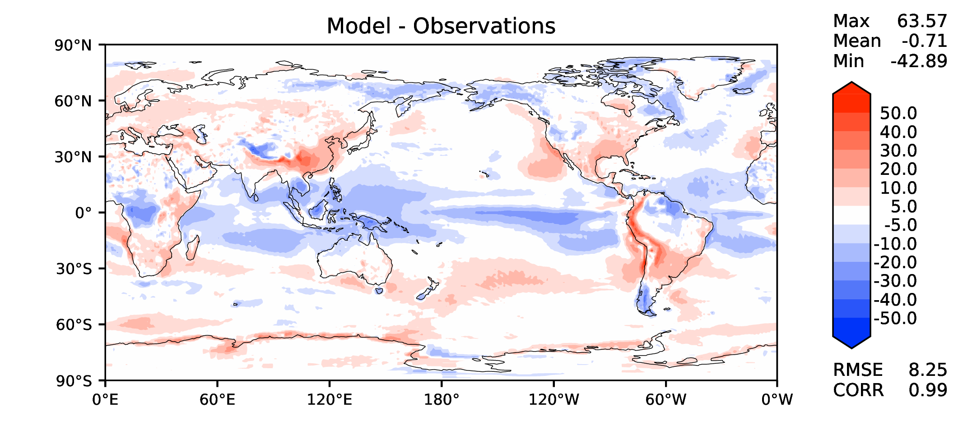
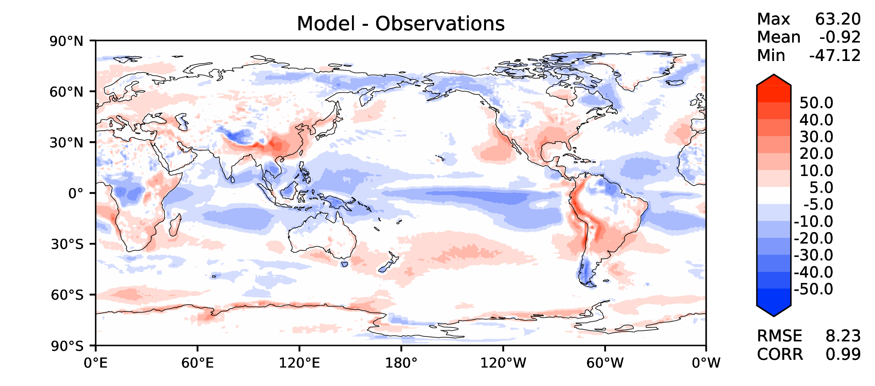
Annual TOA net radiation
DECKv1b
v2rc2c
v2rc1c
v2beta4

Slide 9
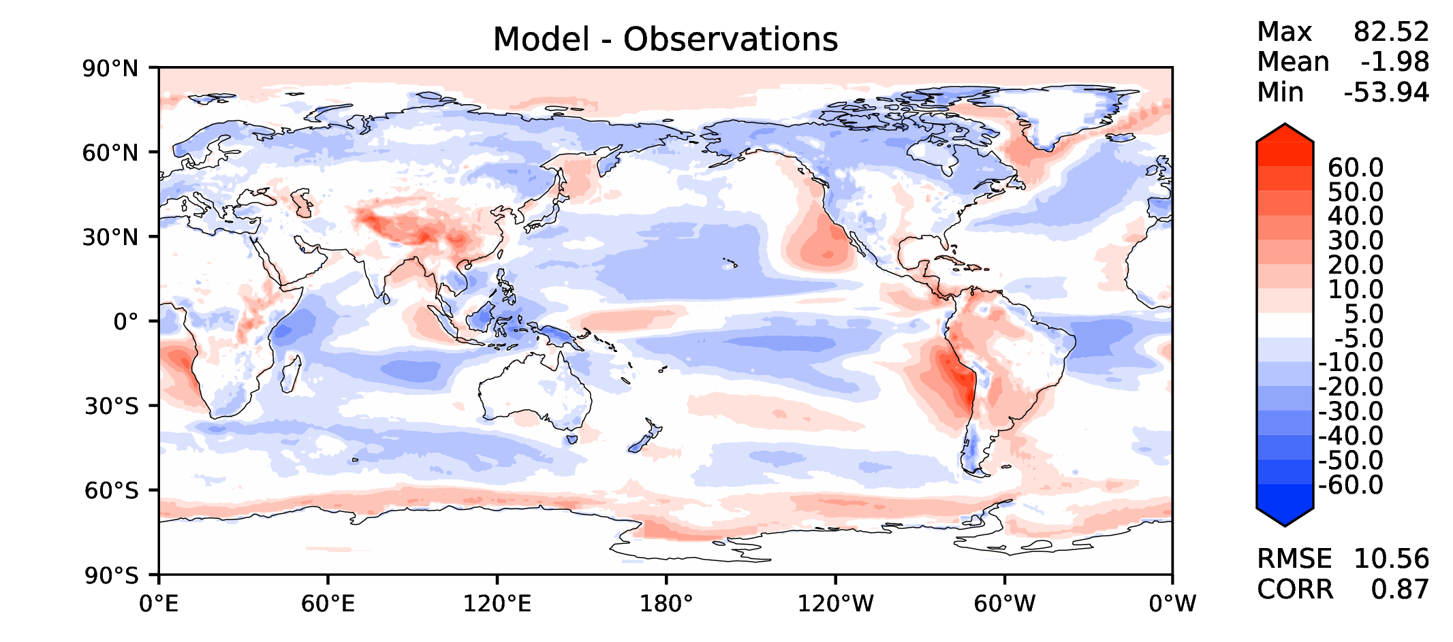
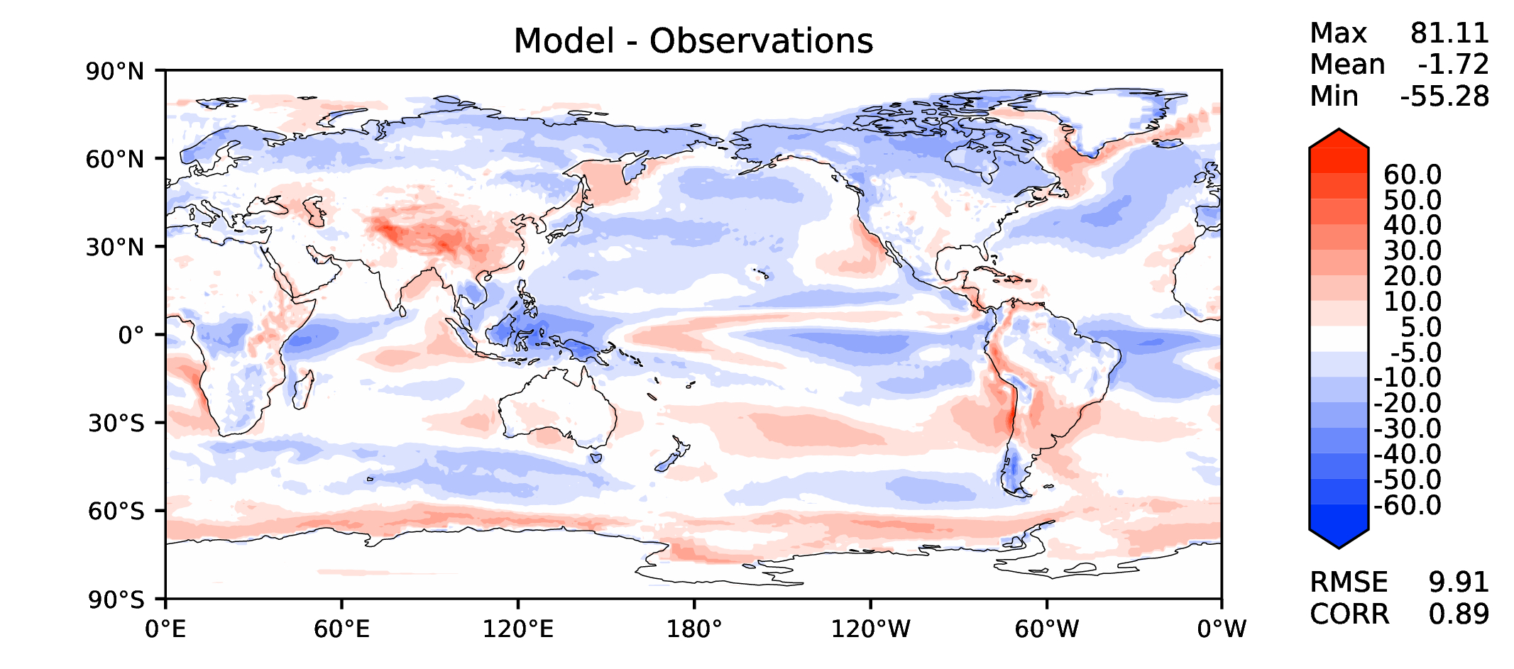
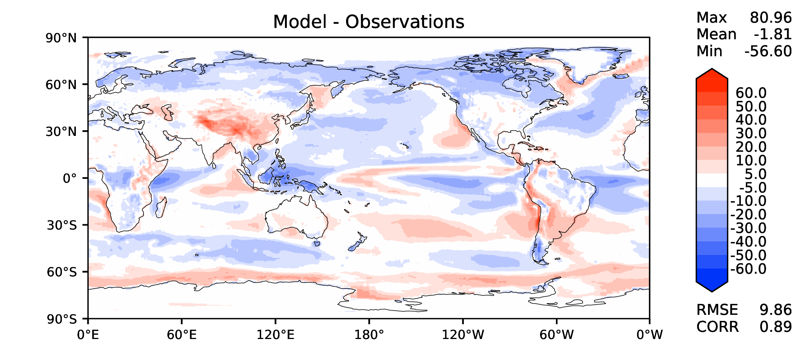
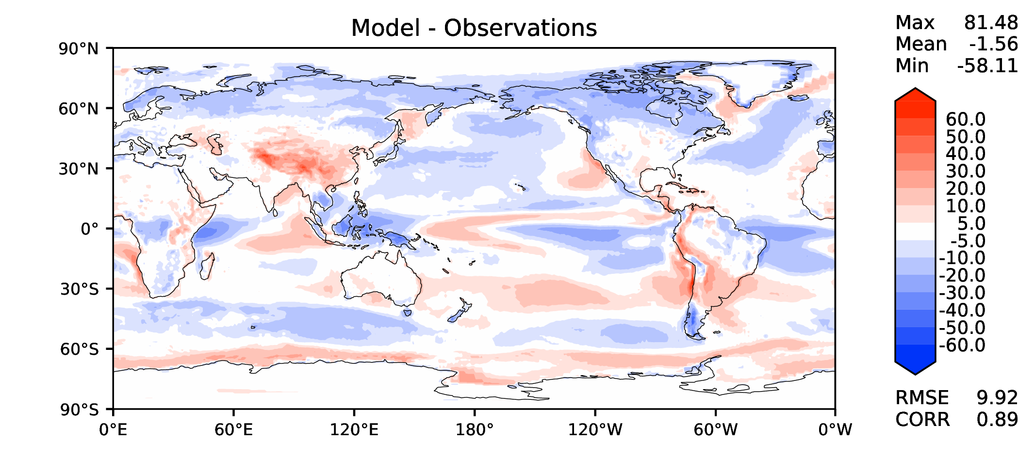
Annual TOA SW CRE
DECKv1b
v2rc2c
v2rc1c
v2beta4

Slide 10
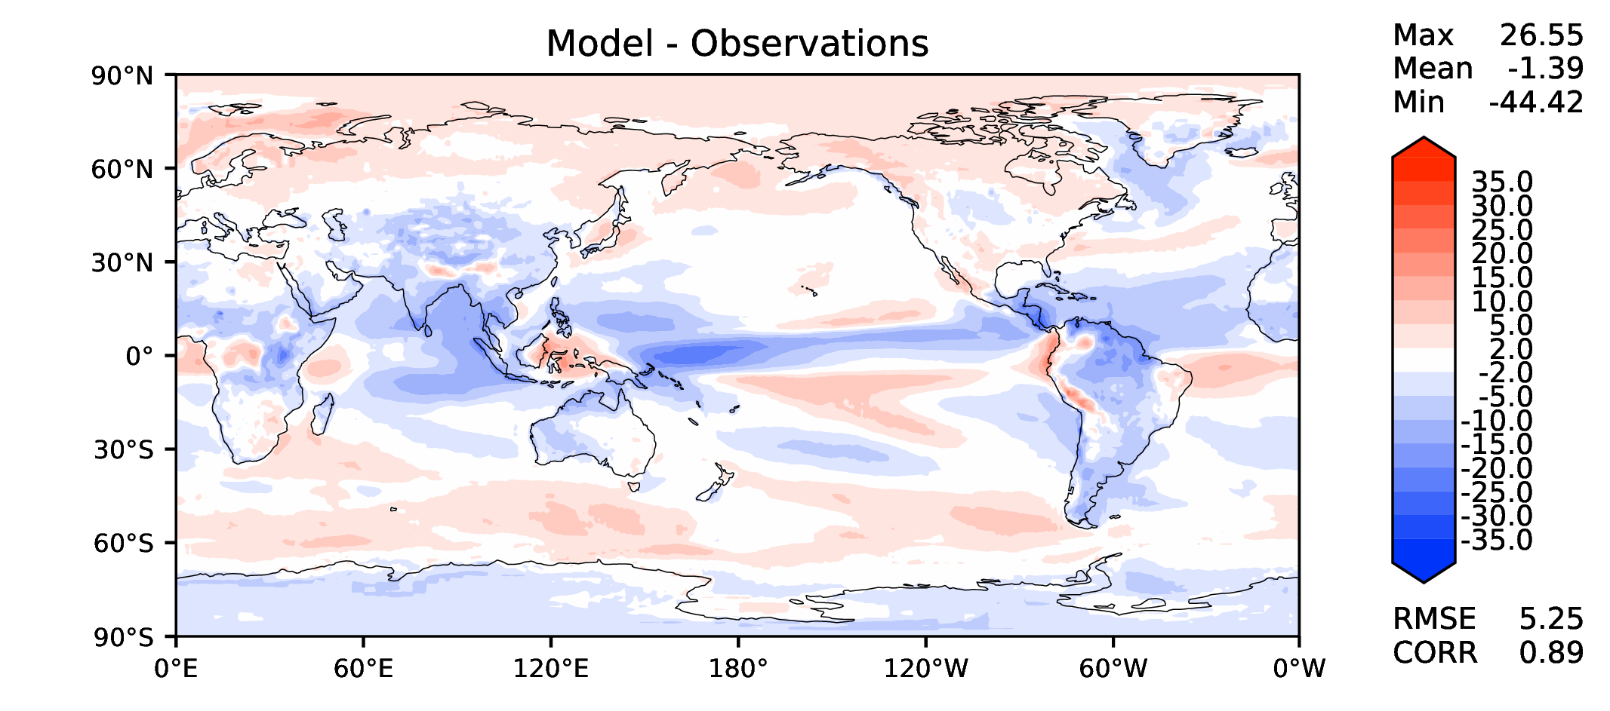
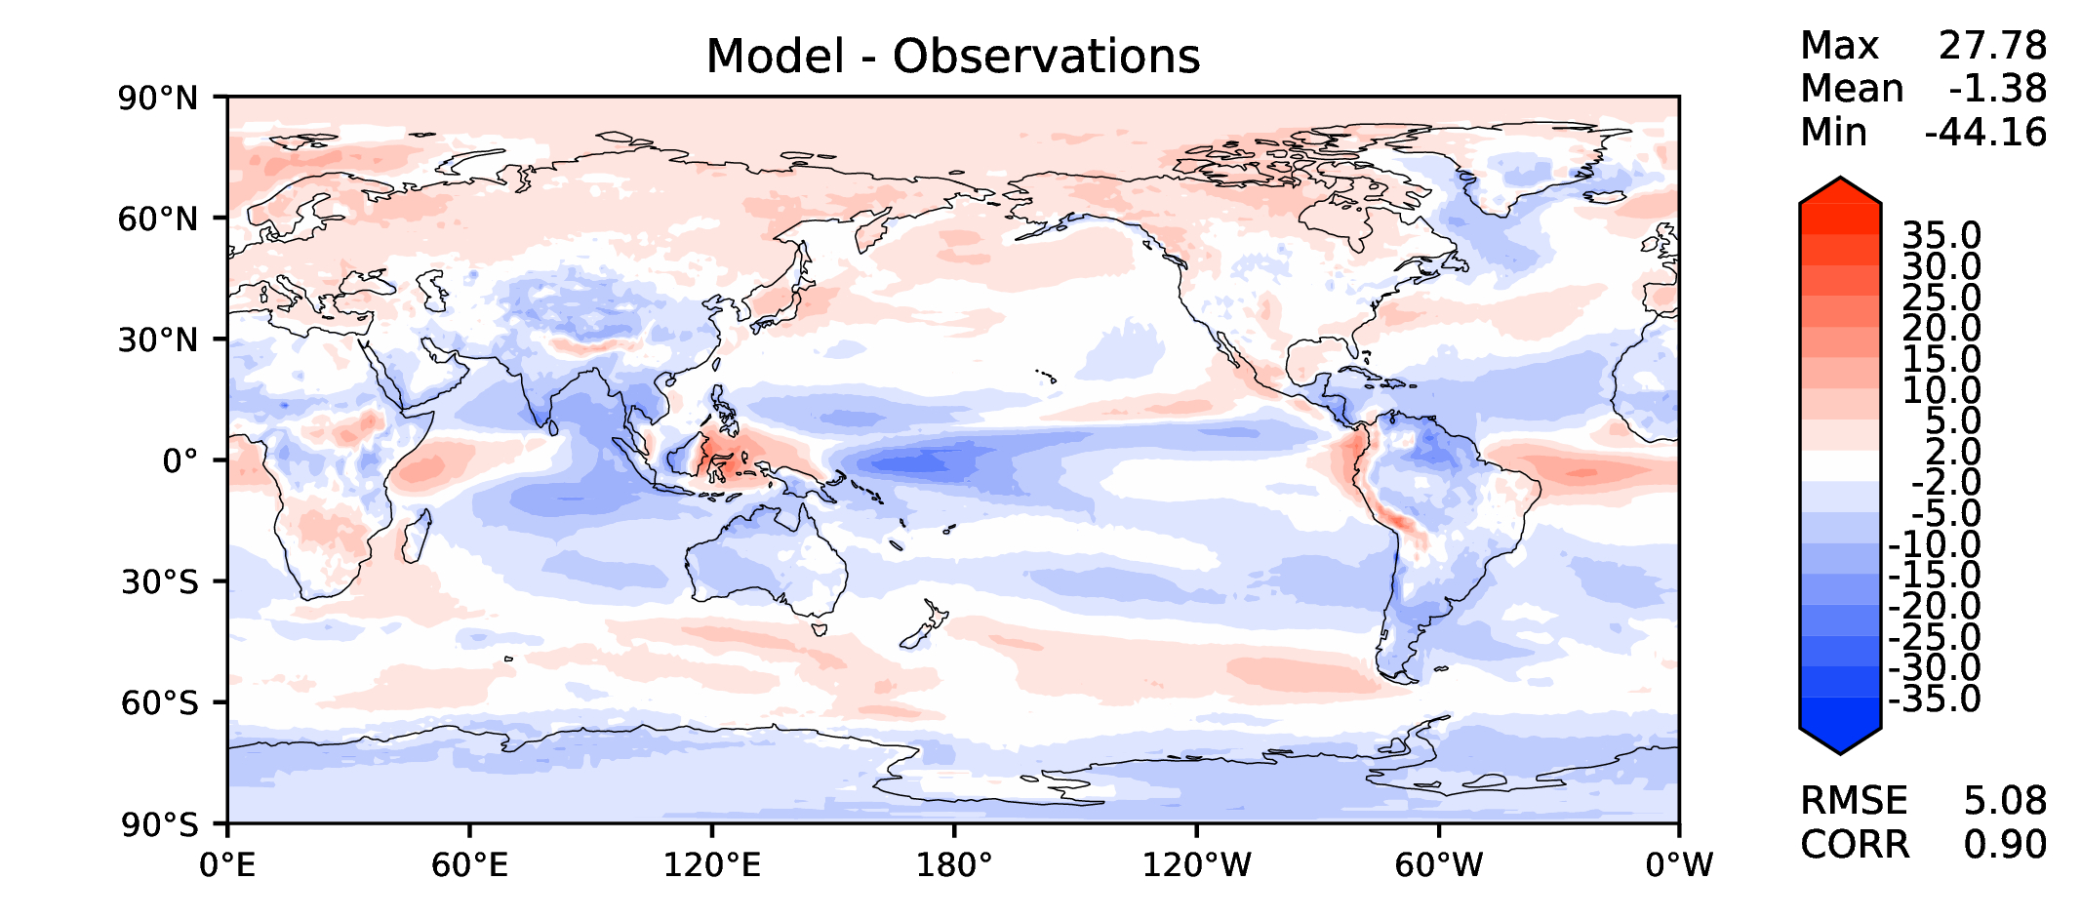
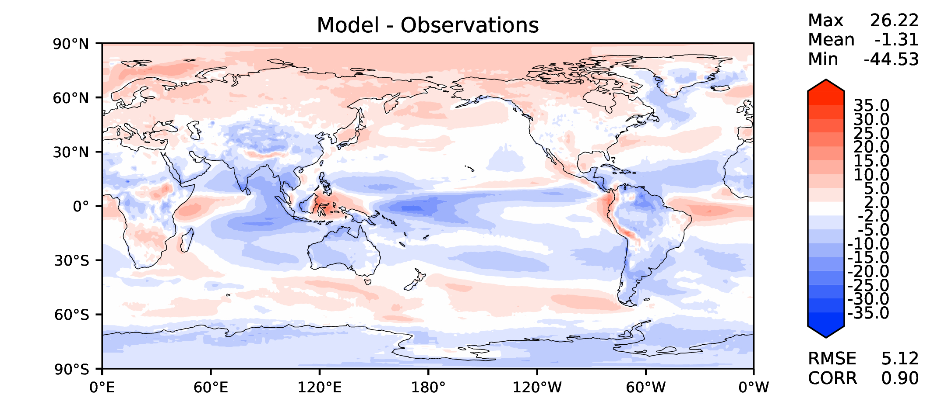
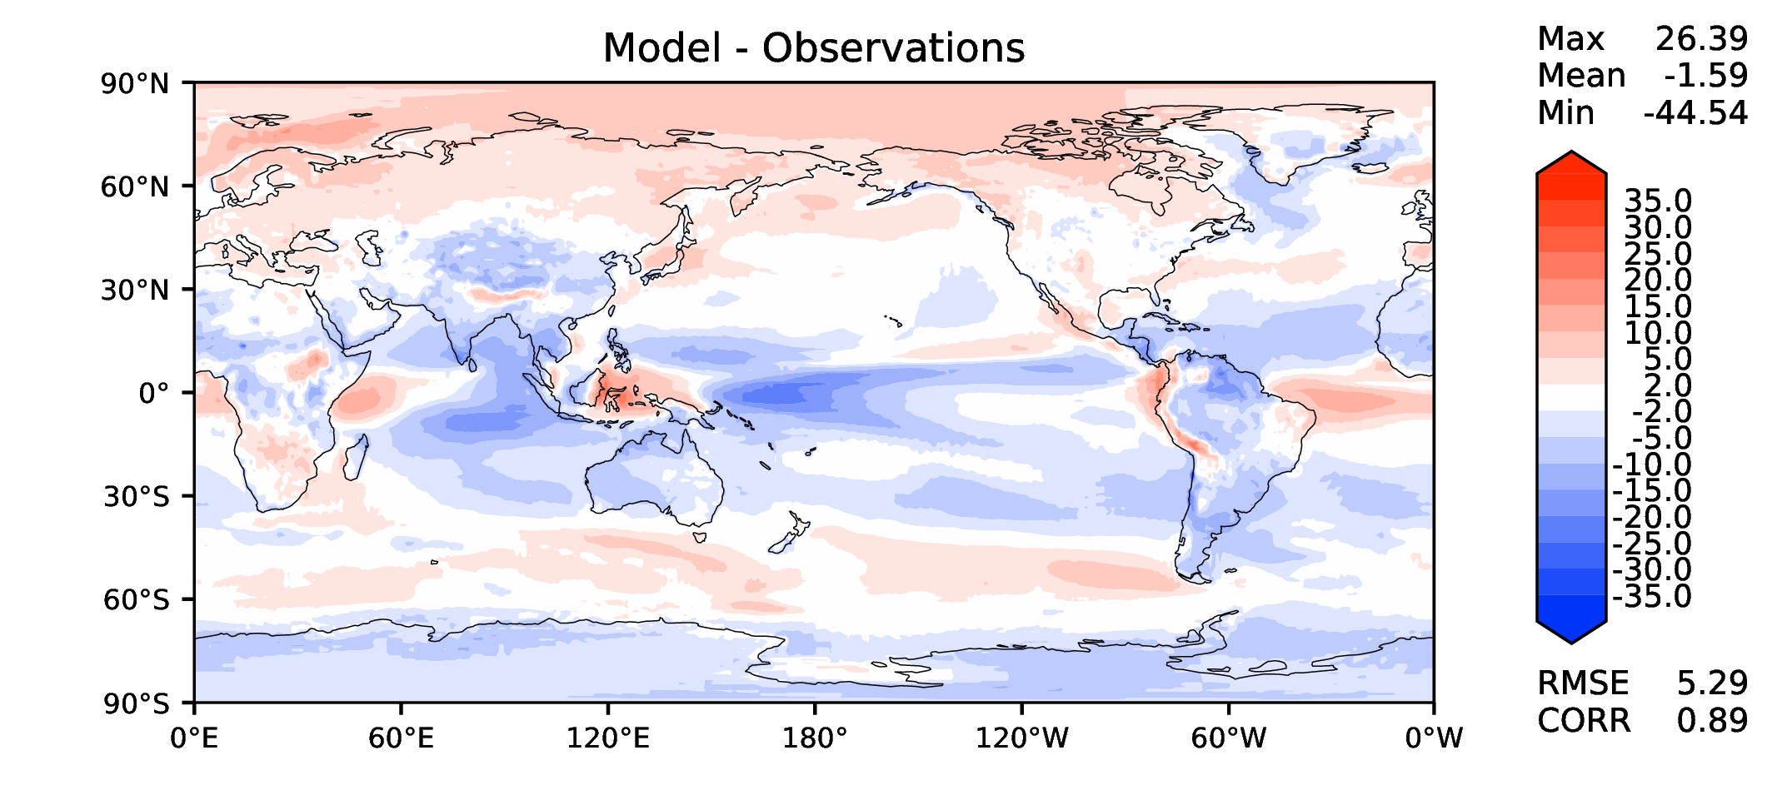
Annual TOA LW CRE
DECKv1b
v2rc2c
v2rc1c
v2beta4

Slide 11
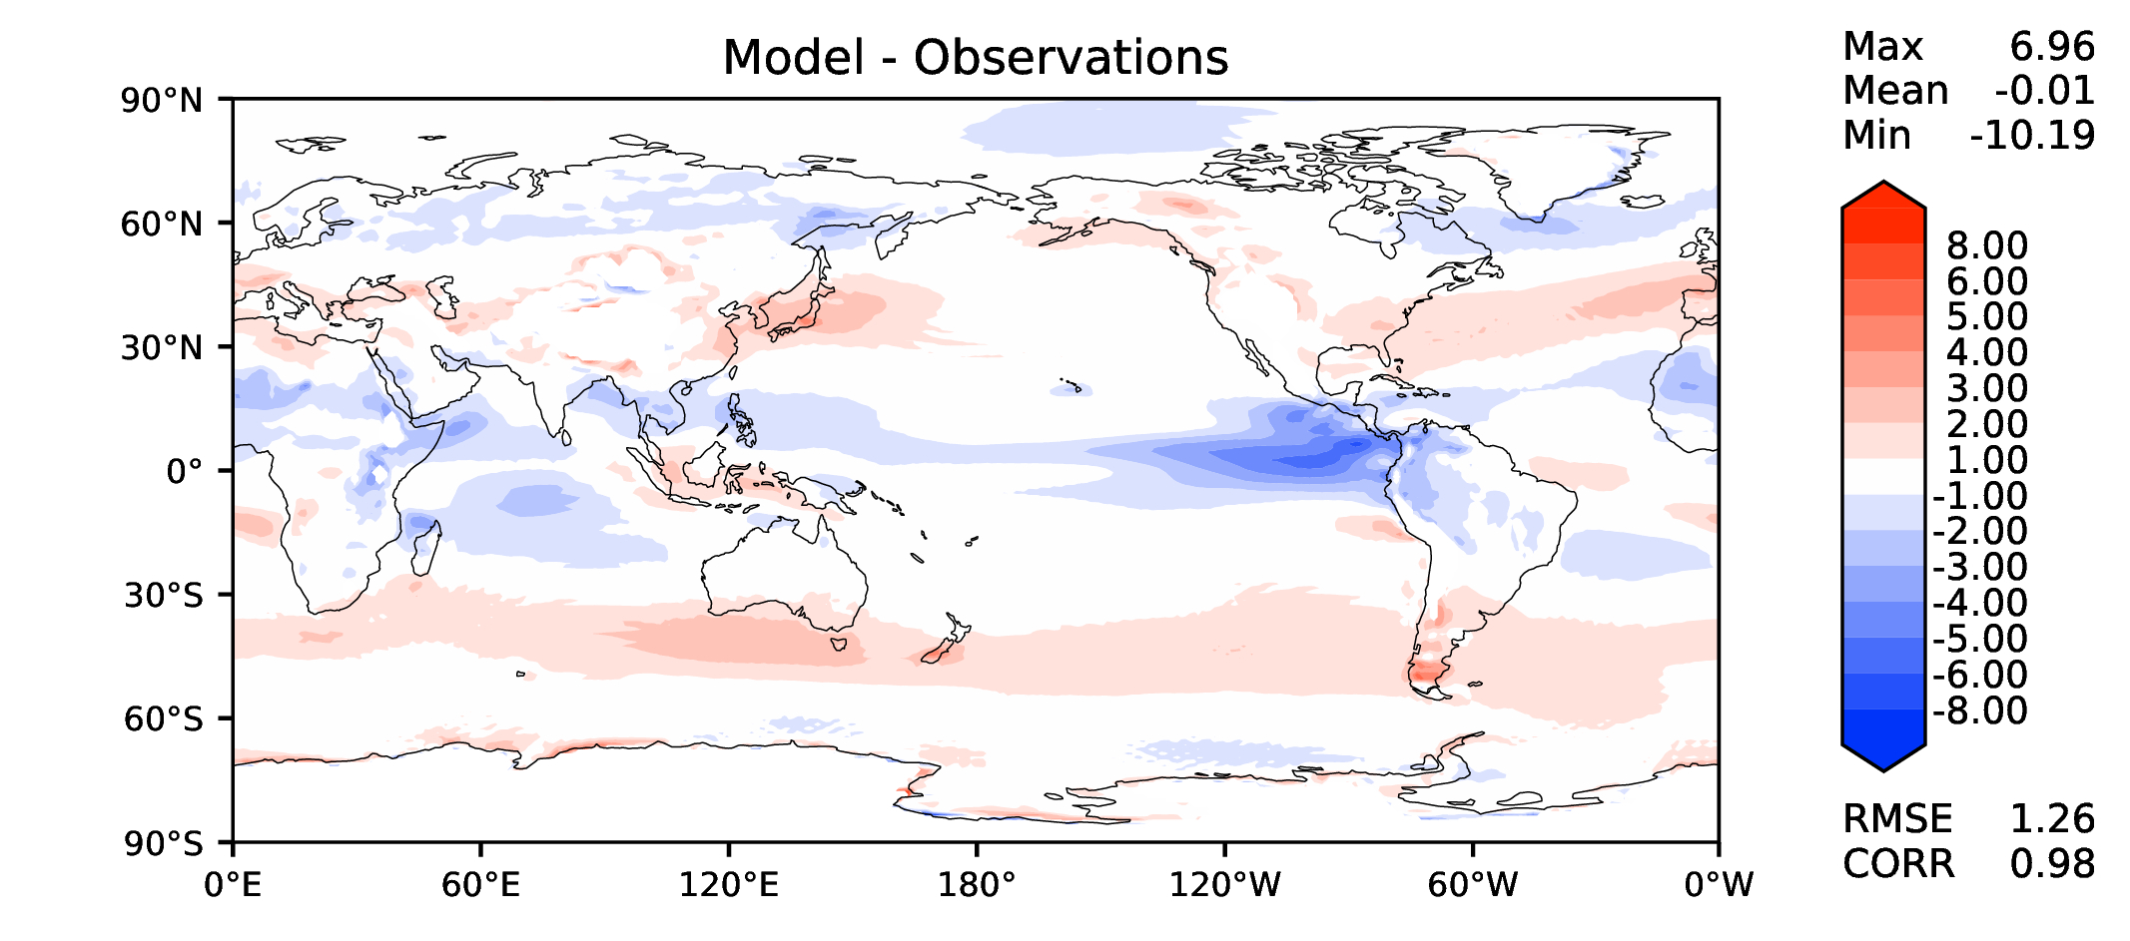
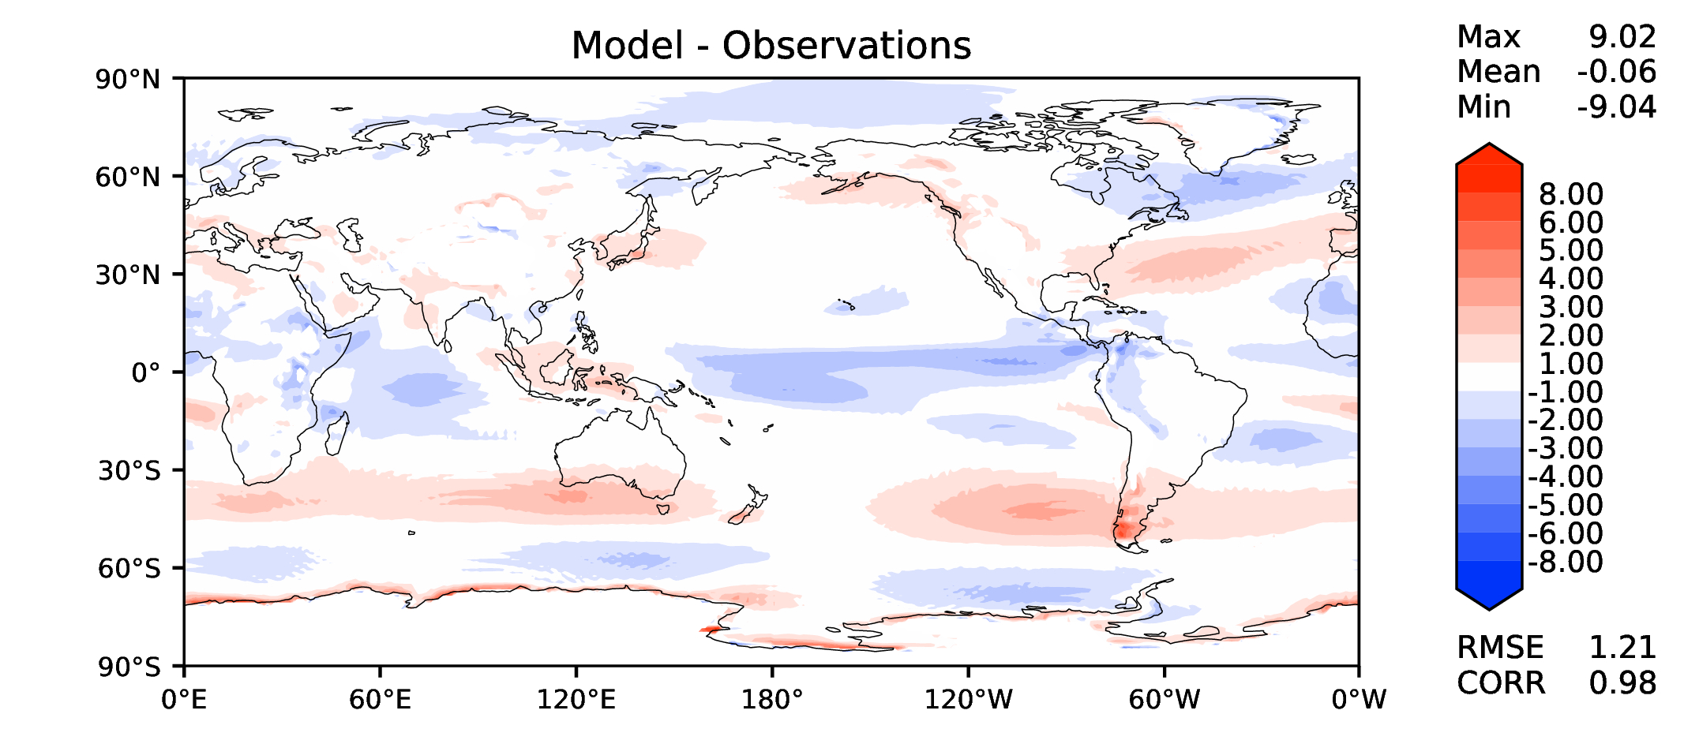
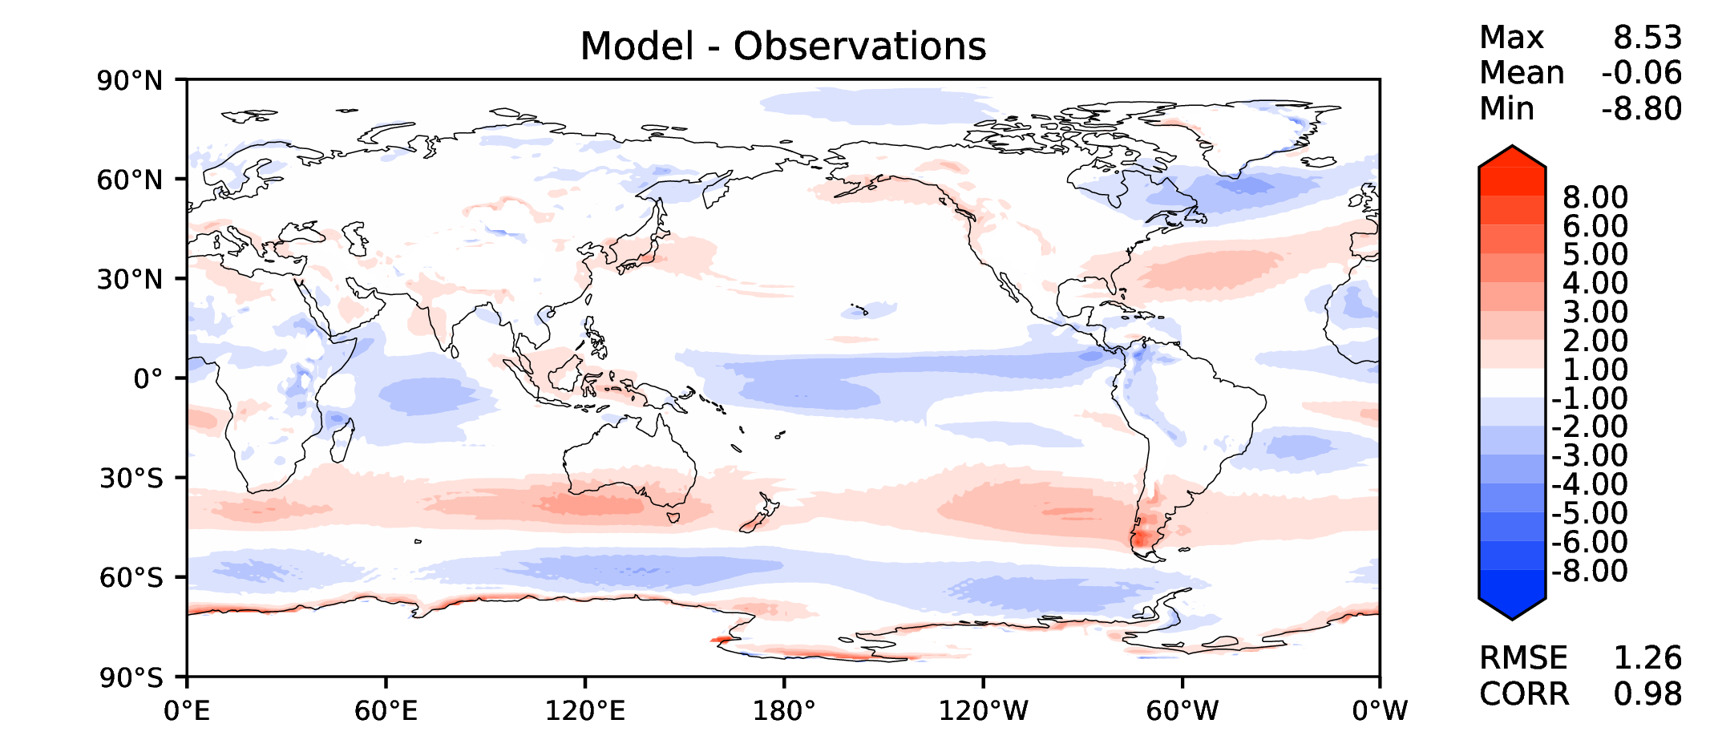
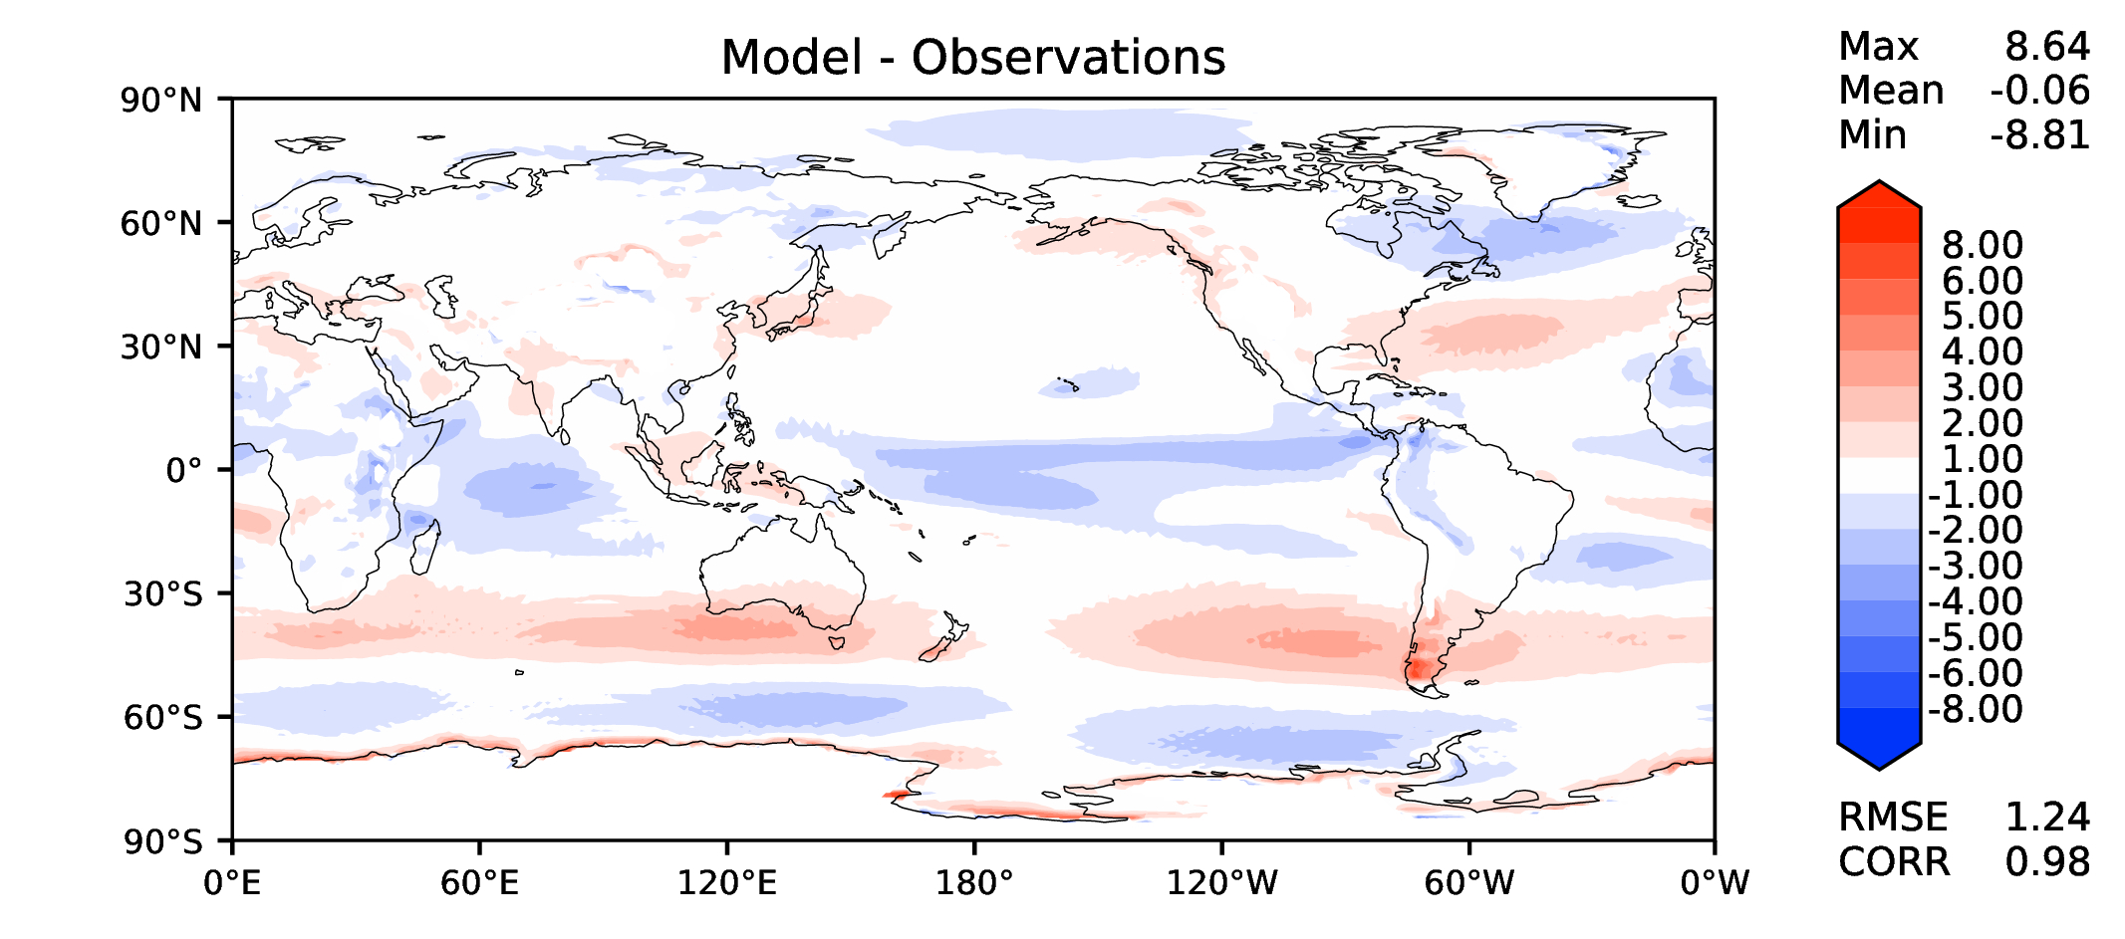
Annual u wind at 850 hPa
DECKv1b
v2rc2c
v2rc1c
v2beta4

Slide 12
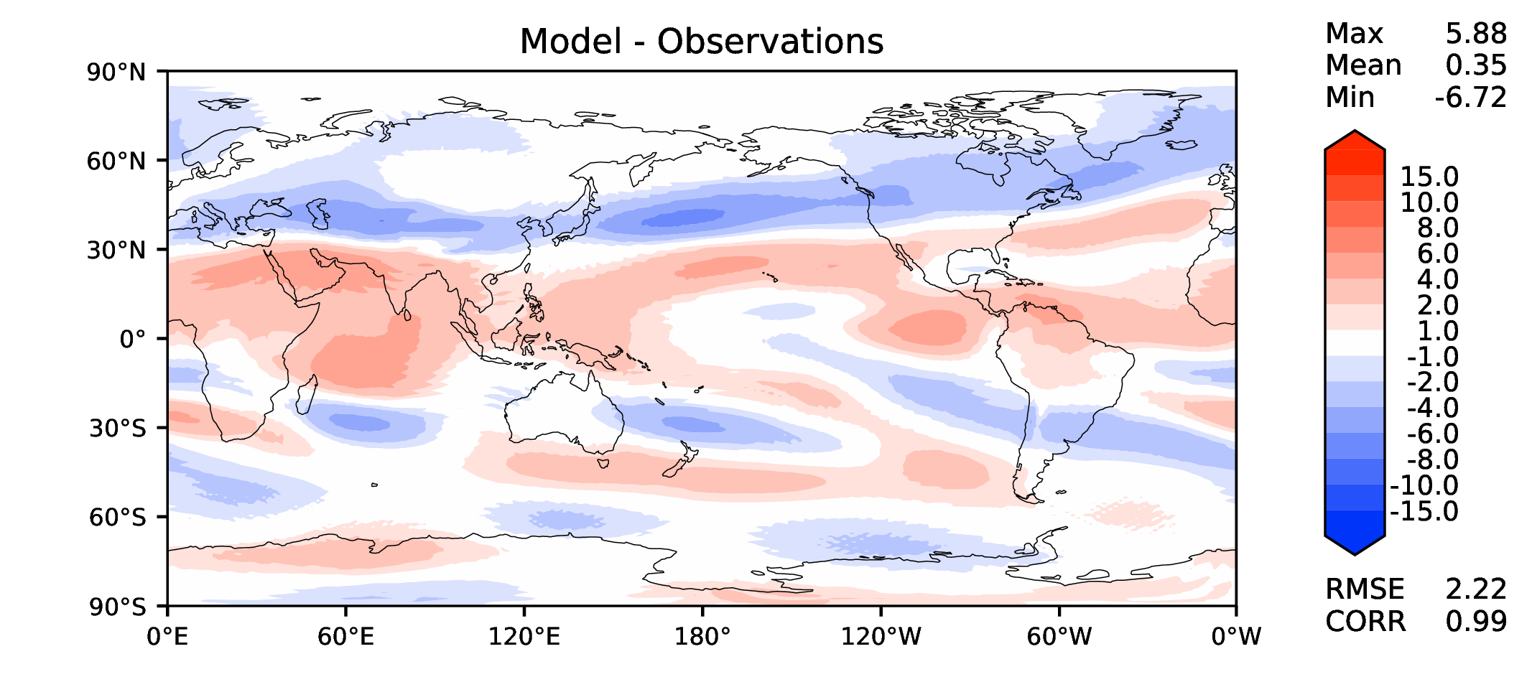
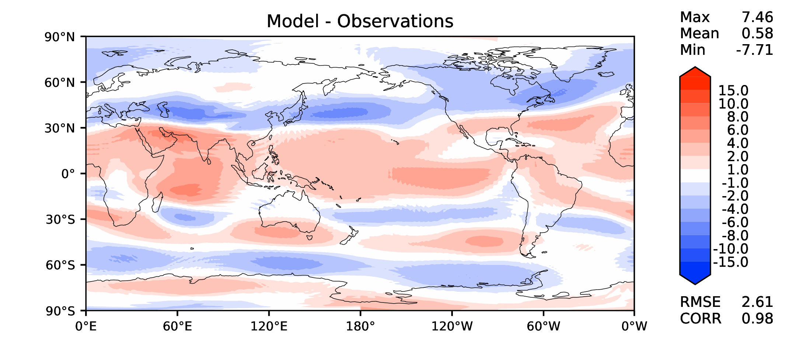
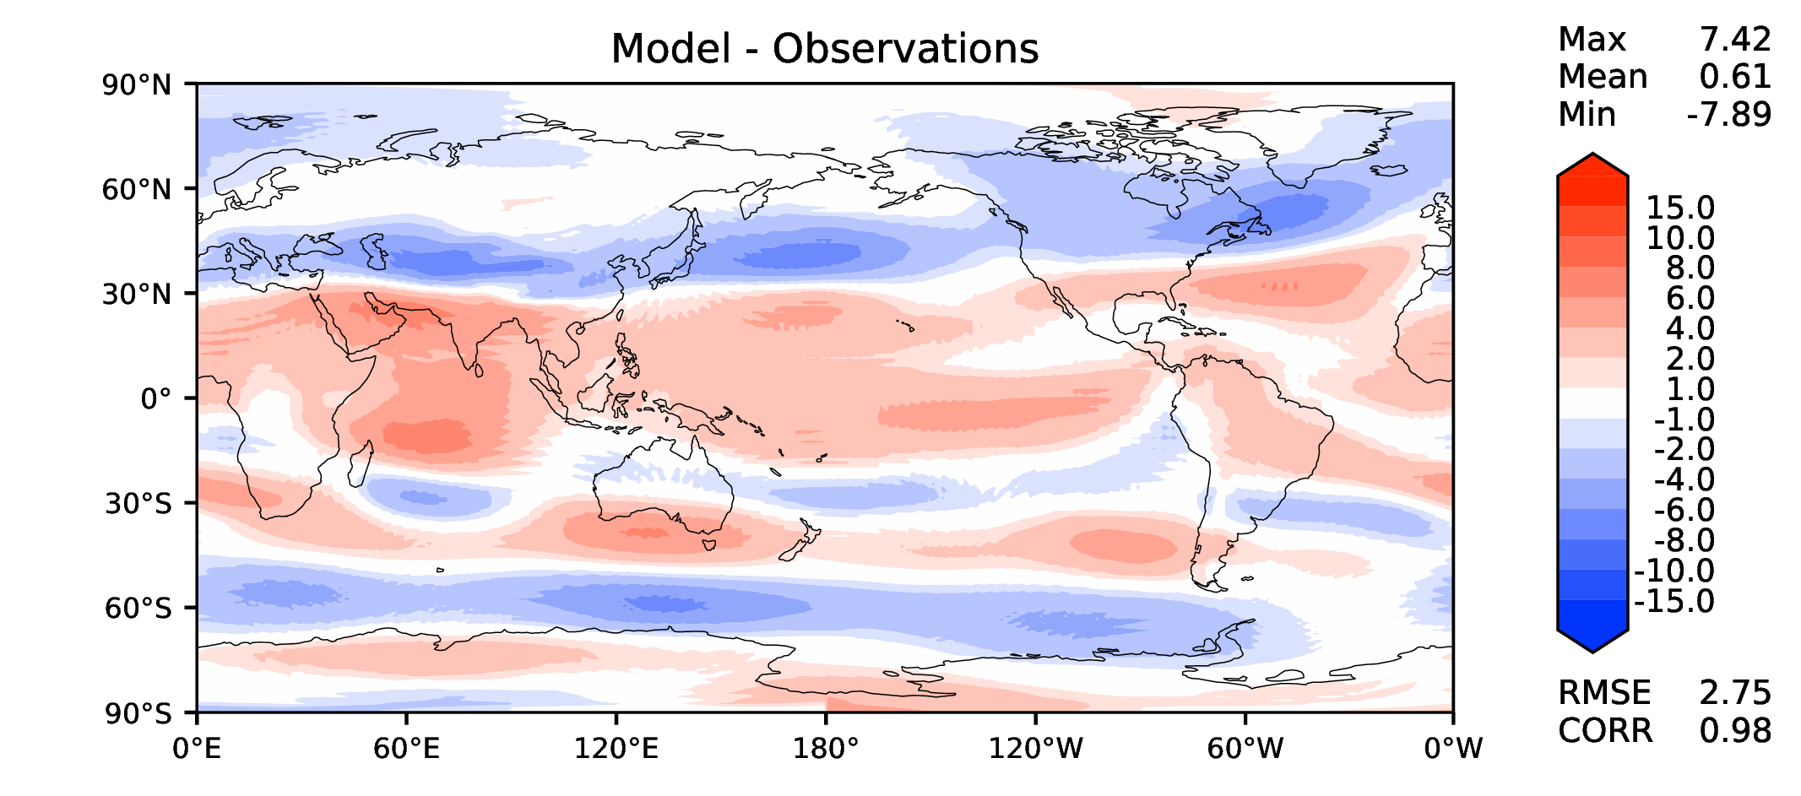
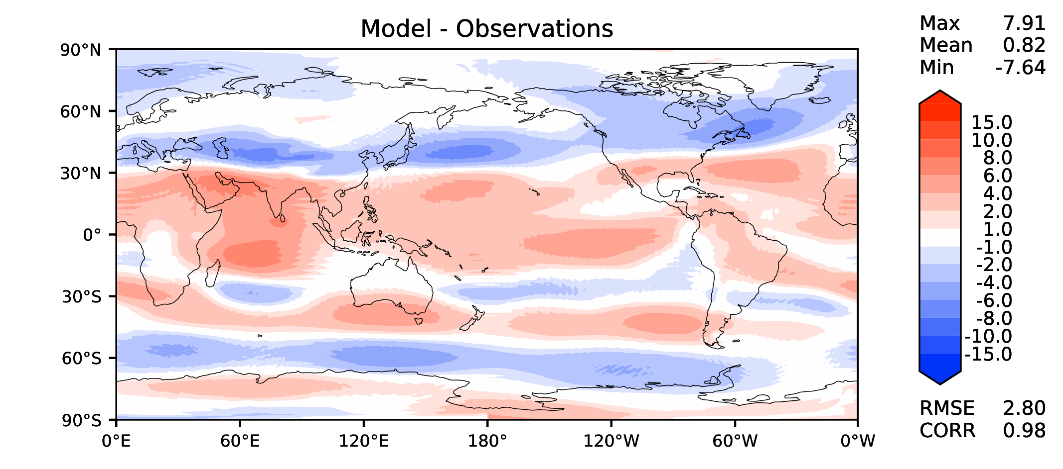
Annual u wind at 200 hPa
DECKv1b
v2rc2c
v2rc1c
v2beta4

Slide 13
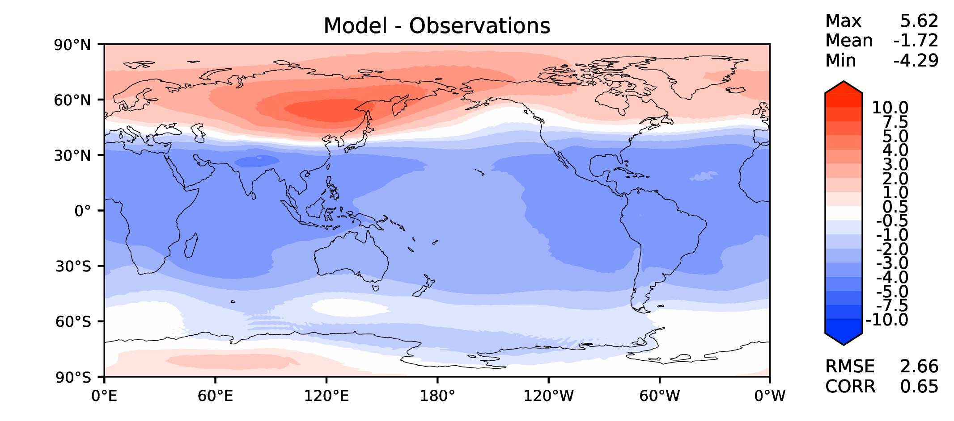
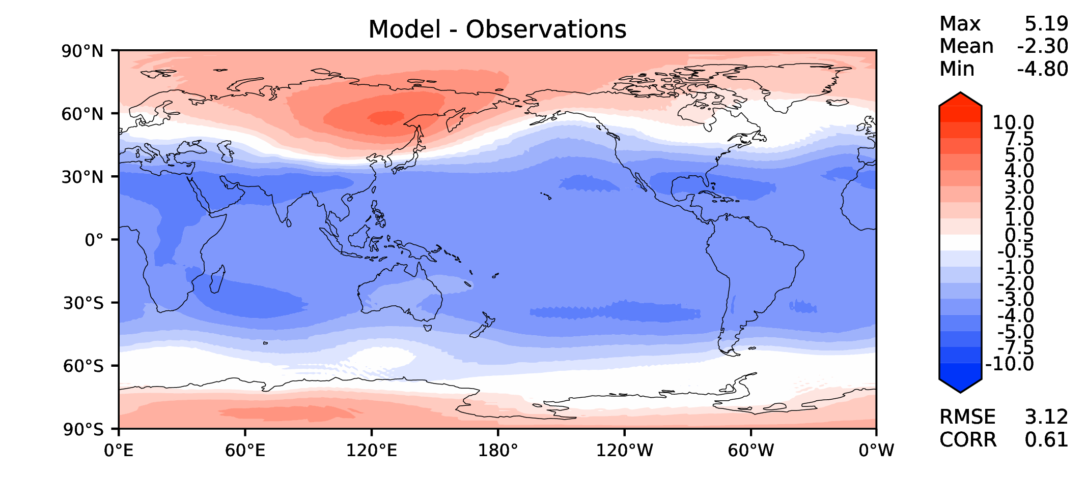
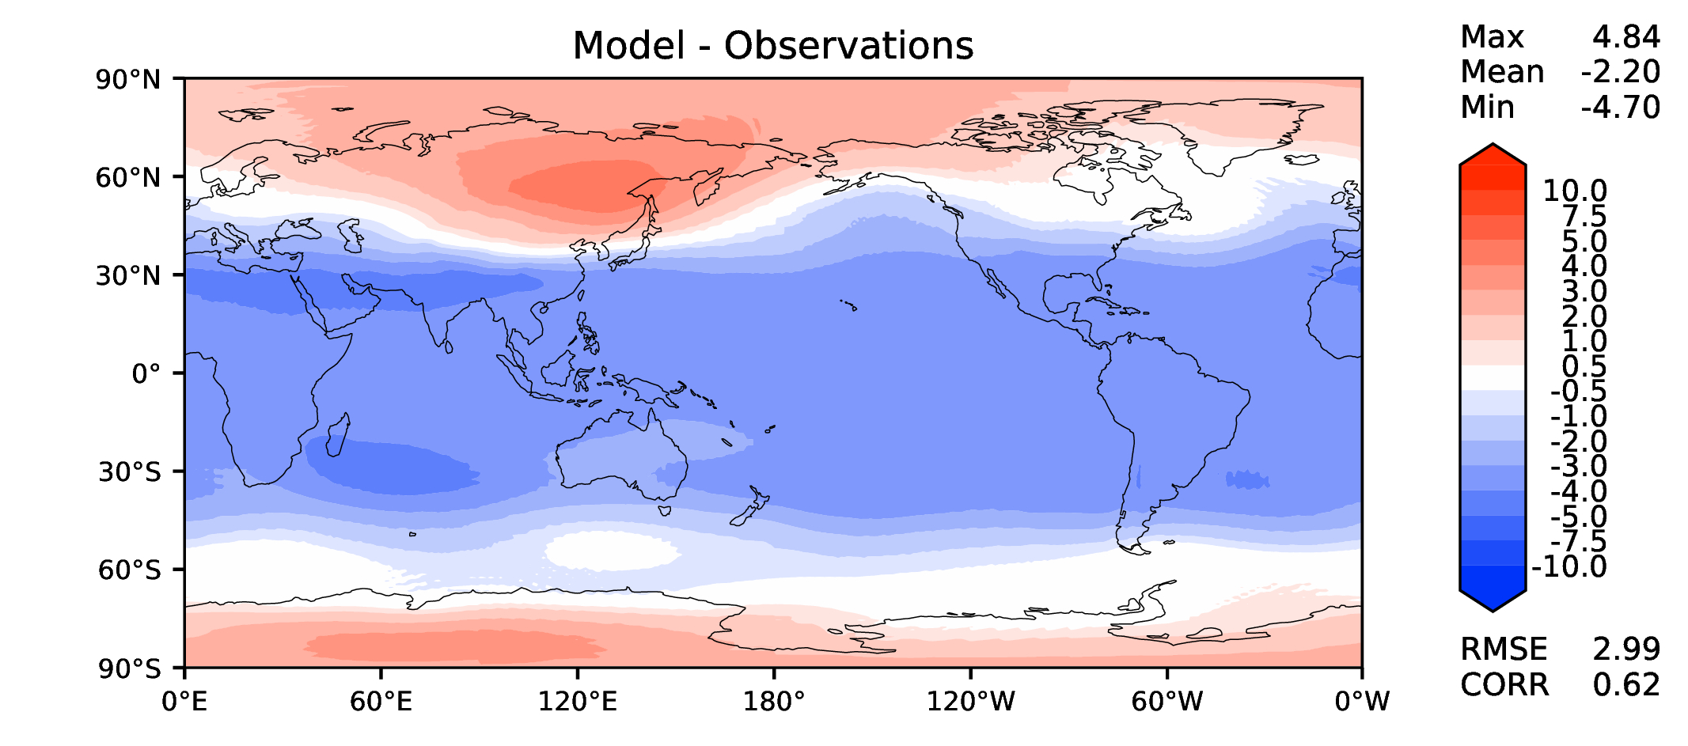
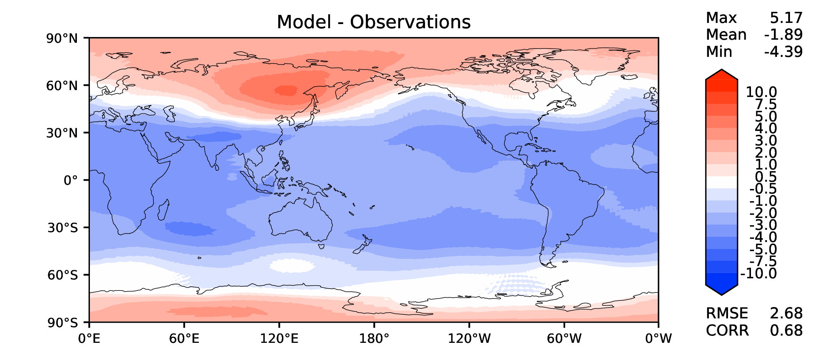
Annual T at 200 hPa
DECKv1b
v2rc2c
v2rc1c
v2beta4

Slide 14
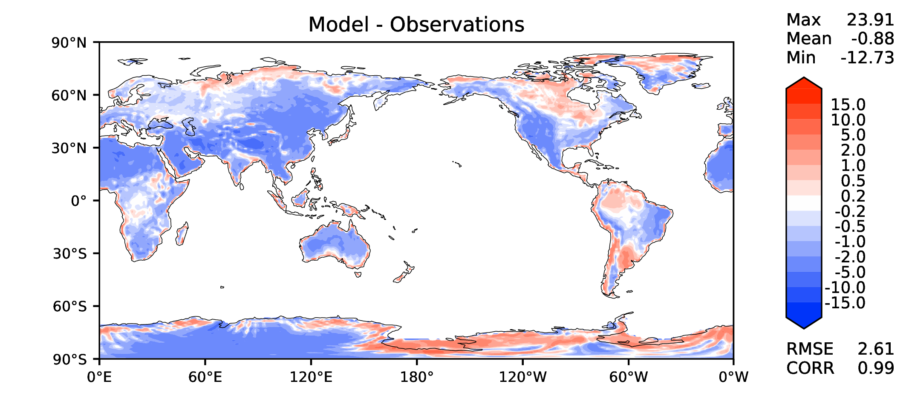
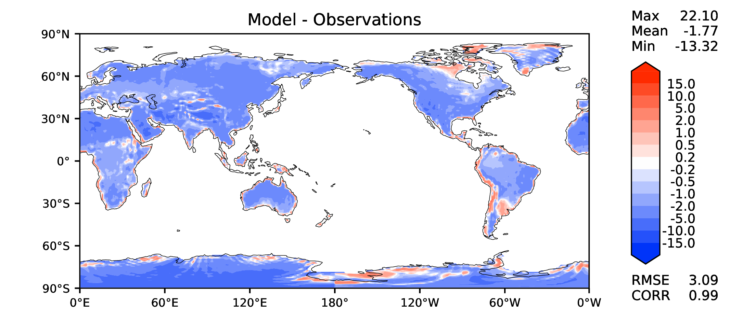
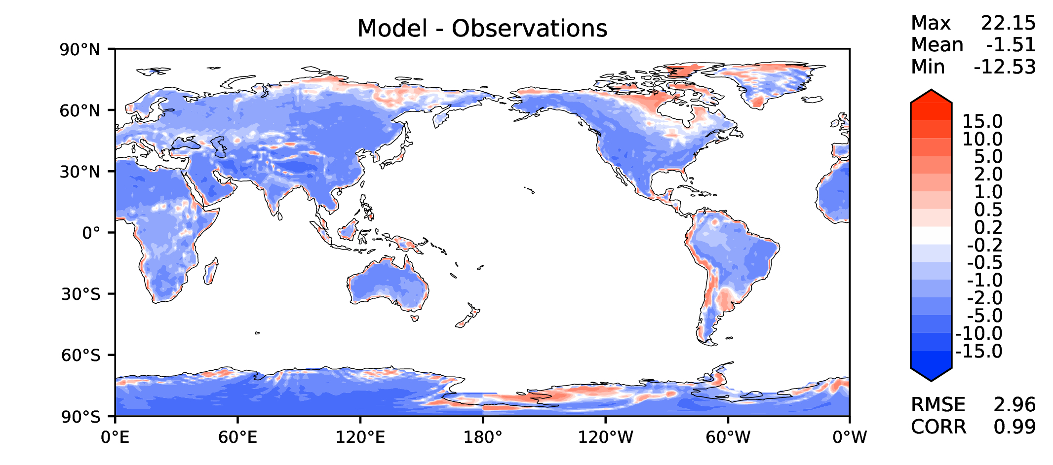

Annual surface air T (land)
DECKv1b
v2rc2c
v2rc1c
v2beta4

Slide 15




JJA surface air T (land)
DECKv1b
v2rc2c
v2rc1c
v2beta4

Slide 16




Aerosol optical depth
DECKv1b
v2rc2c
v2rc1c
v2beta4

Slide 17




TAUXY ANN ocean
DECKv1b
v2rc2c
v2rc1c
v2beta4

