Slide 1
Summary table (RMSE vs obs)
Variable | Season | v2beta4 | v2rc1c | v2rc1e | v2rc1e_1
SST | ANN | 1.23 | 1.16 | 1.20 | 1.24
PRECT | ANN | 1.05 | 0.99 | 0.97 | 1.01
PRECT | DJF | 1.40 | 1.39 | 1.31 | 1.39
PRECT | MAM | 1.33 | 1.24 | 1.23 | 1.27
PRECT | JJA | 1.46 | 1.37 | 1.33 | 1.37
PRECT | SON | 1.36 | 1.34 | 1.24 | 1.31
RESTOM | ANN | 8.46 | 8.42 | 8.64 | 8.44
SWCF | ANN | 9.96 | 9.95 | 10.27 | 9.94
LWCF | ANN | 5.45 | 5.26 | 5.07 | 5.53
u850 | ANN | 1.20 | 1.26 | 1.17 | 1.21
u200 | ANN | 3.04 | 2.90 | 2.78 | 2.84
T200 | ANN | 2.39 | 2.68 | 3.09 | 3.27
TREFHT | ANN | 2.76 | 2.88 | 3.07 | 3.16
TREFHT | JJA | 3.05 | 3.03 | 3.23 | 3.23
AODVIS | ANN | 0.06 | 0.06 | 0.06 | 0.06
TAUXY | ANN | 0.02 | 0.02 | 0.02 | 0.02
CLDLWP_OCN | ANN | 40.02 | 42.96 | 36.60 | 37.89

Slide 2
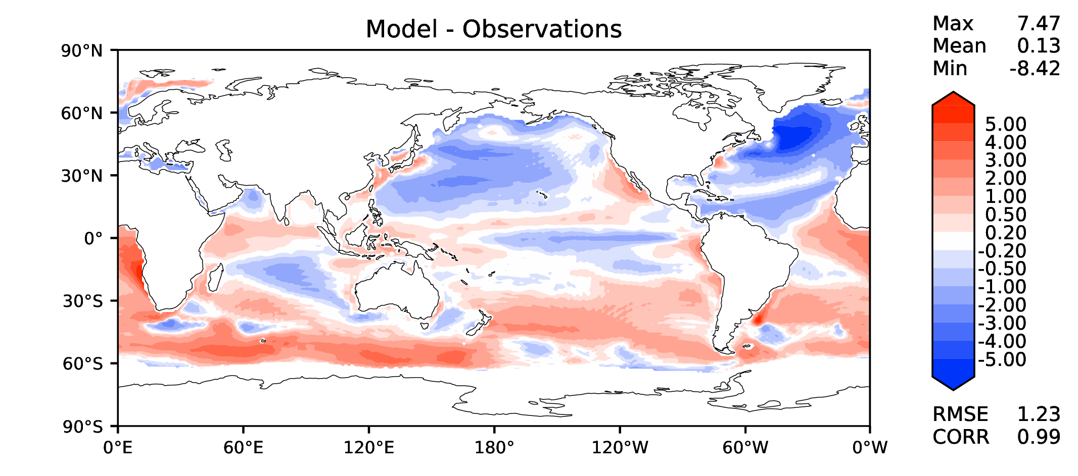
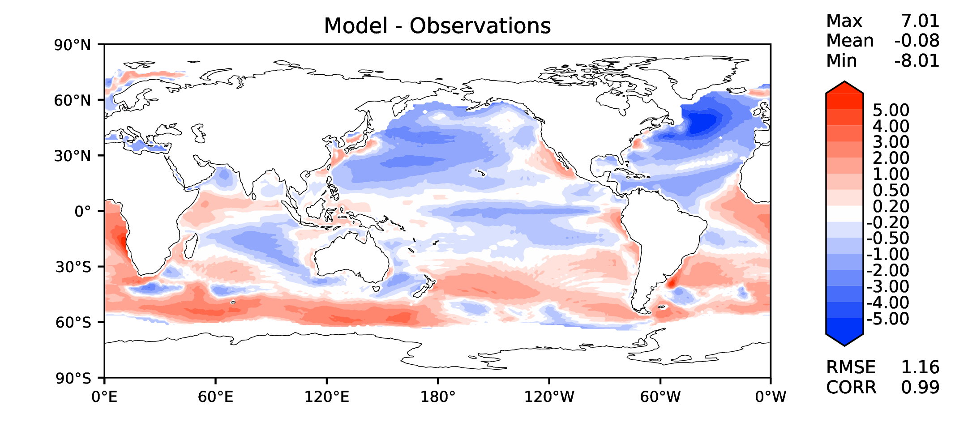
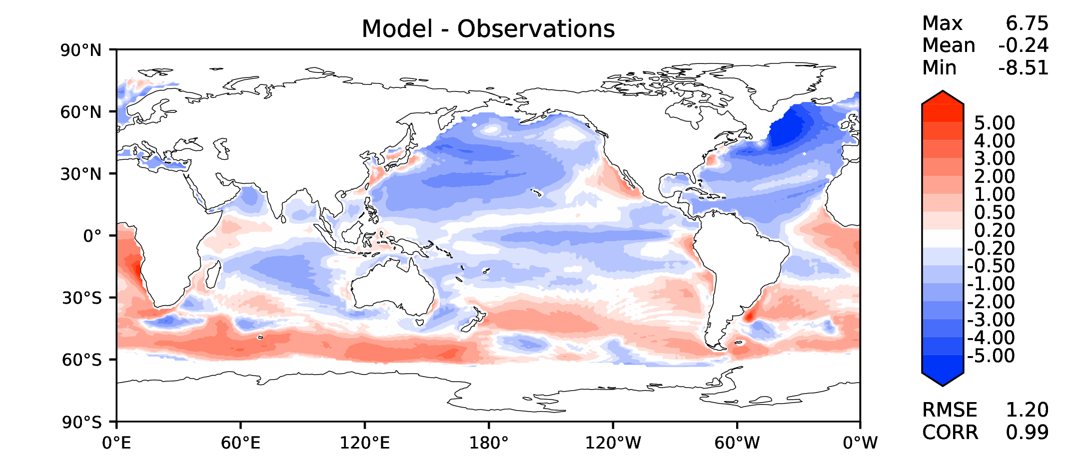
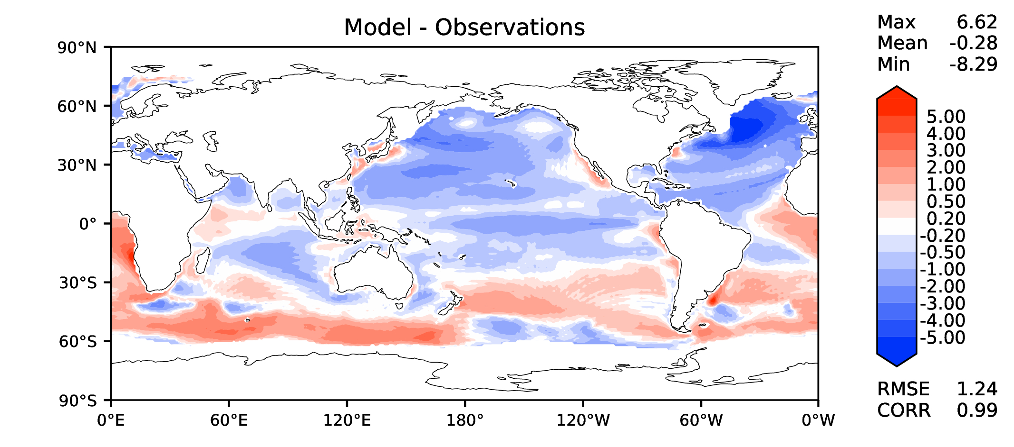
Annual SST (pre-industrial)
v2beta4
v2rc1c
v2rc1e
v2rc1e_1

Slide 3
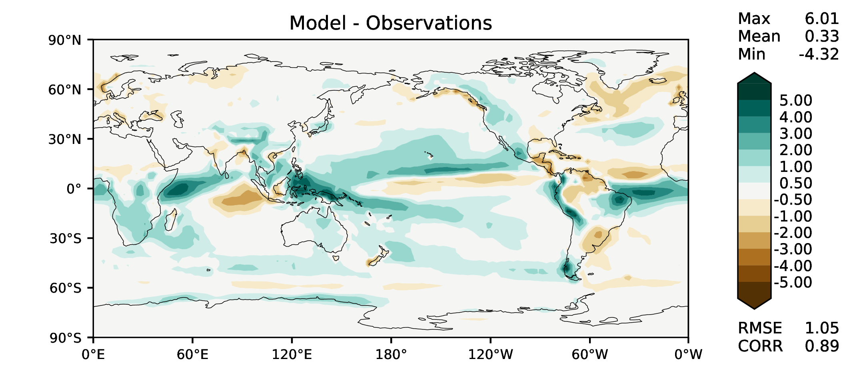
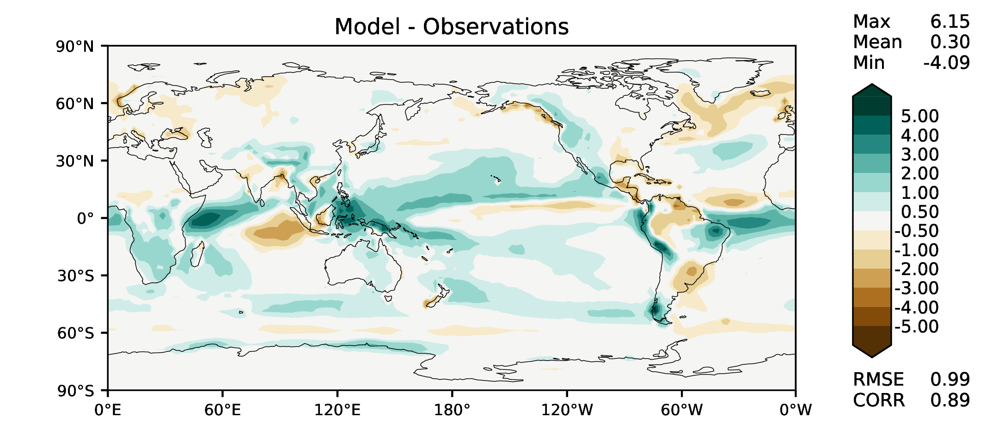
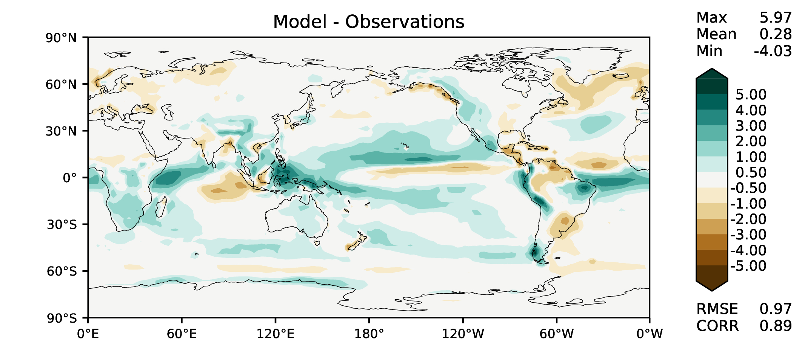
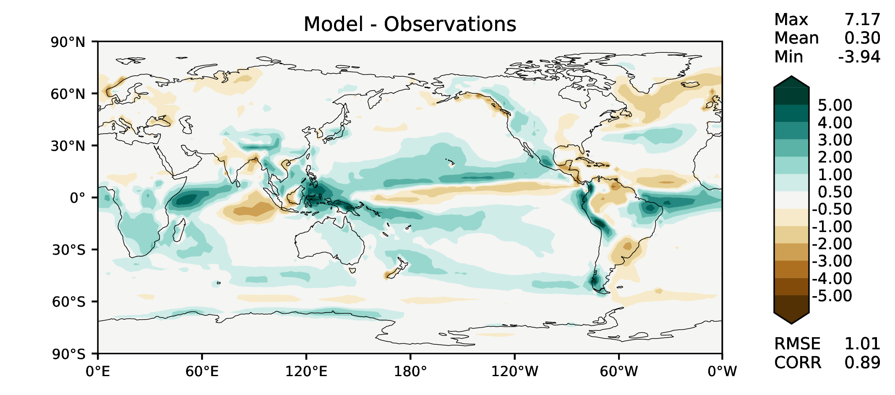
Annual total precipitation
v2beta4
v2rc1c
v2rc1e
v2rc1e_1

Slide 4
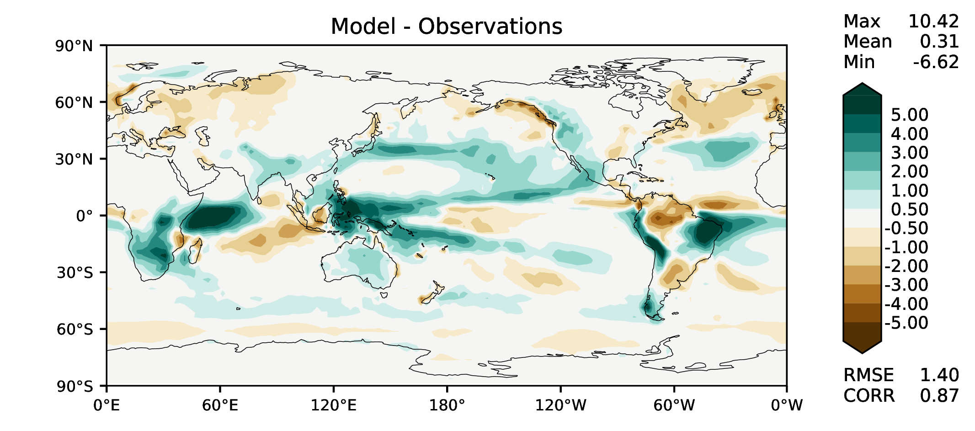


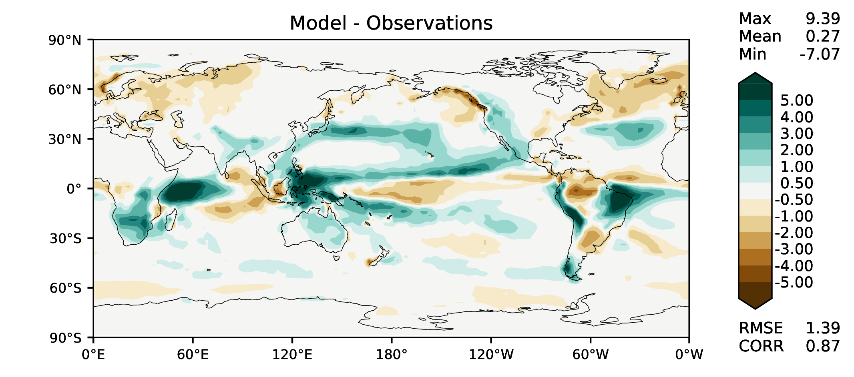
DJF total precipitation
v2beta4
v2rc1c
v2rc1e
v2rc1e_1

Slide 5
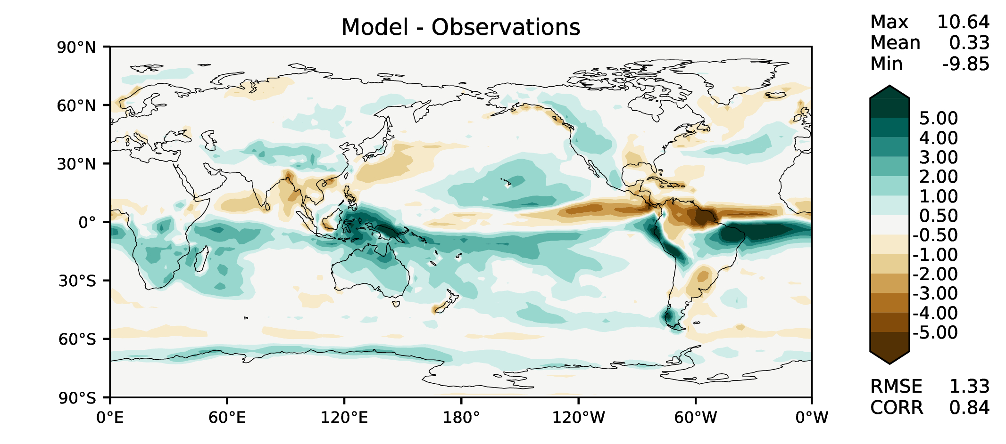
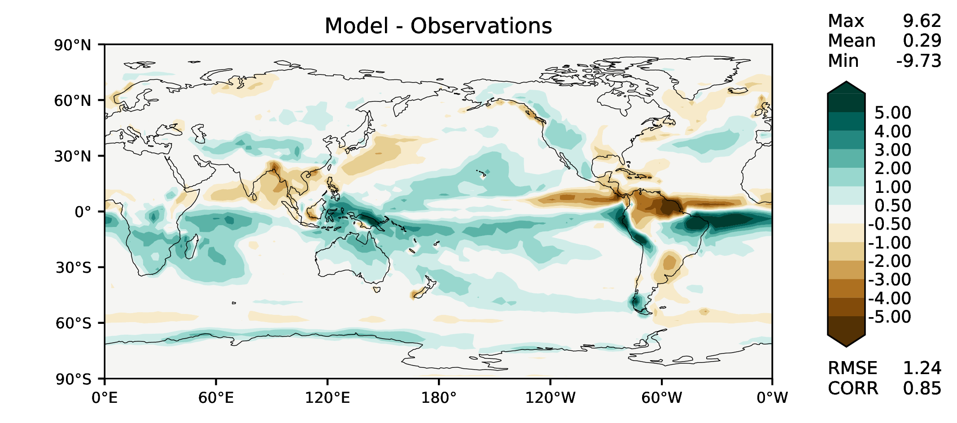
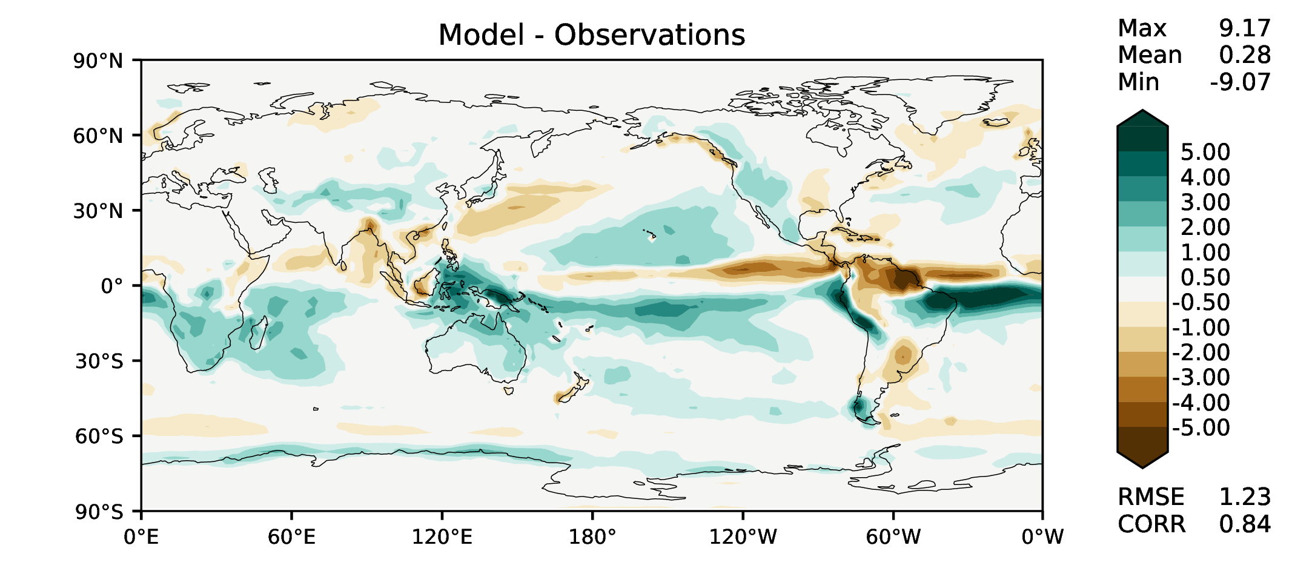

MAM total precipitation
v2beta4
v2rc1c
v2rc1e
v2rc1e_1

Slide 6
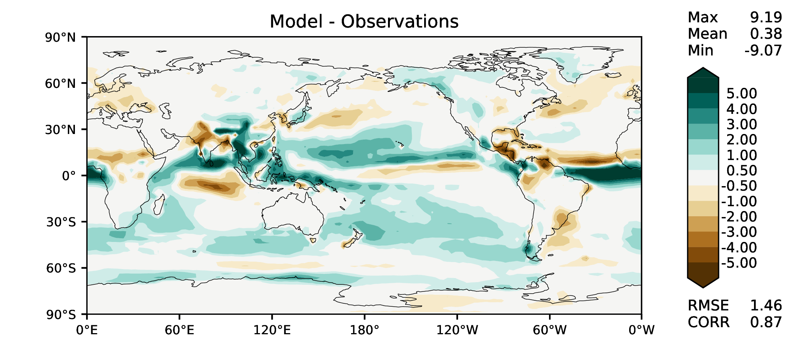
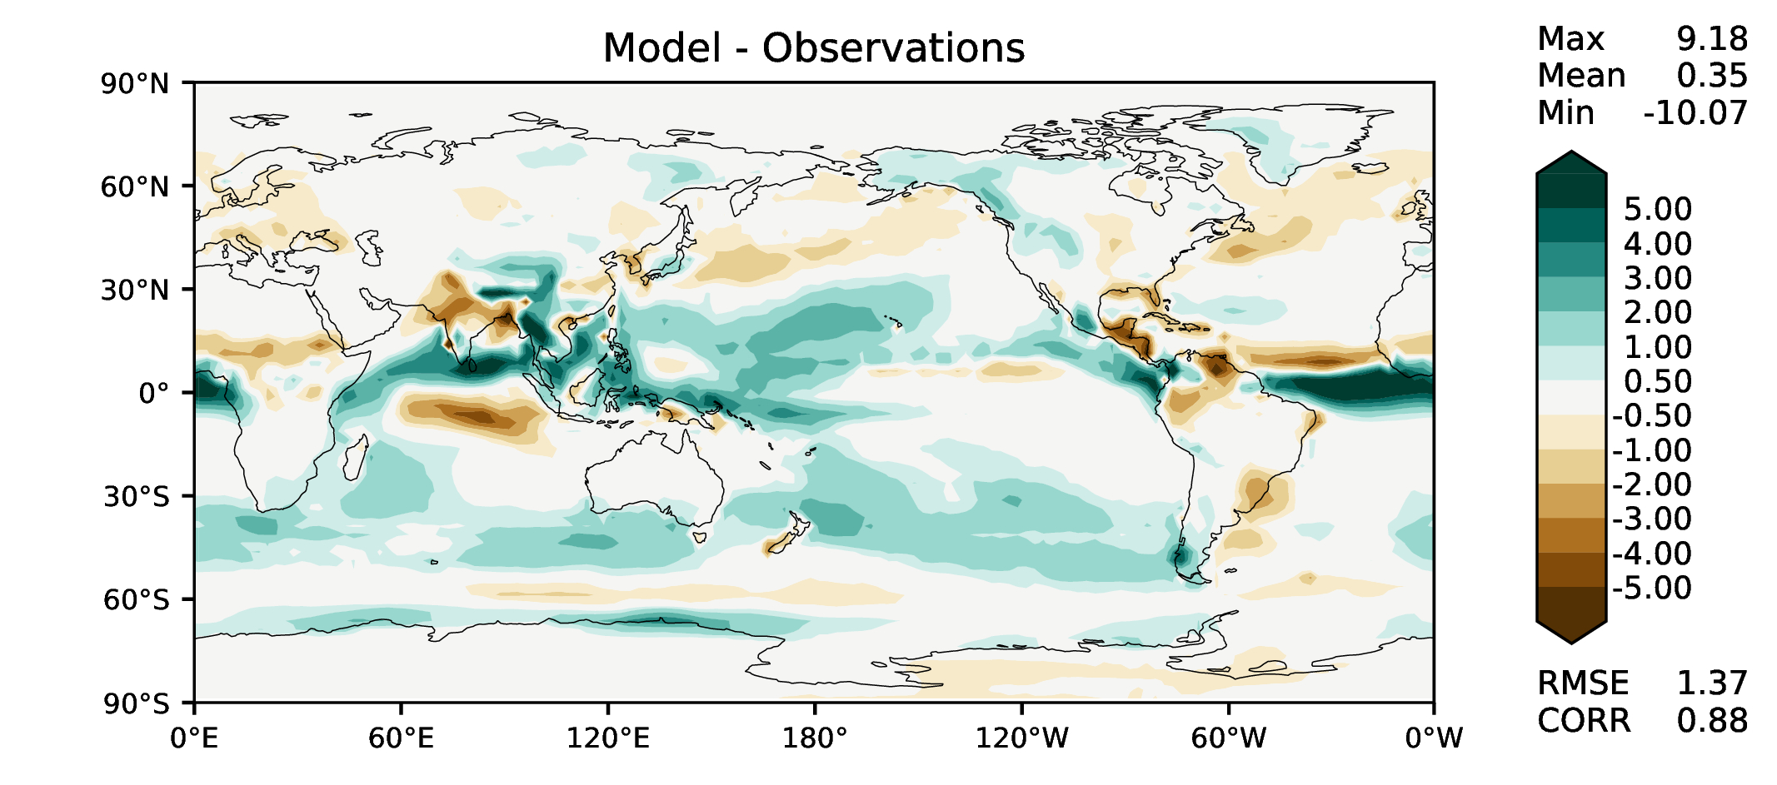
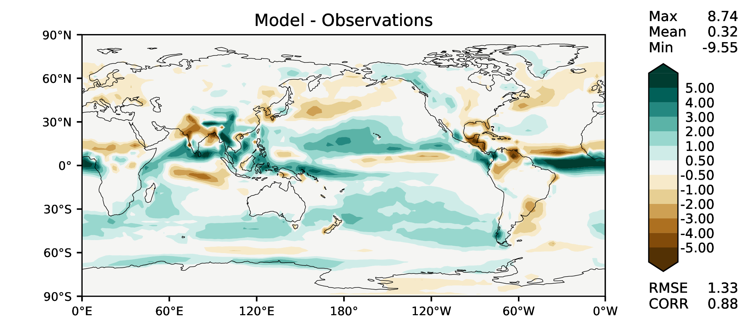
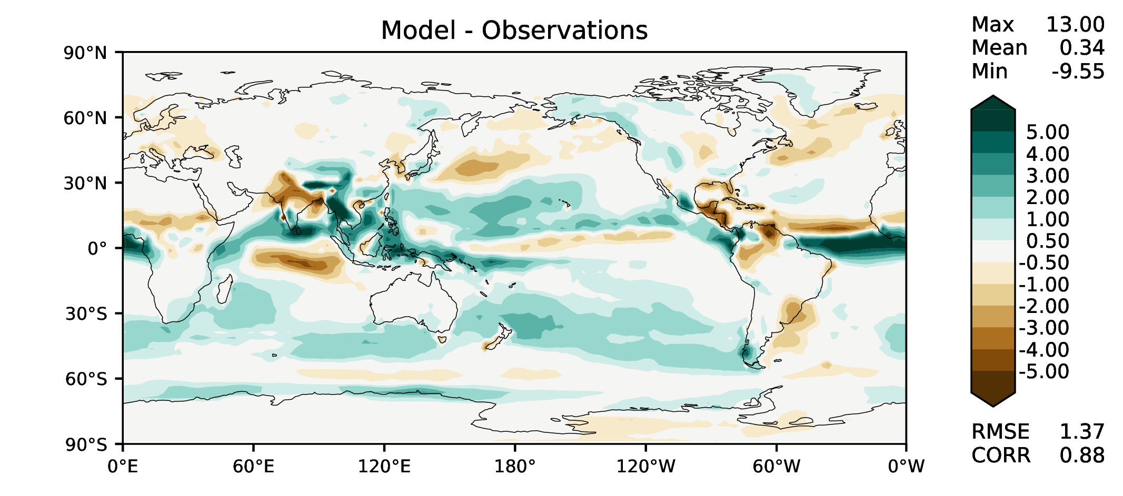
JJA total precipitation
v2beta4
v2rc1c
v2rc1e
v2rc1e_1

Slide 7
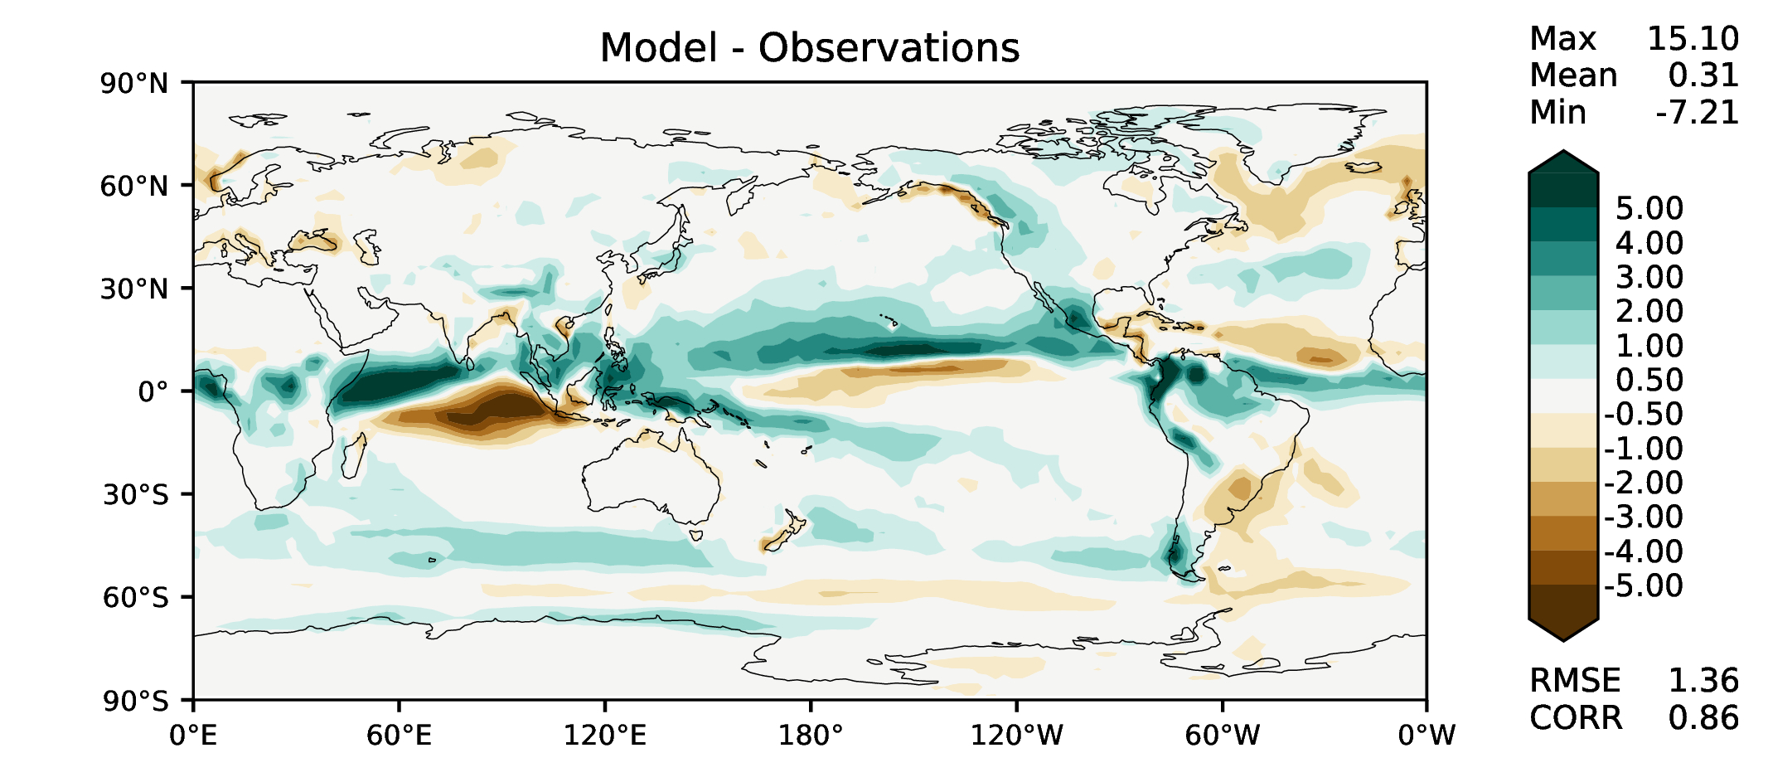
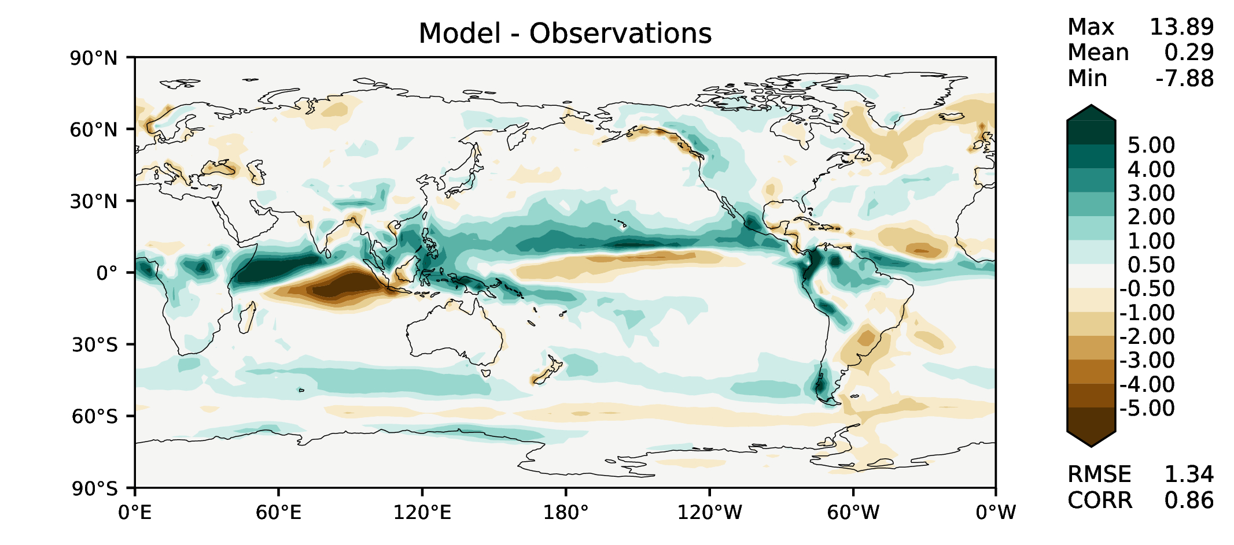
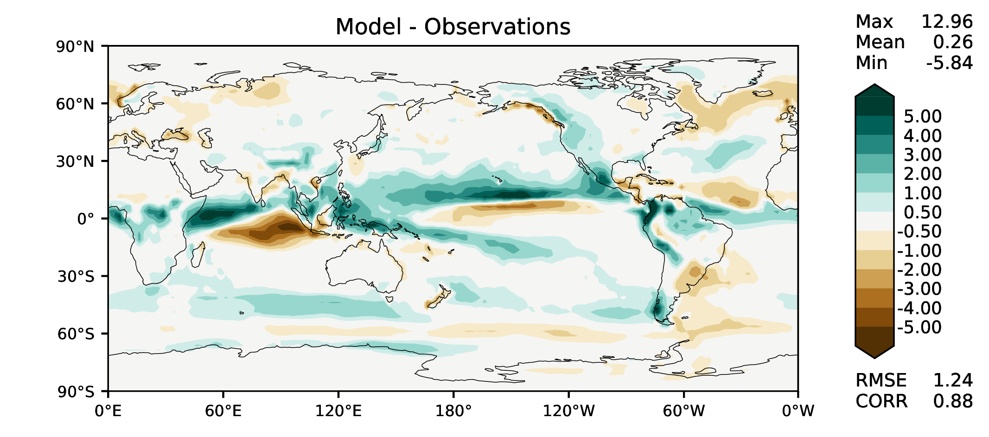
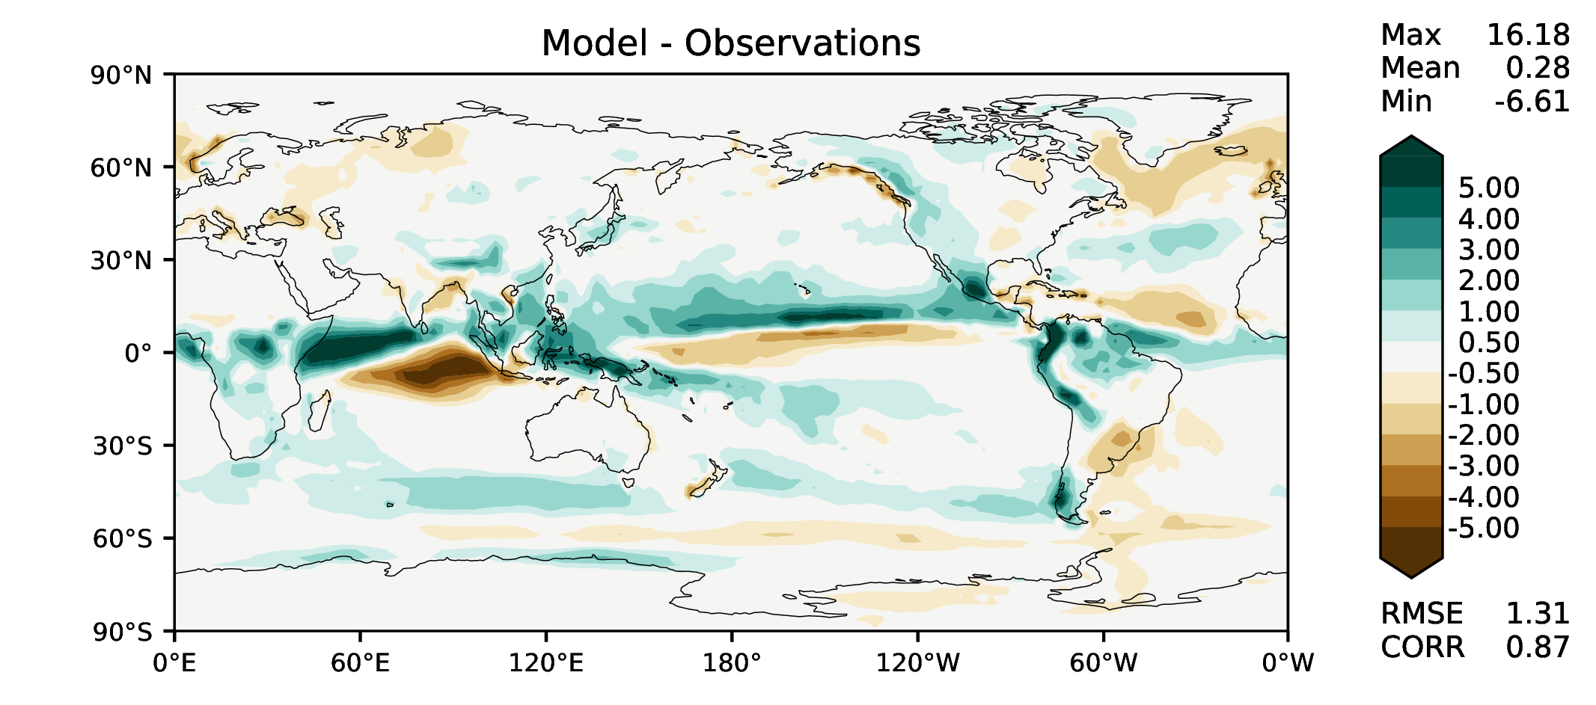
SON total precipitation
v2beta4
v2rc1c
v2rc1e
v2rc1e_1

Slide 8
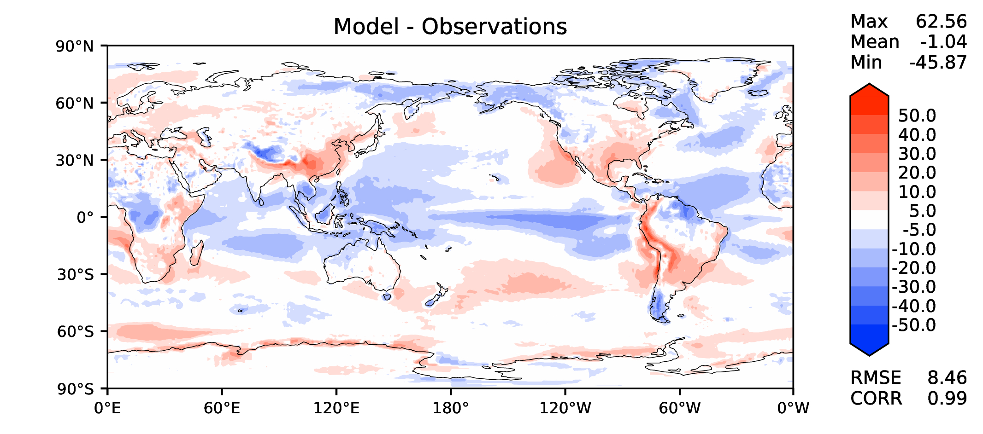
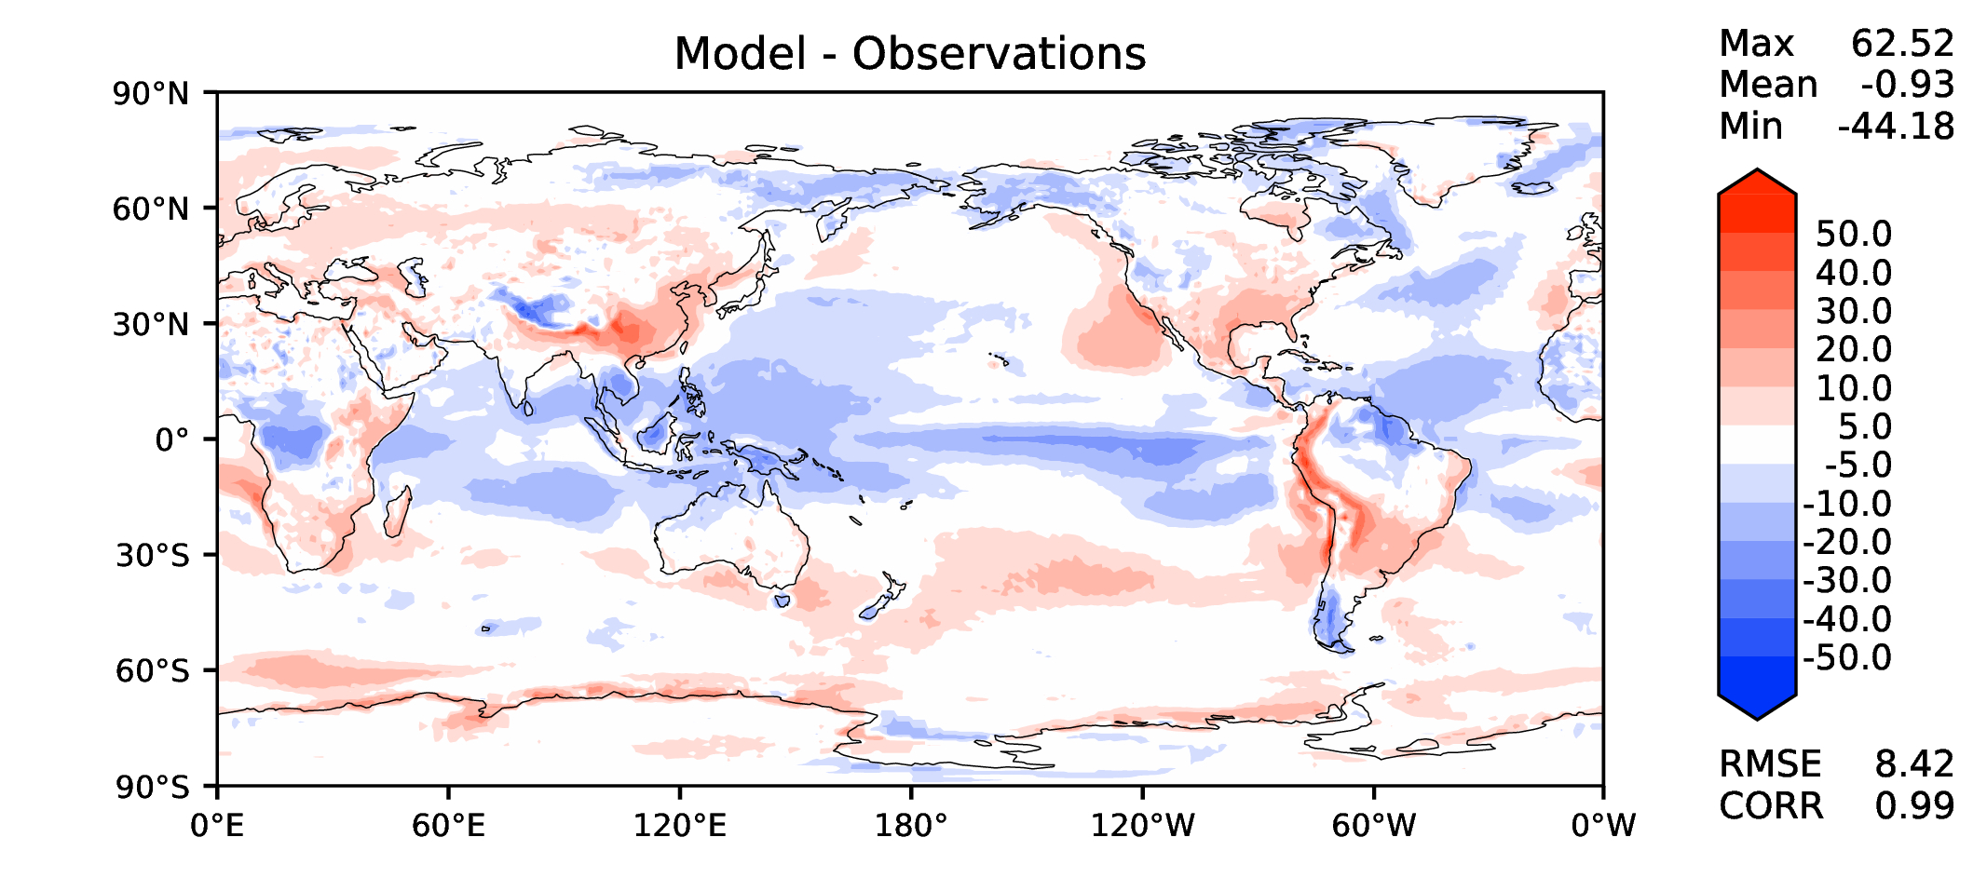
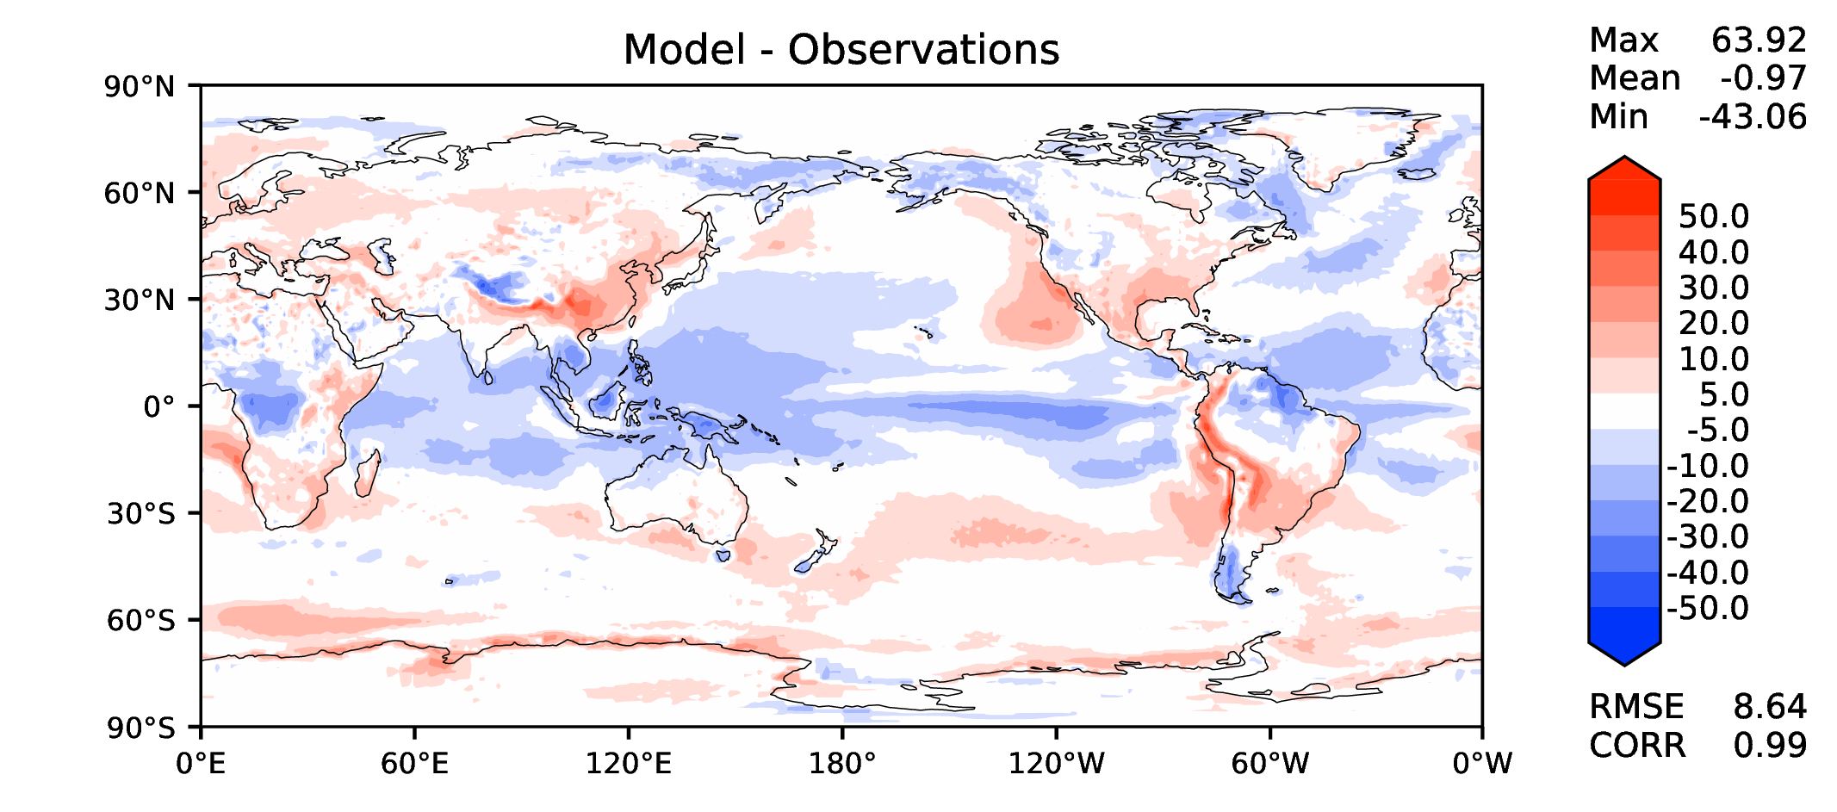
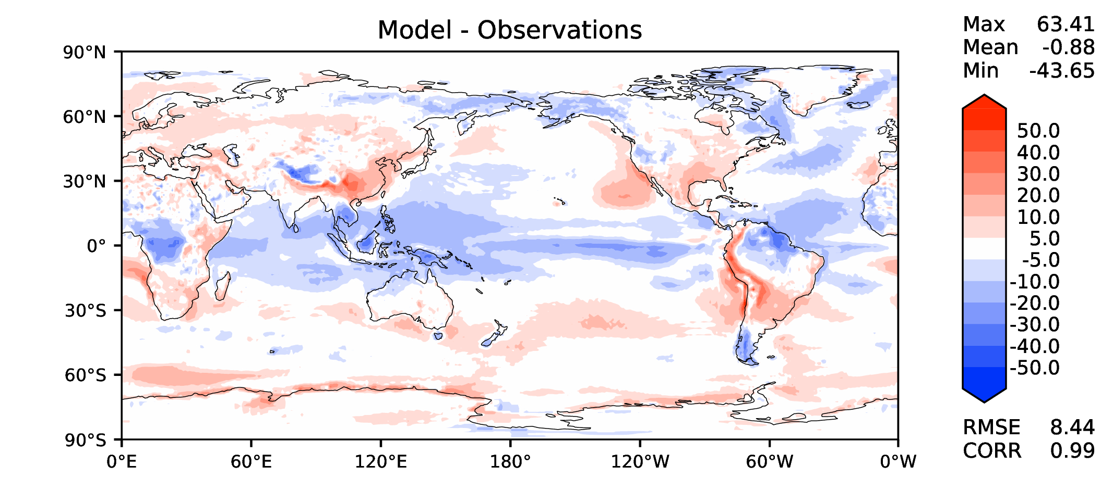
Annual TOA net radiation
v2beta4
v2rc1c
v2rc1e
v2rc1e_1

Slide 9
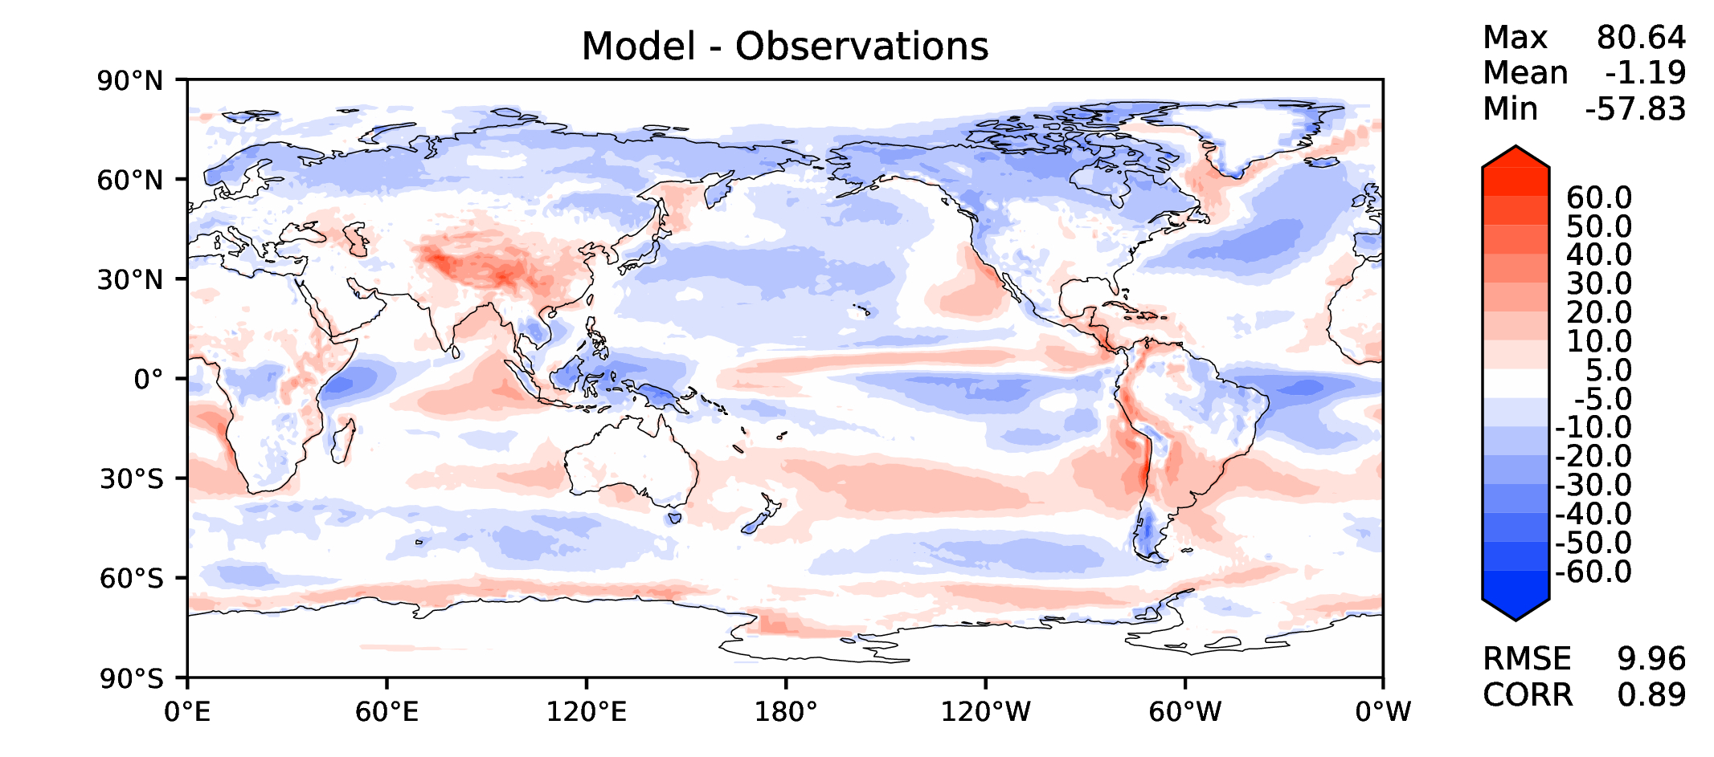
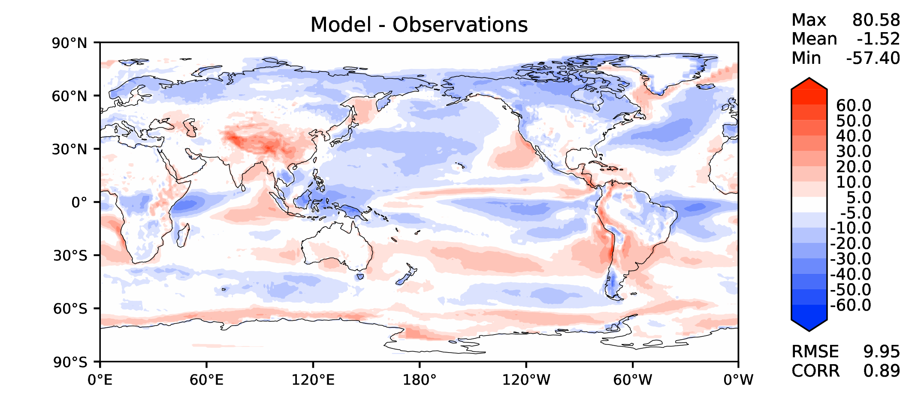
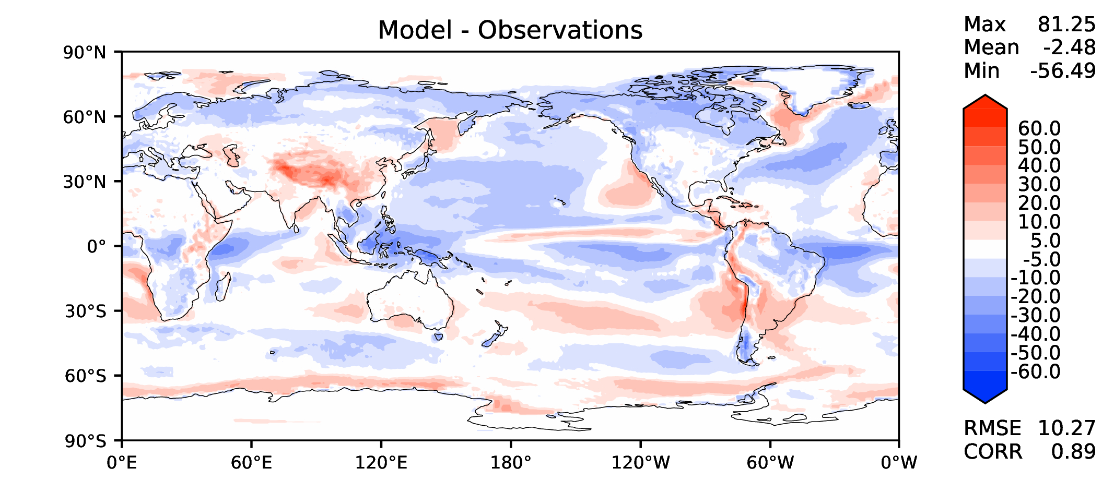
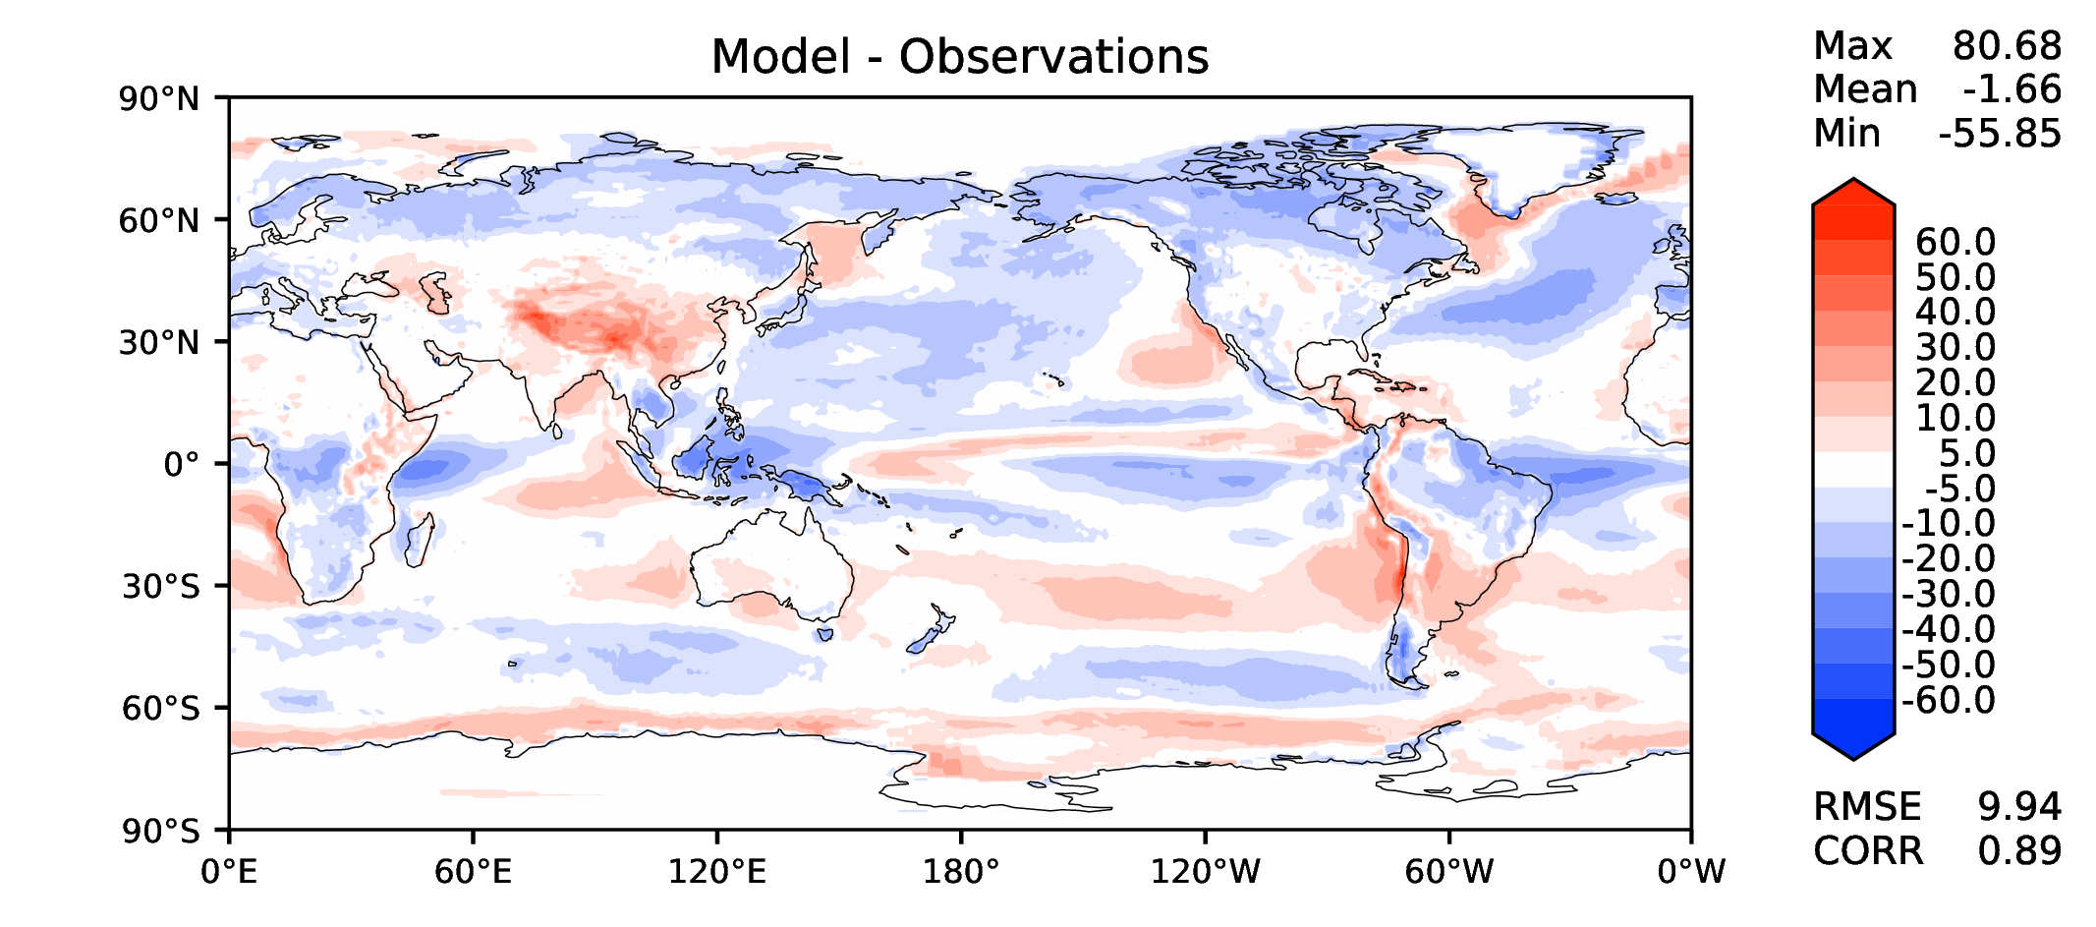
Annual TOA SW CRE
v2beta4
v2rc1c
v2rc1e
v2rc1e_1

Slide 10
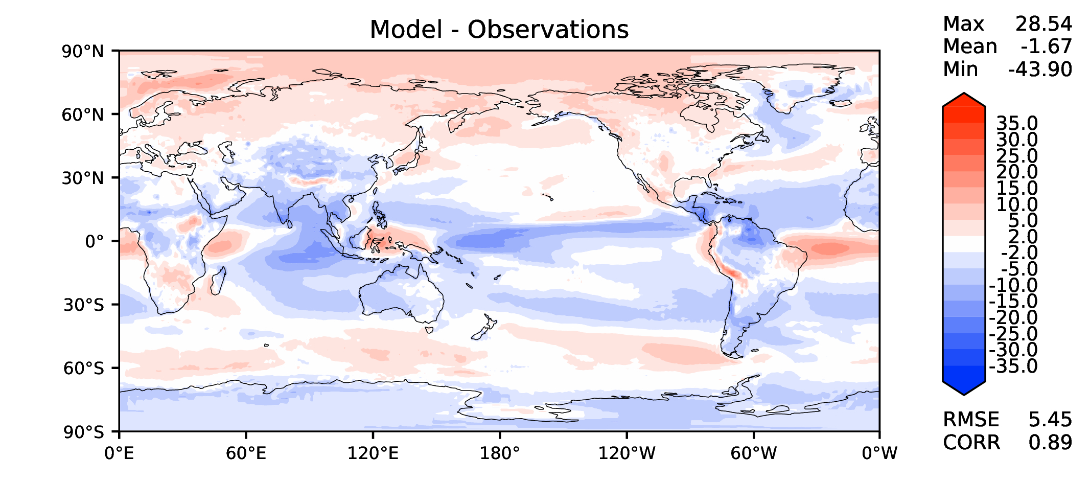
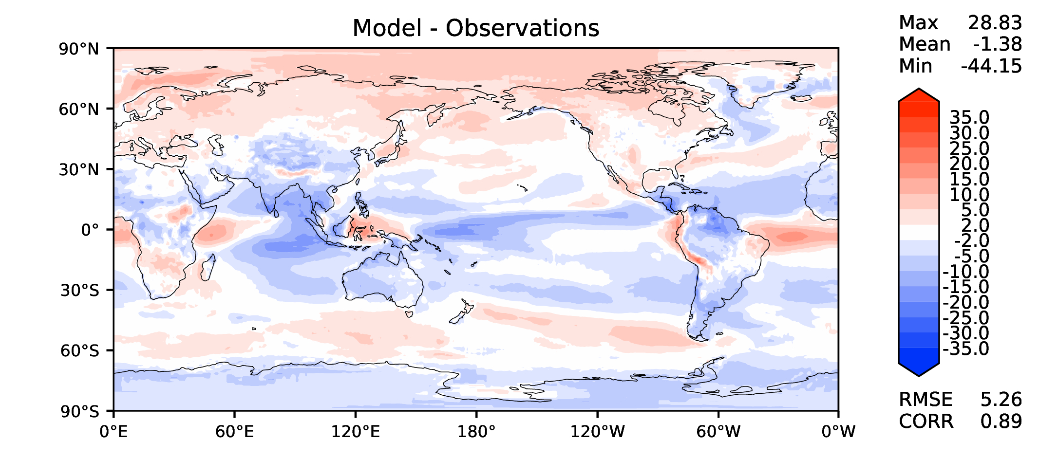
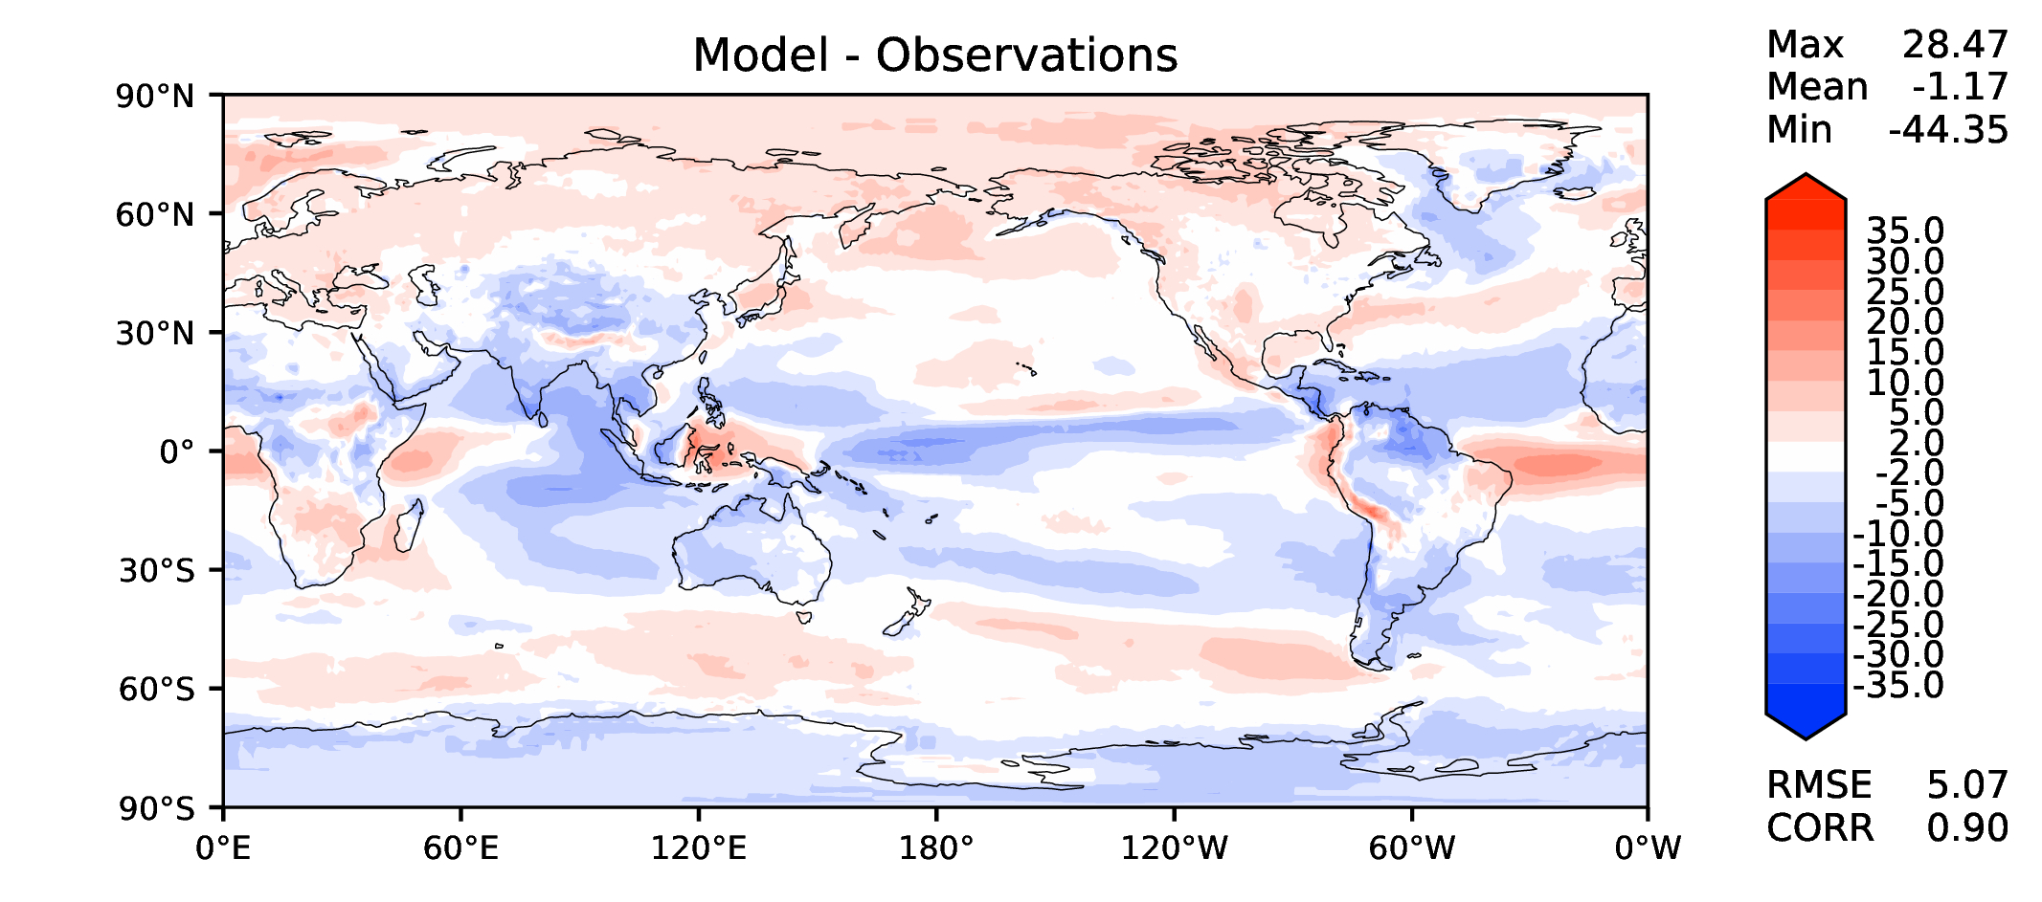
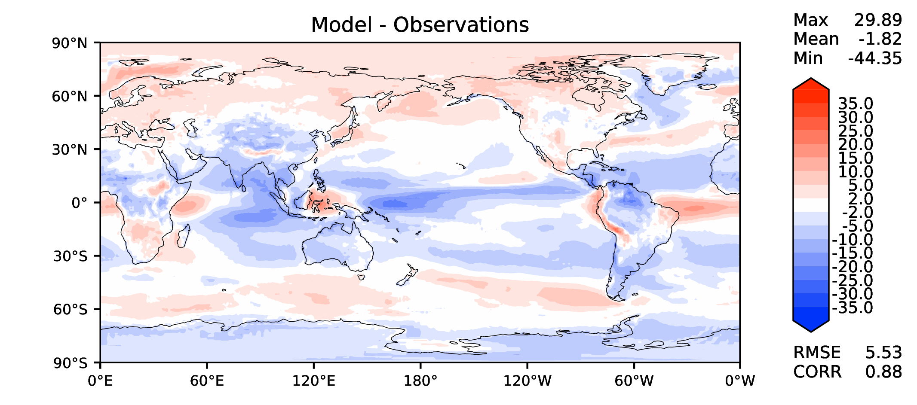
Annual TOA LW CRE
v2beta4
v2rc1c
v2rc1e
v2rc1e_1

Slide 11
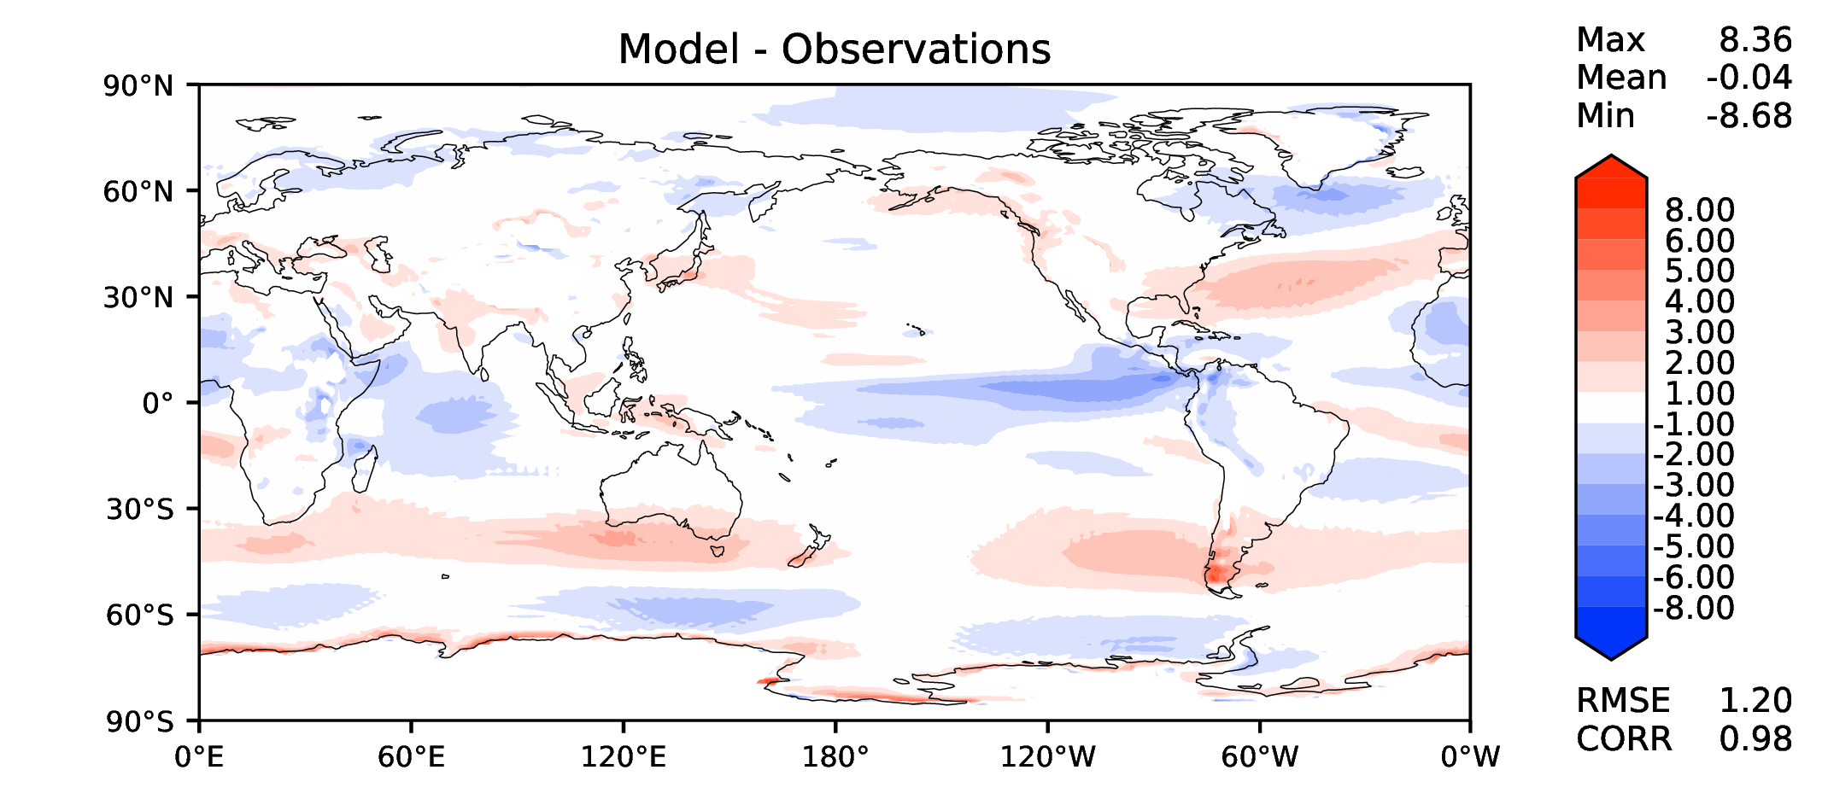
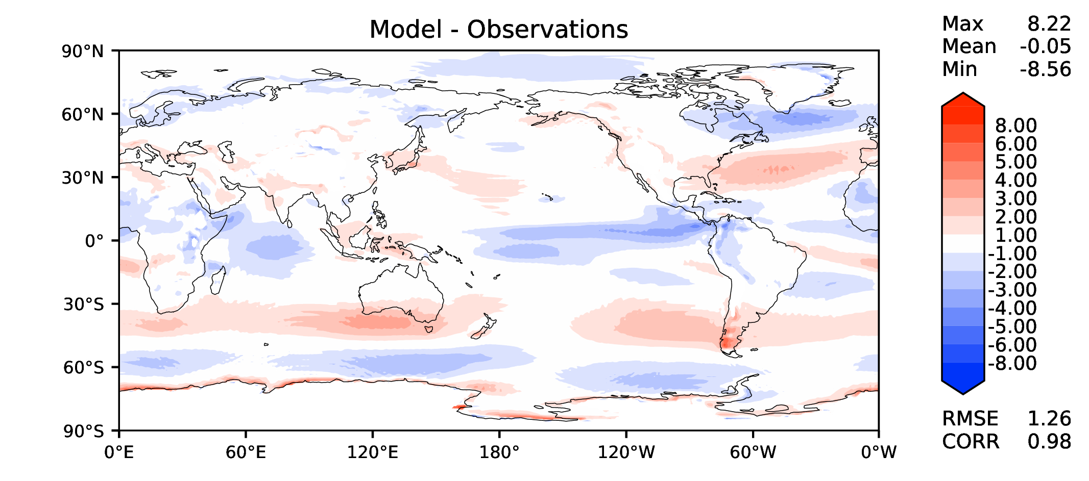
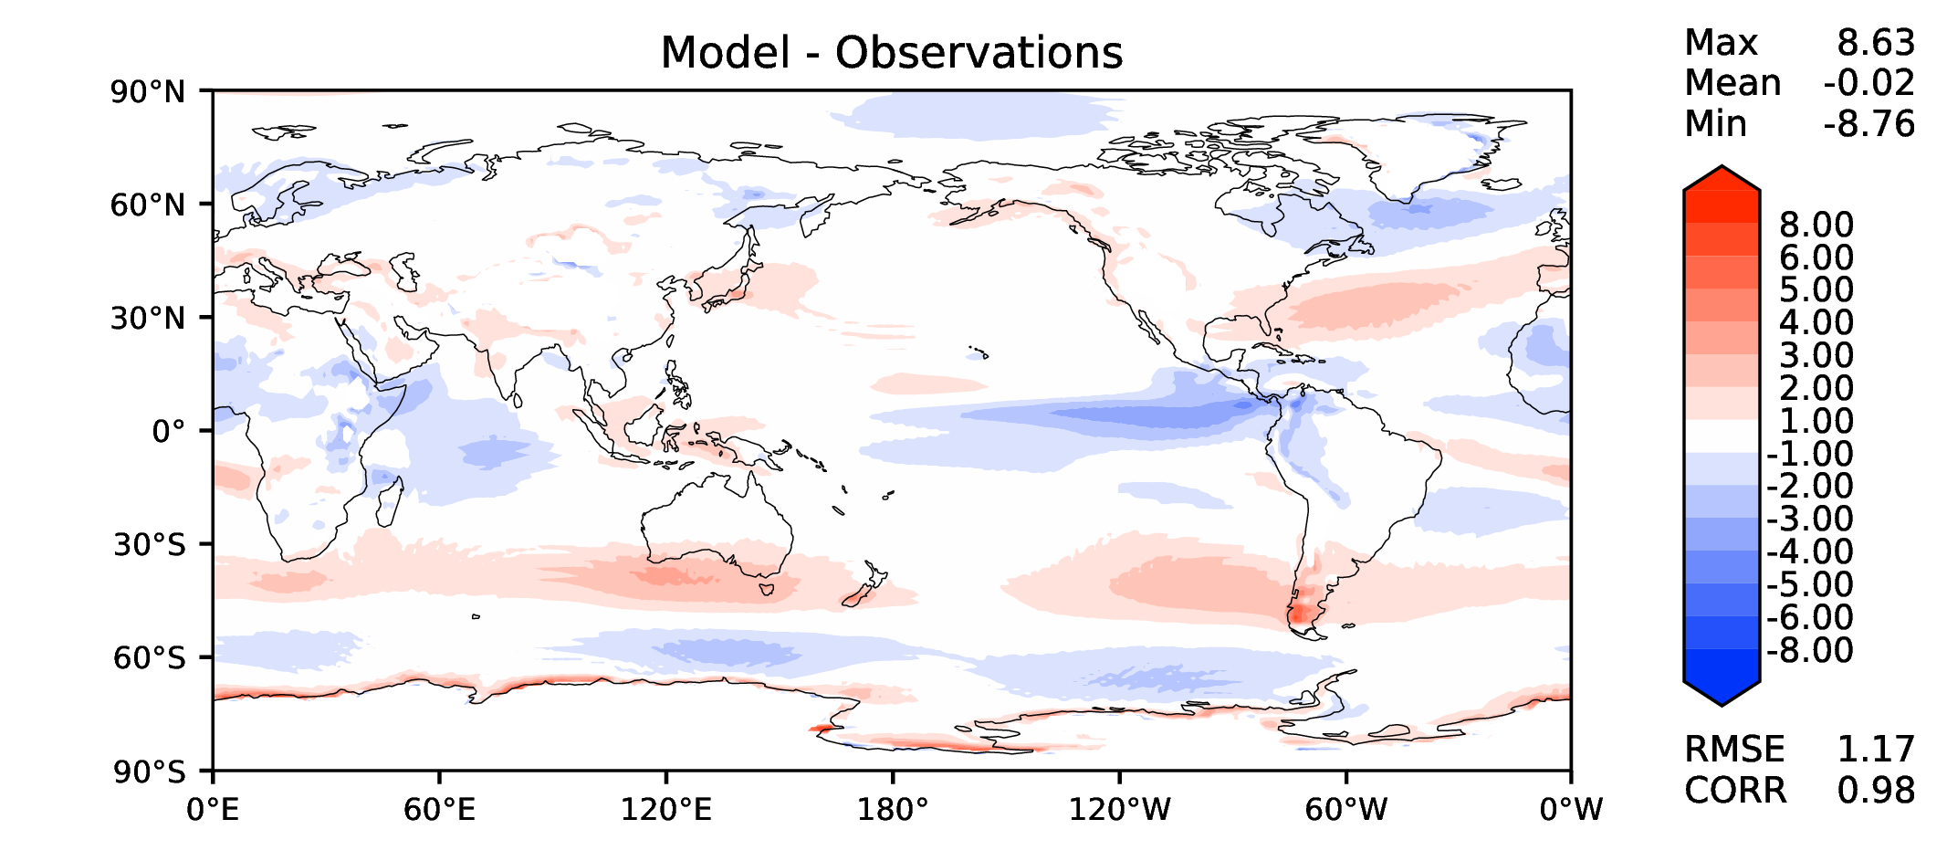
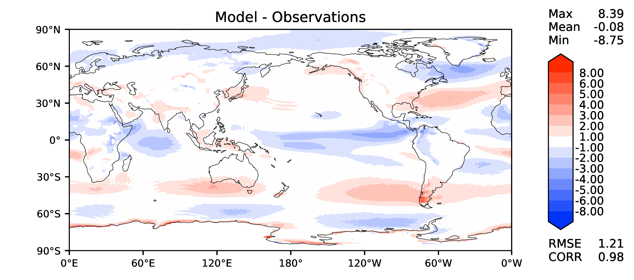
Annual u wind at 850 hPa
v2beta4
v2rc1c
v2rc1e
v2rc1e_1

Slide 12
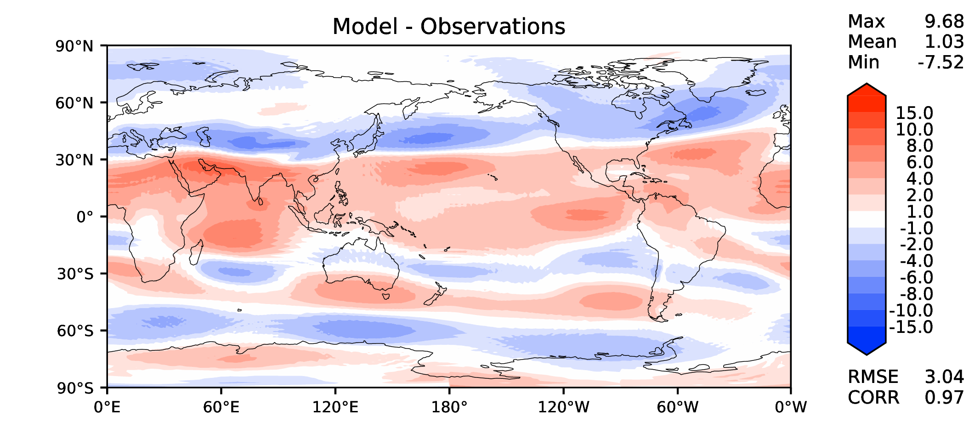
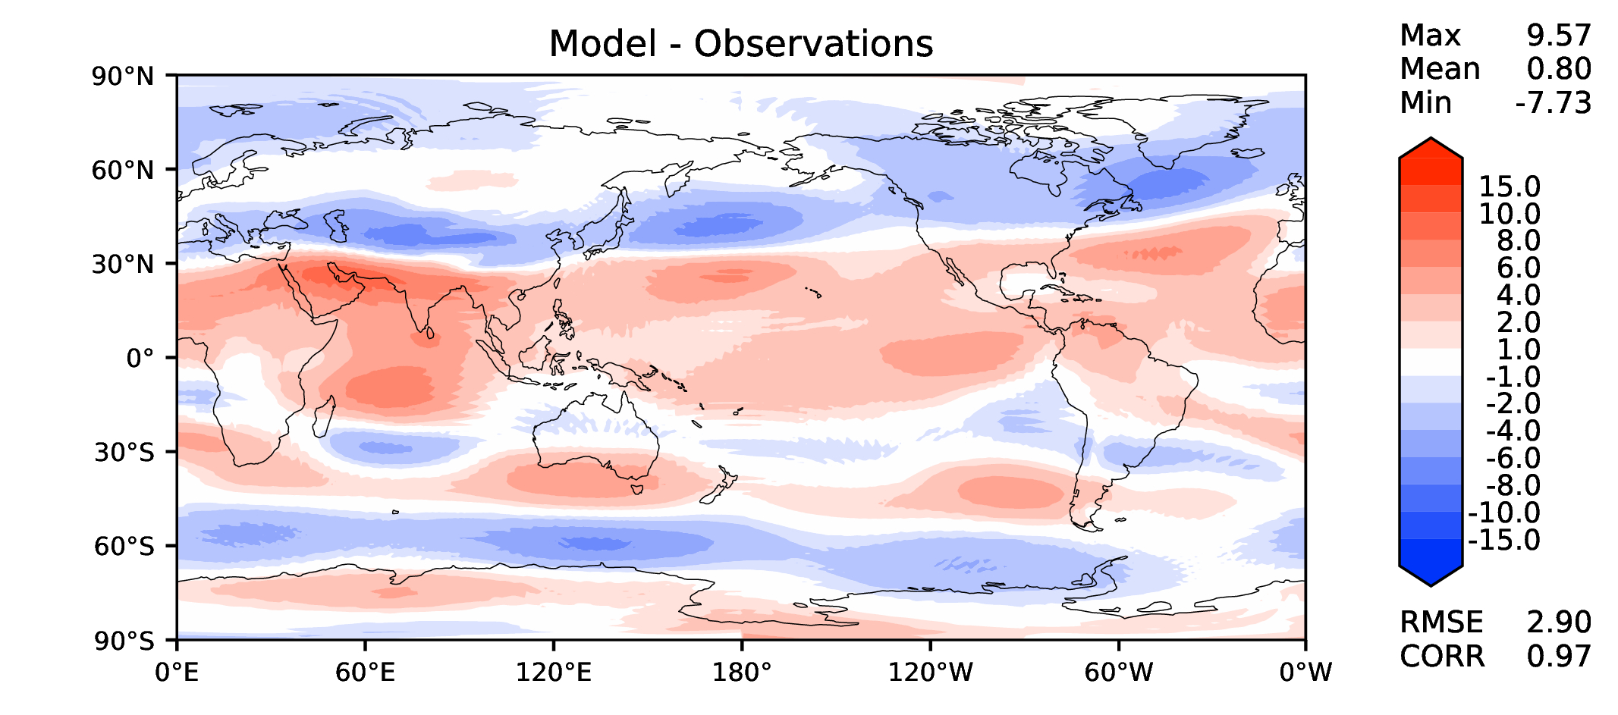
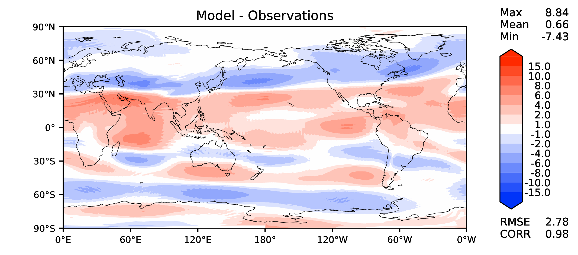
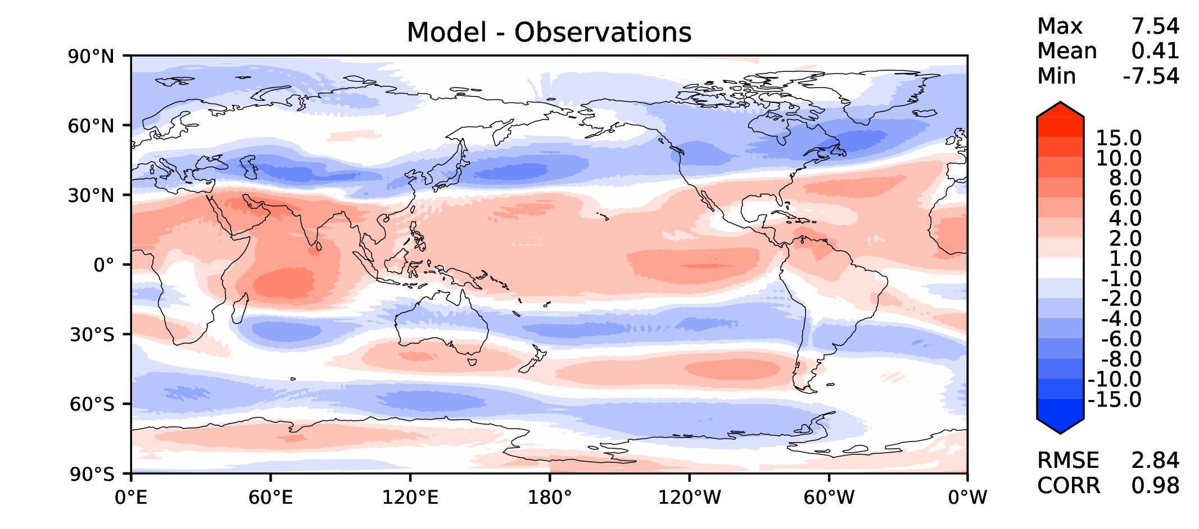
Annual u wind at 200 hPa
v2beta4
v2rc1c
v2rc1e
v2rc1e_1

Slide 13
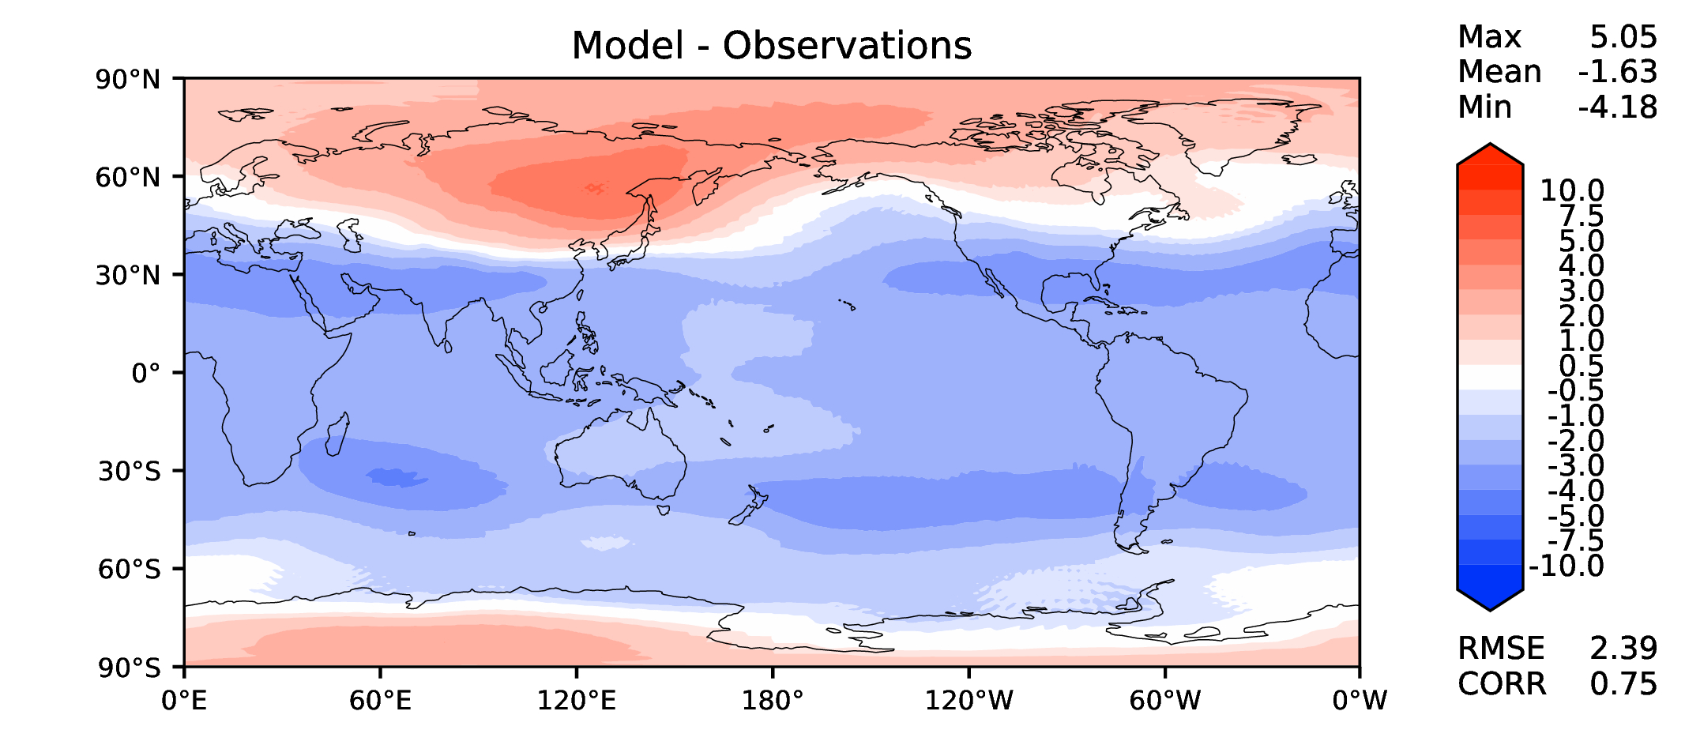
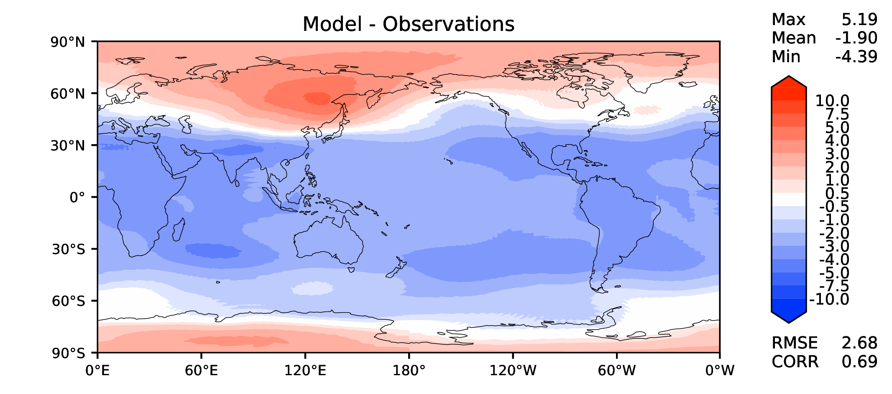
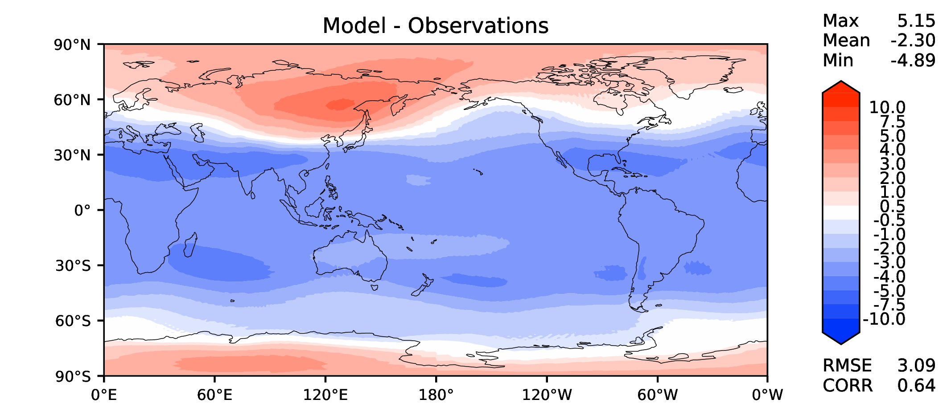
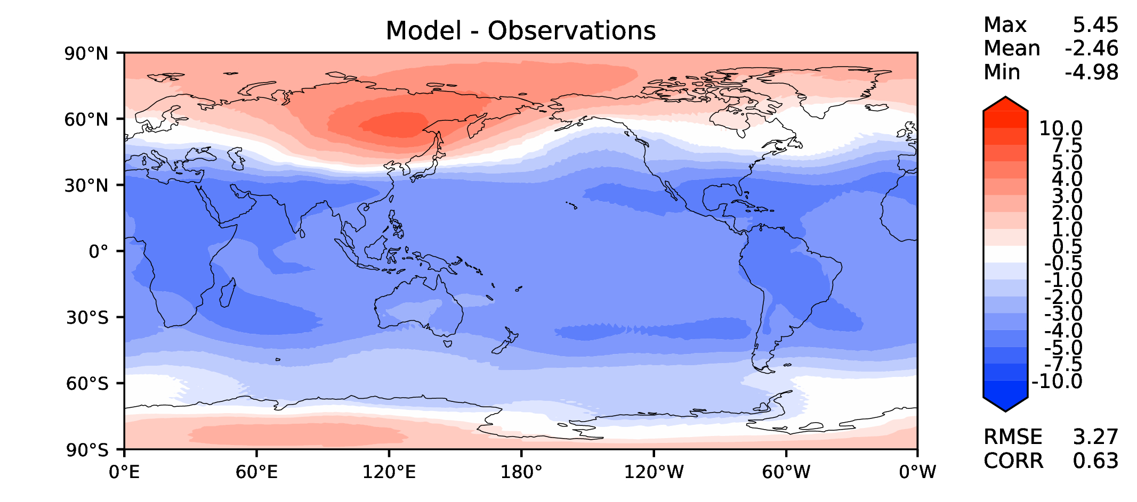
Annual T at 200 hPa
v2beta4
v2rc1c
v2rc1e
v2rc1e_1

Slide 14
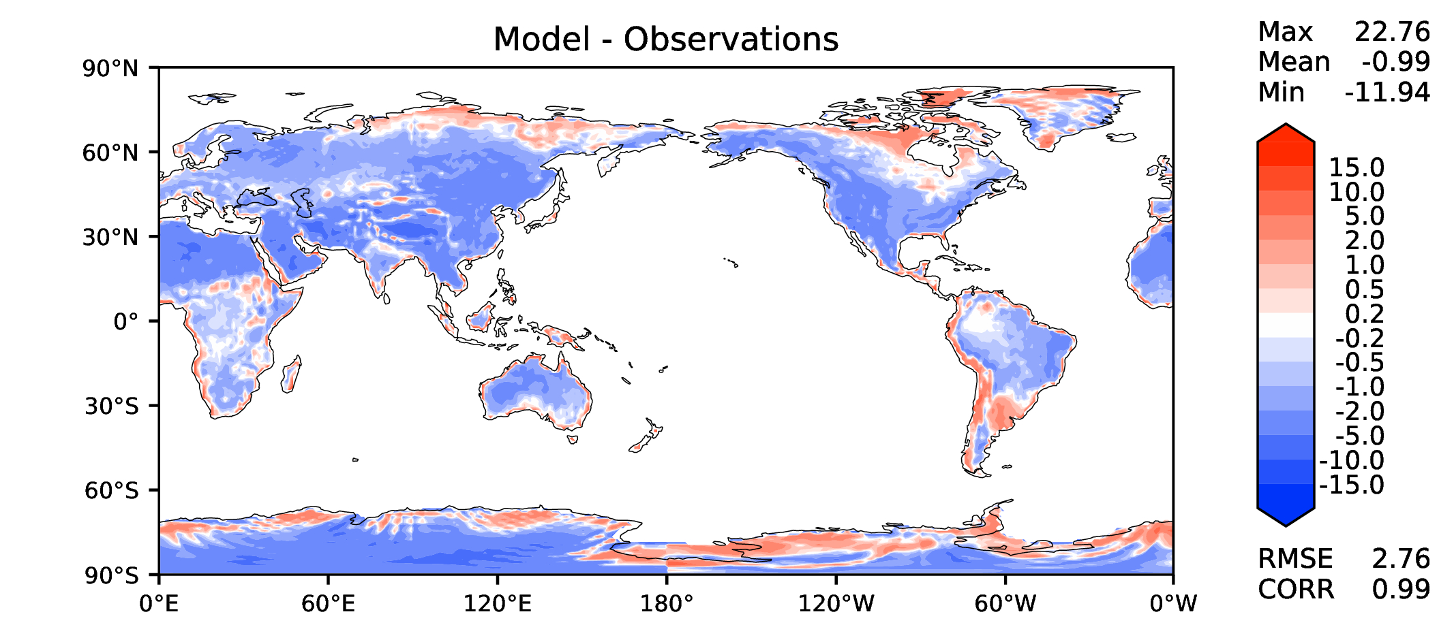
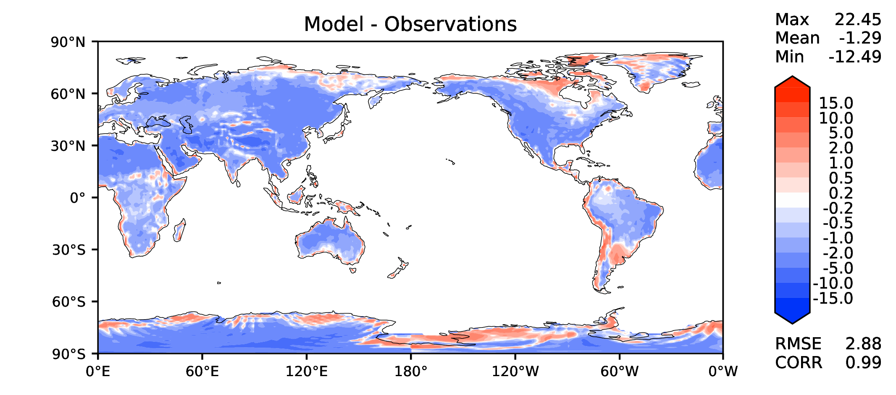
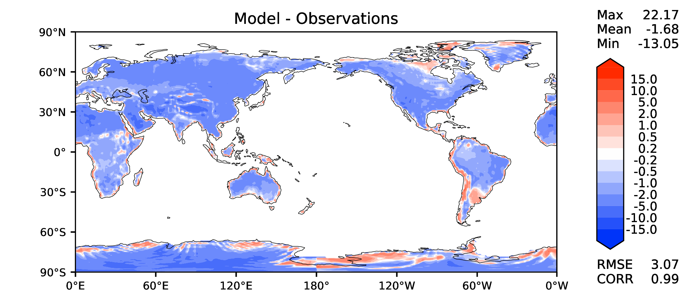
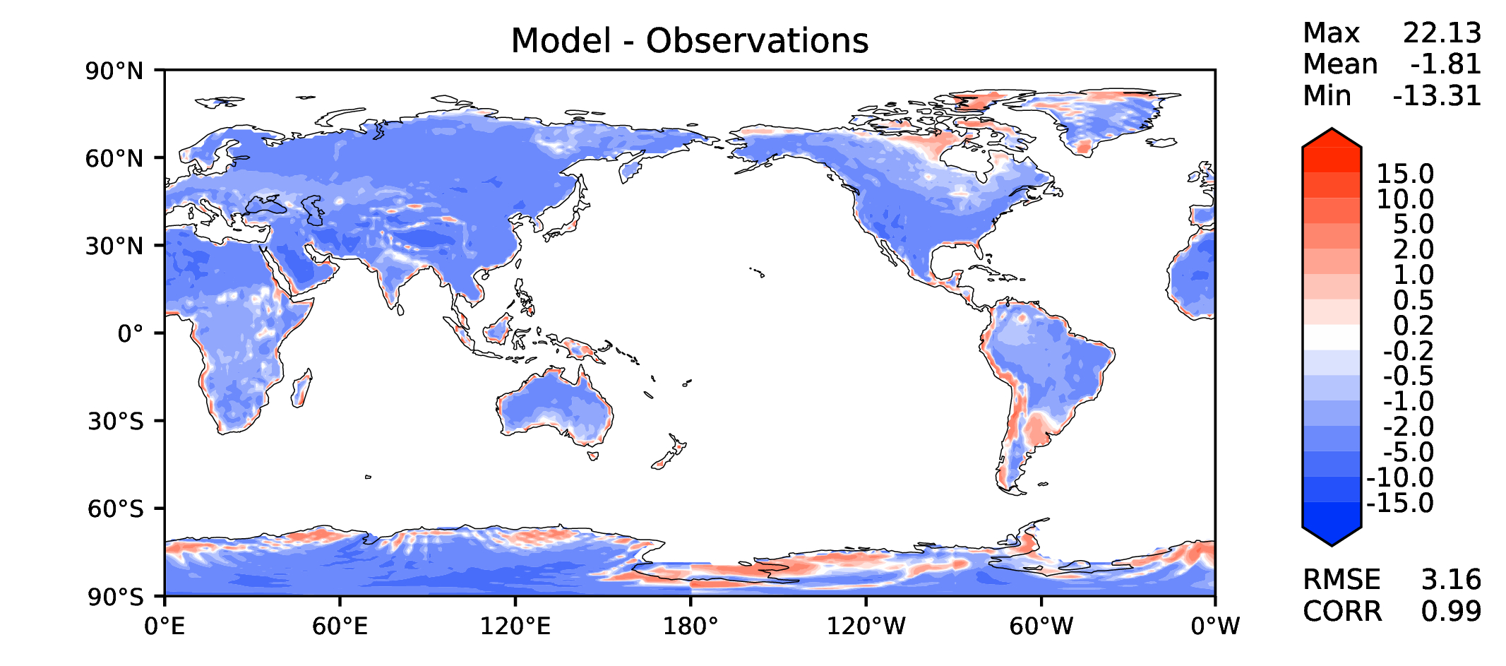
Annual surface air T (land)
v2beta4
v2rc1c
v2rc1e
v2rc1e_1

Slide 15
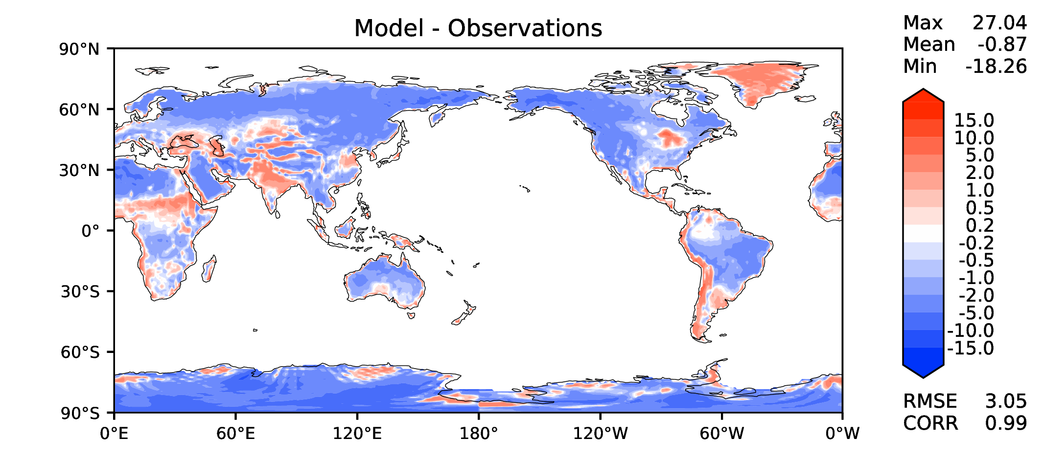



JJA surface air T (land)
v2beta4
v2rc1c
v2rc1e
v2rc1e_1

Slide 16




Aerosol optical depth
v2beta4
v2rc1c
v2rc1e
v2rc1e_1

Slide 17




TAUXY ANN ocean
v2beta4
v2rc1c
v2rc1e
v2rc1e_1

Slide 18




CLDLWP_OCN global SSMI
v2beta4
v2rc1c
v2rc1e
v2rc1e_1

