Slide 1
Summary table (RMSE vs obs)
Variable | Season | v2beta4 | v2rc1c | v2rc1e | v2rc1e_1
SST | ANN | 1.22 | 1.19 | 1.23 | 1.24
PRECT | ANN | 1.01 | 0.98 | 0.96 | 1.01
PRECT | DJF | 1.37 | 1.36 | 1.31 | 1.40
PRECT | MAM | 1.30 | 1.23 | 1.20 | 1.27
PRECT | JJA | 1.42 | 1.34 | 1.31 | 1.37
PRECT | SON | 1.31 | 1.28 | 1.22 | 1.30
RESTOM | ANN | 8.48 | 8.40 | 8.57 | 8.43
SWCF | ANN | 9.94 | 9.84 | 10.22 | 9.94
LWCF | ANN | 5.31 | 5.20 | 5.06 | 5.51
u850 | ANN | 1.20 | 1.21 | 1.19 | 1.20
u200 | ANN | 3.03 | 2.83 | 2.83 | 2.89
T200 | ANN | 2.35 | 2.75 | 3.15 | 3.22
TREFHT | ANN | 2.74 | 2.91 | 3.09 | 3.15
TREFHT | JJA | 3.00 | 3.05 | 3.22 | 3.23
AODVIS | ANN | 0.06 | 0.06 | 0.06 | 0.06
TAUXY | ANN | 0.02 | 0.02 | 0.02 | 0.02
CLDLWP_OCN | ANN | 39.96 | 42.94 | 36.66 | 37.92

Slide 2
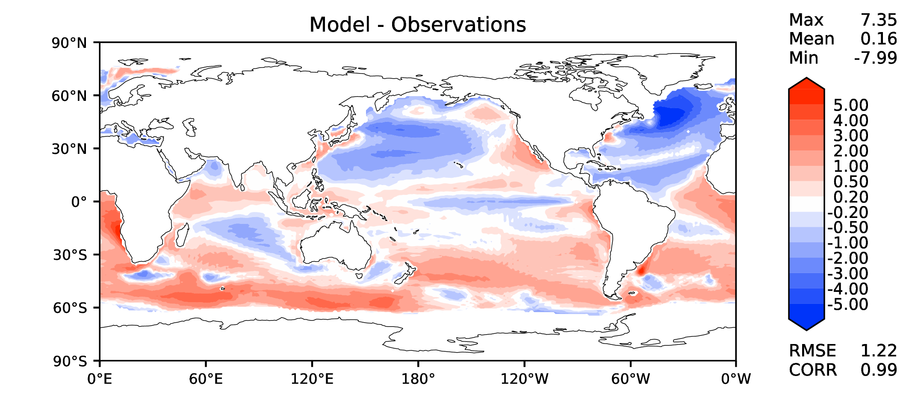
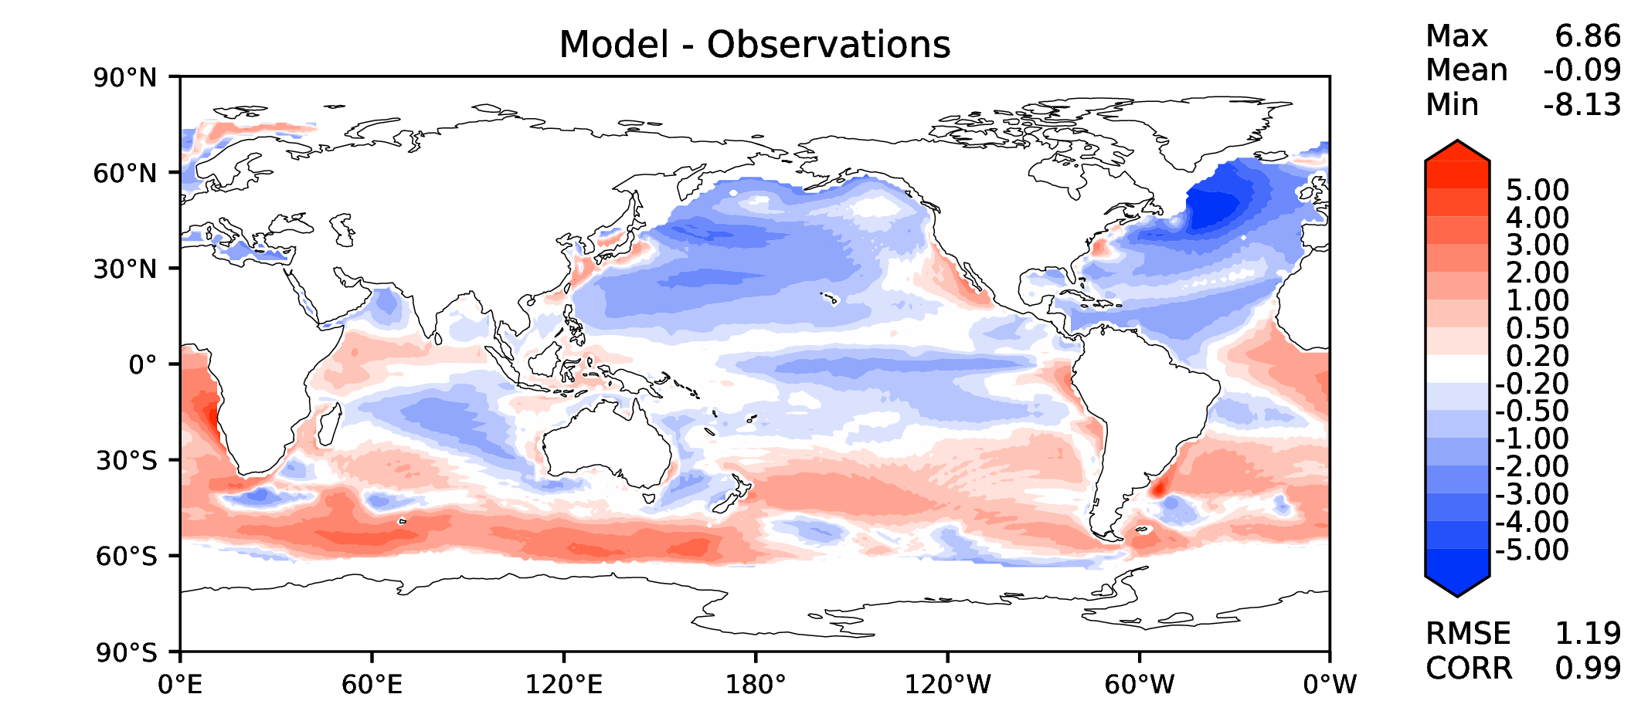
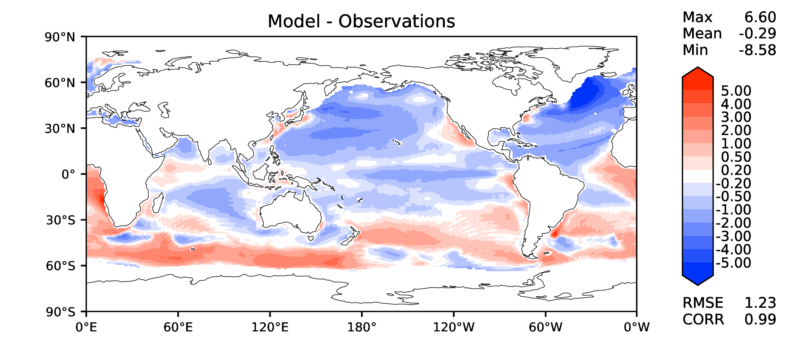
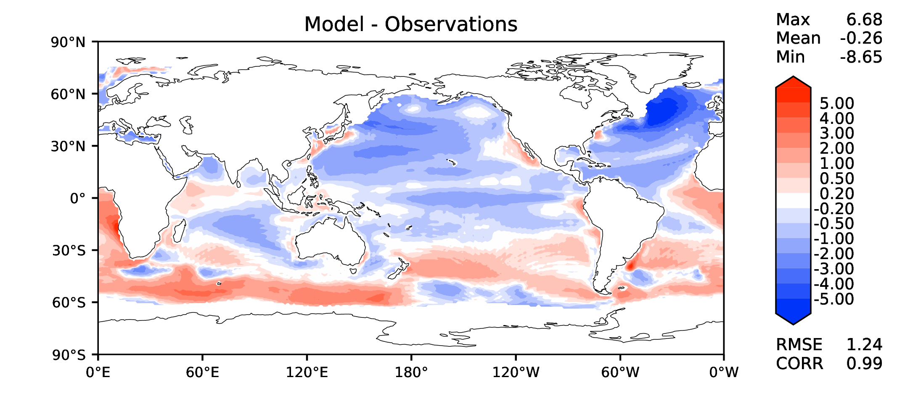
Annual SST (pre-industrial)
v2beta4
v2rc1c
v2rc1e
v2rc1e_1

Slide 3
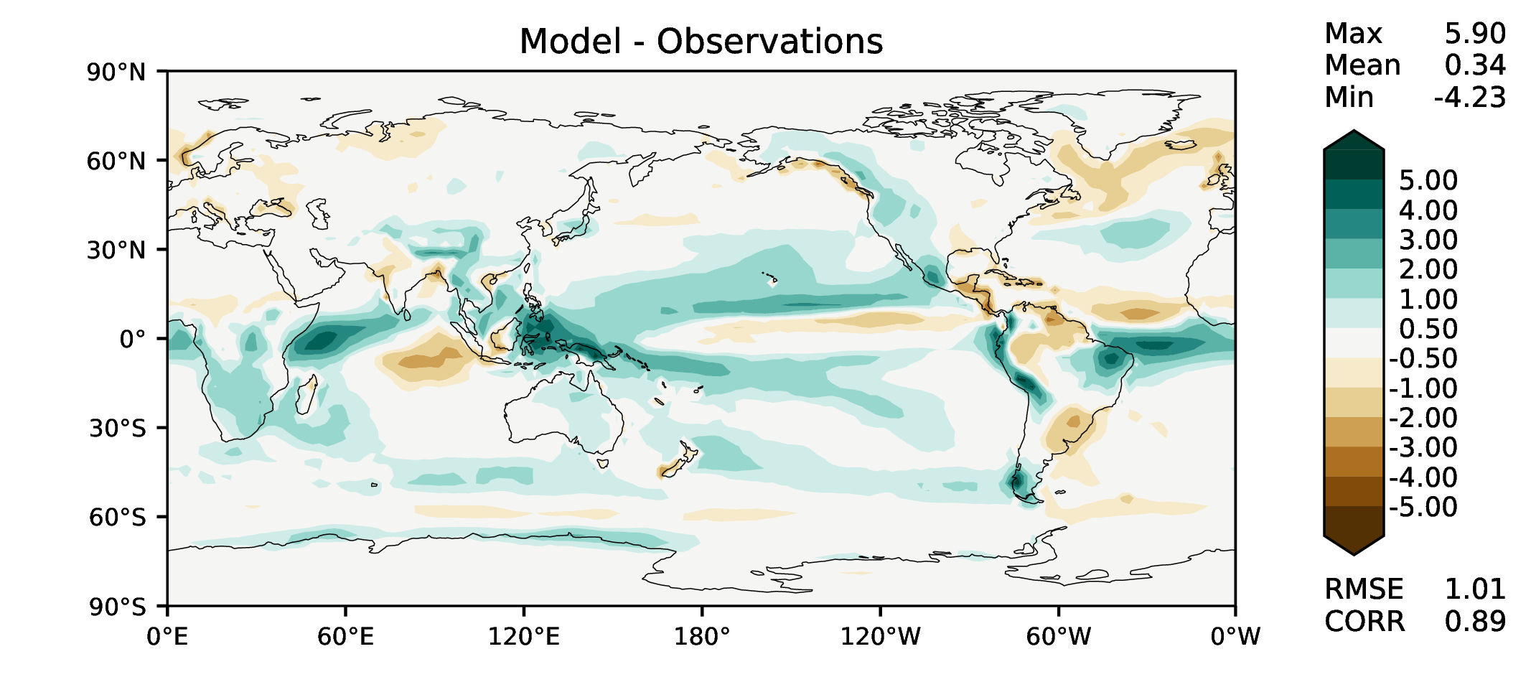
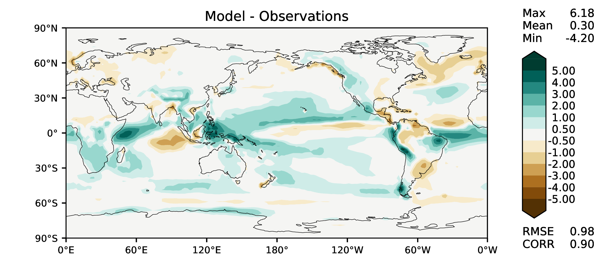
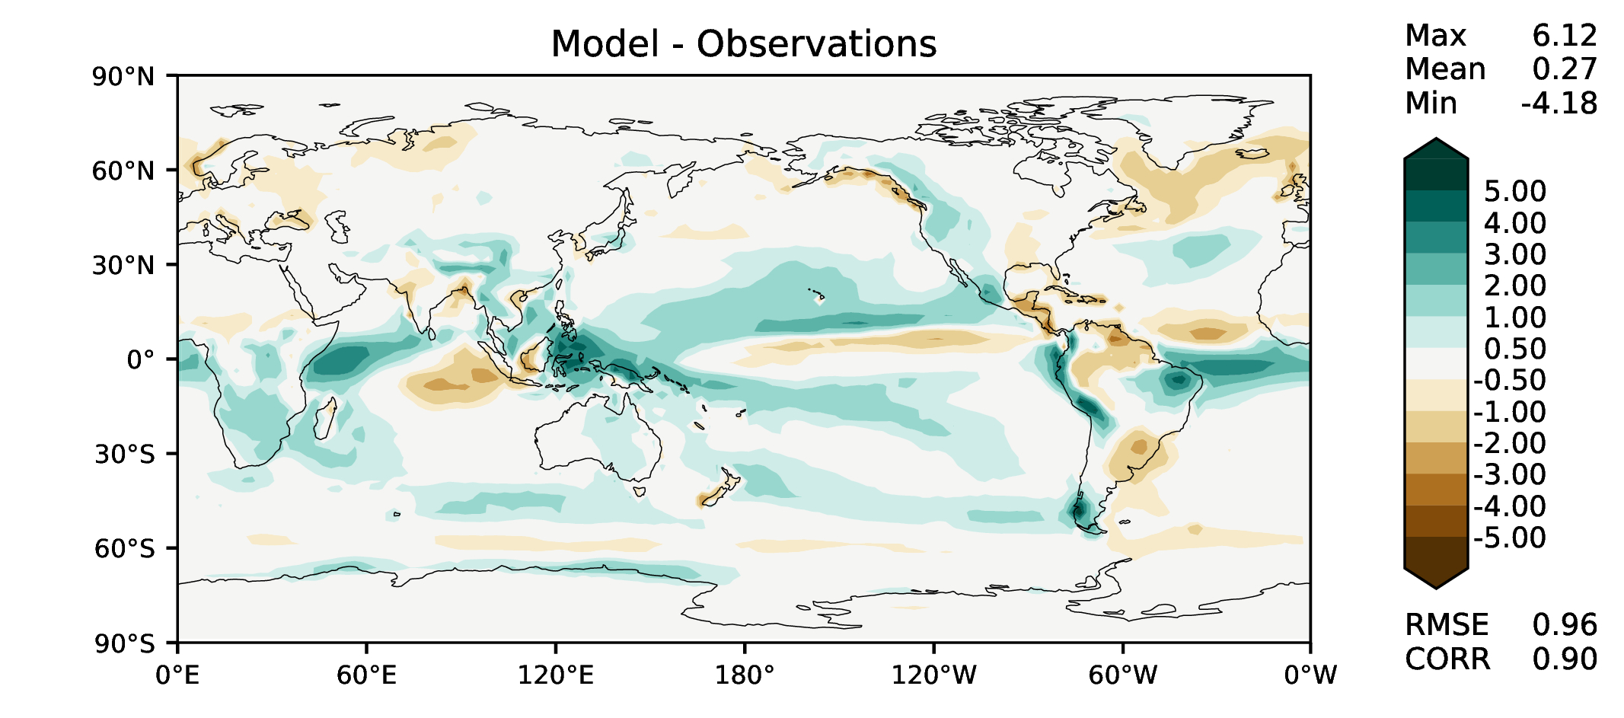
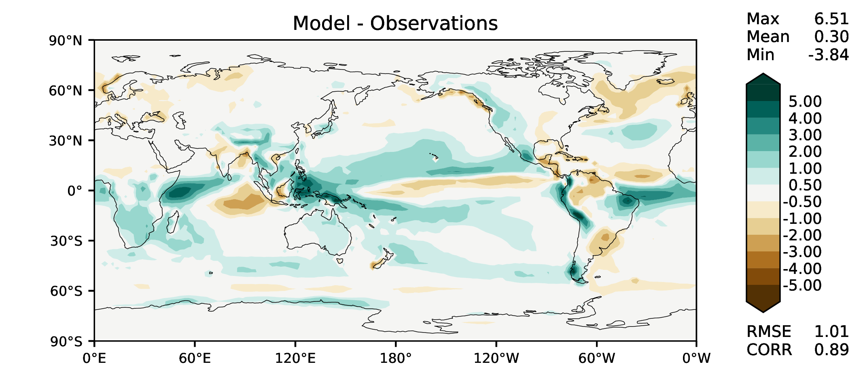
Annual total precipitation
v2beta4
v2rc1c
v2rc1e
v2rc1e_1

Slide 4
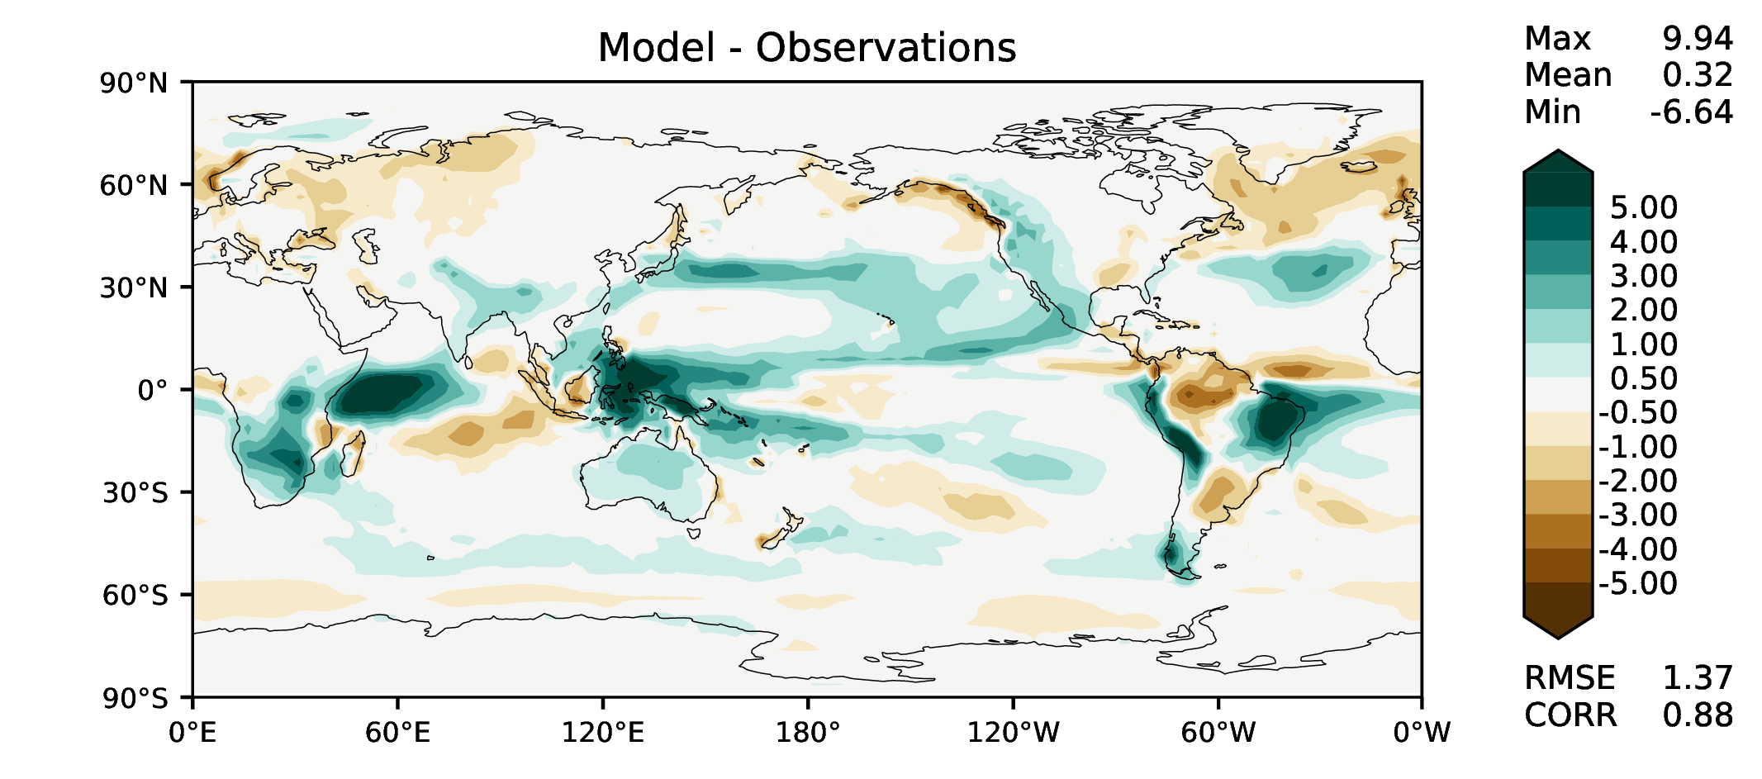
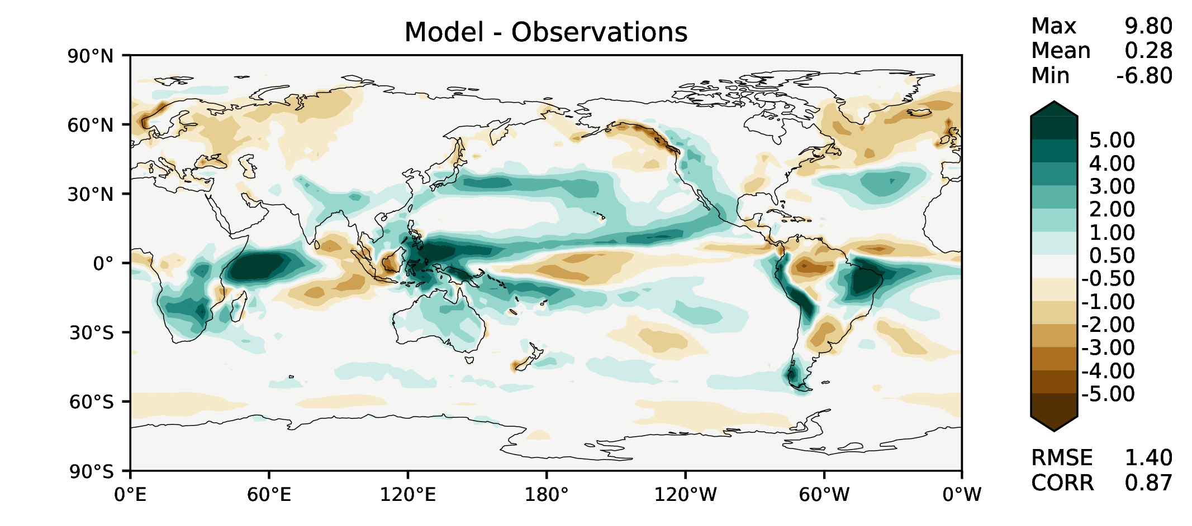
DJF total precipitation
v2beta4
v2rc1c
v2rc1e
v2rc1e_1

Slide 5
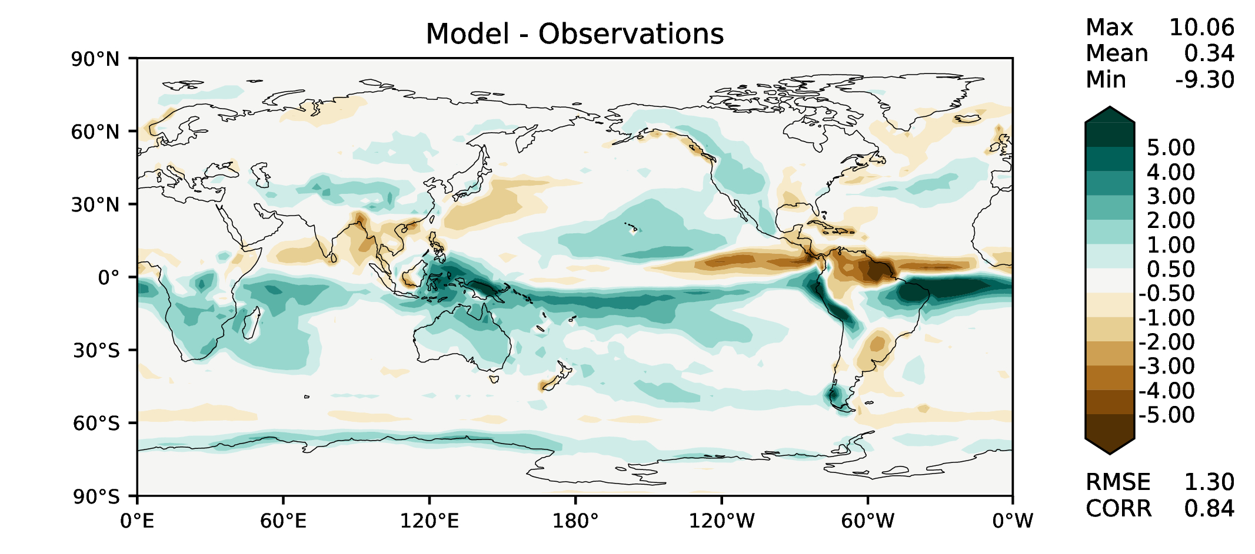
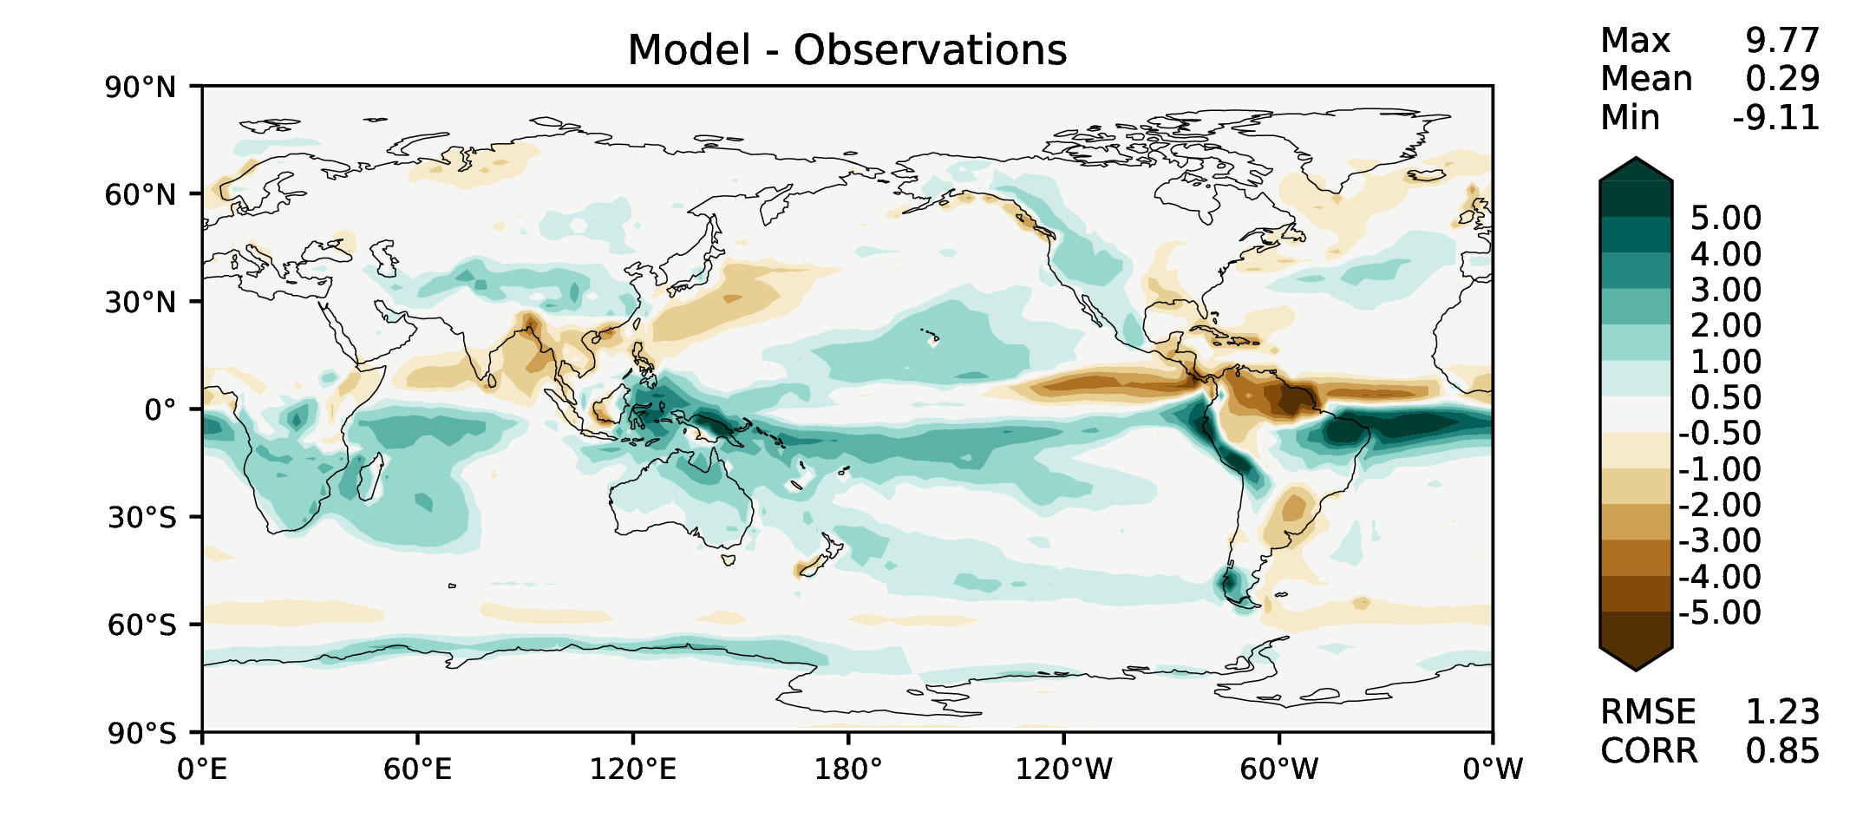
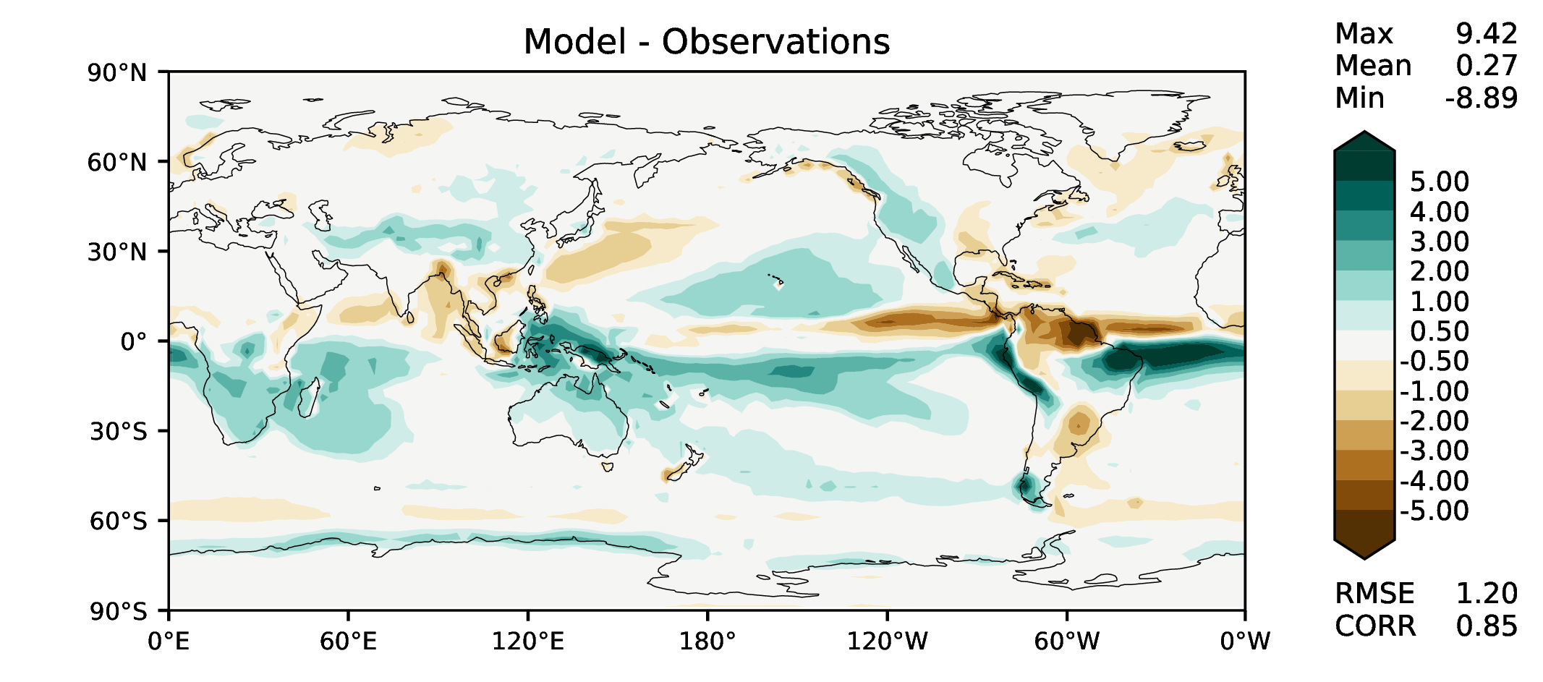
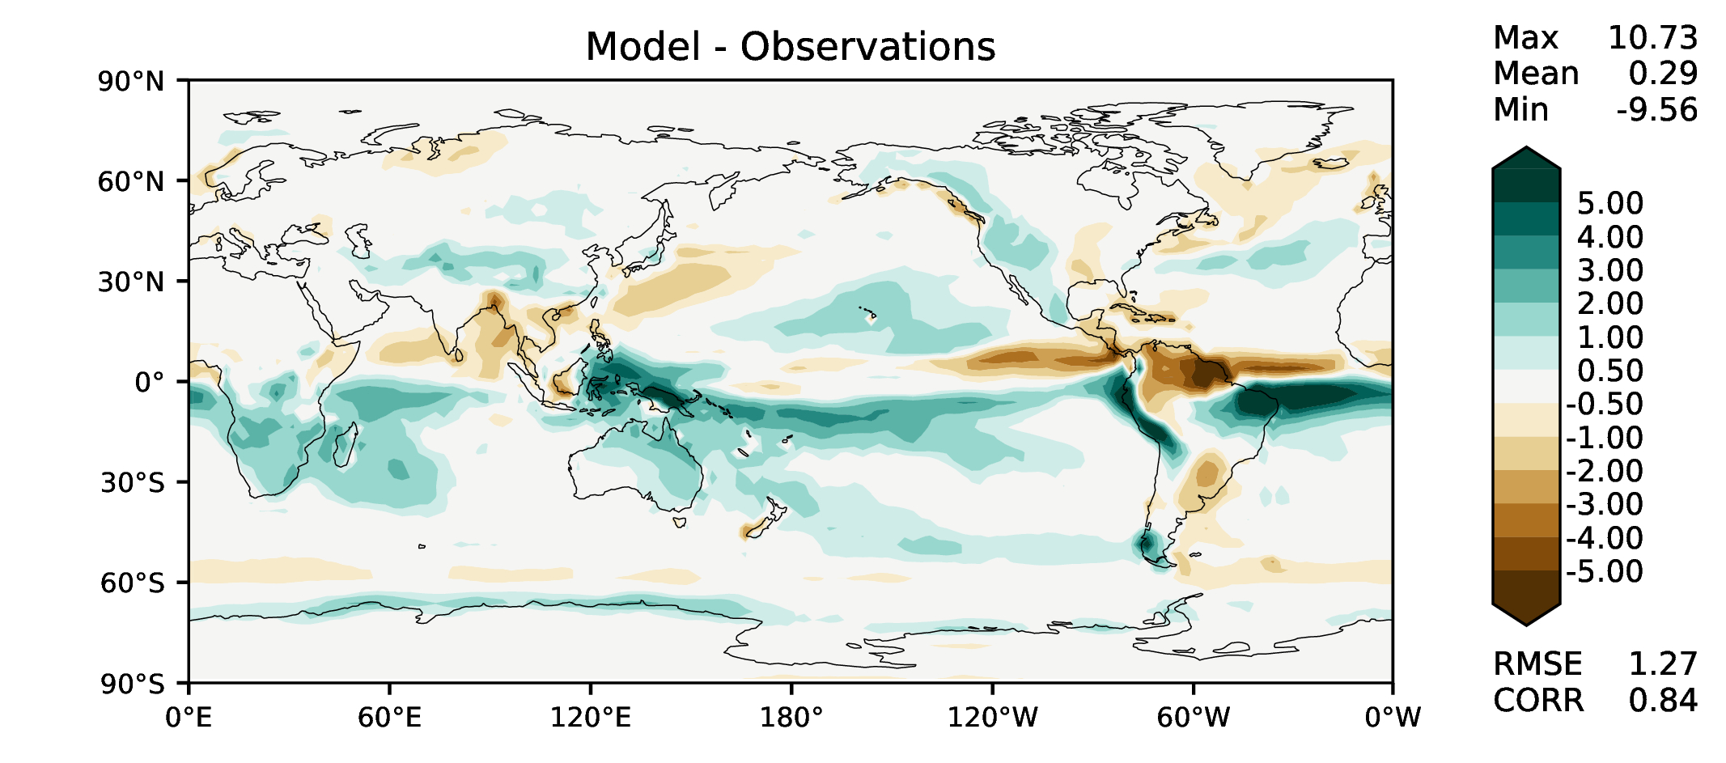
MAM total precipitation
v2beta4
v2rc1c
v2rc1e
v2rc1e_1

Slide 6
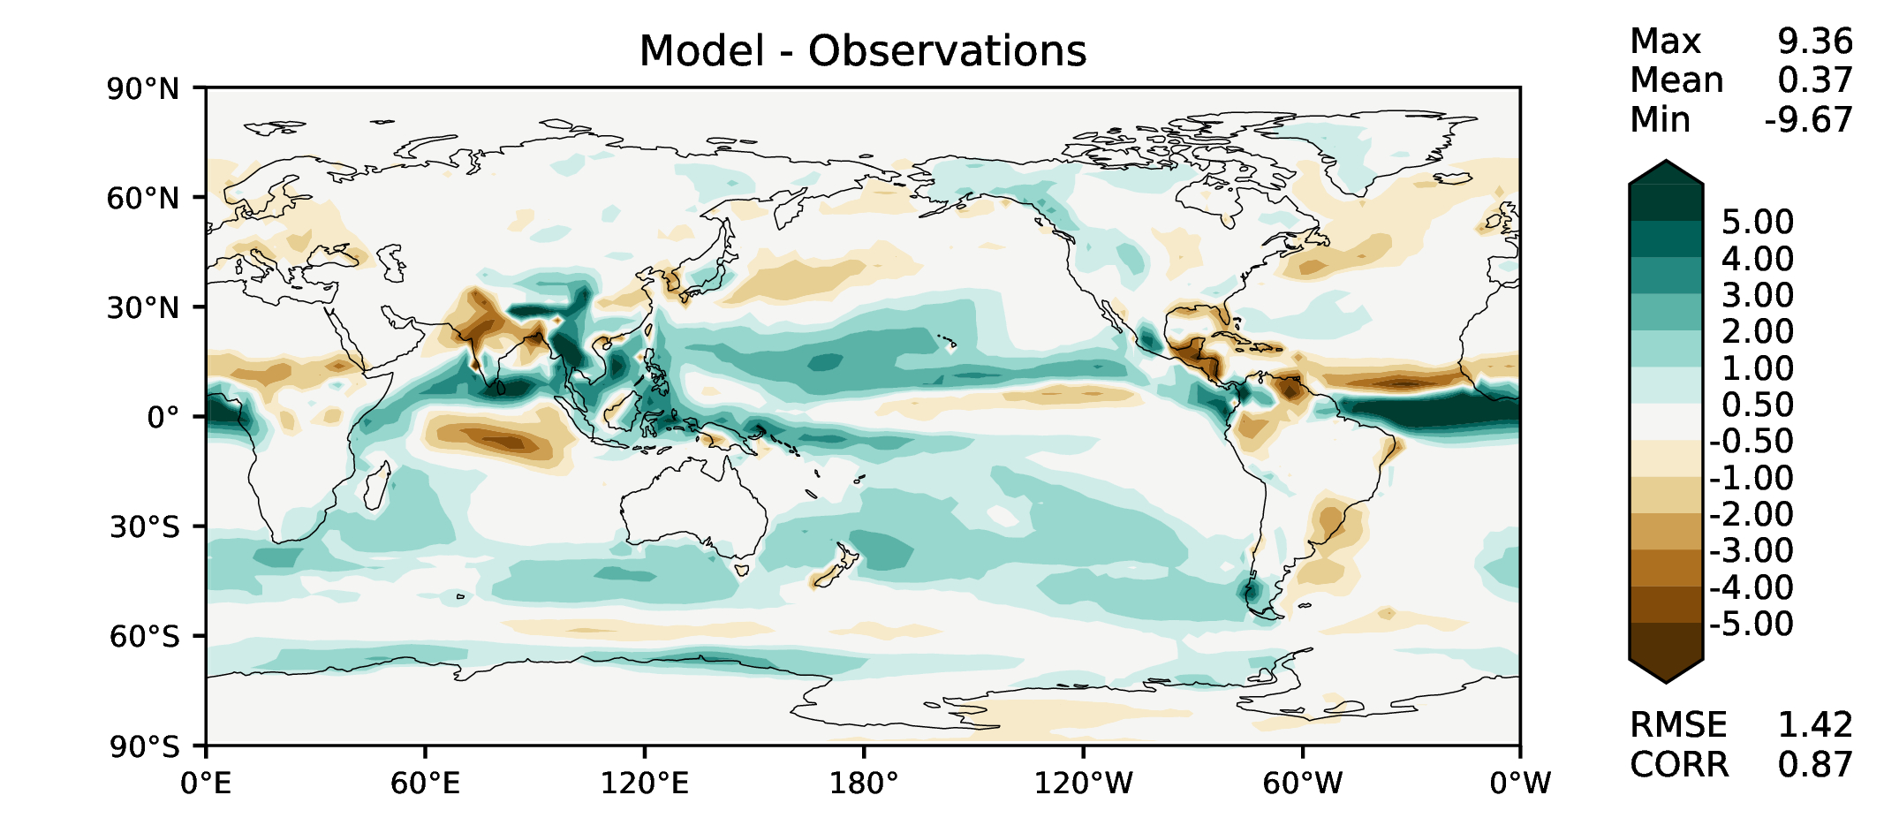
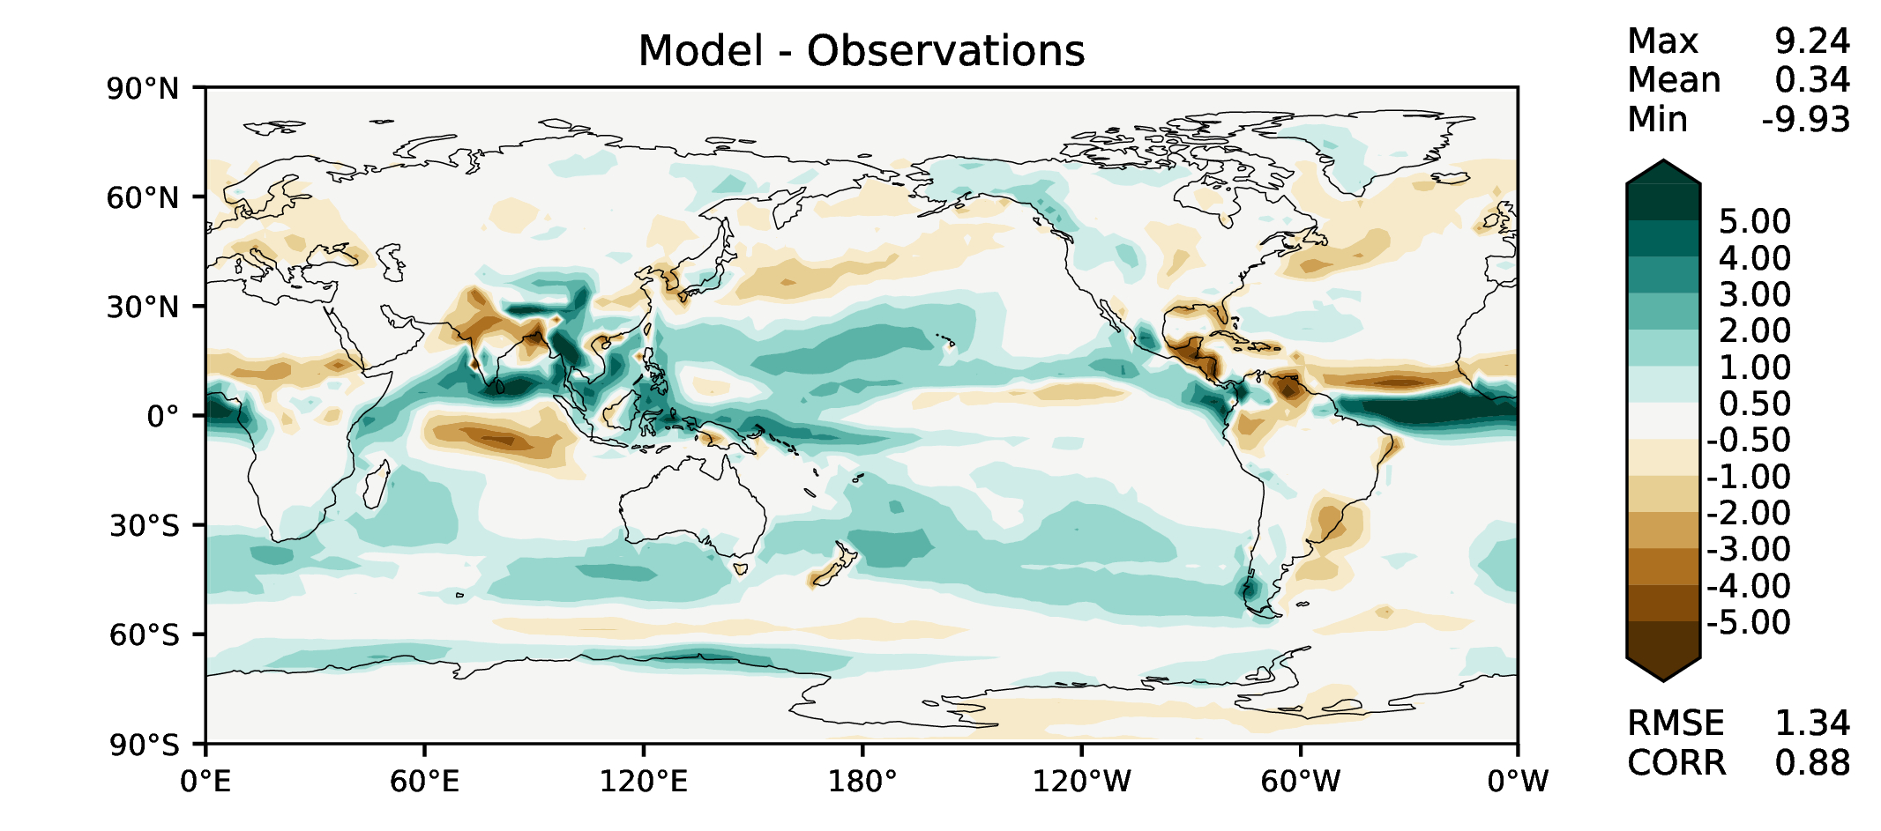
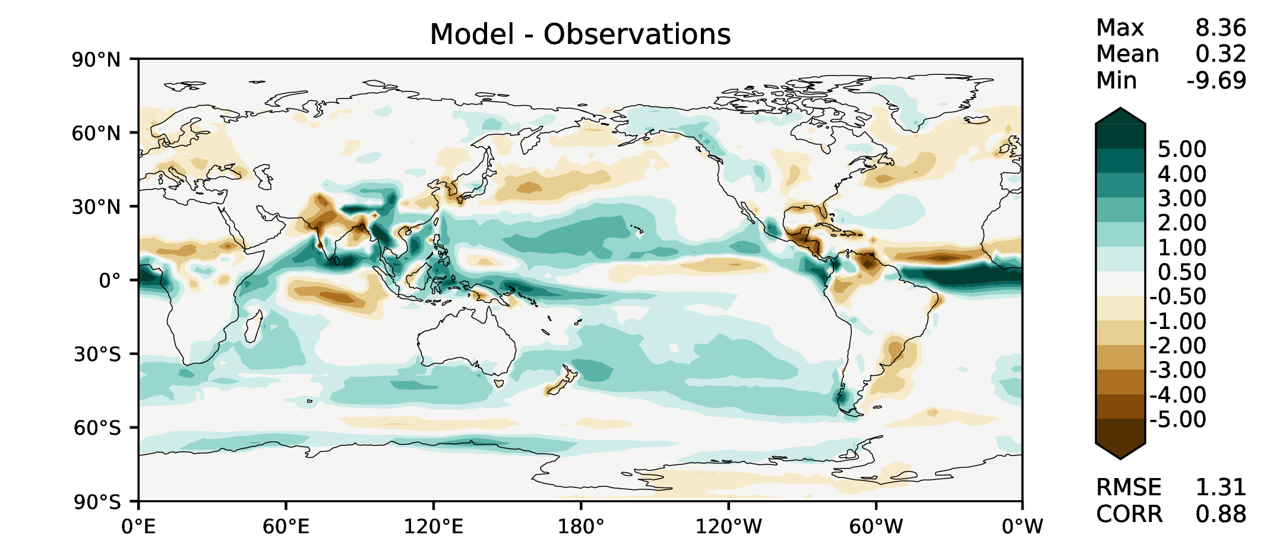
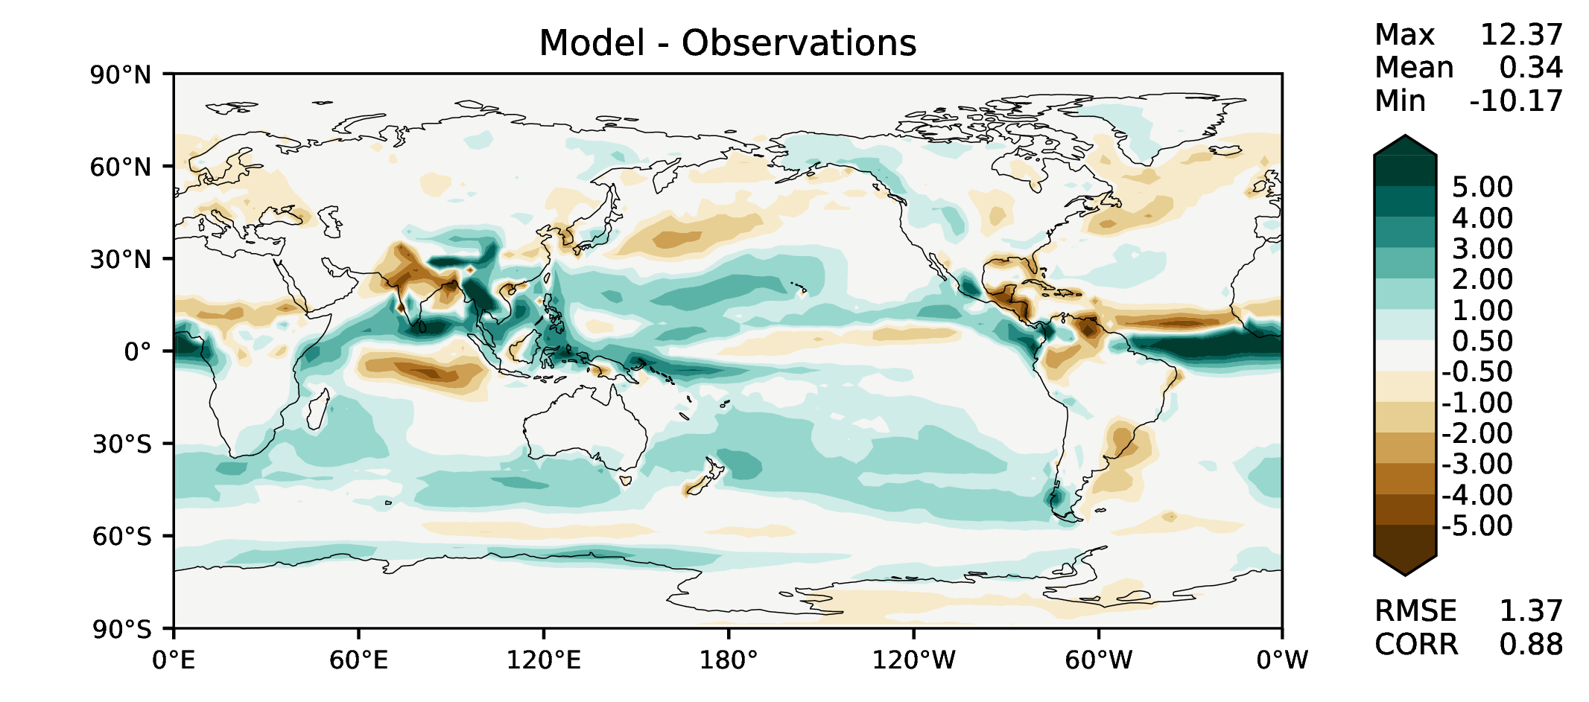
JJA total precipitation
v2beta4
v2rc1c
v2rc1e
v2rc1e_1

Slide 7
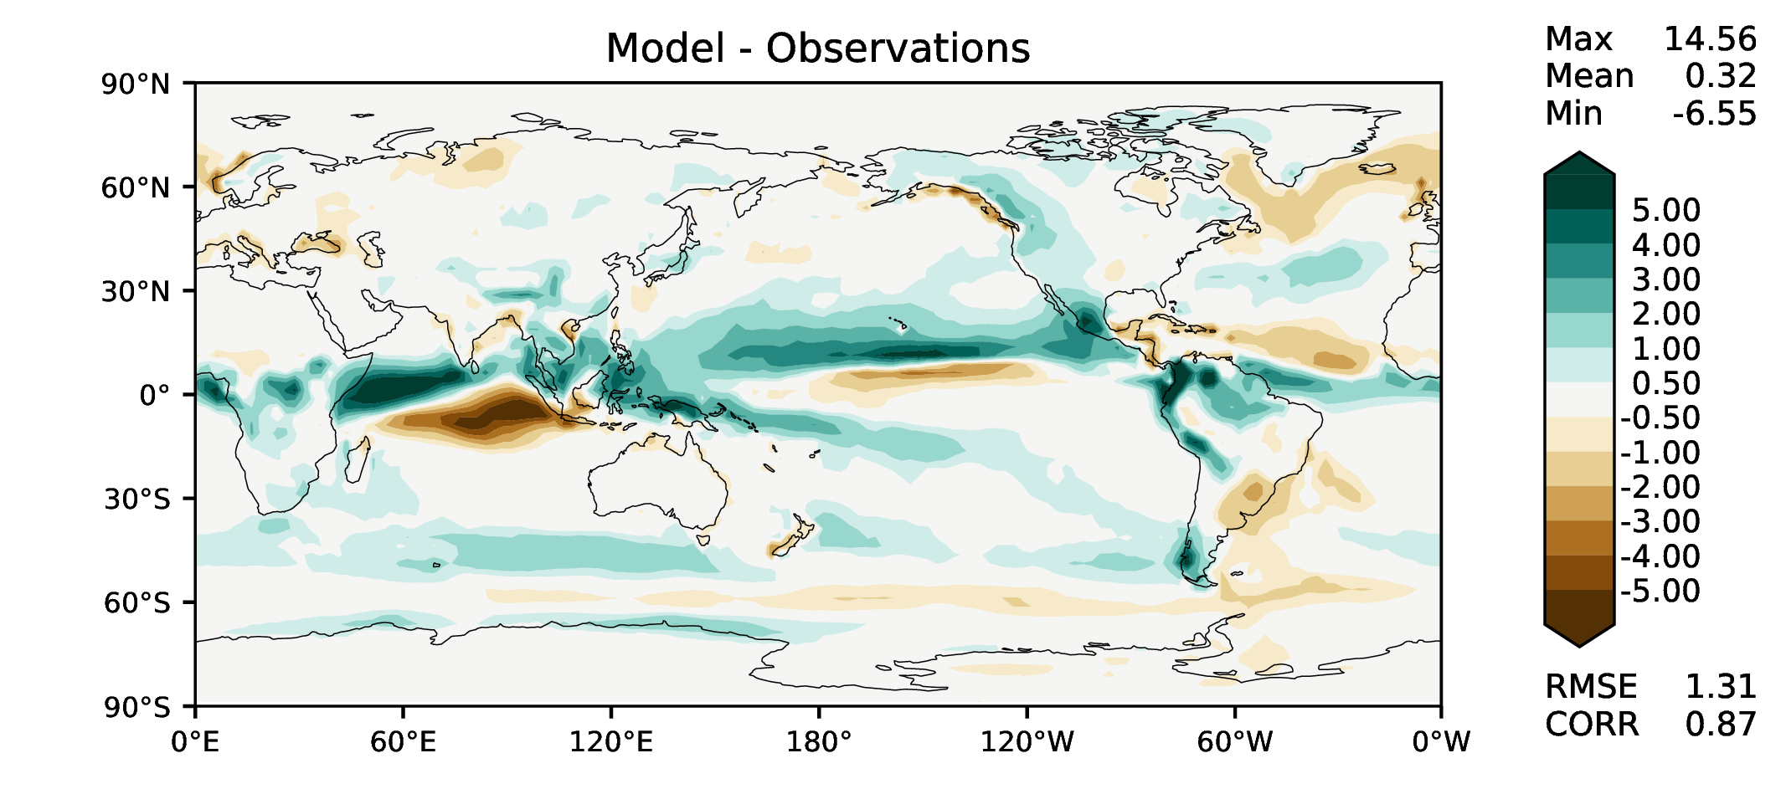
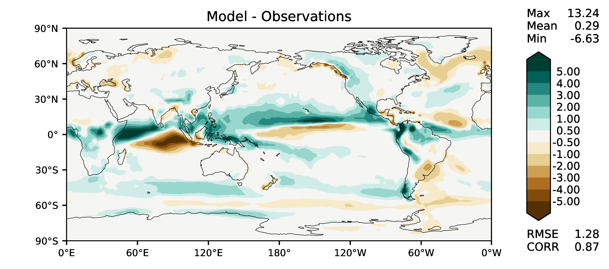
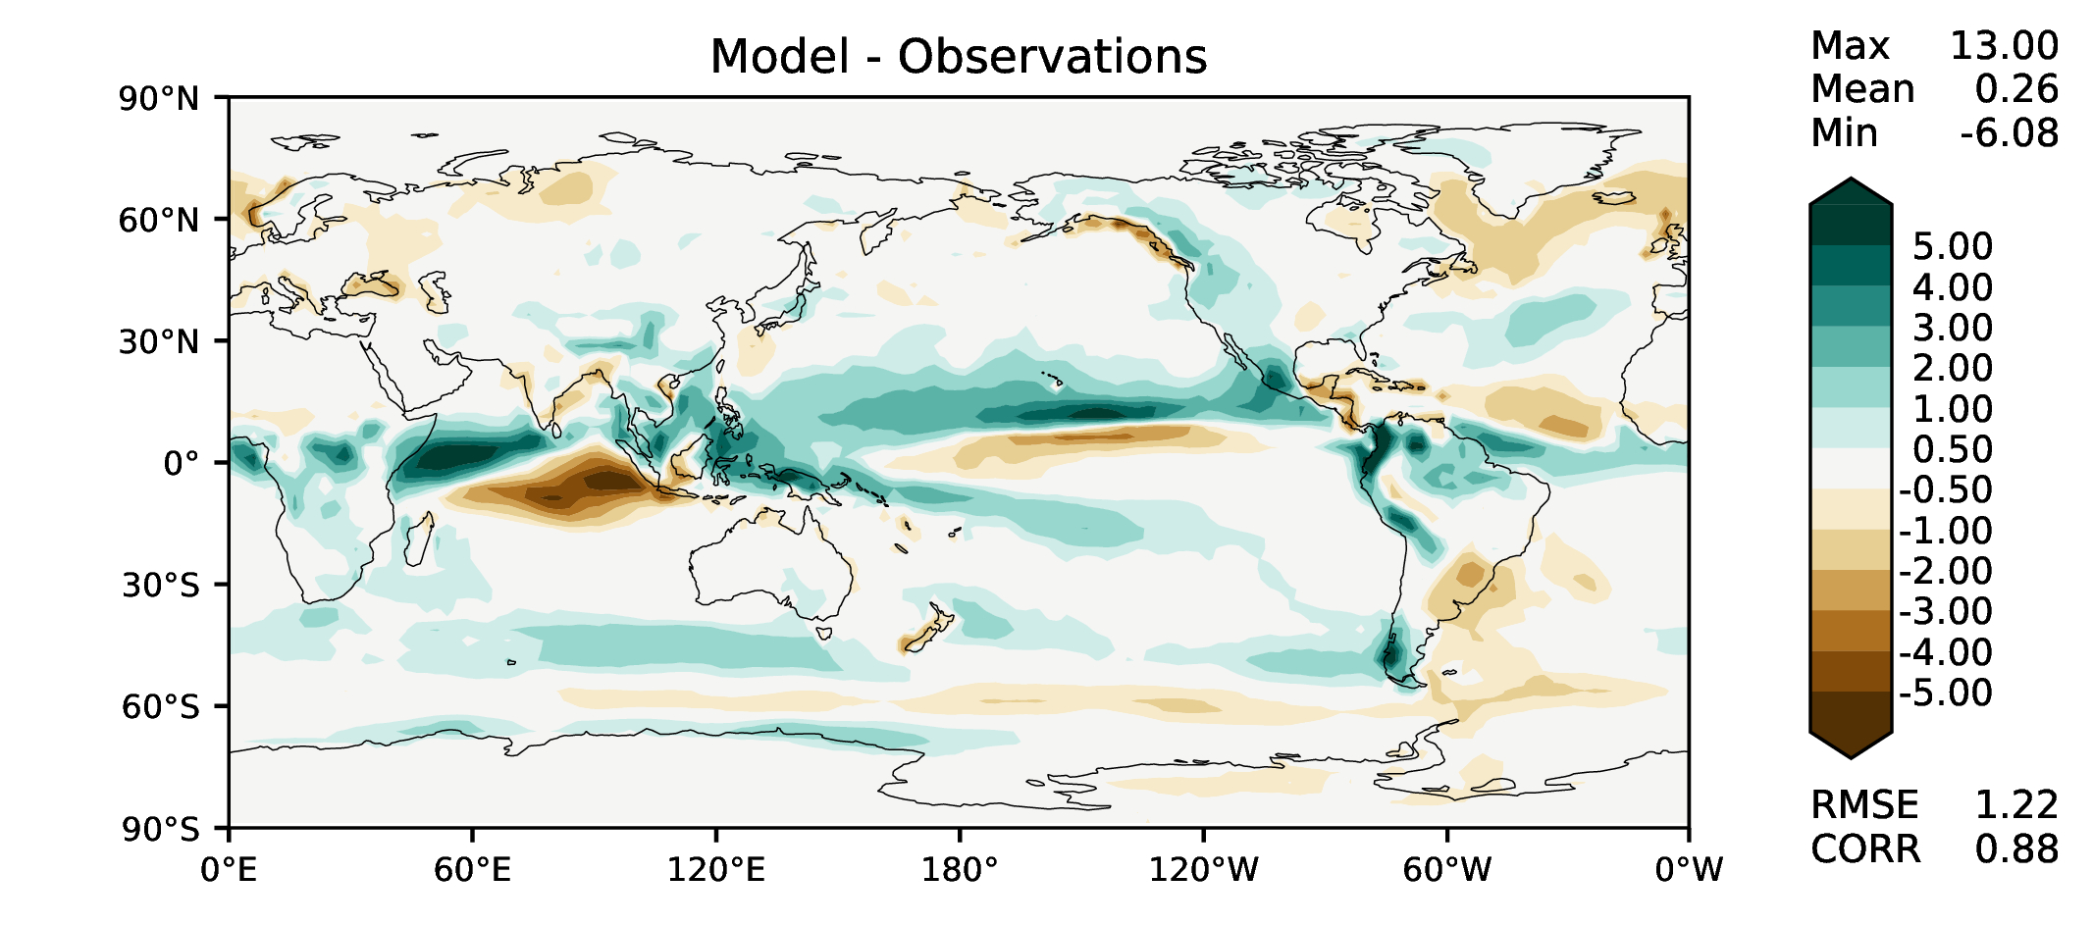
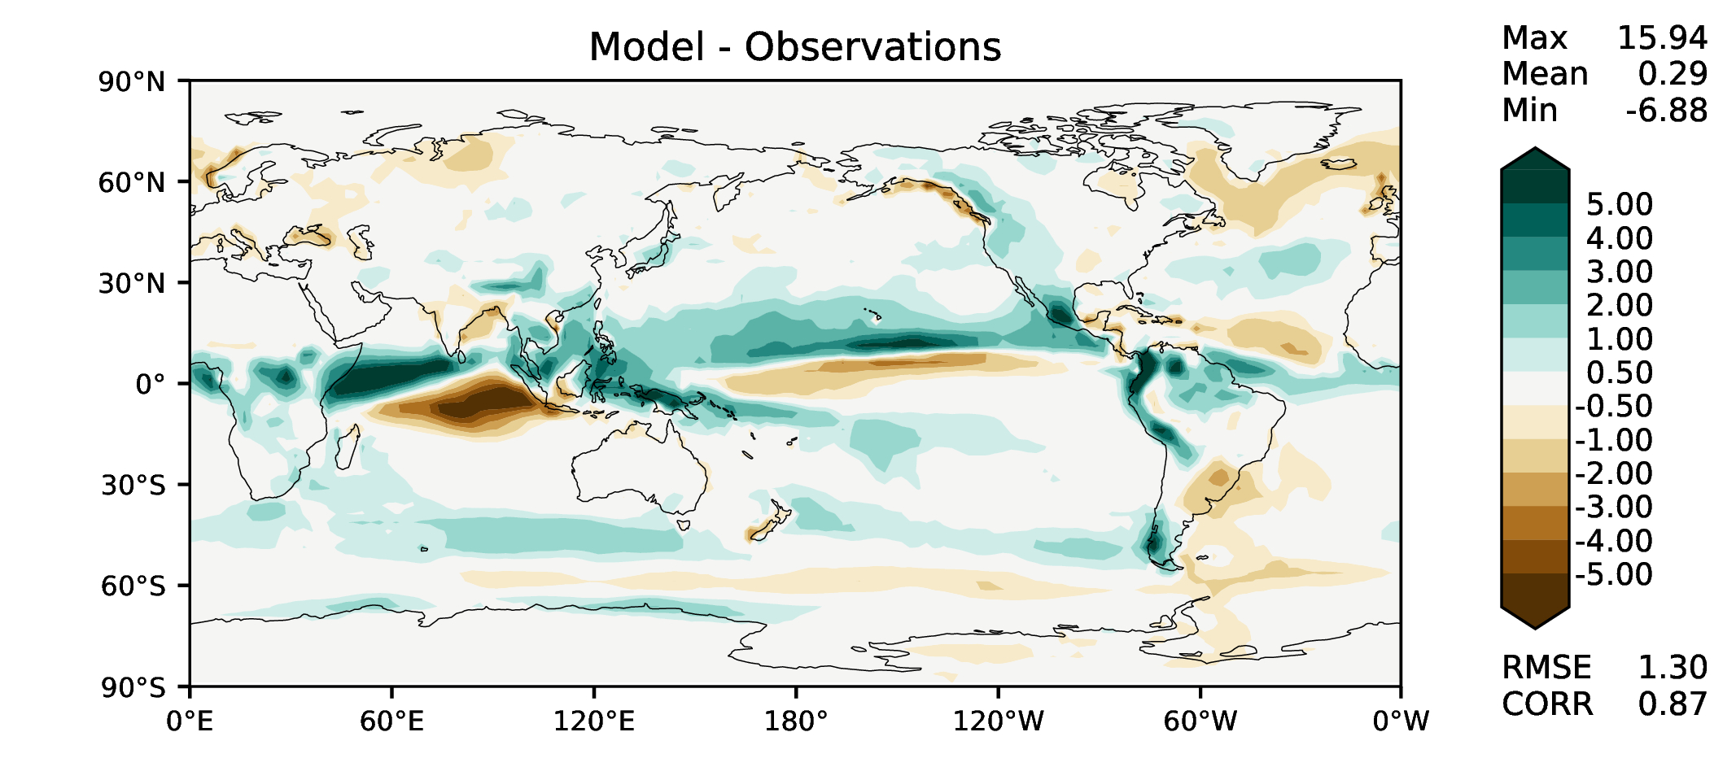
SON total precipitation
v2beta4
v2rc1c
v2rc1e
v2rc1e_1

Slide 8
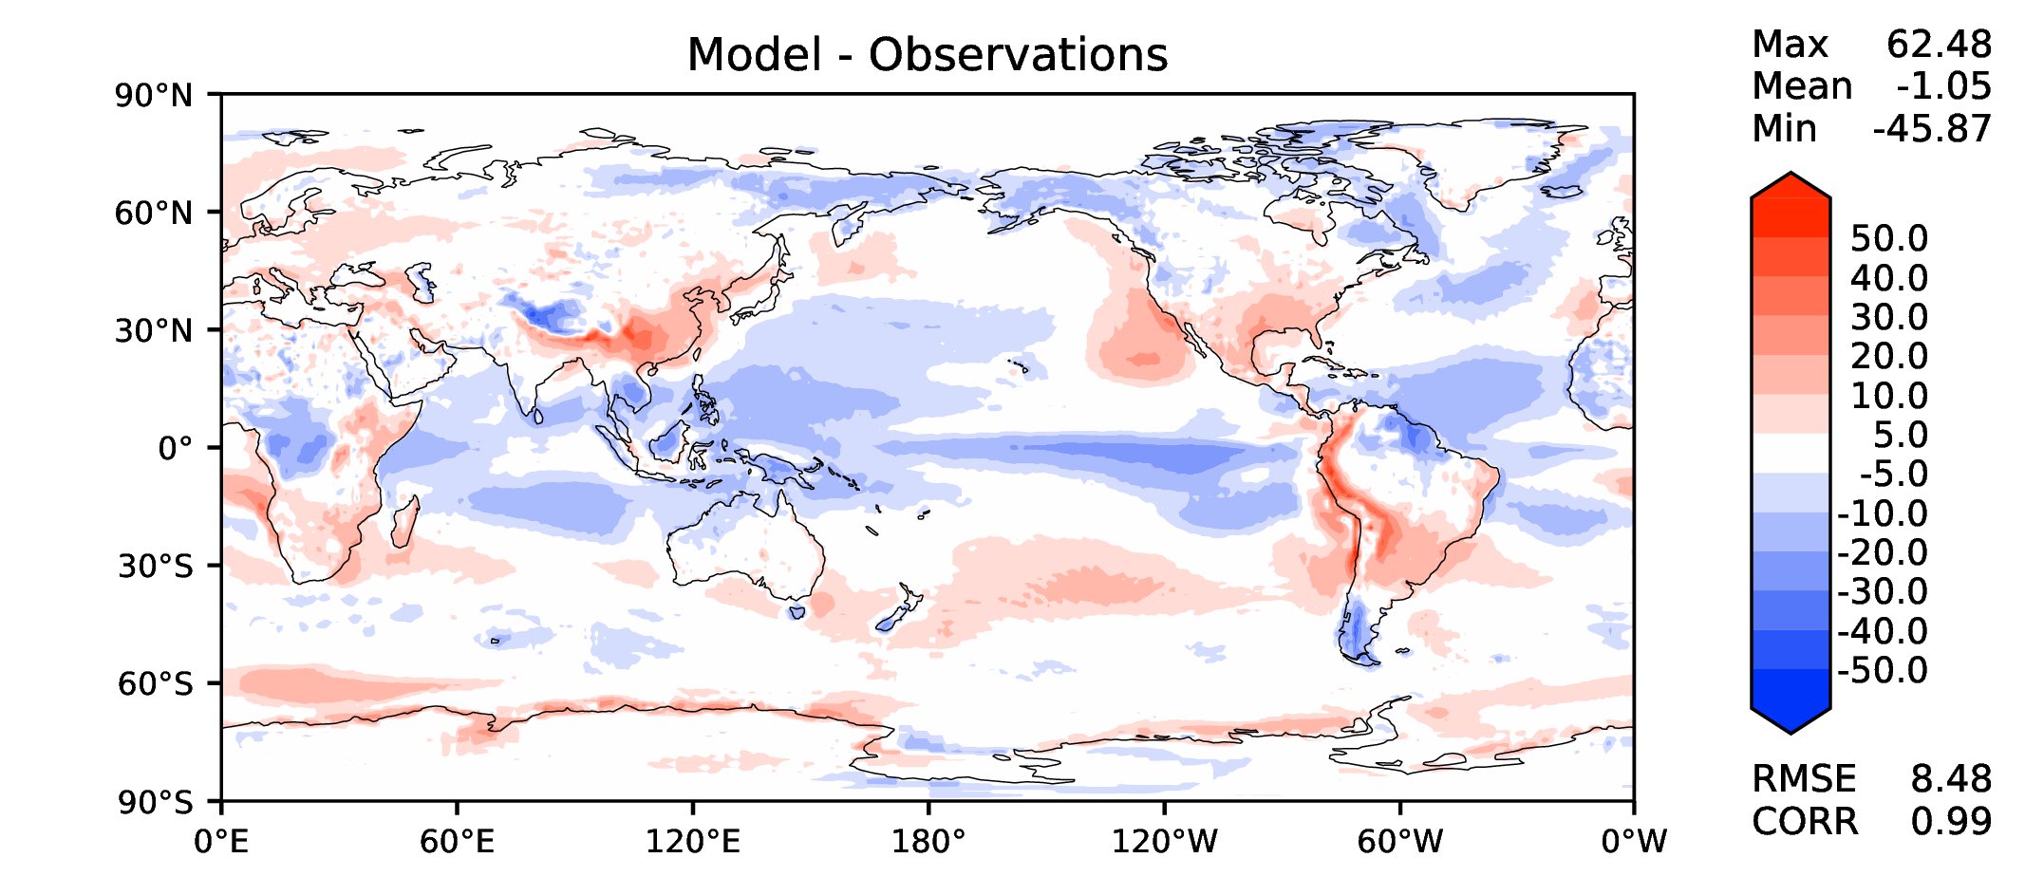
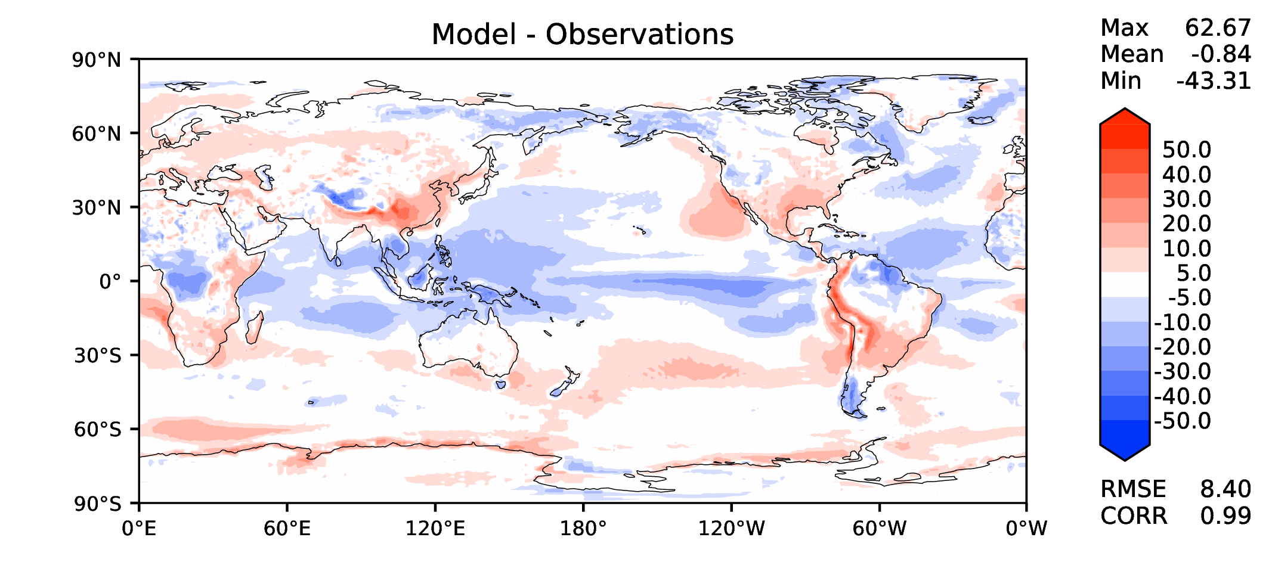
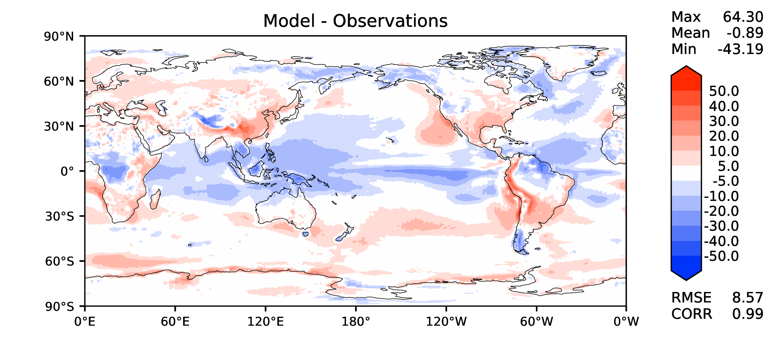
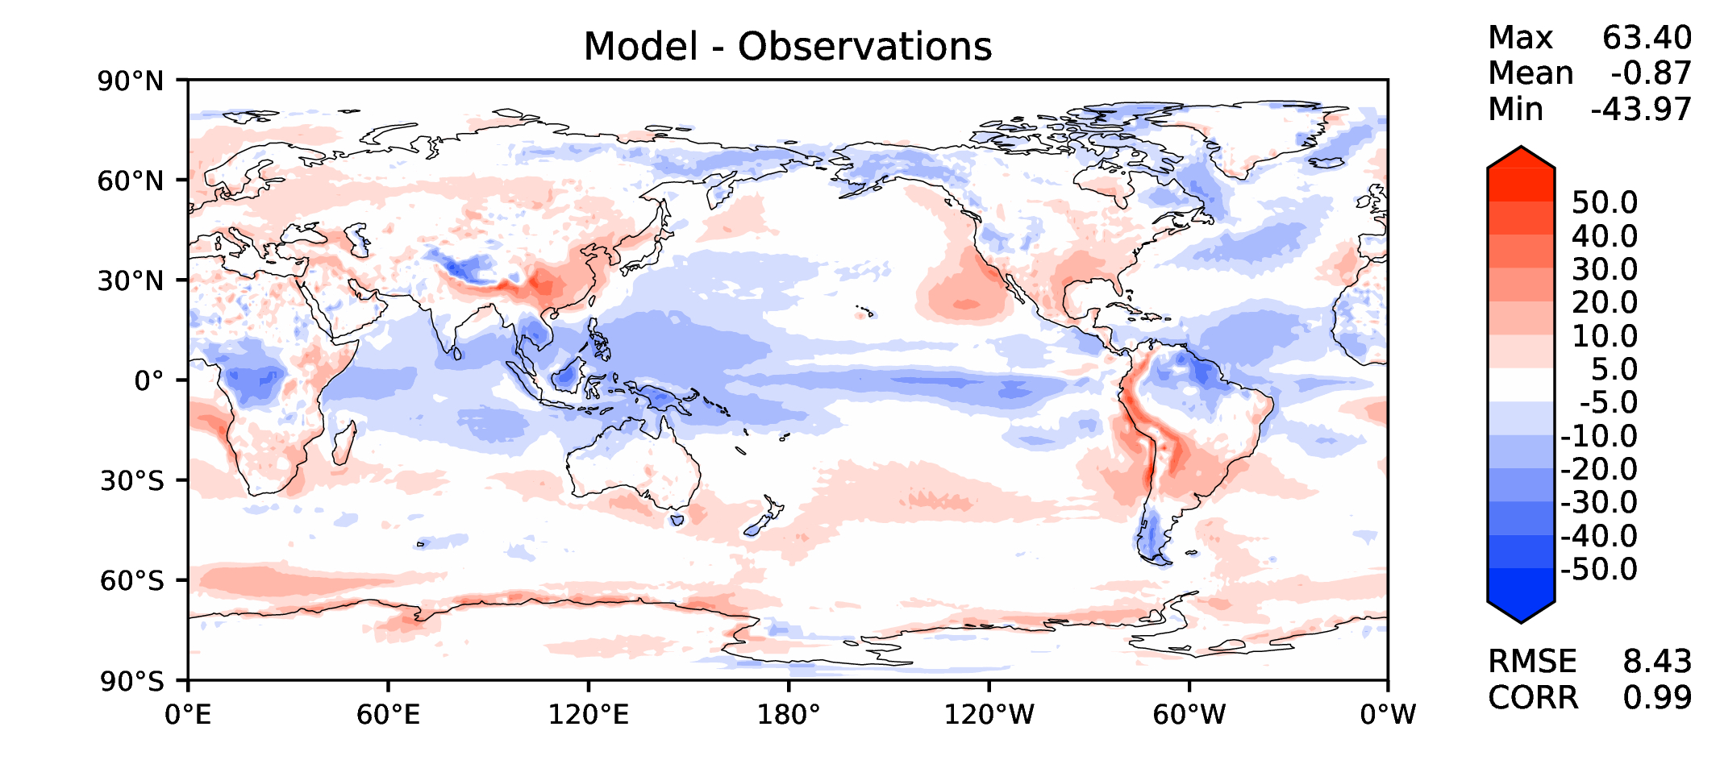
Annual TOA net radiation
v2beta4
v2rc1c
v2rc1e
v2rc1e_1

Slide 9
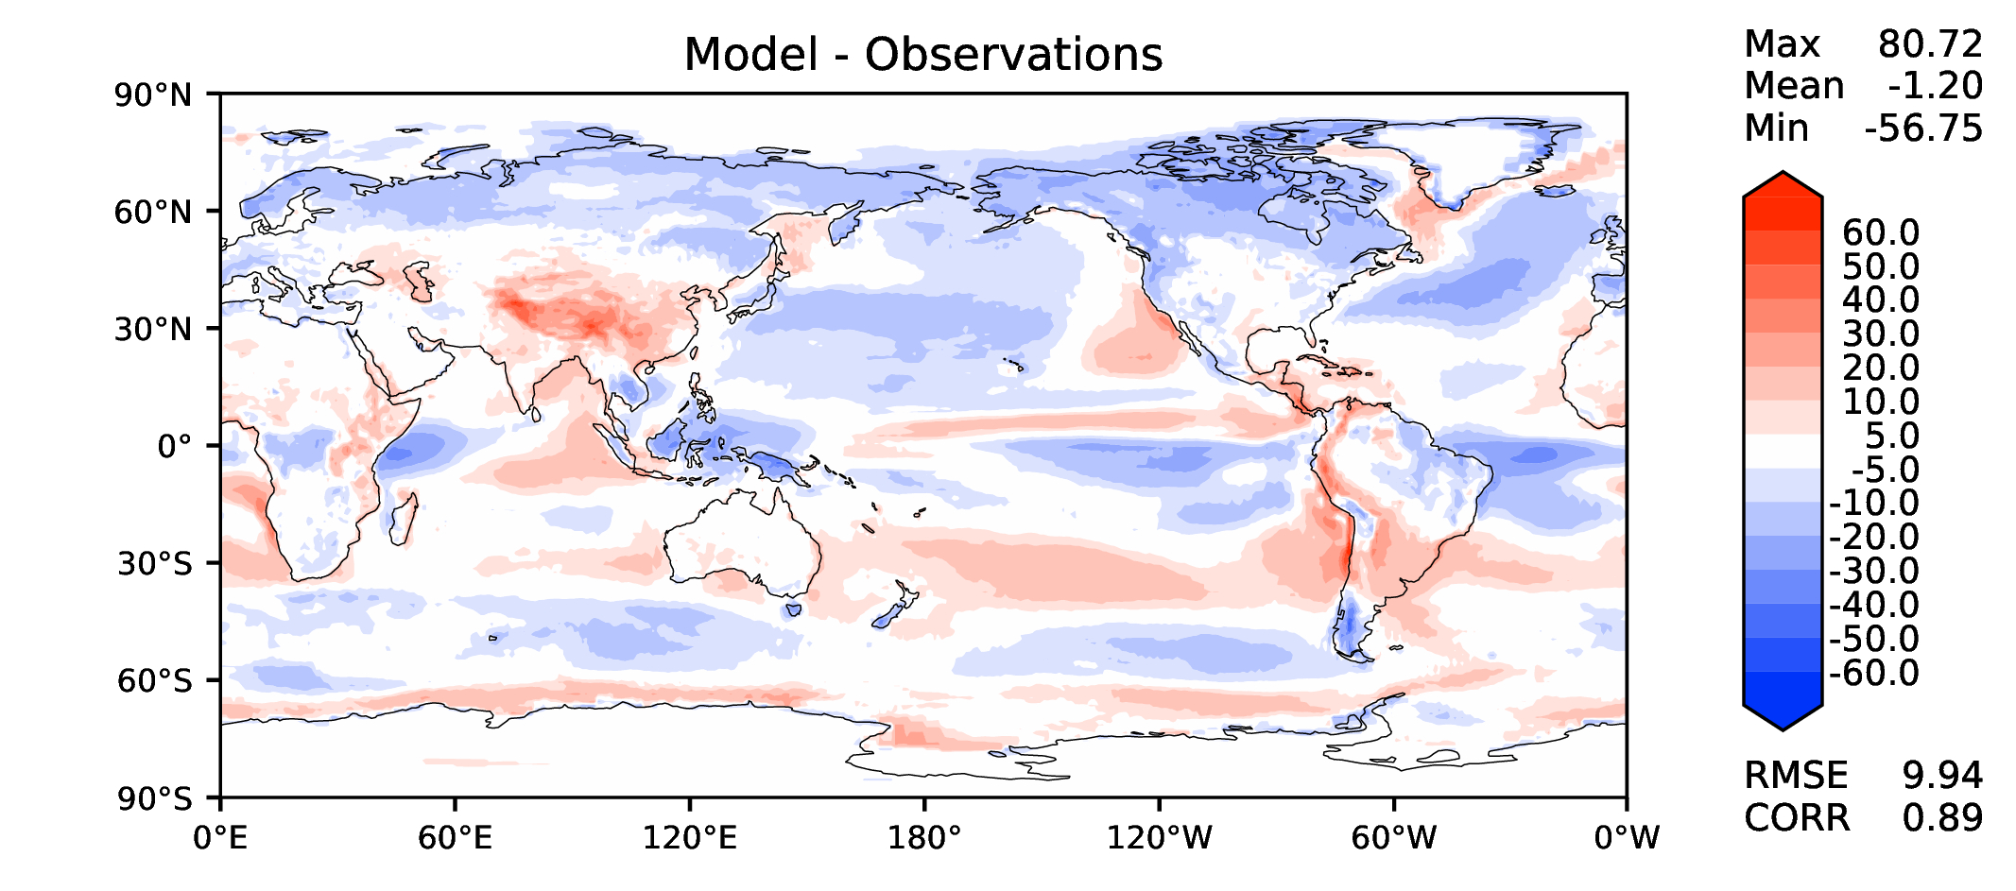
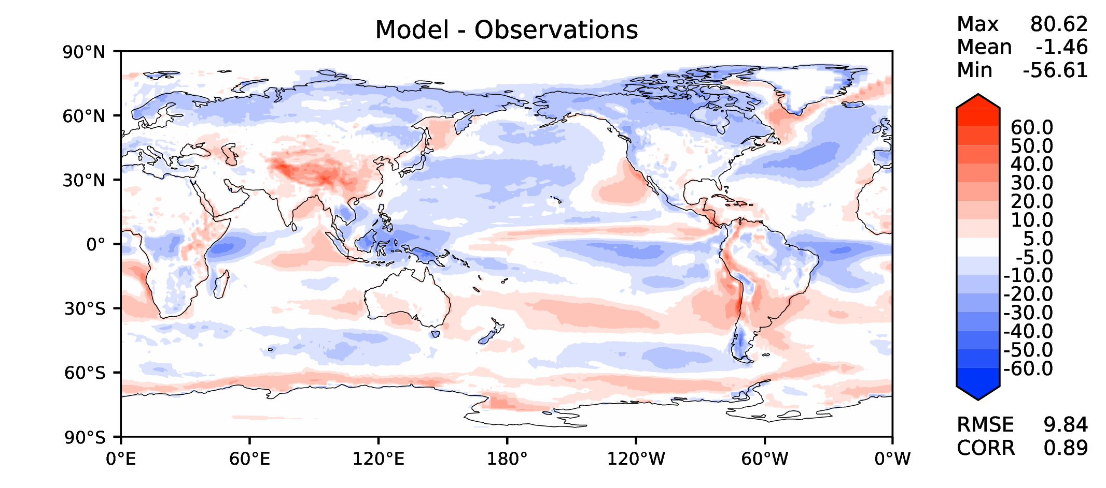
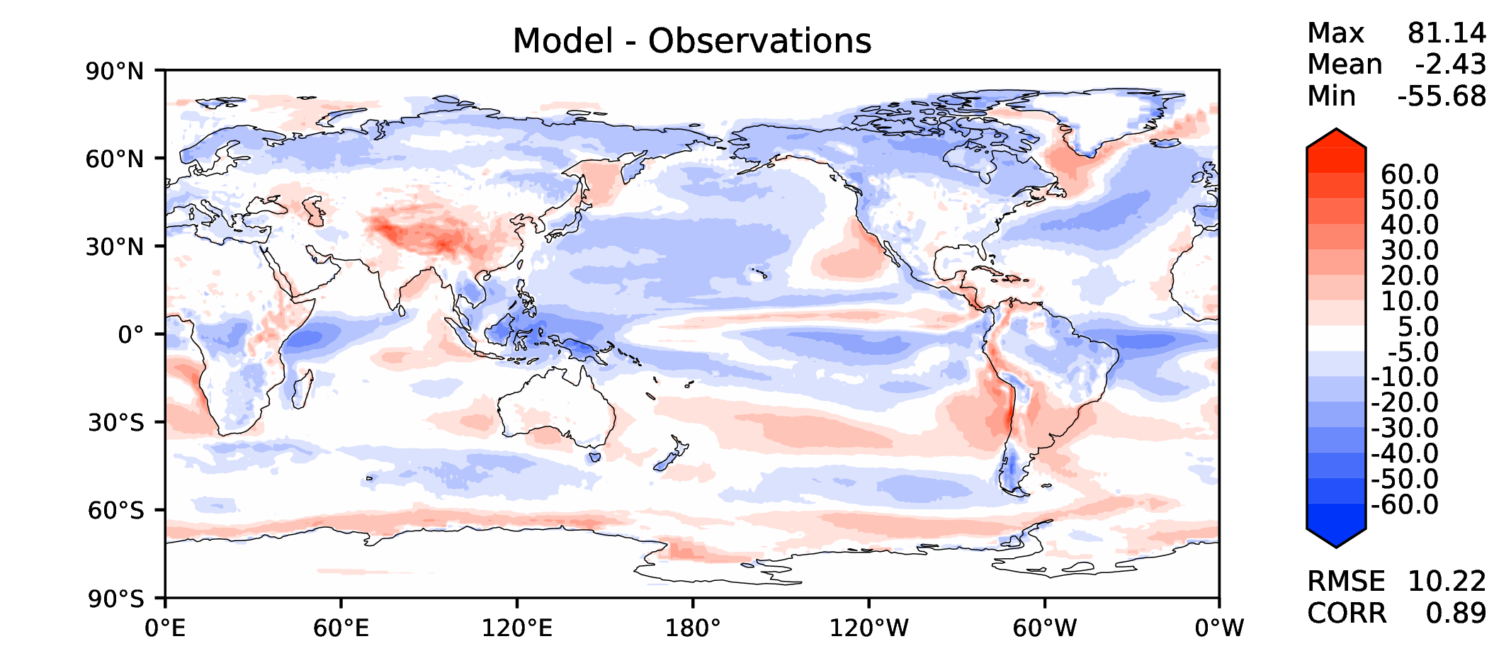
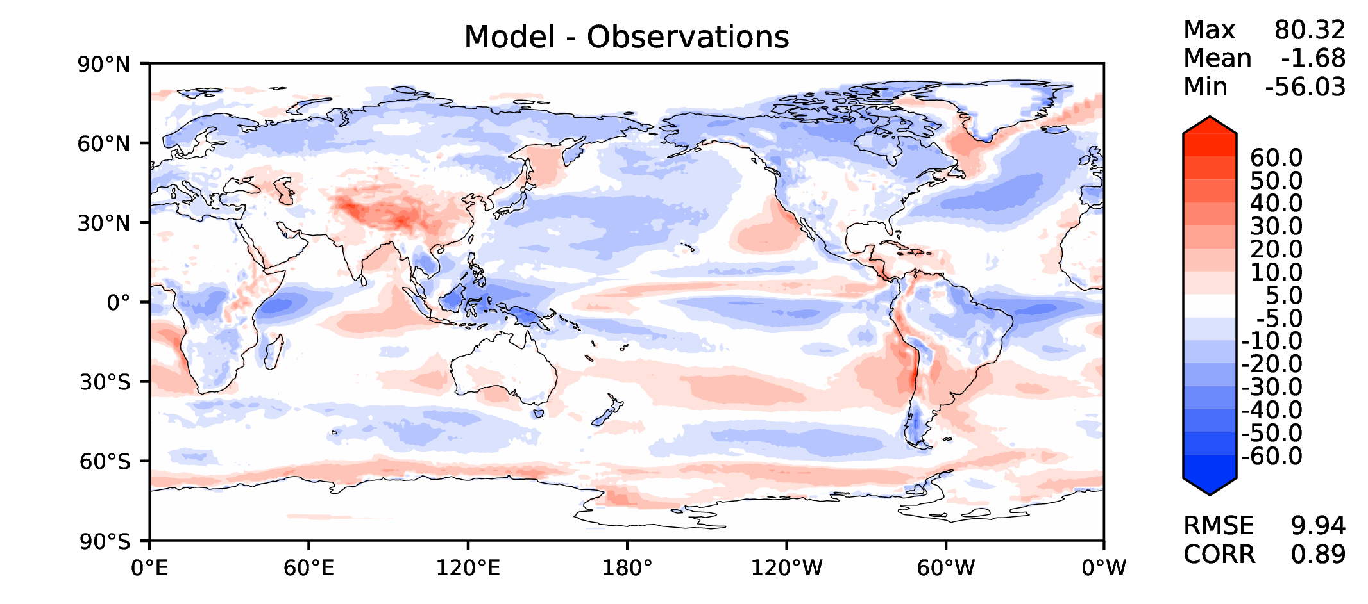
Annual TOA SW CRE
v2beta4
v2rc1c
v2rc1e
v2rc1e_1

Slide 10
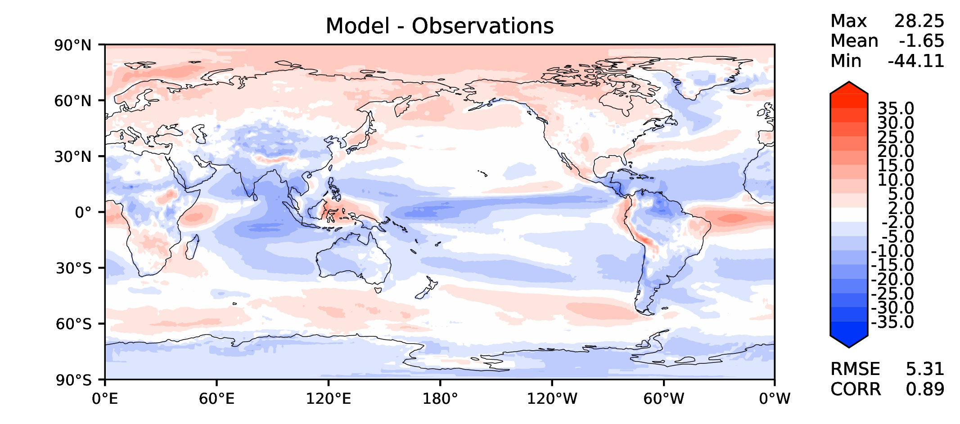
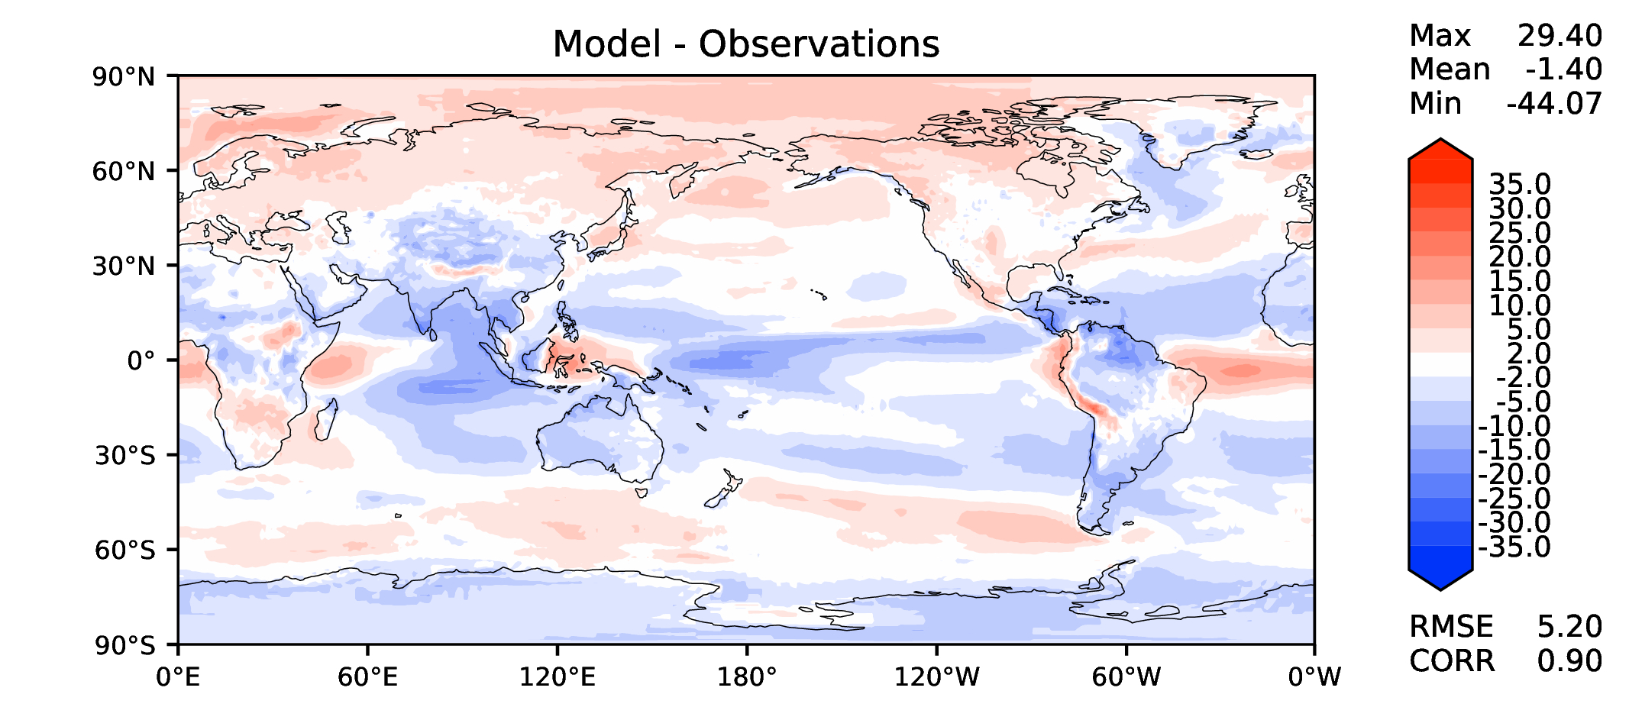
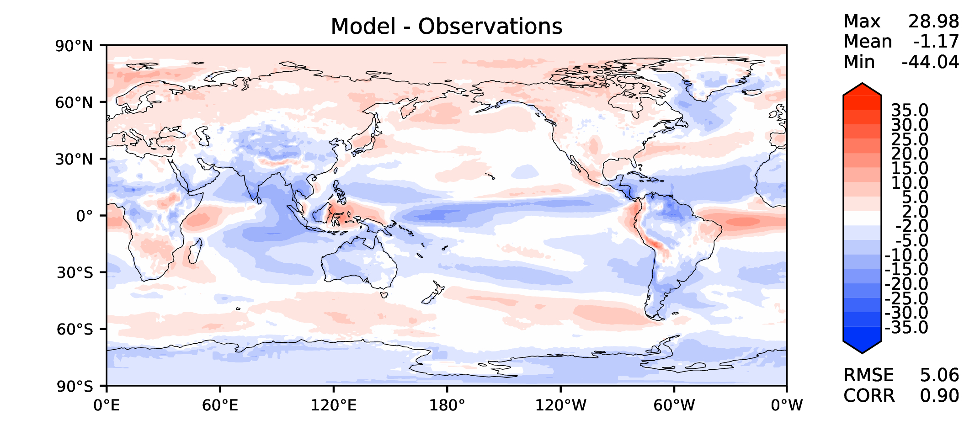
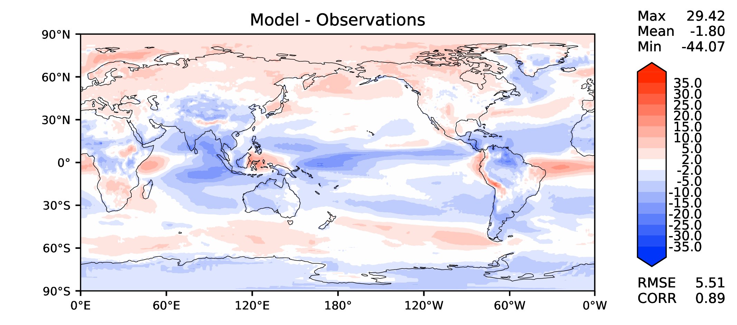
Annual TOA LW CRE
v2beta4
v2rc1c
v2rc1e
v2rc1e_1

Slide 11
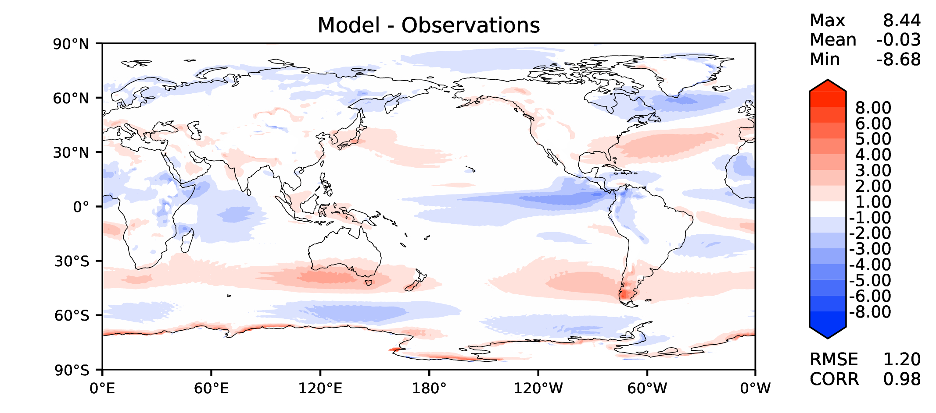
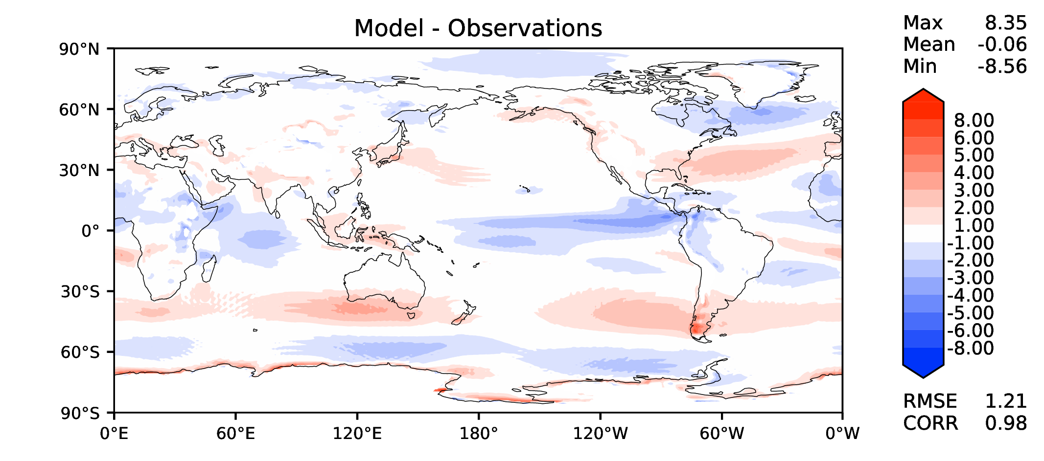
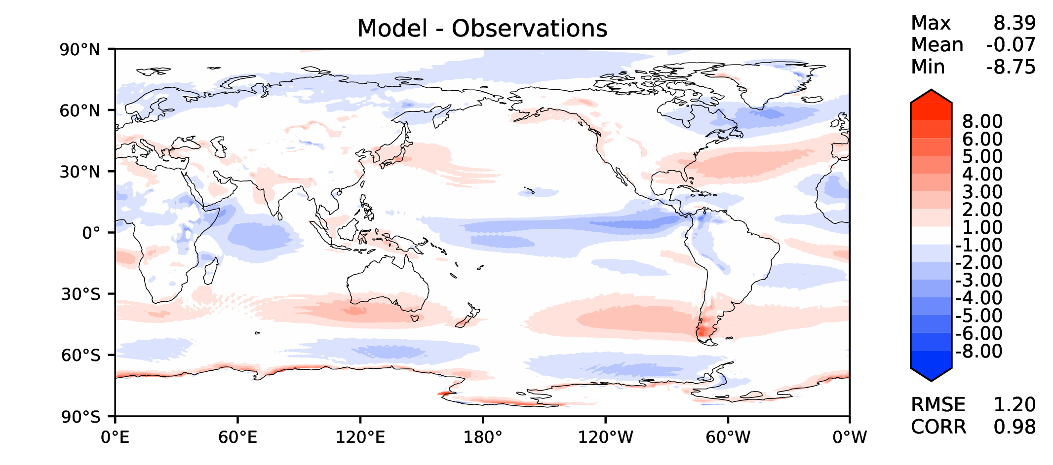
Annual u wind at 850 hPa
v2beta4
v2rc1c
v2rc1e
v2rc1e_1

Slide 12
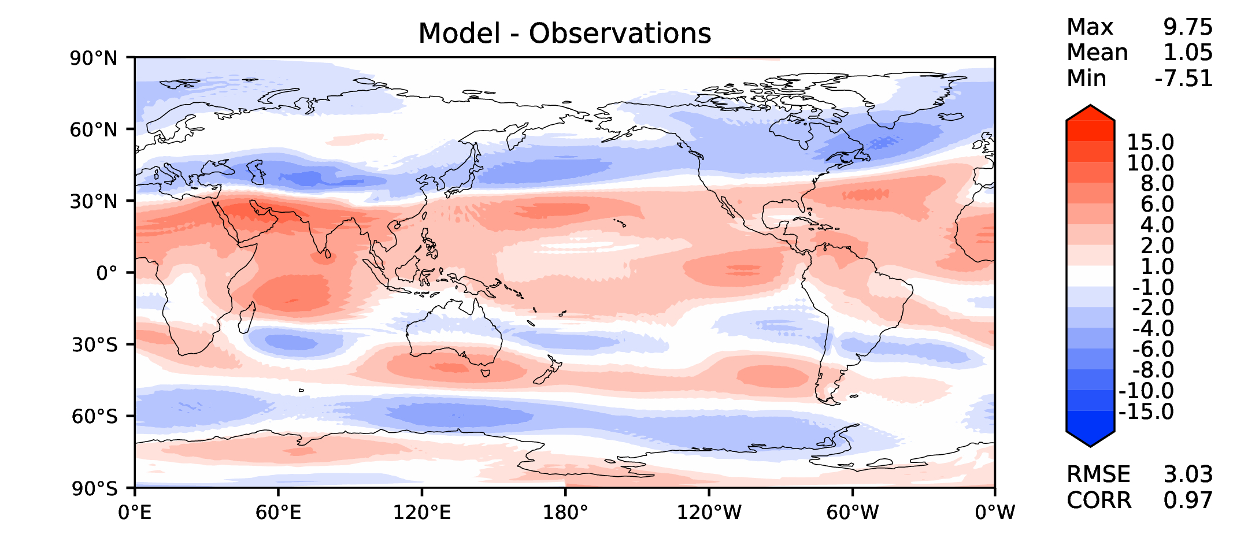
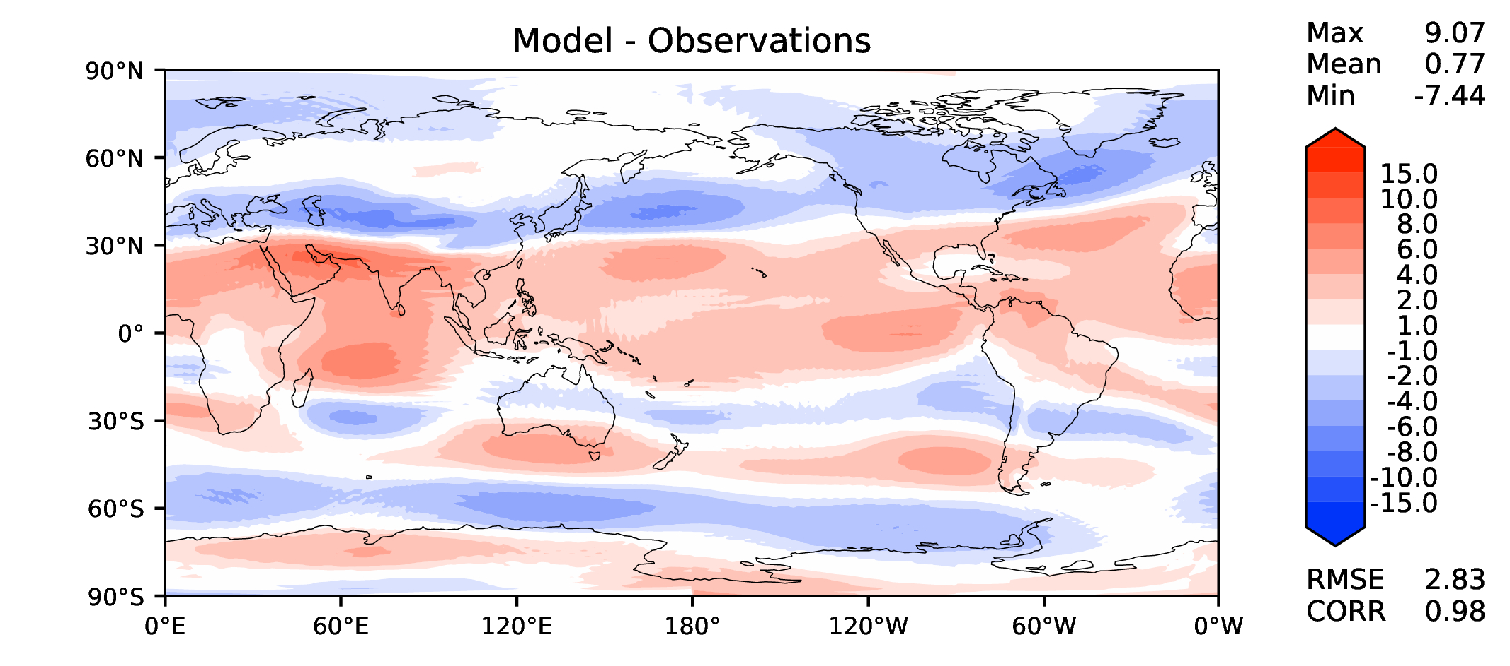
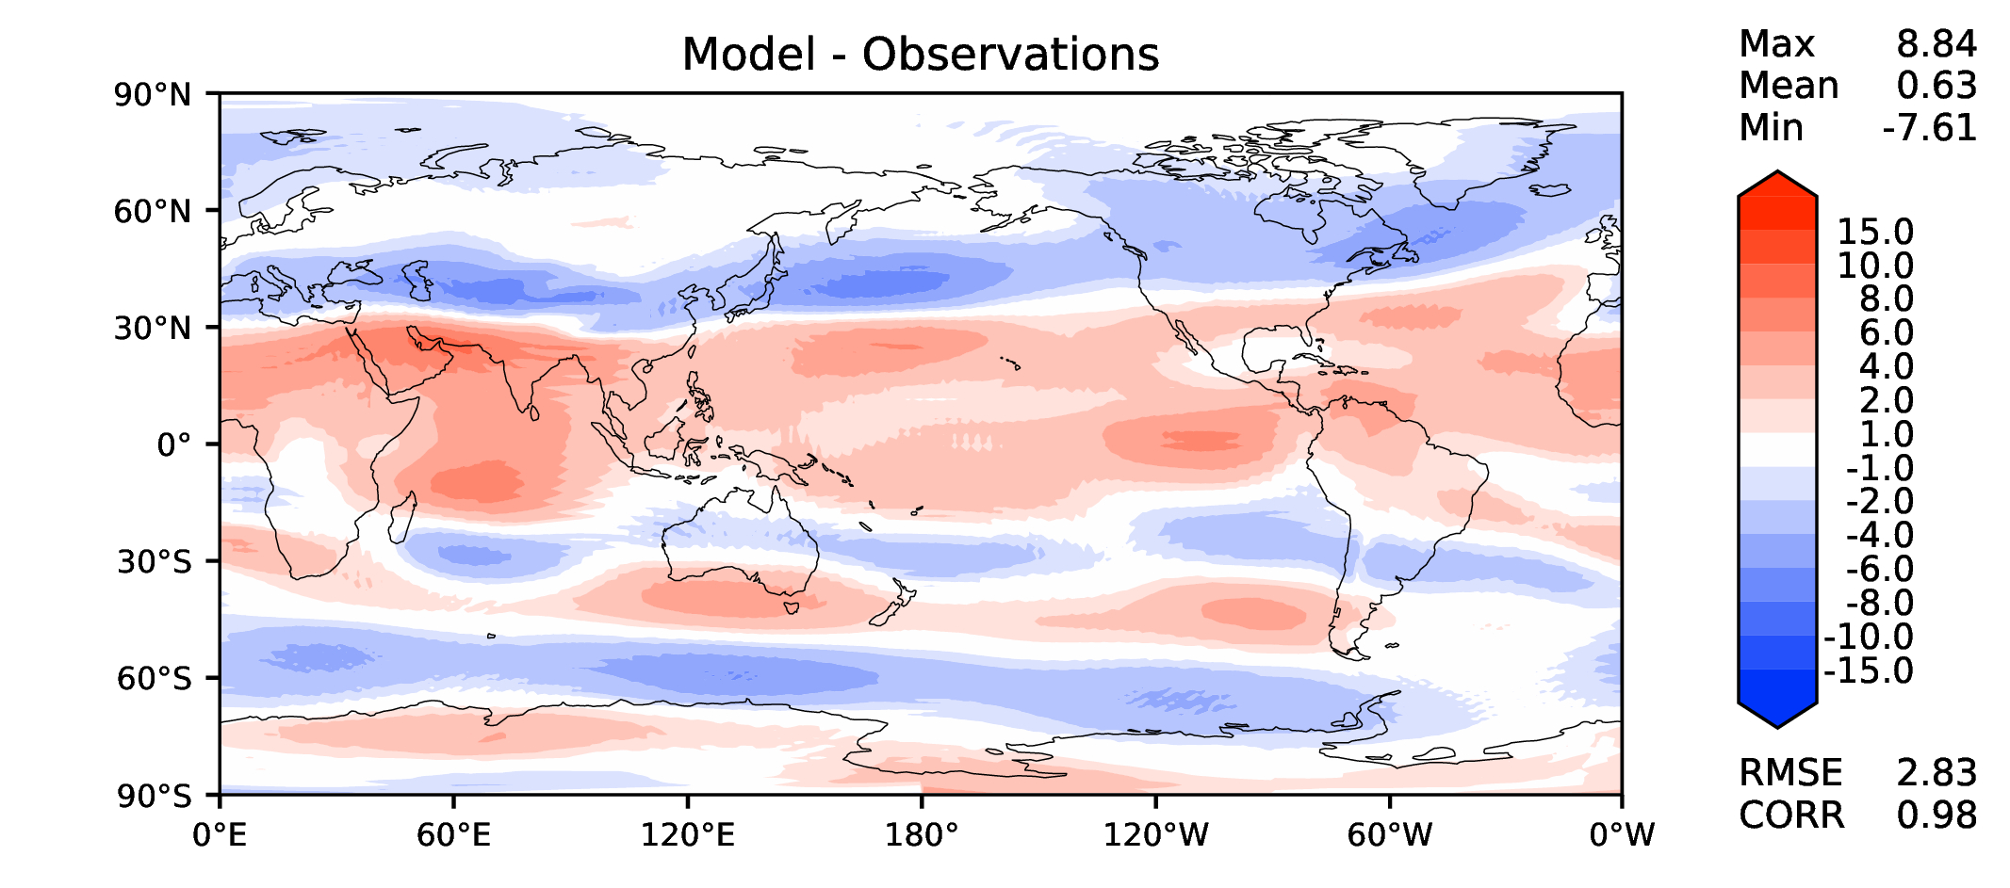
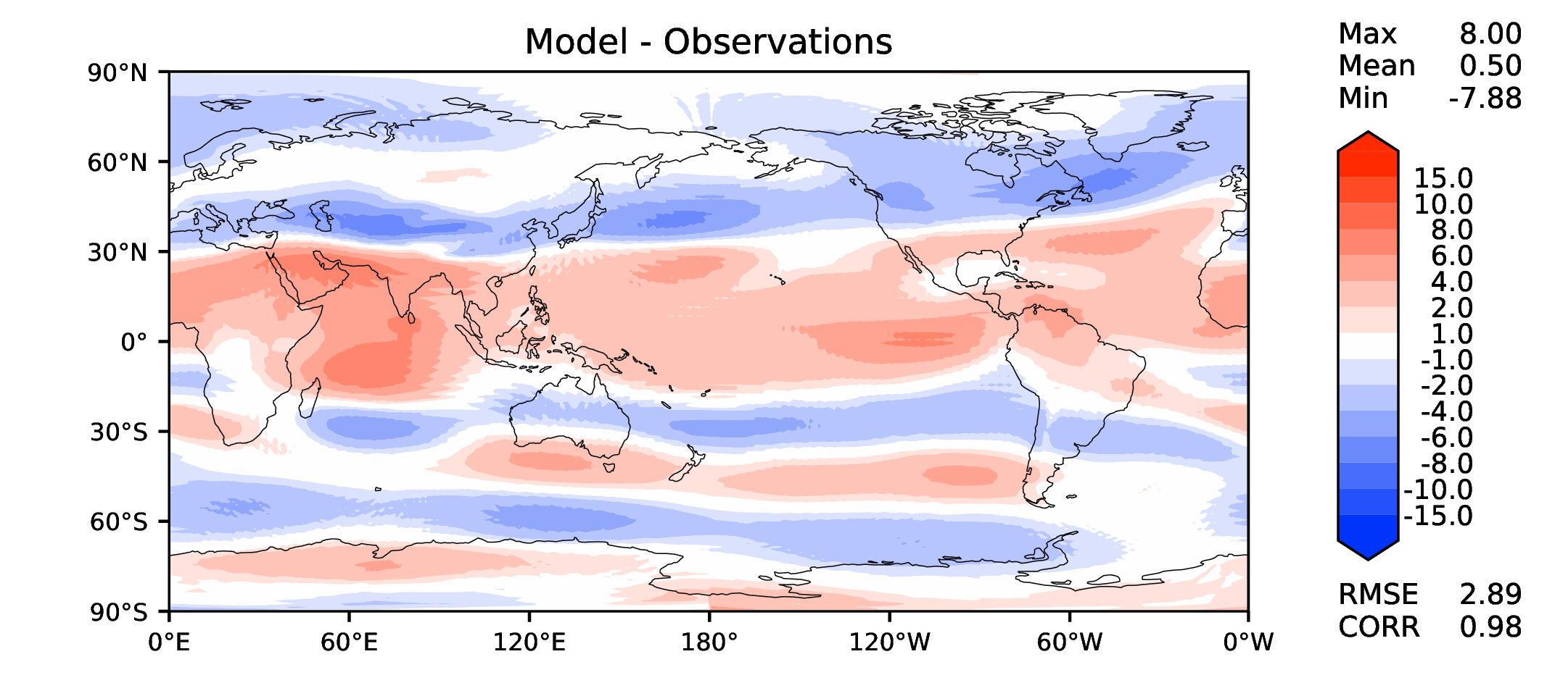
Annual u wind at 200 hPa
v2beta4
v2rc1c
v2rc1e
v2rc1e_1

Slide 13
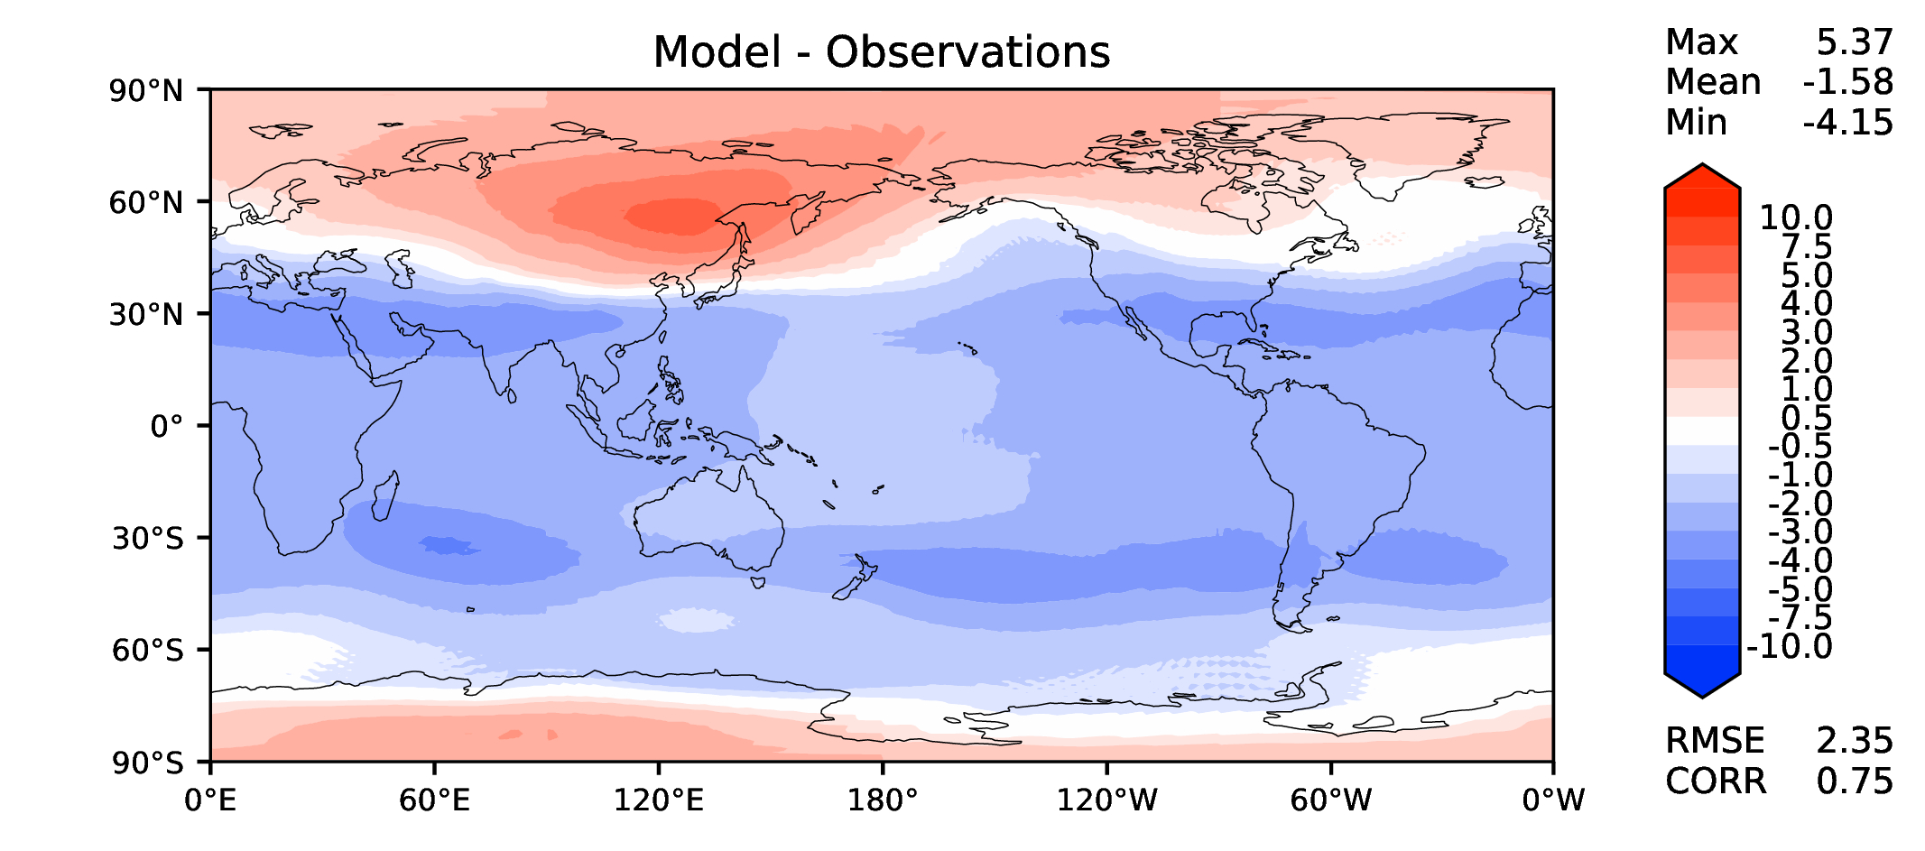
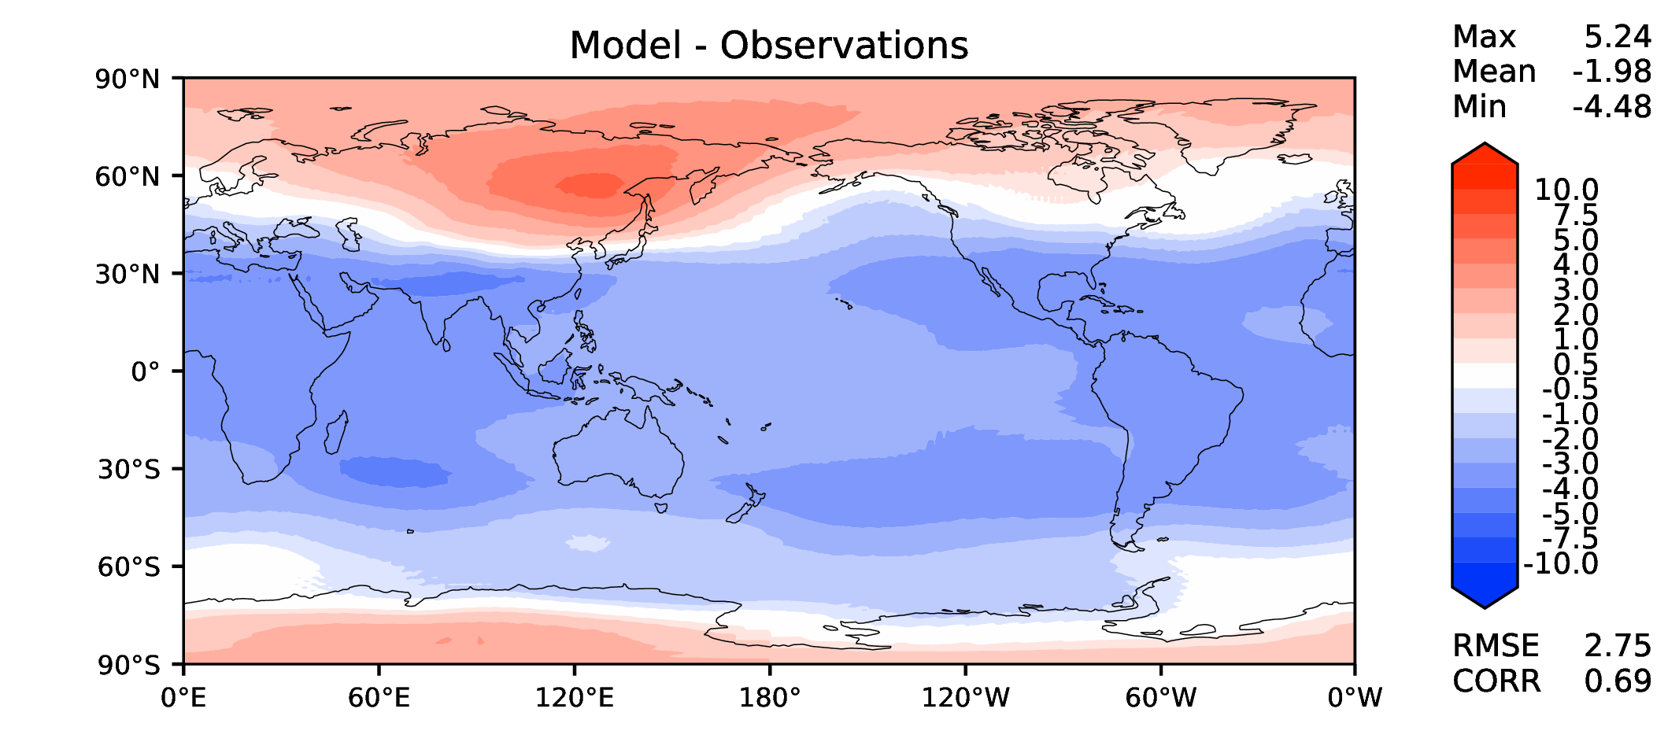
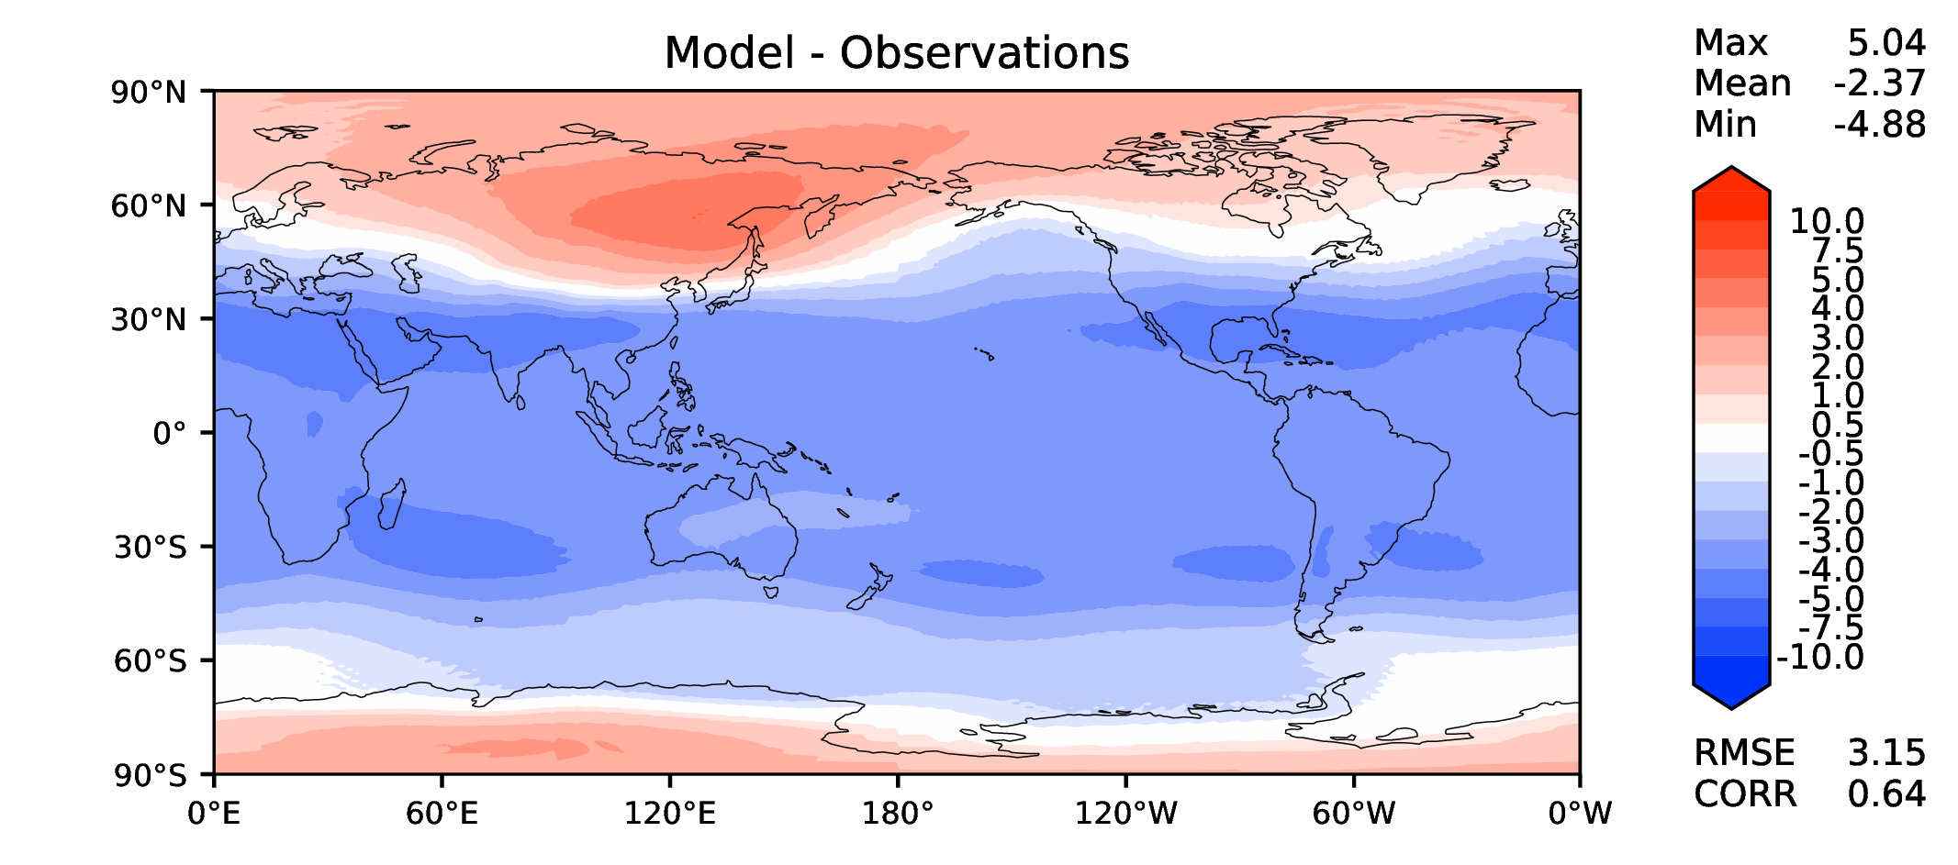
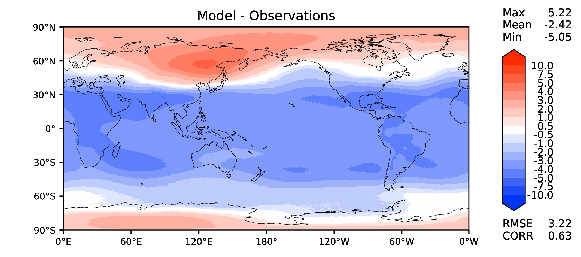
Annual T at 200 hPa
v2beta4
v2rc1c
v2rc1e
v2rc1e_1

Slide 14
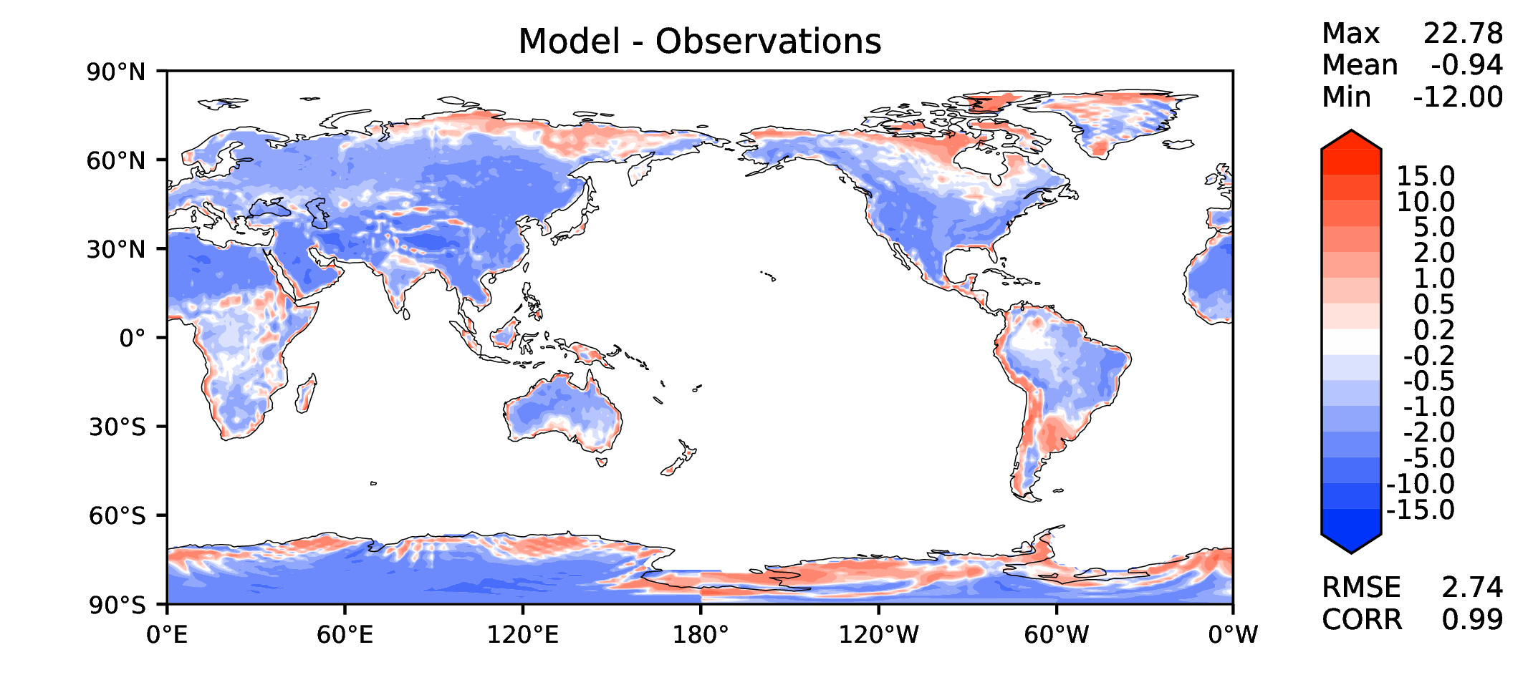
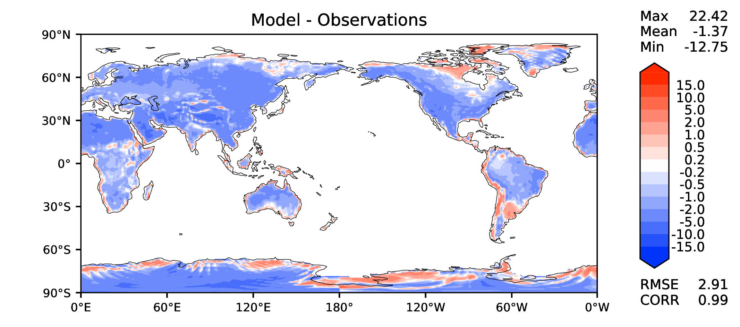
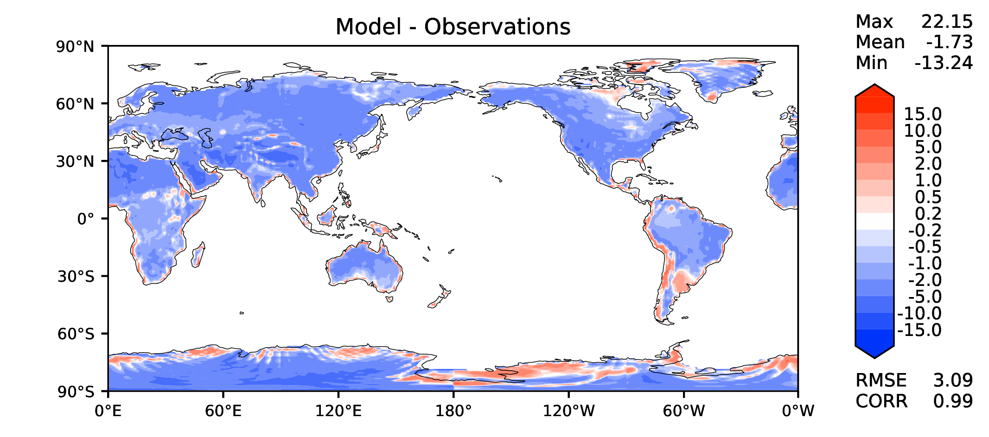
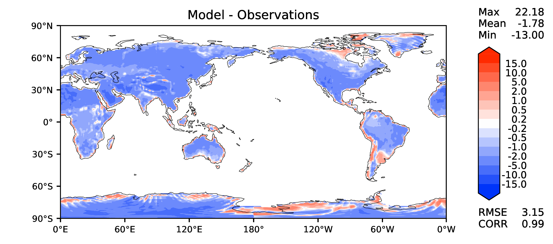
Annual surface air T (land)
v2beta4
v2rc1c
v2rc1e
v2rc1e_1

Slide 15
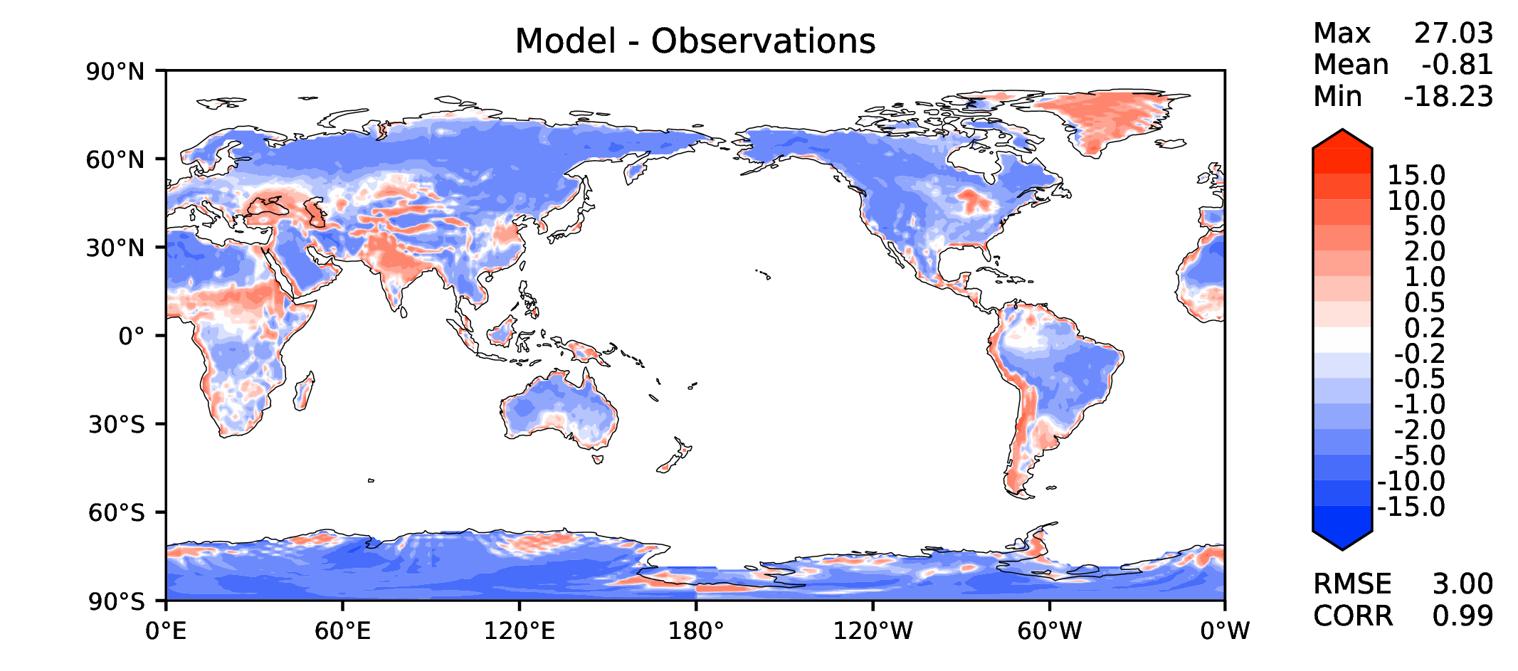
JJA surface air T (land)
v2beta4
v2rc1c
v2rc1e
v2rc1e_1

Slide 16
Aerosol optical depth
v2beta4
v2rc1c
v2rc1e
v2rc1e_1

Slide 17
TAUXY ANN ocean
v2beta4
v2rc1c
v2rc1e
v2rc1e_1

Slide 18
CLDLWP_OCN global SSMI
v2beta4
v2rc1c
v2rc1e
v2rc1e_1

