Slide 1
Summary table (RMSE vs obs)
Variable | Season | DECKv1b | v2beta4 | v2rc1c | v2rc1e
SST | ANN | 1.10 | 1.22 | 1.19 | 1.23
PRECT | ANN | 1.12 | 1.01 | 0.98 | 0.96
PRECT | DJF | 1.40 | 1.37 | 1.36 | 1.31
PRECT | MAM | 1.51 | 1.30 | 1.23 | 1.20
PRECT | JJA | 1.51 | 1.42 | 1.34 | 1.31
PRECT | SON | 1.30 | 1.31 | 1.28 | 1.22
RESTOM | ANN | 9.28 | 8.48 | 8.40 | 8.57
SWCF | ANN | 10.61 | 9.94 | 9.84 | 10.22
LWCF | ANN | 5.28 | 5.31 | 5.20 | 5.06
u850 | ANN | 1.28 | 1.20 | 1.21 | 1.19
u200 | ANN | 2.20 | 3.03 | 2.83 | 2.83
T200 | ANN | 2.62 | 2.35 | 2.75 | 3.15
TREFHT | ANN | 2.58 | 2.74 | 2.91 | 3.09
TREFHT | JJA | 2.84 | 3.00 | 3.05 | 3.22
AODVIS | ANN | 0.07 | 0.06 | 0.06 | 0.06
TAUXY | ANN | 0.02 | 0.02 | 0.02 | 0.02

Slide 2
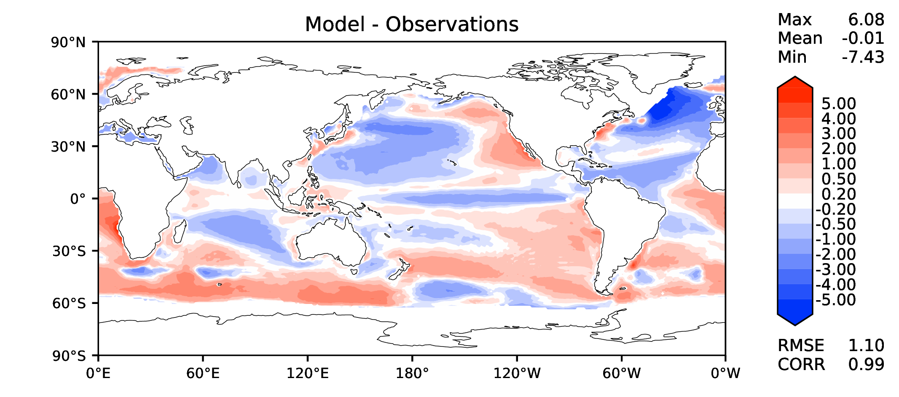
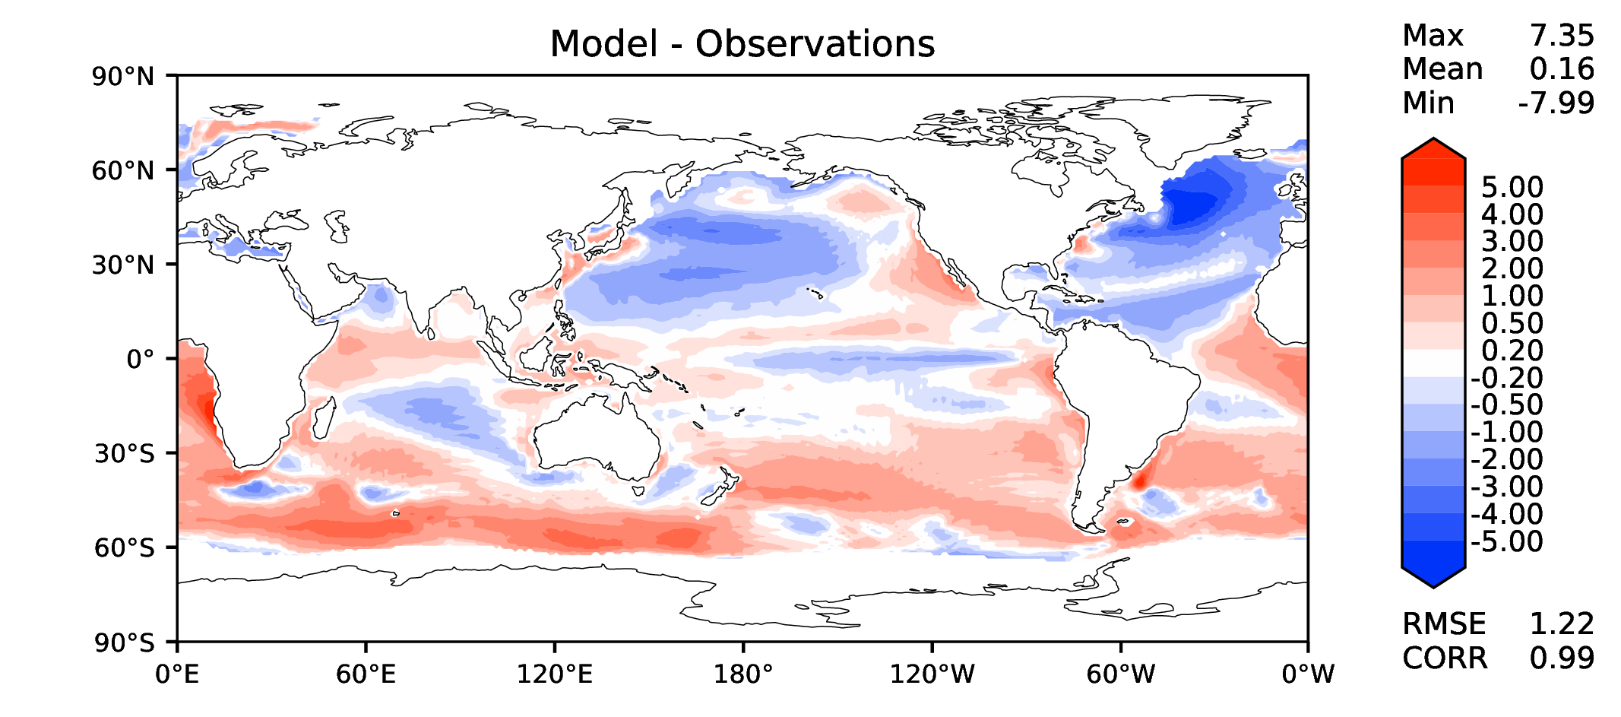
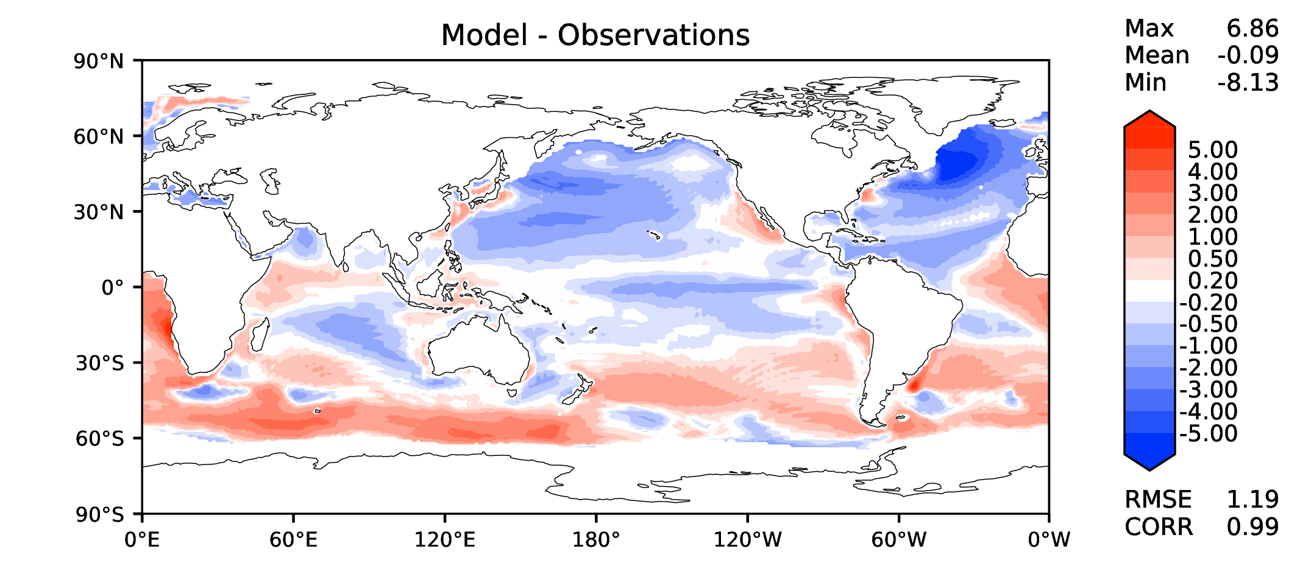
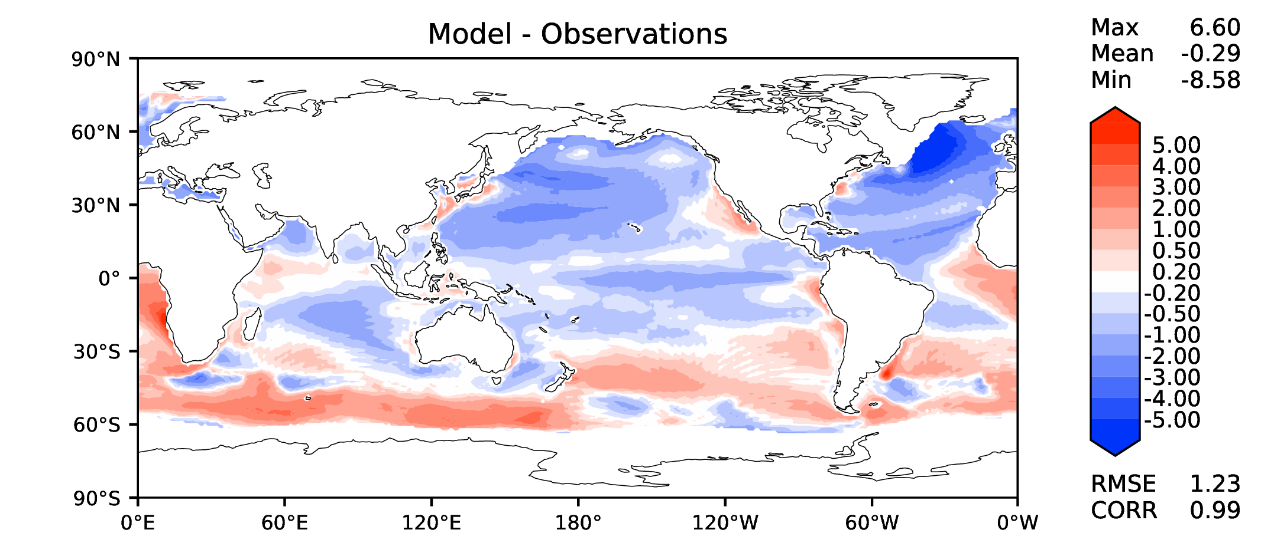
Annual SST (pre-industrial)
DECKv1b
v2beta4
v2rc1c
v2rc1e

Slide 3
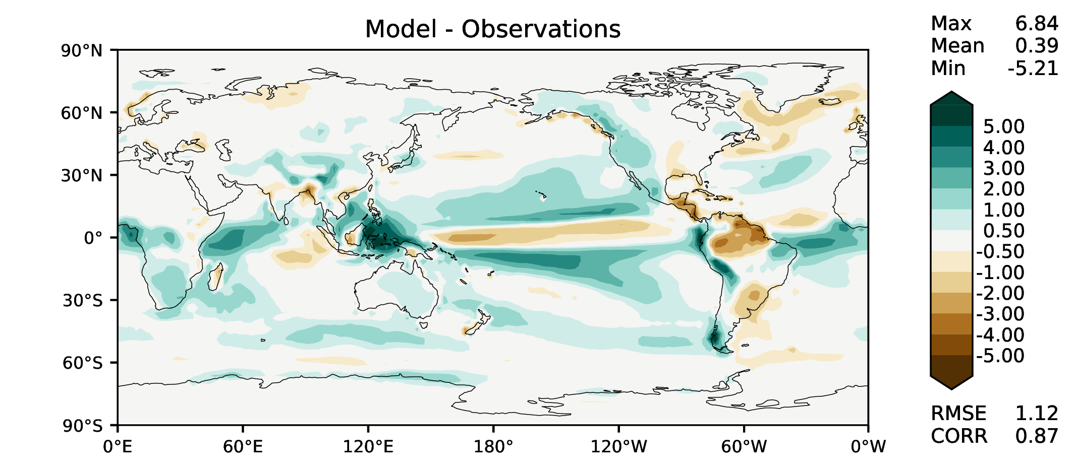
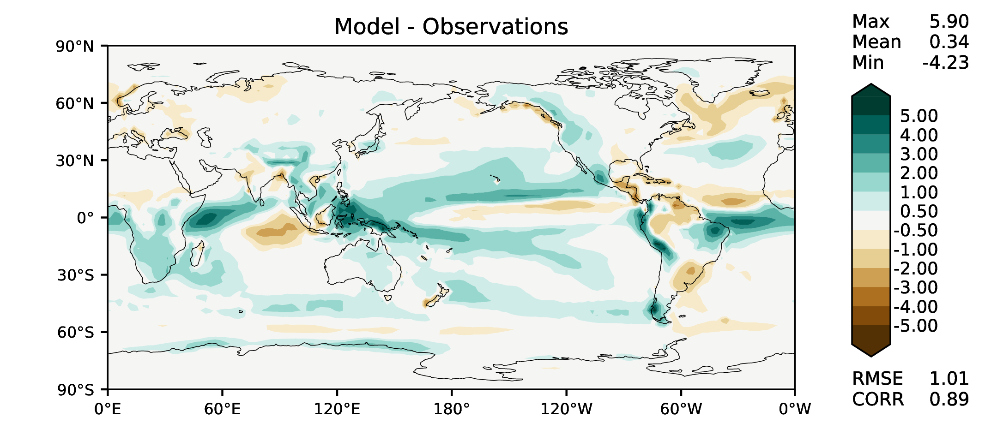
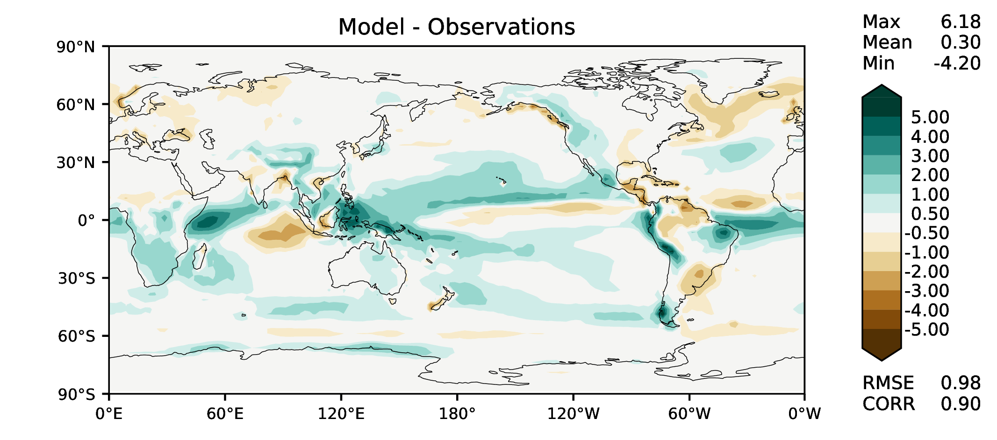
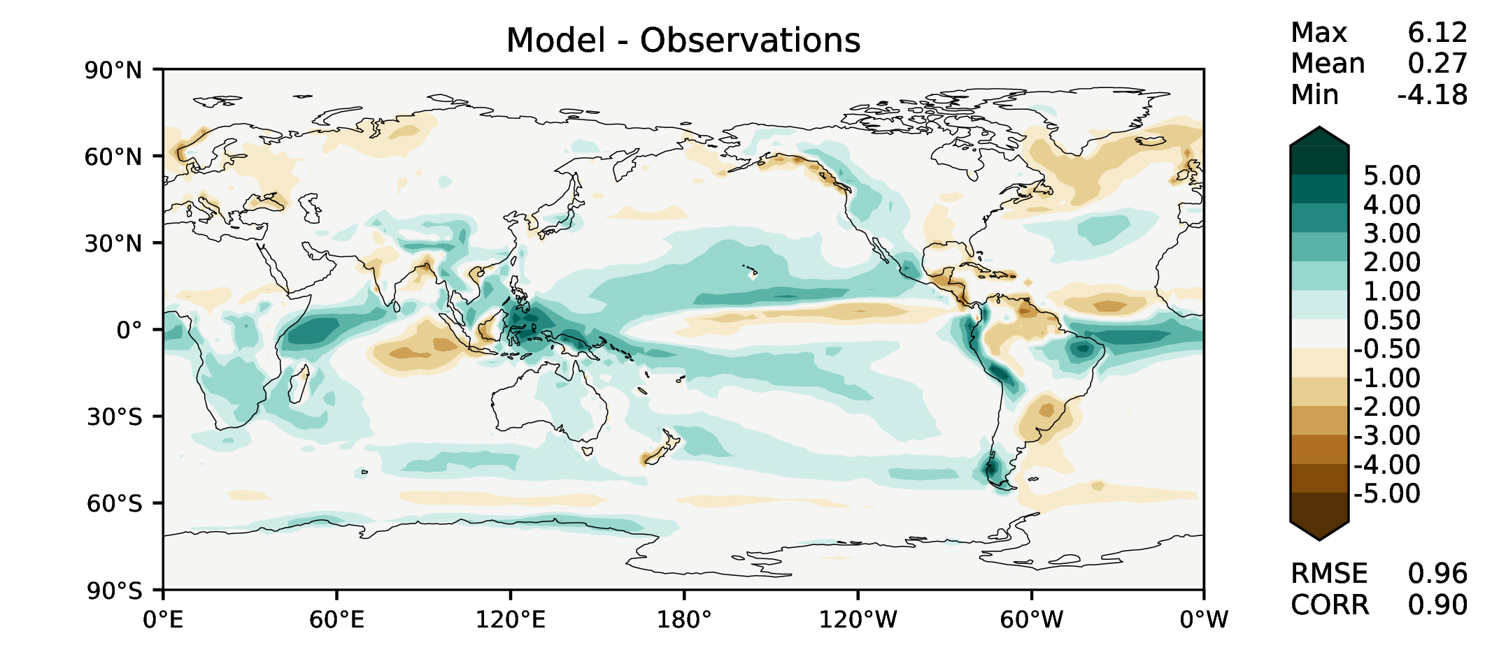
Annual total precipitation
DECKv1b
v2beta4
v2rc1c
v2rc1e

Slide 4
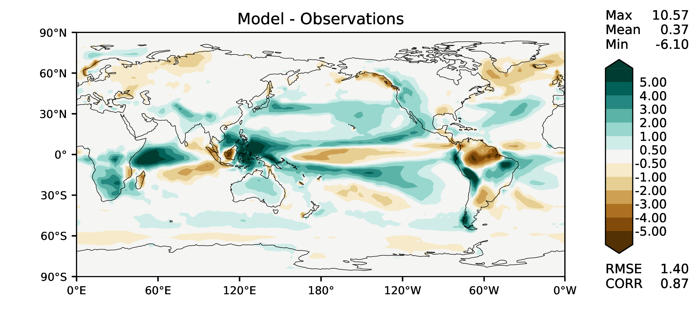
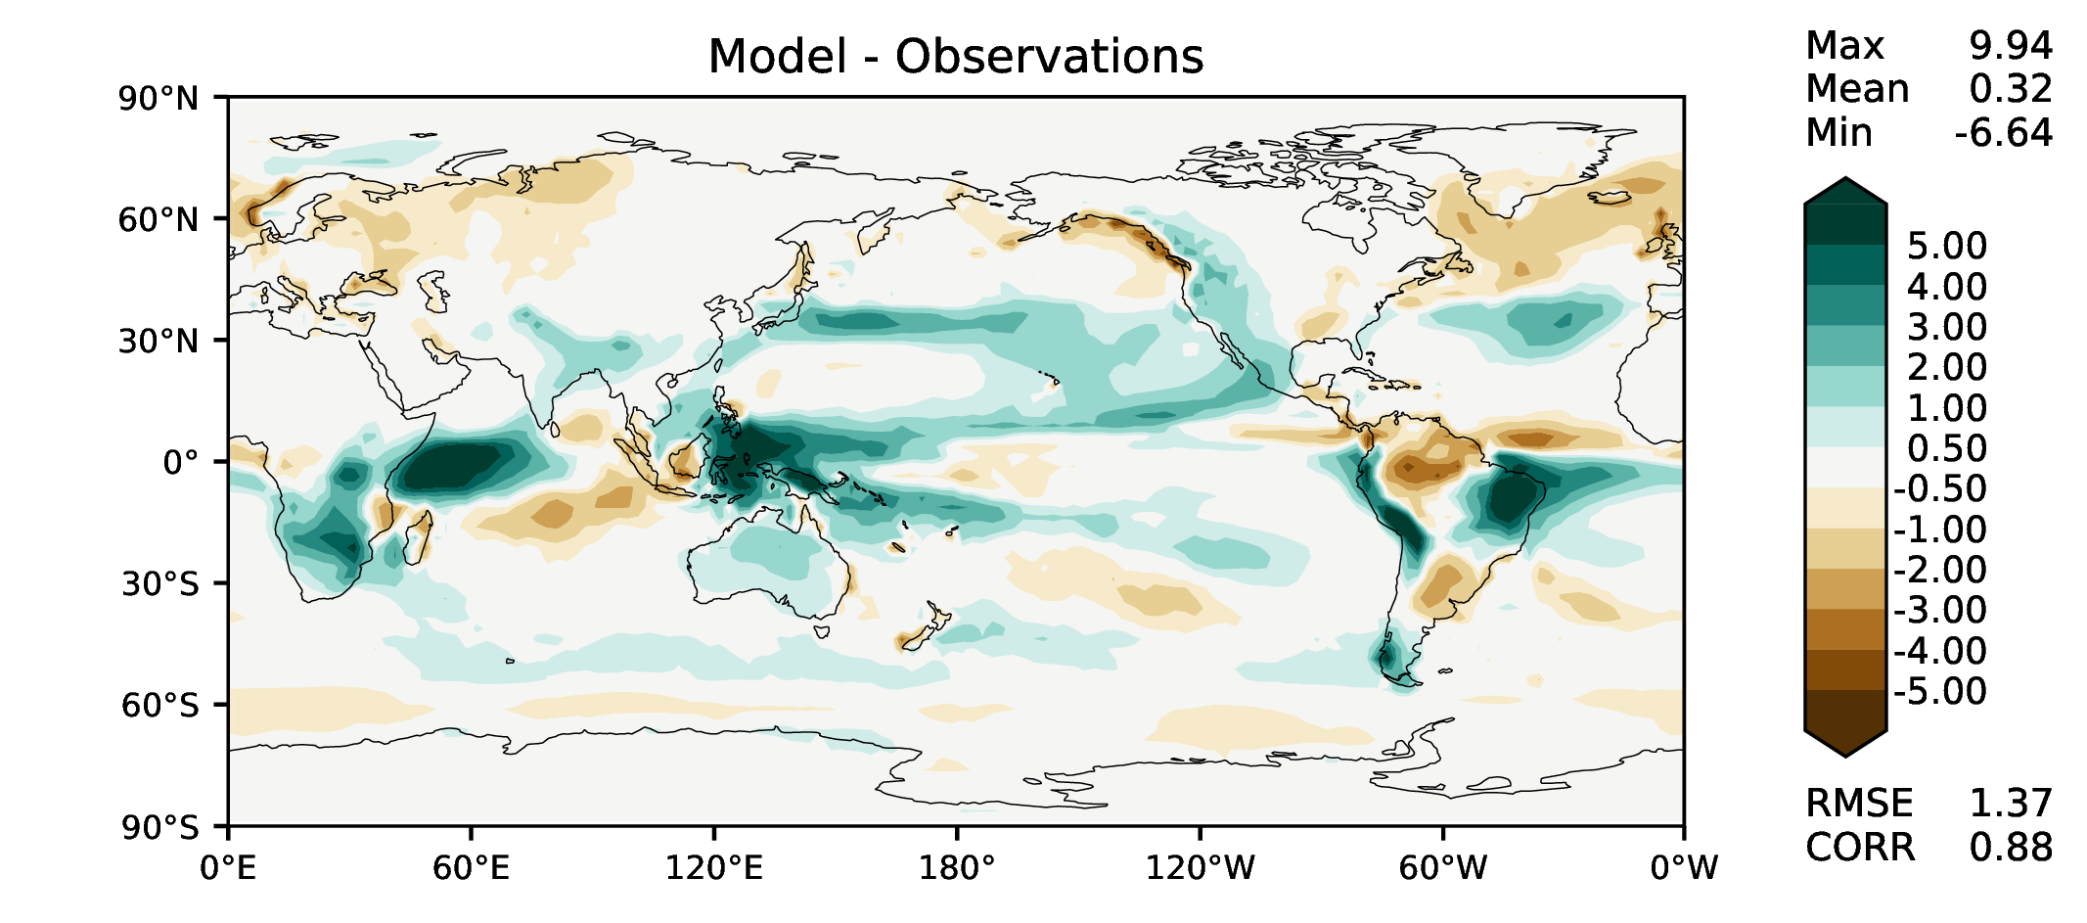


DJF total precipitation
DECKv1b
v2beta4
v2rc1c
v2rc1e

Slide 5
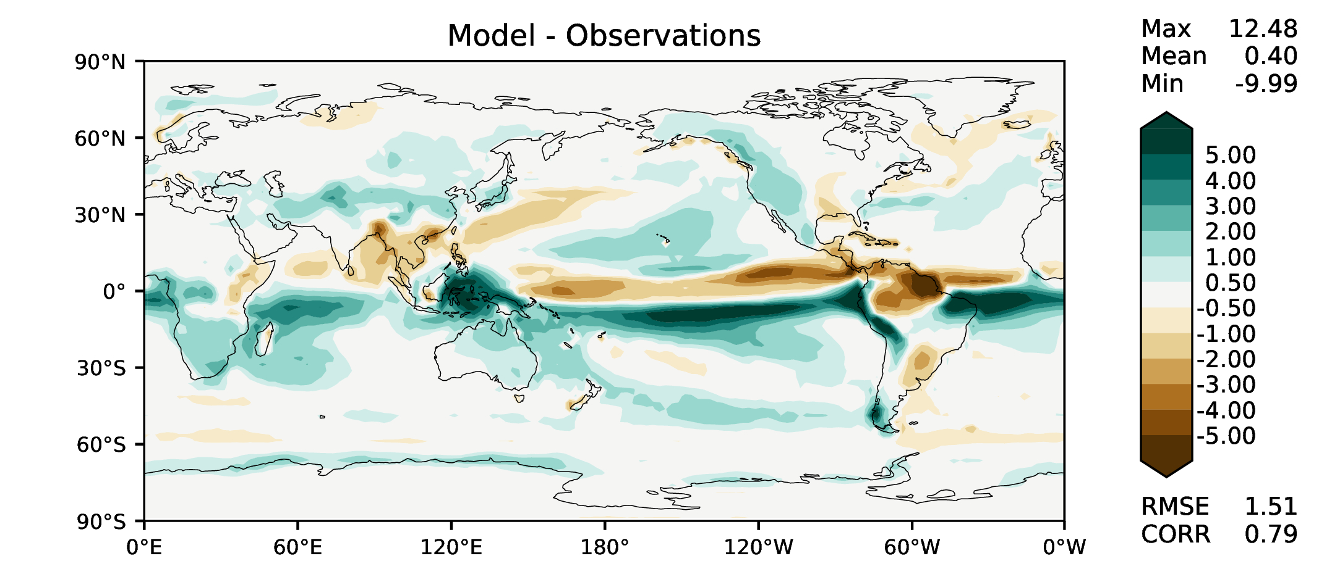
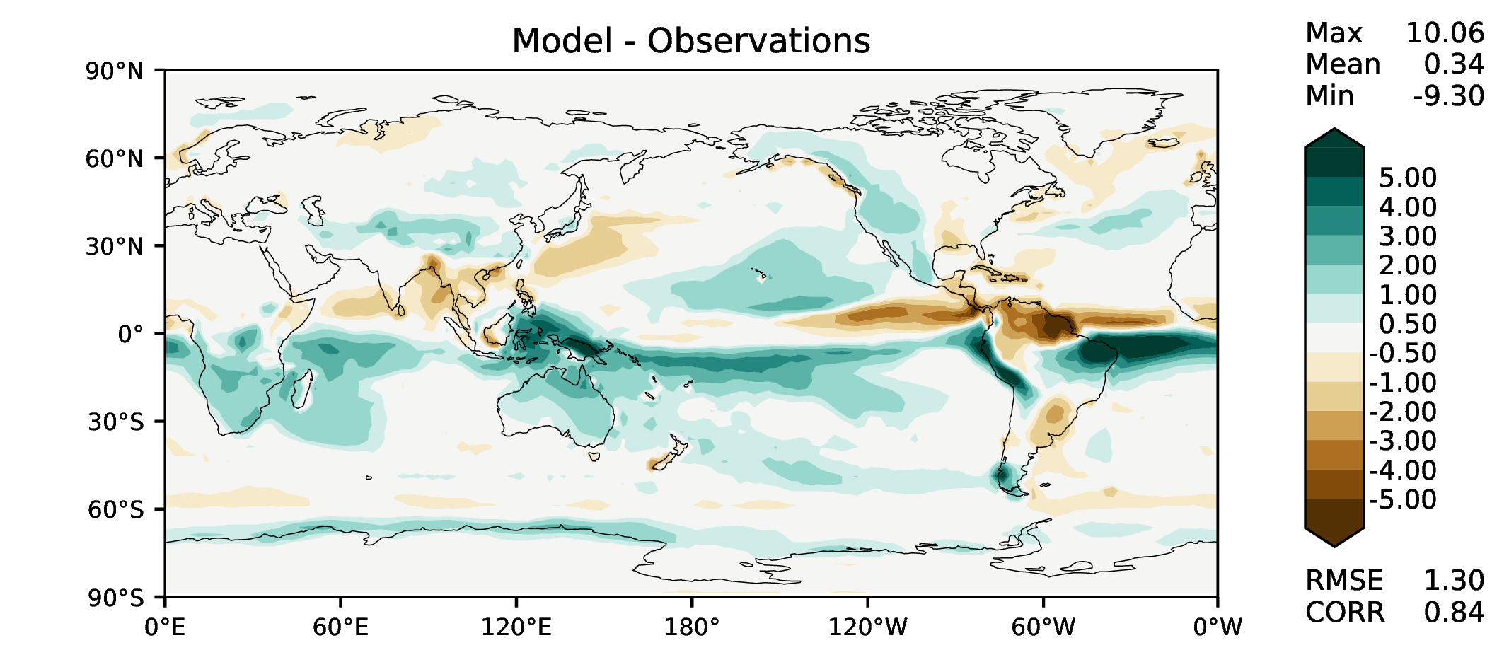
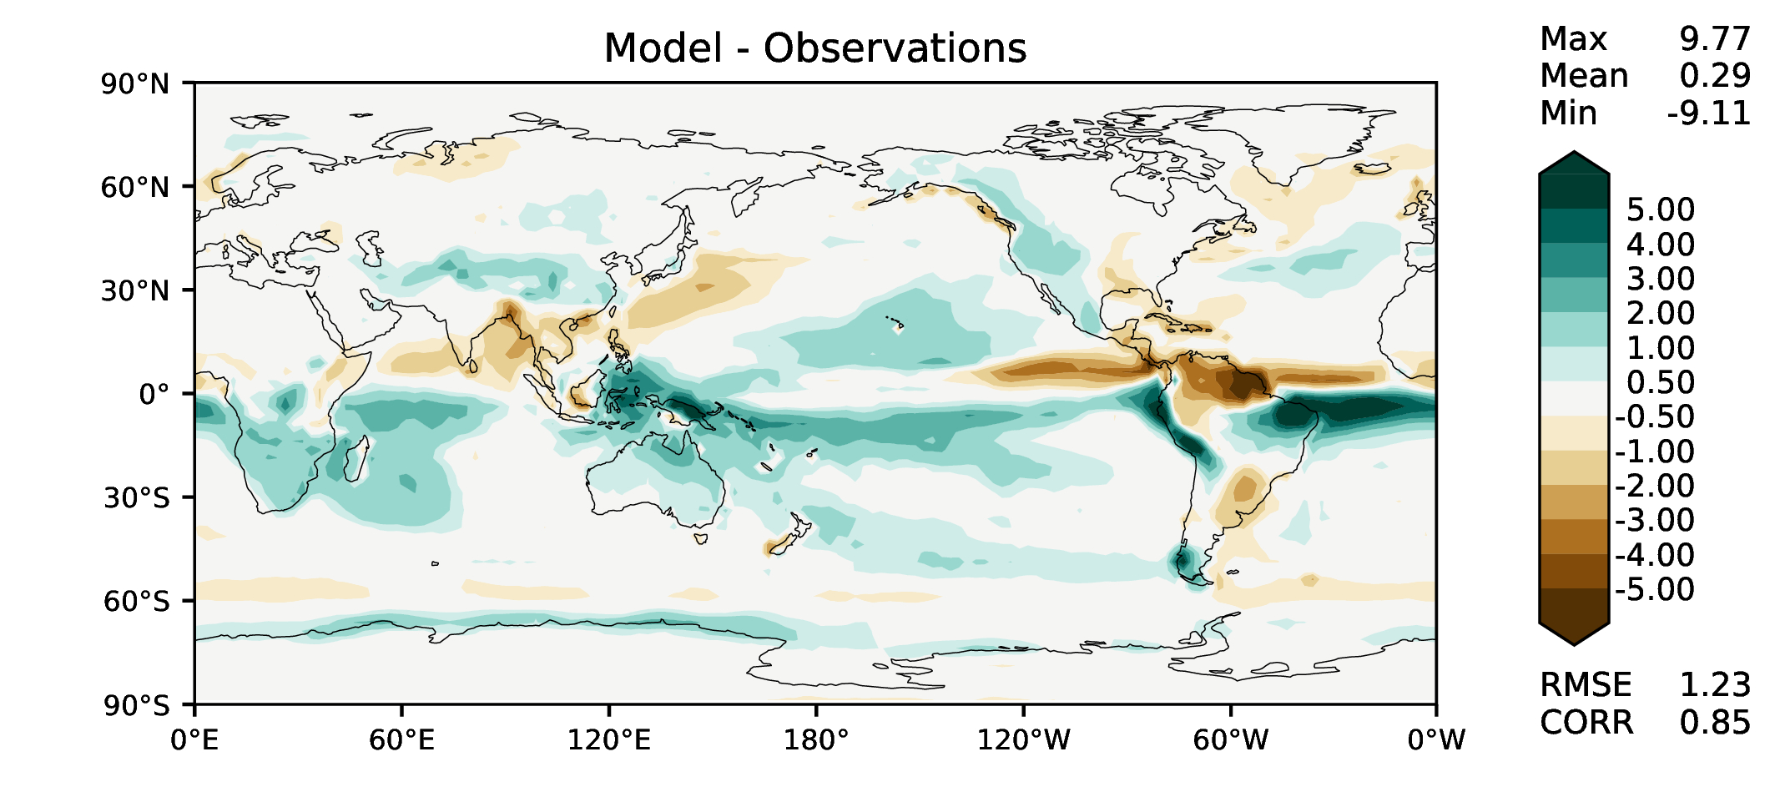
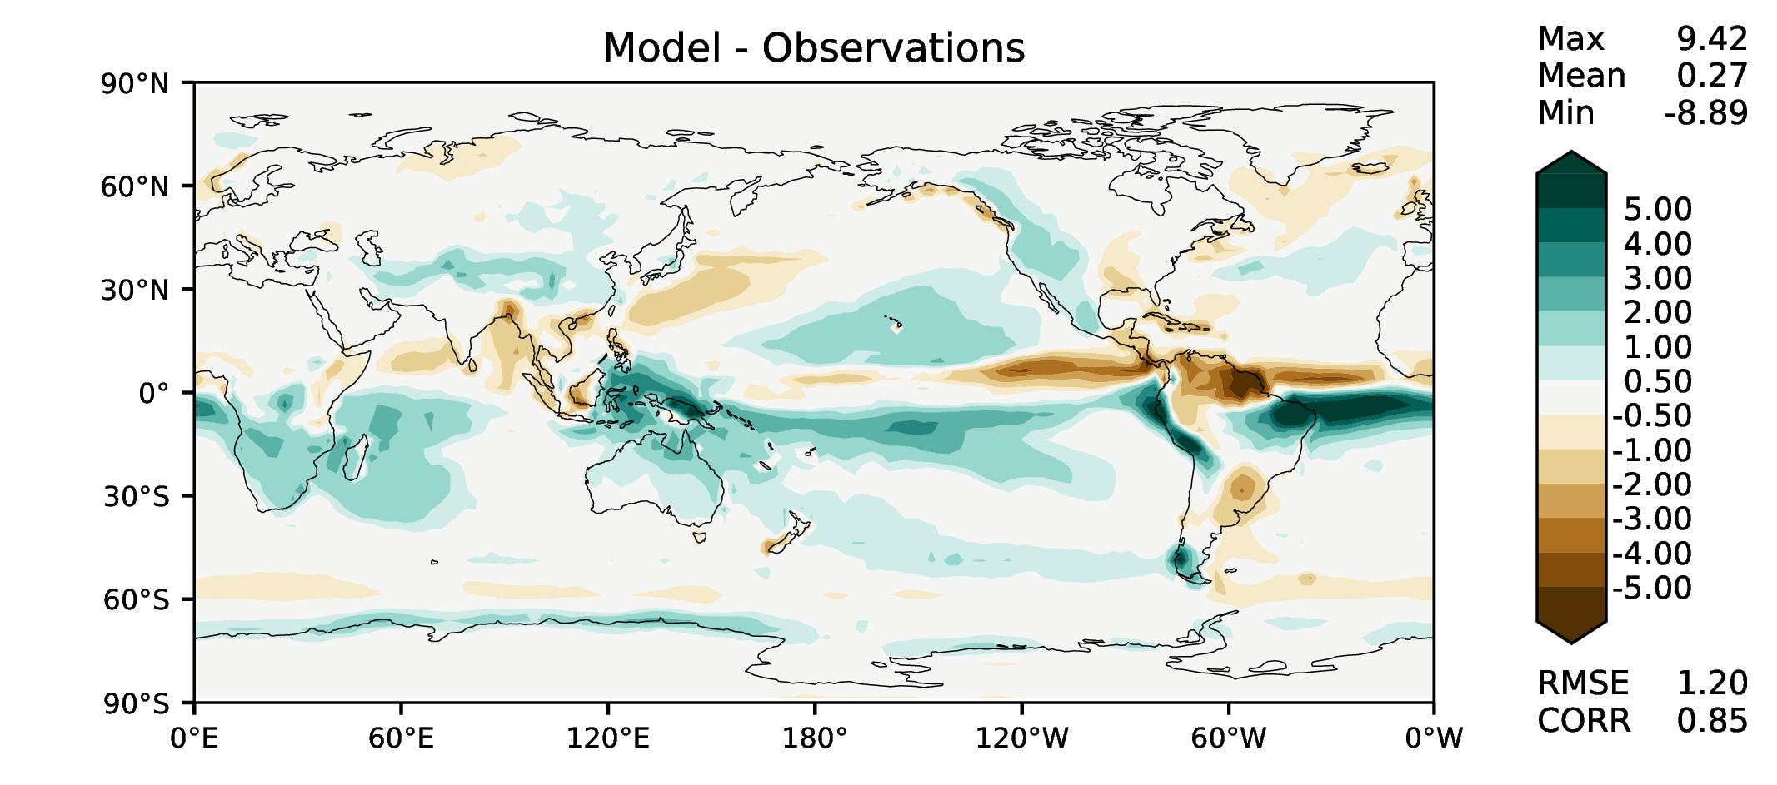
MAM total precipitation
DECKv1b
v2beta4
v2rc1c
v2rc1e

Slide 6
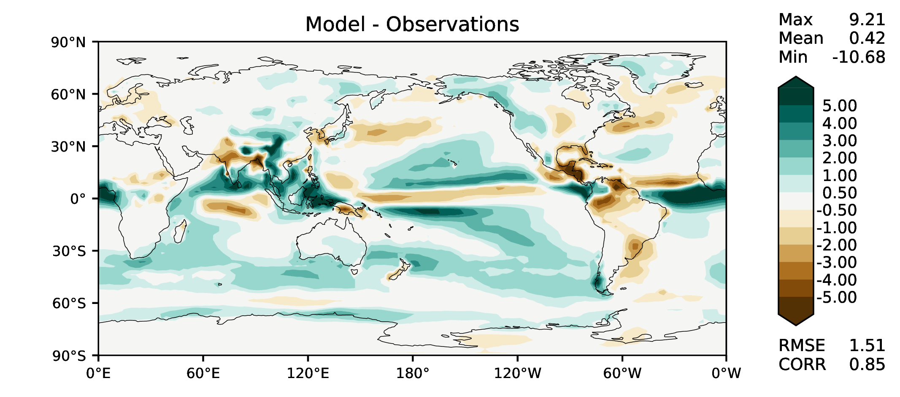
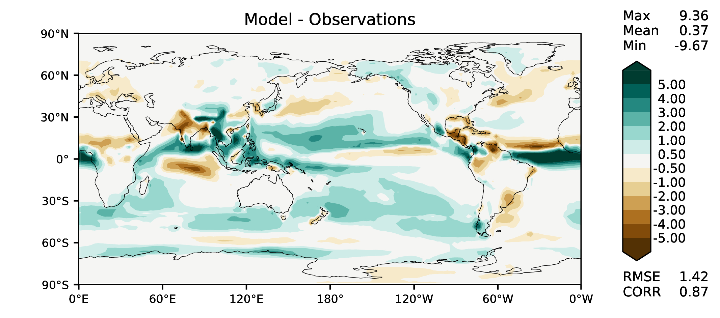
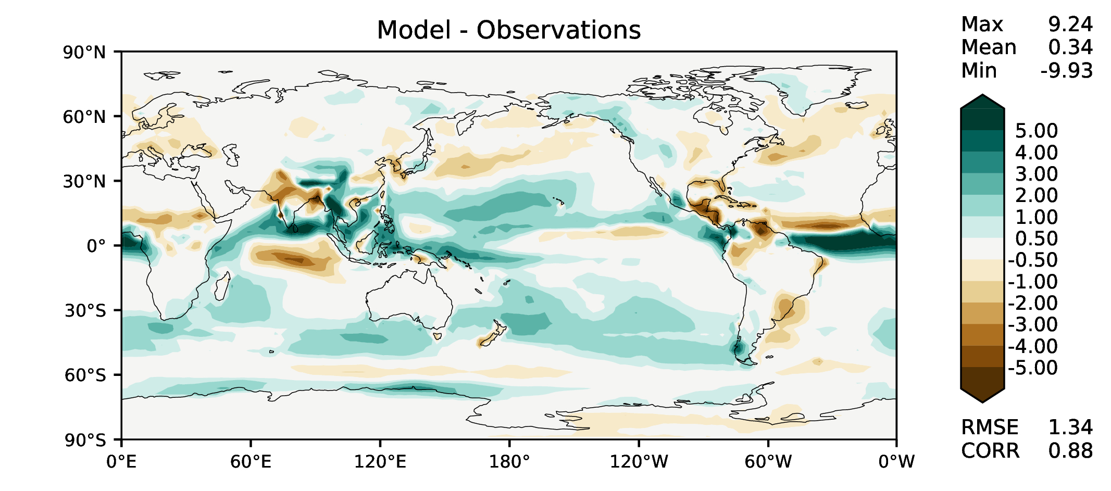
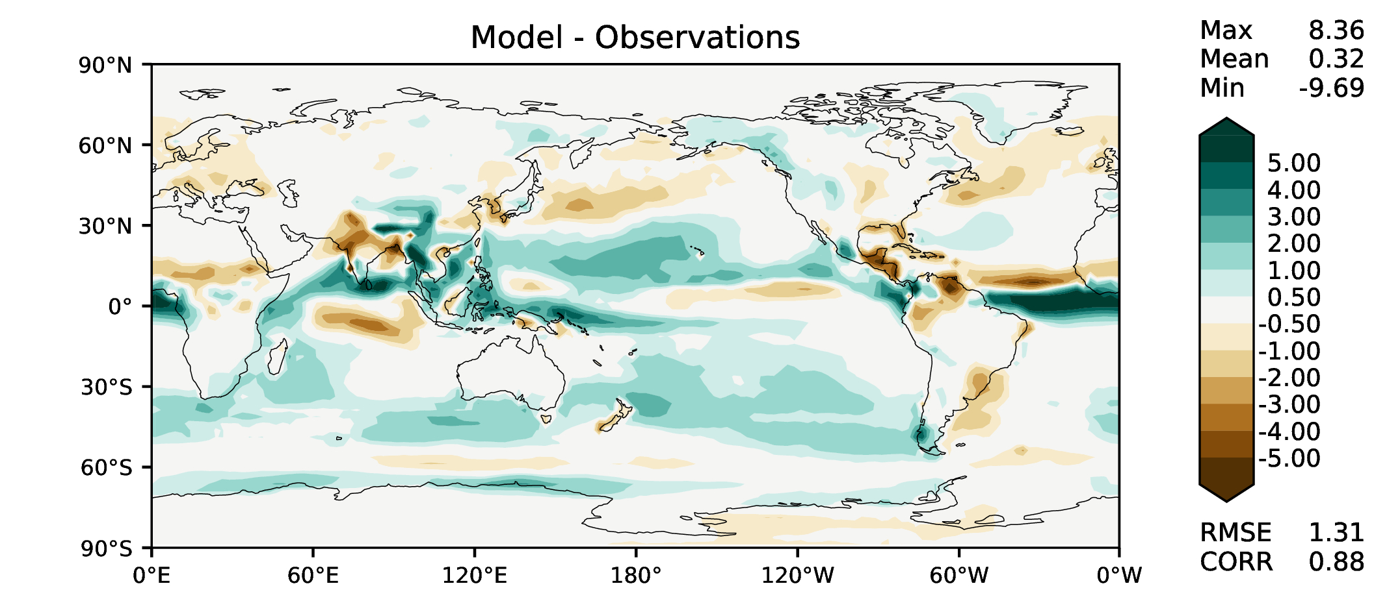
JJA total precipitation
DECKv1b
v2beta4
v2rc1c
v2rc1e

Slide 7
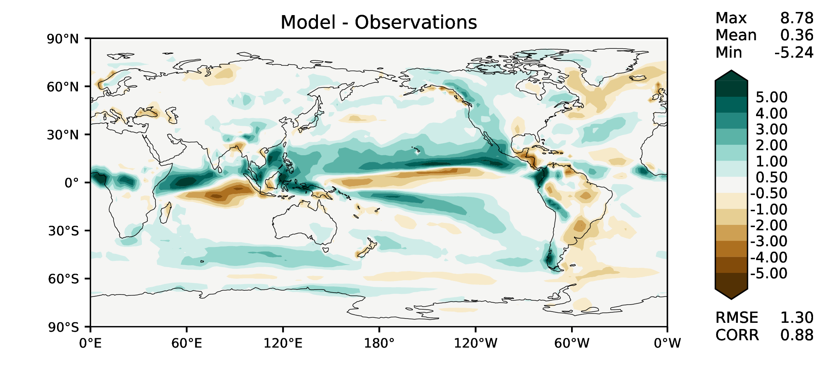
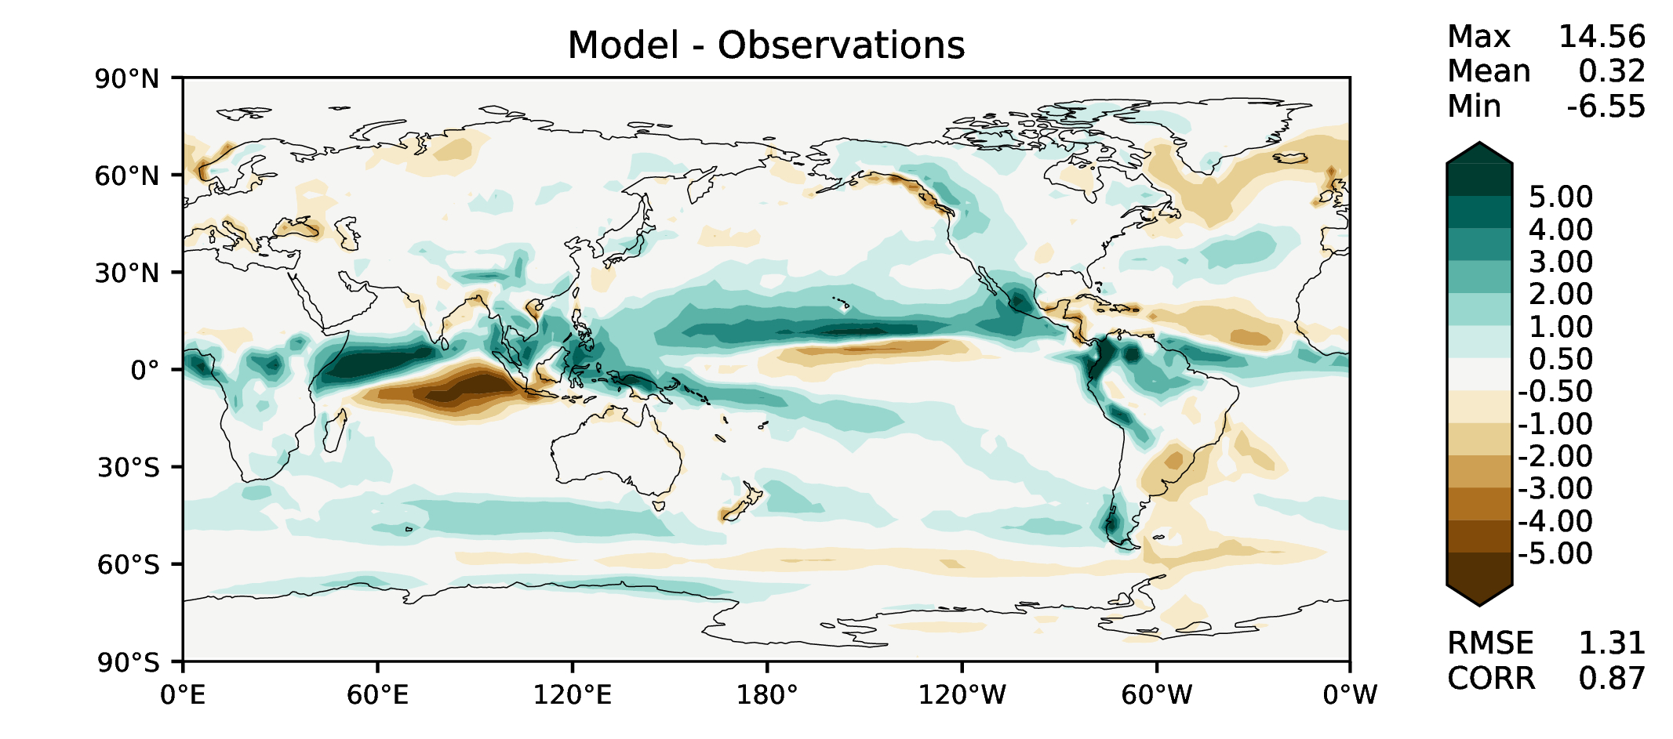
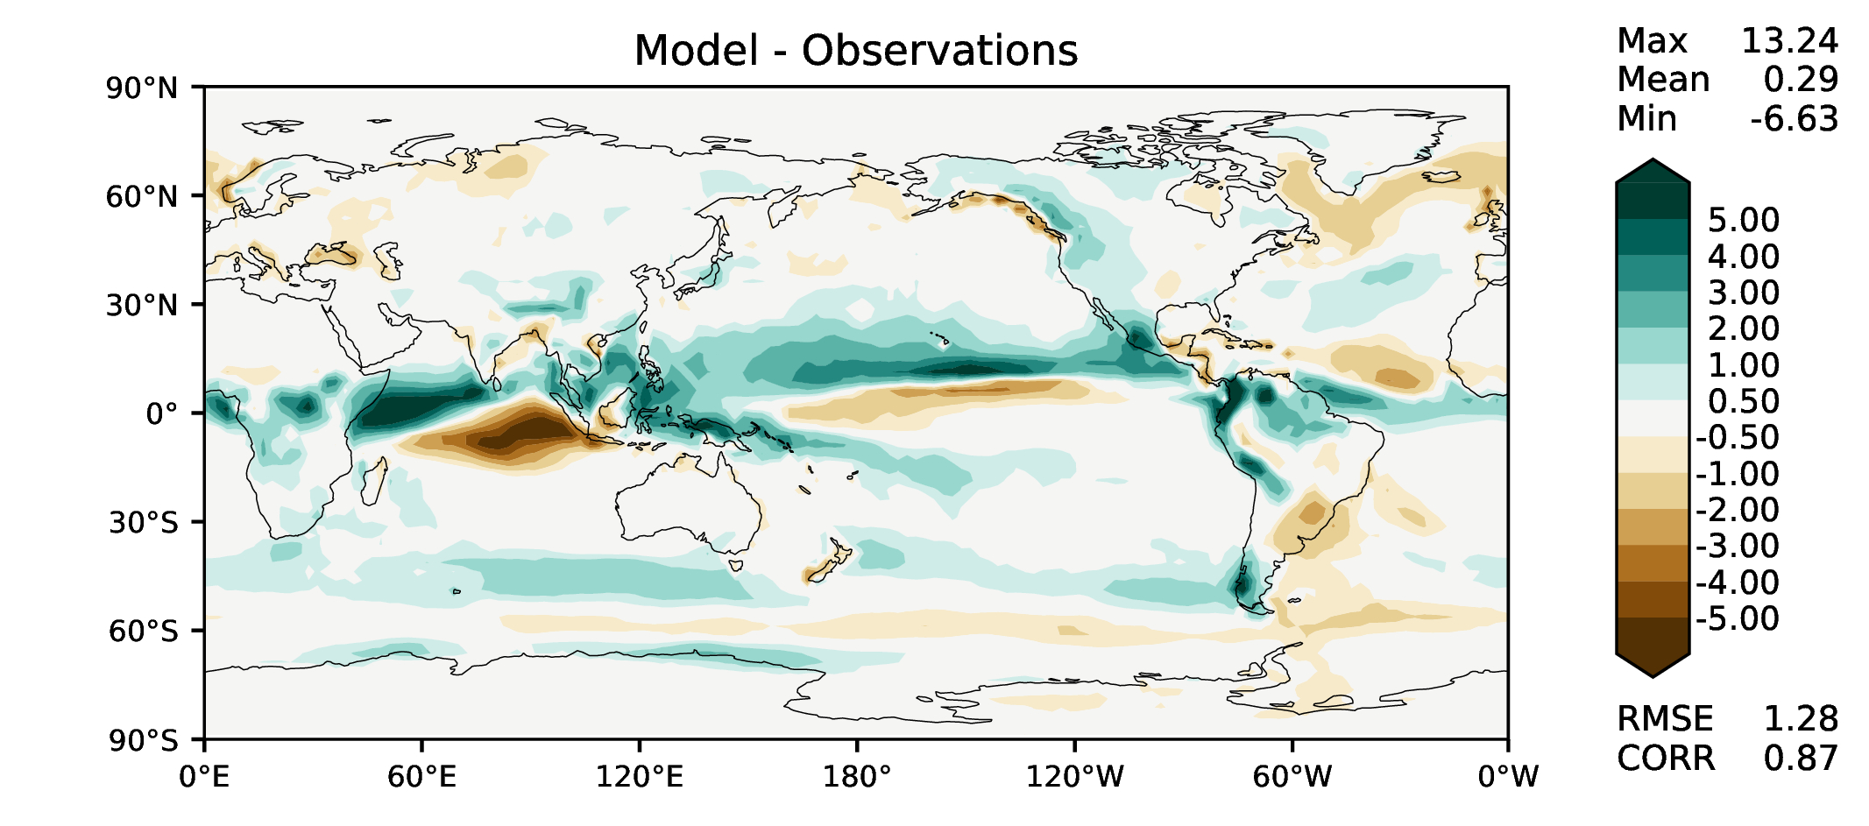
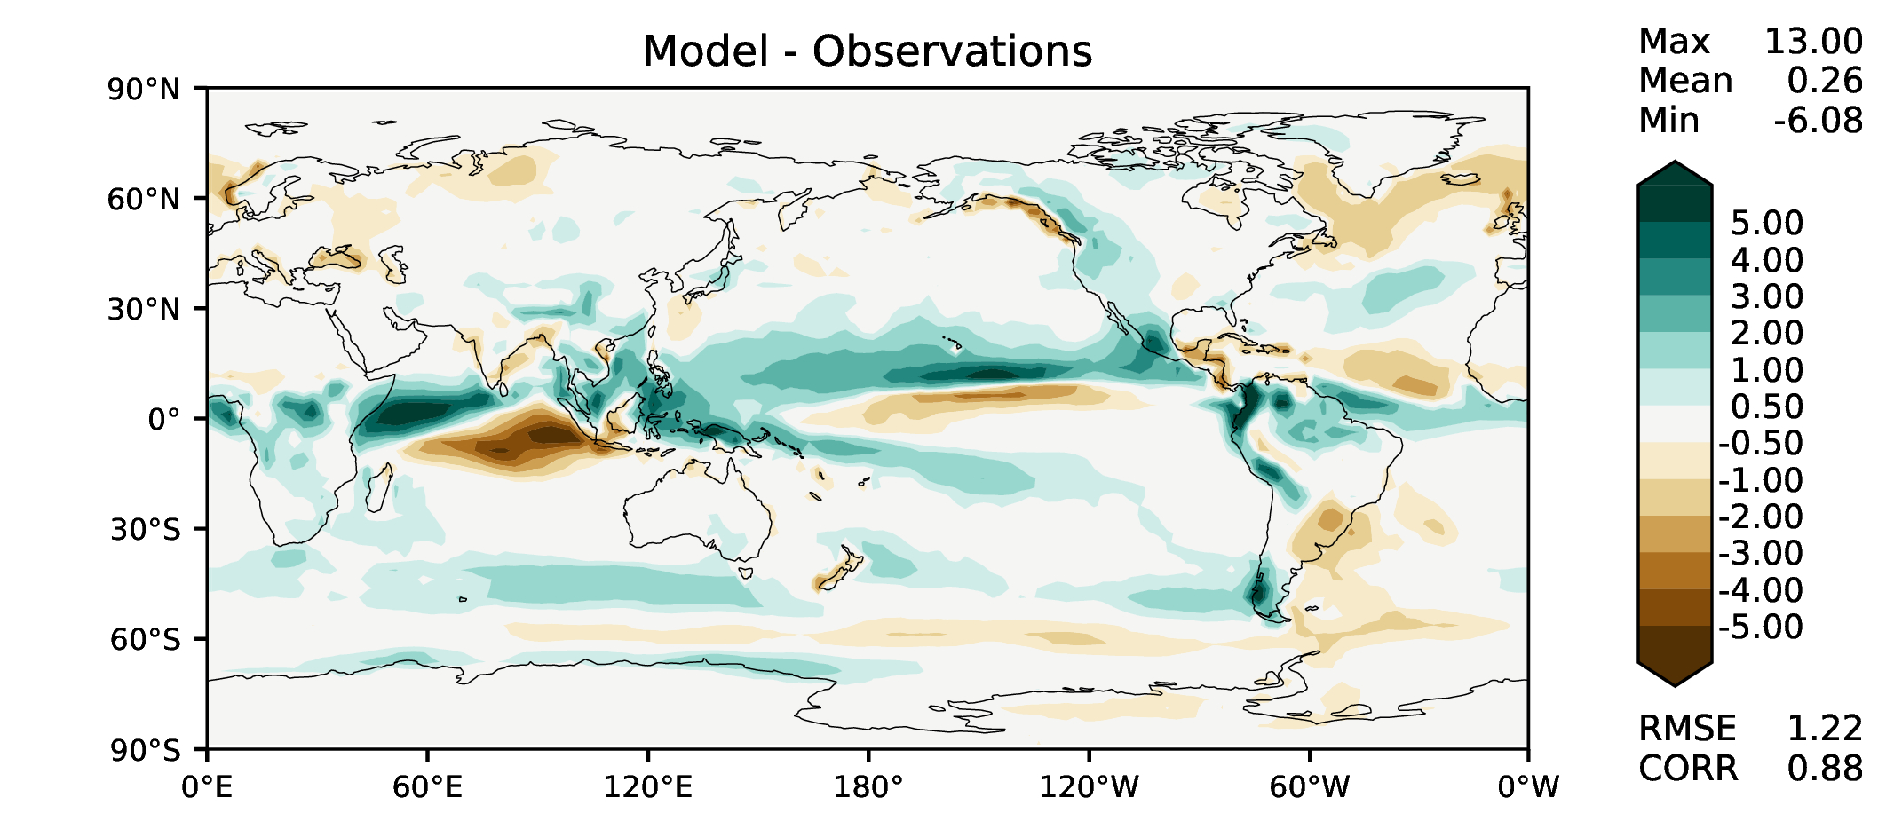
SON total precipitation
DECKv1b
v2beta4
v2rc1c
v2rc1e

Slide 8
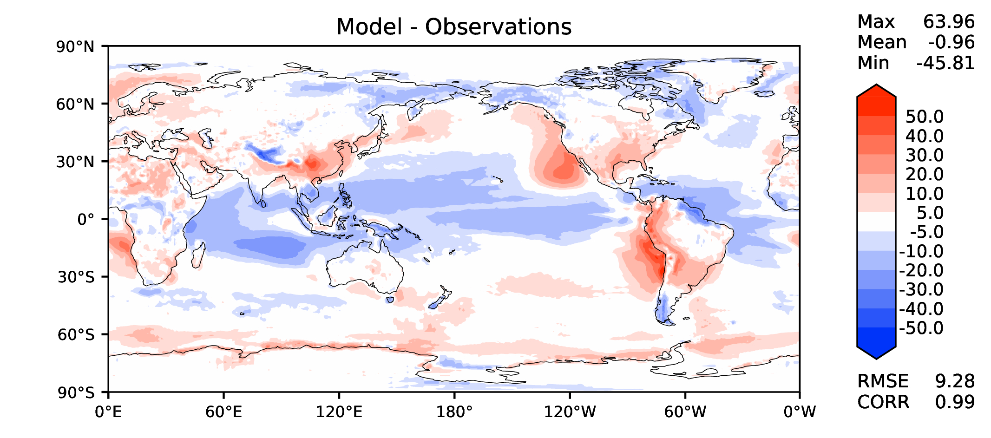
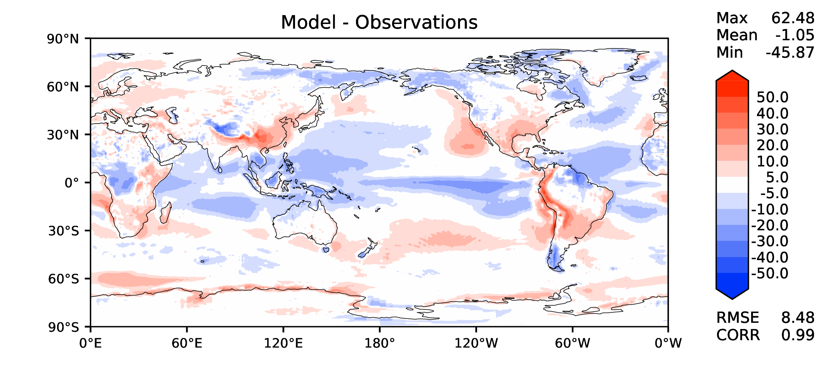
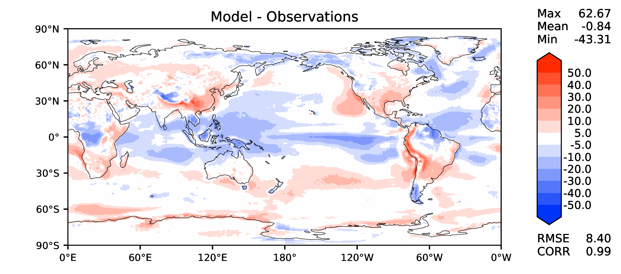
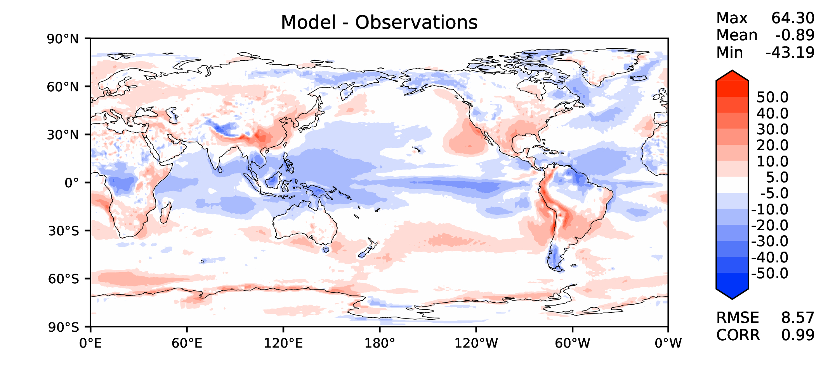
Annual TOA net radiation
DECKv1b
v2beta4
v2rc1c
v2rc1e

Slide 9
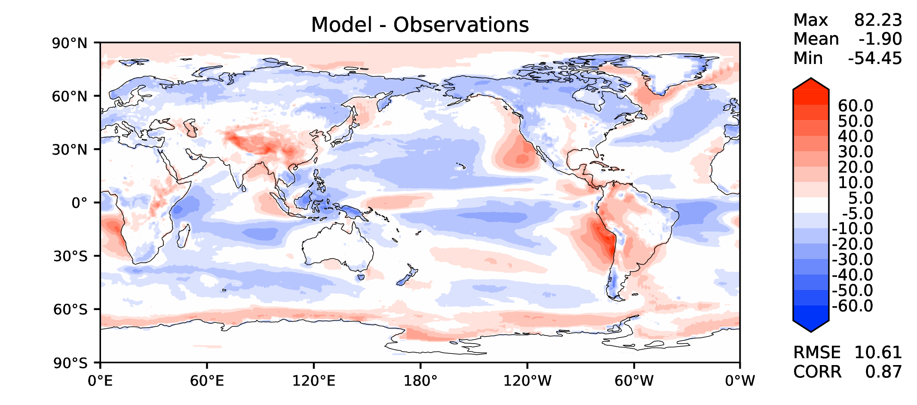
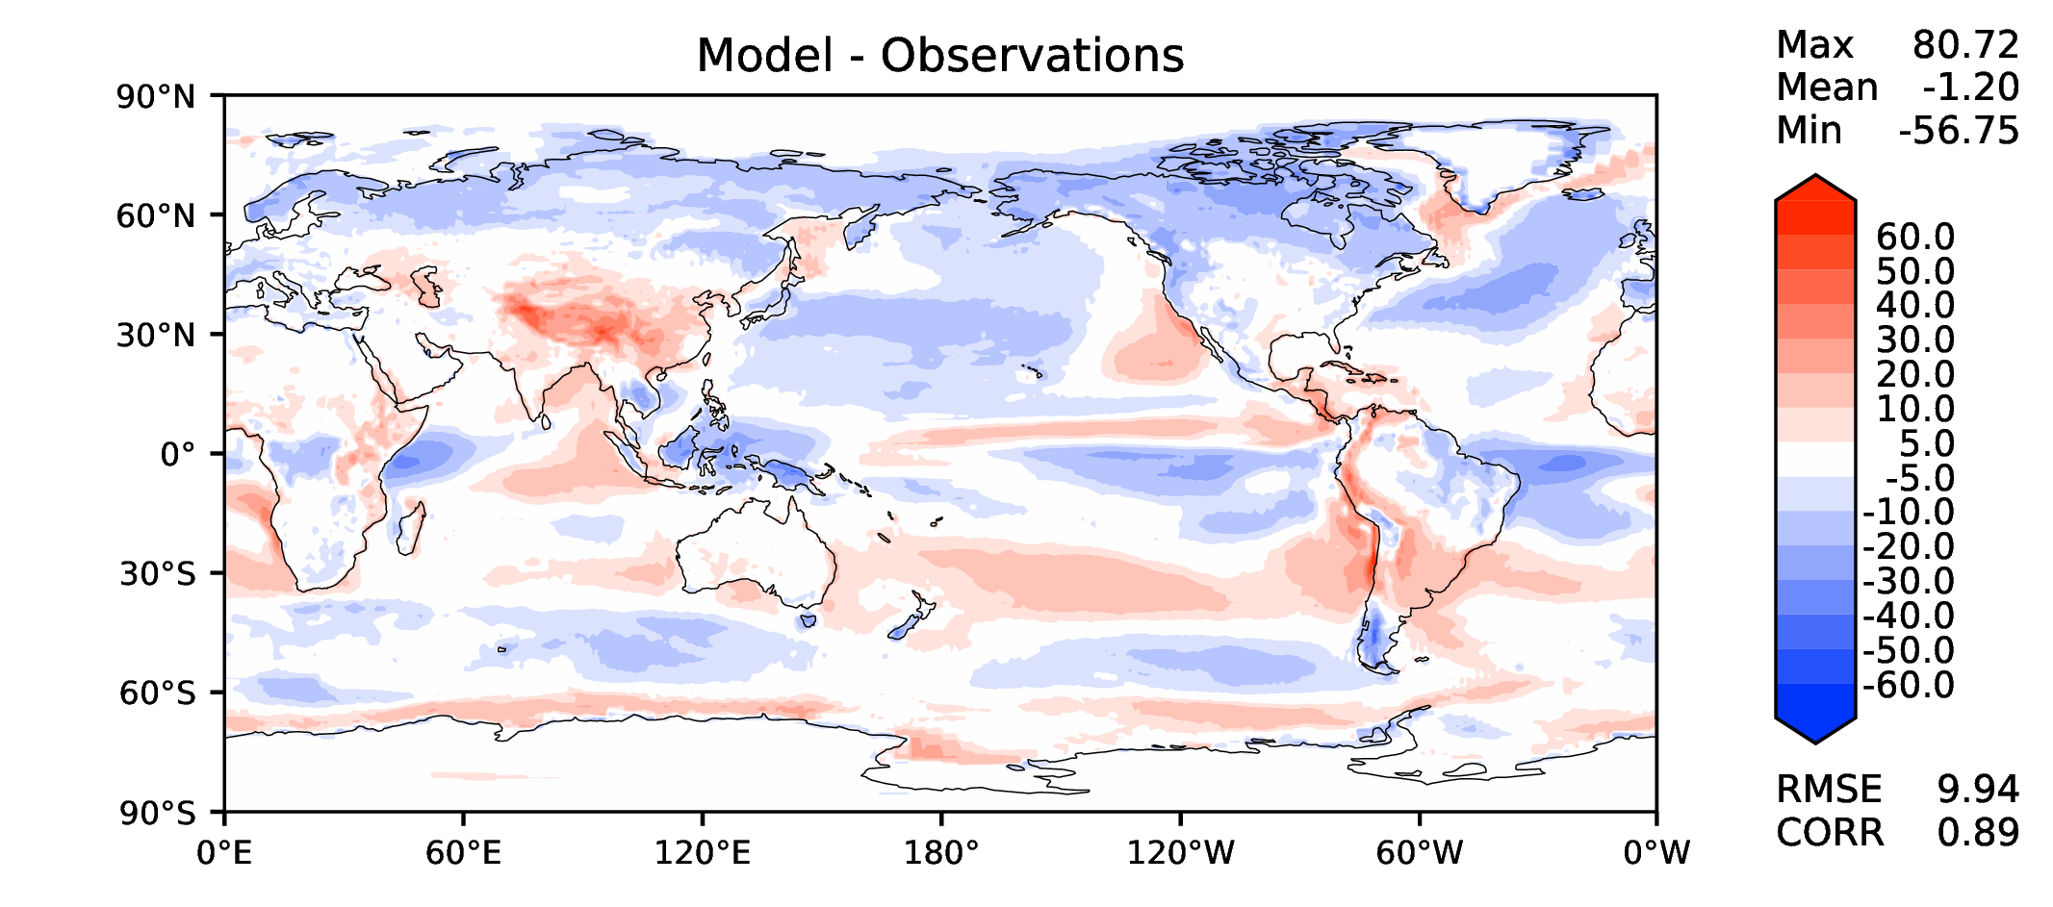
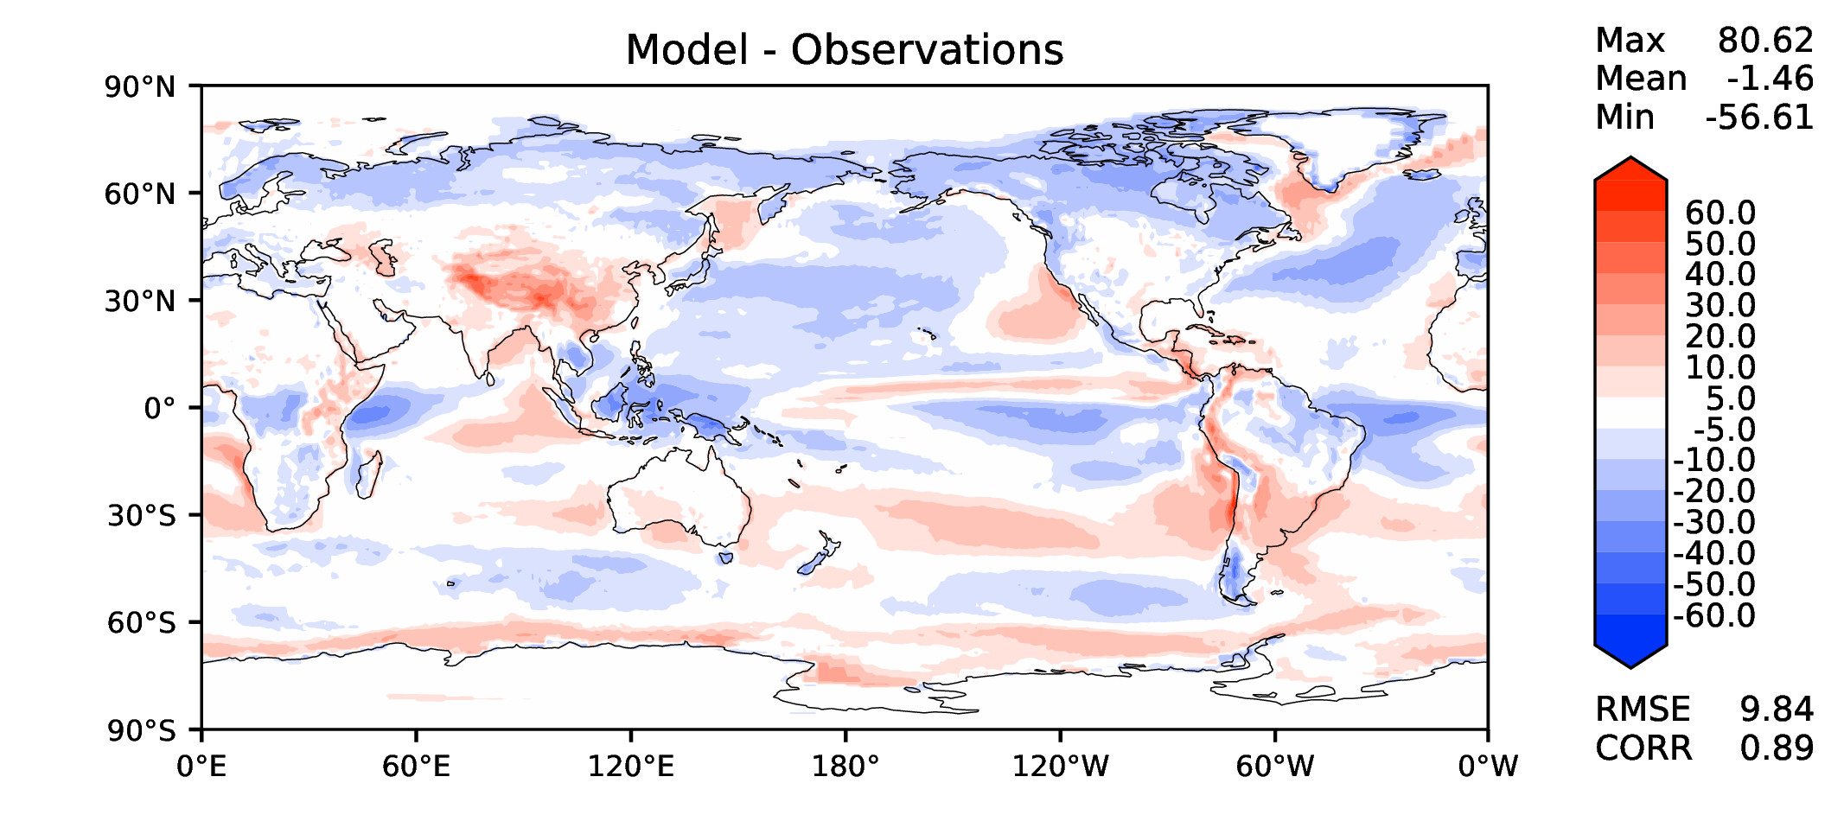
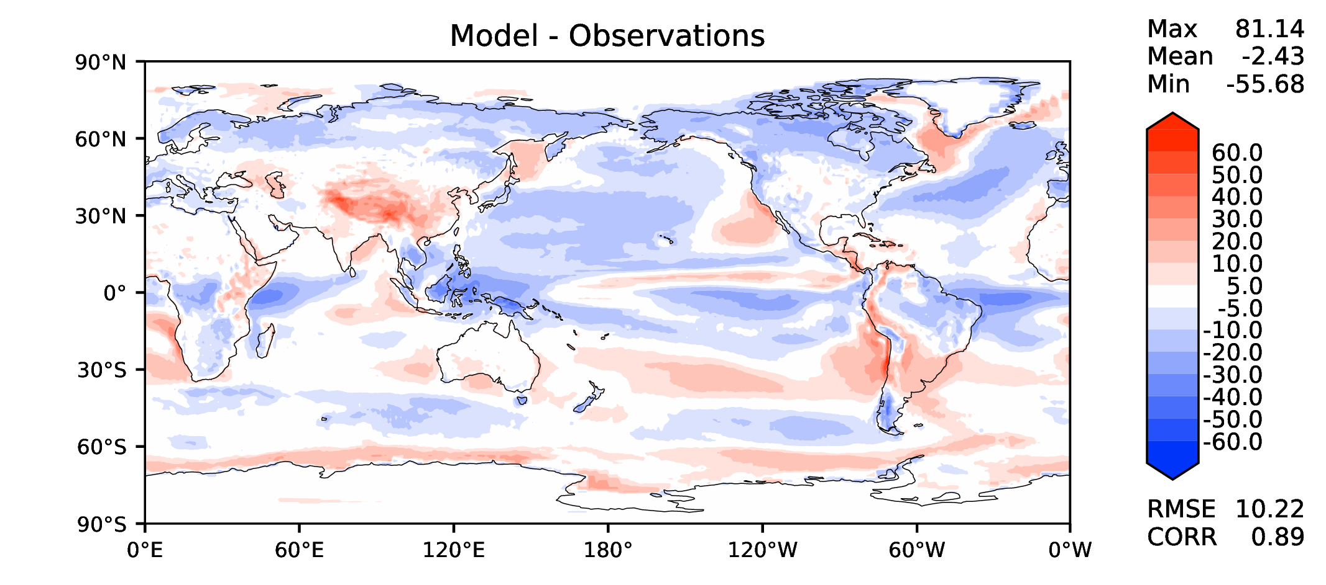
Annual TOA SW CRE
DECKv1b
v2beta4
v2rc1c
v2rc1e

Slide 10
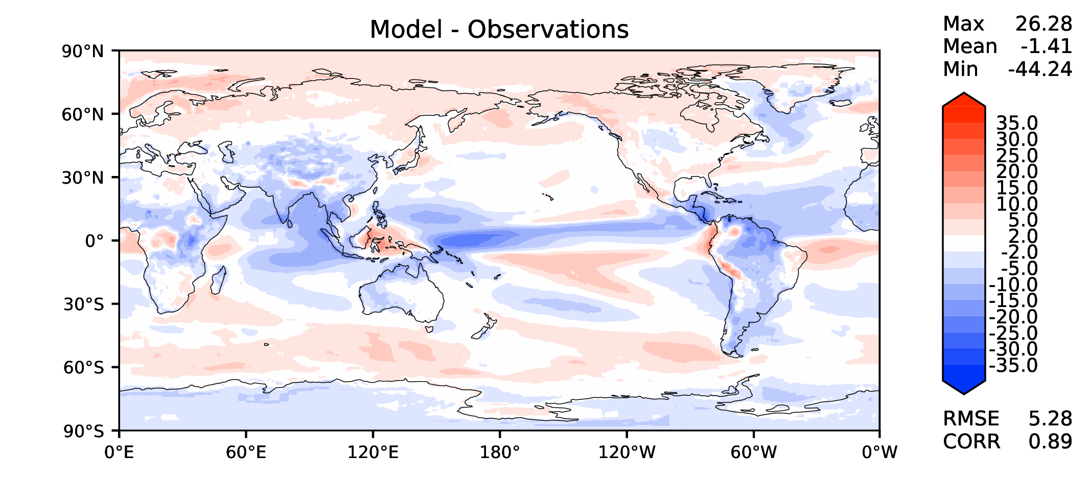
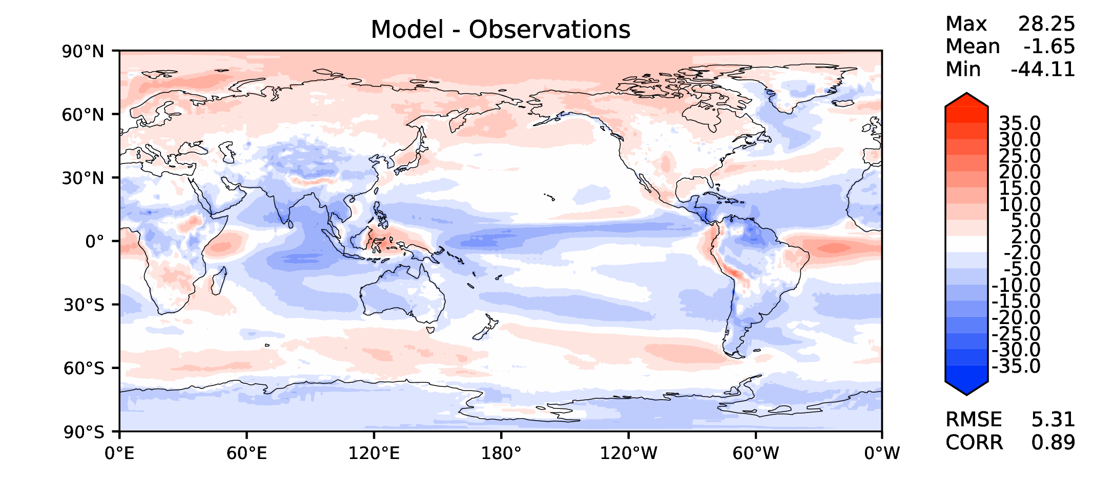
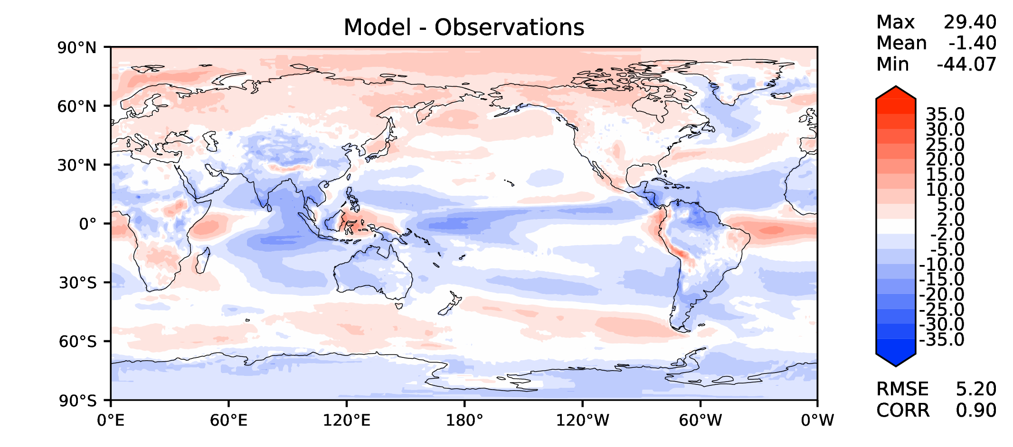
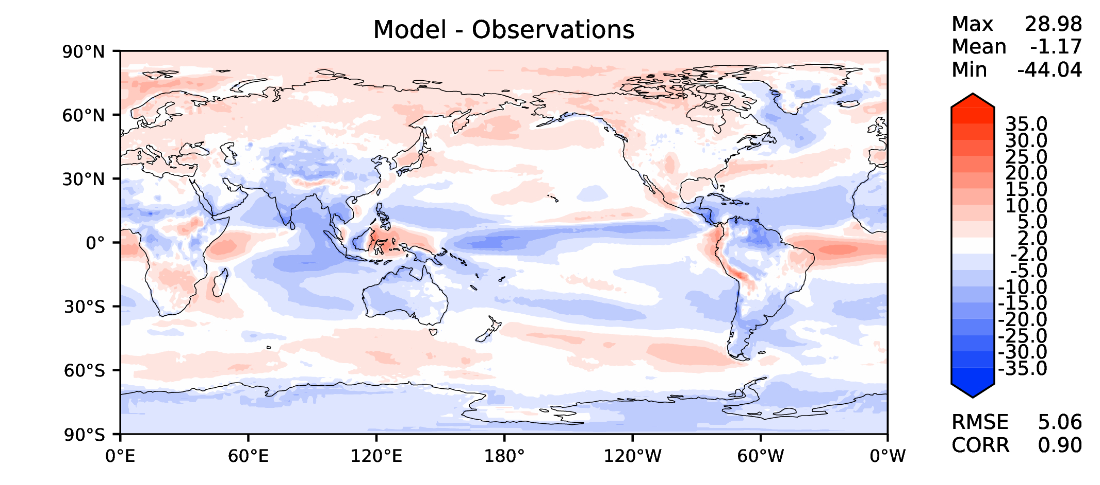
Annual TOA LW CRE
DECKv1b
v2beta4
v2rc1c
v2rc1e

Slide 11
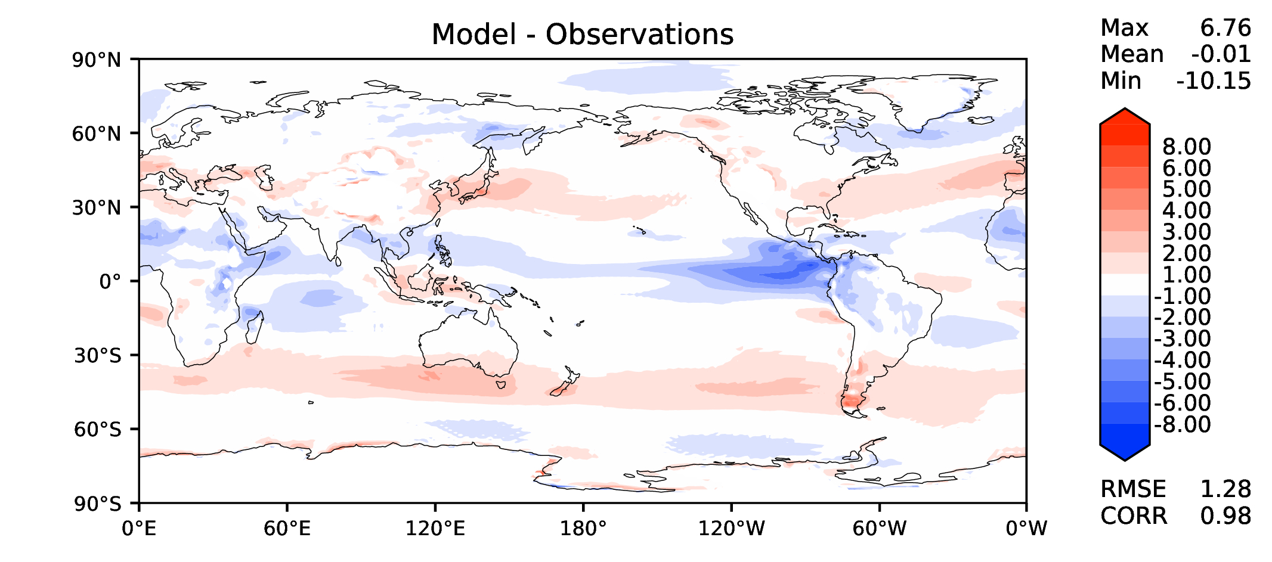
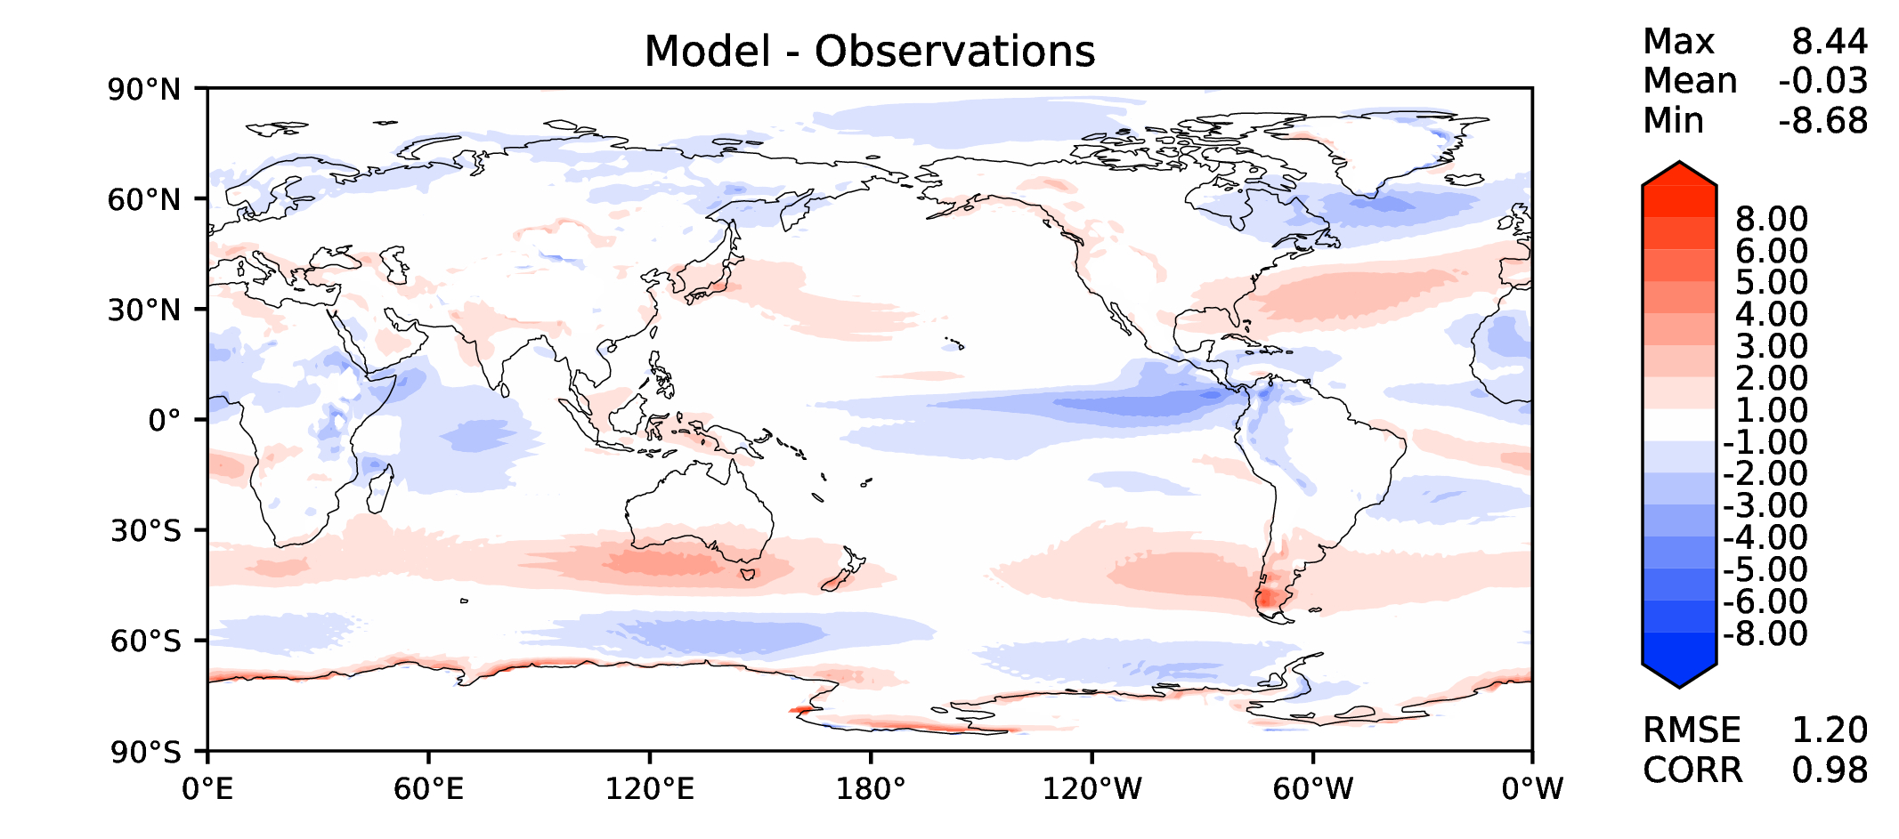
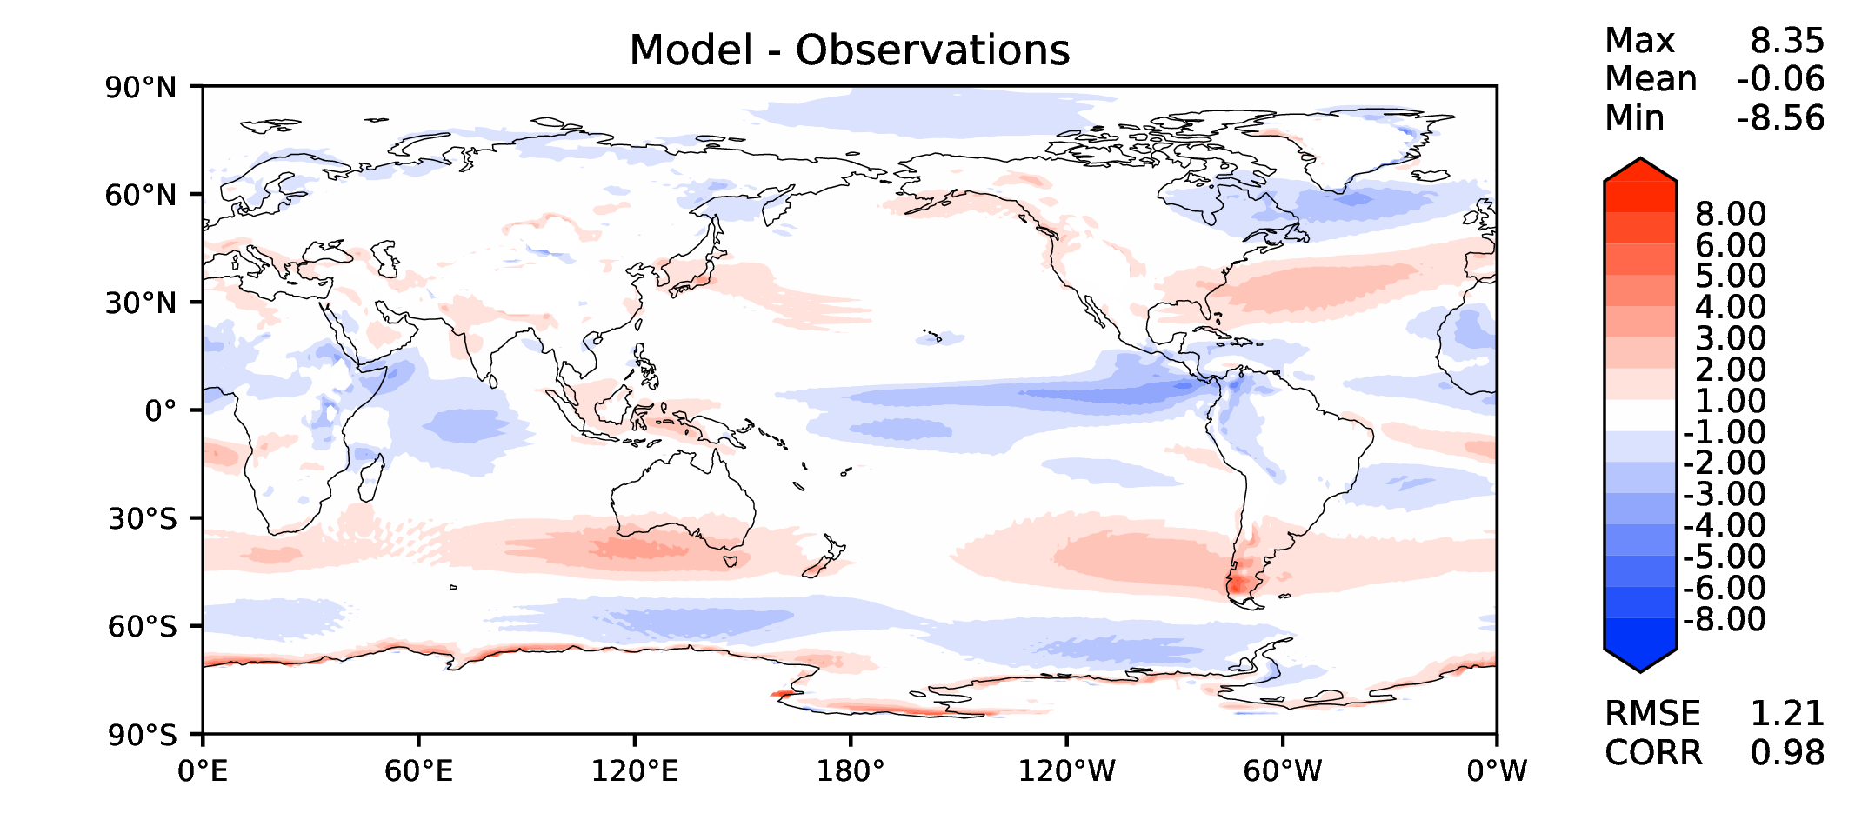

Annual u wind at 850 hPa
DECKv1b
v2beta4
v2rc1c
v2rc1e

Slide 12
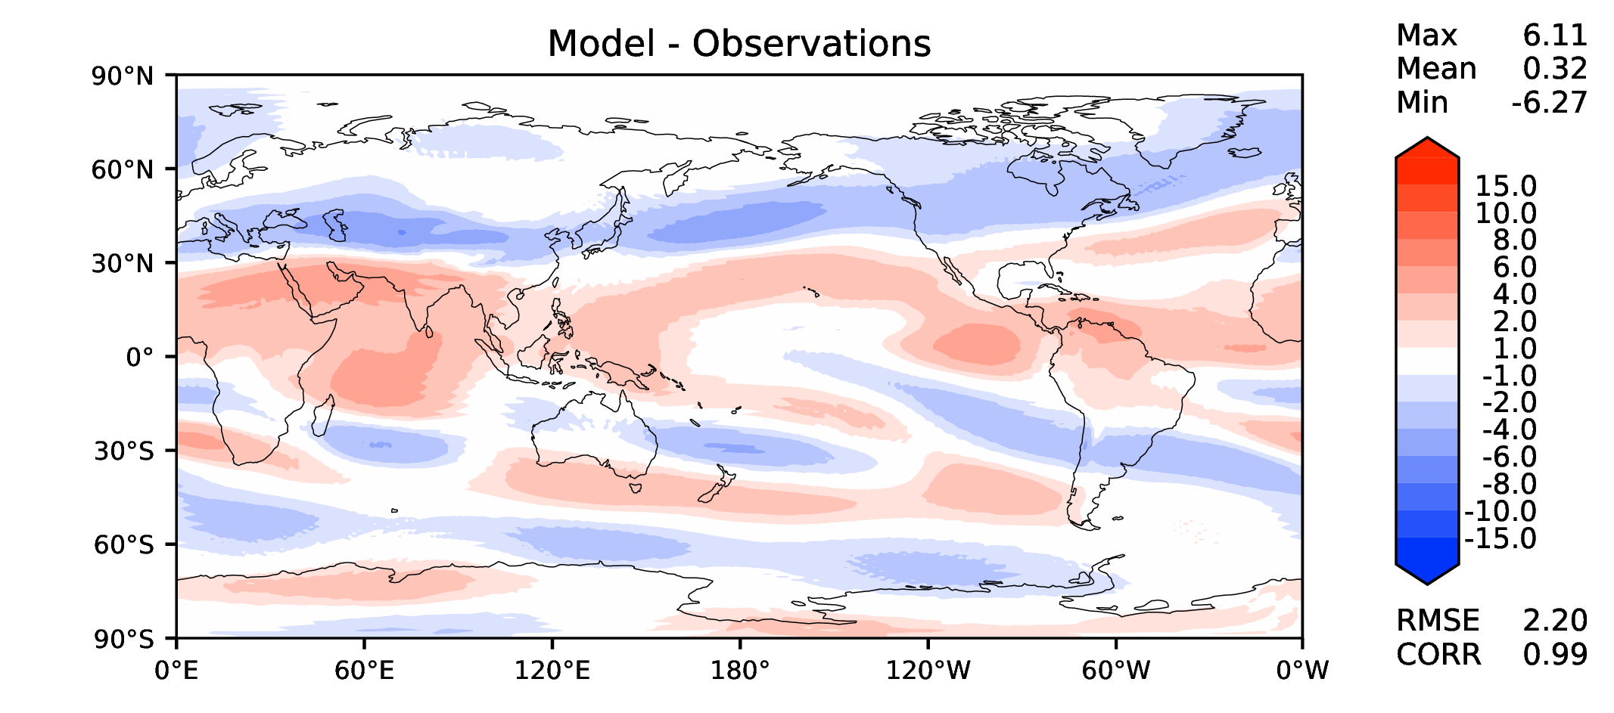
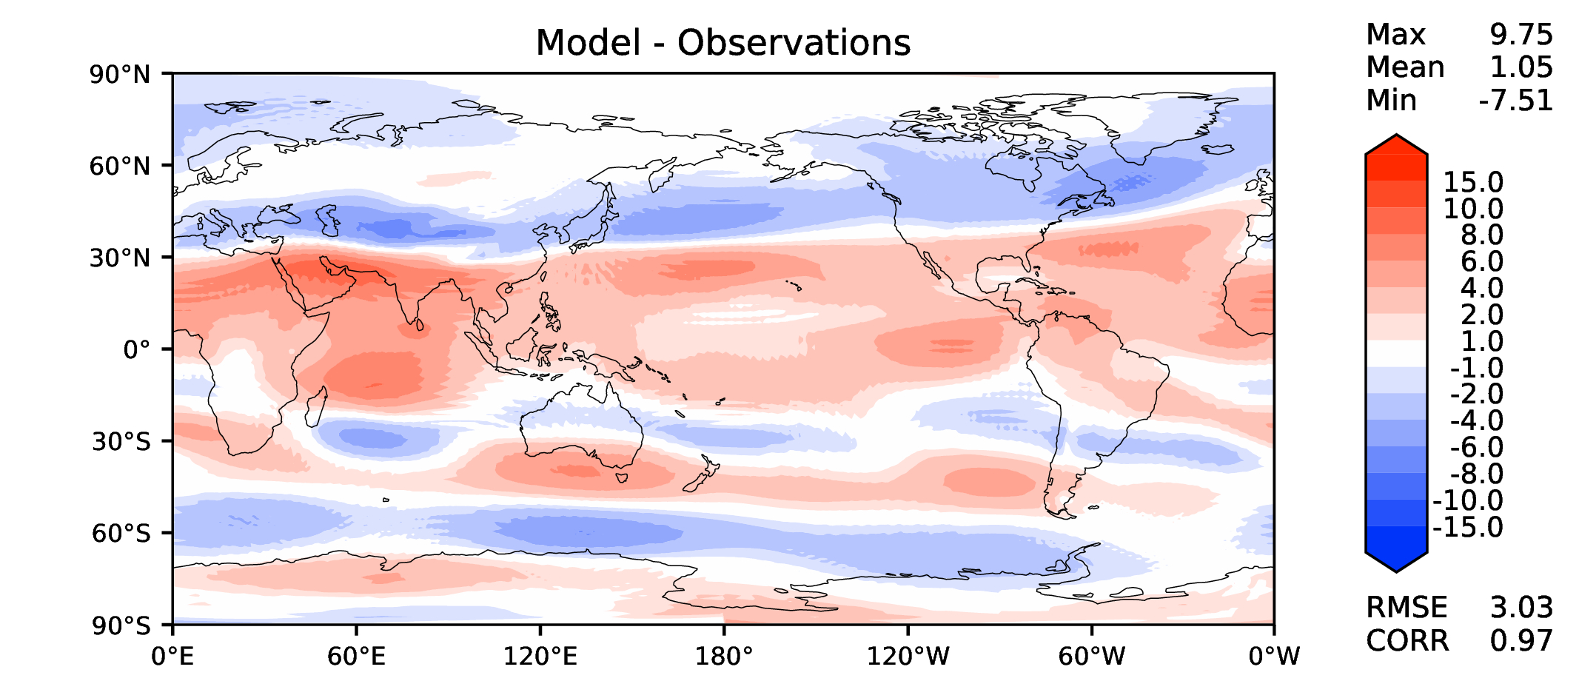
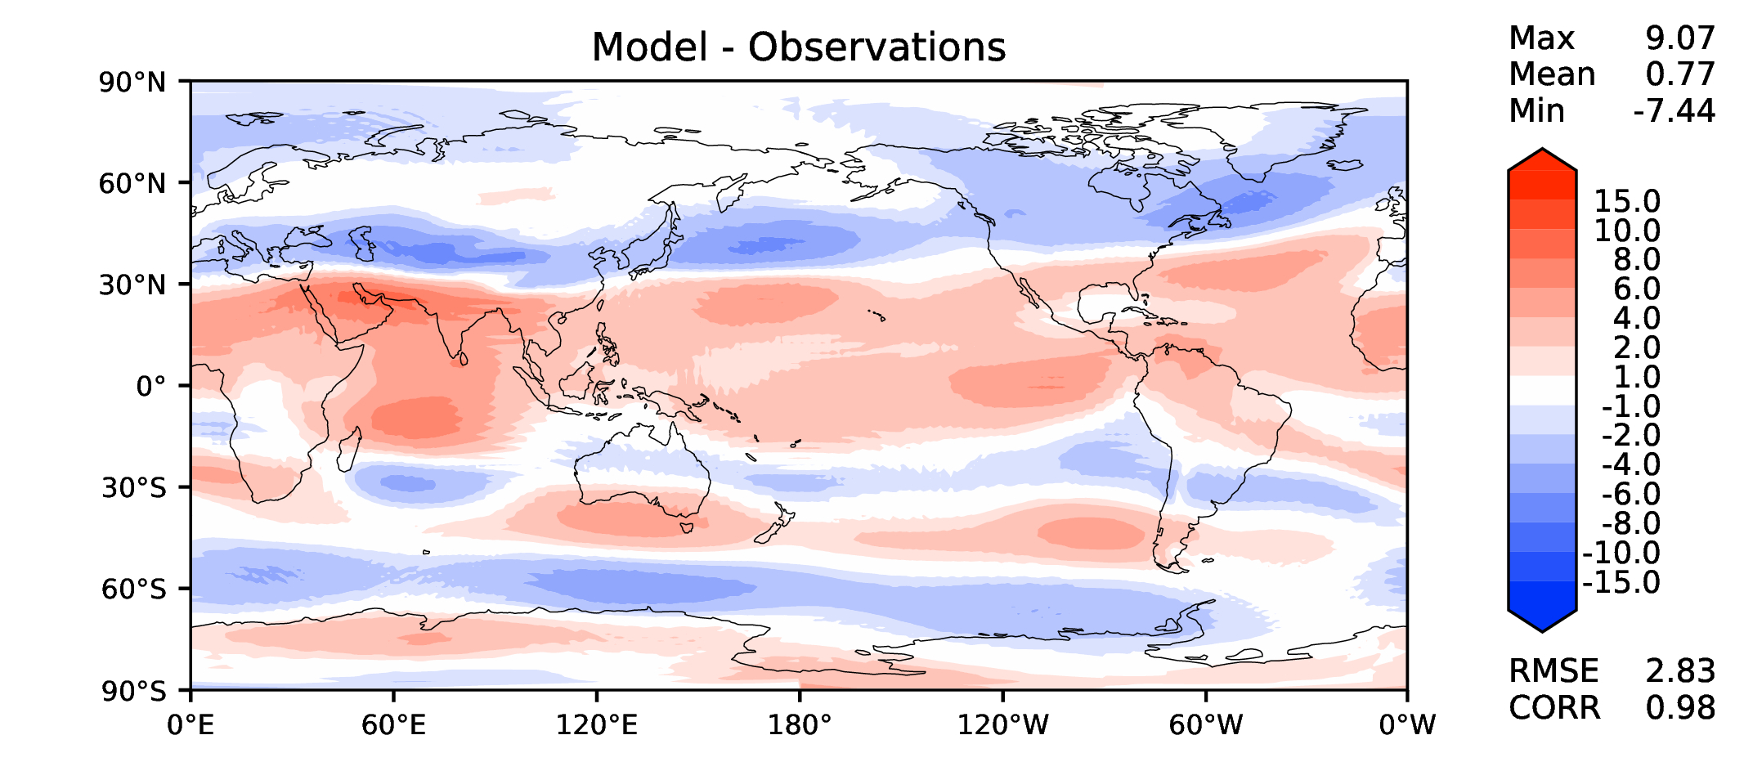
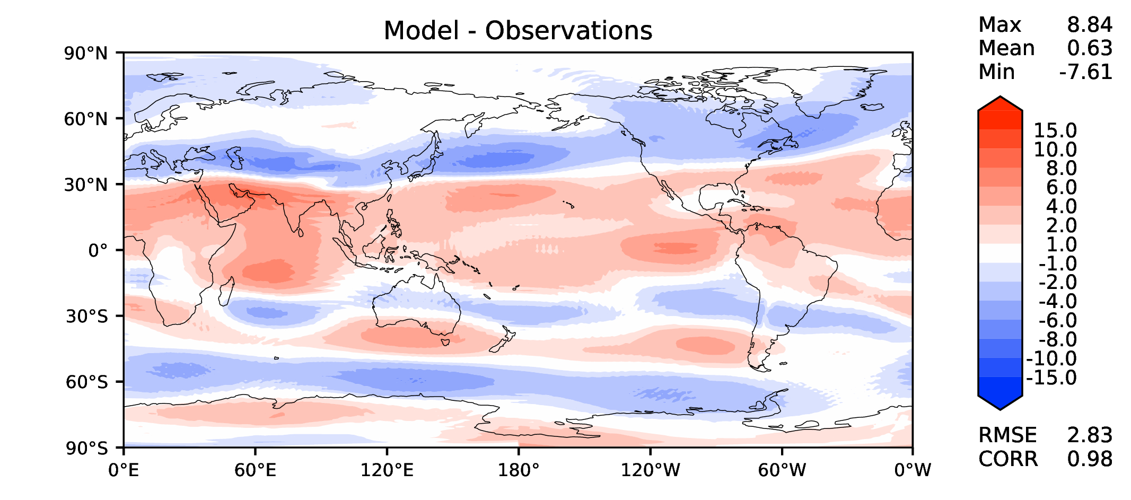
Annual u wind at 200 hPa
DECKv1b
v2beta4
v2rc1c
v2rc1e

Slide 13
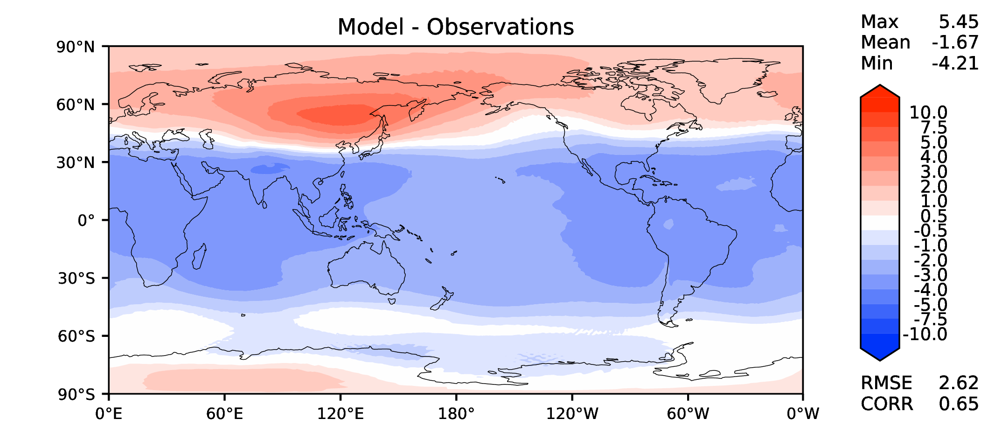
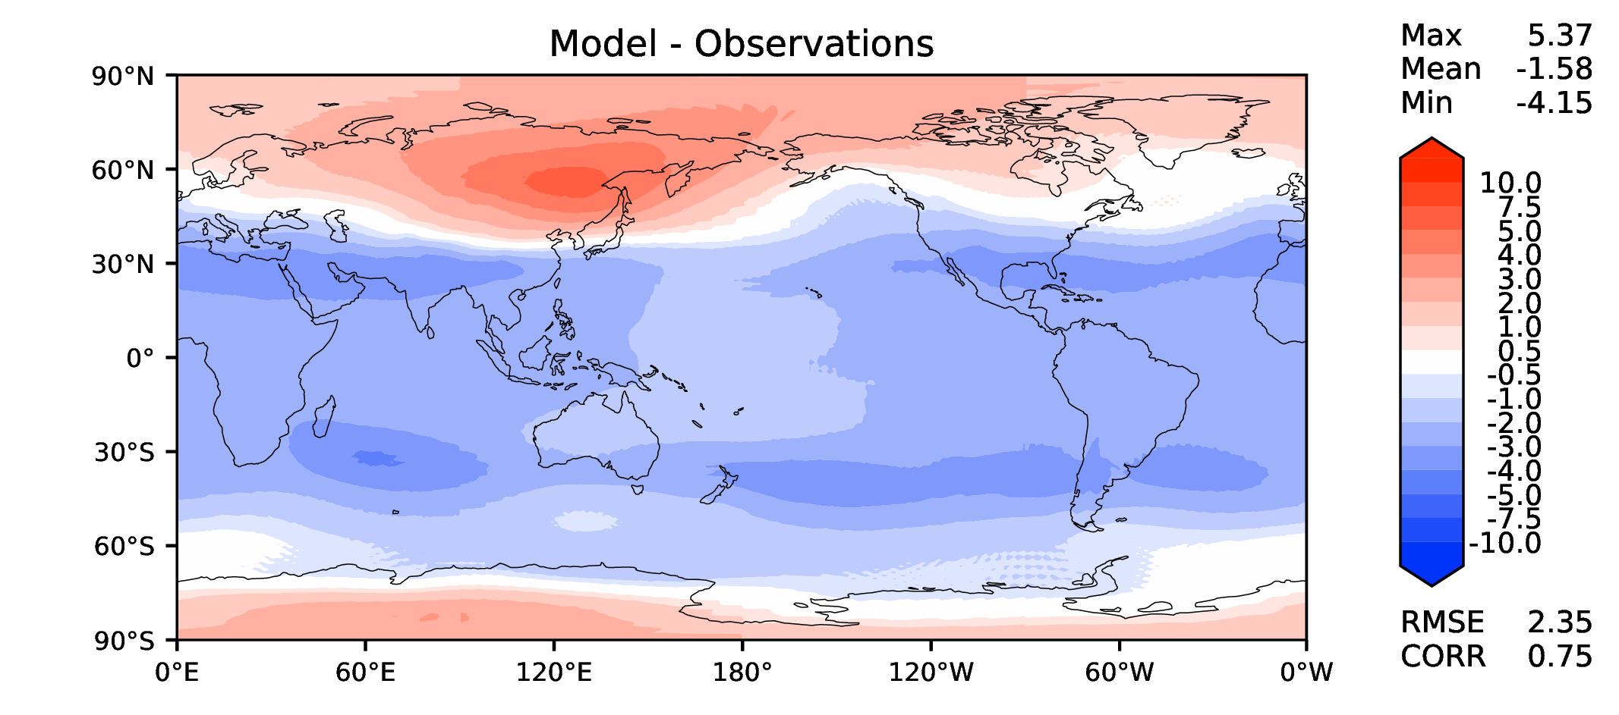
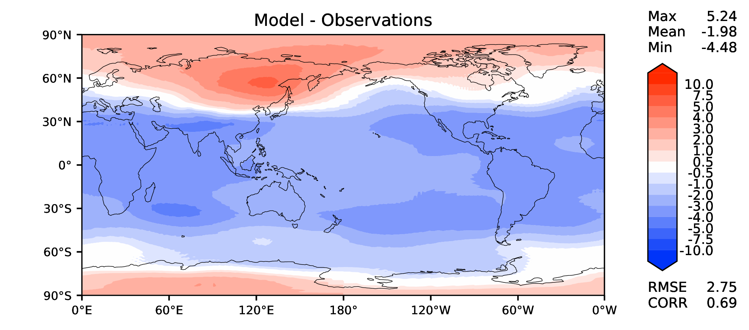
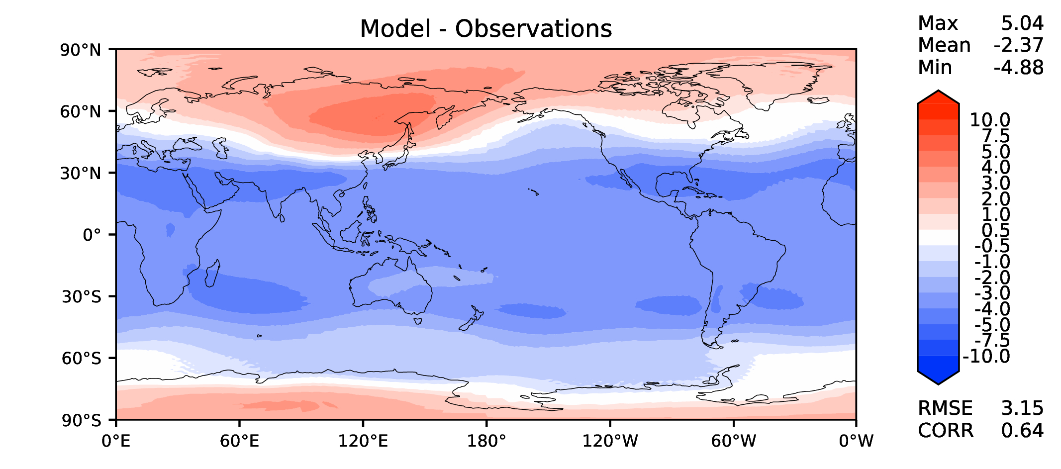
Annual T at 200 hPa
DECKv1b
v2beta4
v2rc1c
v2rc1e

Slide 14
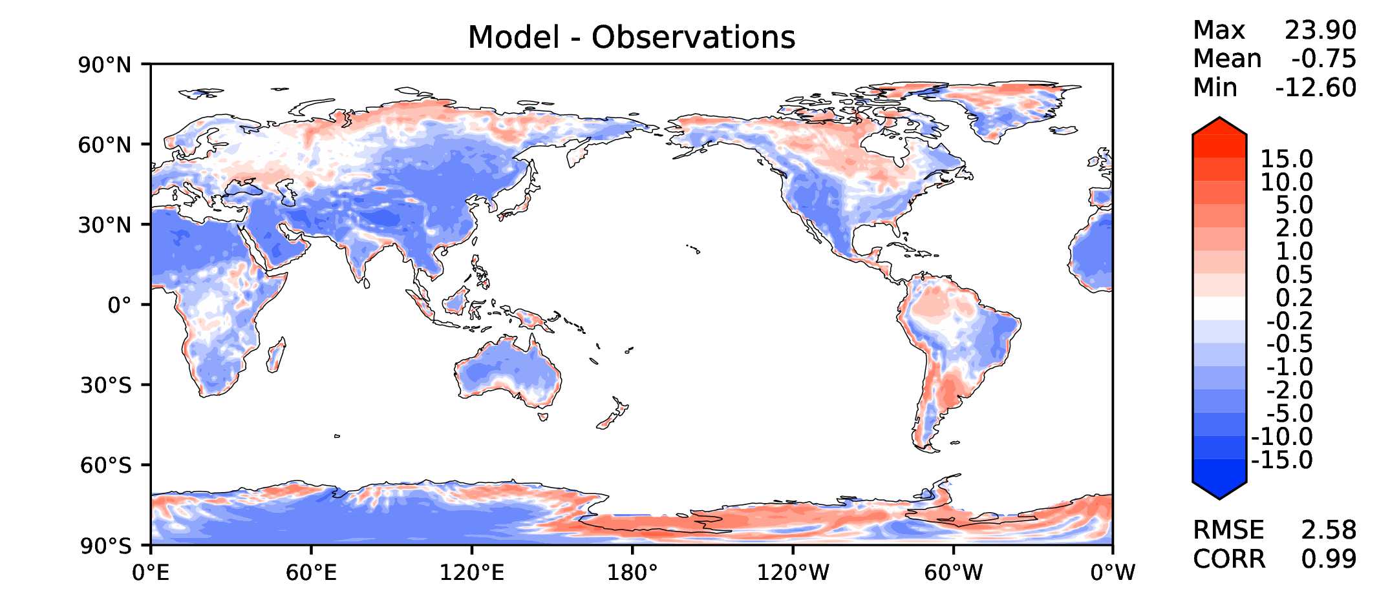
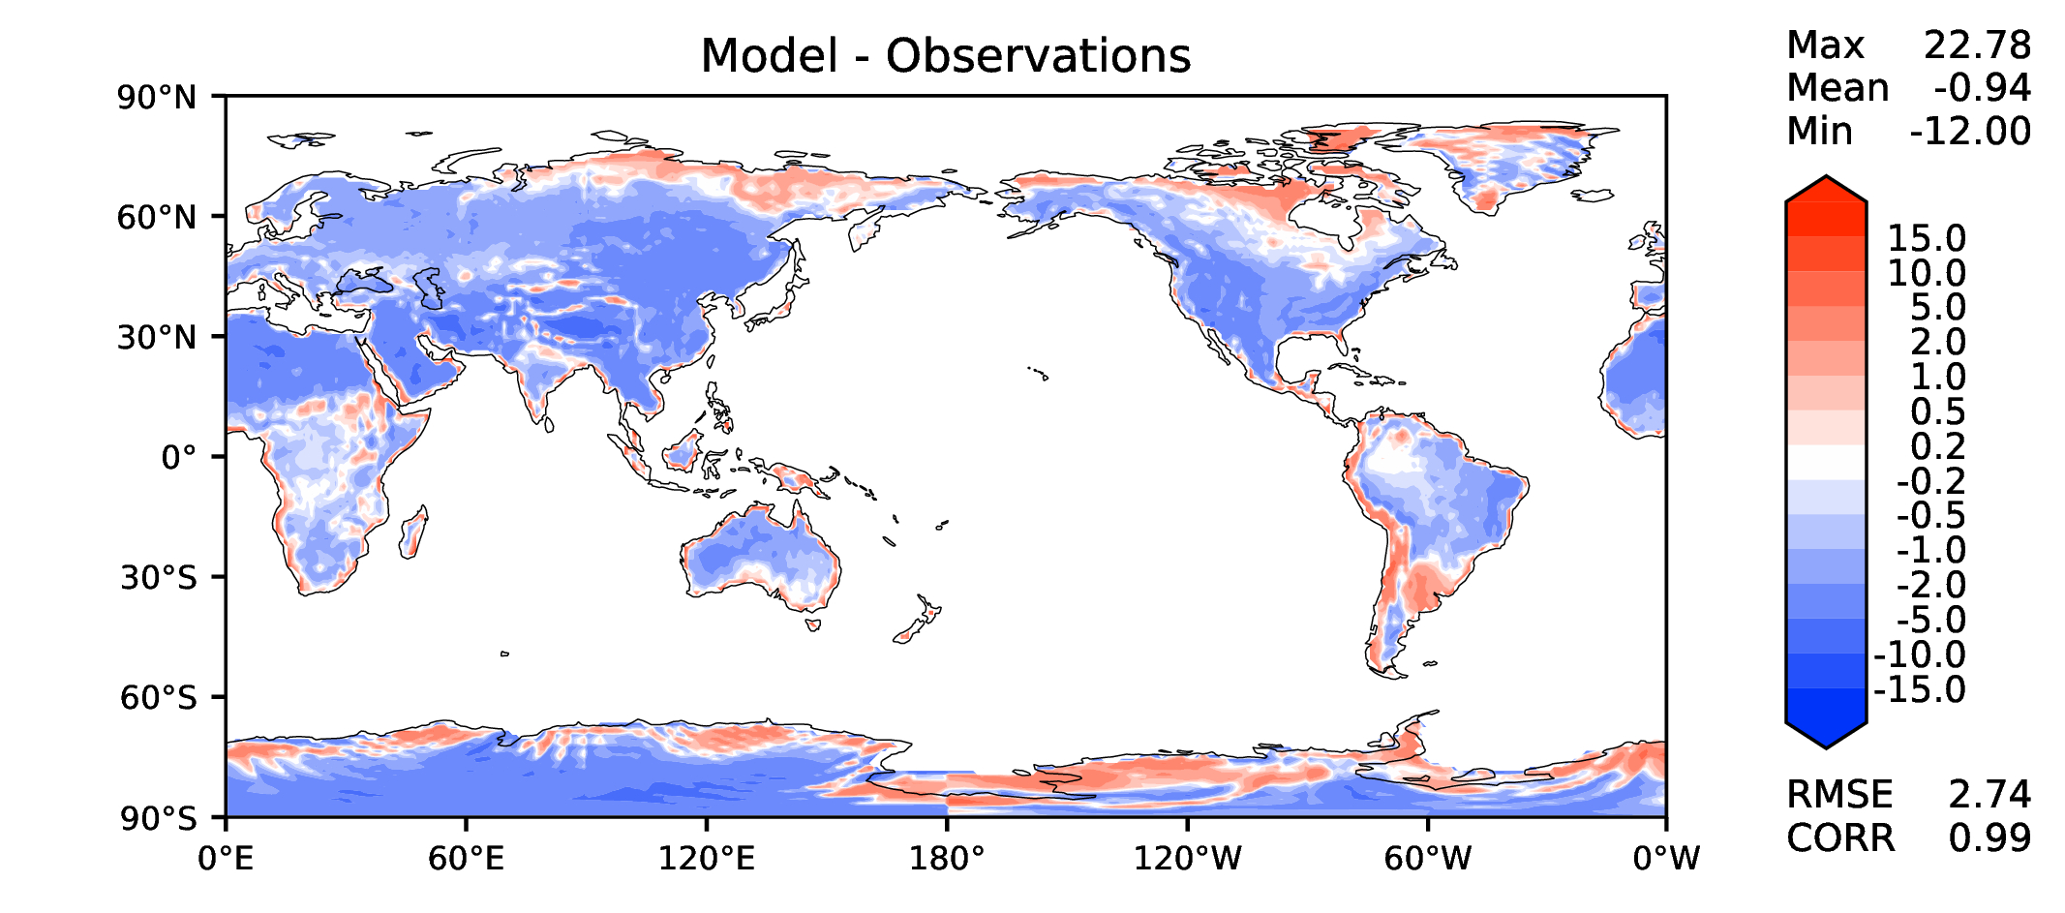
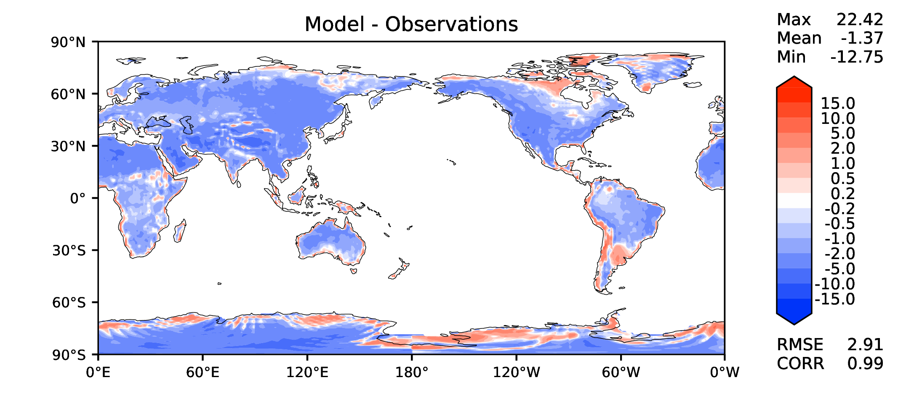
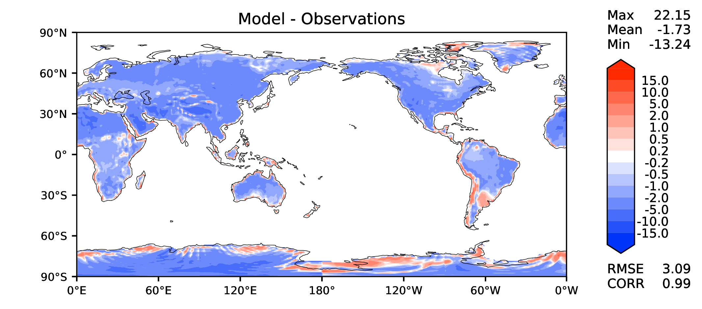
Annual surface air T (land)
DECKv1b
v2beta4
v2rc1c
v2rc1e

Slide 15
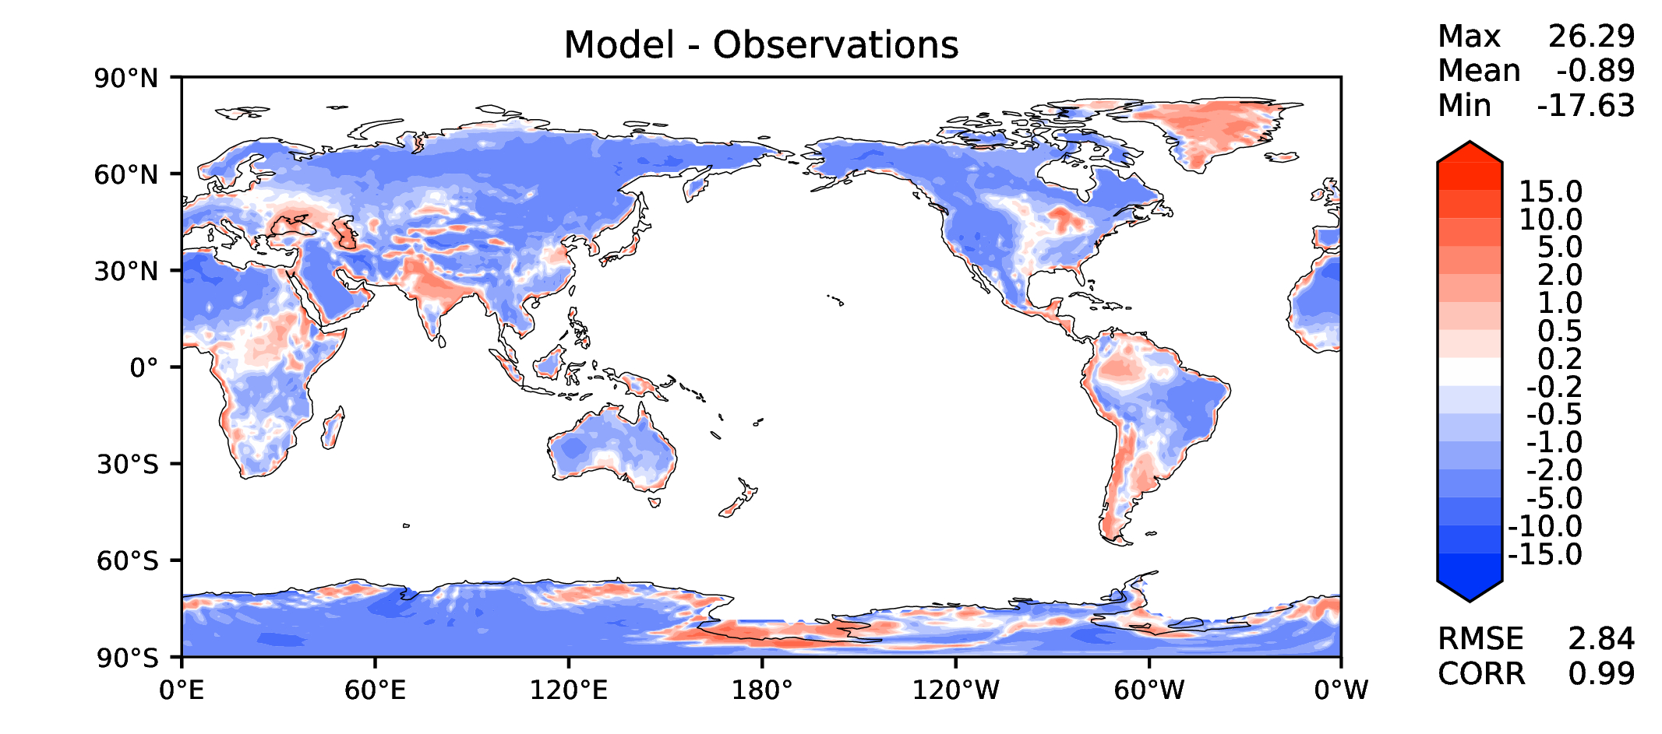



JJA surface air T (land)
DECKv1b
v2beta4
v2rc1c
v2rc1e

Slide 16




Aerosol optical depth
DECKv1b
v2beta4
v2rc1c
v2rc1e

Slide 17




TAUXY ANN ocean
DECKv1b
v2beta4
v2rc1c
v2rc1e

