Slide 1
Summary table (RMSE vs obs)
Variable | Season | DECKv1 | v2rc1a | v2rc1b | v2rc1c
SST | ANN | 1.08 | 1.10 | 1.25 | 1.09
PRECT | ANN | 1.11 | 1.02 | 0.96 | 0.98
PRECT | DJF | 1.42 | 1.43 | 1.31 | 1.37
PRECT | MAM | 1.52 | 1.25 | 1.22 | 1.19
PRECT | JJA | 1.48 | 1.40 | 1.36 | 1.34
PRECT | SON | 1.28 | 1.33 | 1.24 | 1.26
RESTOM | ANN | 9.26 | 8.31 | 8.19 | 8.35
SWCF | ANN | 10.52 | 10.01 | 10.05 | 9.83
LWCF | ANN | 5.28 | 5.36 | 5.09 | 5.21
u850 | ANN | 1.28 | 1.27 | 1.20 | 1.22
u200 | ANN | 2.11 | 2.98 | 2.83 | 2.86
T200 | ANN | 2.61 | 2.72 | 2.89 | 2.82
TREFHT | ANN | 2.59 | 2.93 | 3.23 | 2.90
TREFHT | JJA | 2.83 | 3.16 | 3.40 | 3.11
AODVIS | ANN | 0.07 | 0.06 | 0.06 | 0.06
TAUXY | ANN | 0.02 | 0.02 | 0.02 | 0.02
CLDLWP_OCN | ANN | 43.79 | 39.64 | 39.15 | 43.02

Slide 2
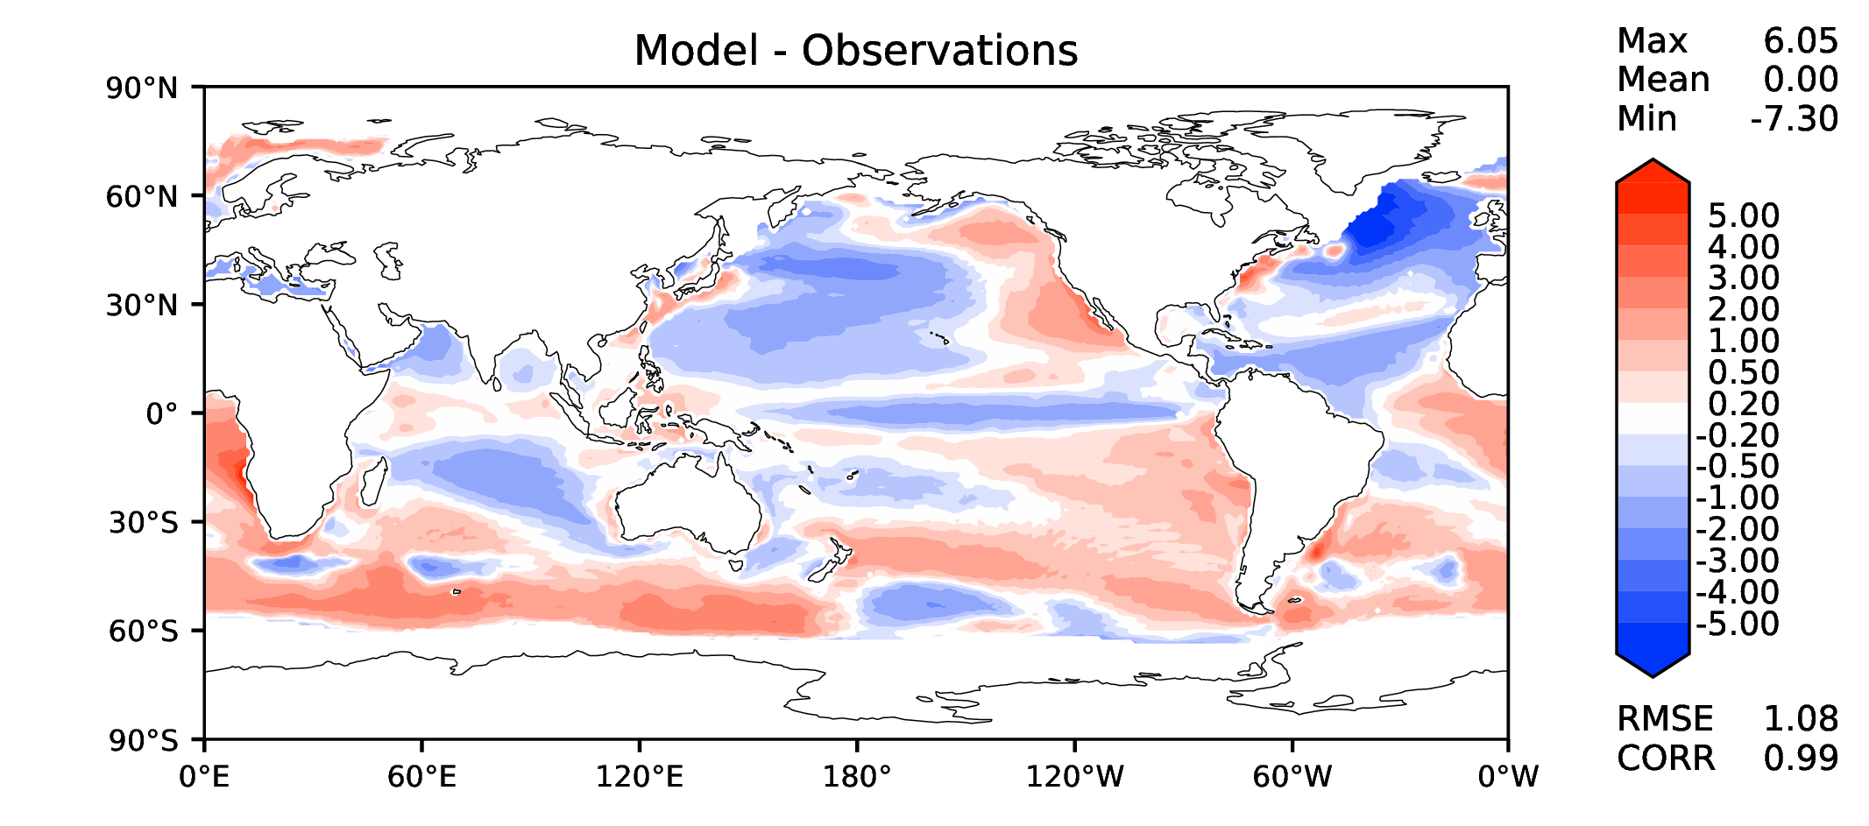
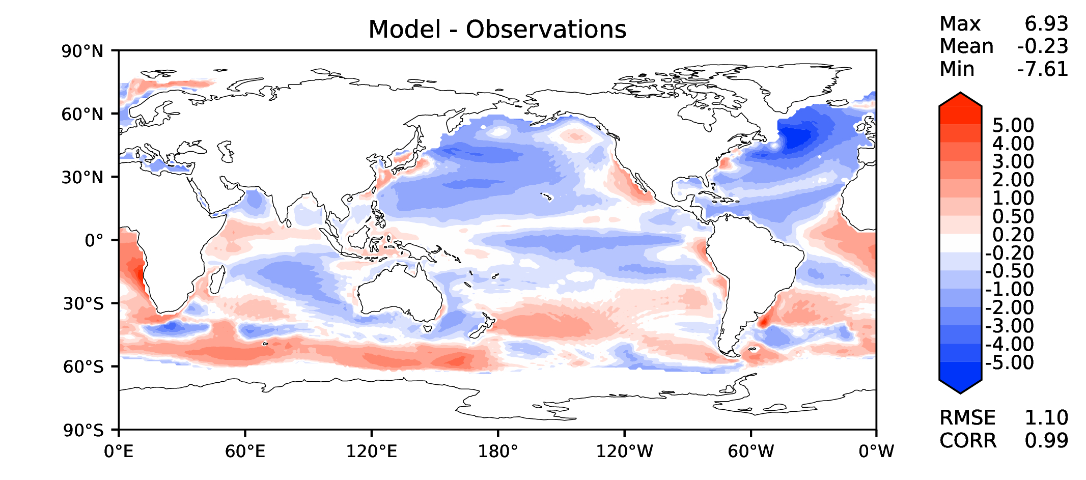
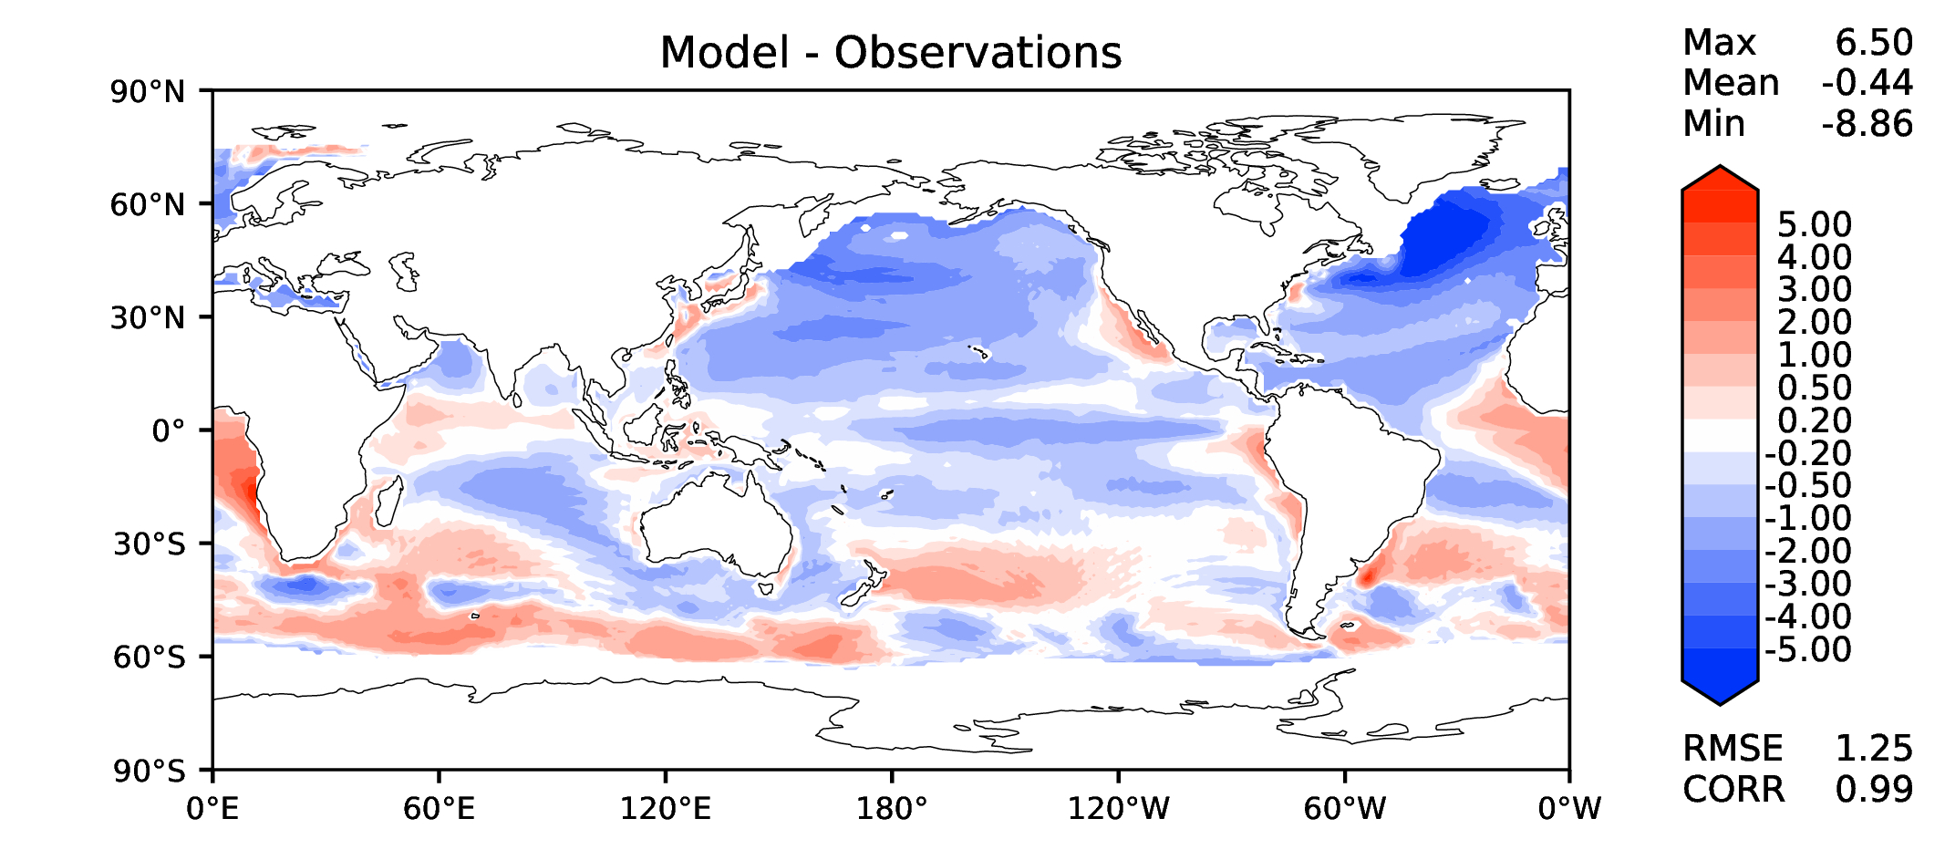
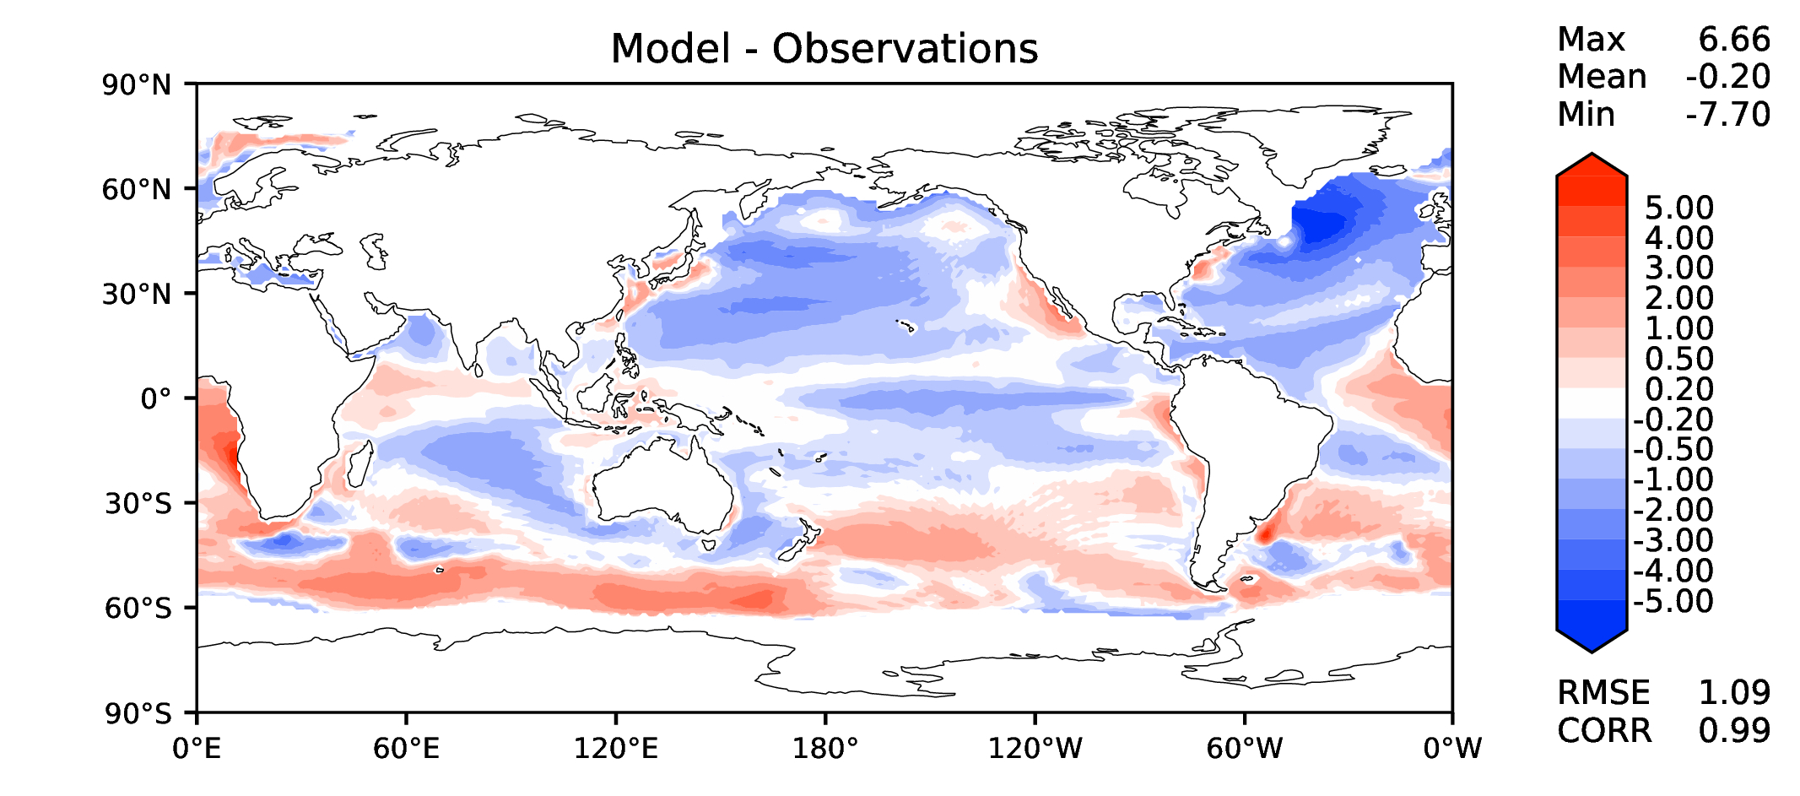
Annual SST (pre-industrial)
DECKv1
v2rc1a
v2rc1b
v2rc1c

Slide 3
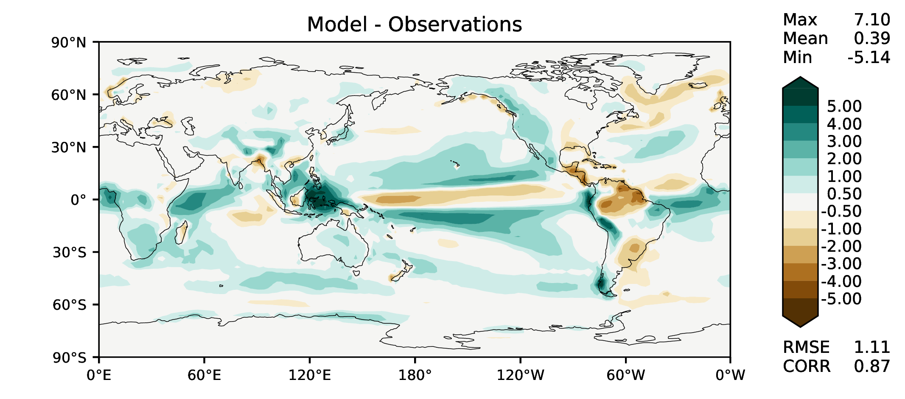
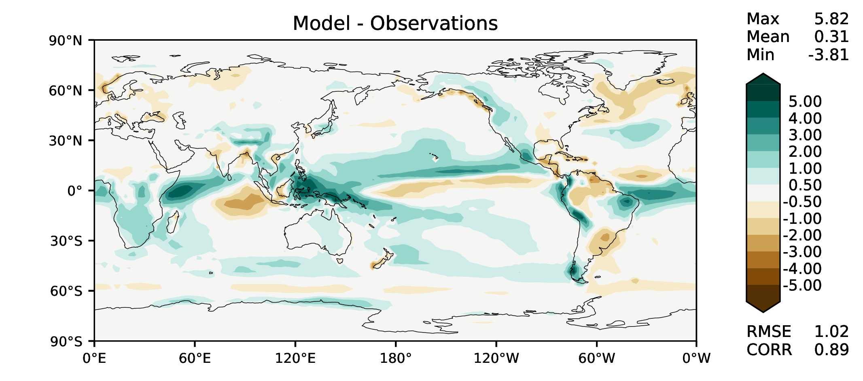
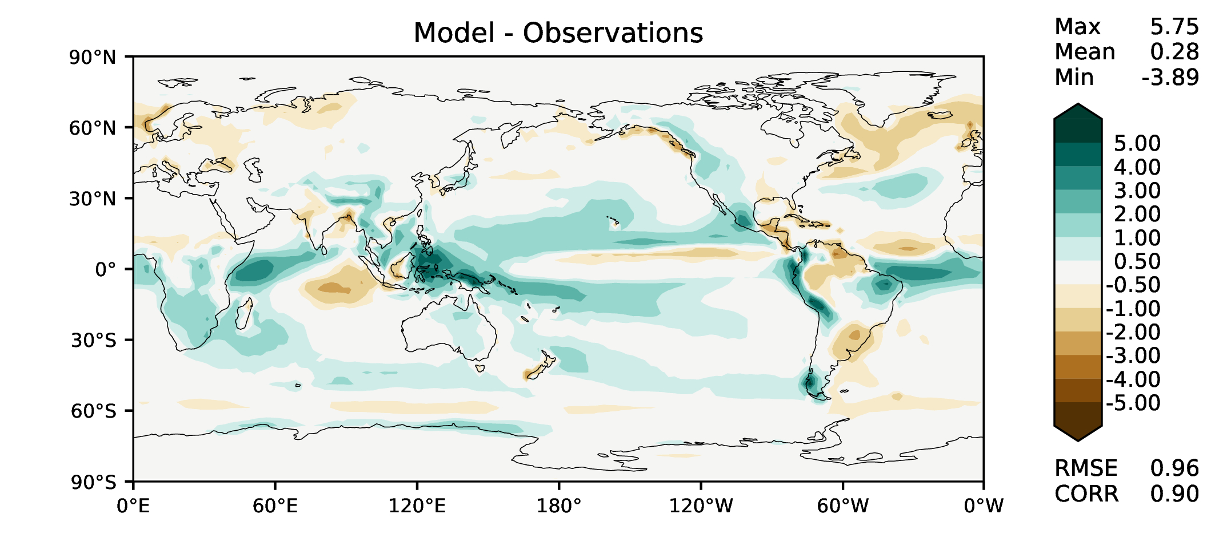
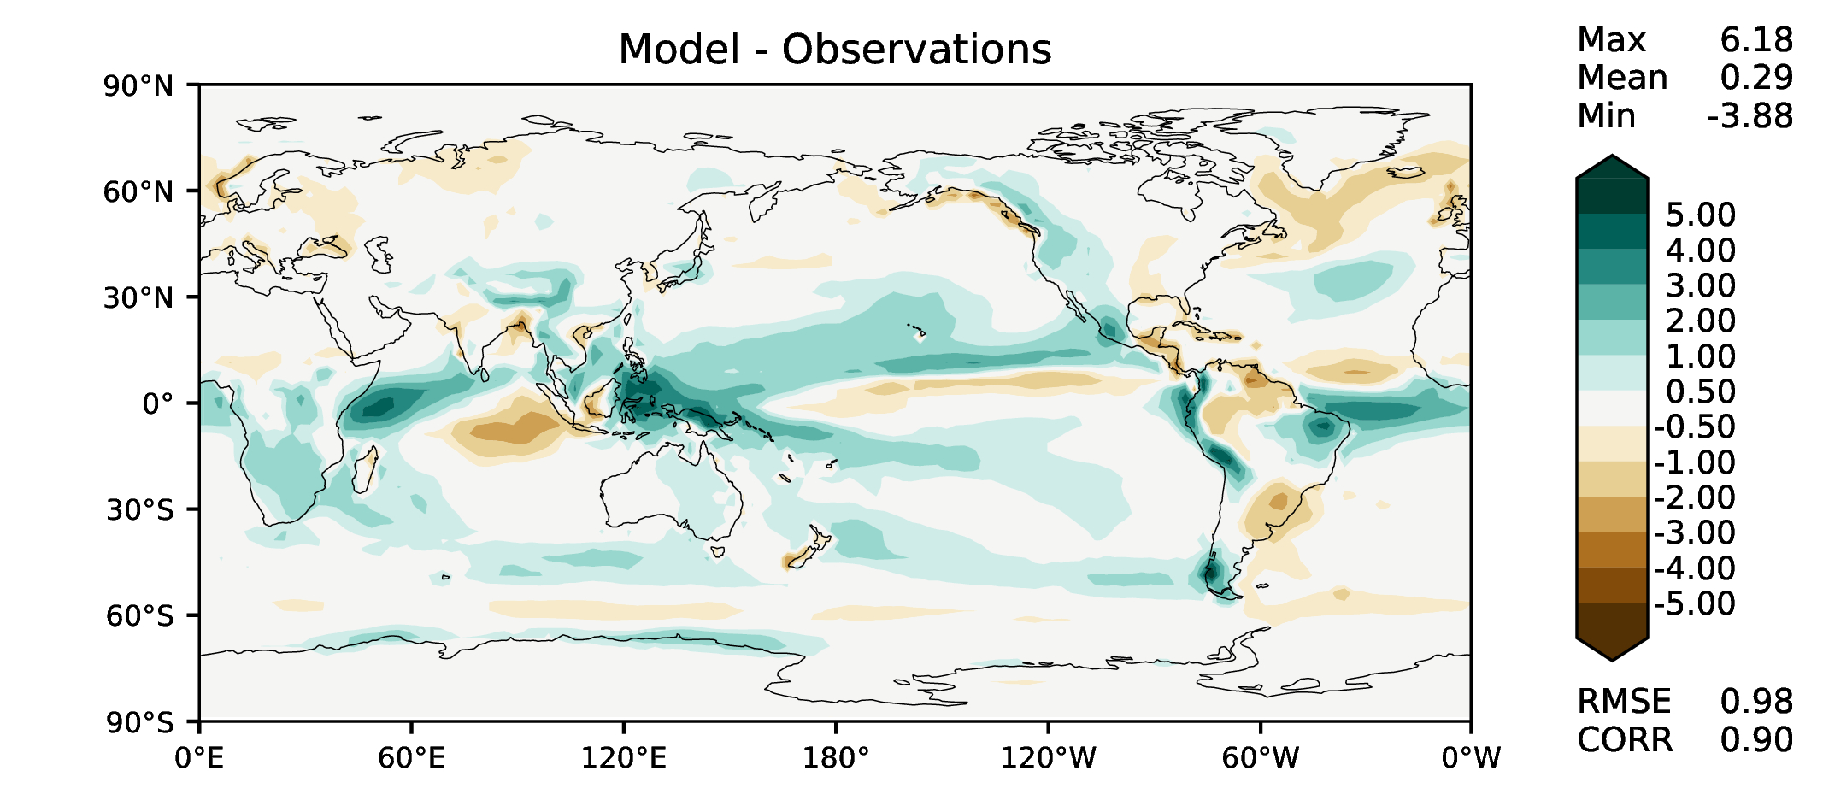
Annual total precipitation
DECKv1
v2rc1a
v2rc1b
v2rc1c

Slide 4
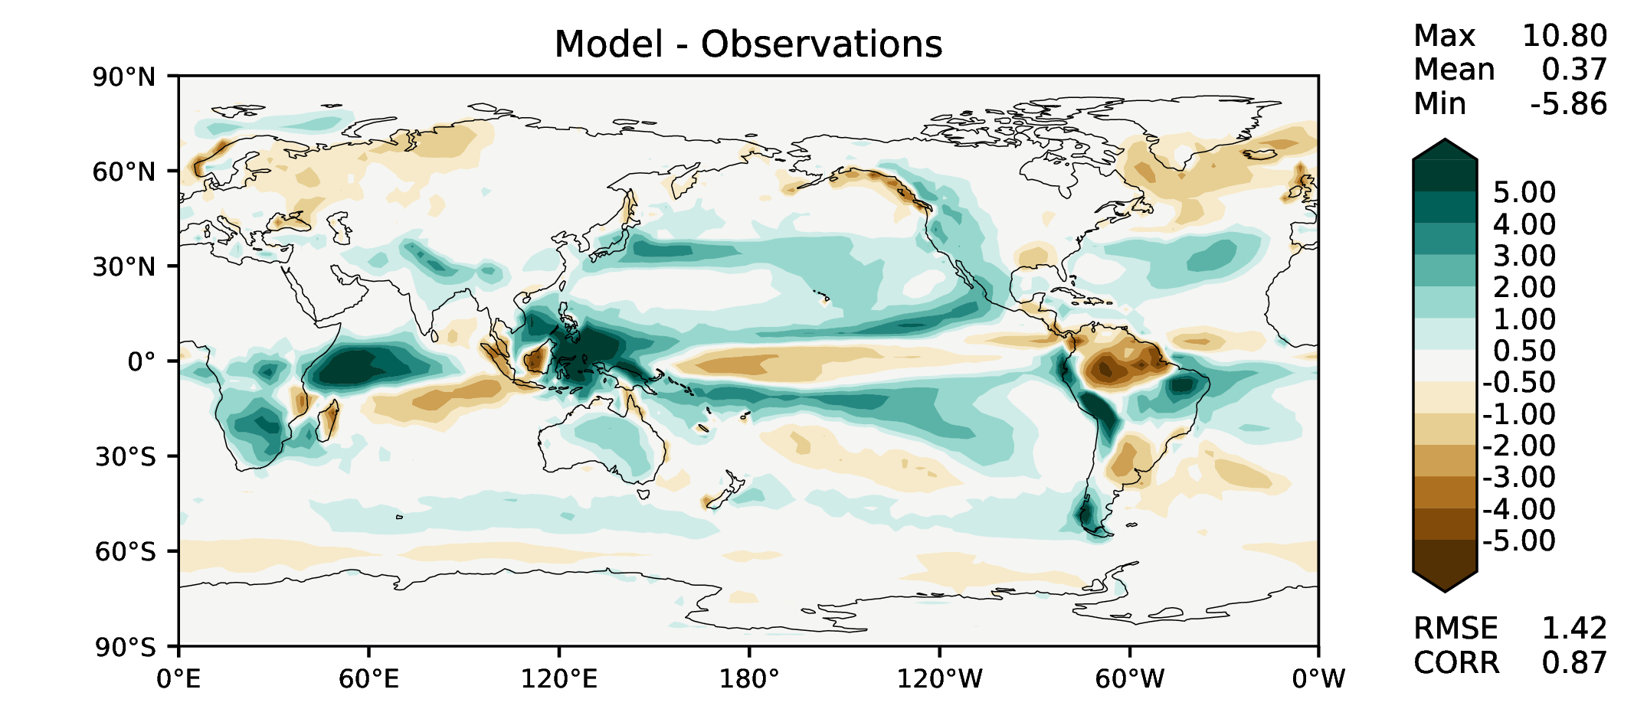
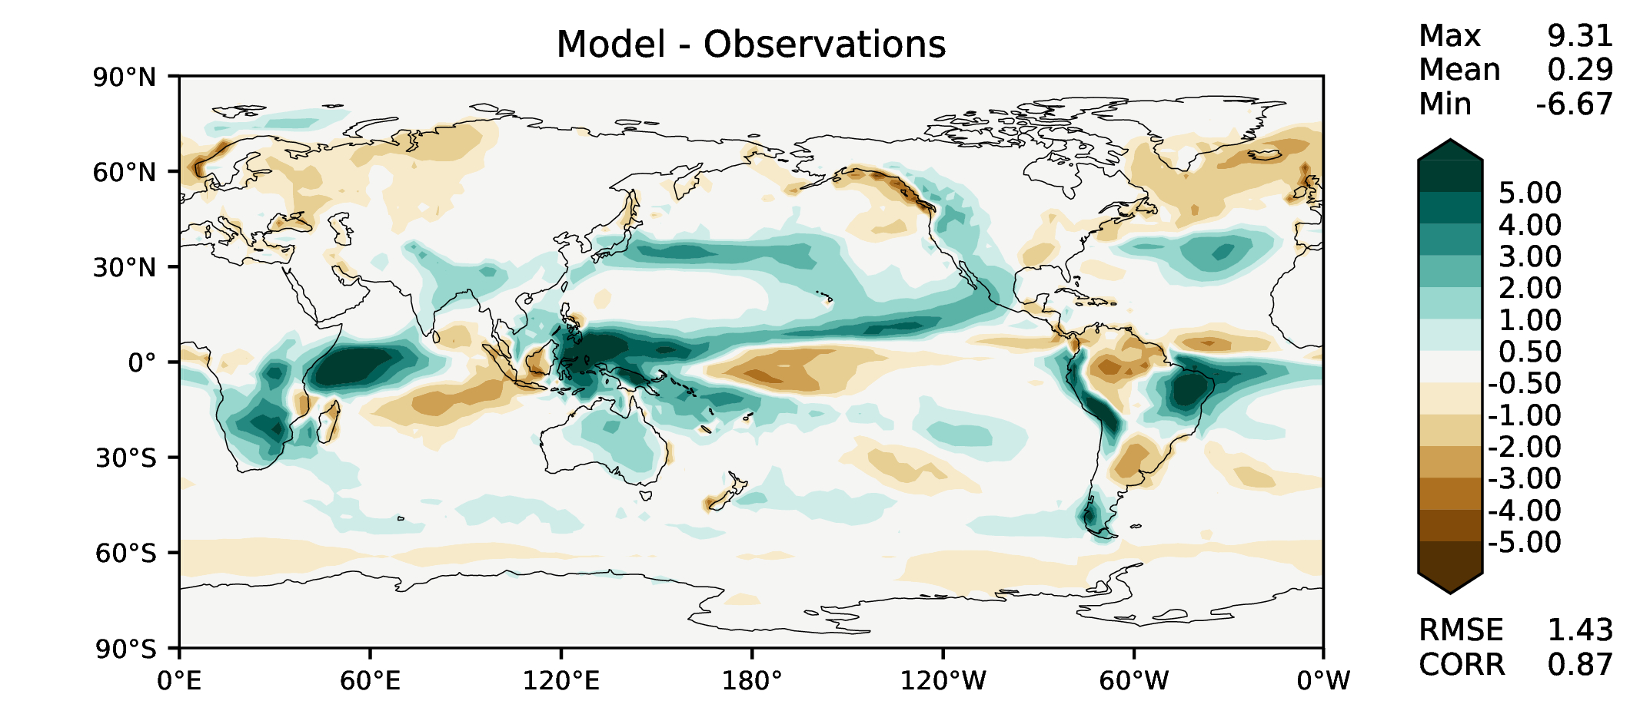
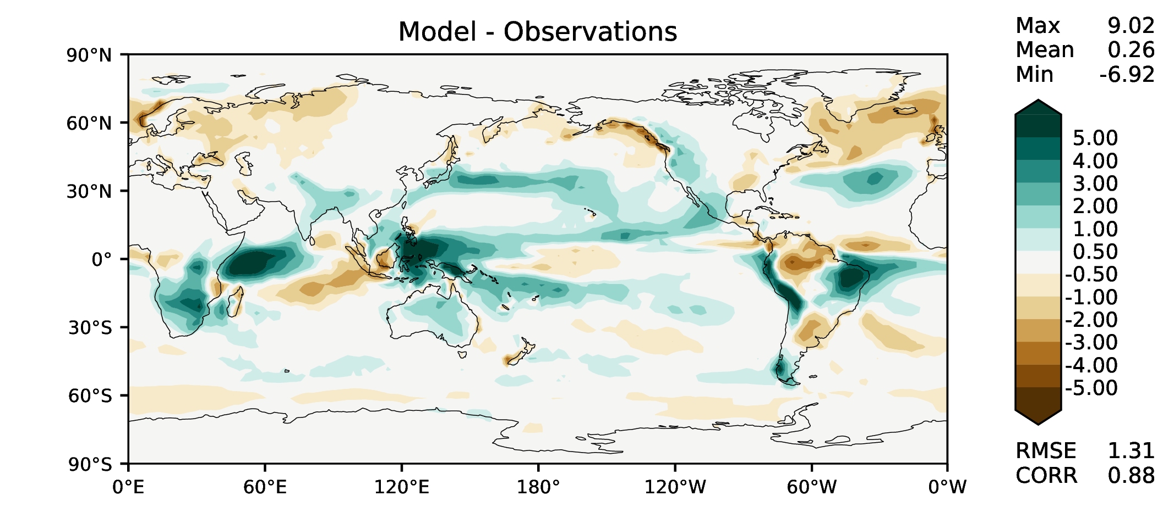
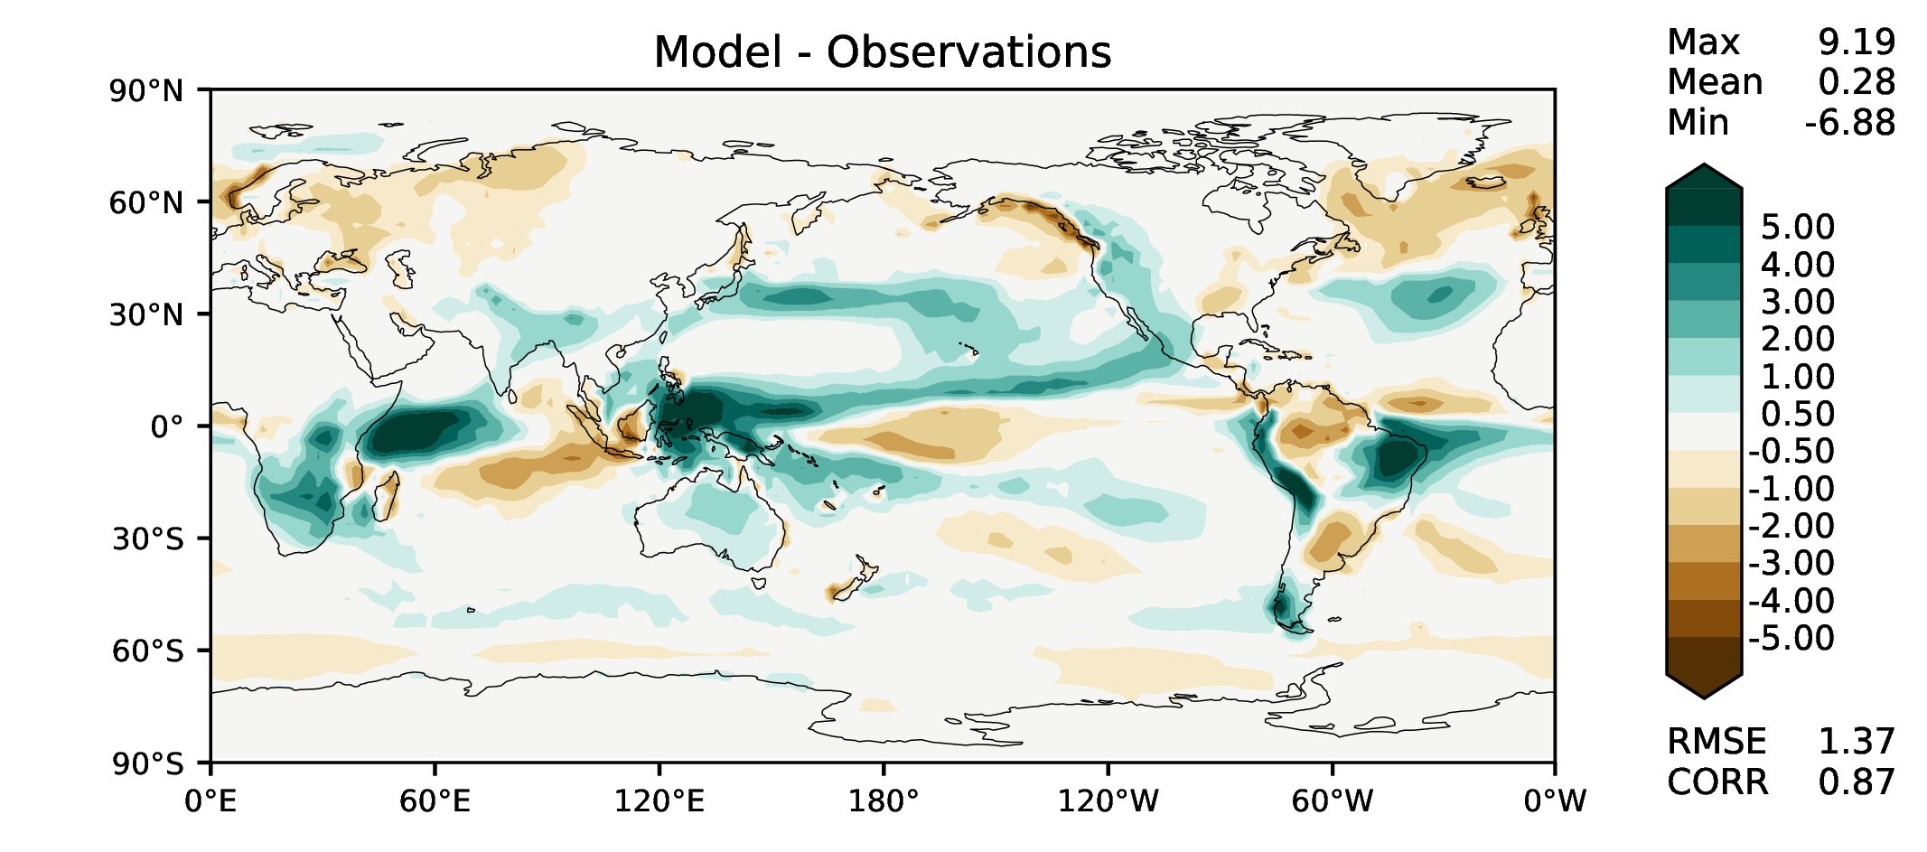
DJF total precipitation
DECKv1
v2rc1a
v2rc1b
v2rc1c

Slide 5
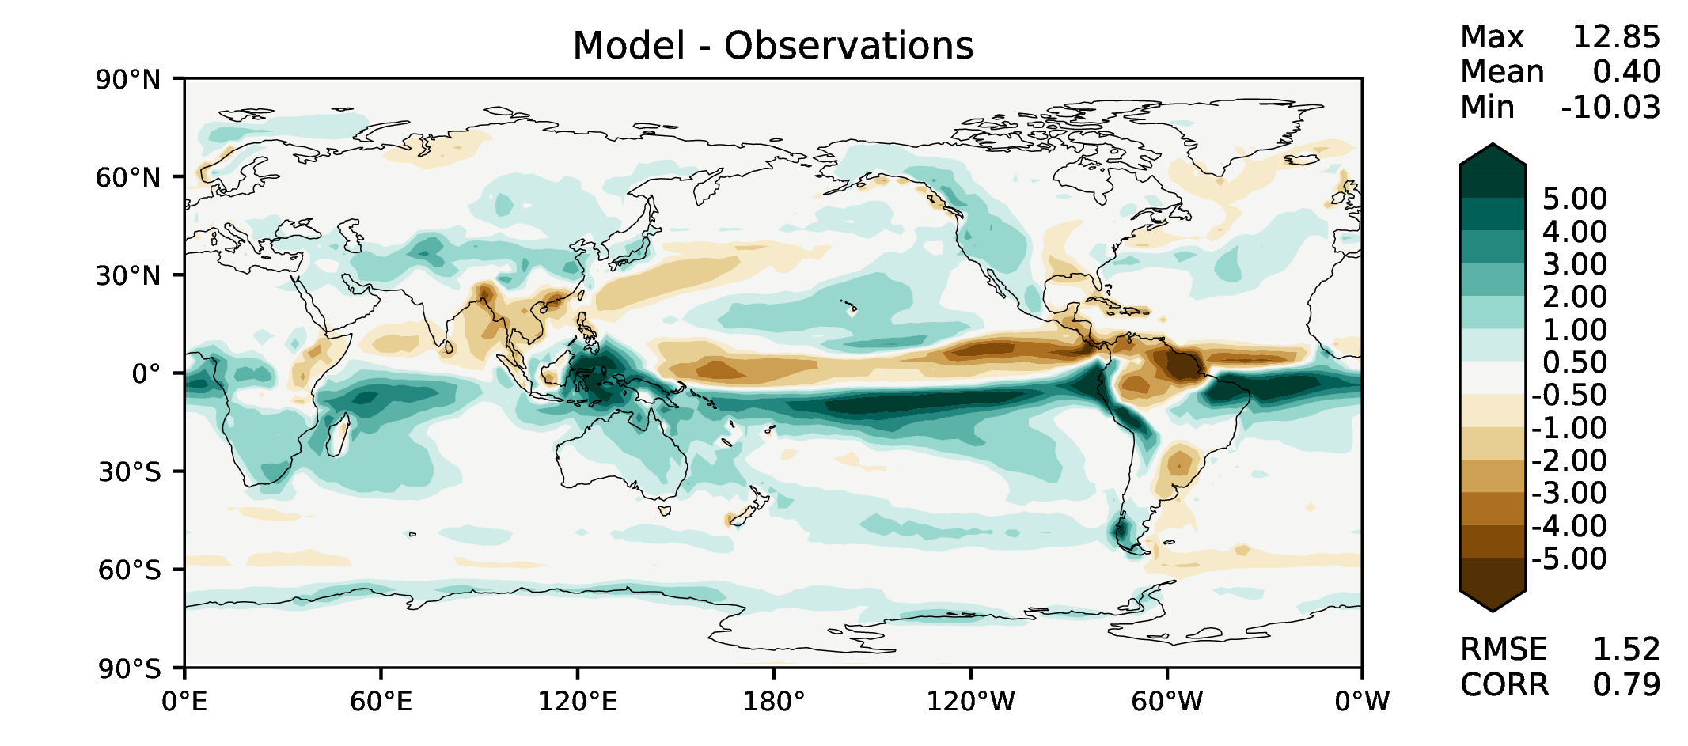
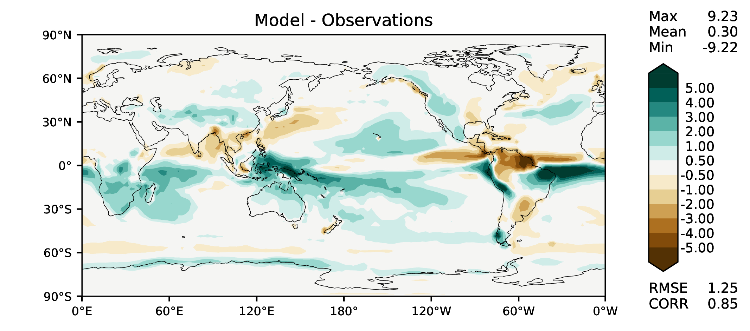
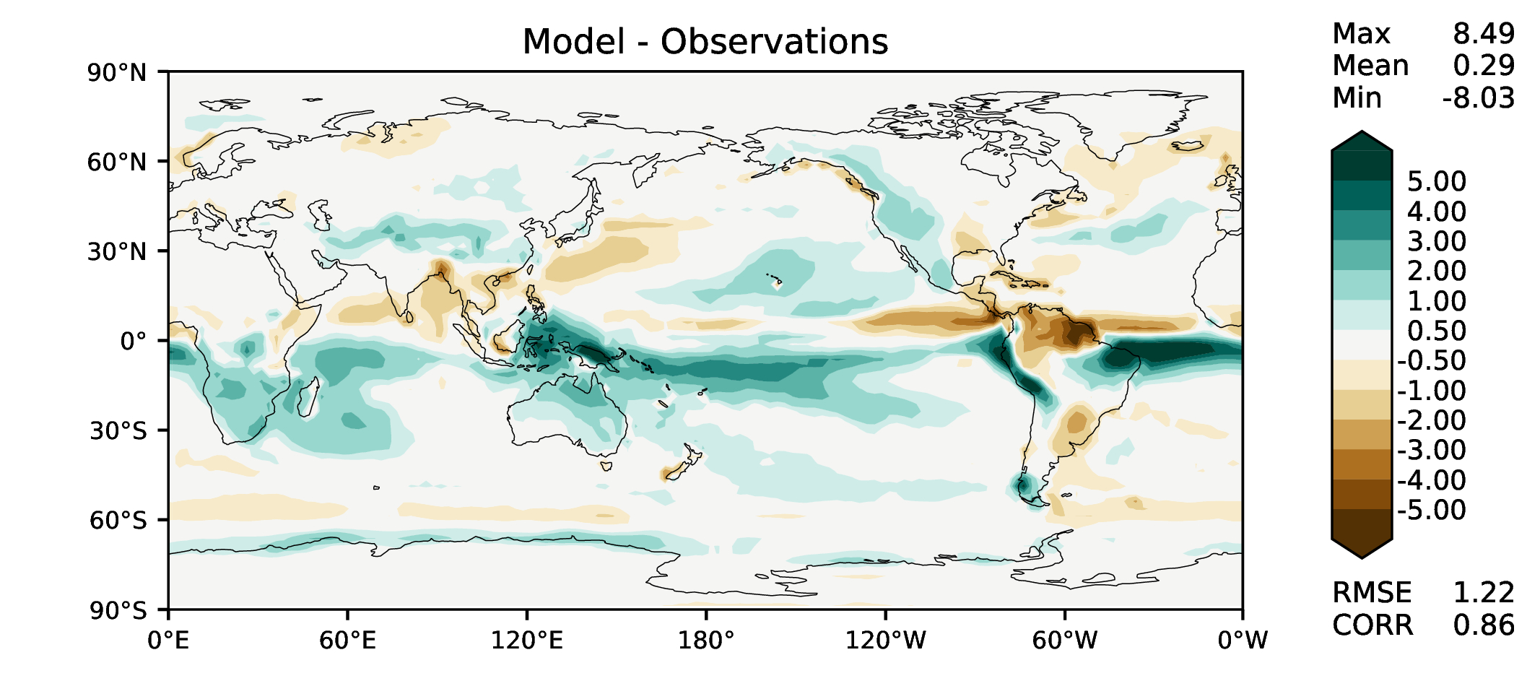
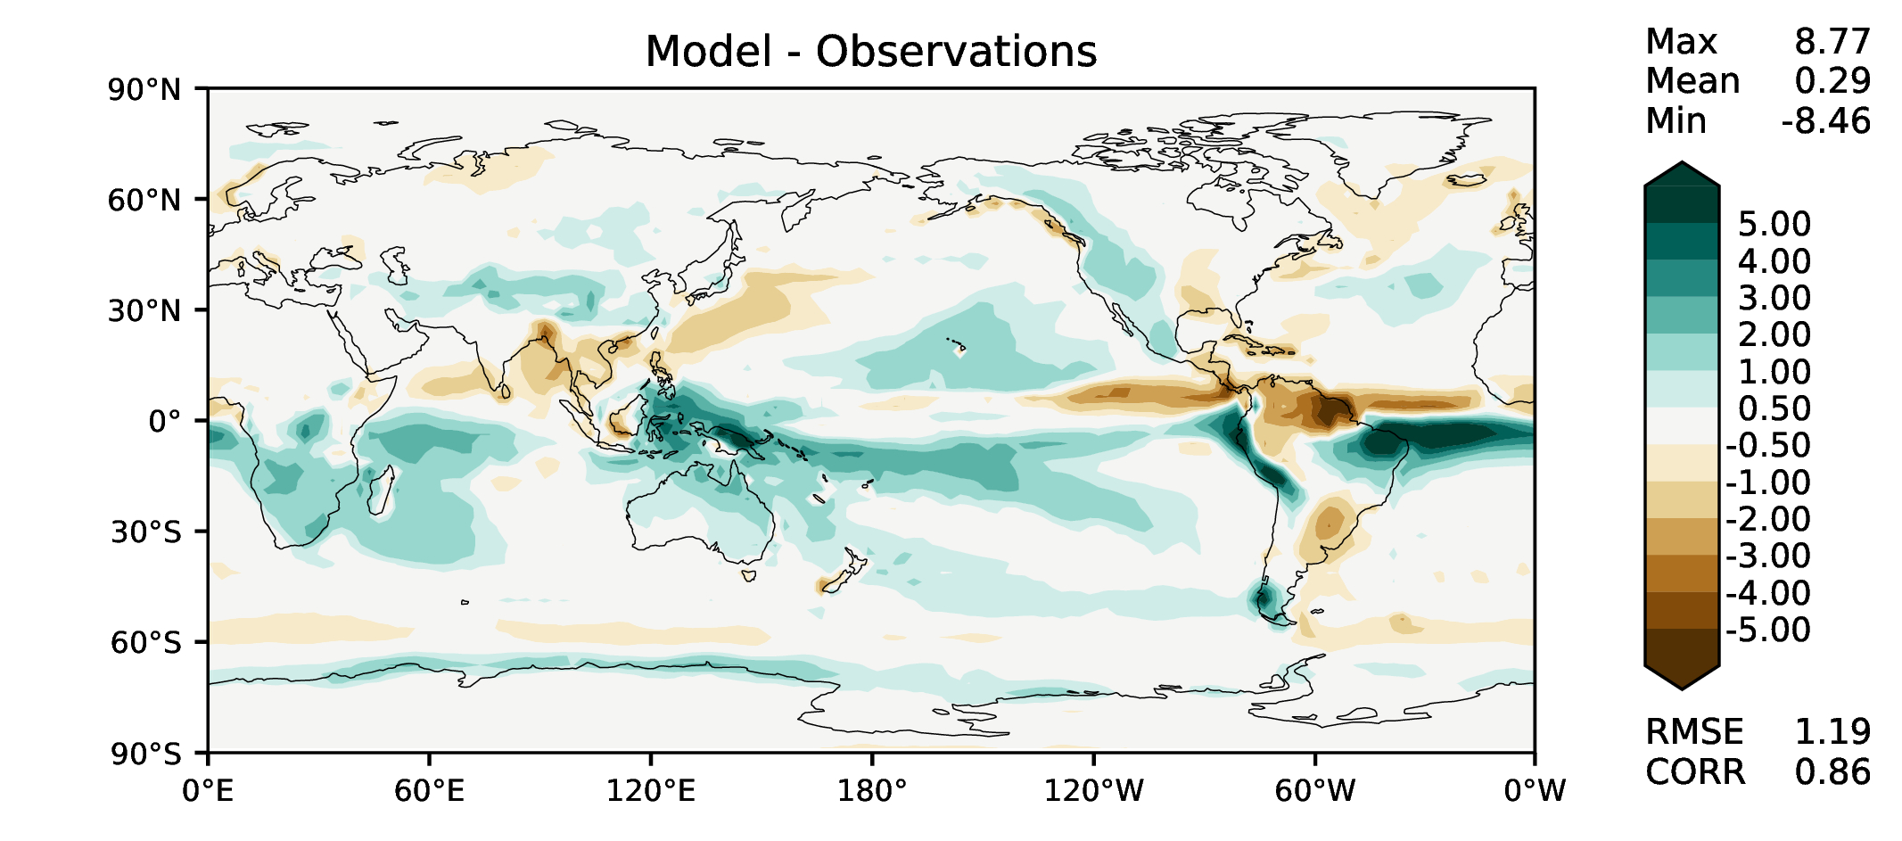
MAM total precipitation
DECKv1
v2rc1a
v2rc1b
v2rc1c

Slide 6
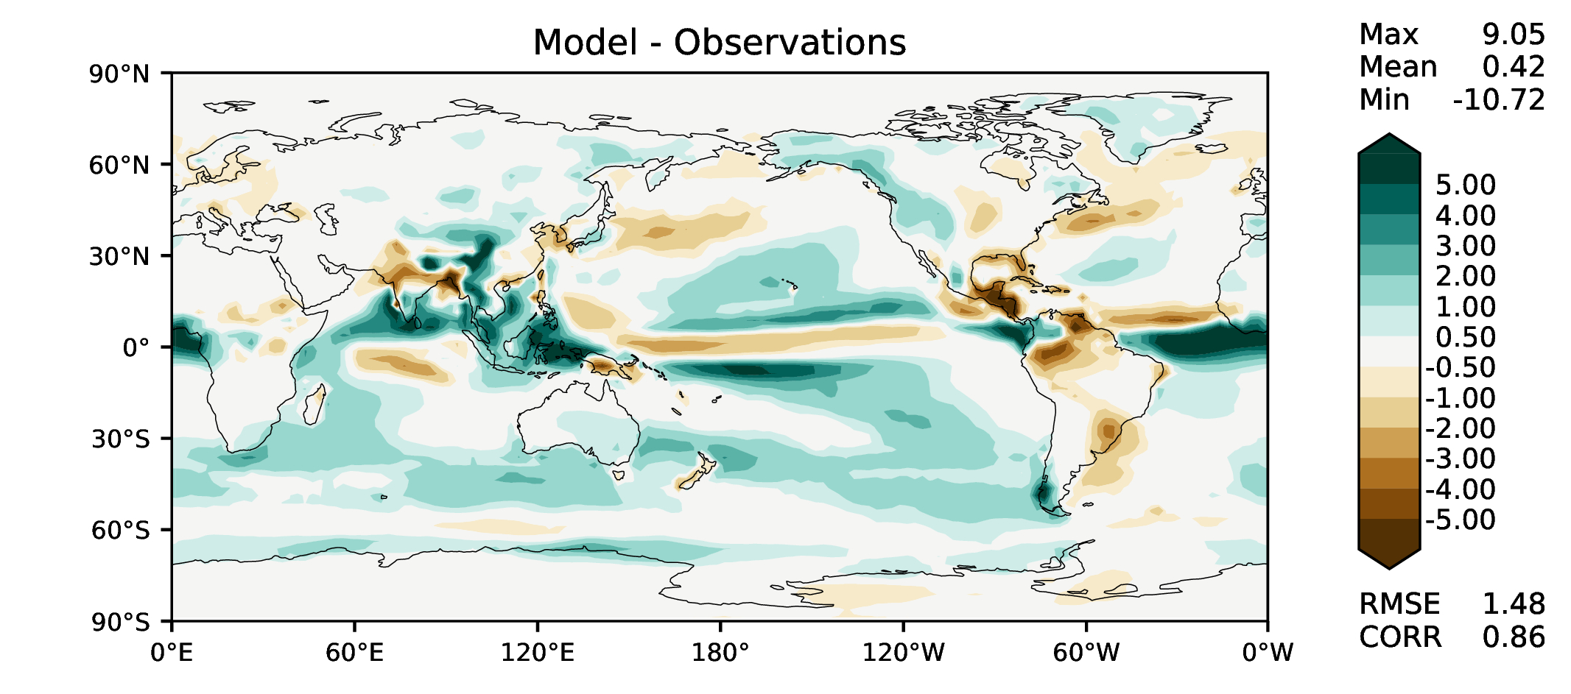
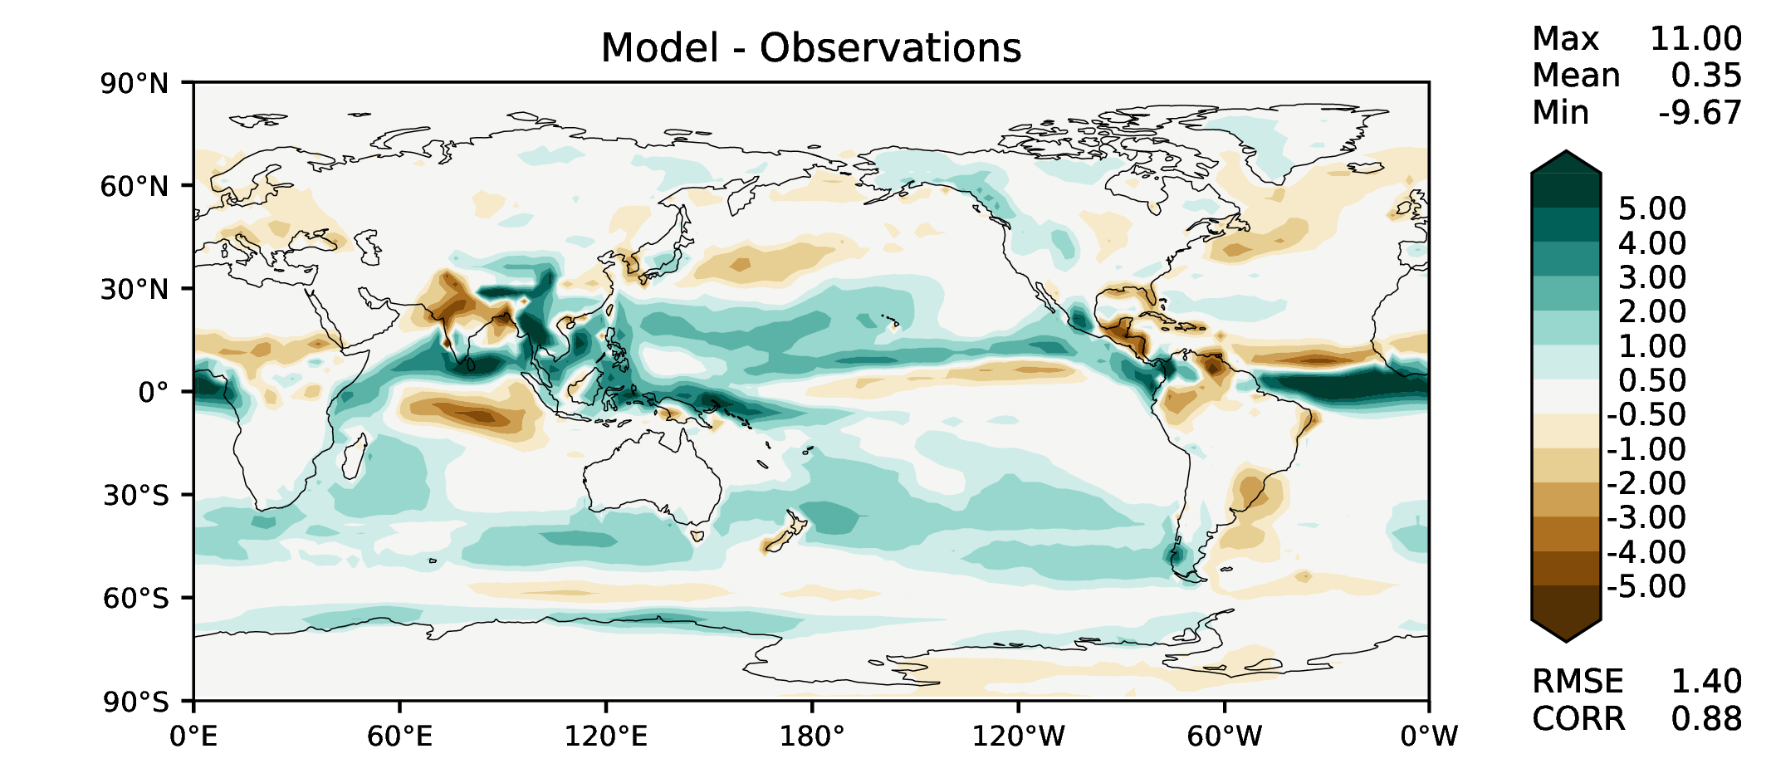
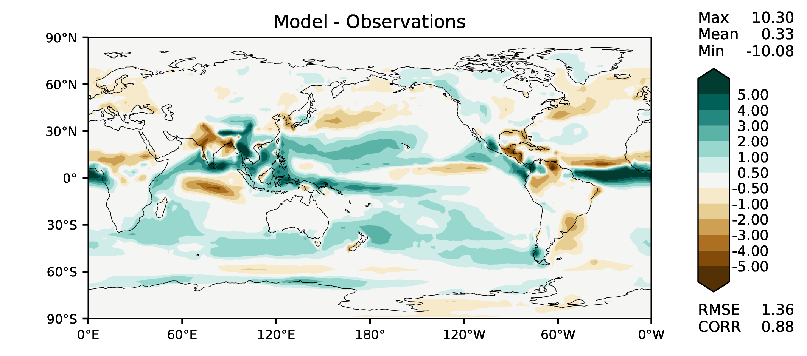
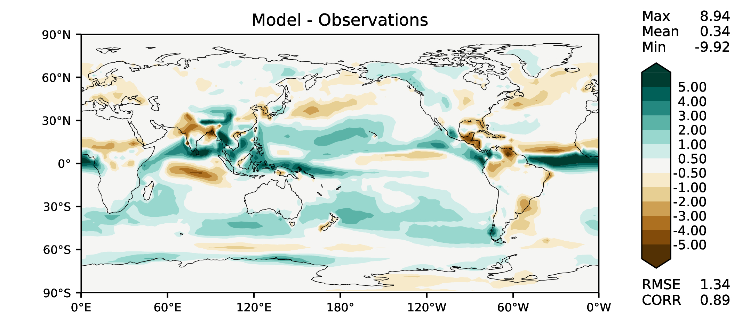
JJA total precipitation
DECKv1
v2rc1a
v2rc1b
v2rc1c

Slide 7
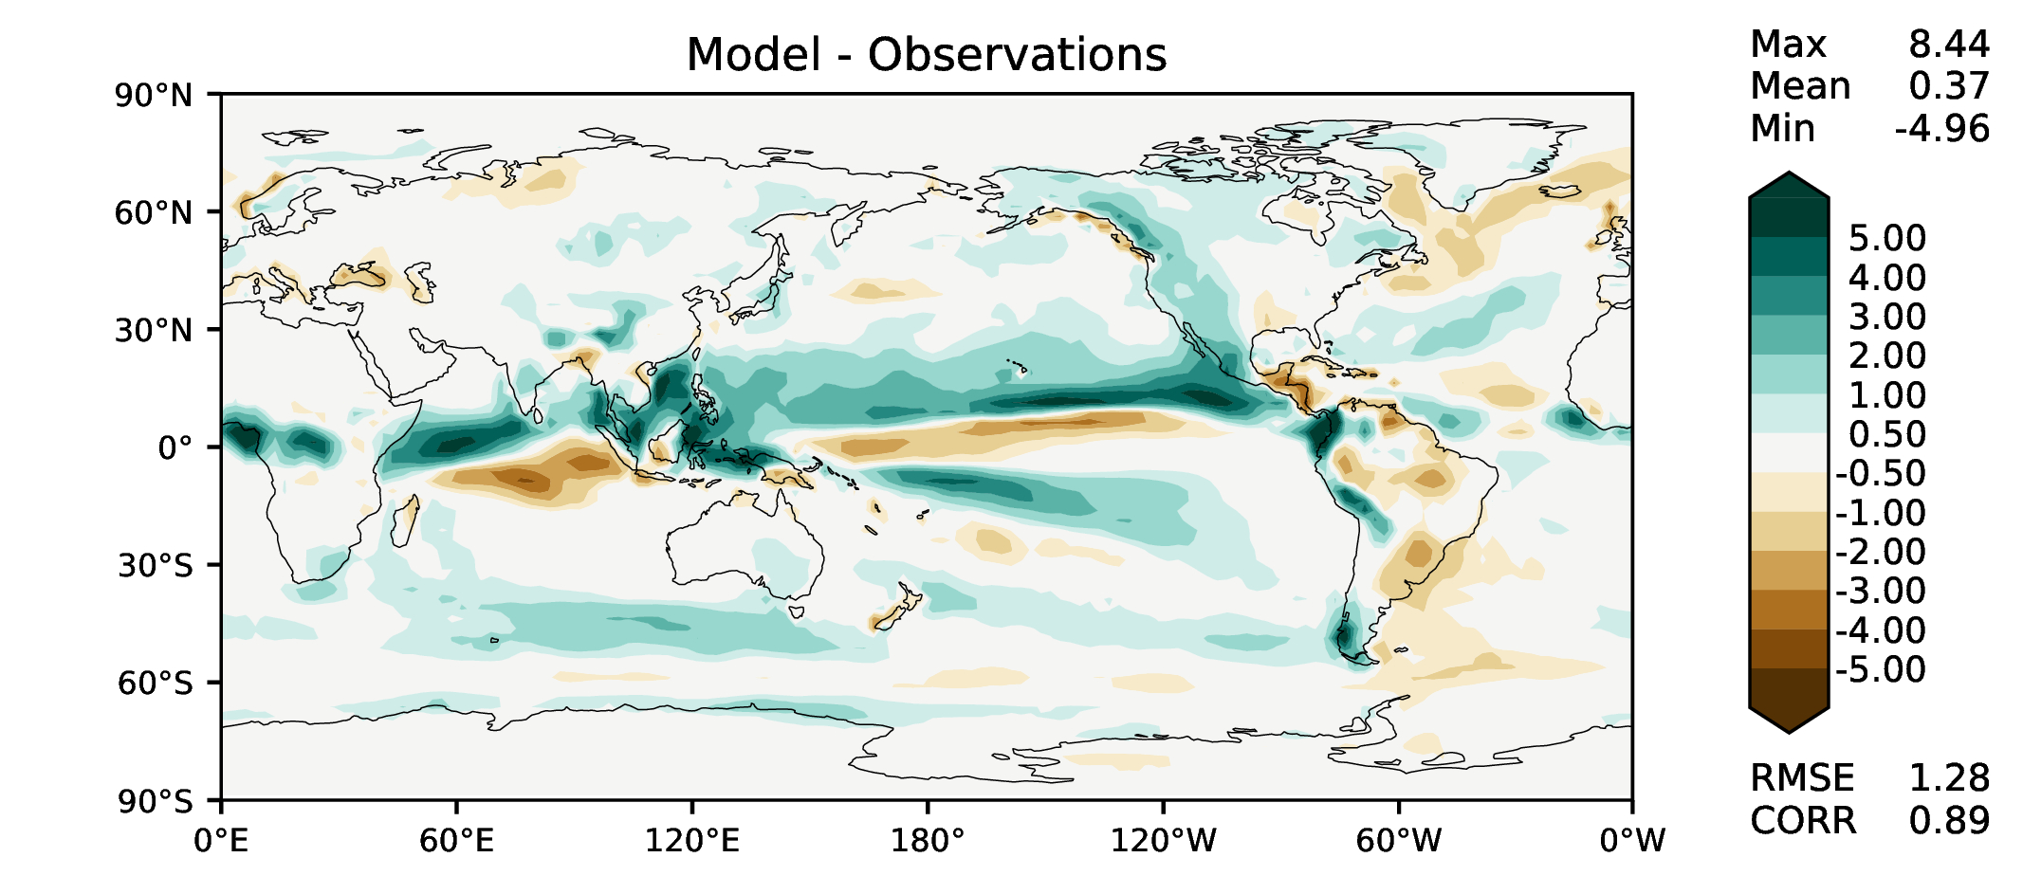
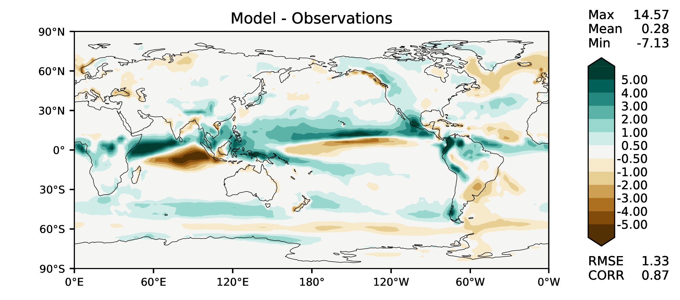
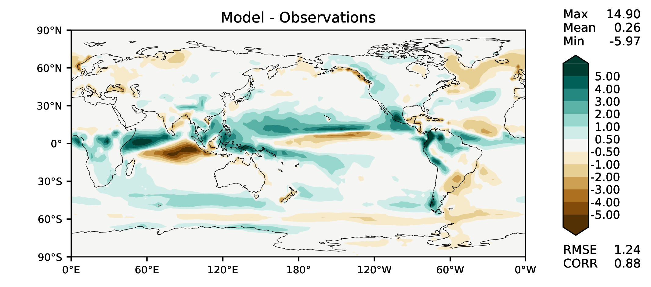
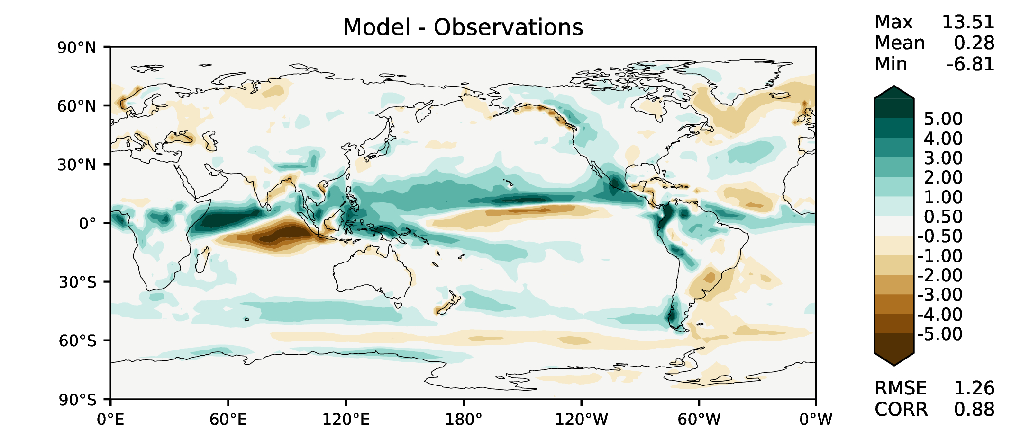
SON total precipitation
DECKv1
v2rc1a
v2rc1b
v2rc1c

Slide 8
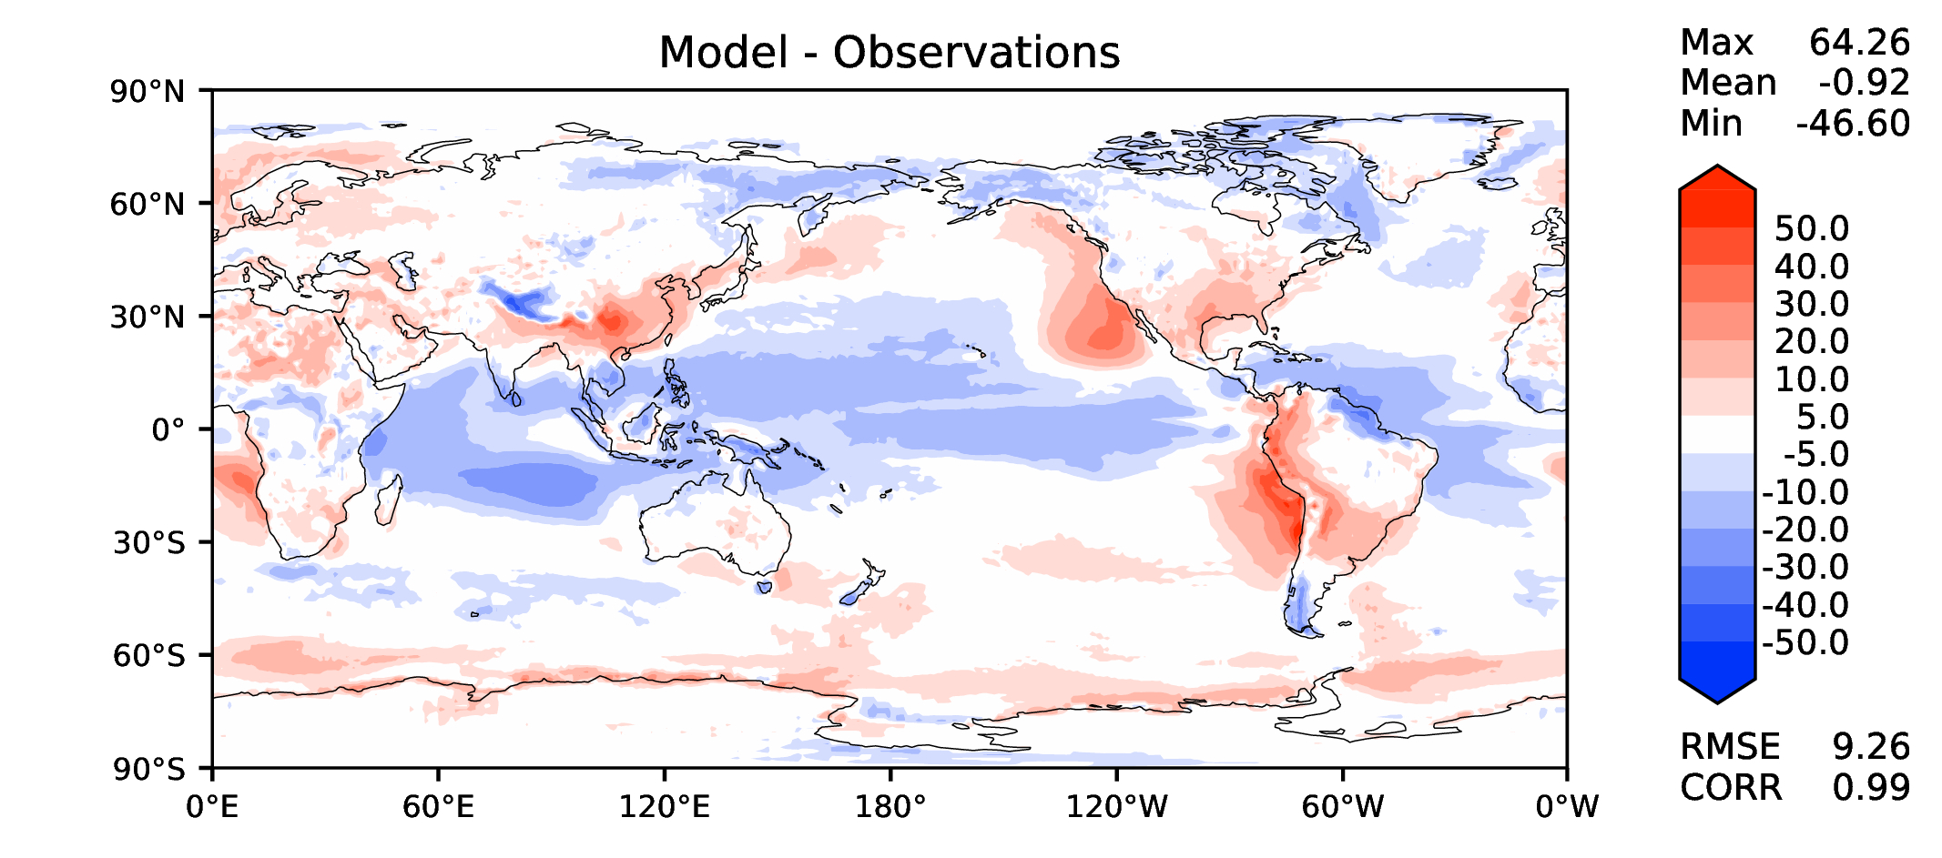
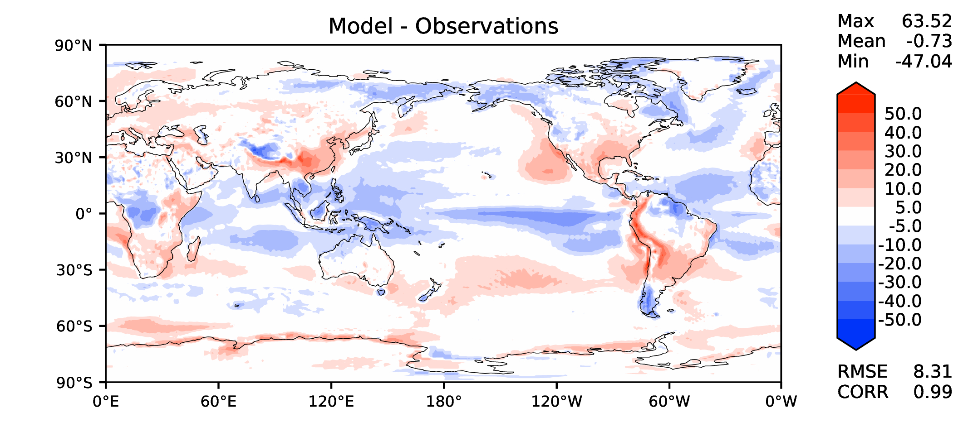
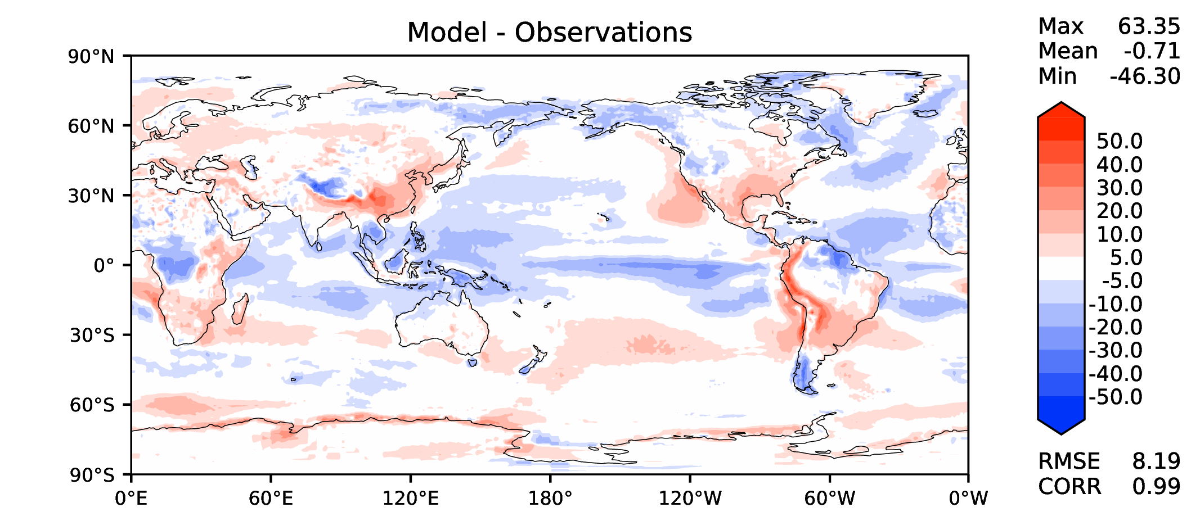
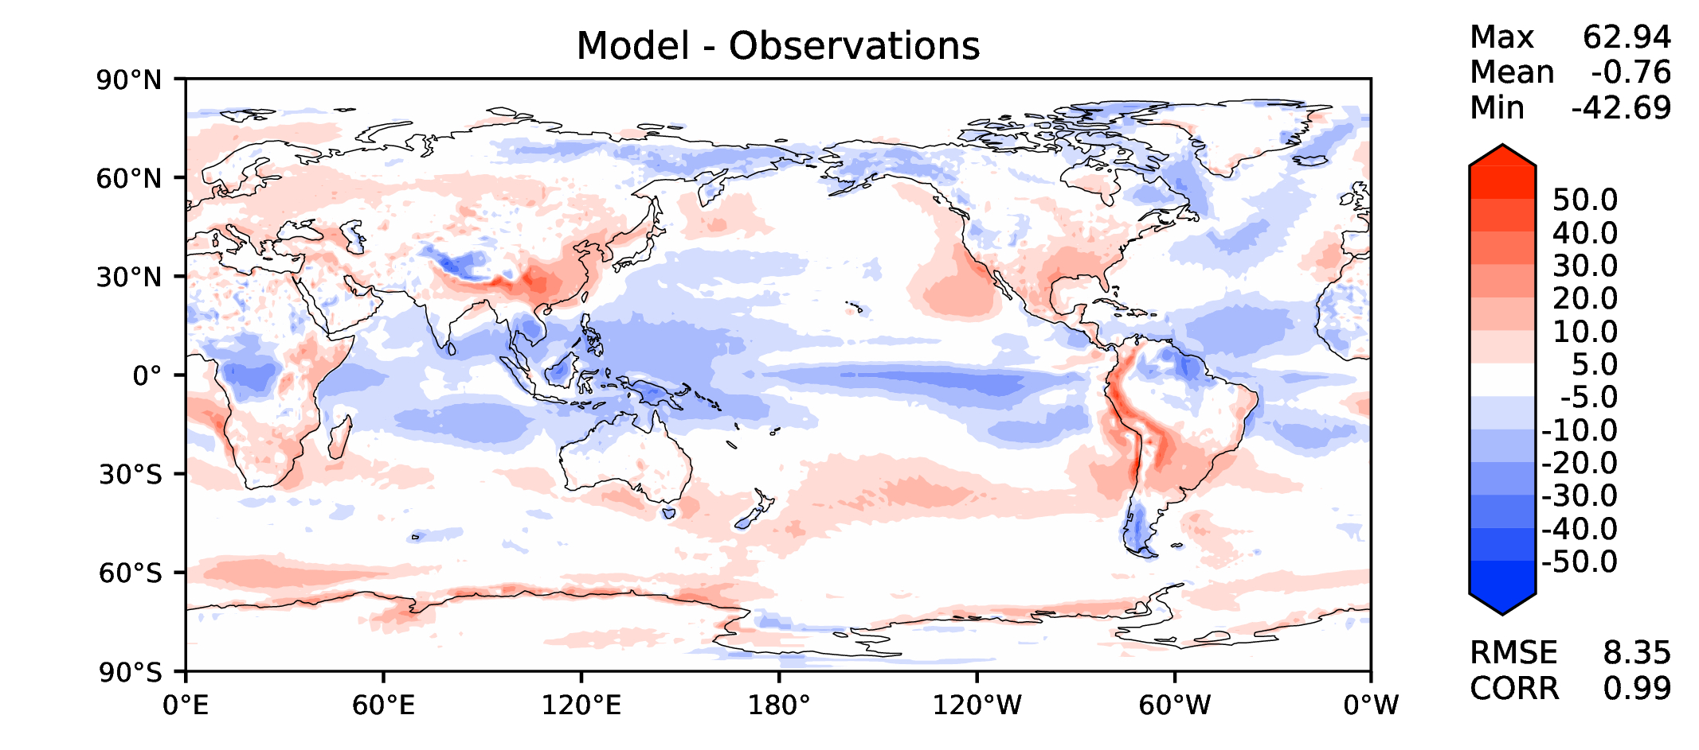
Annual TOA net radiation
DECKv1
v2rc1a
v2rc1b
v2rc1c

Slide 9
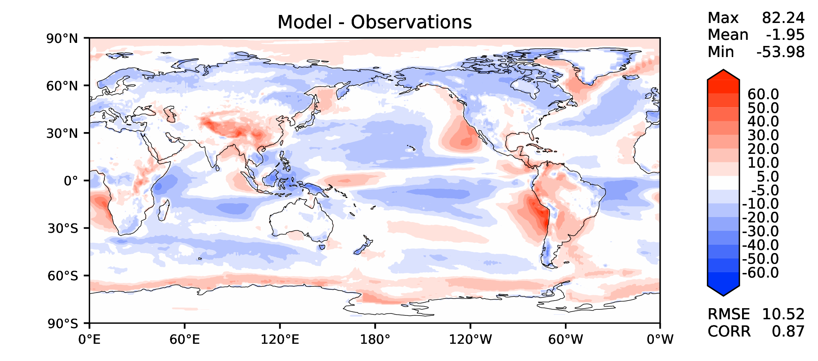
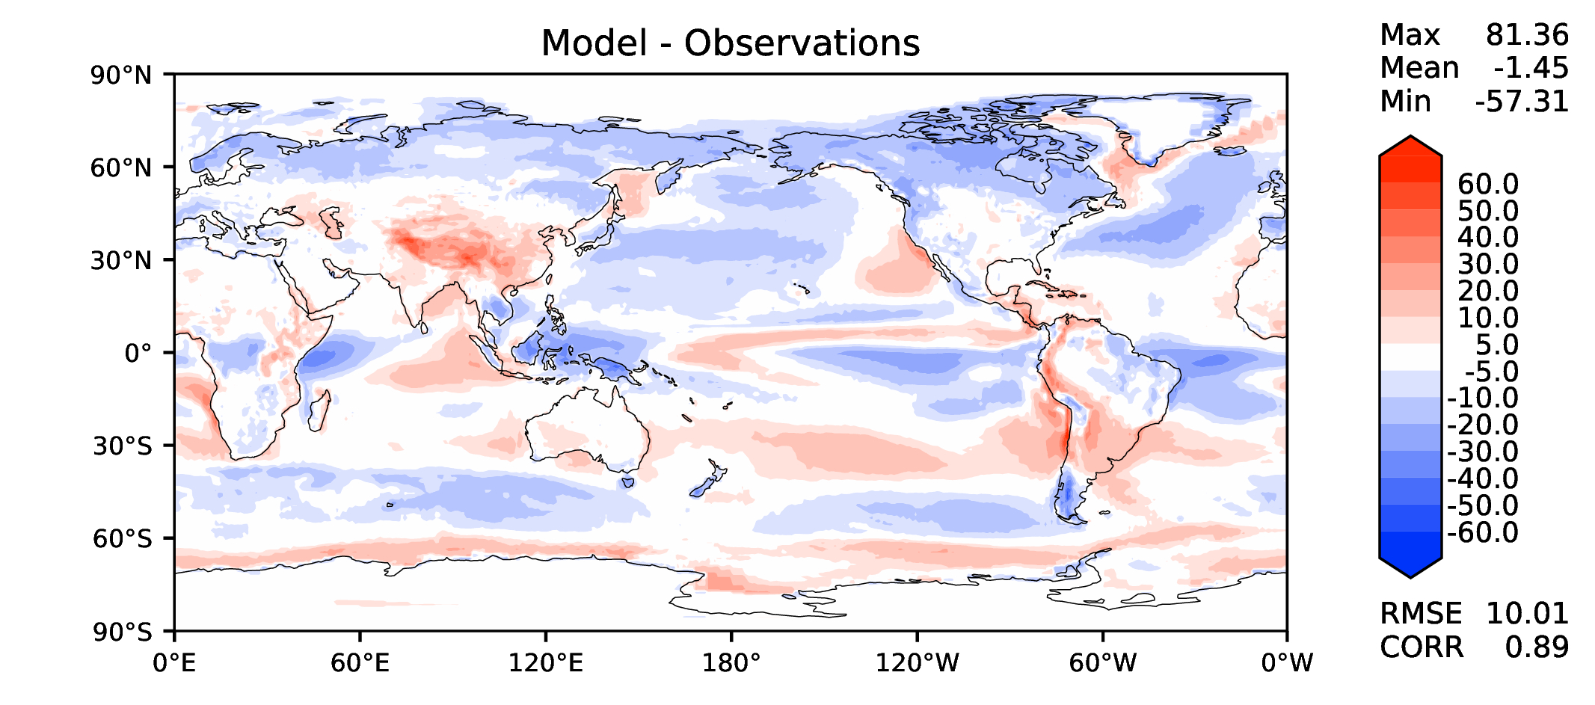
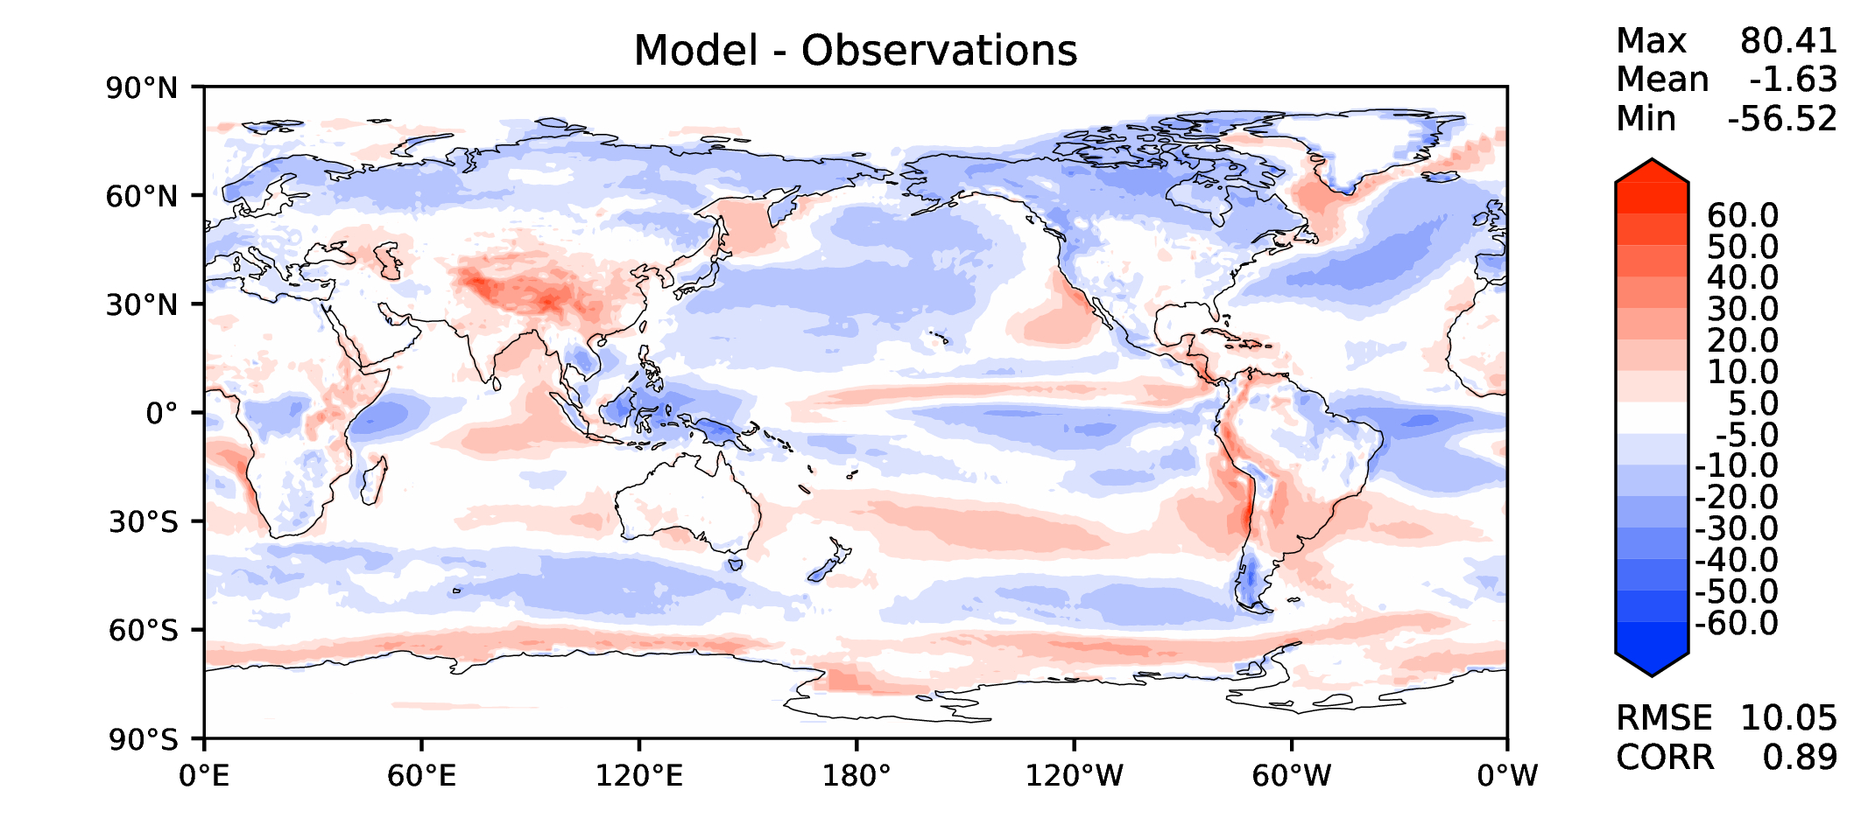
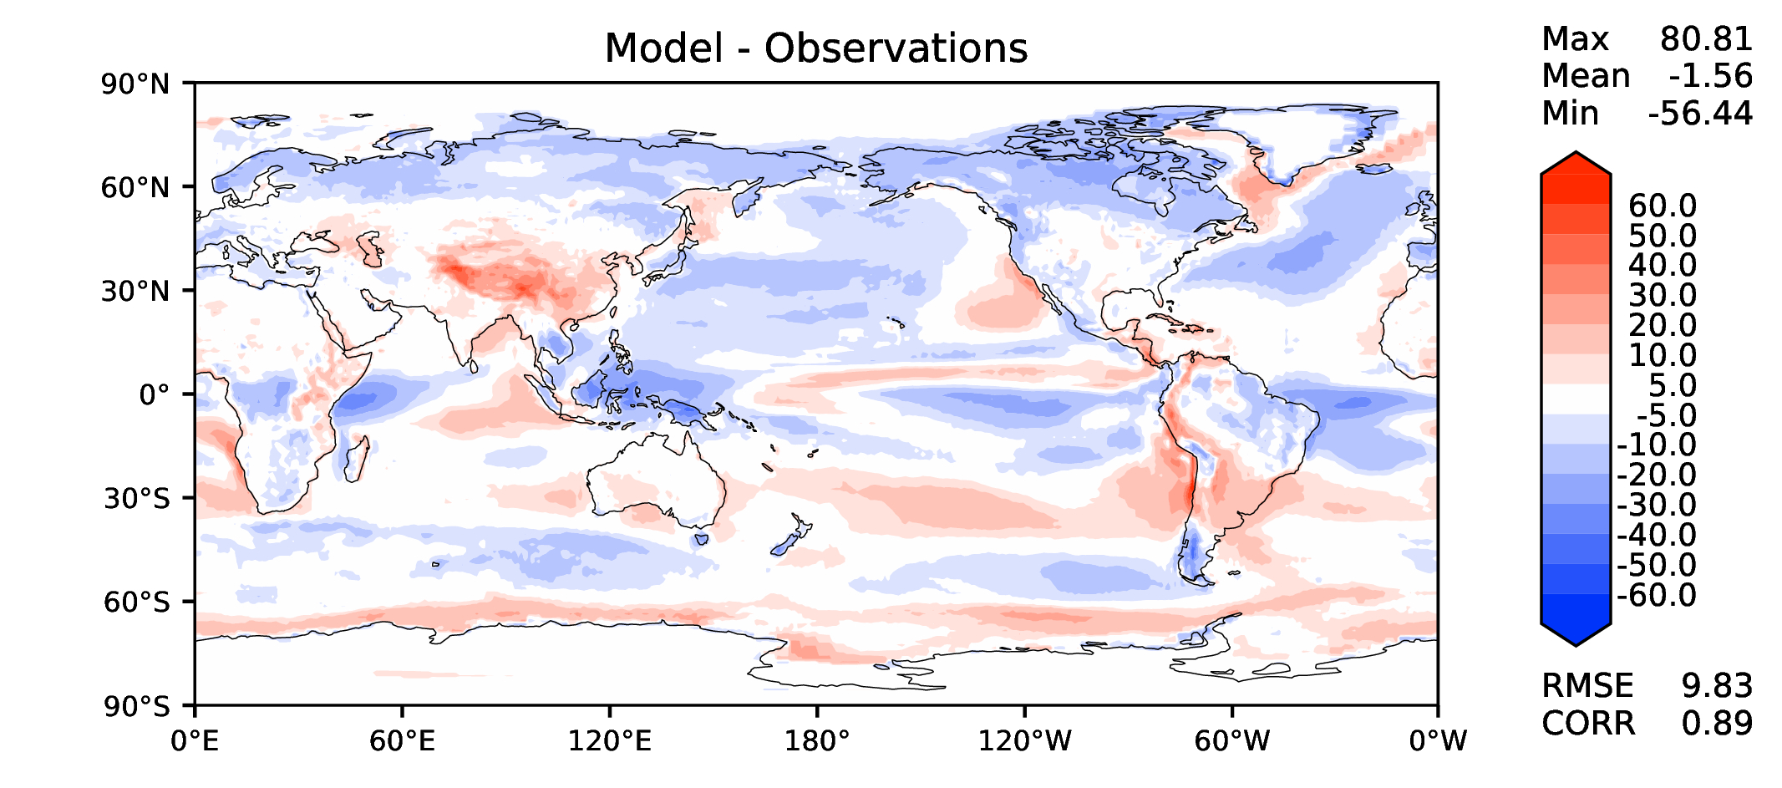
Annual TOA SW CRE
DECKv1
v2rc1a
v2rc1b
v2rc1c

Slide 10
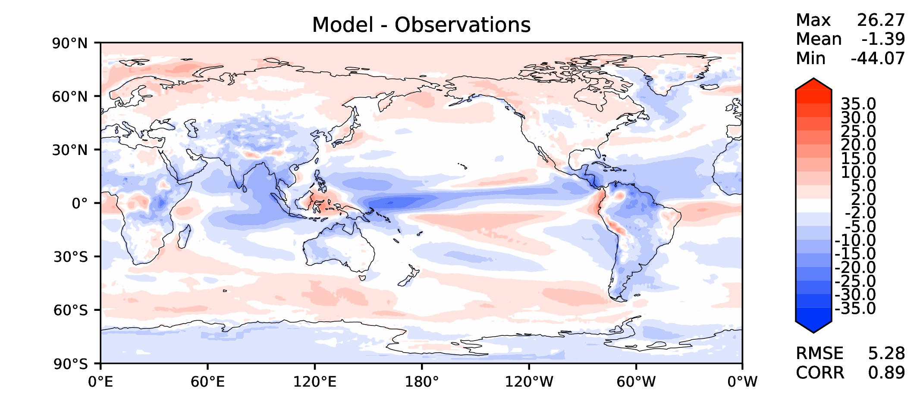
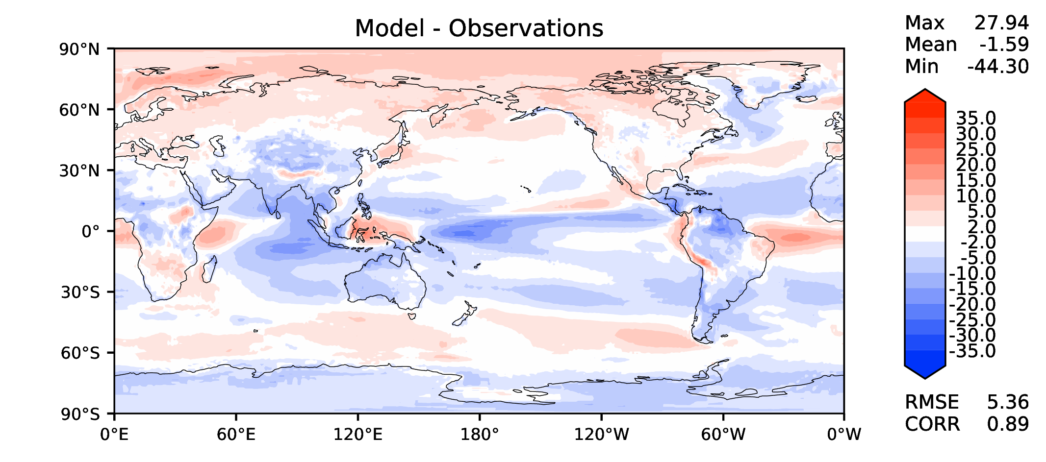
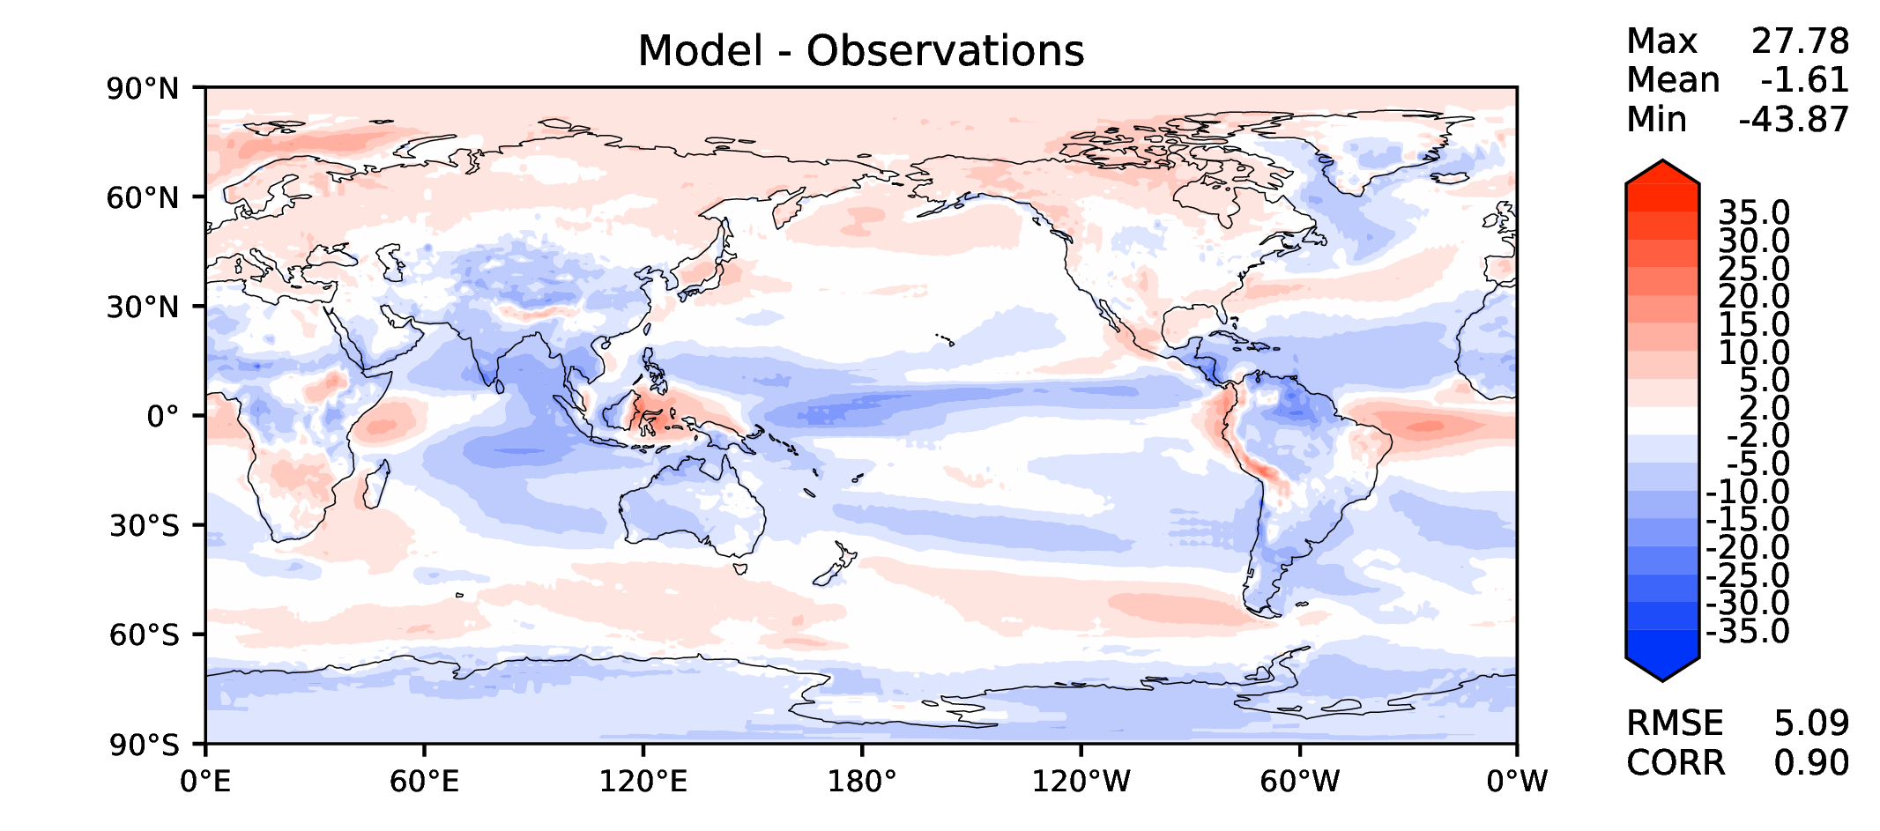
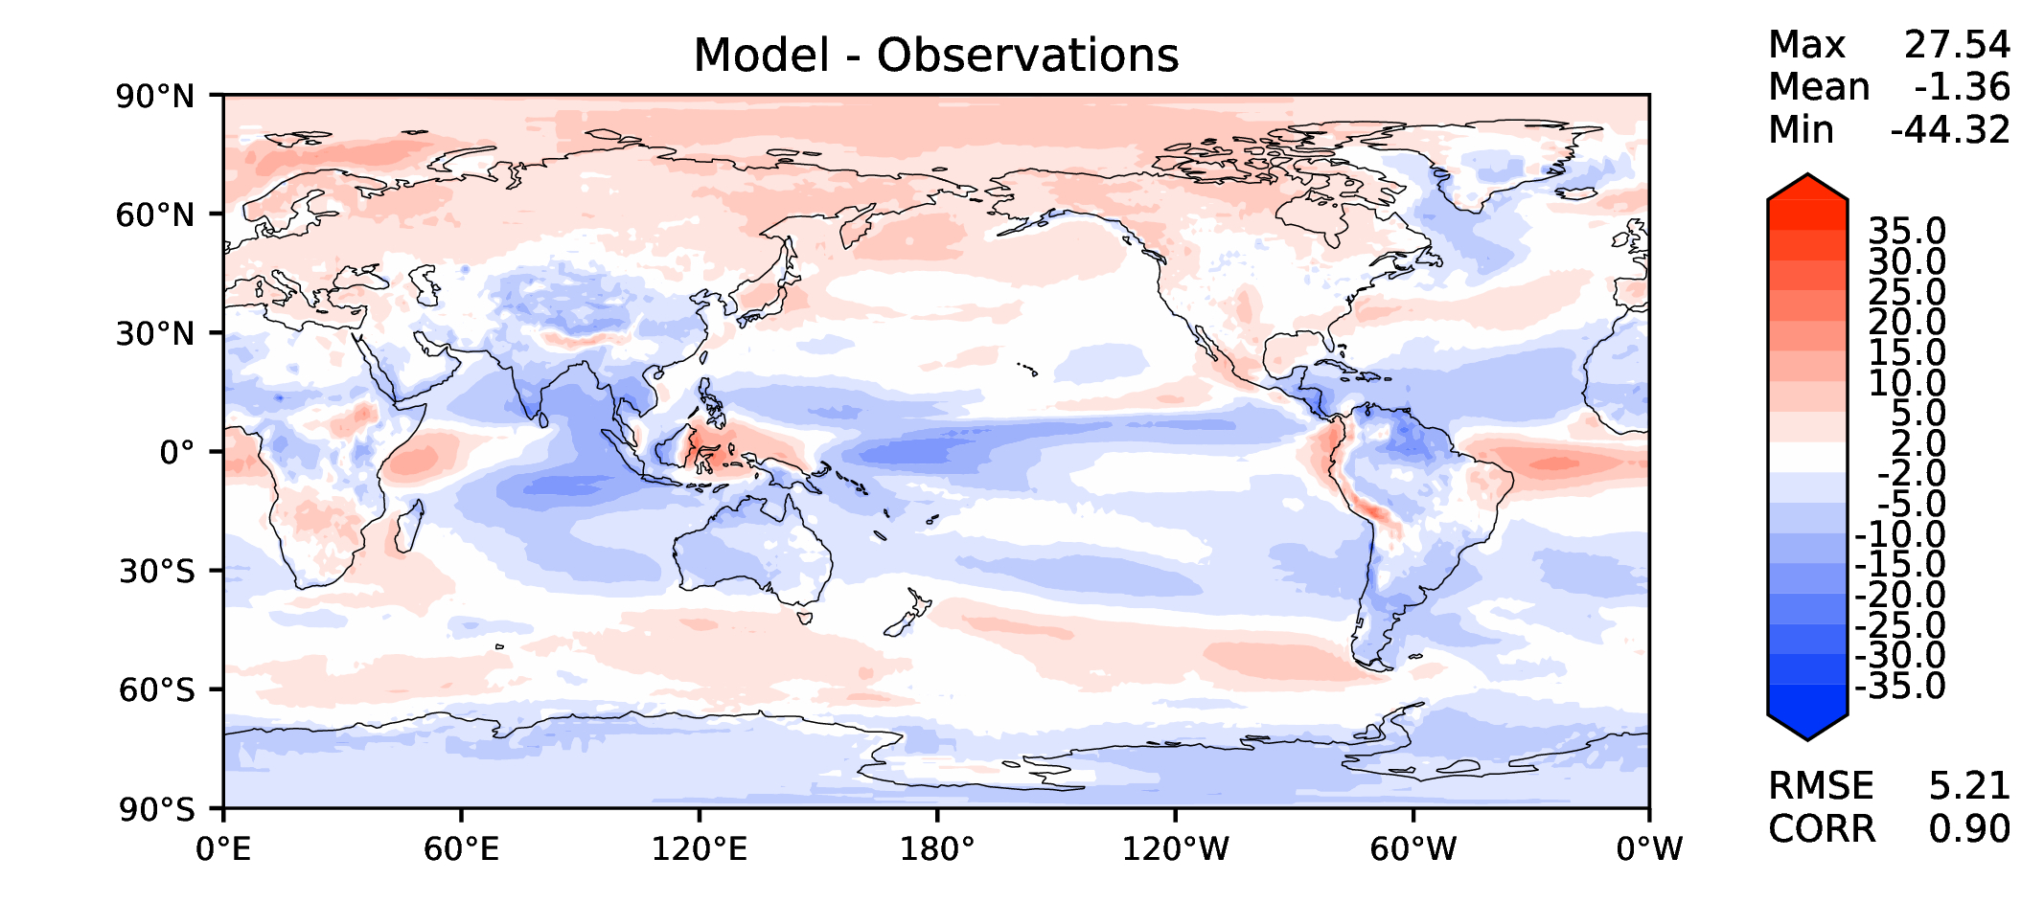
Annual TOA LW CRE
DECKv1
v2rc1a
v2rc1b
v2rc1c

Slide 11
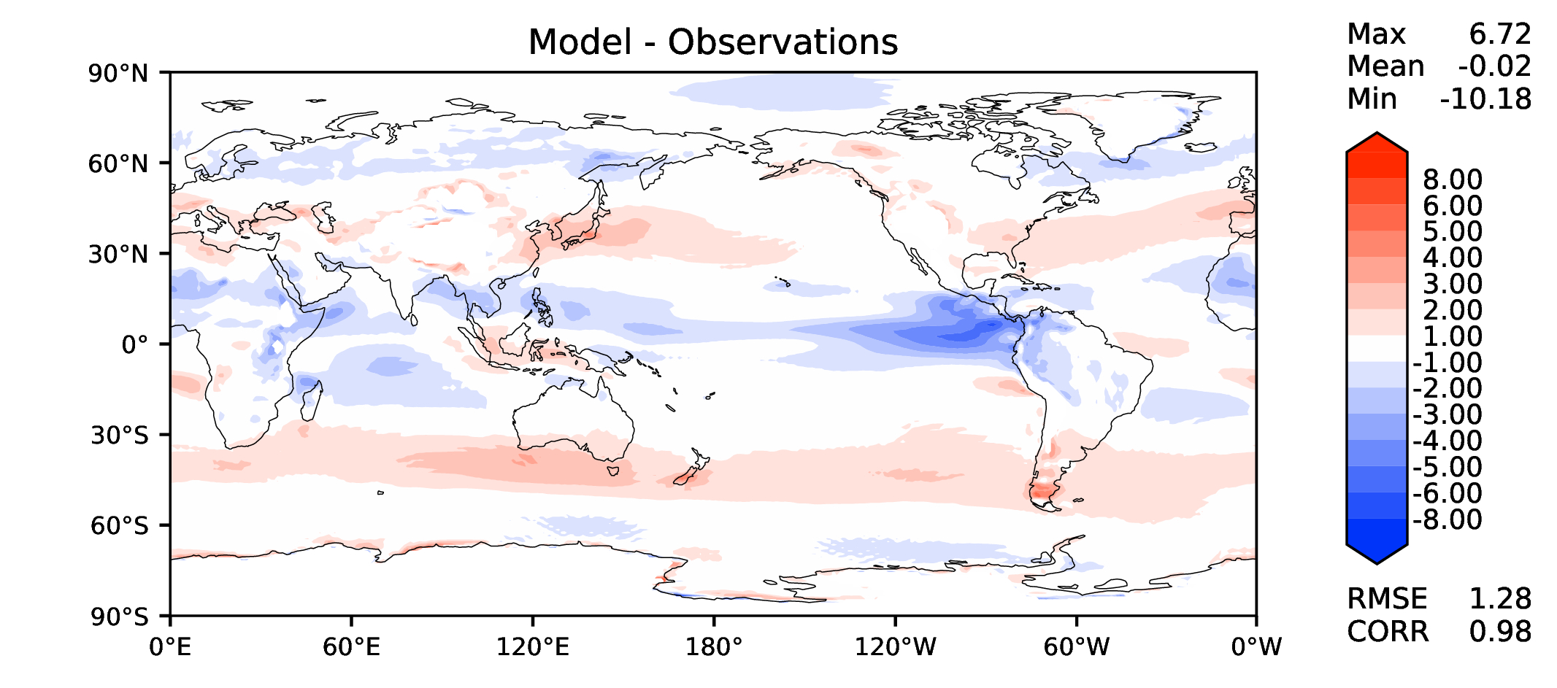
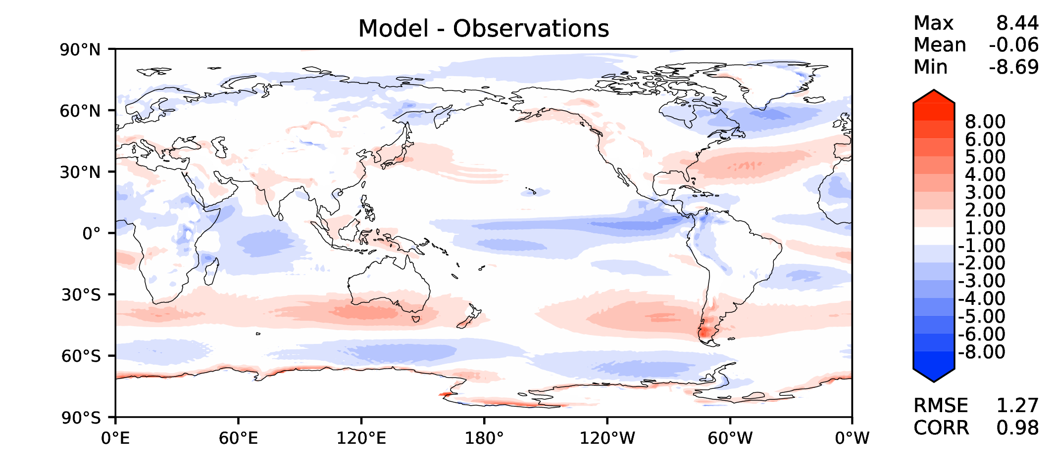
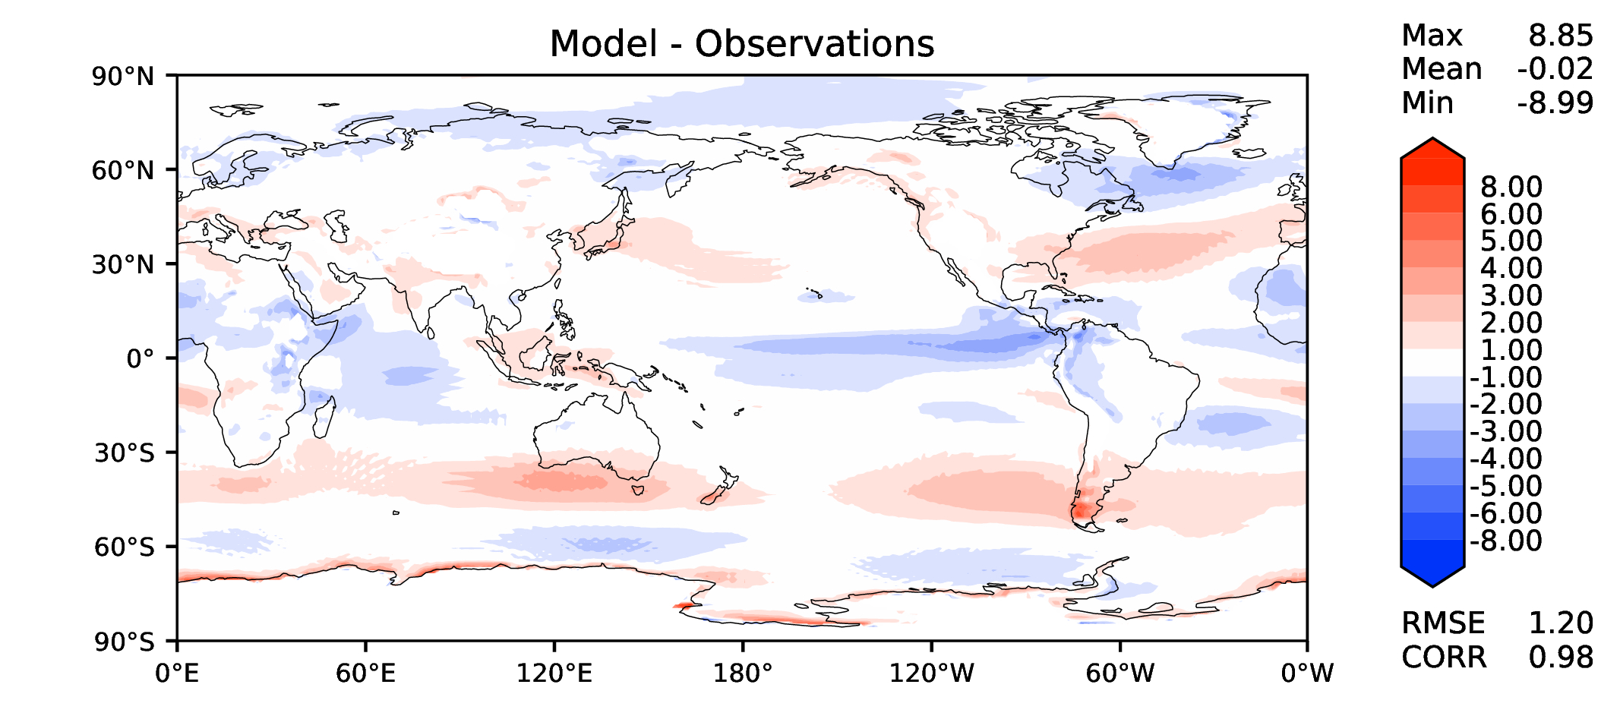
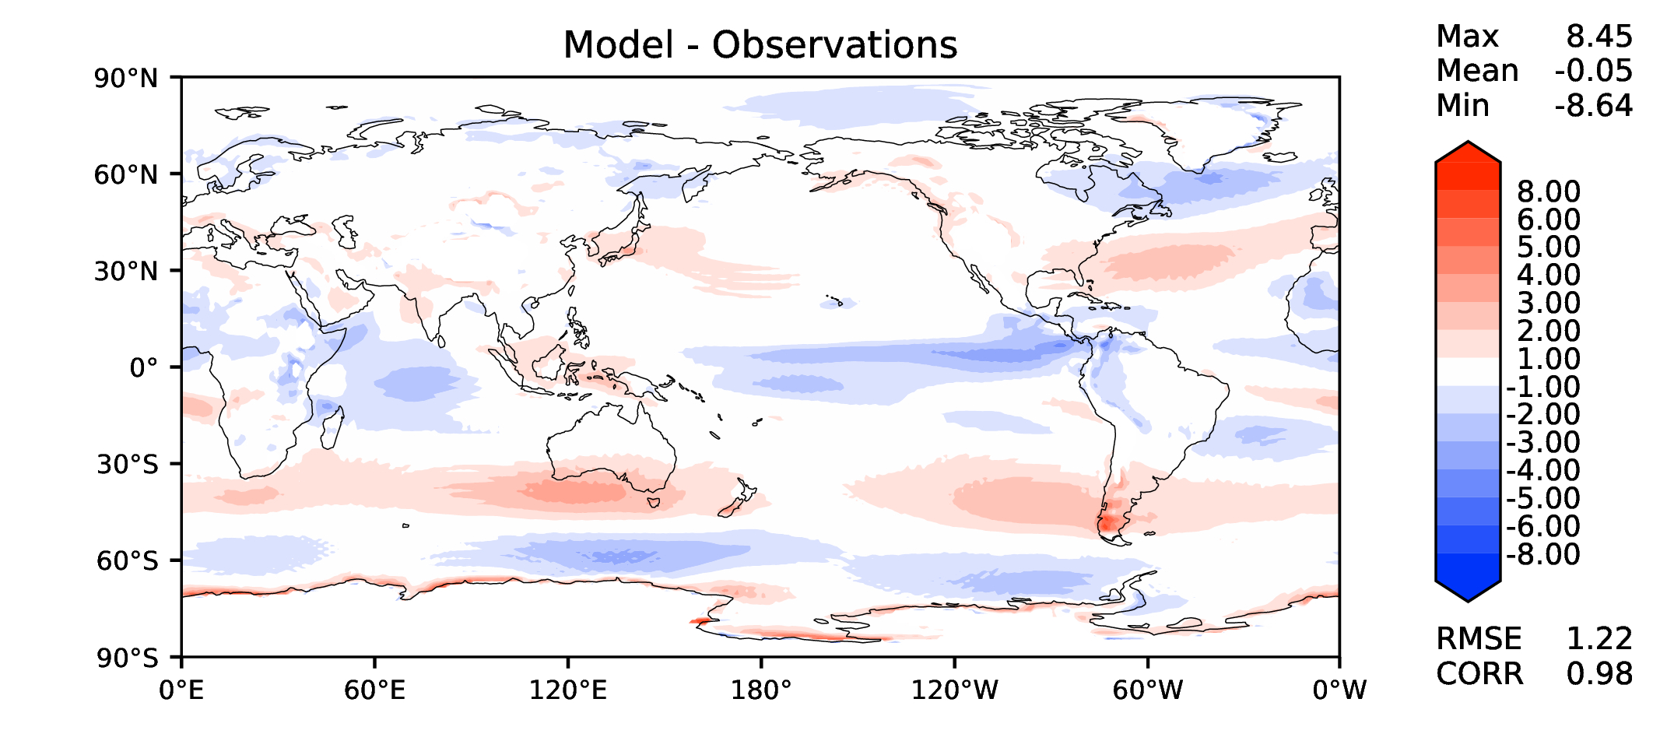
Annual u wind at 850 hPa
DECKv1
v2rc1a
v2rc1b
v2rc1c

Slide 12
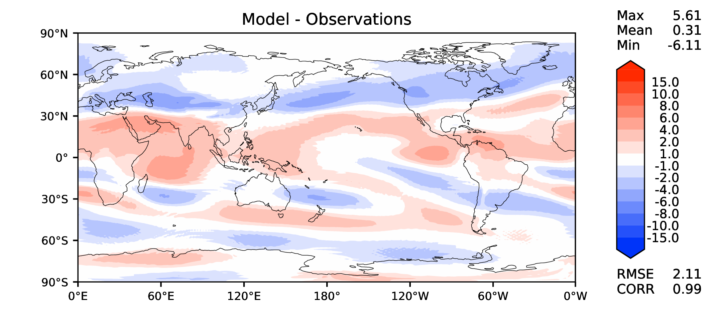
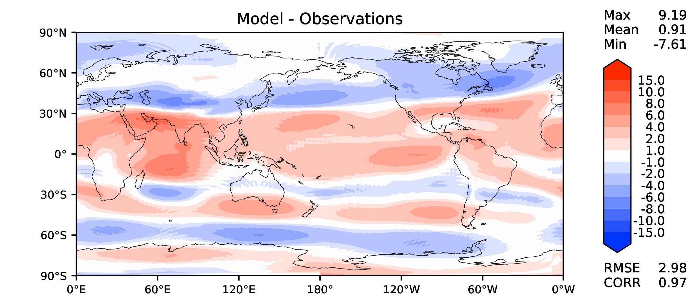
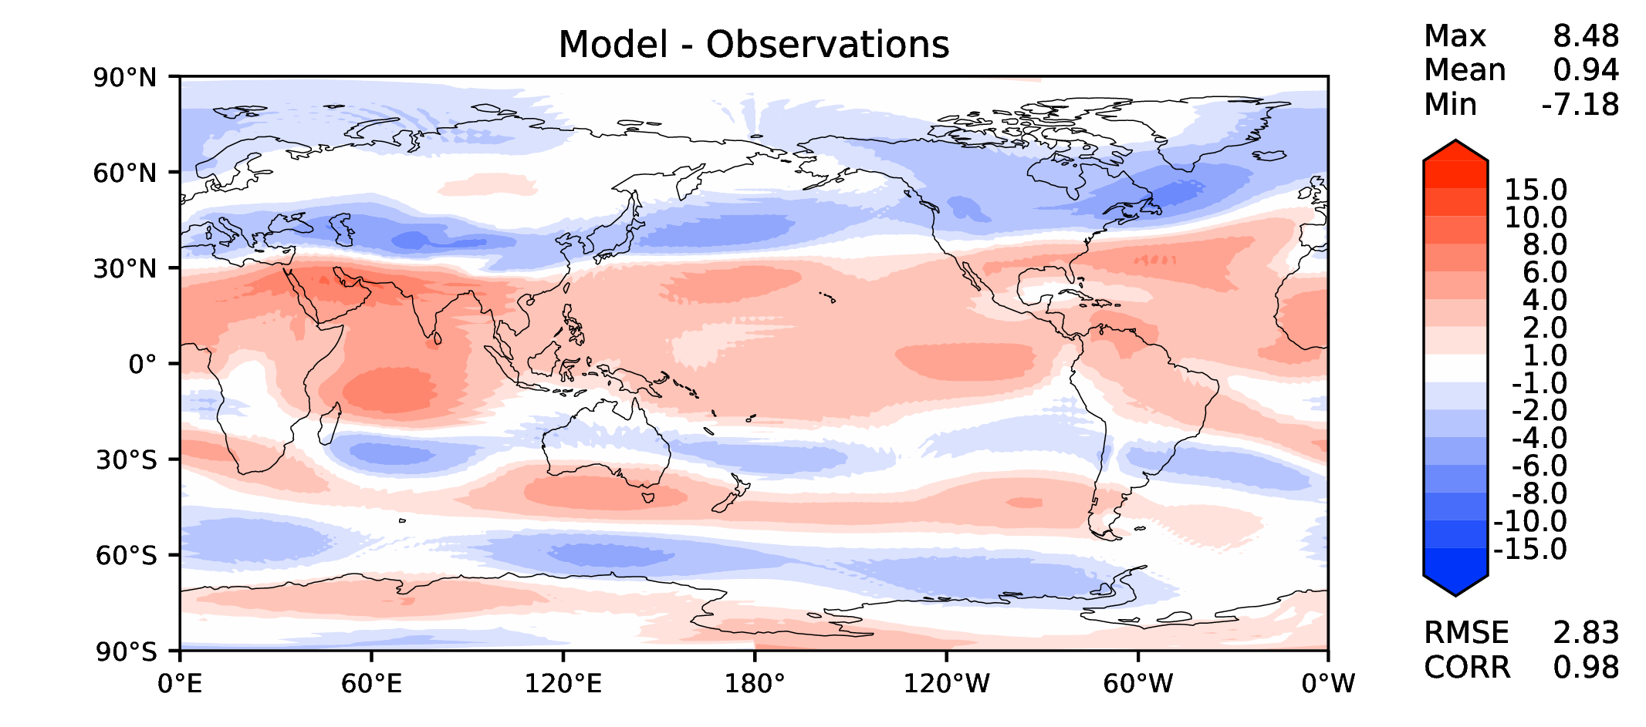
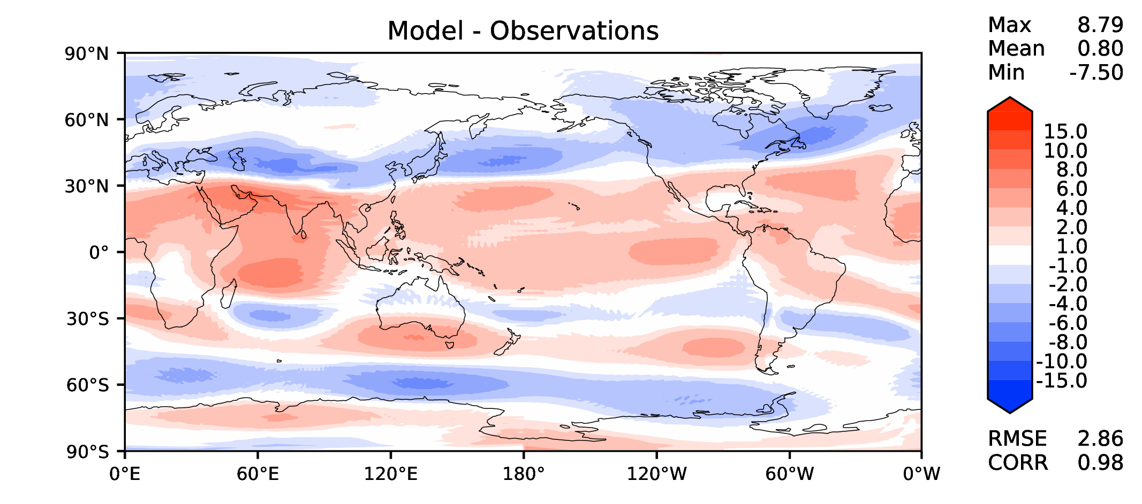
Annual u wind at 200 hPa
DECKv1
v2rc1a
v2rc1b
v2rc1c

Slide 13
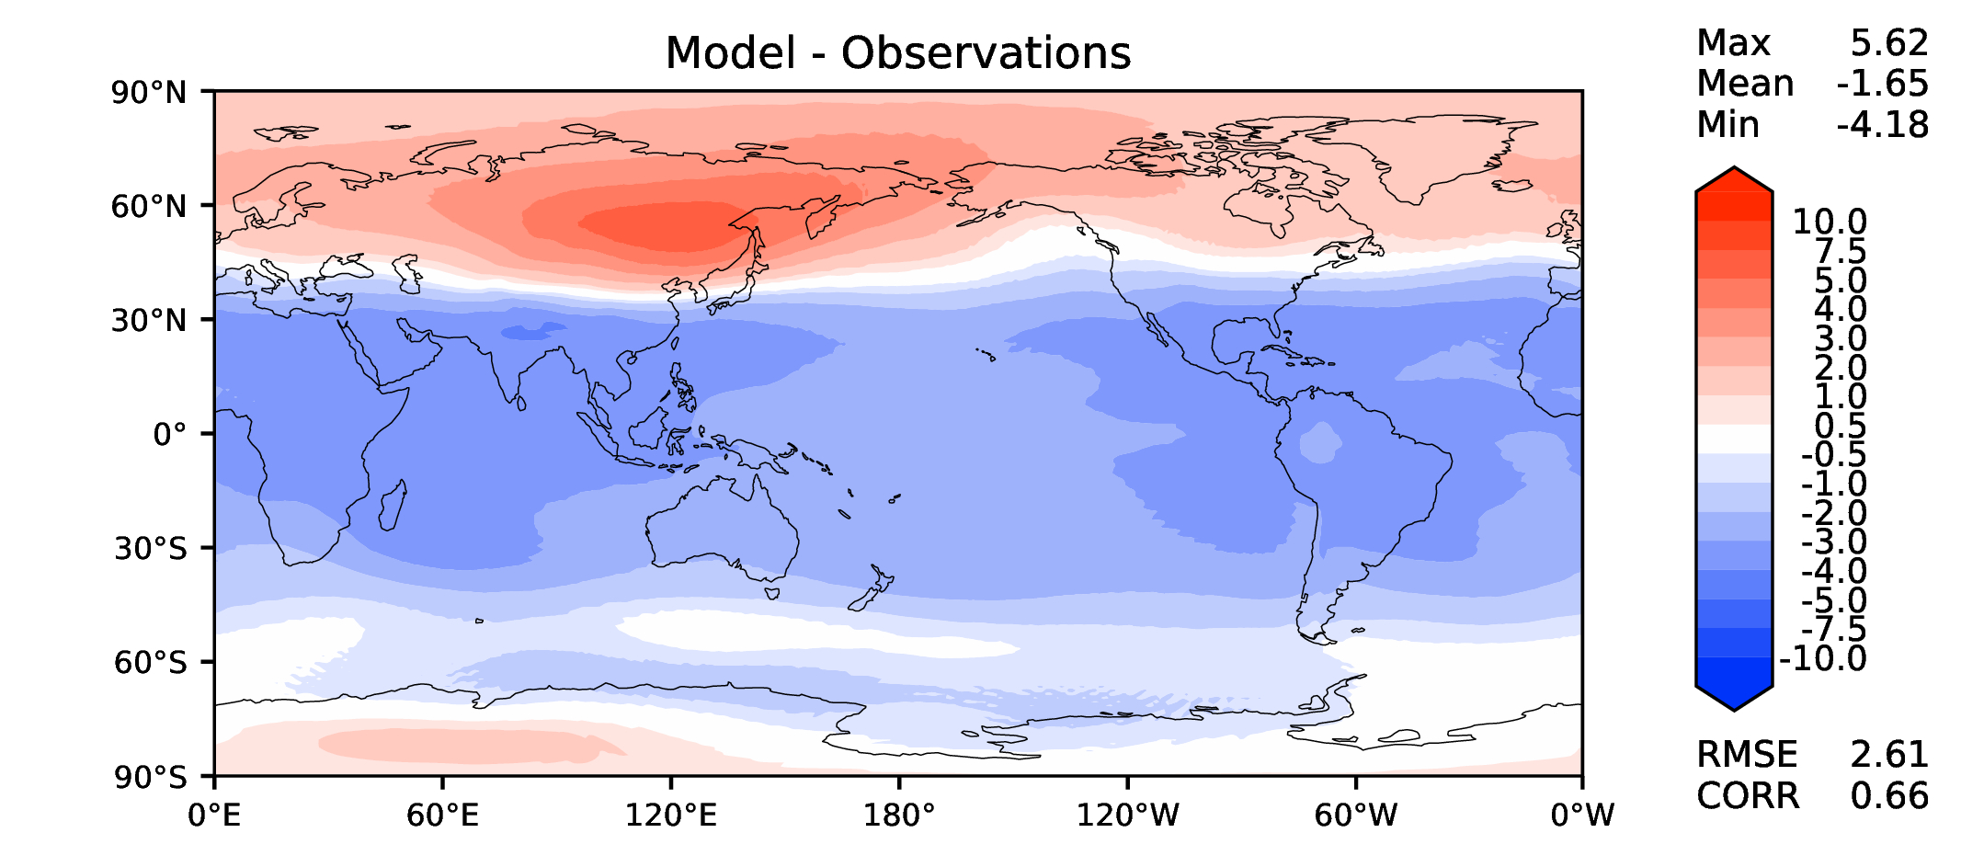
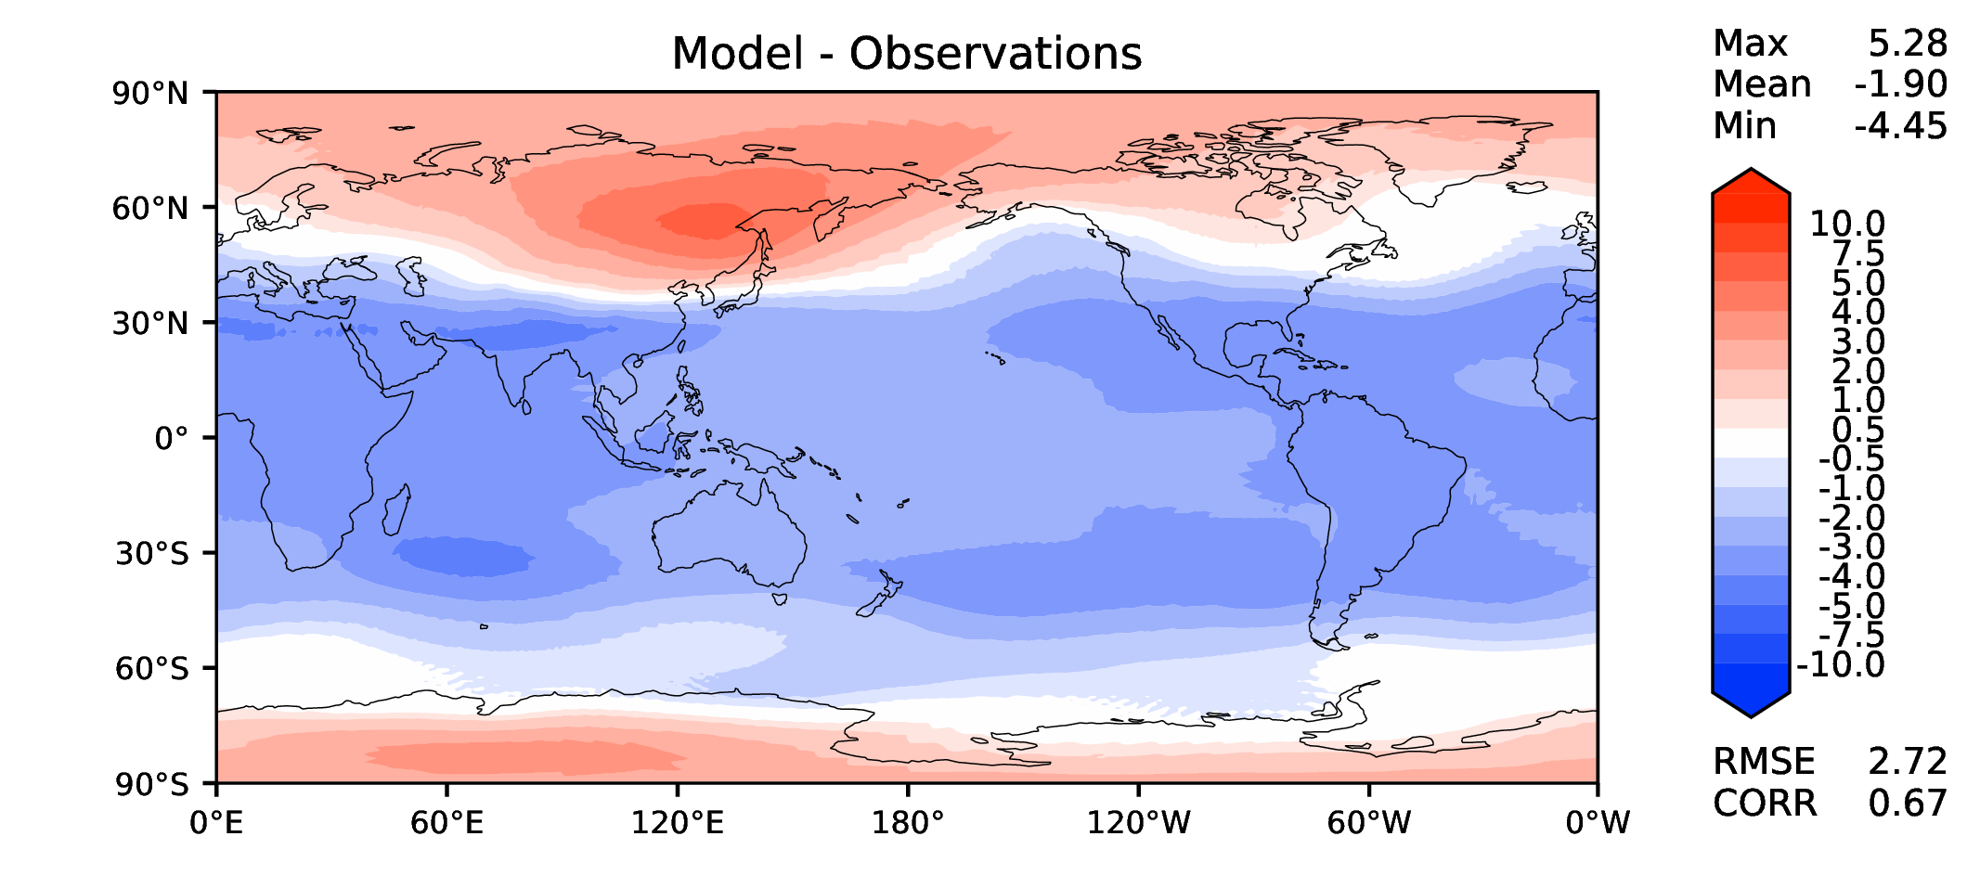
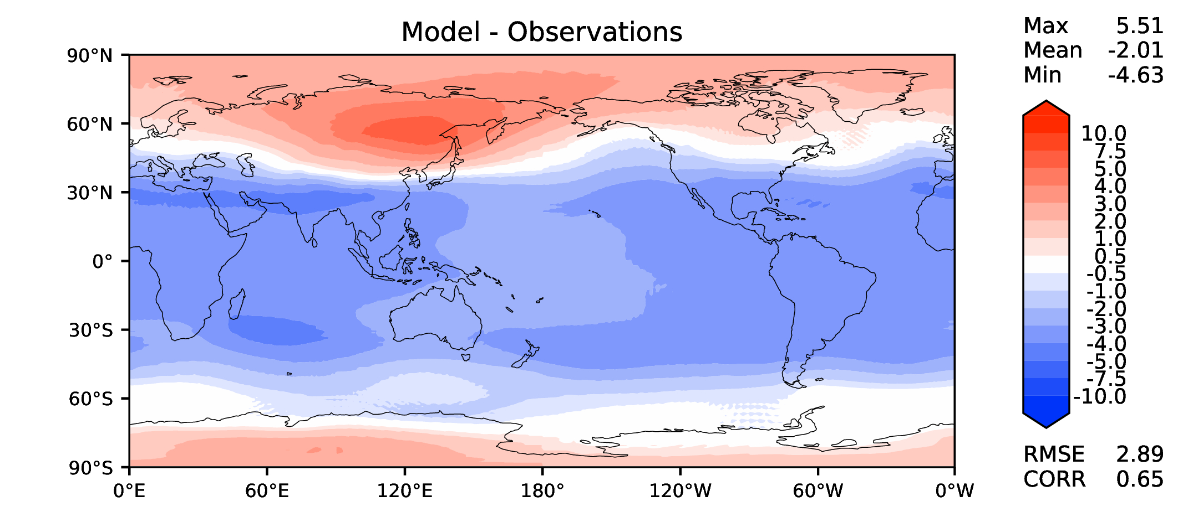
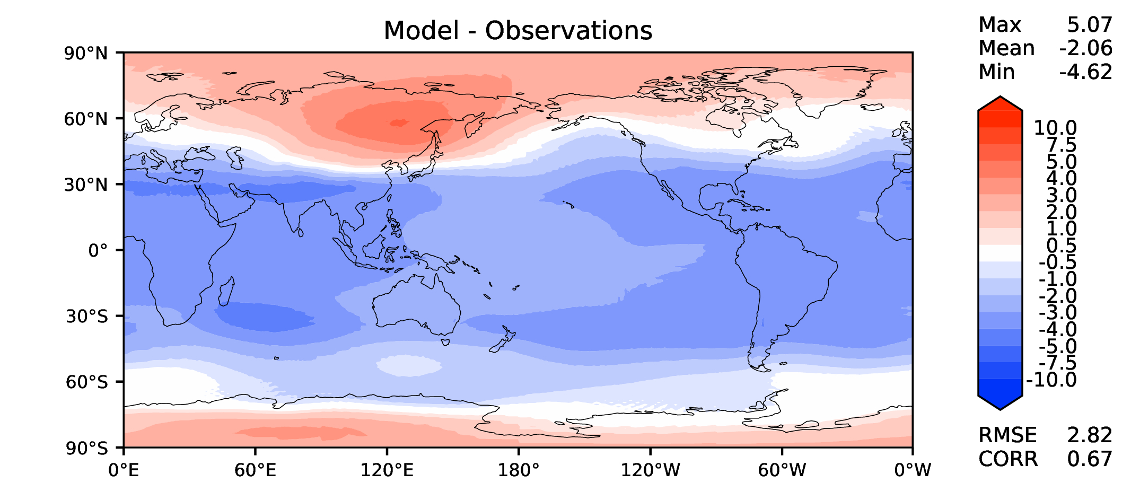
Annual T at 200 hPa
DECKv1
v2rc1a
v2rc1b
v2rc1c

Slide 14
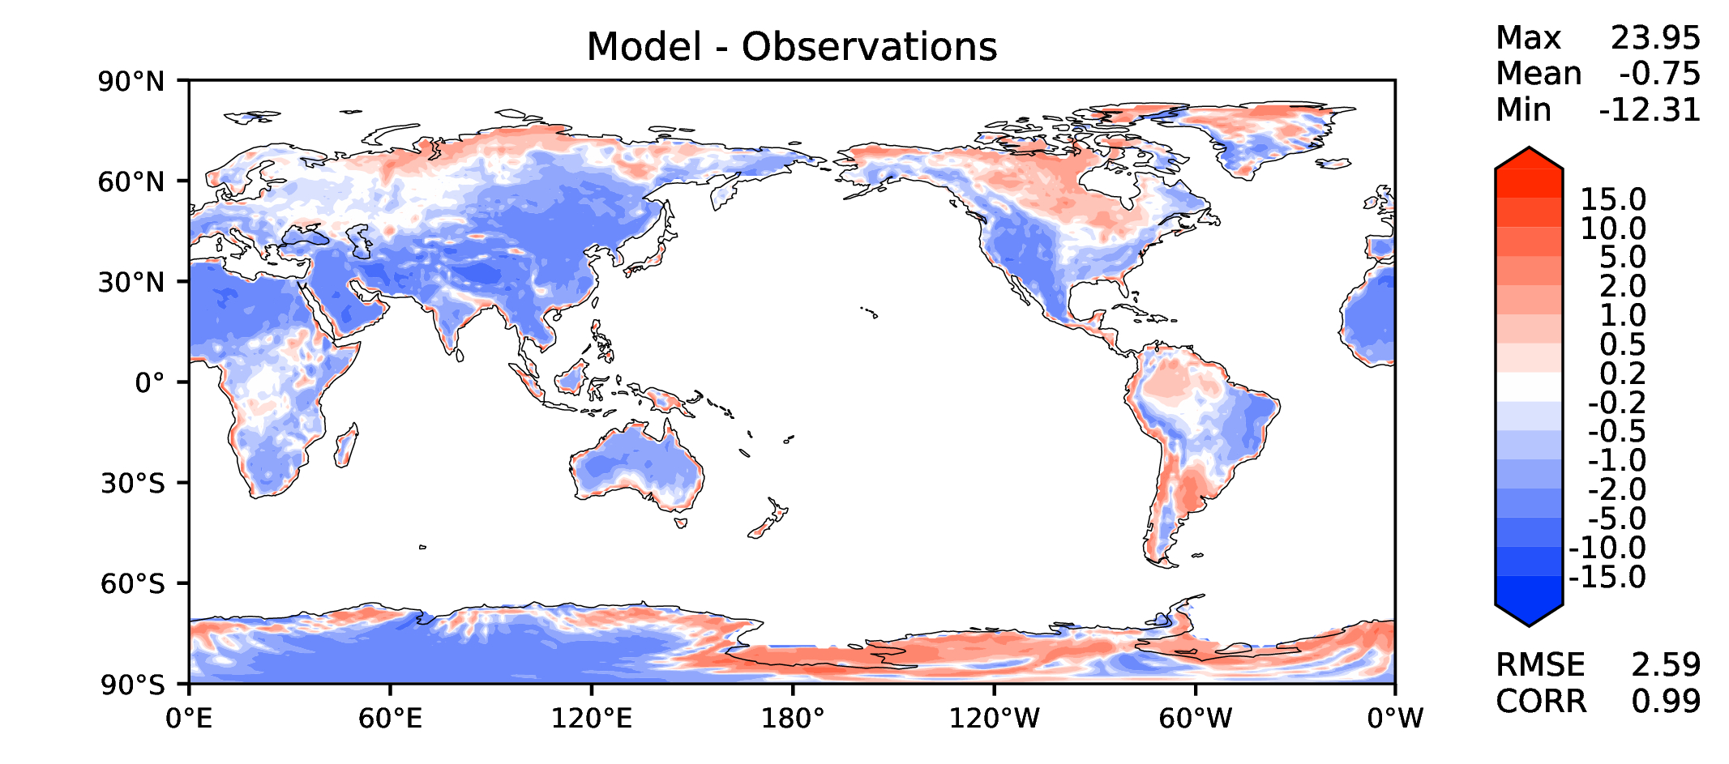
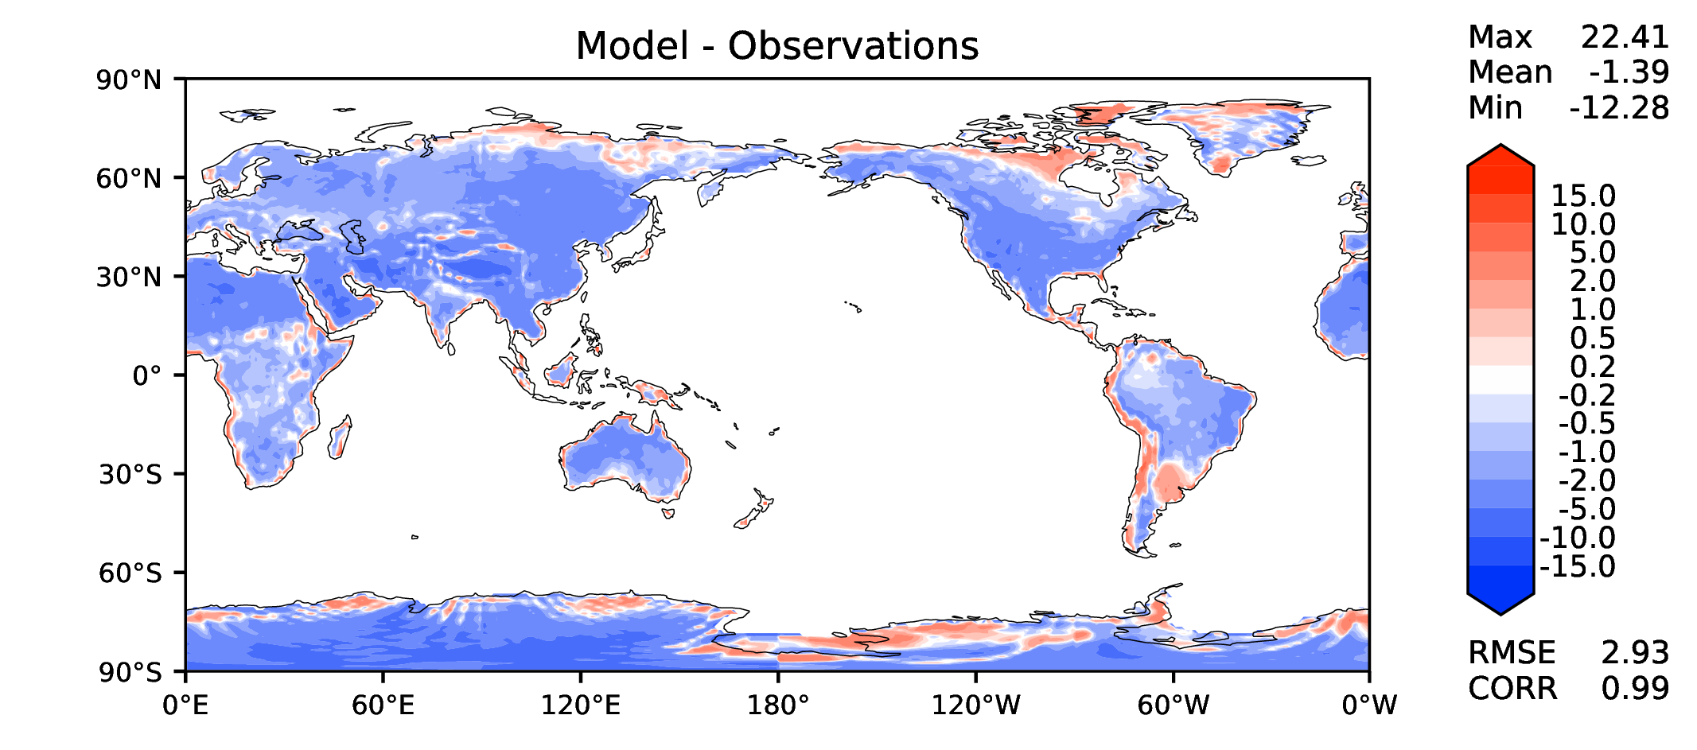
Annual surface air T (land)
DECKv1
v2rc1a
v2rc1b
v2rc1c

Slide 15
JJA surface air T (land)
DECKv1
v2rc1a
v2rc1b
v2rc1c

Slide 16
Aerosol optical depth
DECKv1
v2rc1a
v2rc1b
v2rc1c

Slide 17
TAUXY ANN ocean
DECKv1
v2rc1a
v2rc1b
v2rc1c

Slide 18
CLDLWP_OCN global SSMI
DECKv1
v2rc1a
v2rc1b
v2rc1c

