Slide 1
Summary table (RMSE vs obs)
Variable | Season | DECKv1 | v2beta4 | v2rc1a | v2rc1c
SST | ANN | 1.08 | 0.97 | 1.04 | 1.04
PRECT | ANN | 1.11 | 1.00 | 0.98 | 0.95
PRECT | DJF | 1.40 | 1.41 | 1.40 | 1.36
PRECT | MAM | 1.52 | 1.17 | 1.14 | 1.08
PRECT | JJA | 1.51 | 1.36 | 1.35 | 1.30
PRECT | SON | 1.28 | 1.32 | 1.30 | 1.24
RESTOM | ANN | 9.34 | 8.23 | 8.21 | 8.25
SWCF | ANN | 10.56 | 9.92 | 9.99 | 9.86
LWCF | ANN | 5.25 | 5.29 | 5.17 | 5.12
u850 | ANN | 1.26 | 1.24 | 1.30 | 1.26
u200 | ANN | 2.22 | 2.80 | 2.83 | 2.75
T200 | ANN | 2.66 | 2.68 | 2.88 | 2.99
TREFHT | ANN | 2.61 | 2.81 | 2.97 | 2.96
TREFHT | JJA | 2.88 | 3.11 | 3.24 | 3.20
AODVIS | ANN | 0.07 | 0.06 | 0.06 | 0.06
TAUXY | ANN | 0.02 | 0.02 | 0.02 | 0.02
CLDLWP_OCN | ANN | 43.78 | 39.59 | 39.45 | 42.93

Slide 2
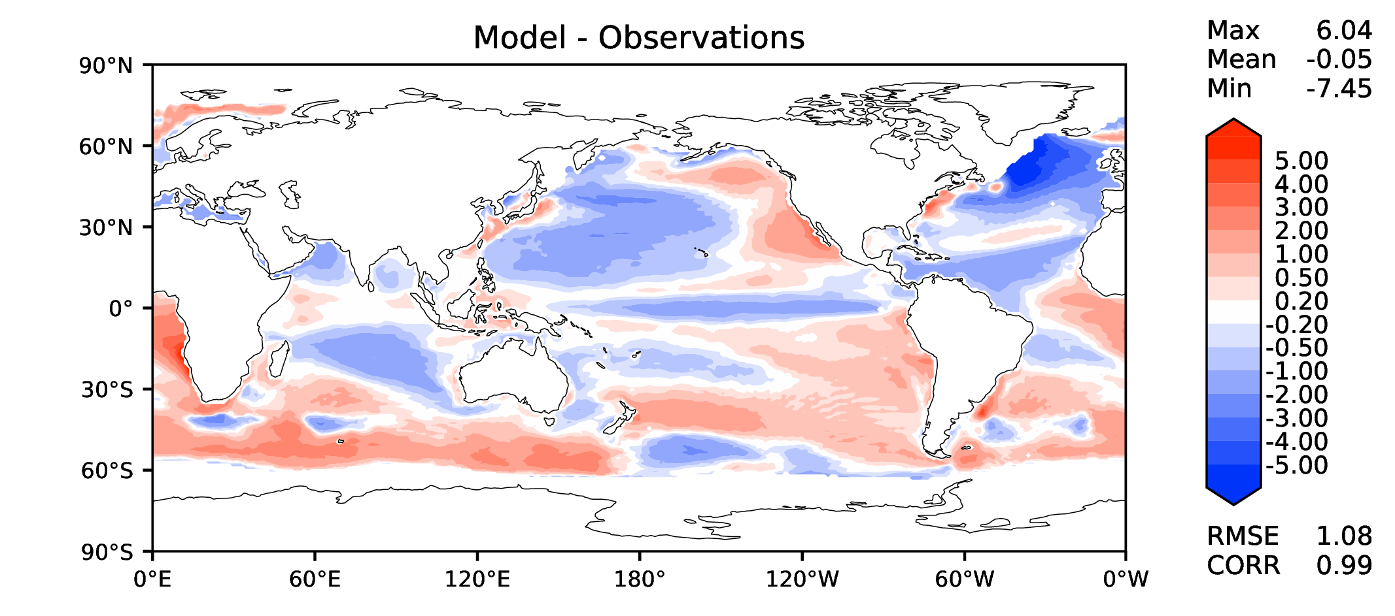
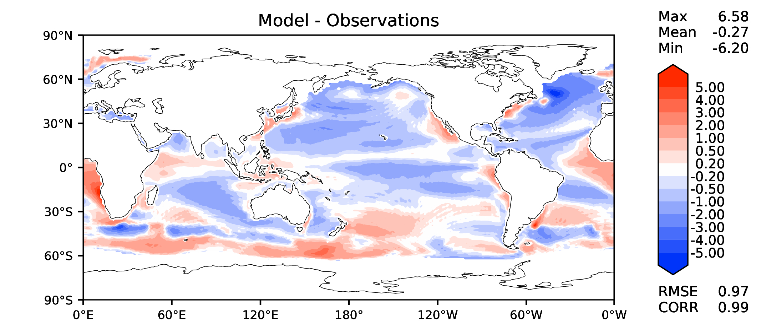
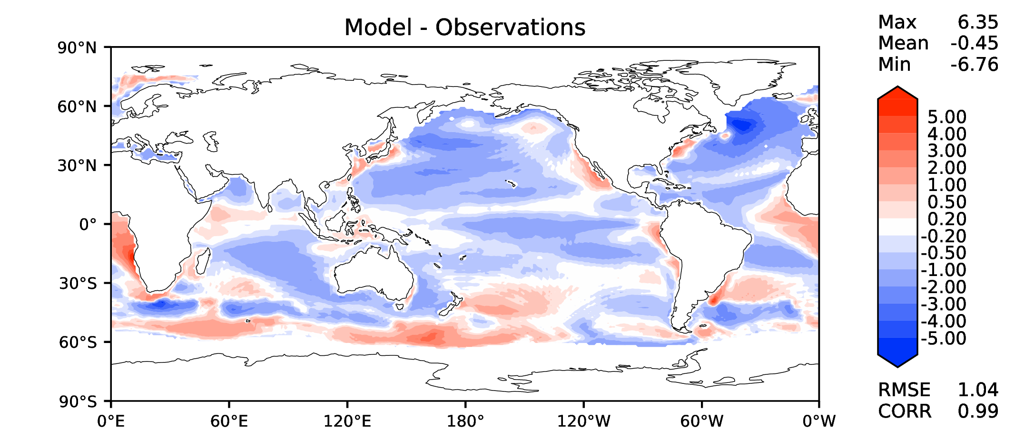
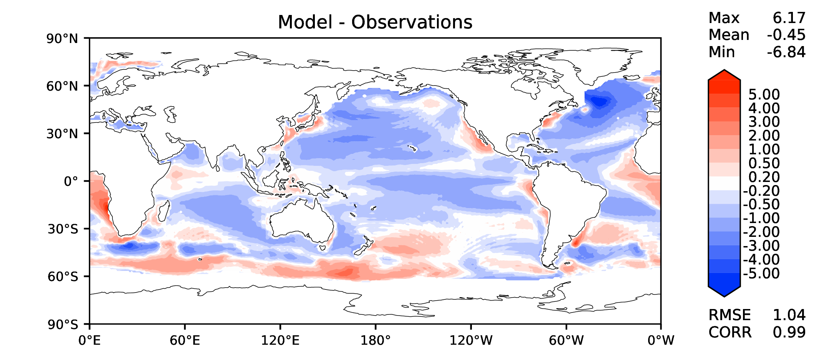
Annual SST (pre-industrial)
DECKv1
v2beta4
v2rc1a
v2rc1c

Slide 3
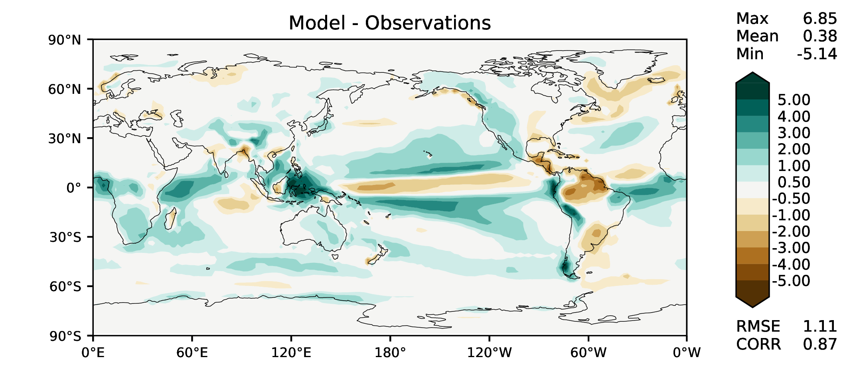
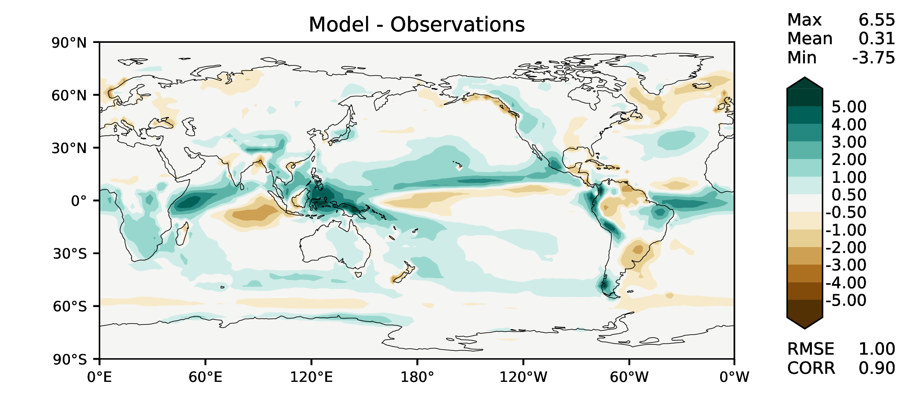
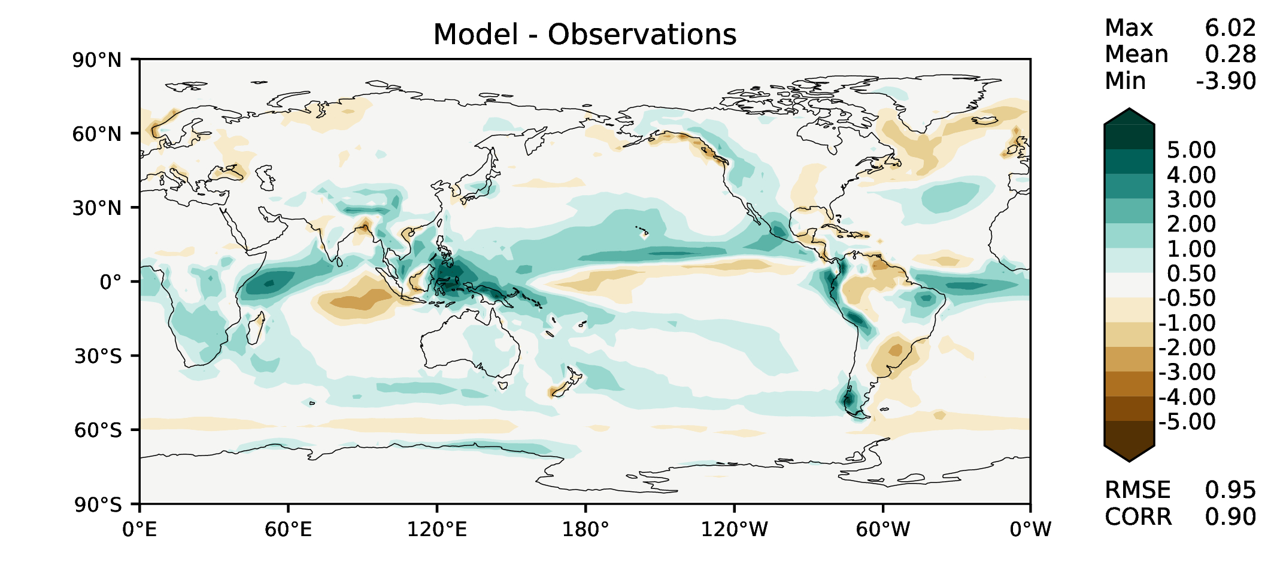
Annual total precipitation
DECKv1
v2beta4
v2rc1a
v2rc1c

Slide 4
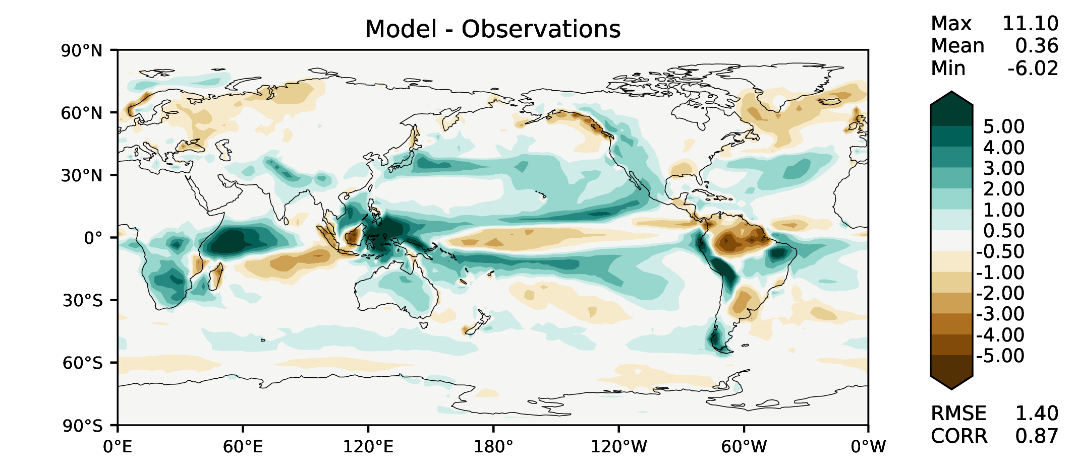
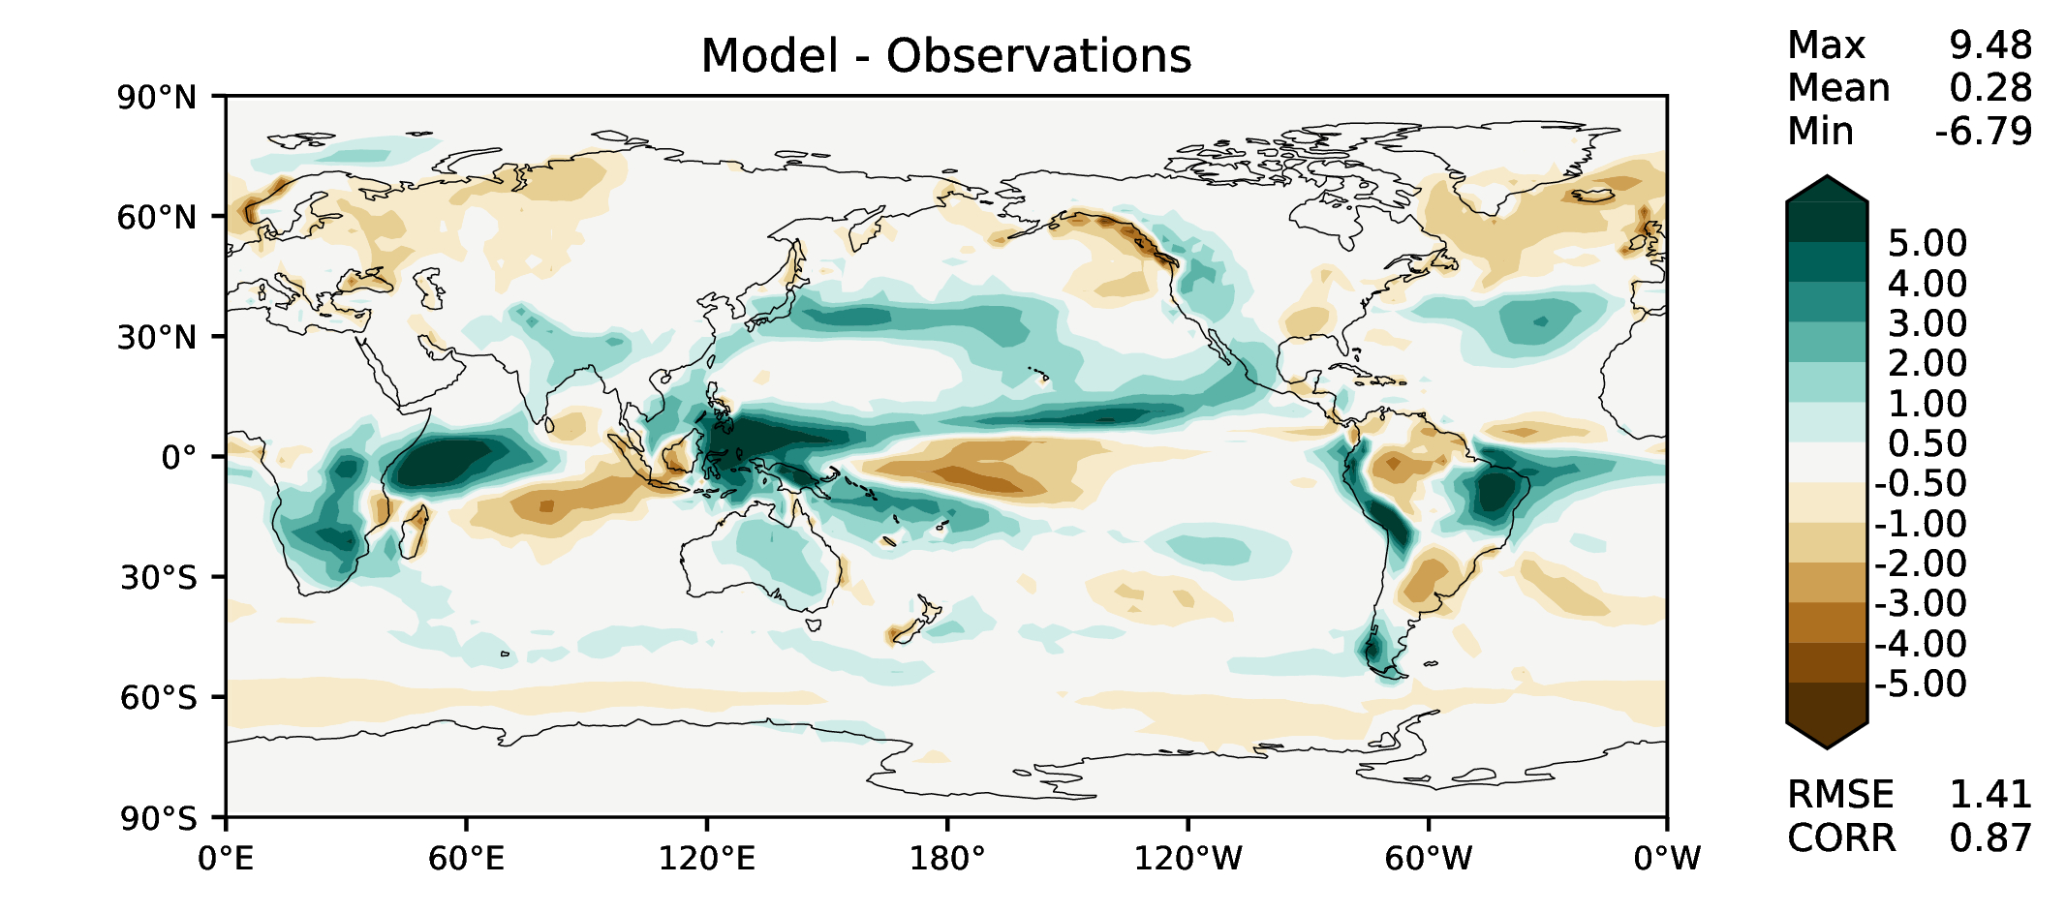
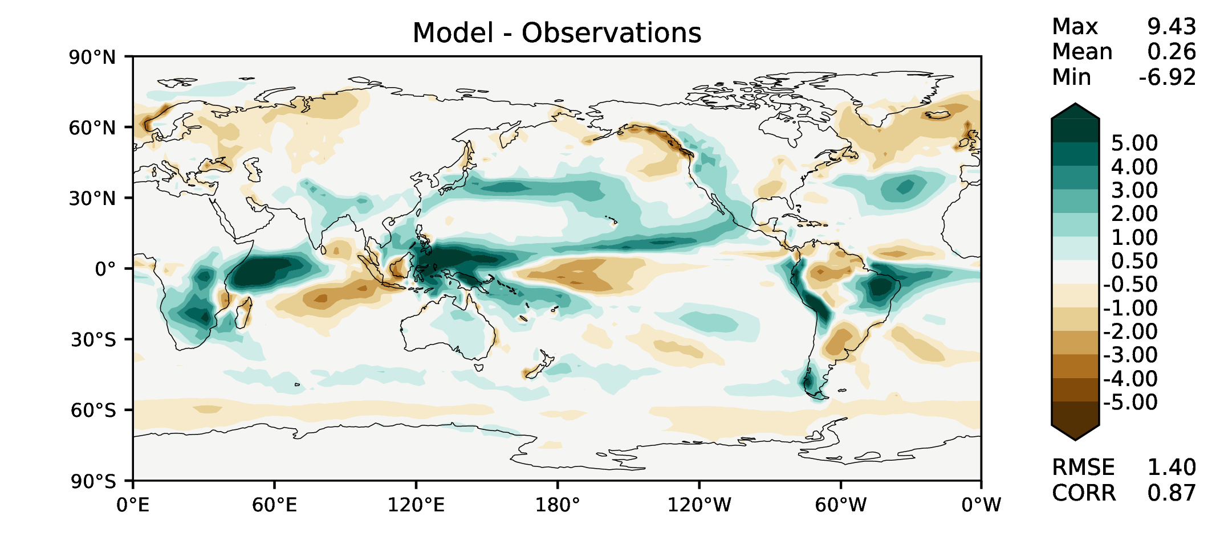
DJF total precipitation
DECKv1
v2beta4
v2rc1a
v2rc1c

Slide 5
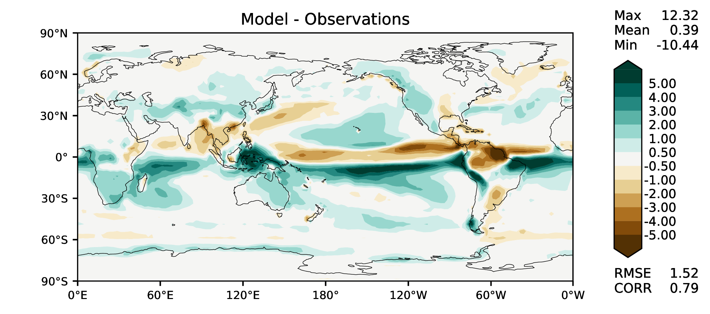
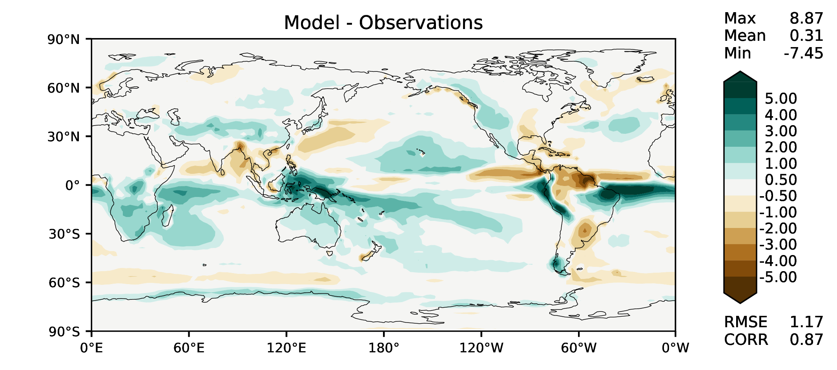
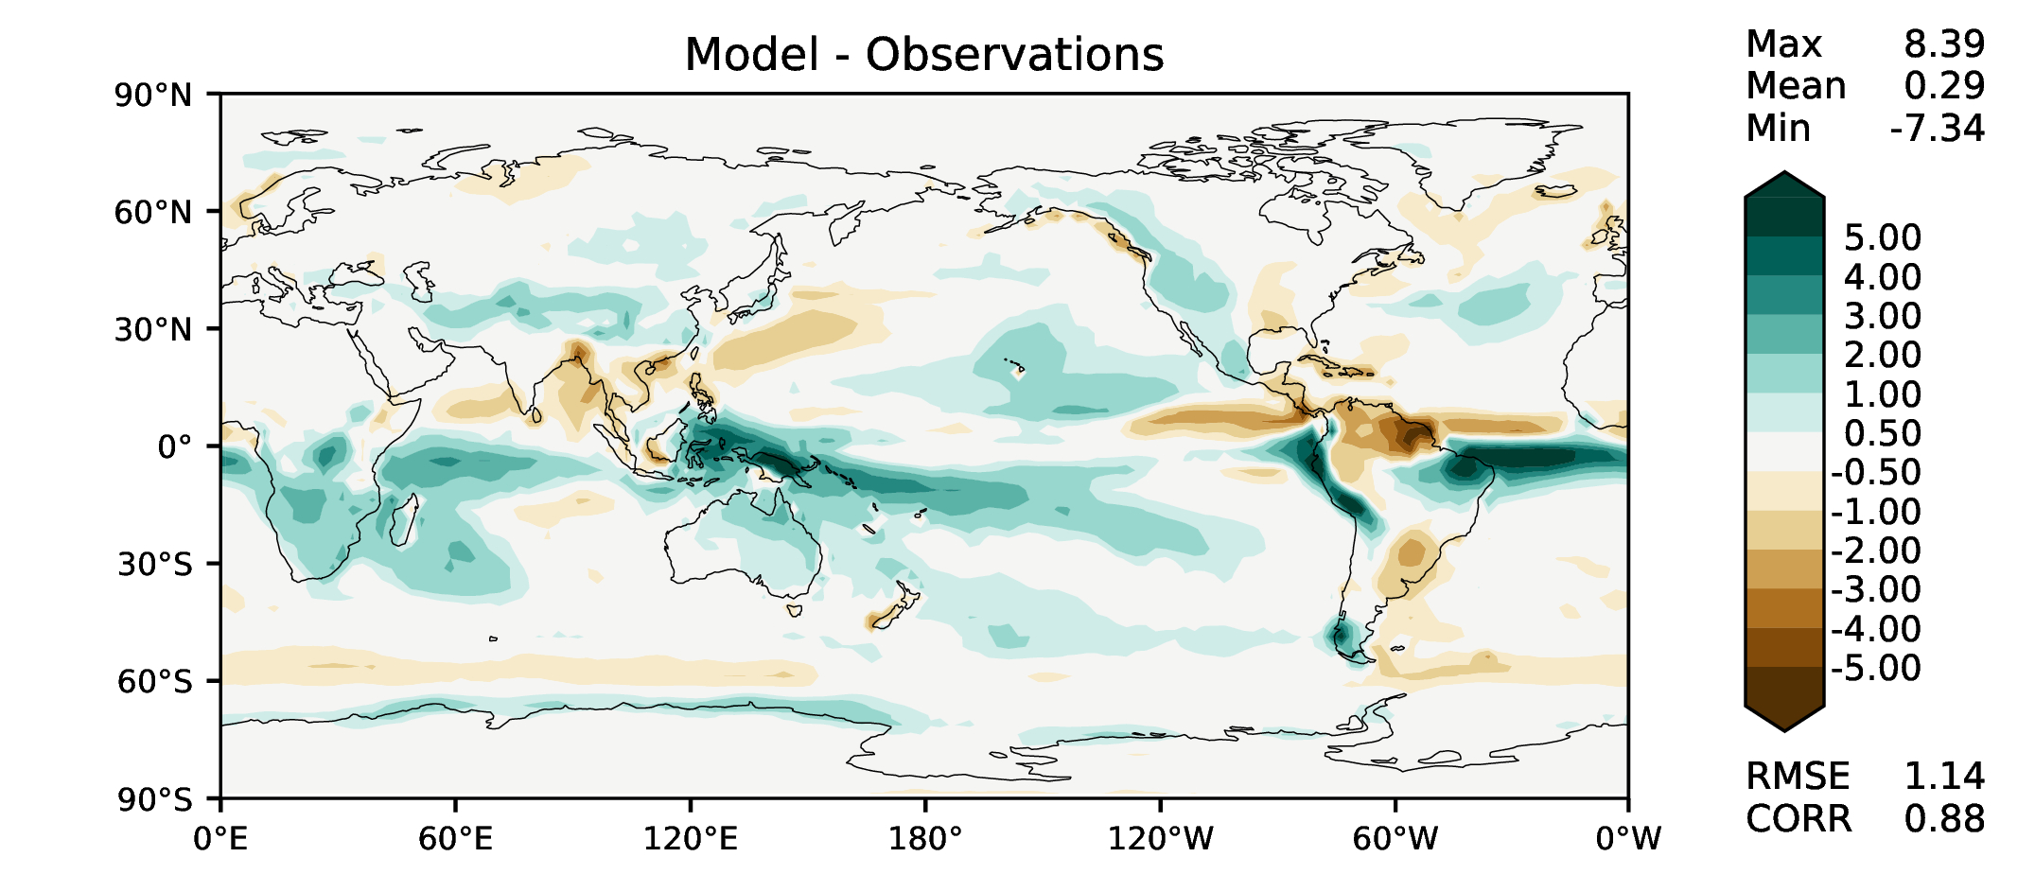
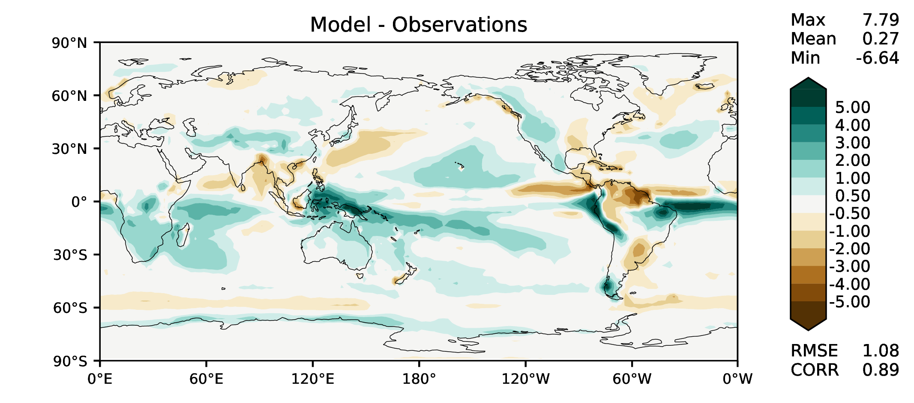
MAM total precipitation
DECKv1
v2beta4
v2rc1a
v2rc1c

Slide 6
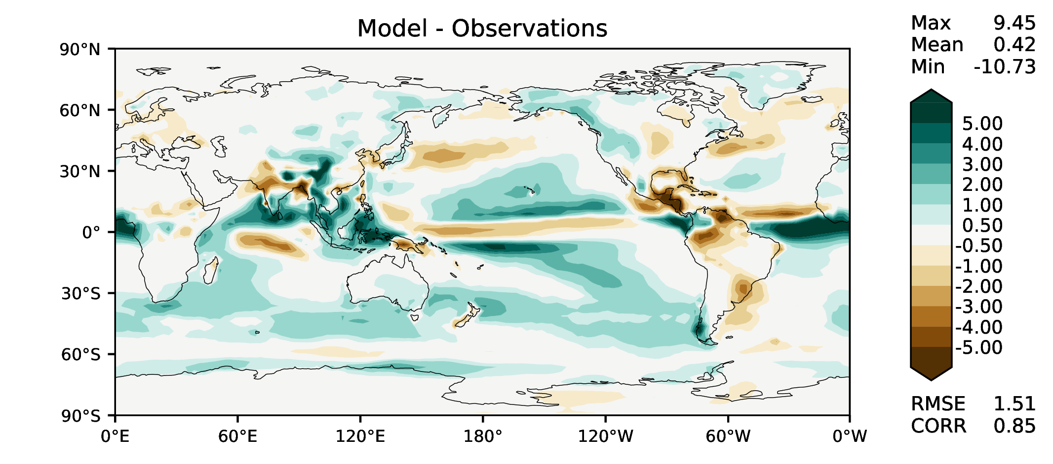
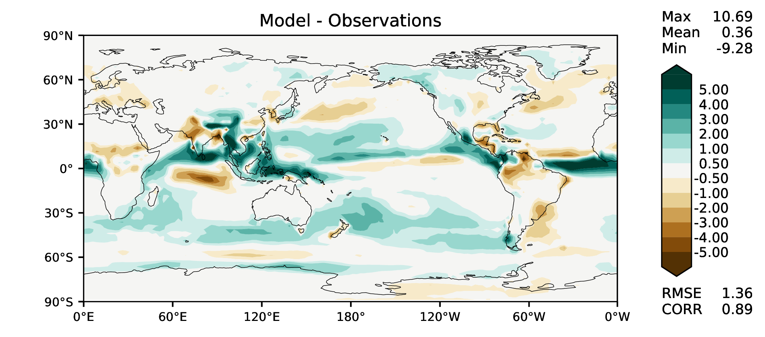
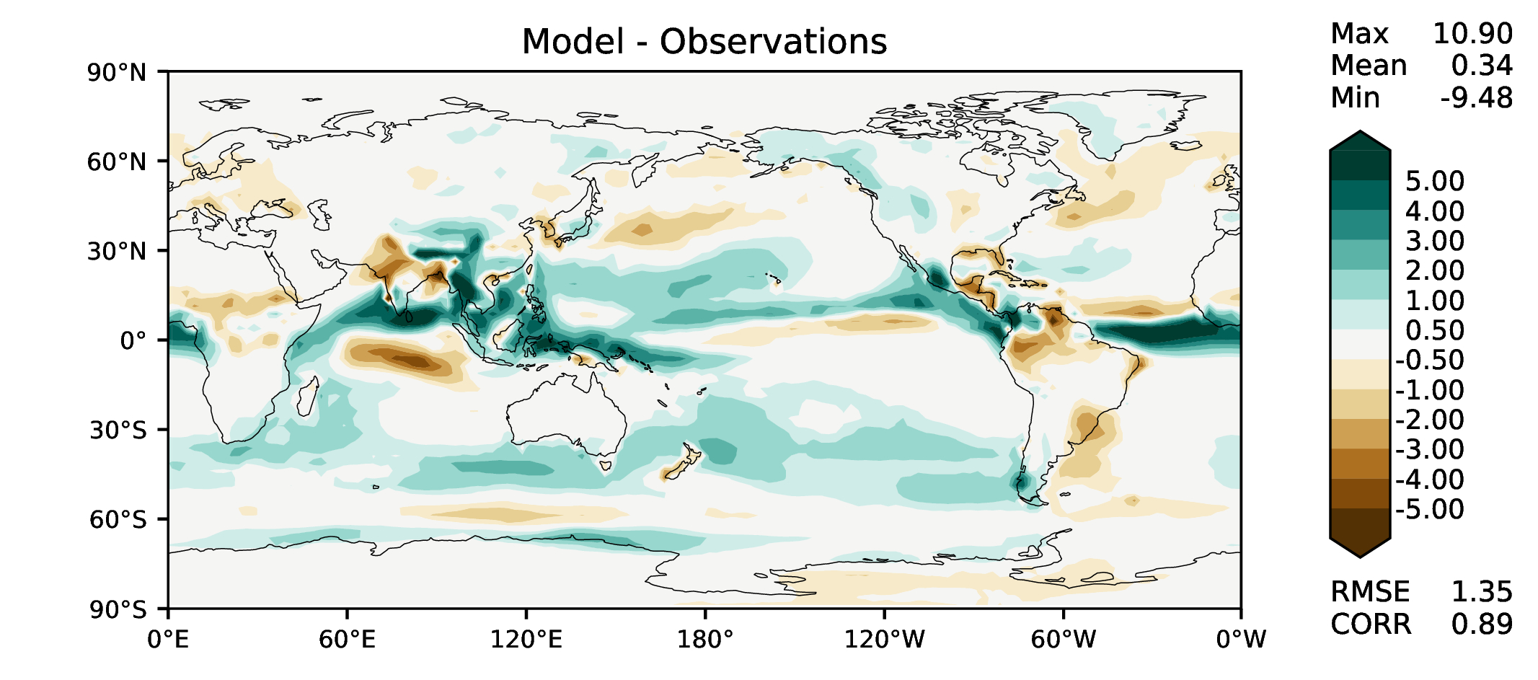
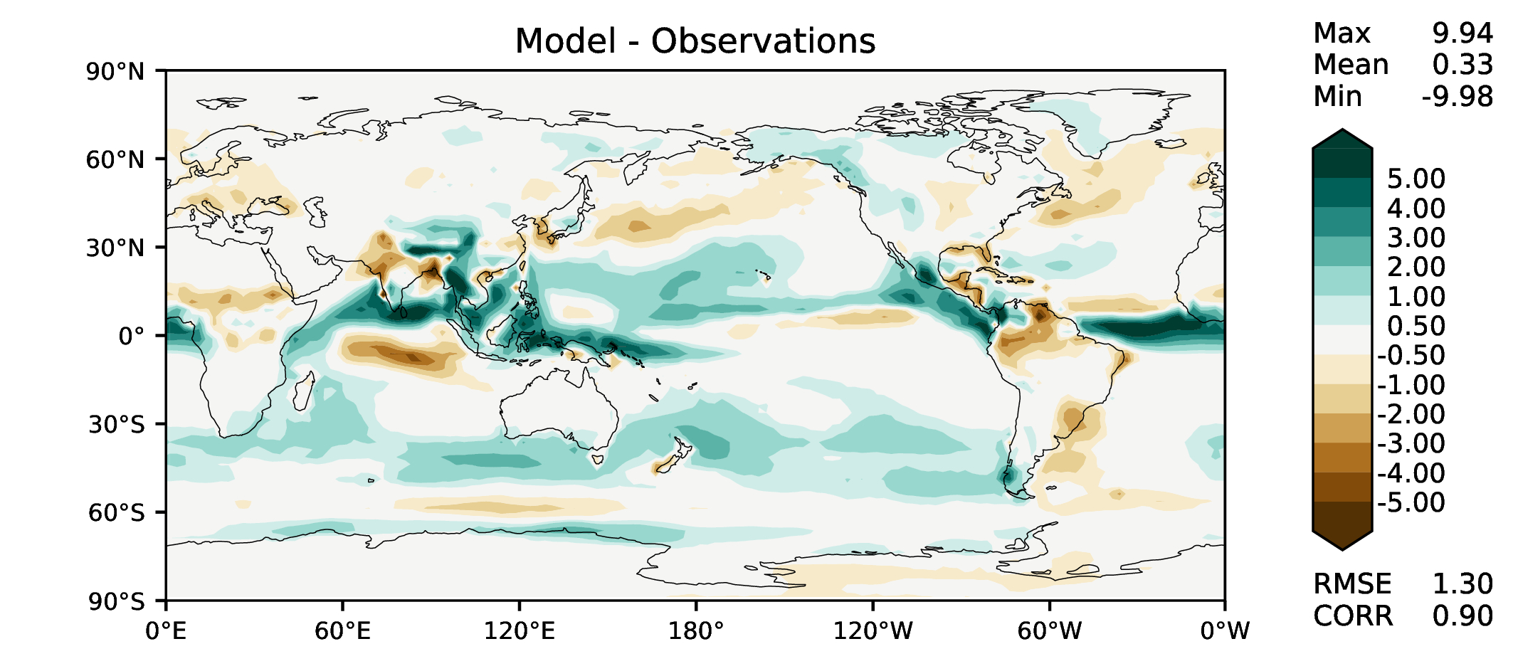
JJA total precipitation
DECKv1
v2beta4
v2rc1a
v2rc1c

Slide 7
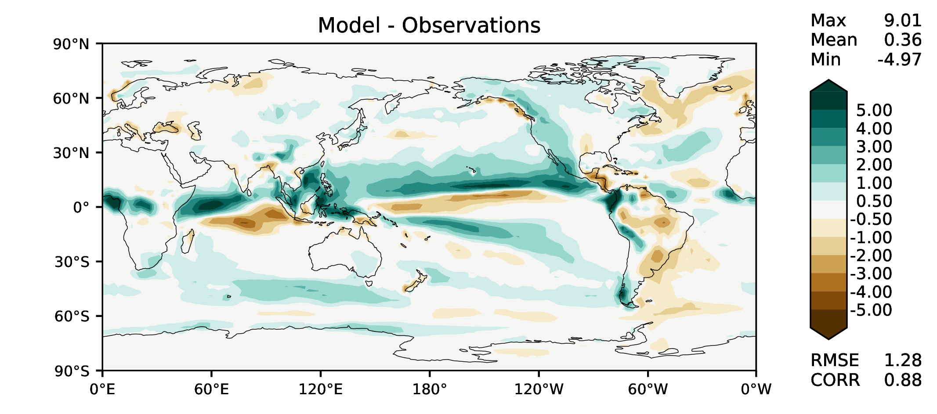
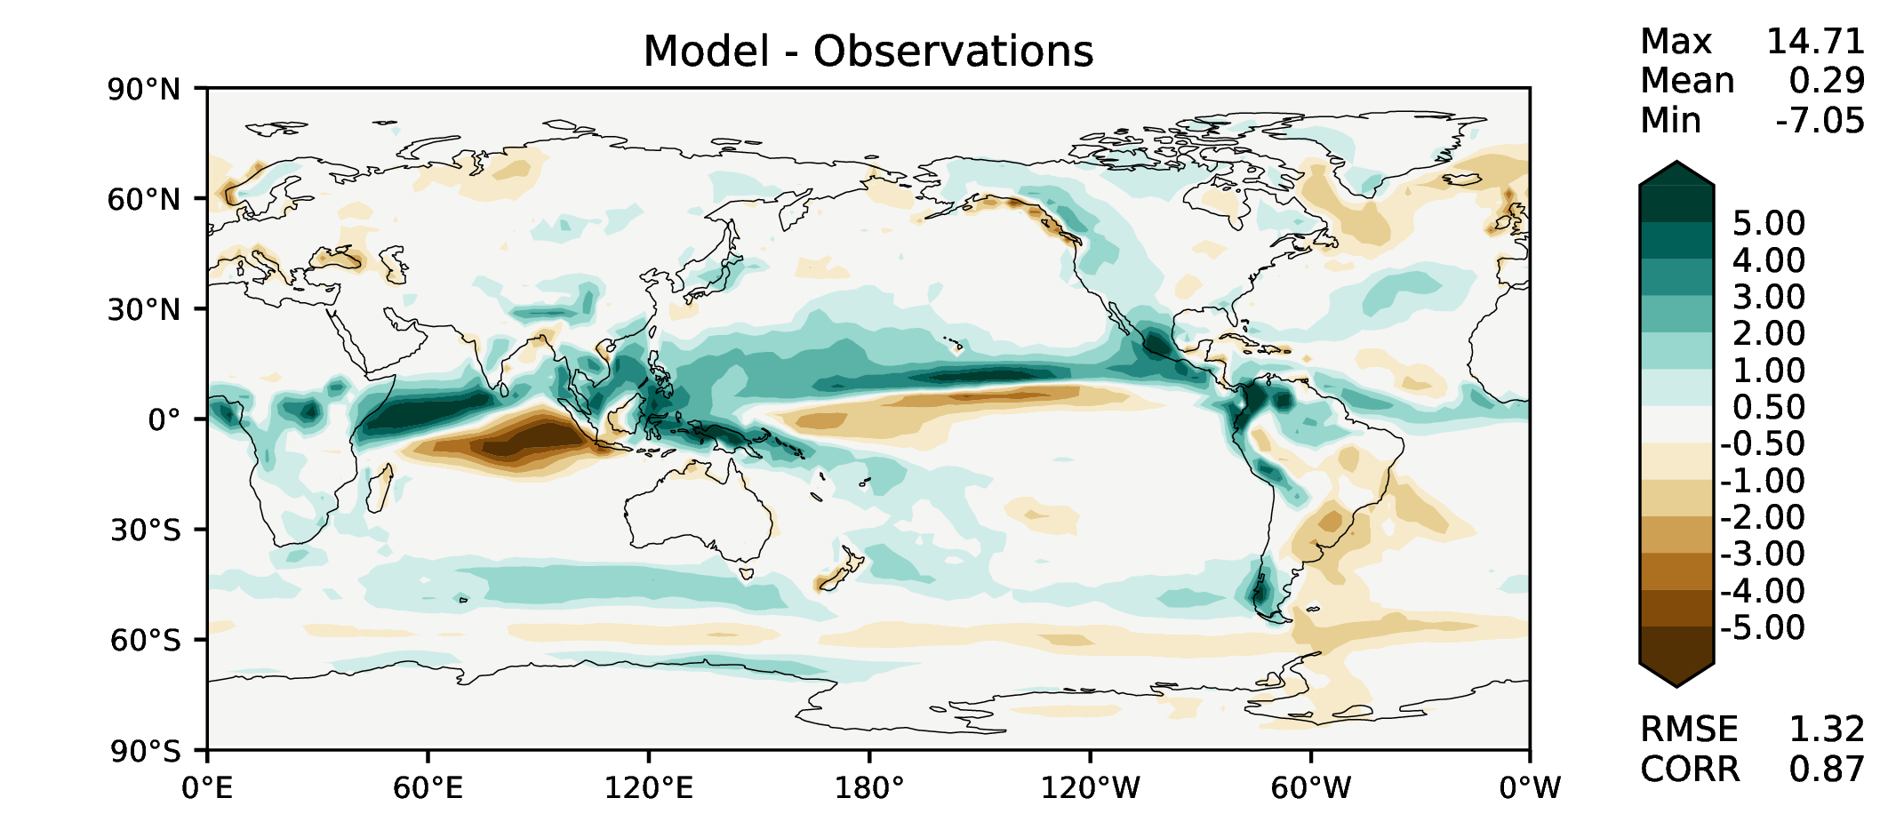
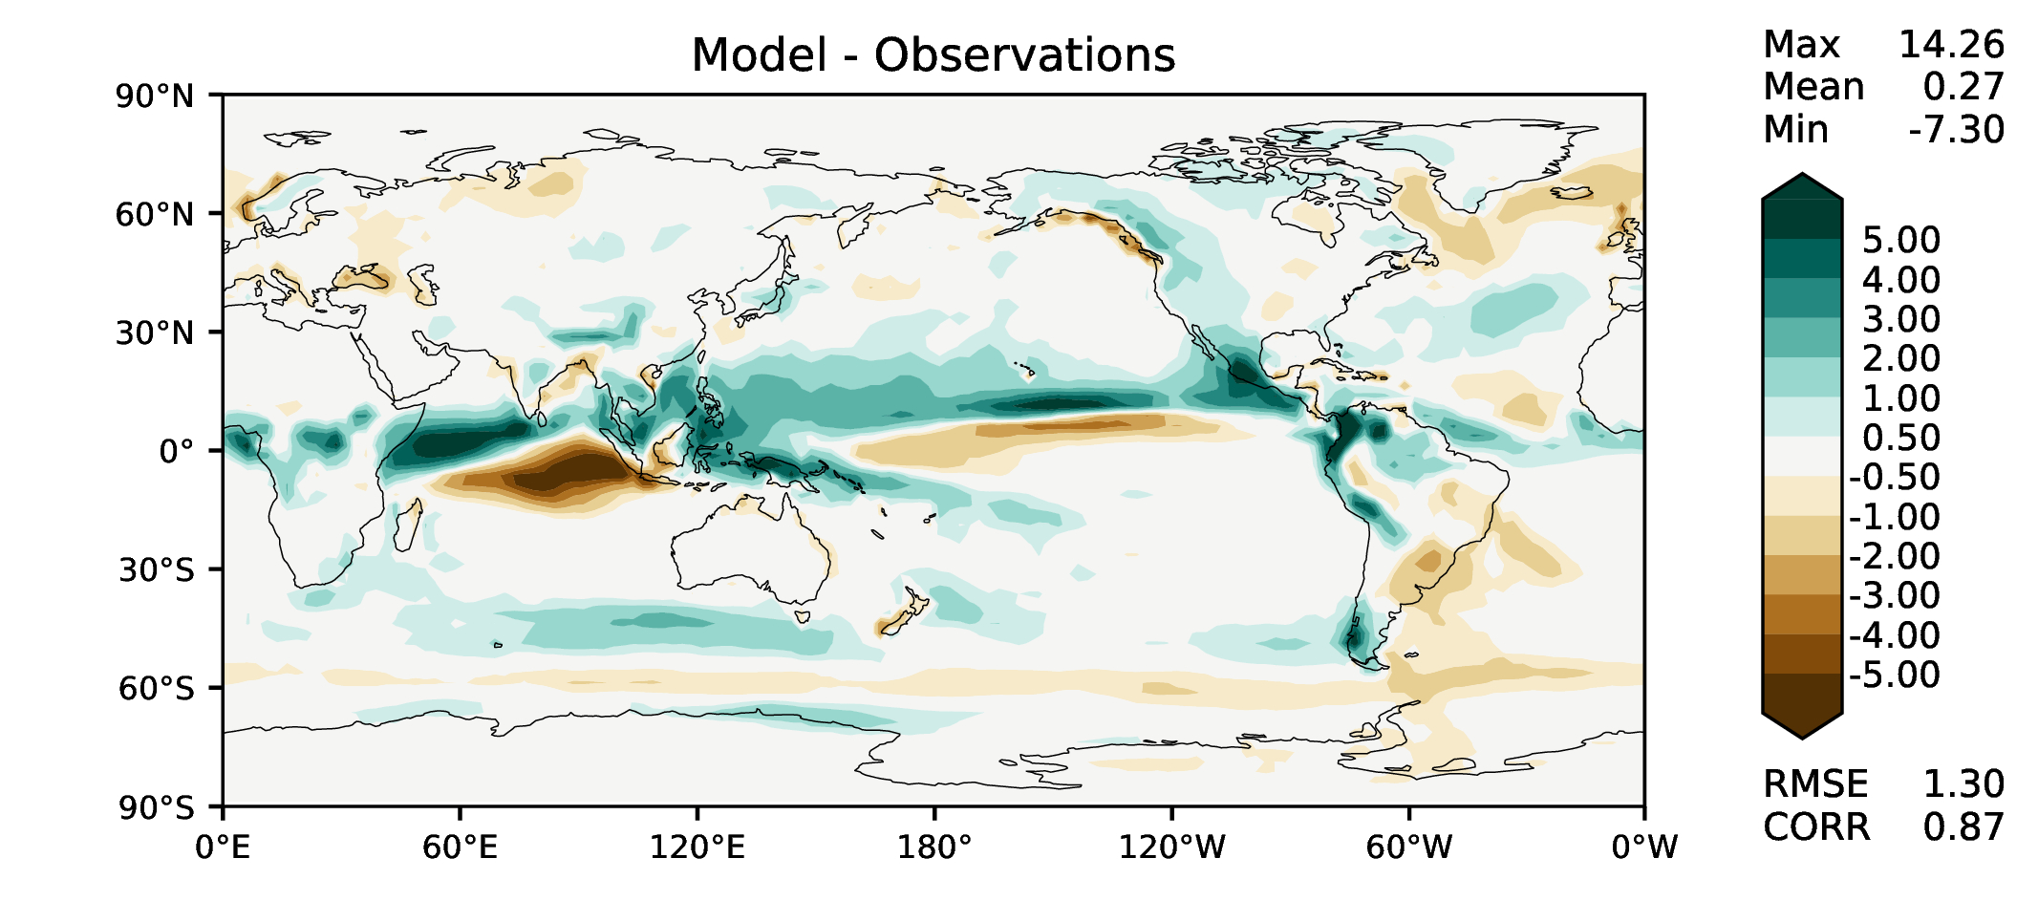
SON total precipitation
DECKv1
v2beta4
v2rc1a
v2rc1c

Slide 8
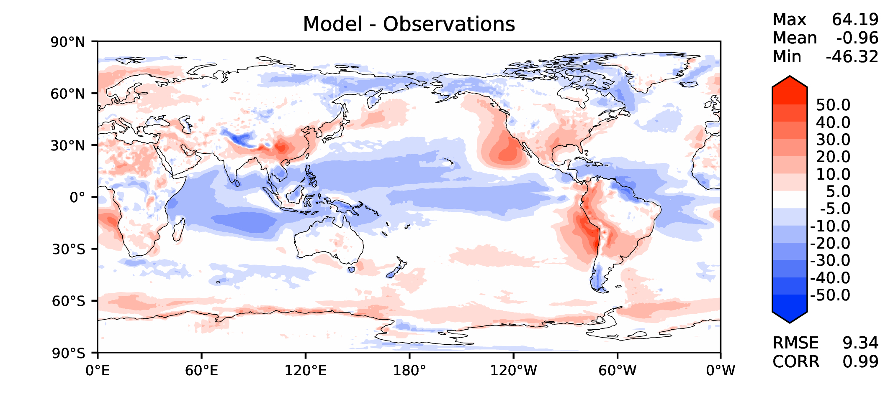
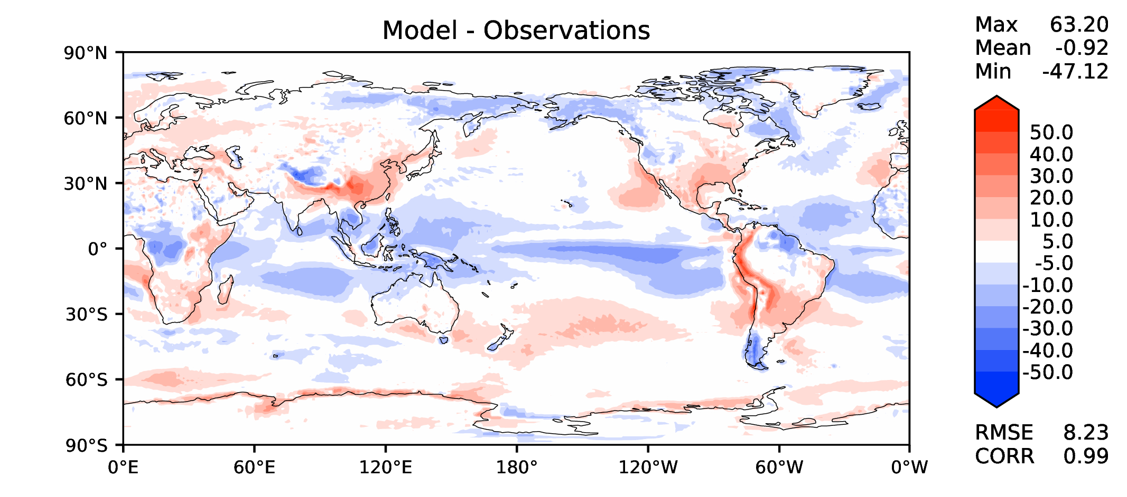
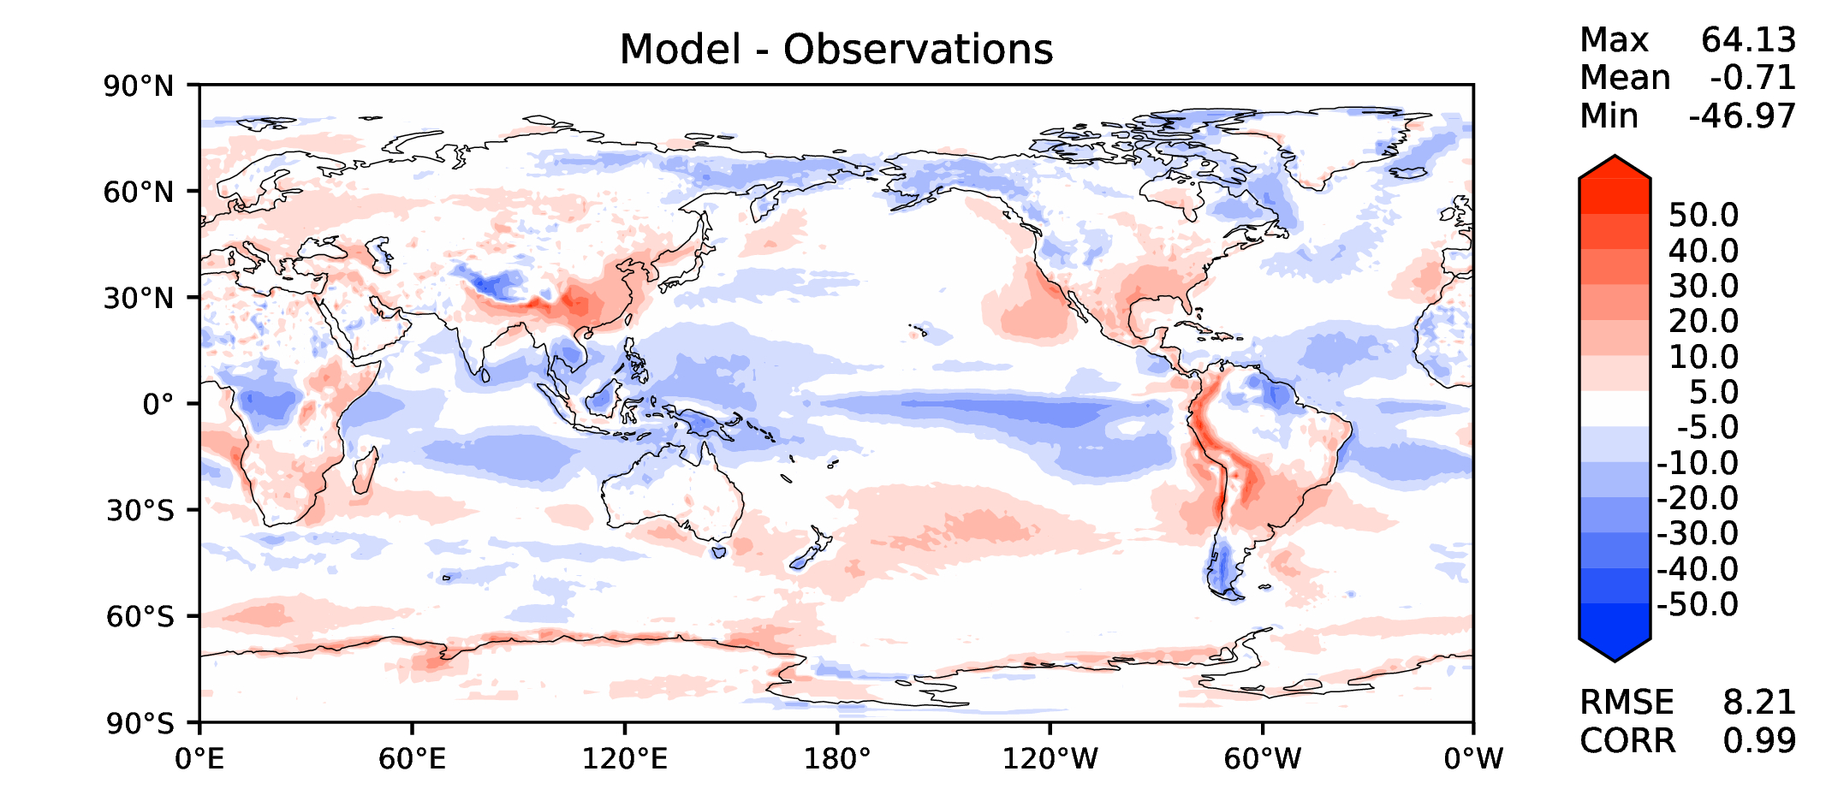
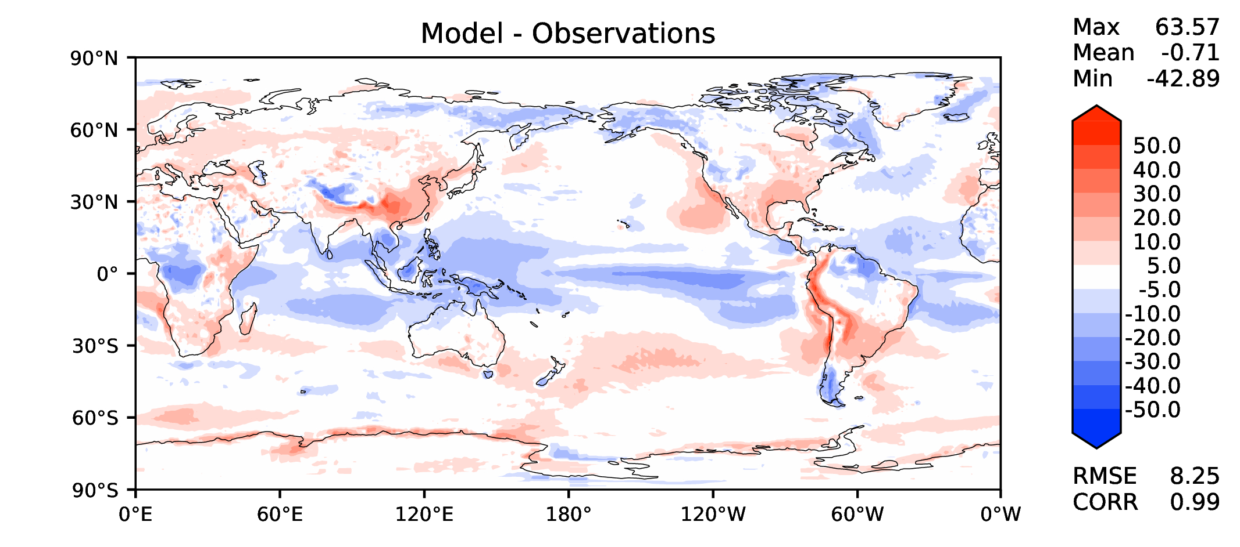
Annual TOA net radiation
DECKv1
v2beta4
v2rc1a
v2rc1c

Slide 9
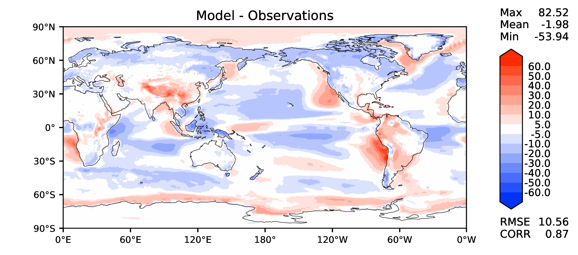
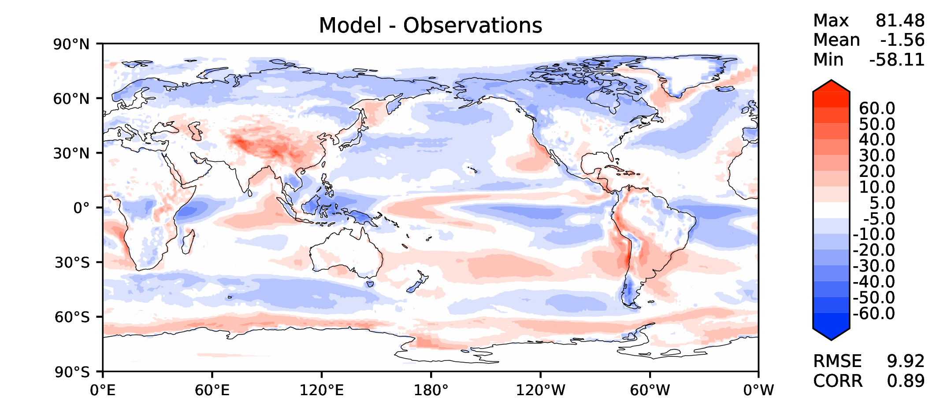
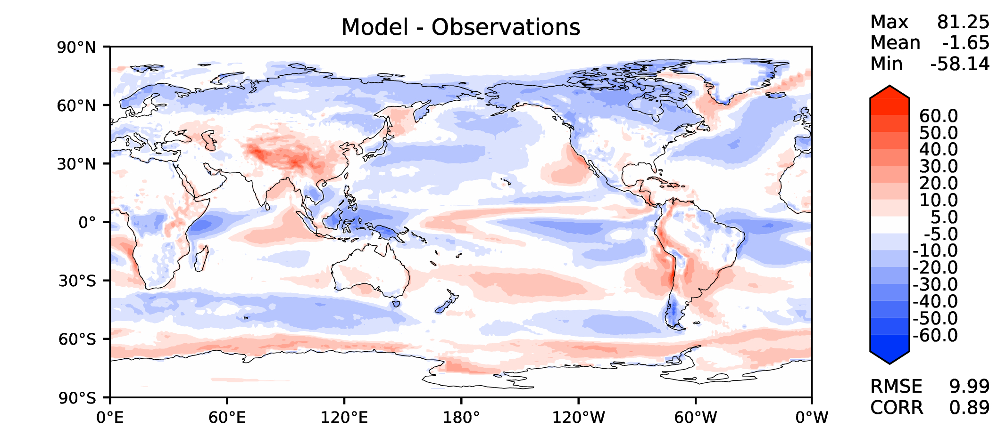
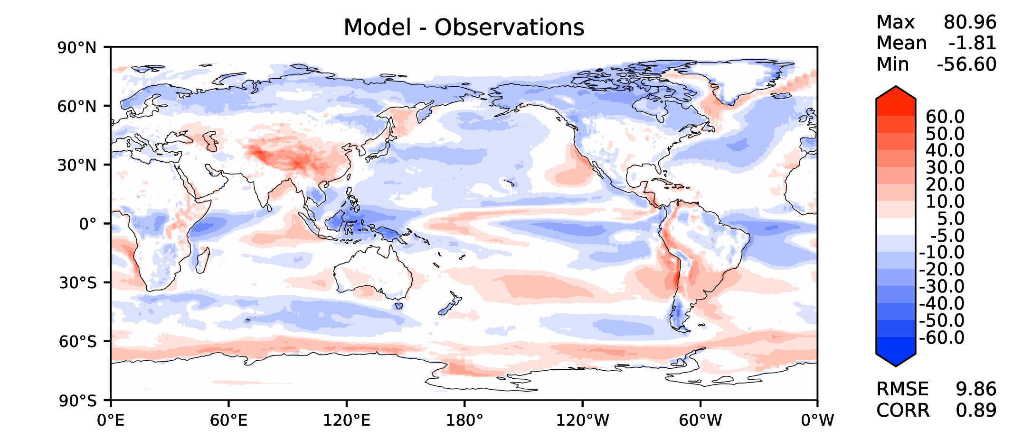
Annual TOA SW CRE
DECKv1
v2beta4
v2rc1a
v2rc1c

Slide 10
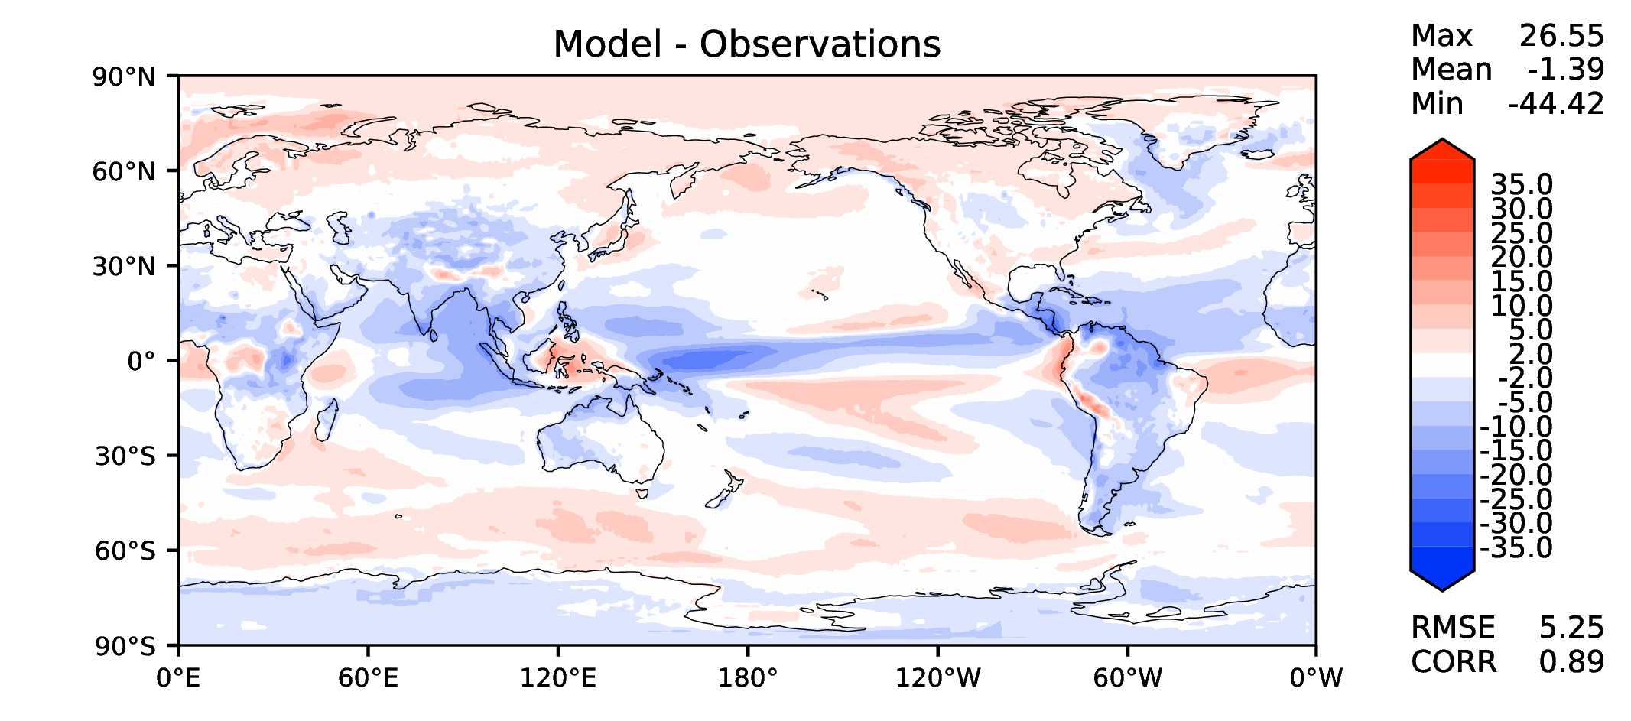
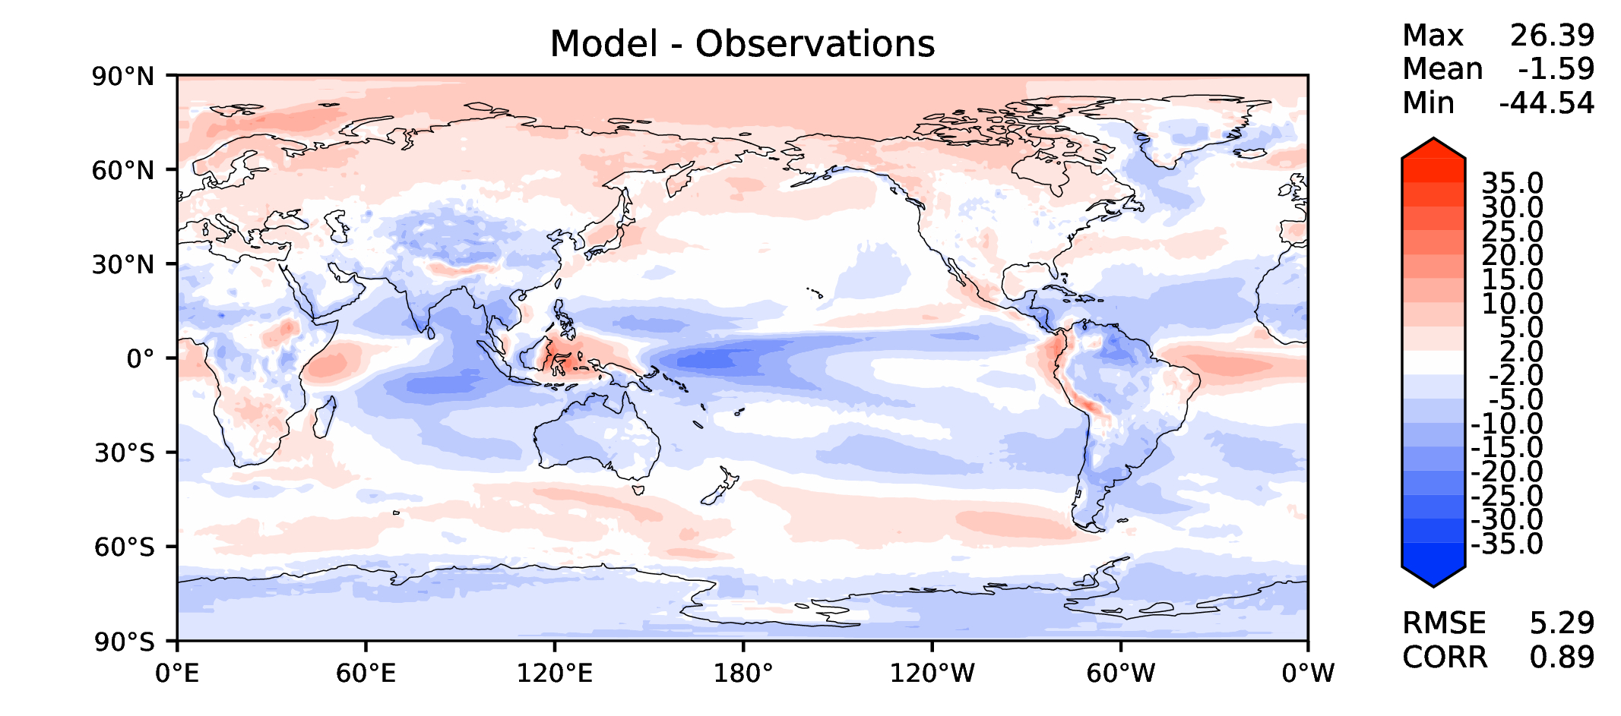
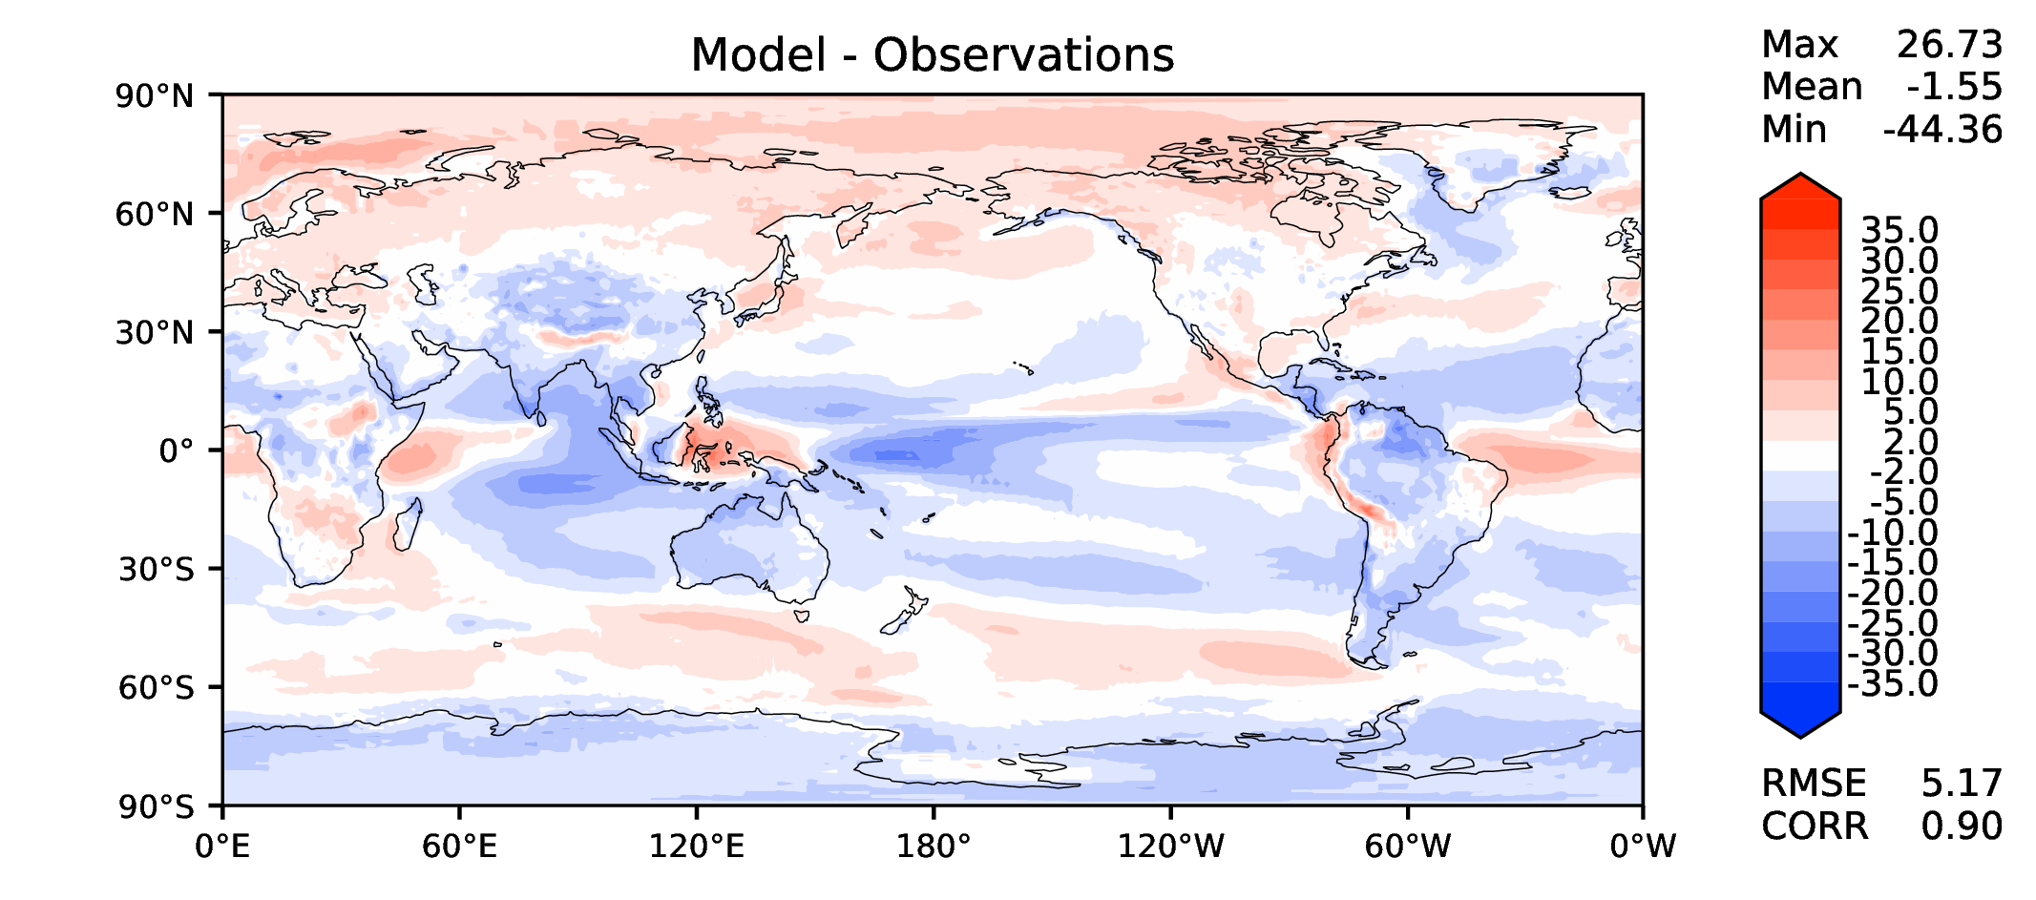
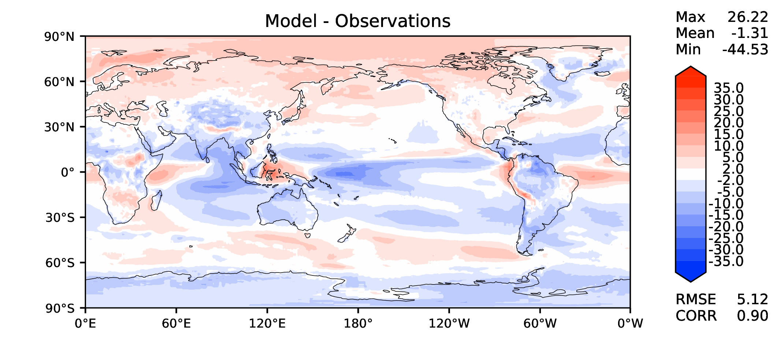
Annual TOA LW CRE
DECKv1
v2beta4
v2rc1a
v2rc1c

Slide 11
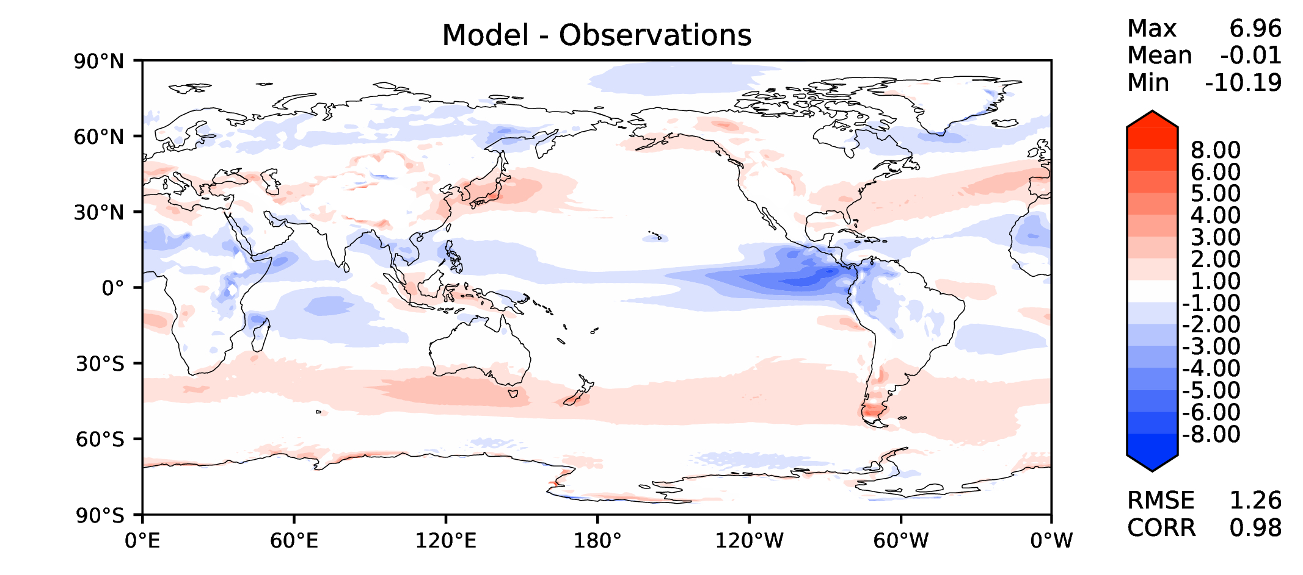
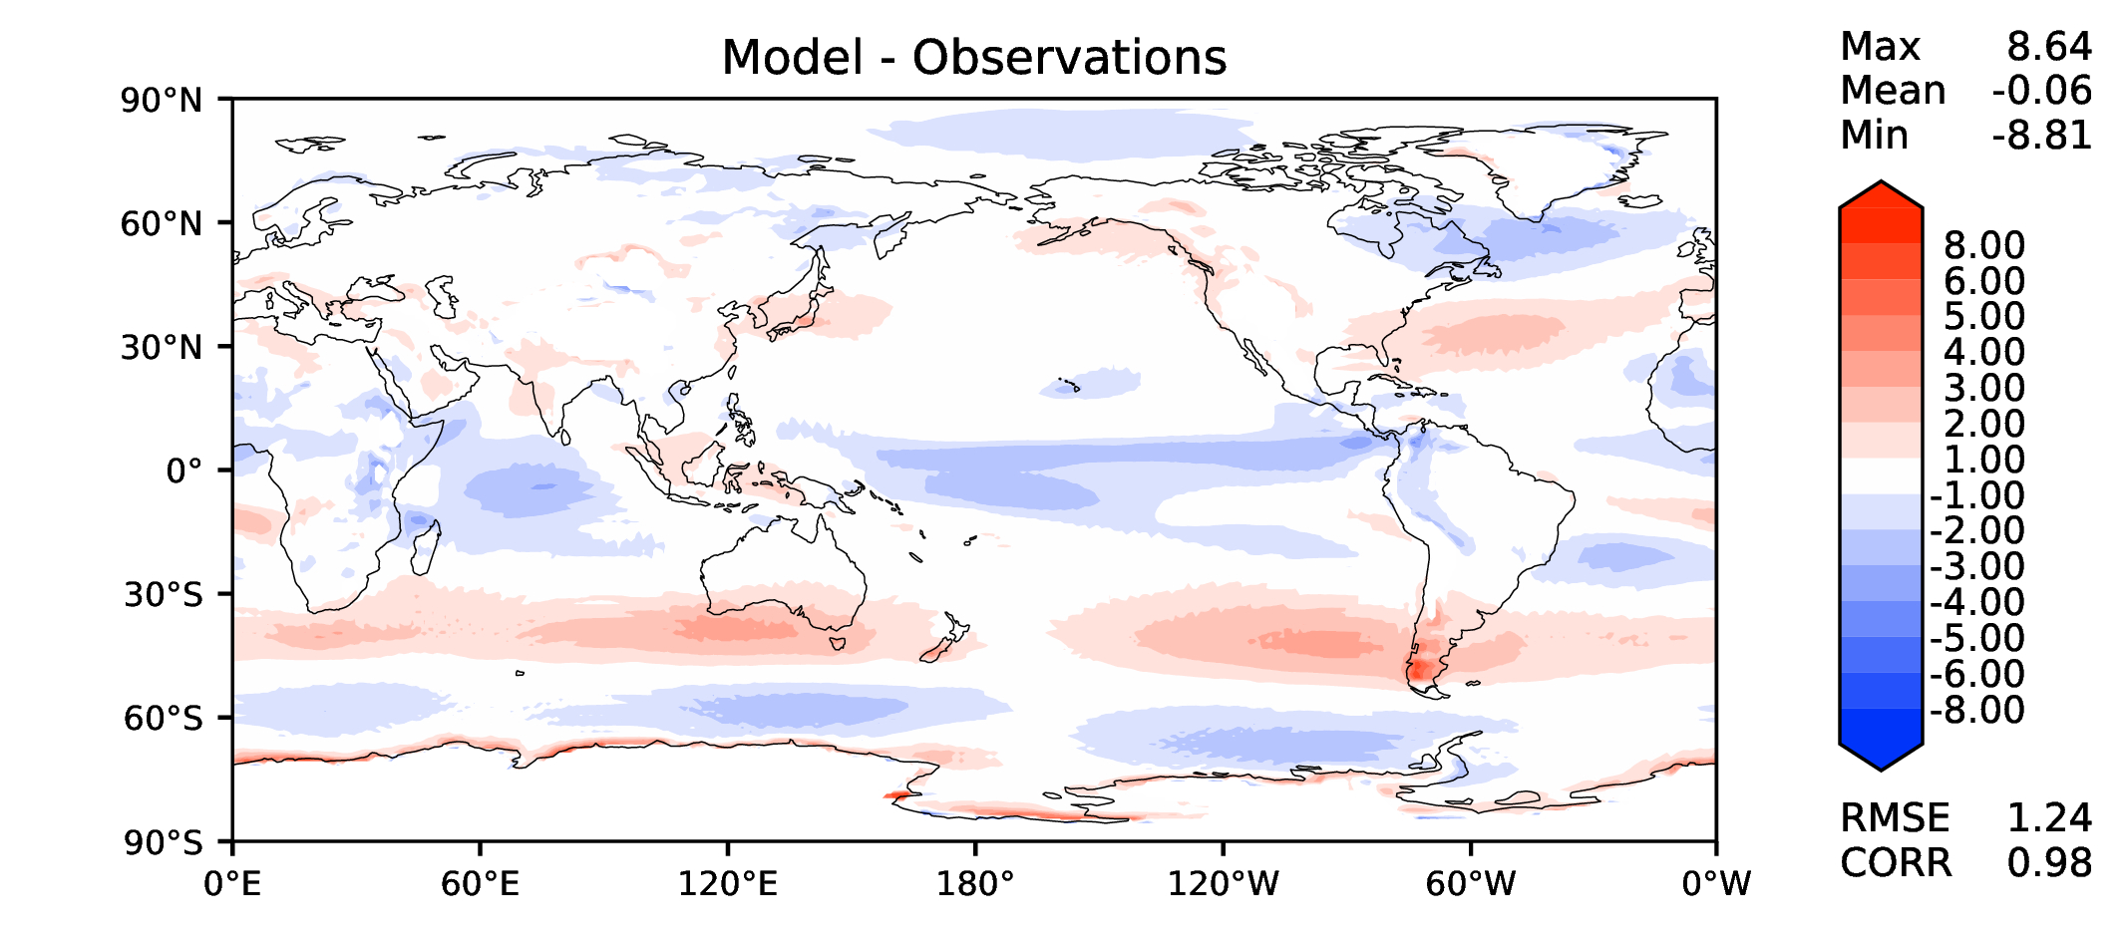
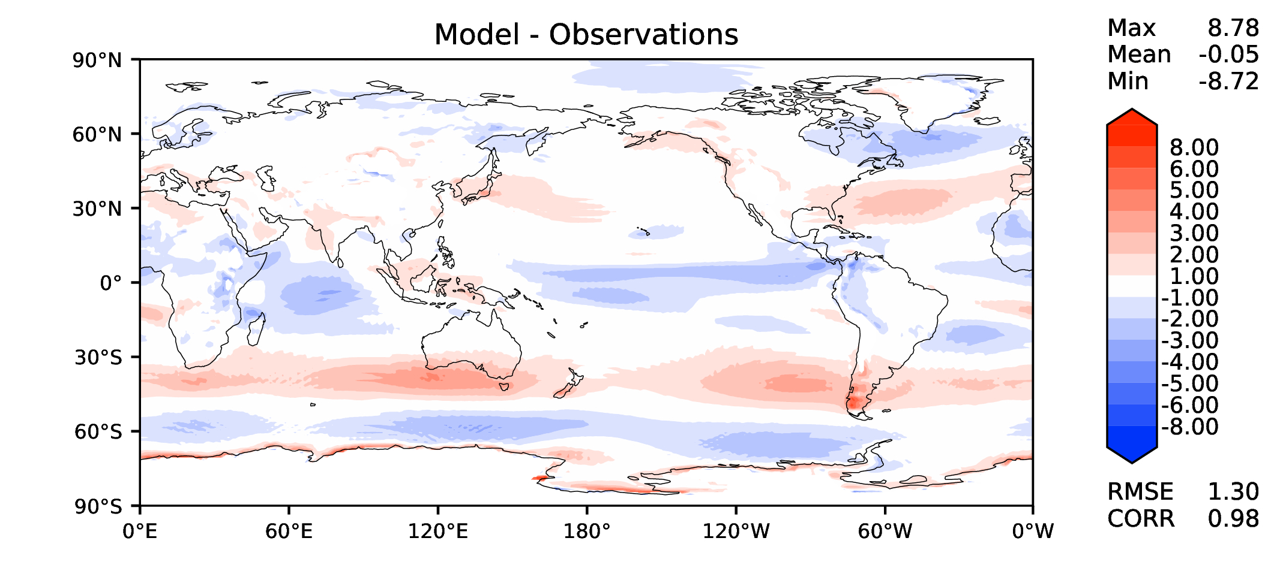
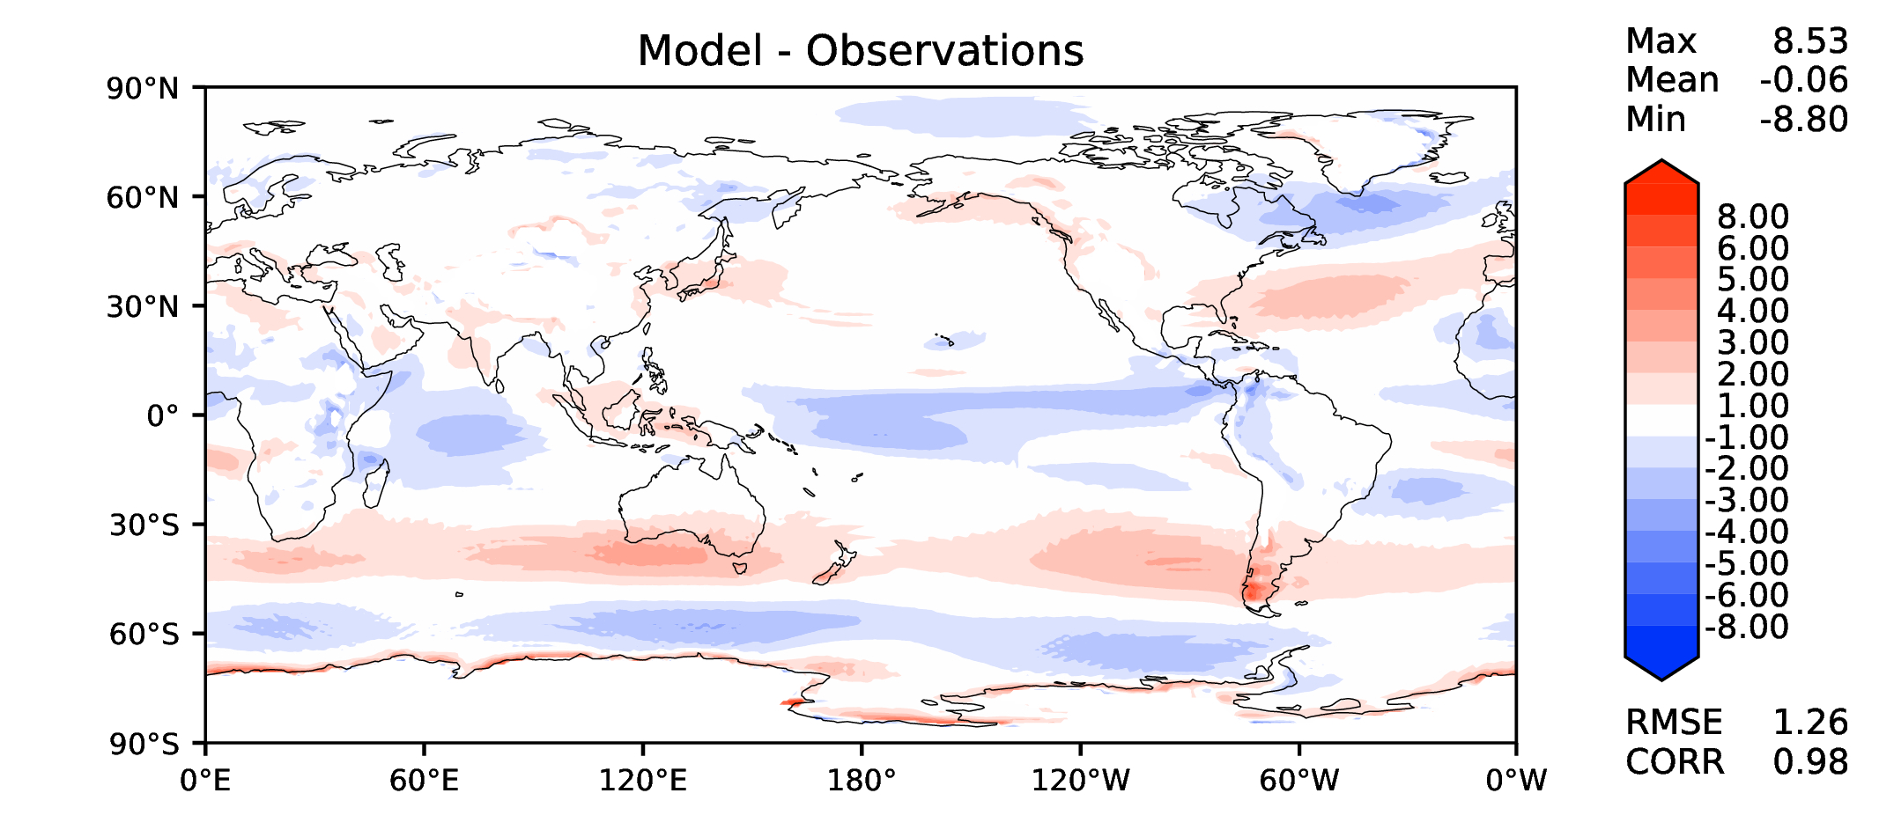
Annual u wind at 850 hPa
DECKv1
v2beta4
v2rc1a
v2rc1c

Slide 12
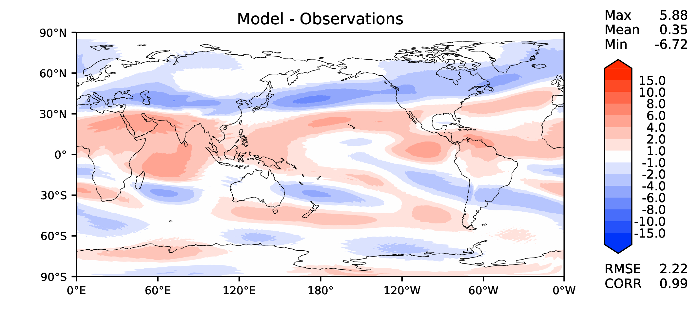
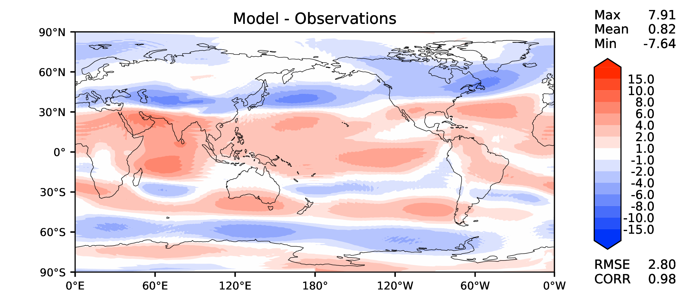
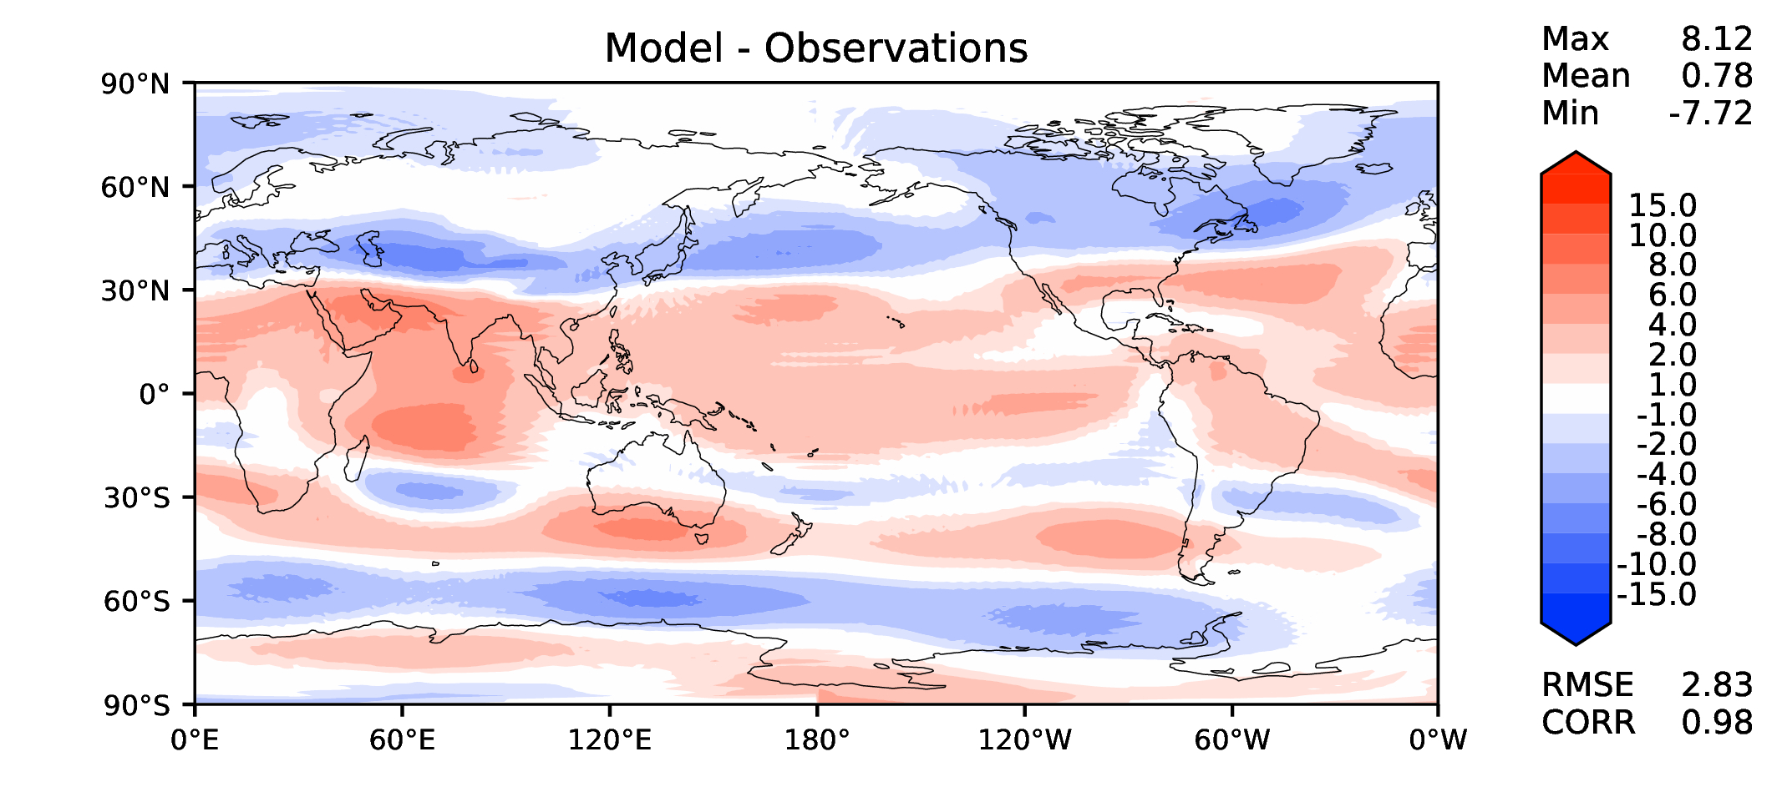
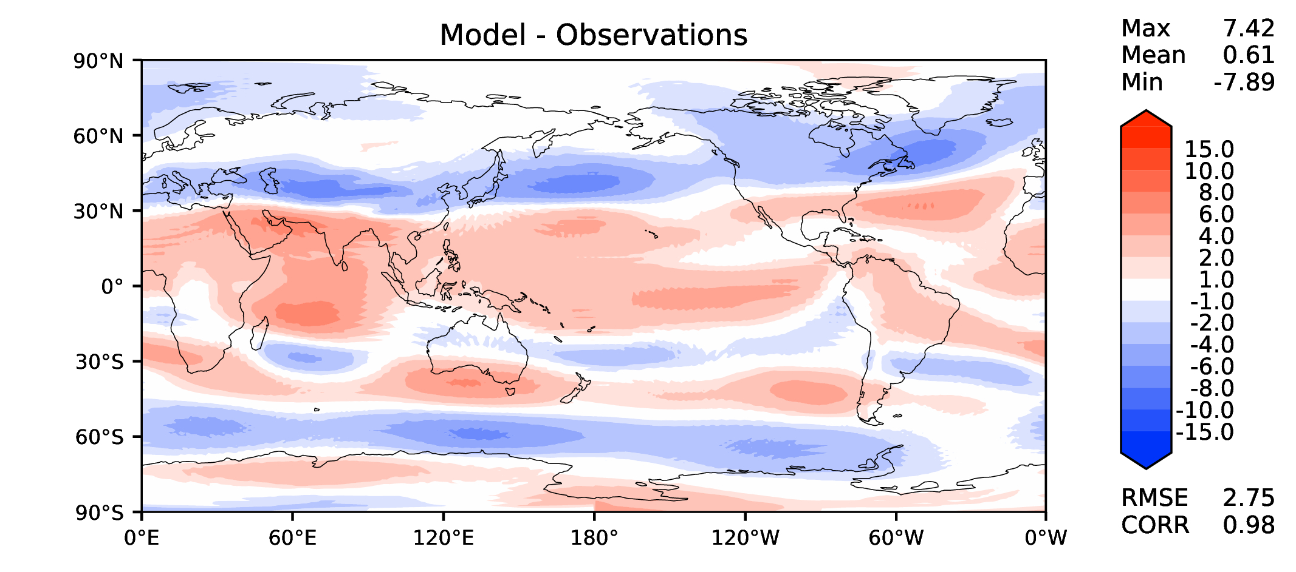
Annual u wind at 200 hPa
DECKv1
v2beta4
v2rc1a
v2rc1c

Slide 13
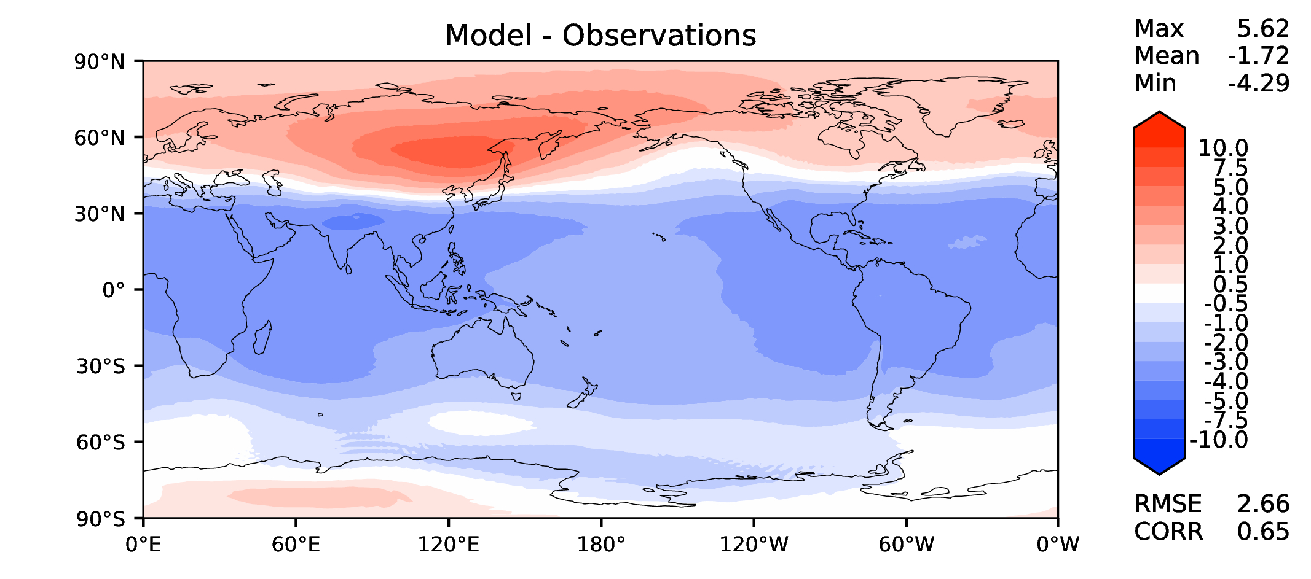
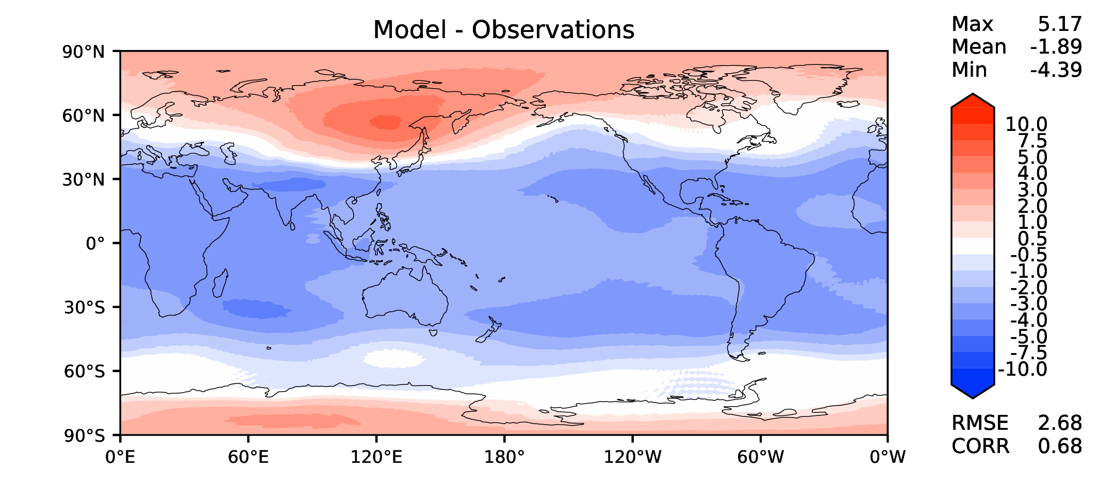
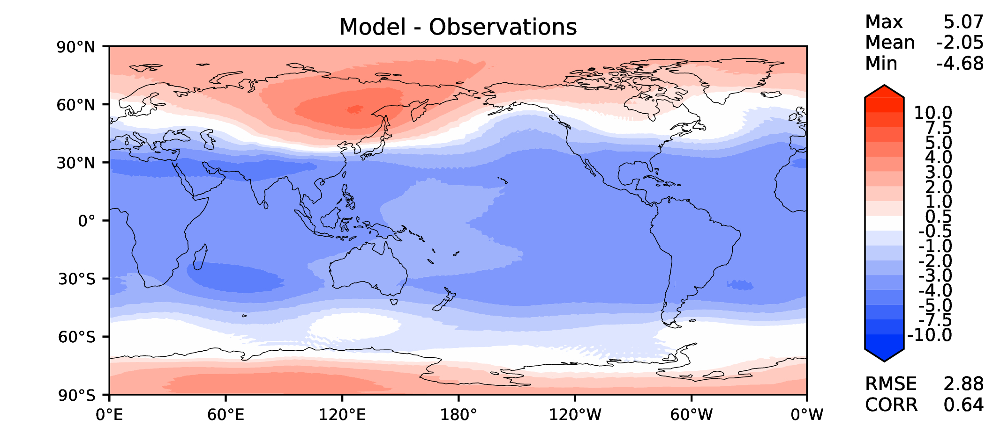
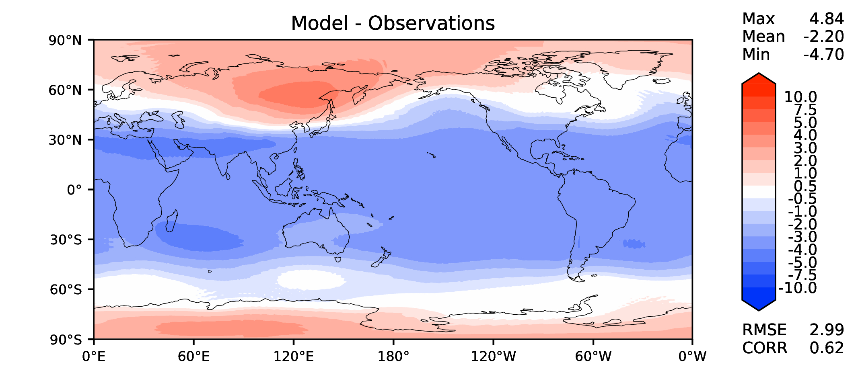
Annual T at 200 hPa
DECKv1
v2beta4
v2rc1a
v2rc1c

Slide 14
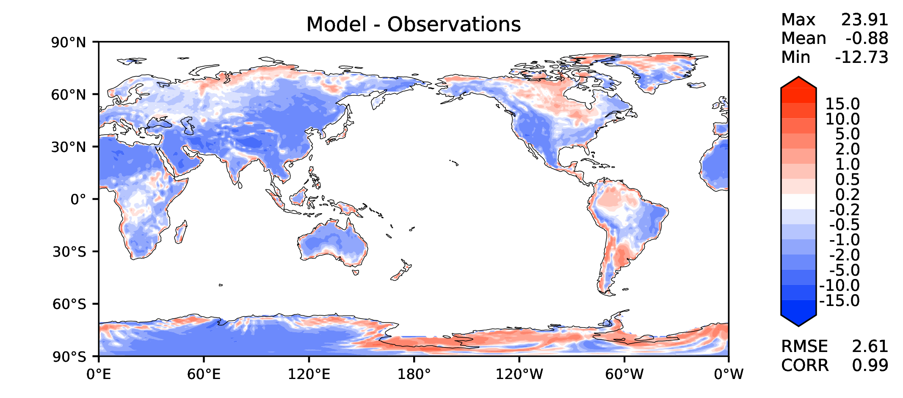
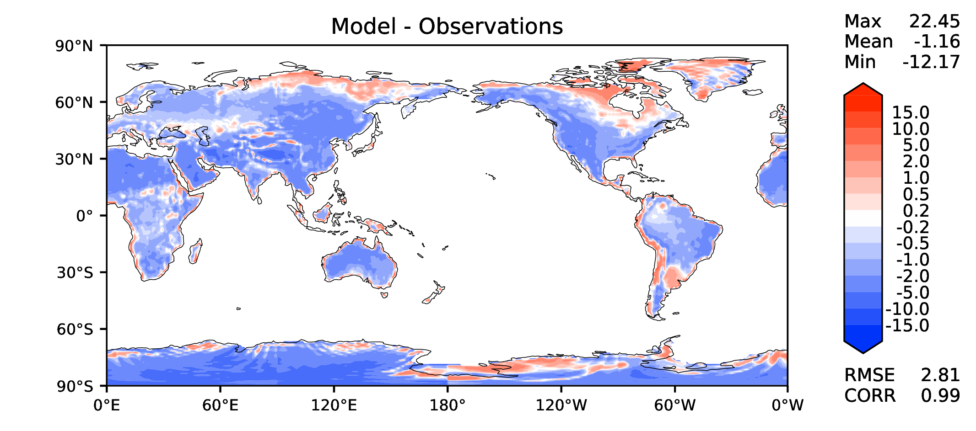
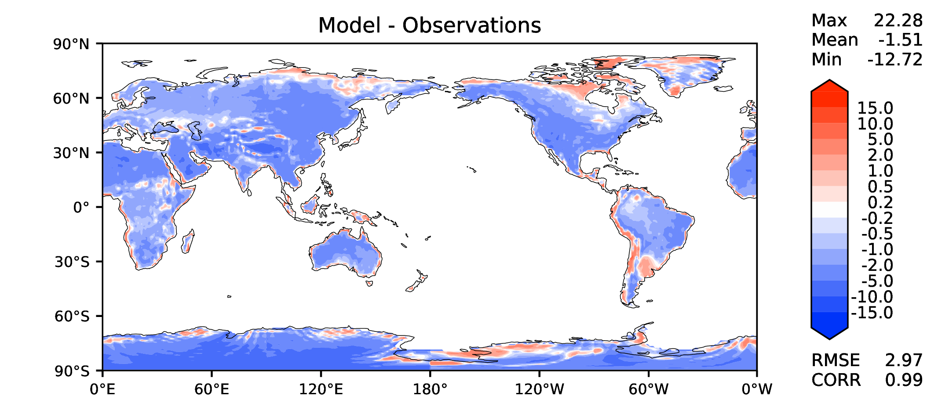
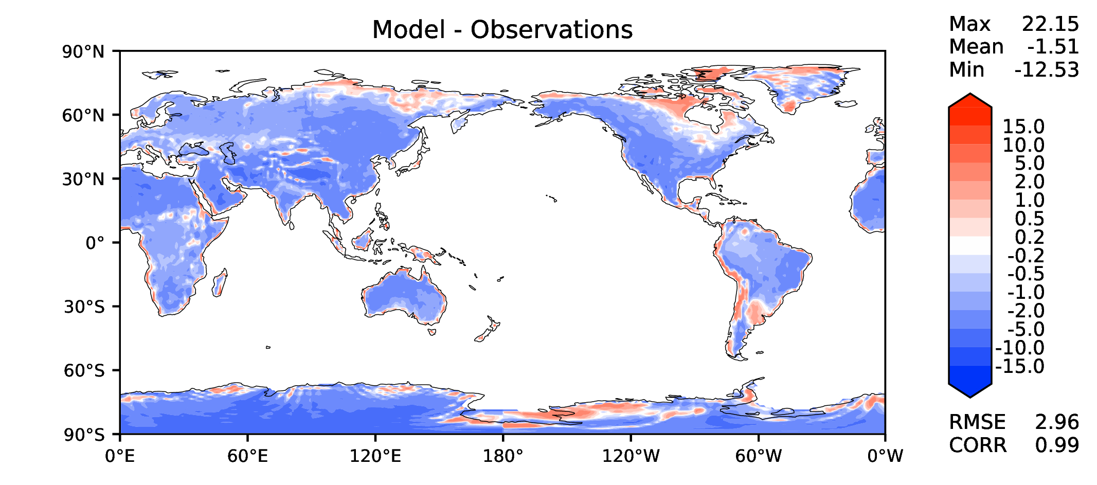
Annual surface air T (land)
DECKv1
v2beta4
v2rc1a
v2rc1c

Slide 15
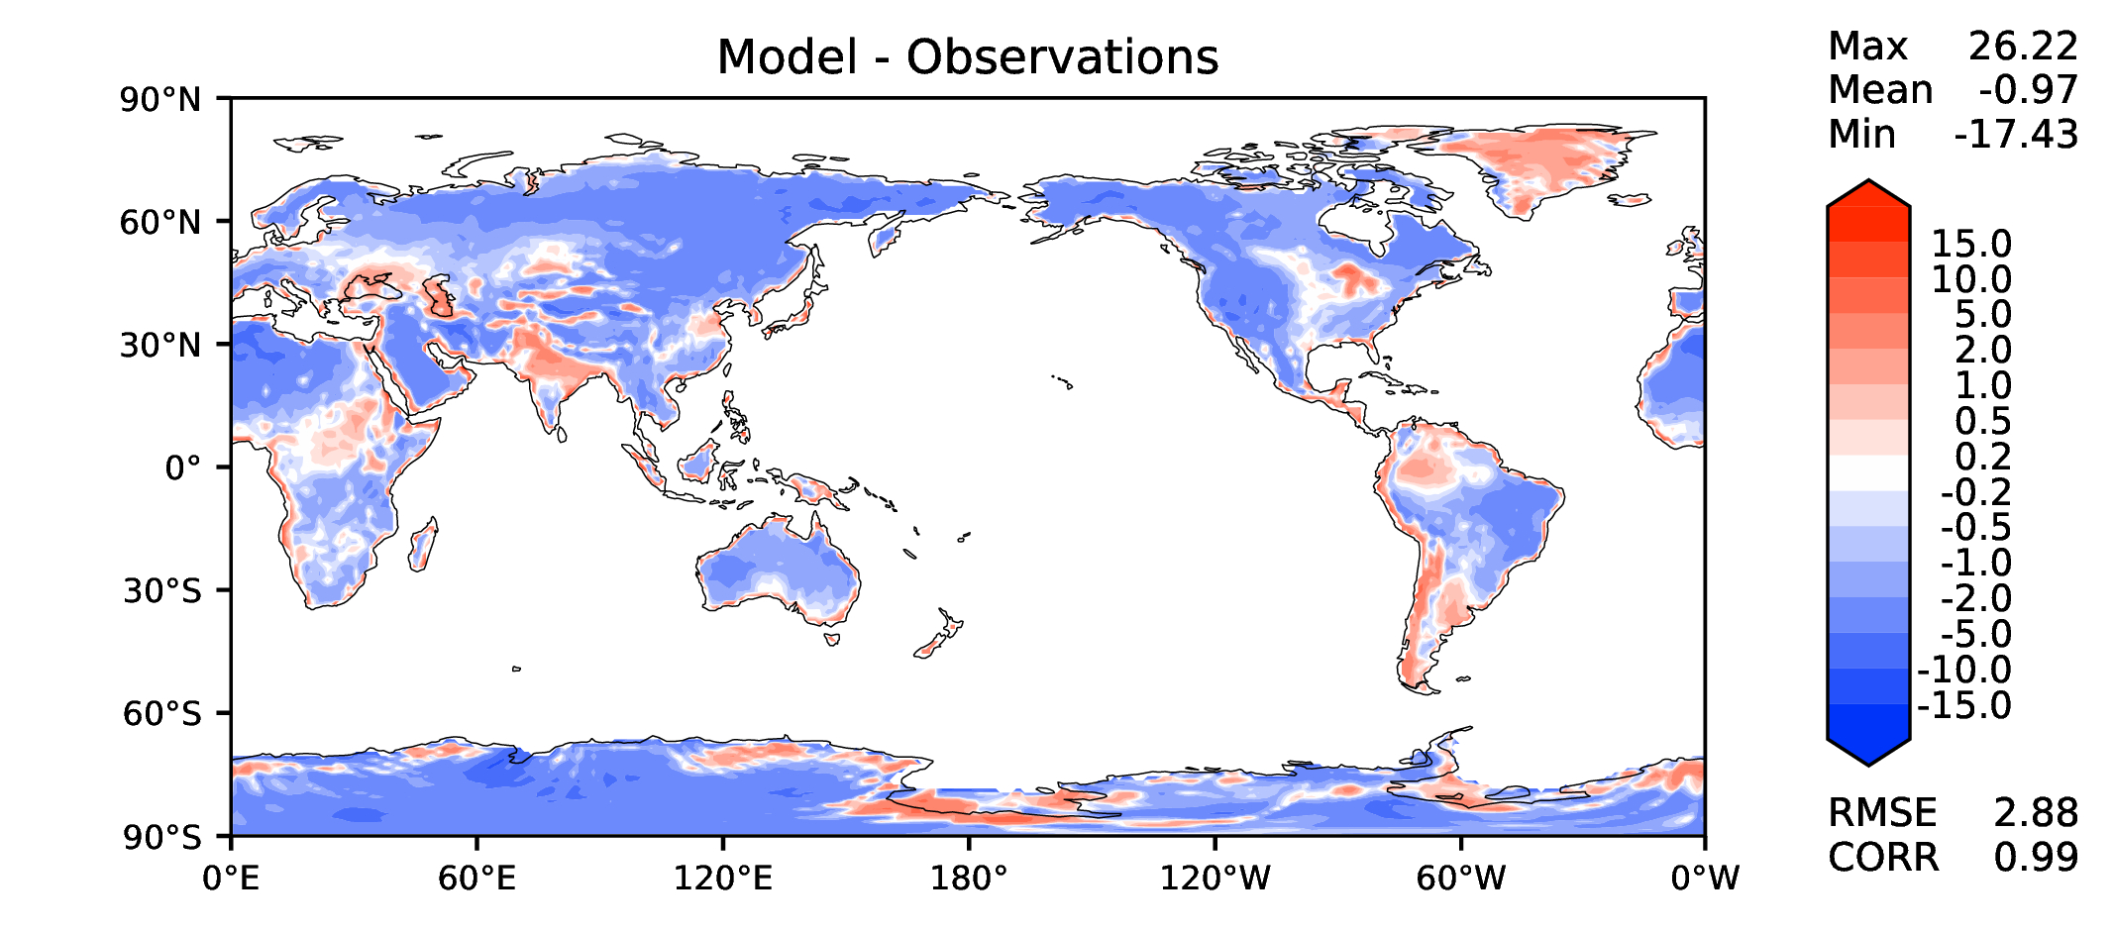
JJA surface air T (land)
DECKv1
v2beta4
v2rc1a
v2rc1c

Slide 16
Aerosol optical depth
DECKv1
v2beta4
v2rc1a
v2rc1c

Slide 17
TAUXY ANN ocean
DECKv1
v2beta4
v2rc1a
v2rc1c

Slide 18
CLDLWP_OCN global SSMI
DECKv1
v2beta4
v2rc1a
v2rc1c

