Slide 1
Summary table (RMSE vs obs)
Variable | Season | DECKv1 | v2beta4 | v2rc1a | v2rc1c
SST | ANN | 1.06 | 0.91 | 0.96 | 0.96
PRECT | ANN | 1.12 | 0.95 | 0.97 | 0.91
PRECT | DJF | 1.43 | 1.32 | 1.31 | 1.25
PRECT | MAM | 1.52 | 1.09 | 1.08 | 1.04
PRECT | JJA | 1.52 | 1.31 | 1.31 | 1.25
PRECT | SON | 1.28 | 1.27 | 1.28 | 1.23
RESTOM | ANN | 9.31 | 8.23 | 8.14 | 8.16
SWCF | ANN | 10.59 | 9.85 | 9.85 | 9.70
LWCF | ANN | 5.28 | 5.08 | 5.08 | 4.91
u850 | ANN | 1.29 | 1.21 | 1.20 | 1.19
u200 | ANN | 2.18 | 2.74 | 2.73 | 2.59
T200 | ANN | 2.64 | 2.61 | 2.77 | 2.89
TREFHT | ANN | 2.59 | 2.83 | 2.92 | 2.92
TREFHT | JJA | 2.88 | 3.16 | 3.22 | 3.14
AODVIS | ANN | 0.07 | 0.06 | 0.06 | 0.06
TAUXY | ANN | 0.02 | 0.02 | 0.02 | 0.02
CLDLWP_OCN | ANN | 43.83 | 39.30 | 39.33 | 42.62

Slide 2
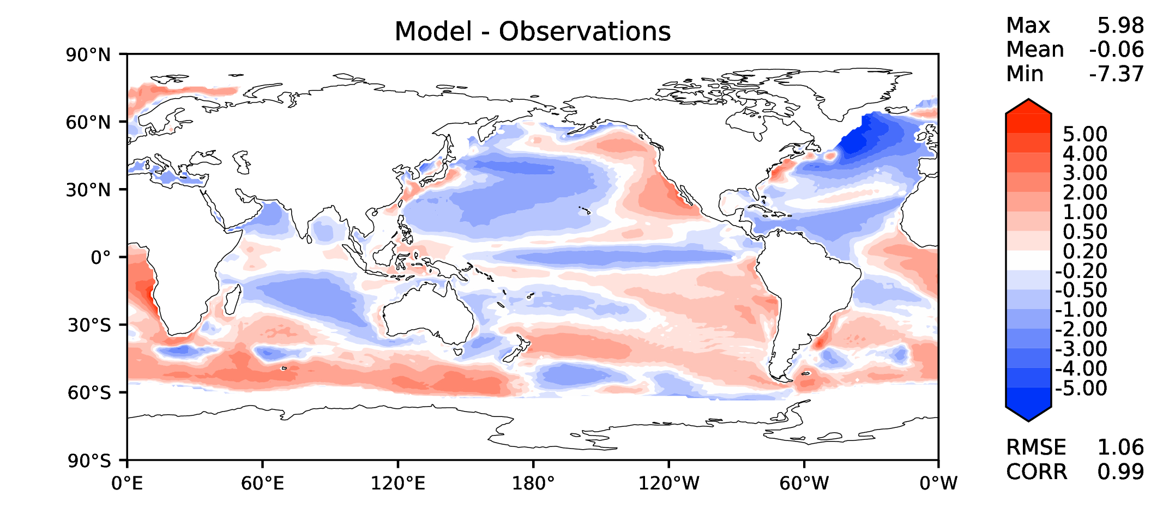
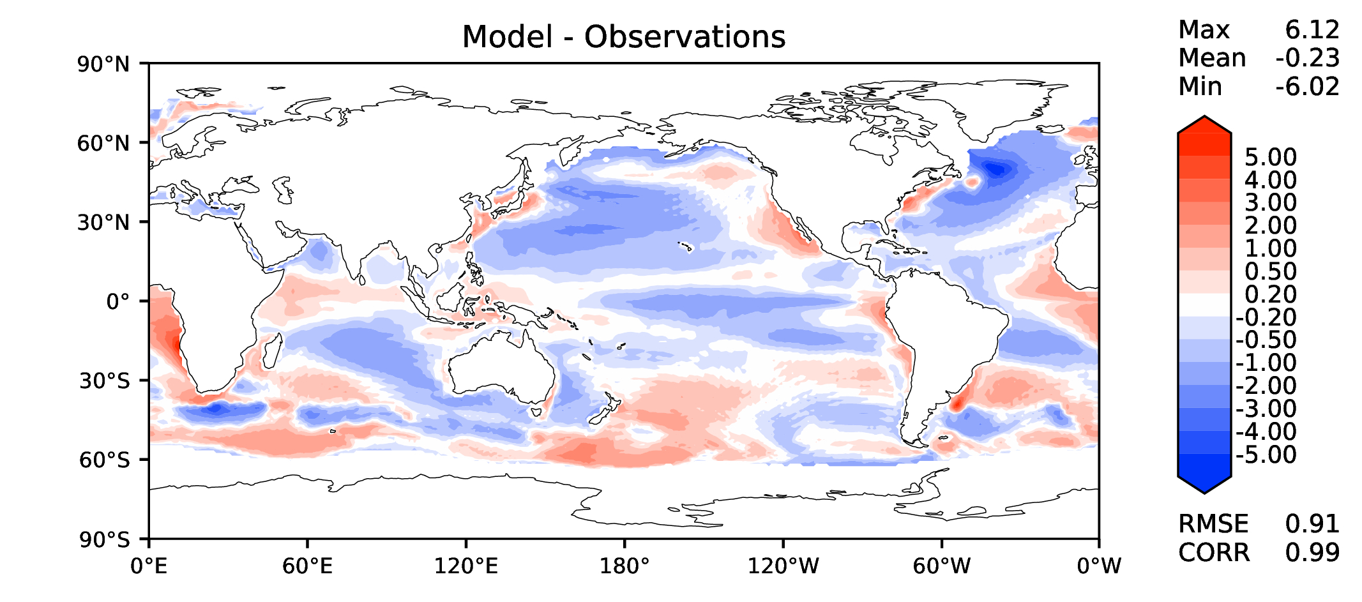
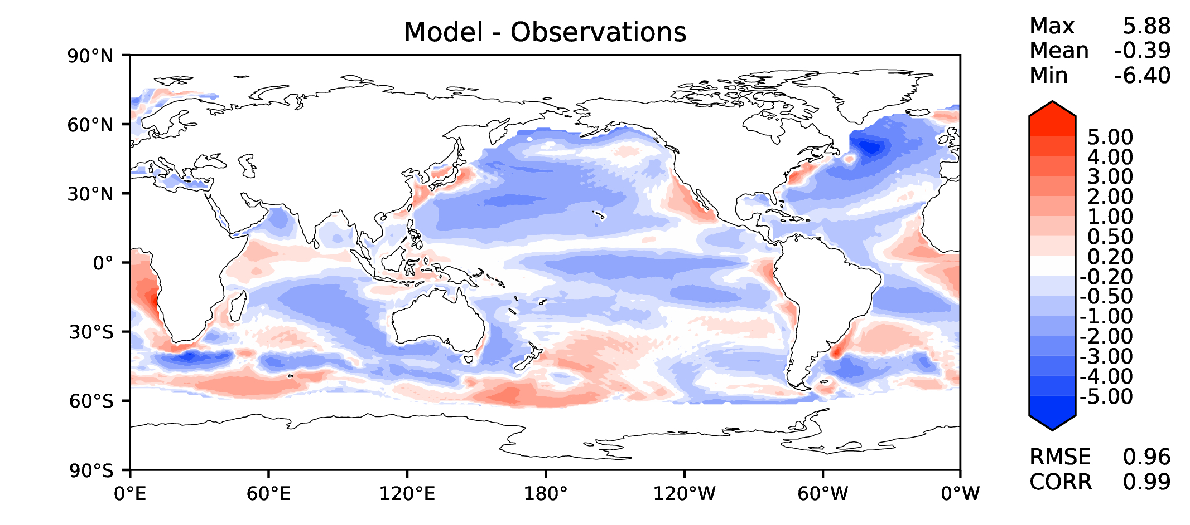
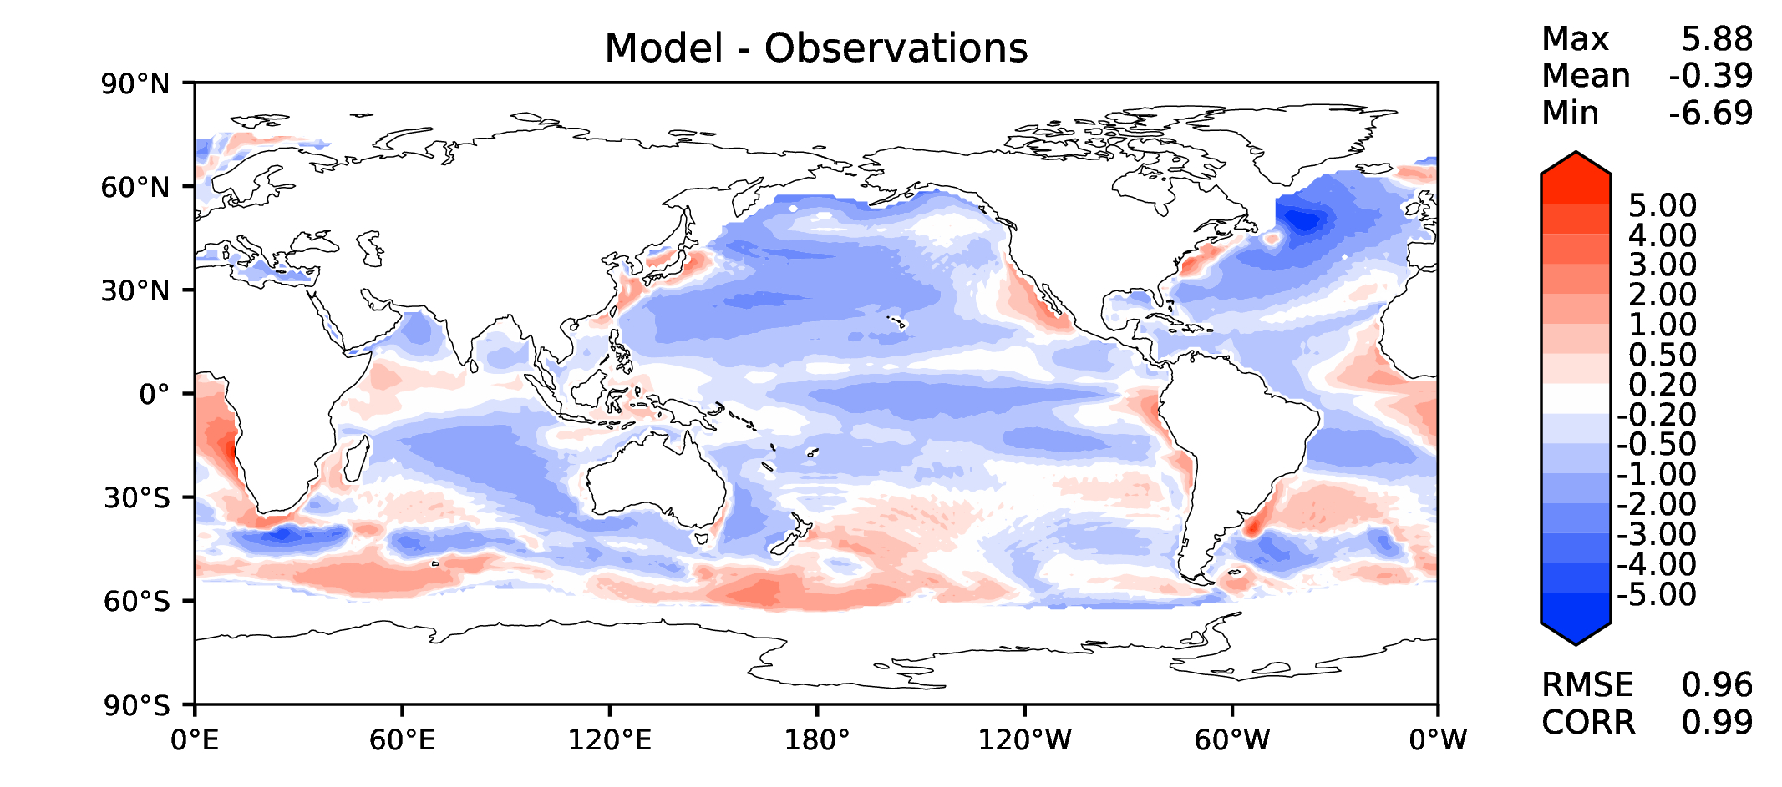
Annual SST (pre-industrial)
DECKv1
v2beta4
v2rc1a
v2rc1c

Slide 3
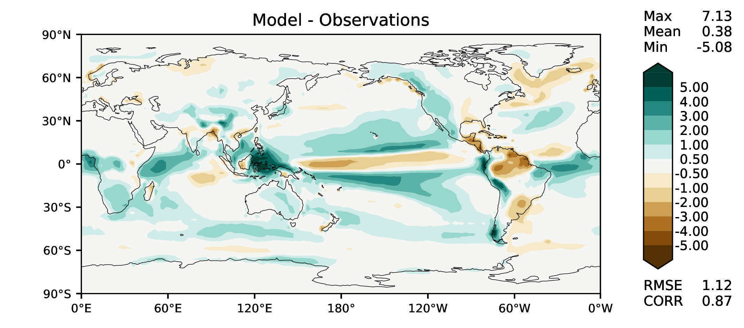
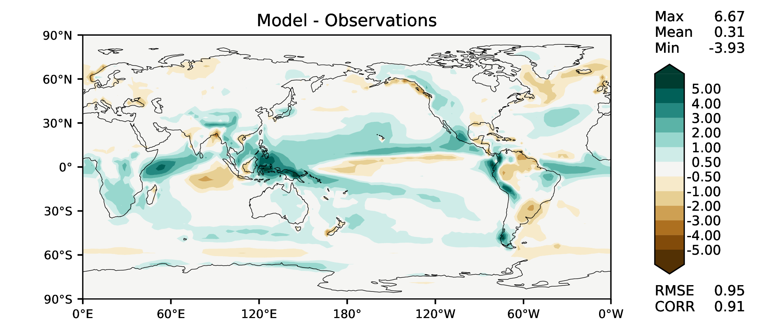
Annual total precipitation
DECKv1
v2beta4
v2rc1a
v2rc1c

Slide 4
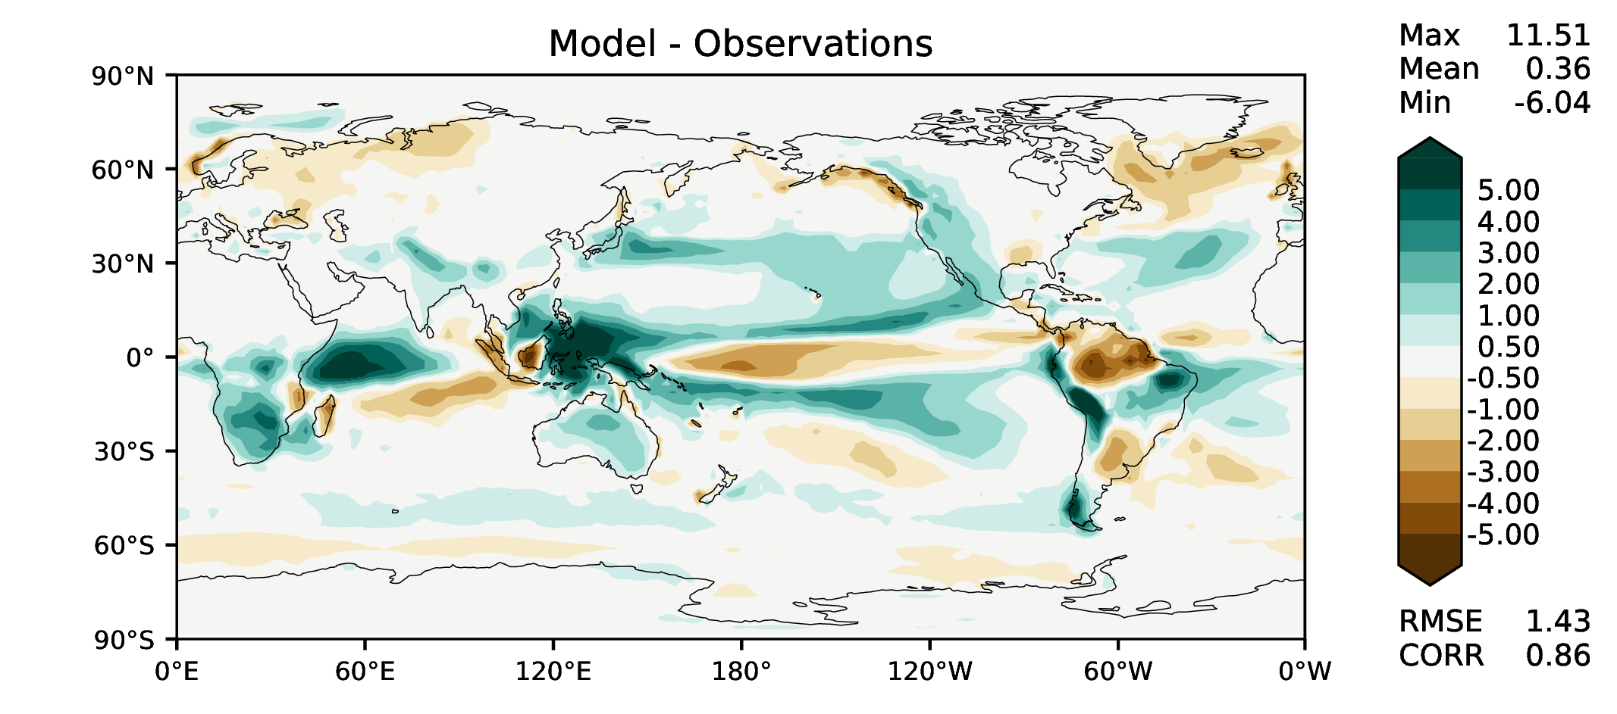
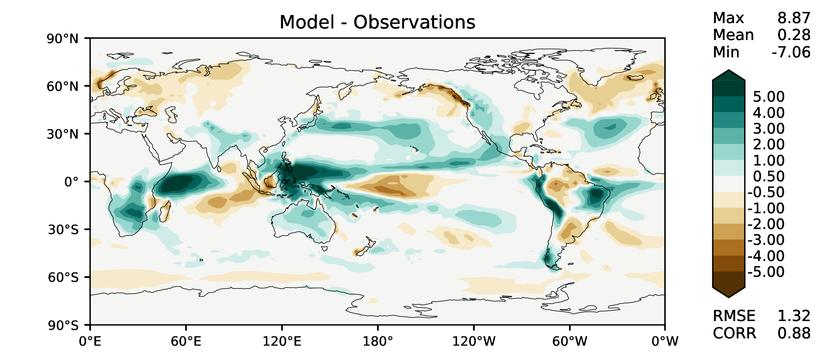
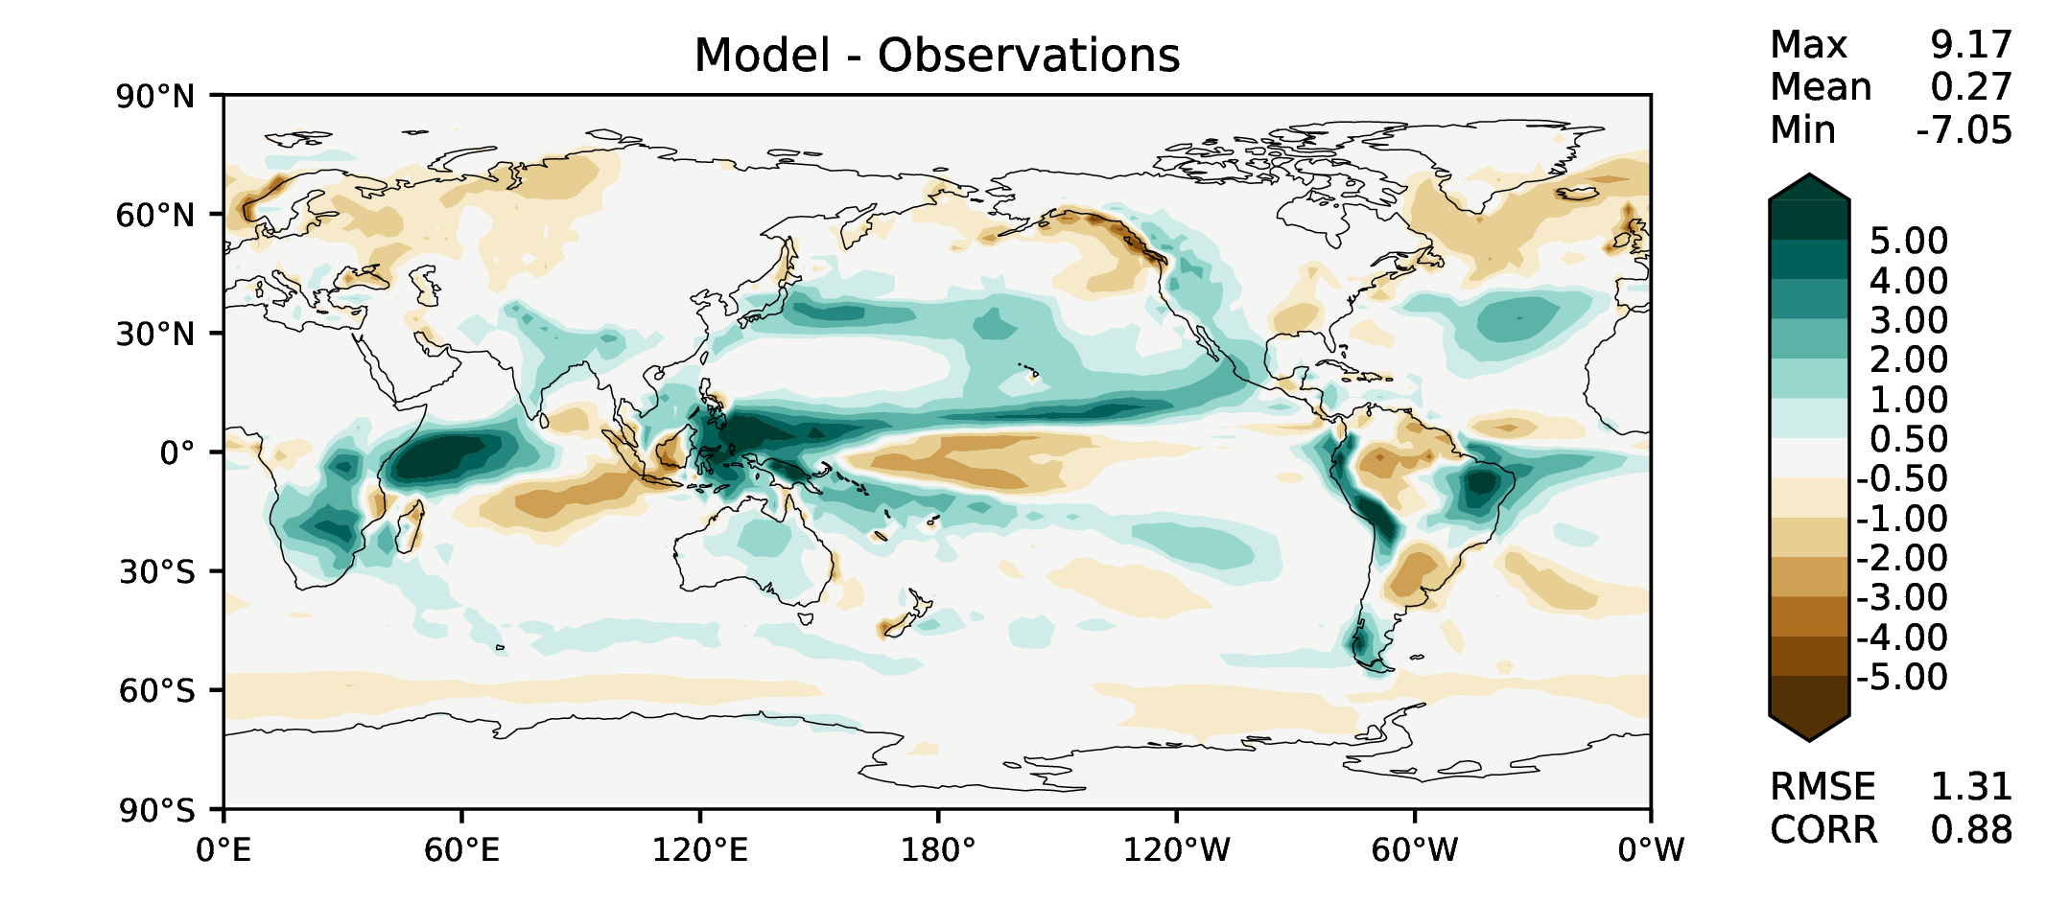
DJF total precipitation
DECKv1
v2beta4
v2rc1a
v2rc1c

Slide 5
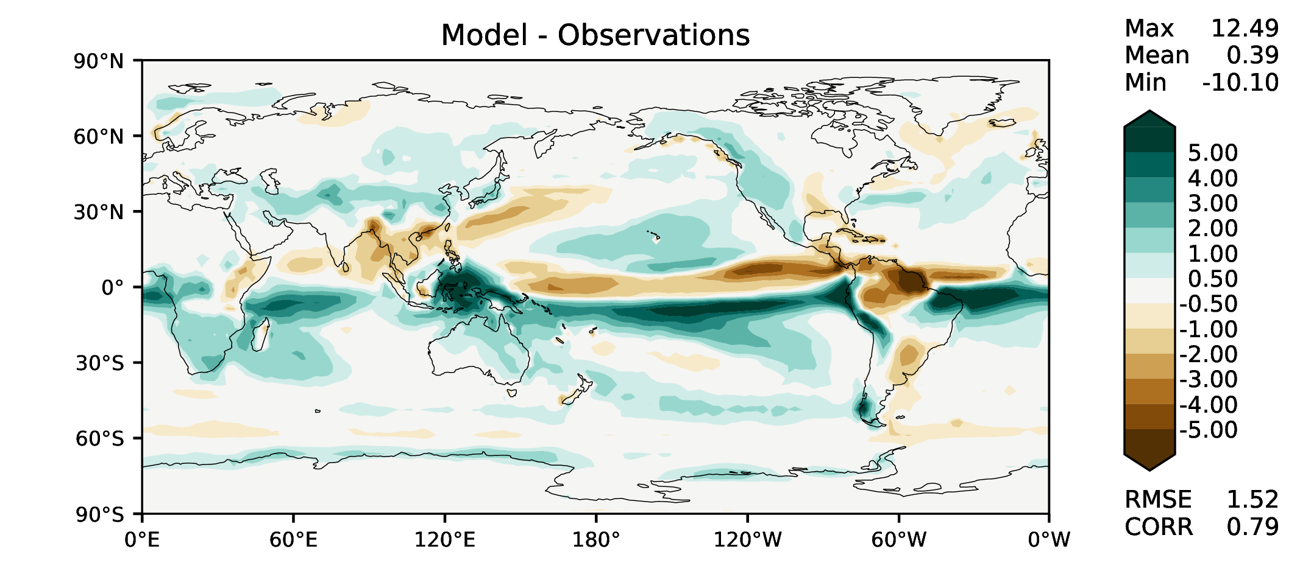
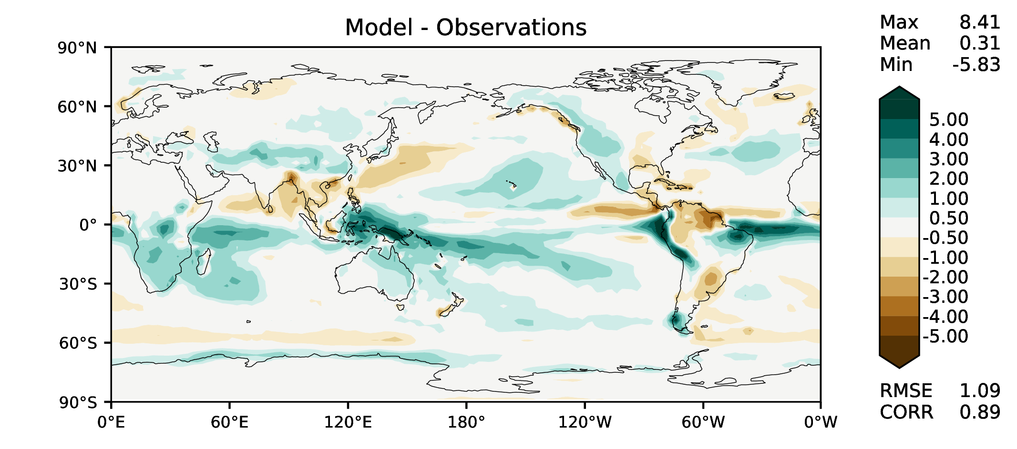
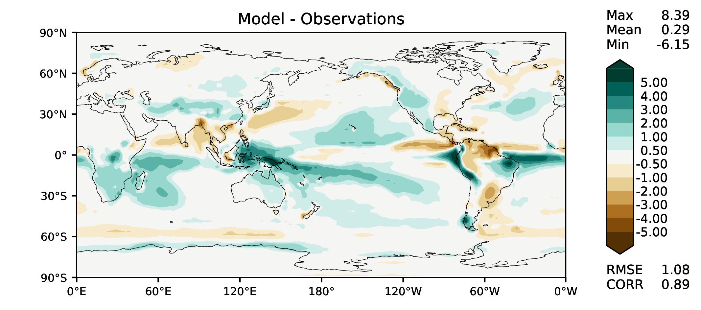
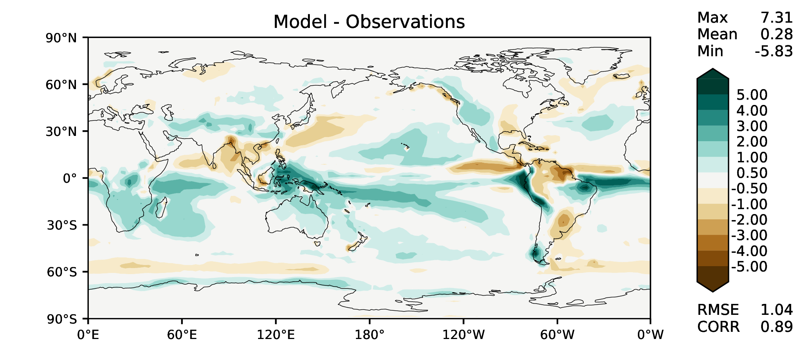
MAM total precipitation
DECKv1
v2beta4
v2rc1a
v2rc1c

Slide 6
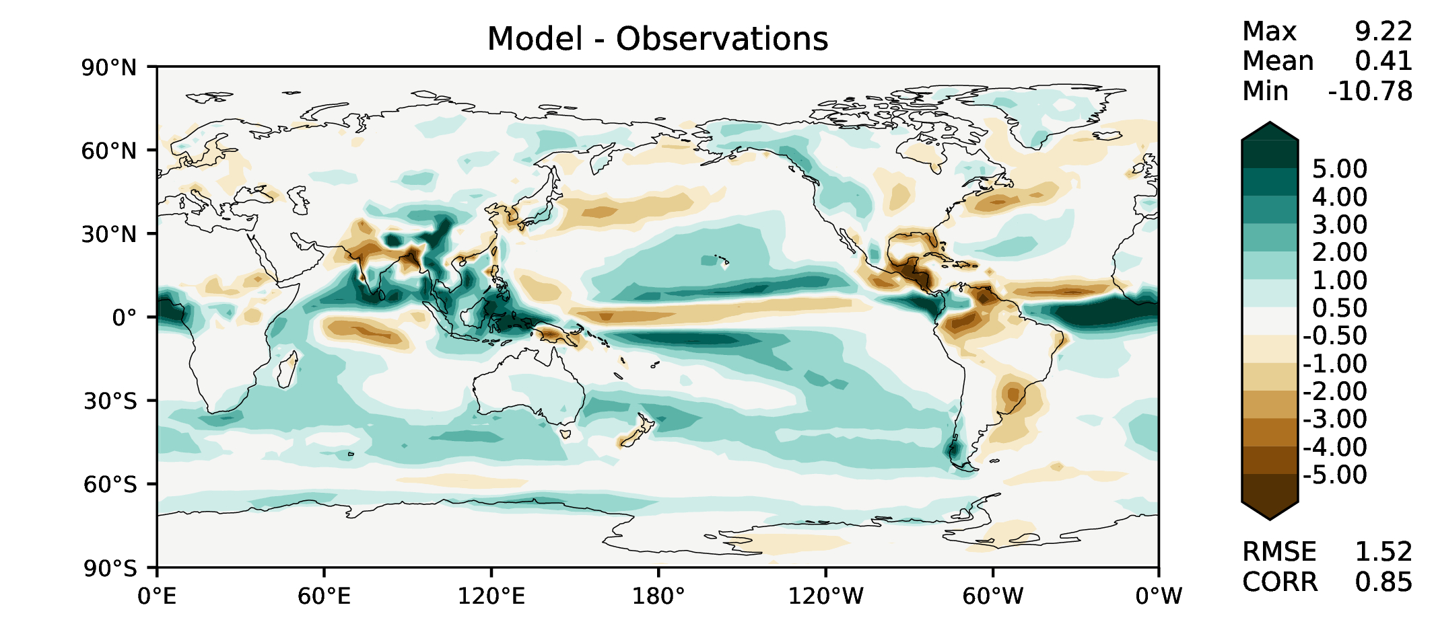
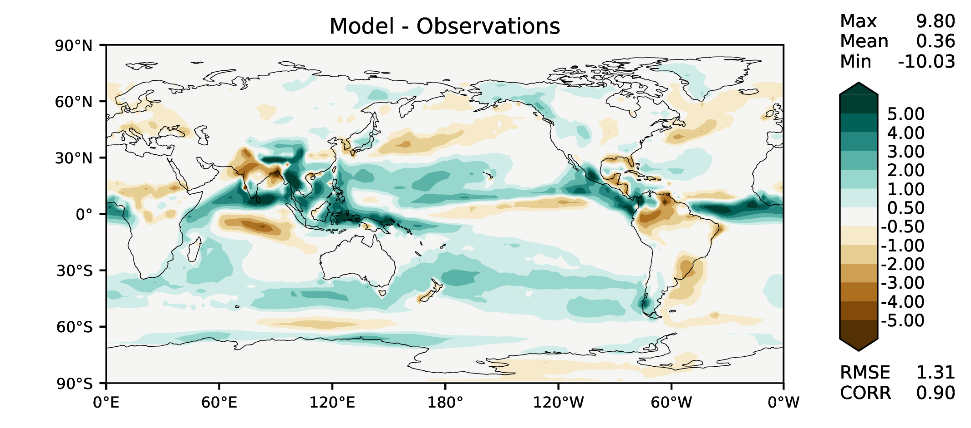
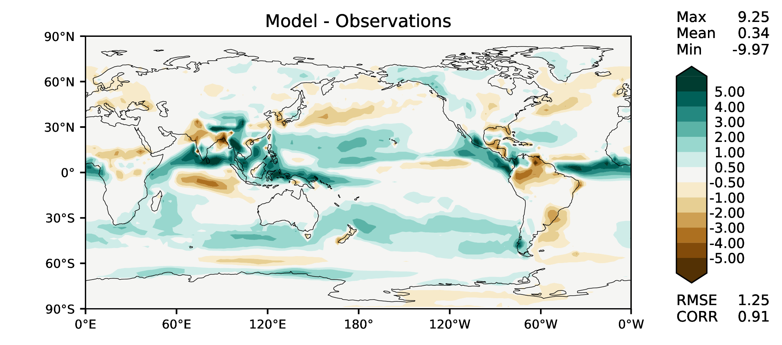
JJA total precipitation
DECKv1
v2beta4
v2rc1a
v2rc1c

Slide 7
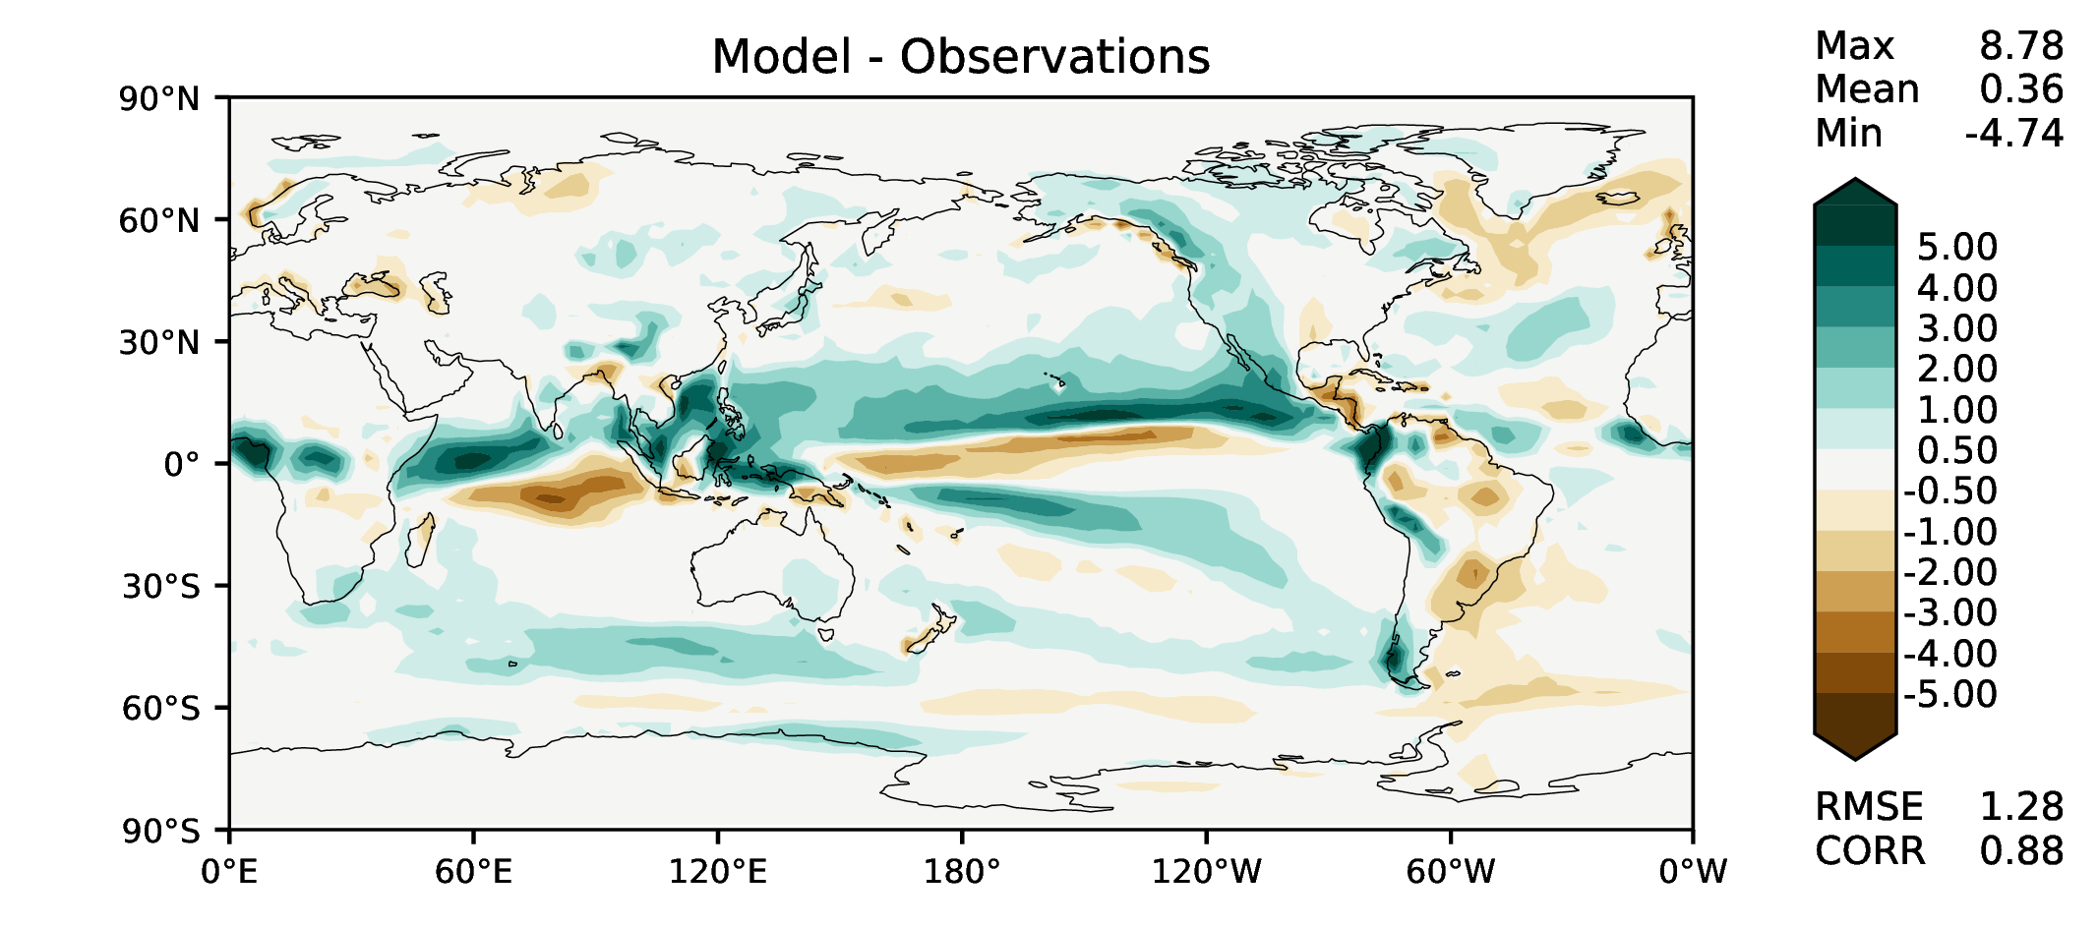
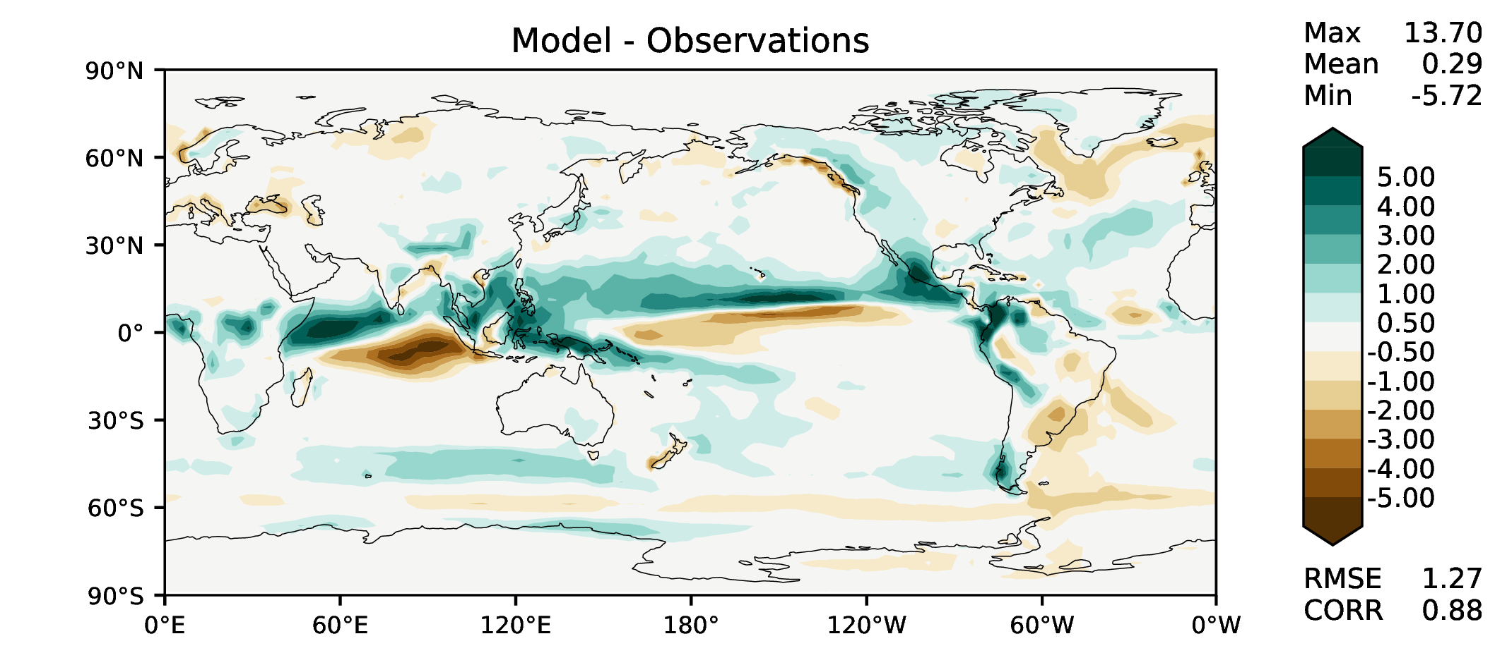
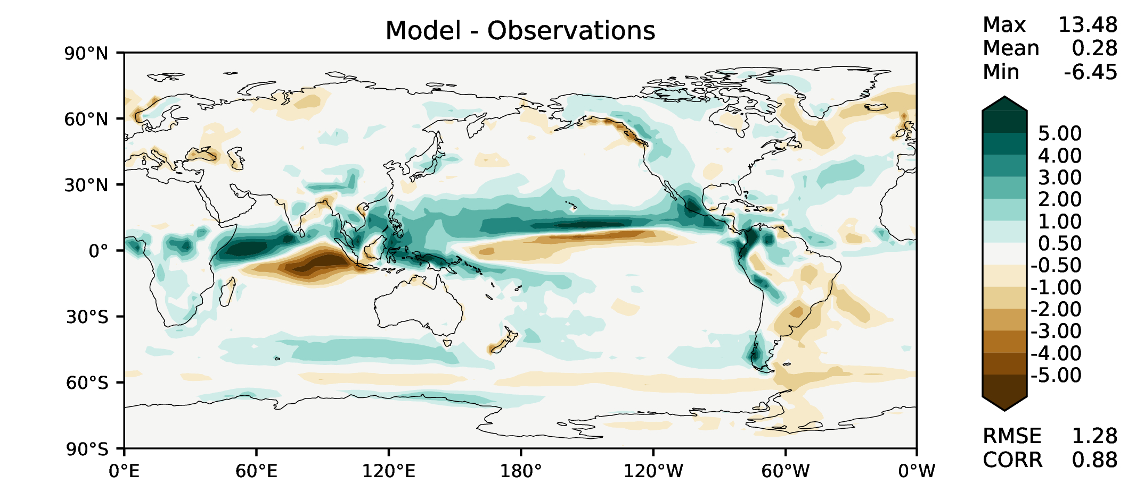
SON total precipitation
DECKv1
v2beta4
v2rc1a
v2rc1c

Slide 8
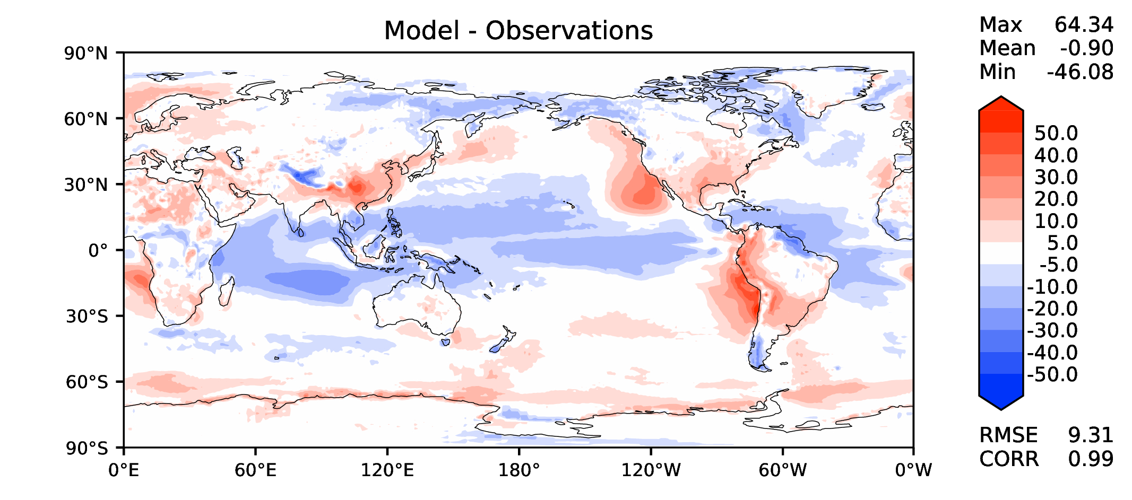
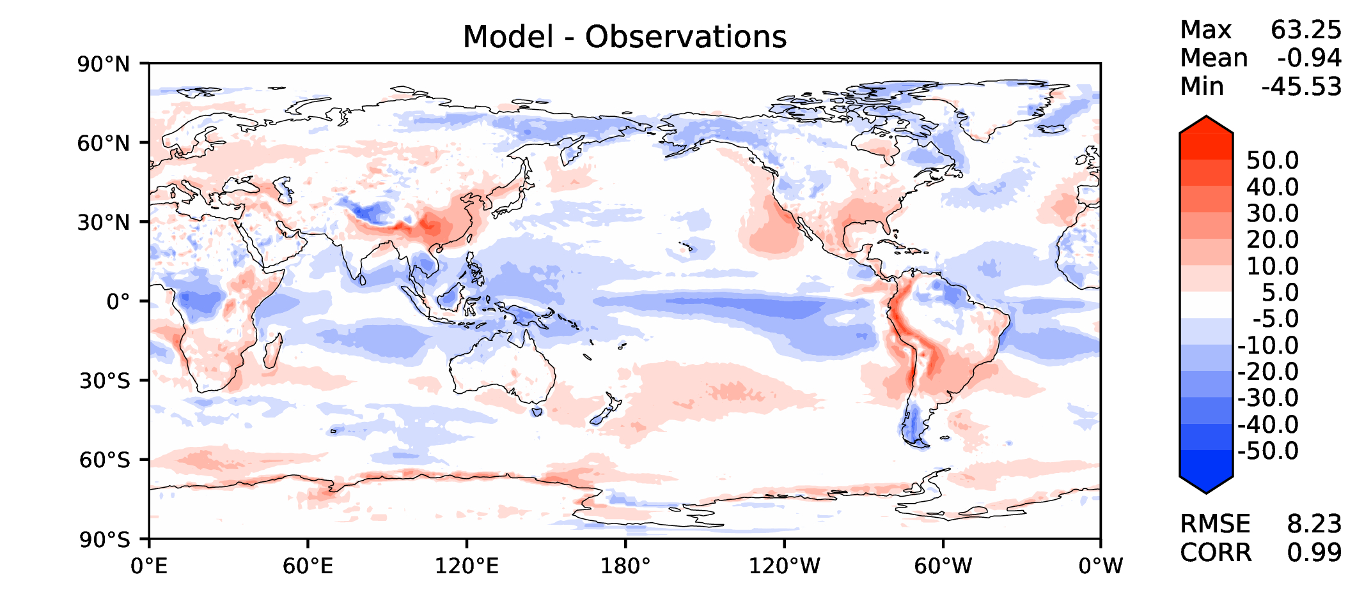
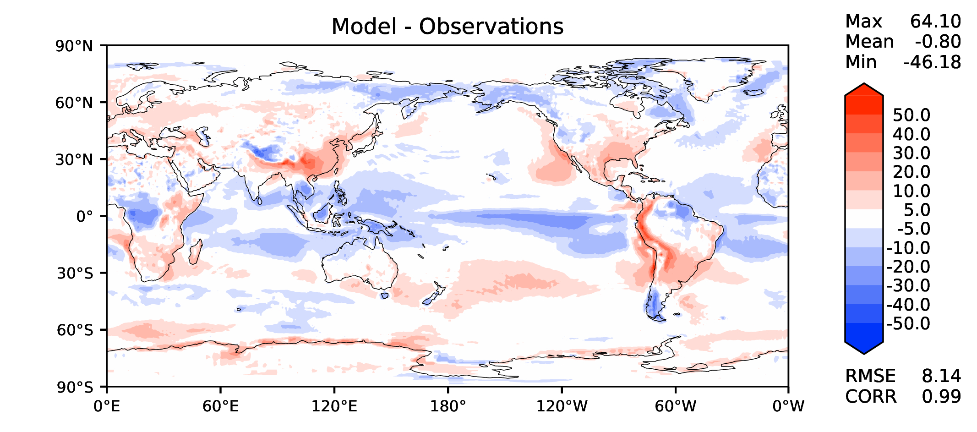
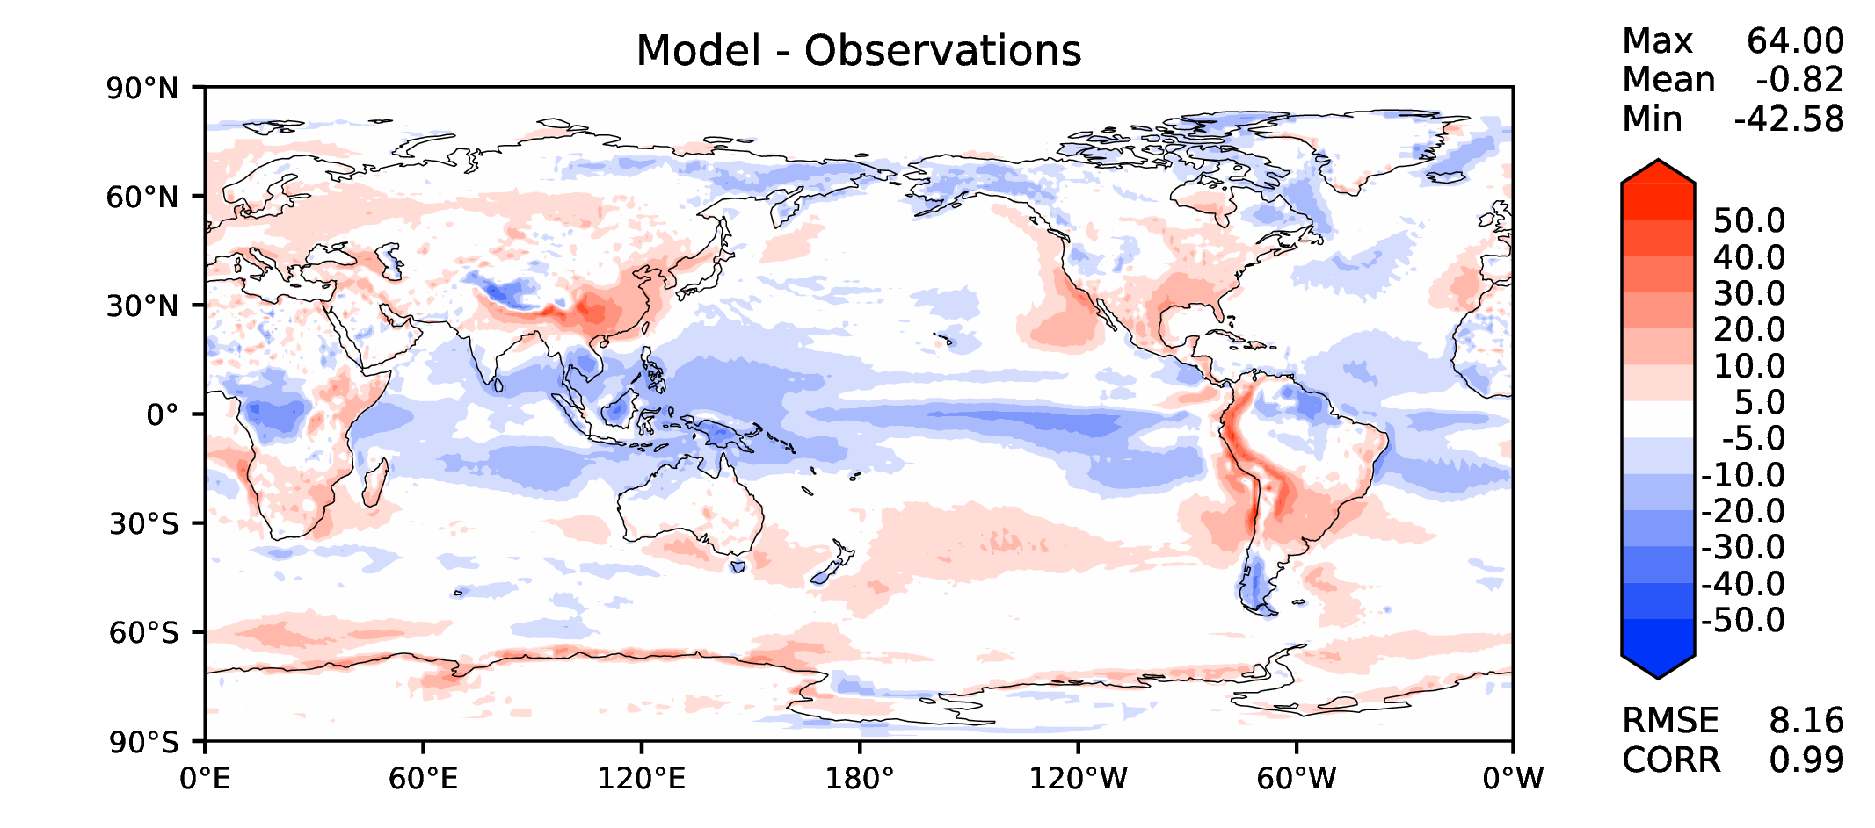
Annual TOA net radiation
DECKv1
v2beta4
v2rc1a
v2rc1c

Slide 9
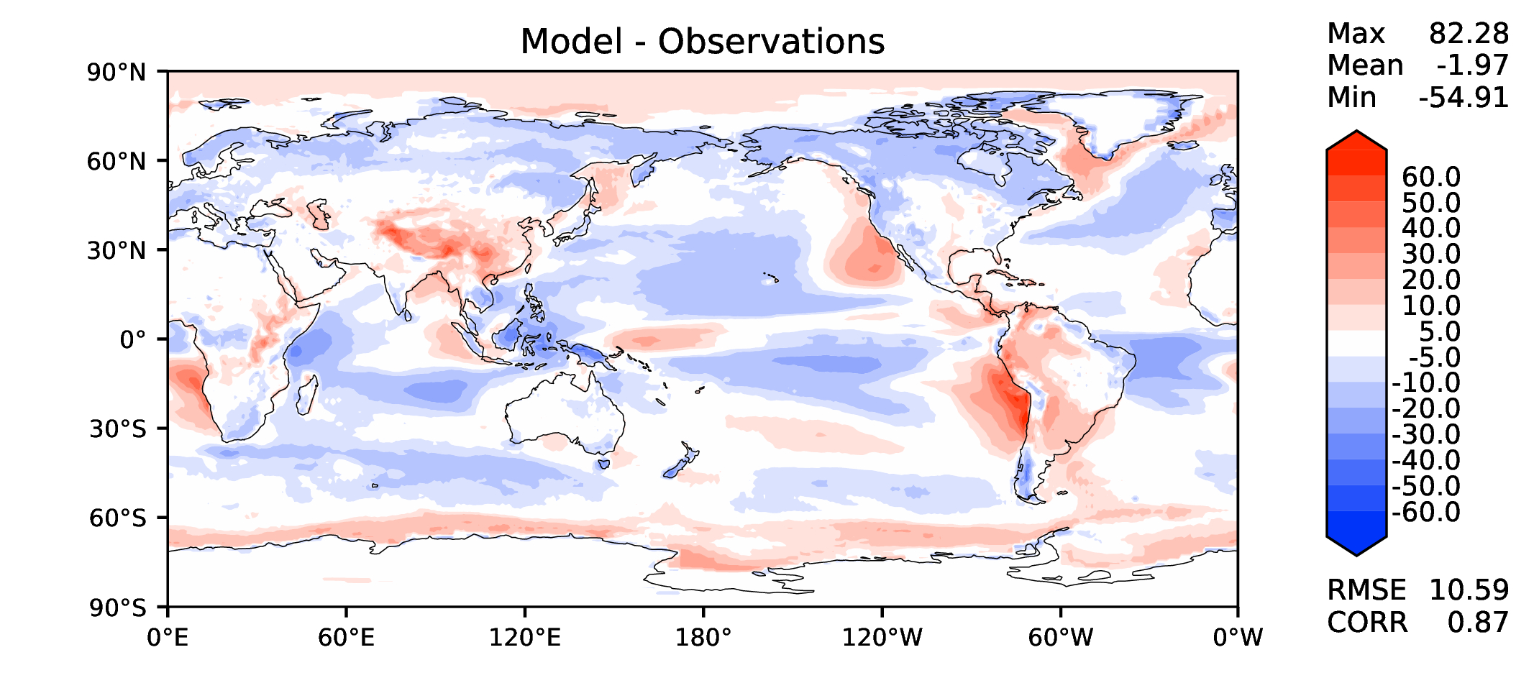
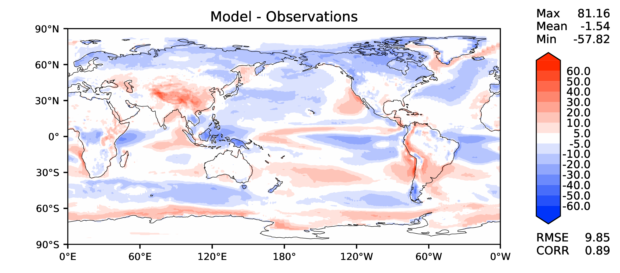
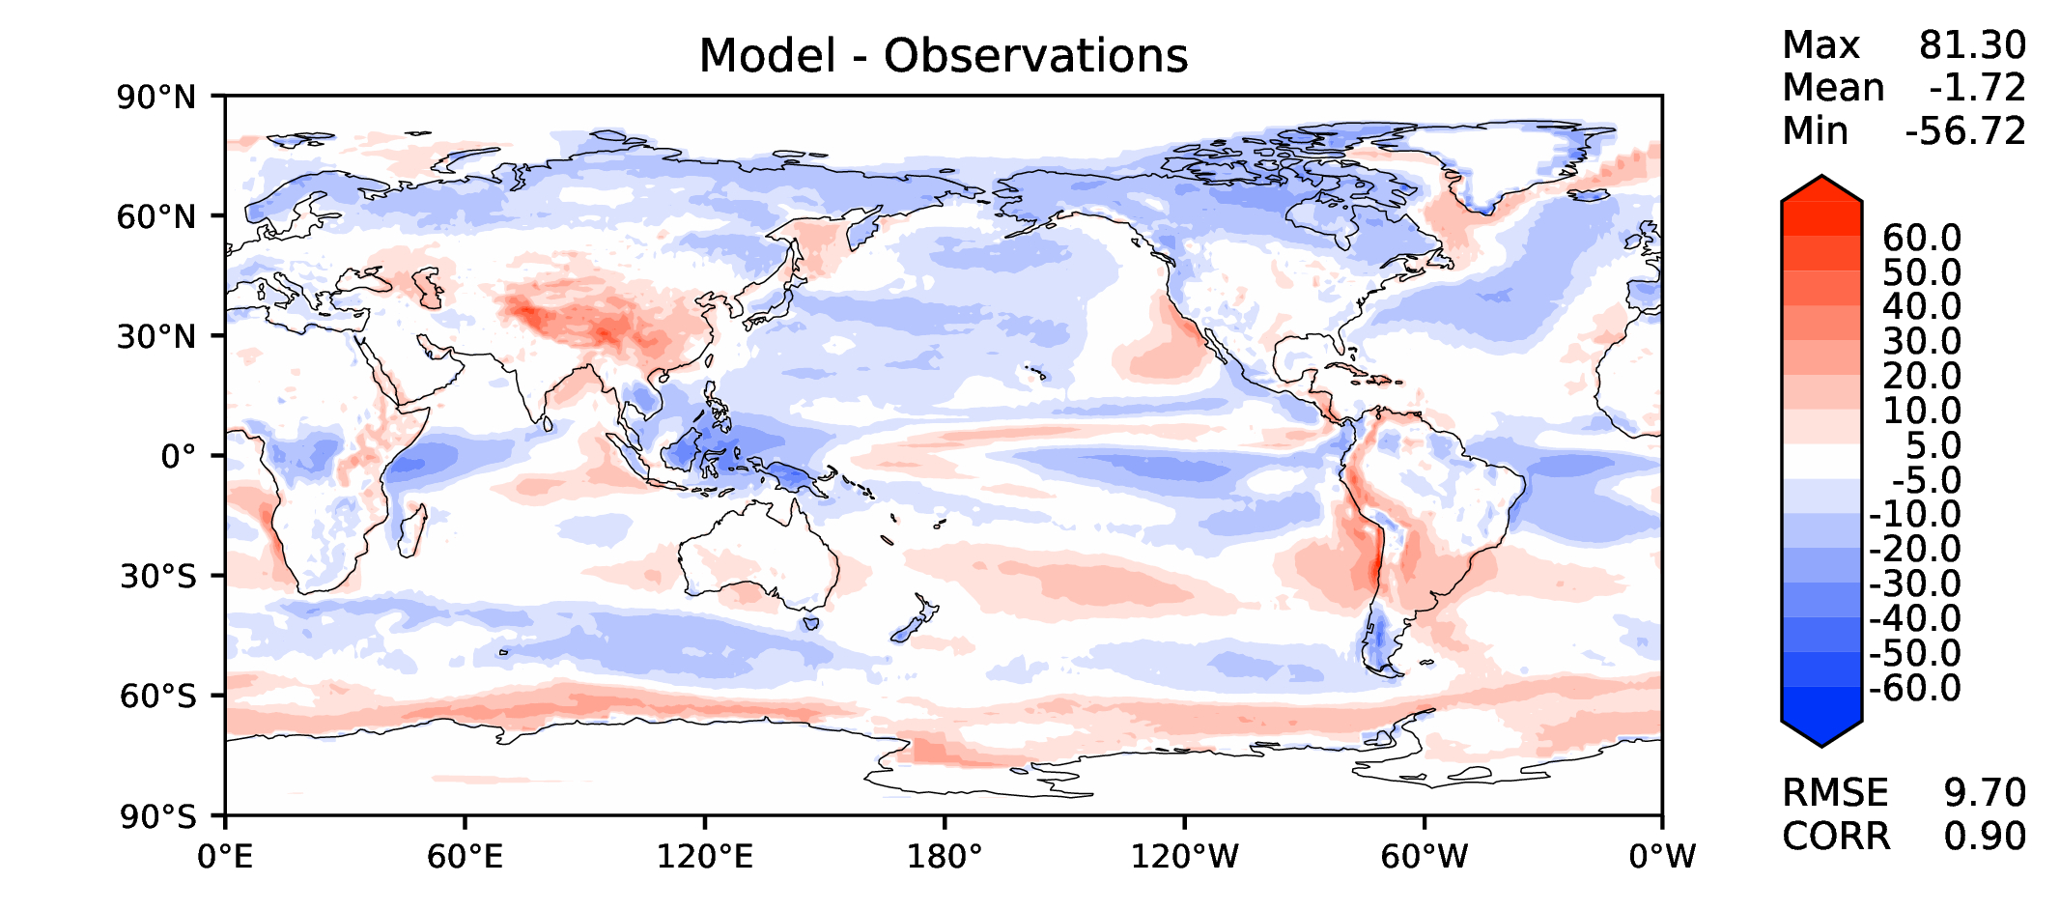
Annual TOA SW CRE
DECKv1
v2beta4
v2rc1a
v2rc1c

Slide 10
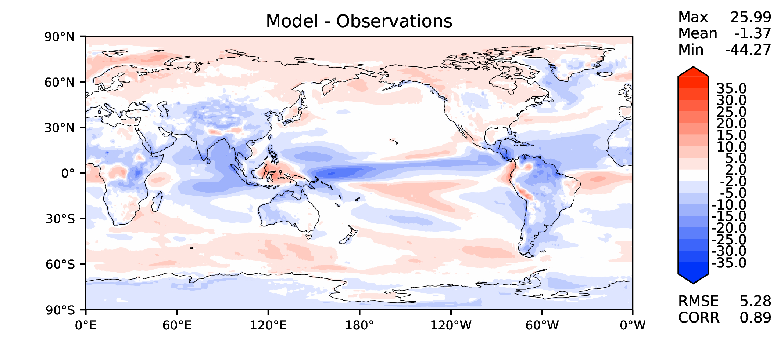
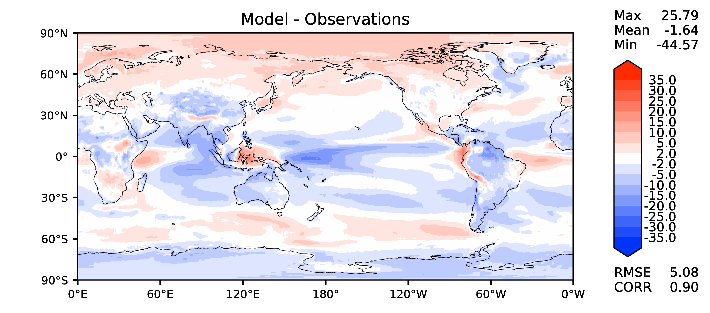
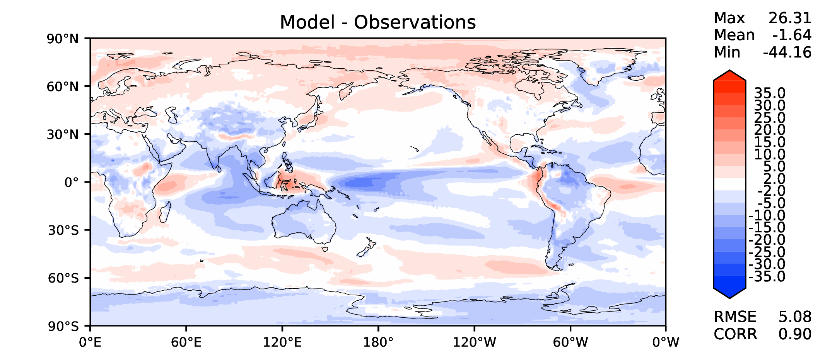
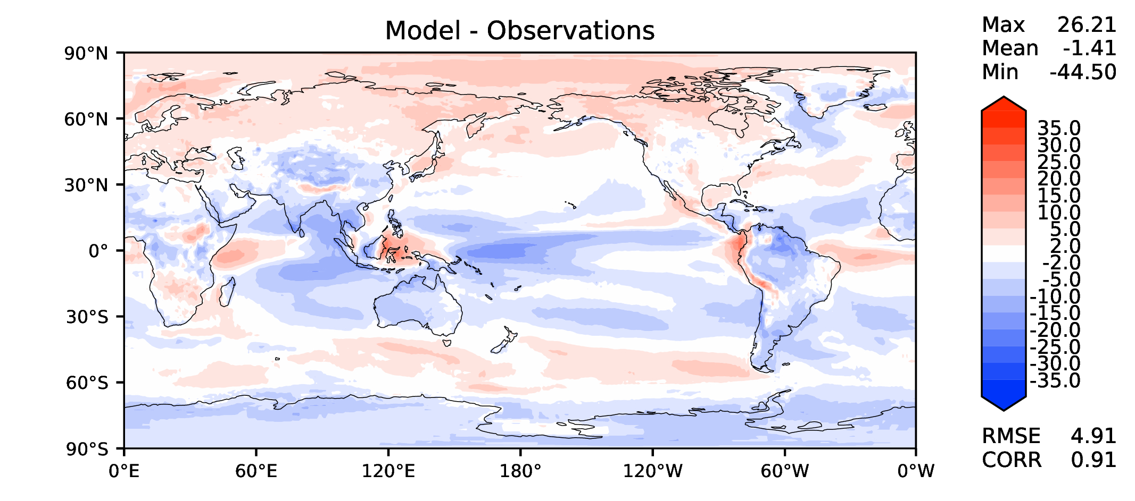
Annual TOA LW CRE
DECKv1
v2beta4
v2rc1a
v2rc1c

Slide 11
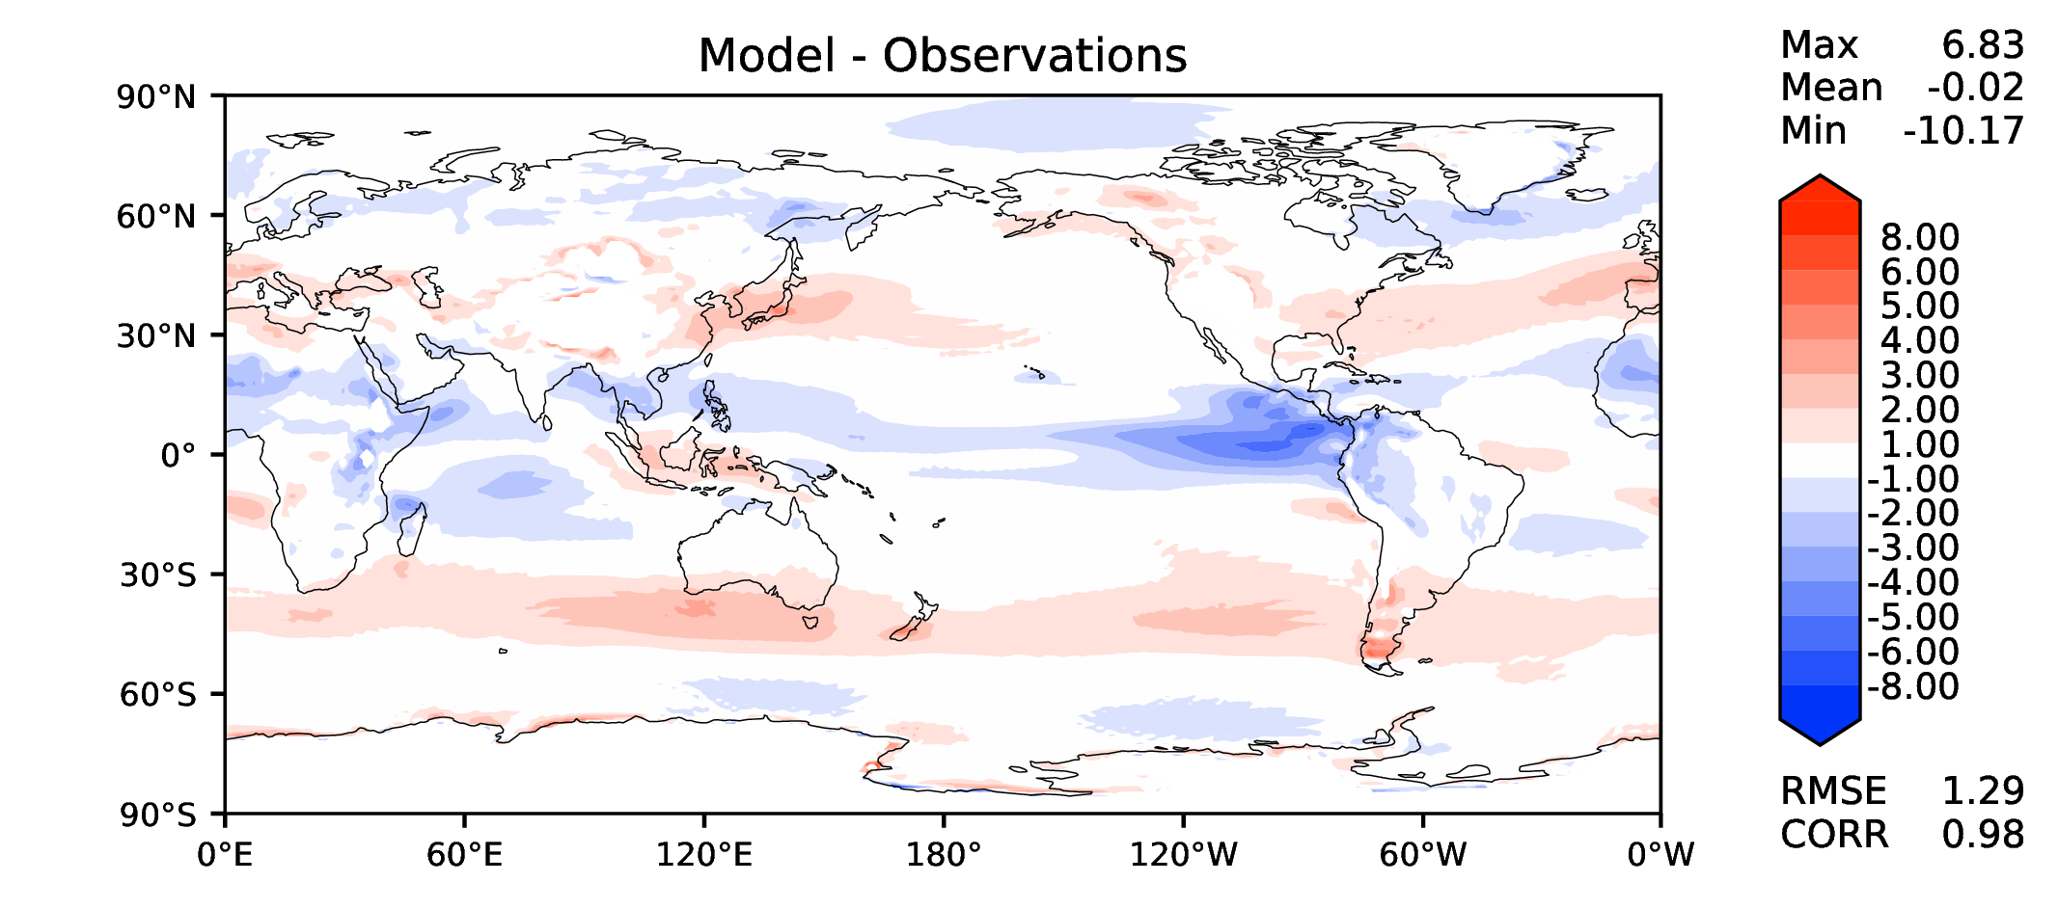
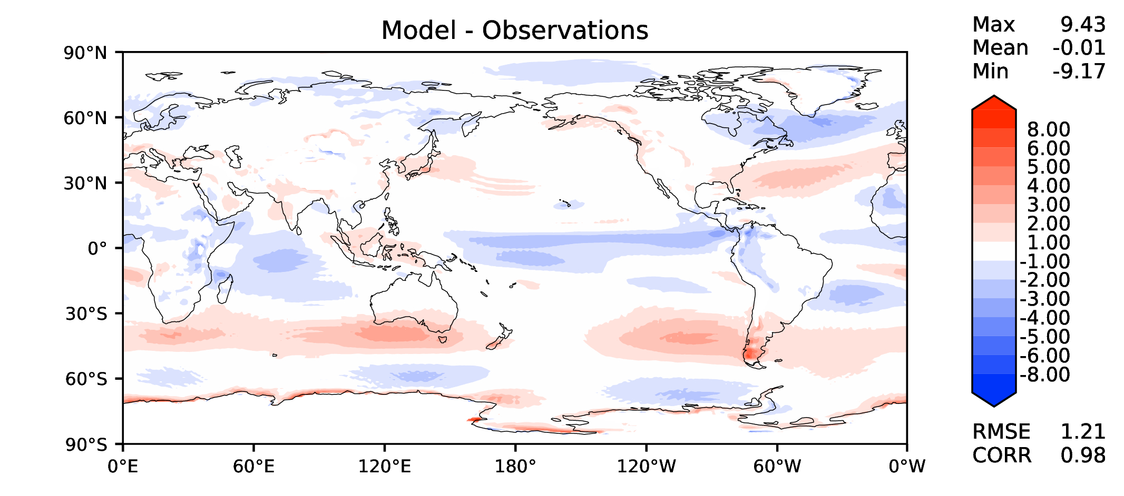
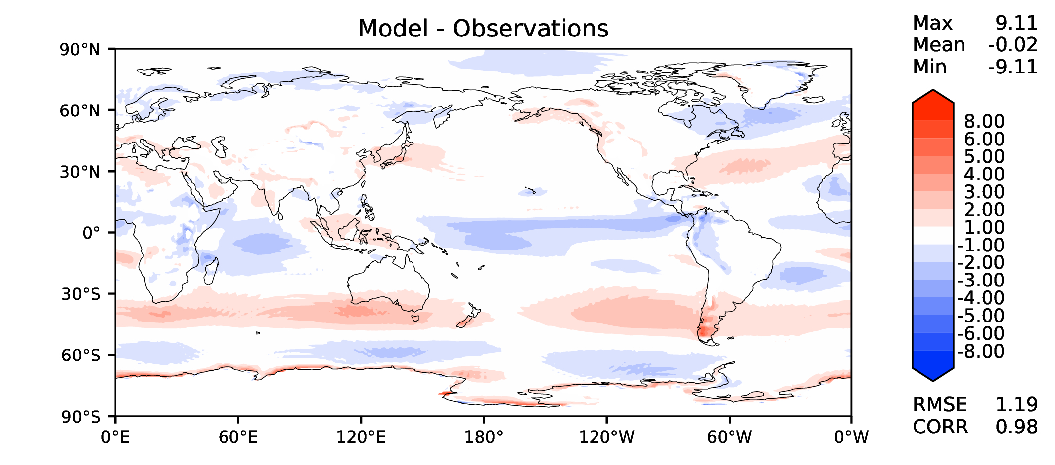
Annual u wind at 850 hPa
DECKv1
v2beta4
v2rc1a
v2rc1c

Slide 12
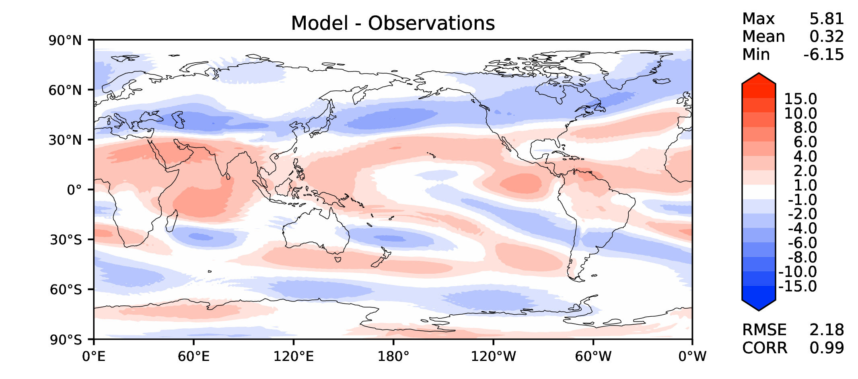
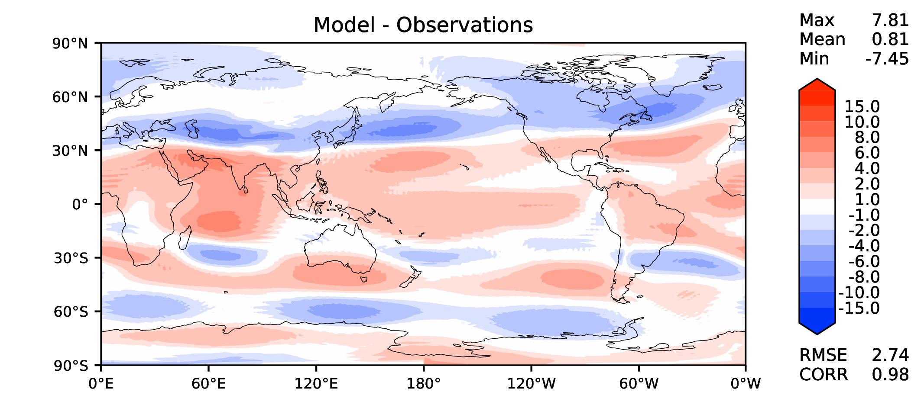
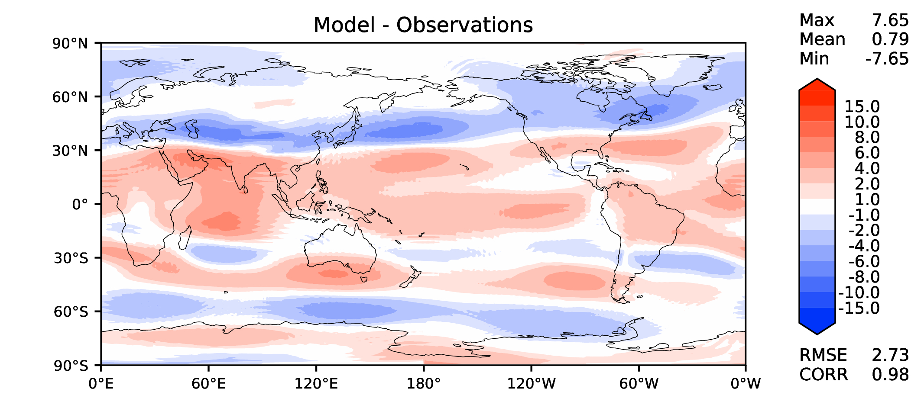
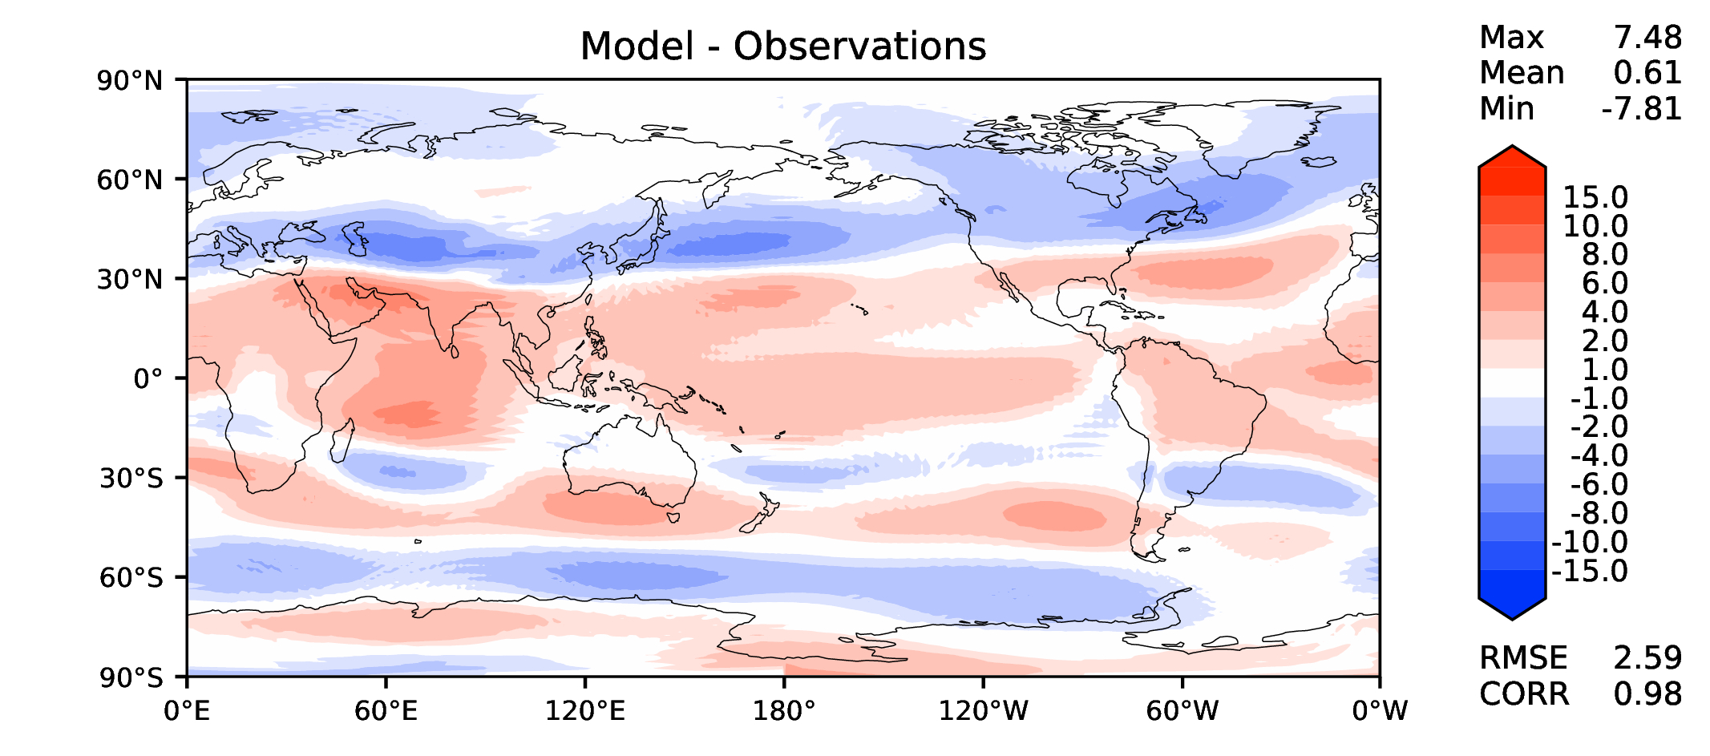
Annual u wind at 200 hPa
DECKv1
v2beta4
v2rc1a
v2rc1c

Slide 13
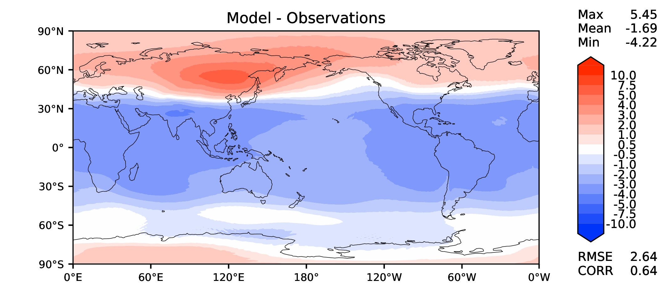
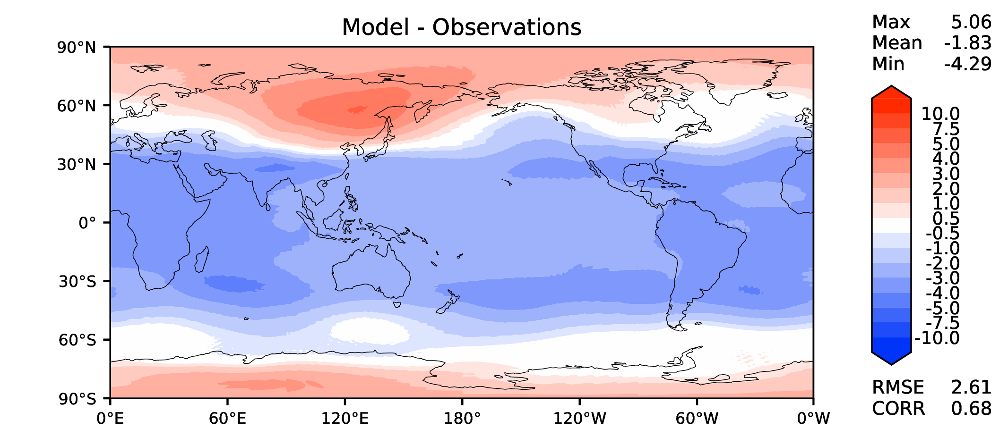
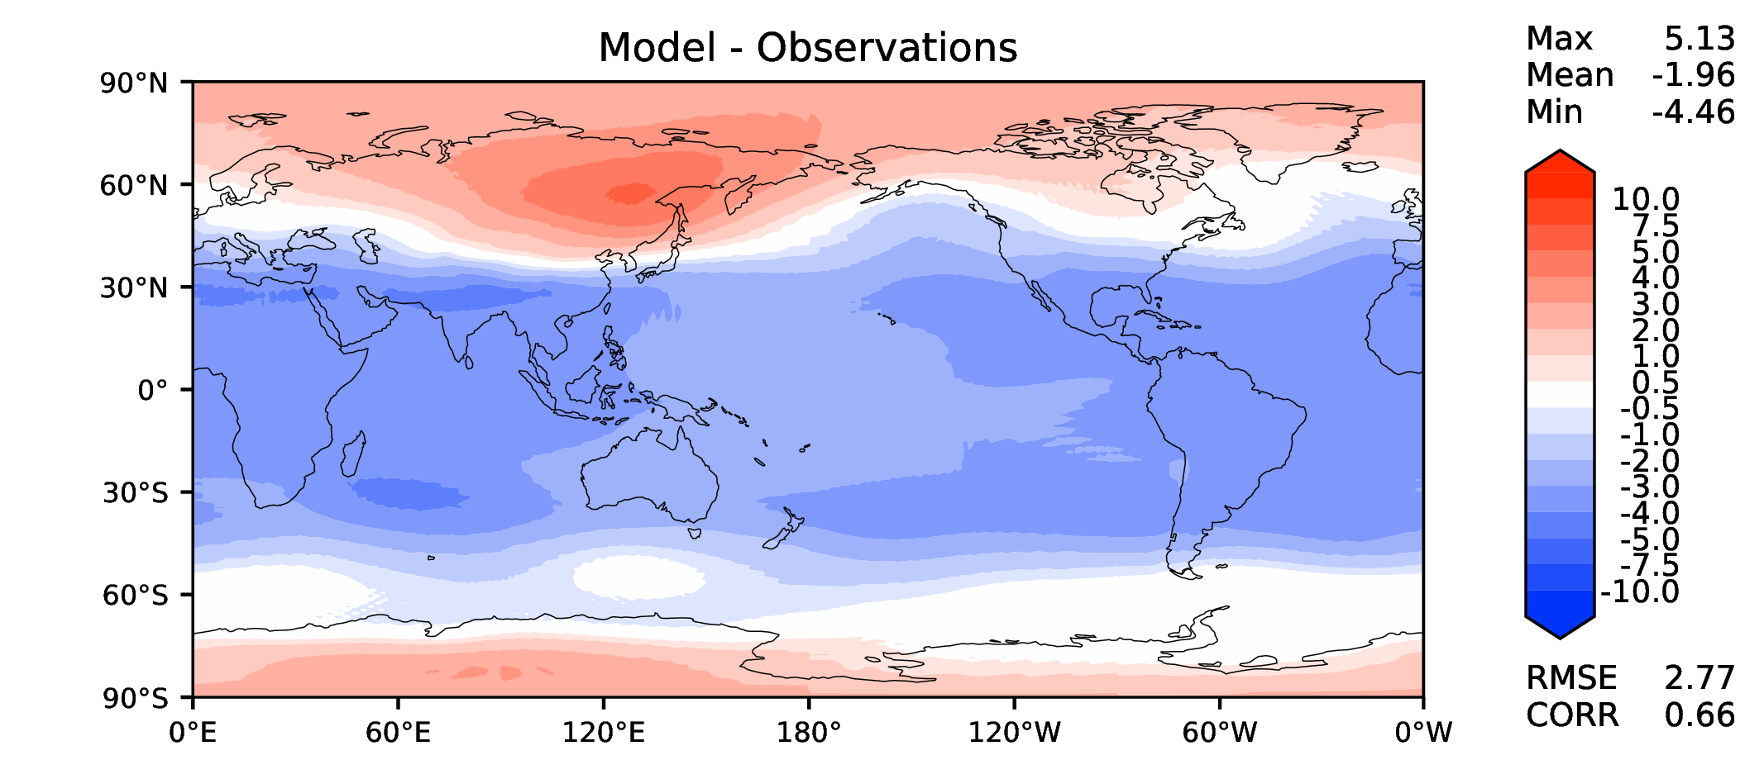
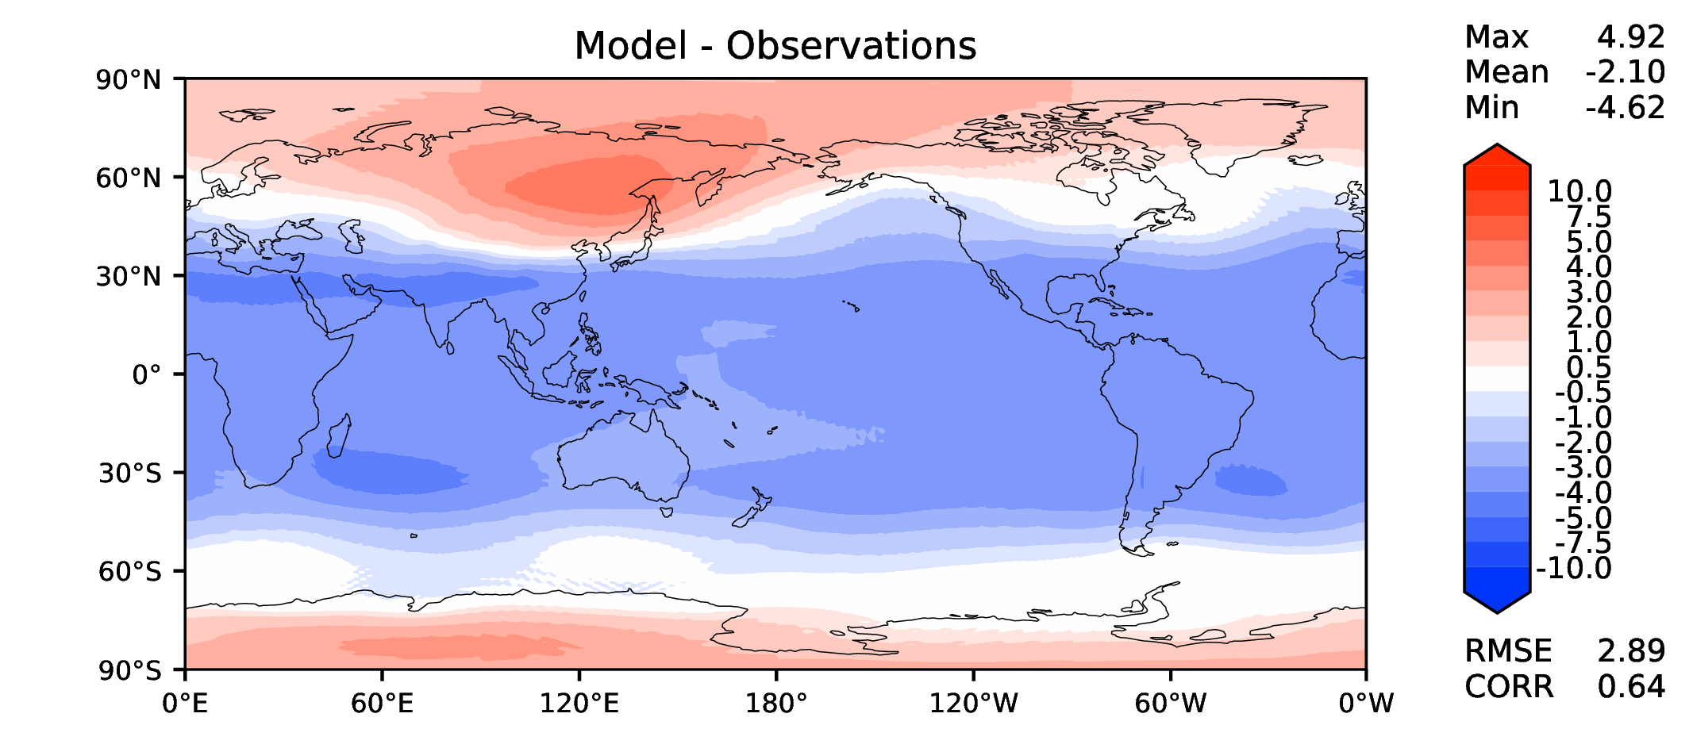
Annual T at 200 hPa
DECKv1
v2beta4
v2rc1a
v2rc1c

Slide 14
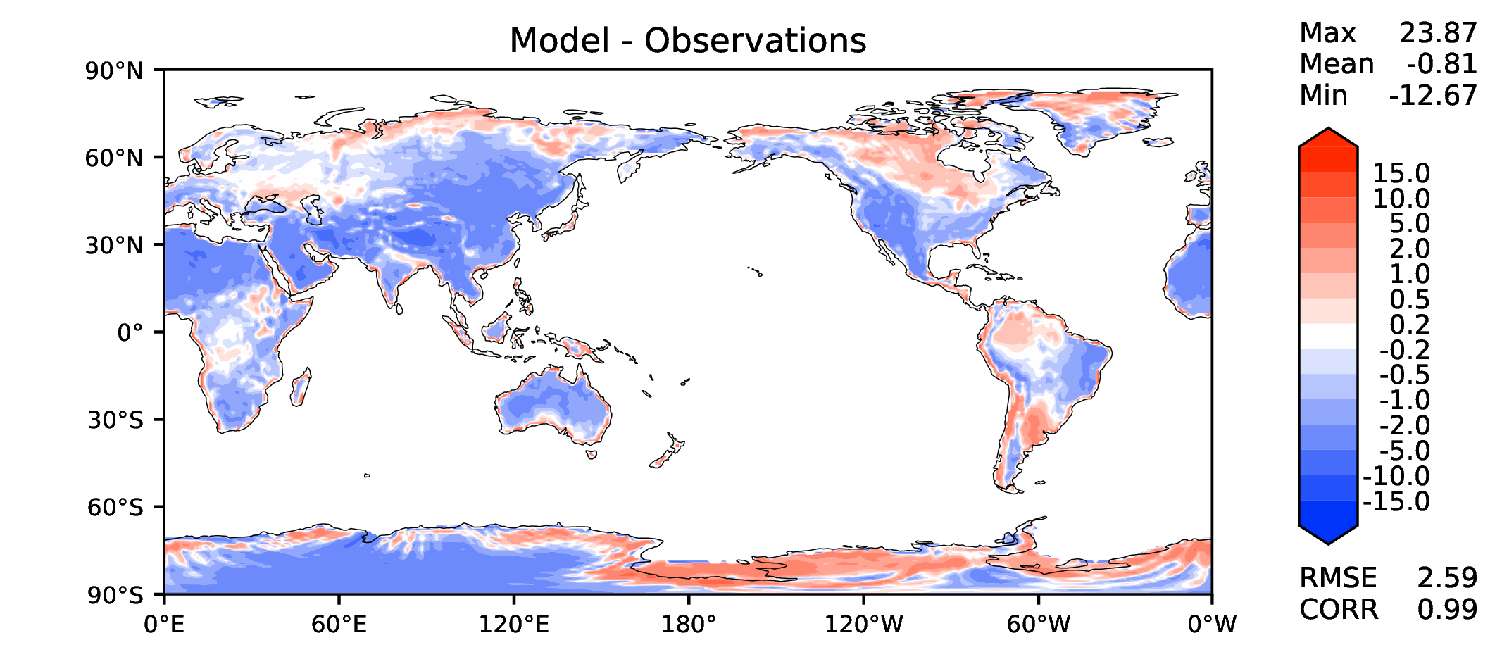
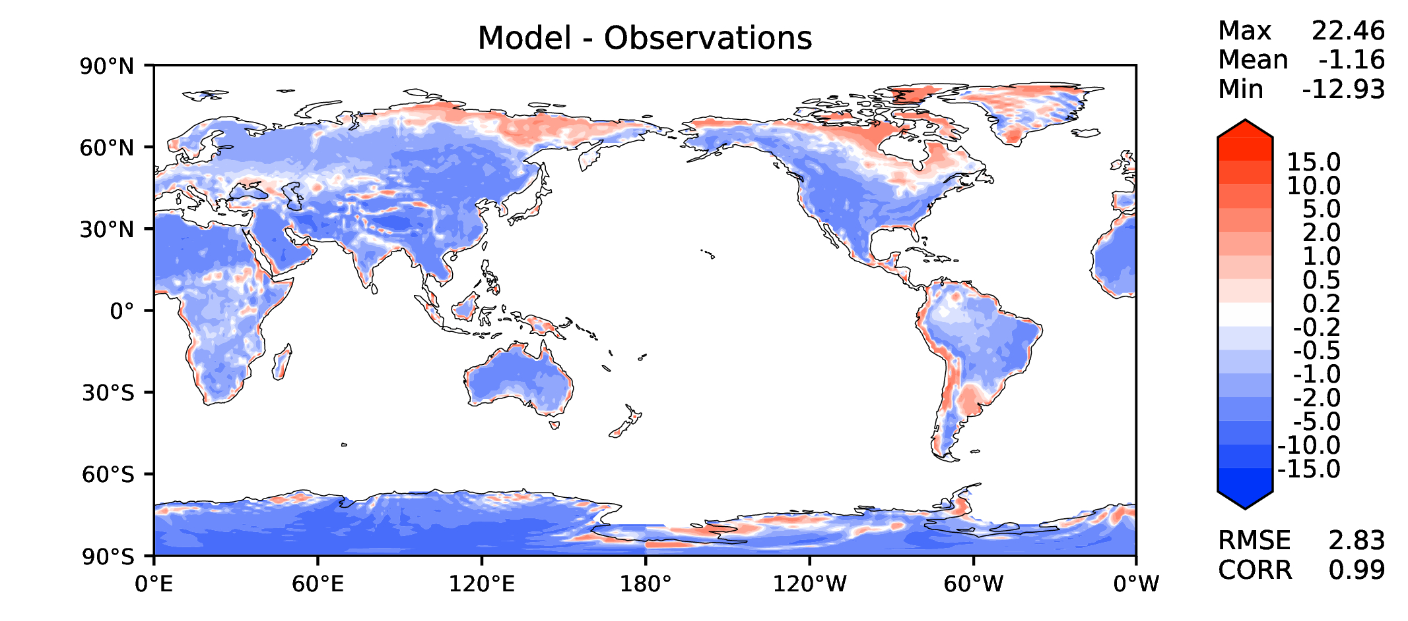
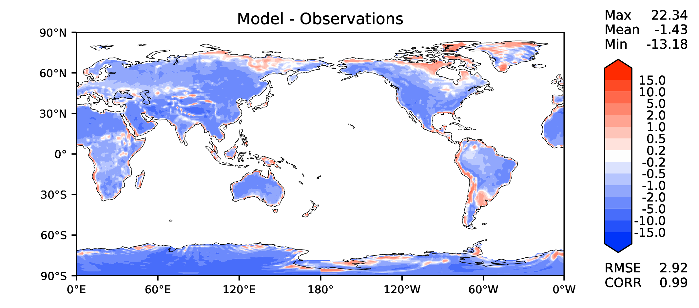
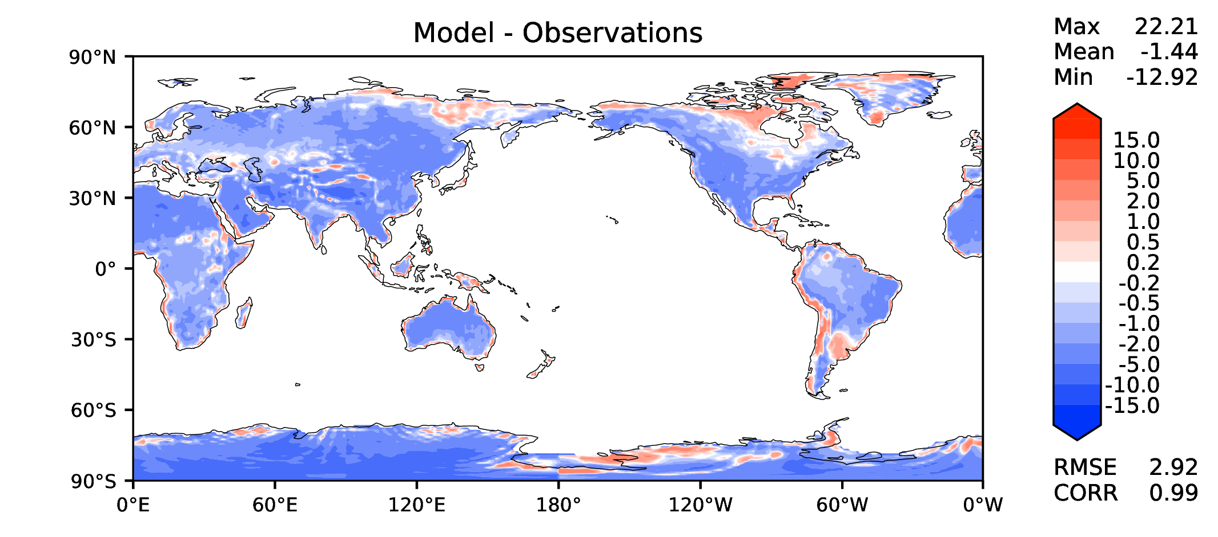
Annual surface air T (land)
DECKv1
v2beta4
v2rc1a
v2rc1c

Slide 15
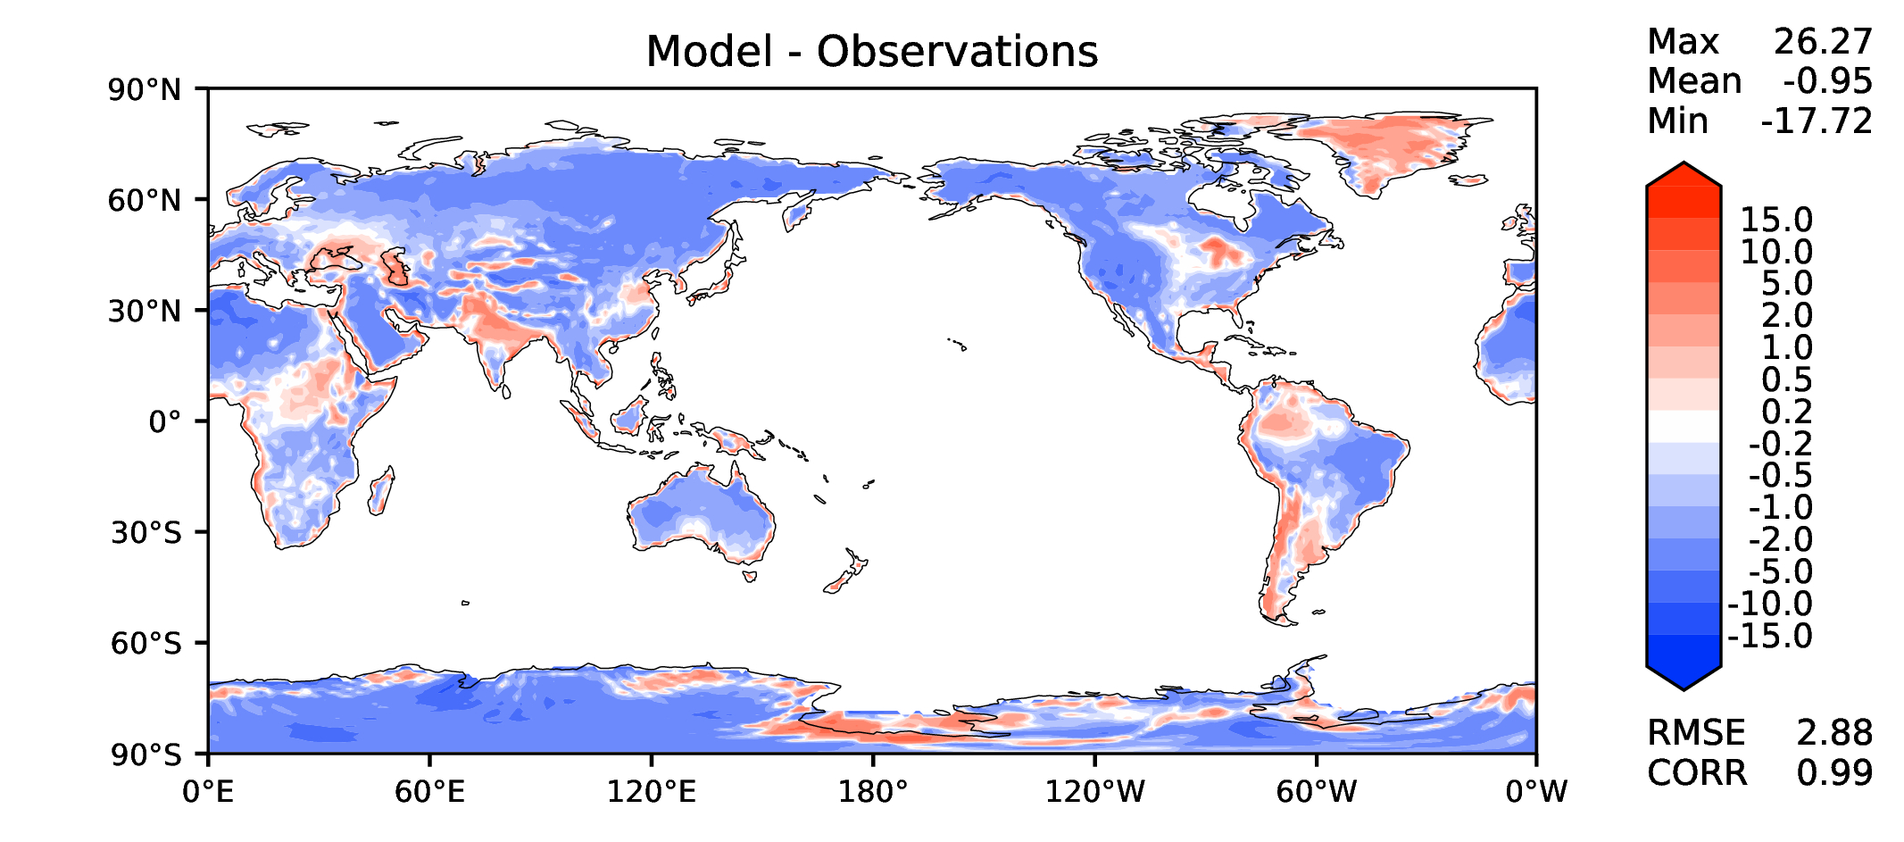
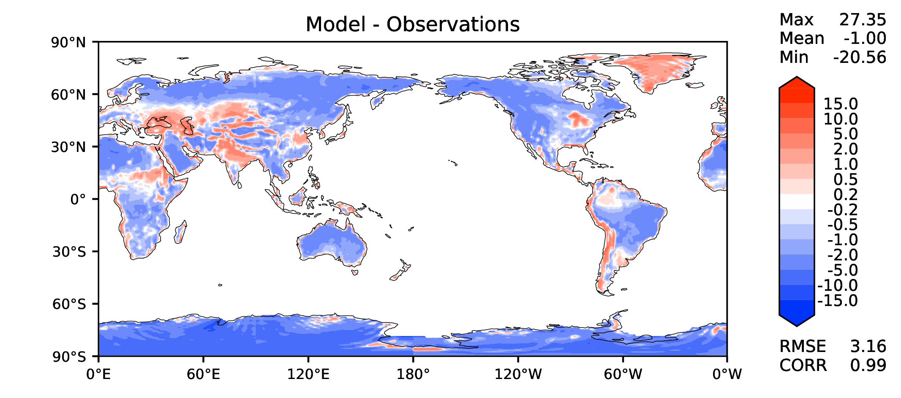
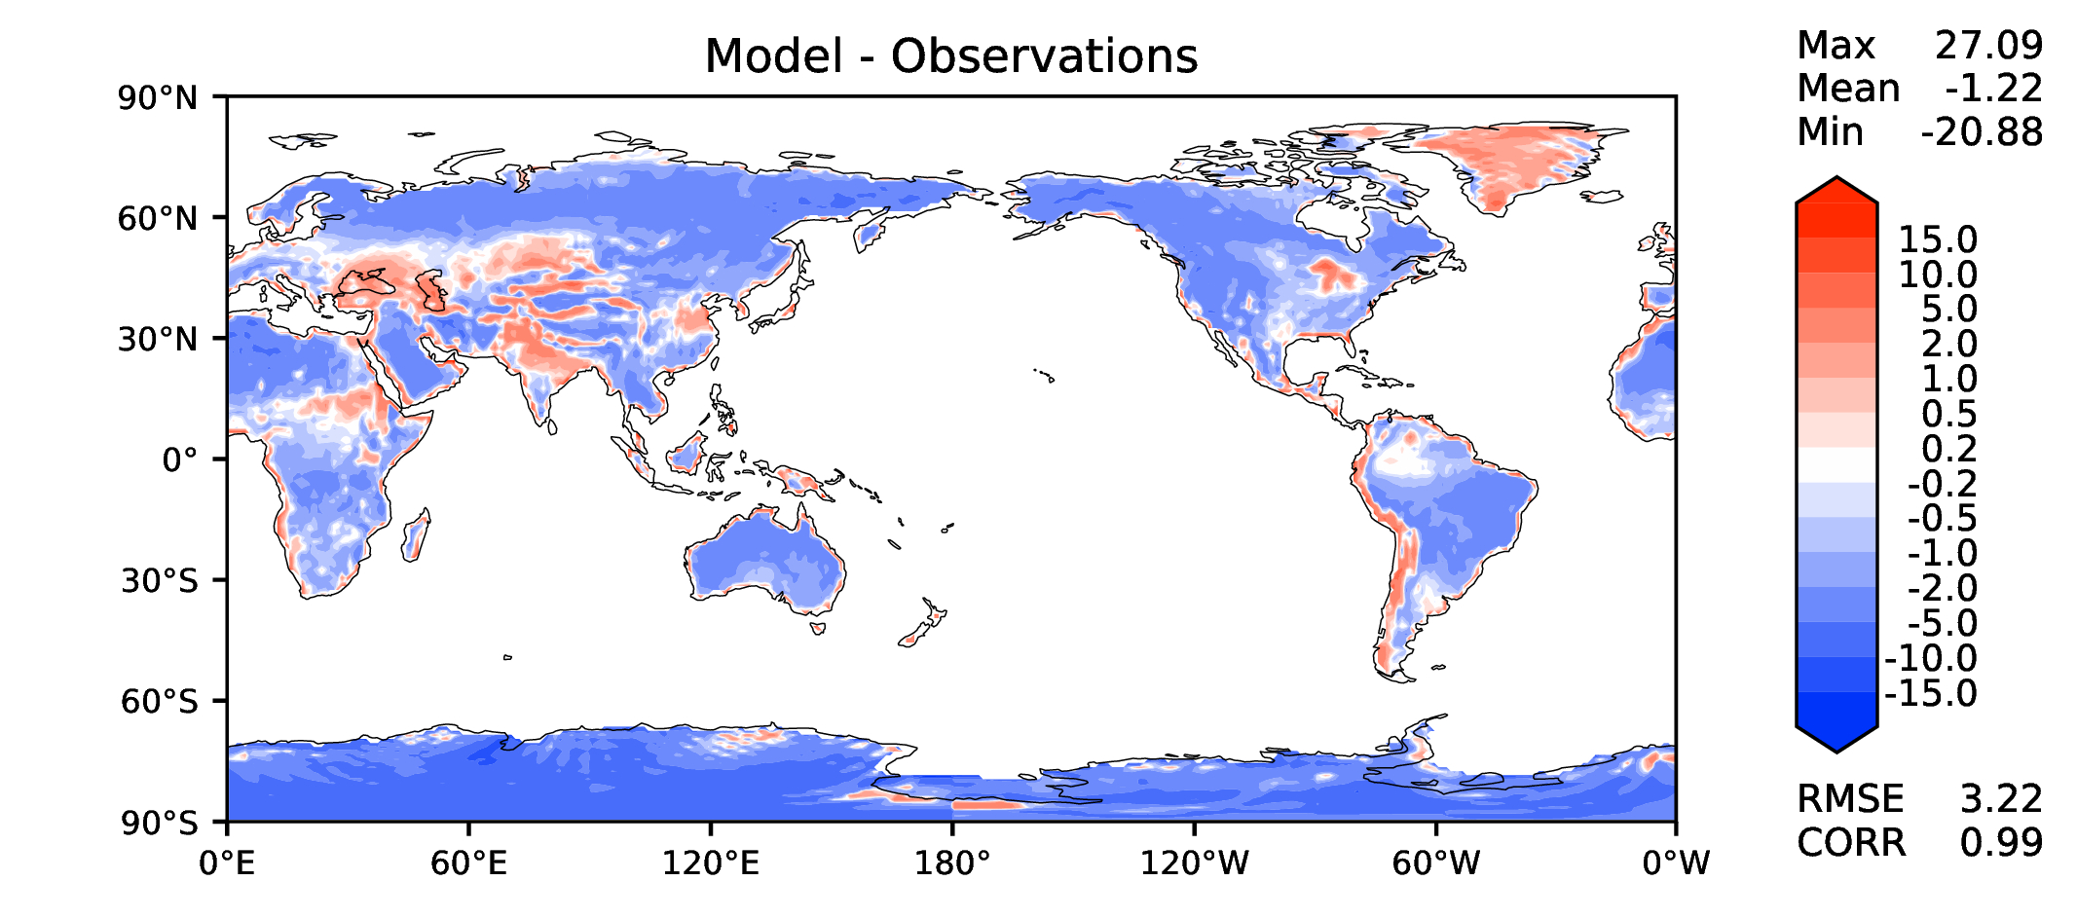
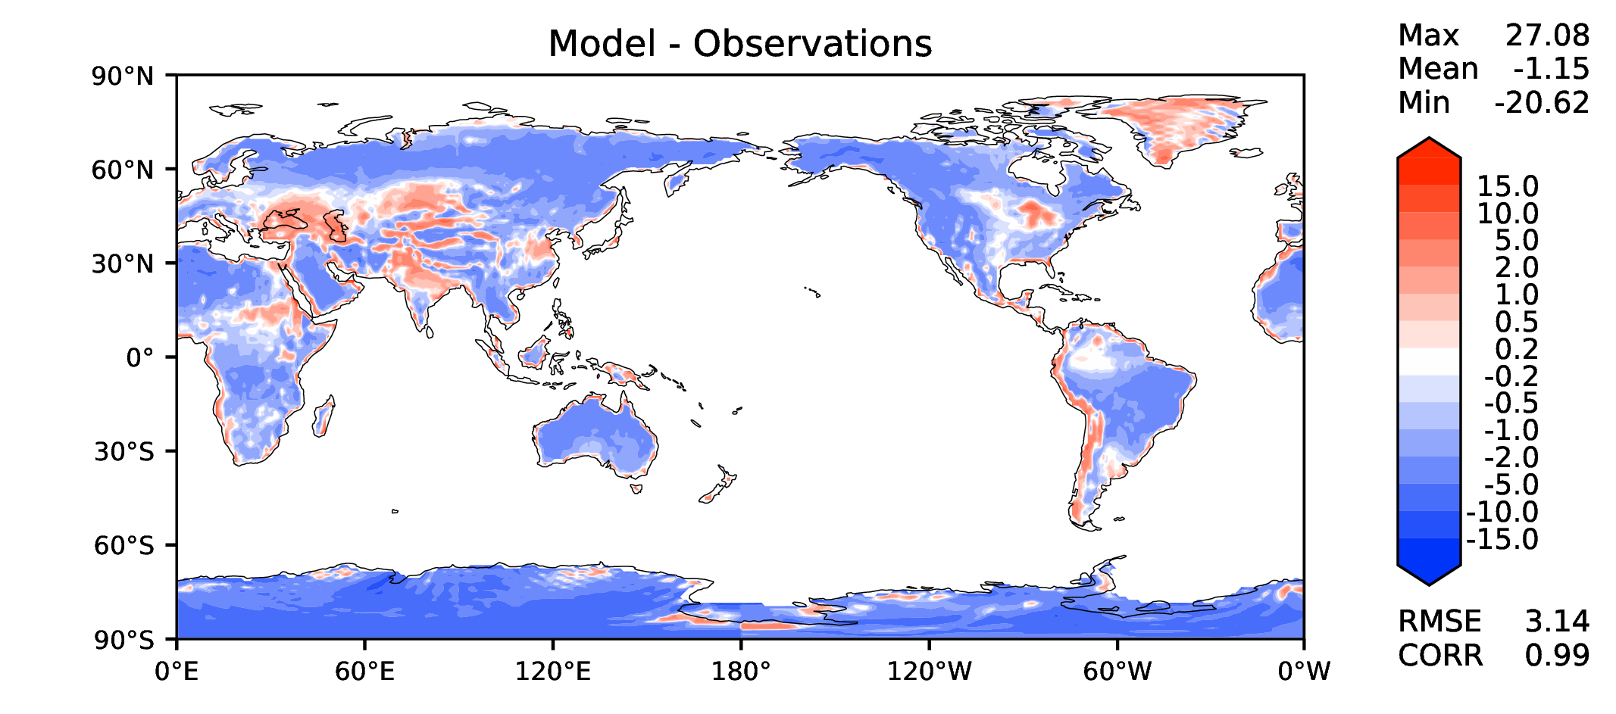
JJA surface air T (land)
DECKv1
v2beta4
v2rc1a
v2rc1c

Slide 16
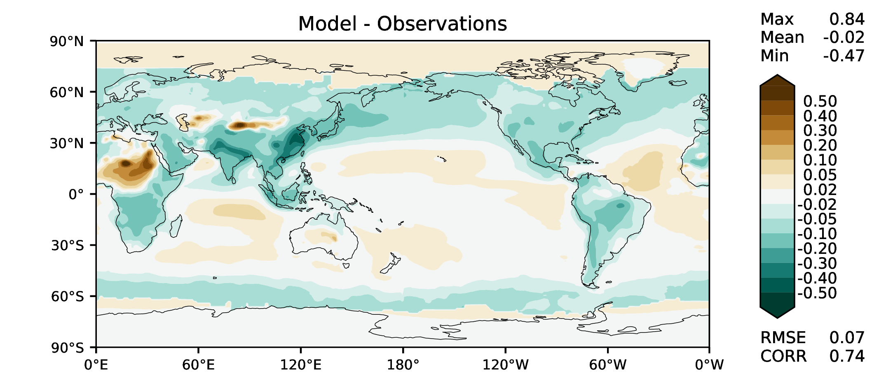
Aerosol optical depth
DECKv1
v2beta4
v2rc1a
v2rc1c

Slide 17
TAUXY ANN ocean
DECKv1
v2beta4
v2rc1a
v2rc1c

Slide 18
CLDLWP_OCN global SSMI
DECKv1
v2beta4
v2rc1a
v2rc1c

