Slide 1
Summary table (RMSE vs obs)
Variable | Season | v2beta4 | v2rc1a | v2rc1c | v2rc1d
SST | ANN | 1.16 | 1.17 | 1.18 | 1.26
PRECT | ANN | 1.02 | 1.02 | 0.99 | 0.99
PRECT | DJF | 1.40 | 1.39 | 1.39 | 1.39
PRECT | MAM | 1.31 | 1.32 | 1.24 | 1.28
PRECT | JJA | 1.41 | 1.41 | 1.36 | 1.37
PRECT | SON | 1.33 | 1.31 | 1.26 | 1.28
RESTOM | ANN | 8.40 | 8.31 | 8.38 | 8.44
SWCF | ANN | 9.98 | 10.03 | 9.86 | 10.05
LWCF | ANN | 5.37 | 5.39 | 5.36 | 5.31
u850 | ANN | 1.22 | 1.21 | 1.19 | 1.25
u200 | ANN | 3.02 | 2.88 | 2.75 | 2.83
T200 | ANN | 2.40 | 2.65 | 2.80 | 2.96
TREFHT | ANN | 2.74 | 2.90 | 2.88 | 3.03
TREFHT | JJA | 3.00 | 3.12 | 3.04 | 3.19
AODVIS | ANN | 0.06 | 0.06 | 0.06 | 0.06
TAUXY | ANN | 0.02 | 0.02 | 0.02 | 0.02
CLDLWP_OCN | ANN | 39.72 | 39.83 | 43.18 | 42.42

Slide 2
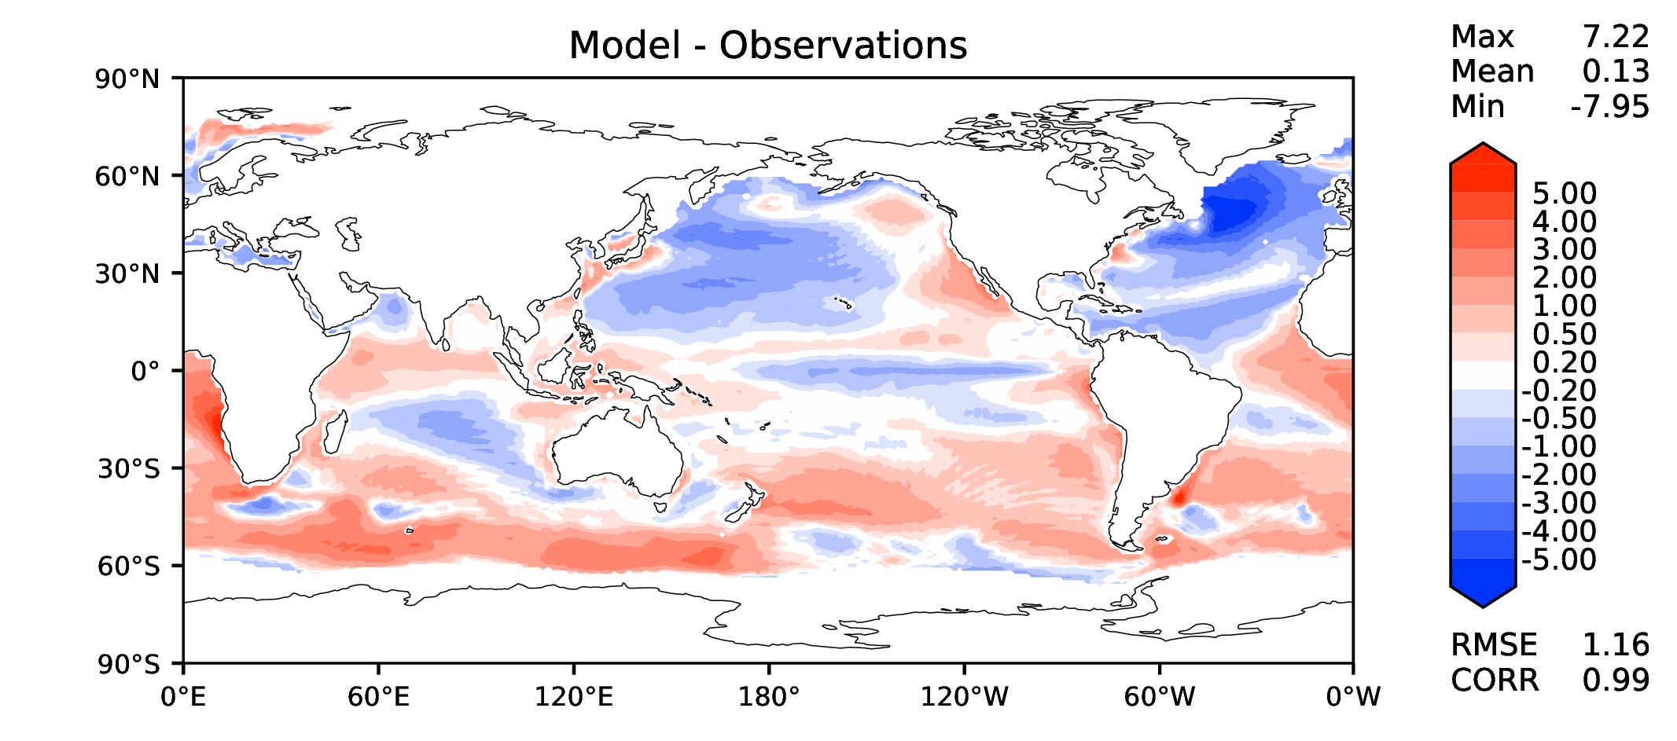
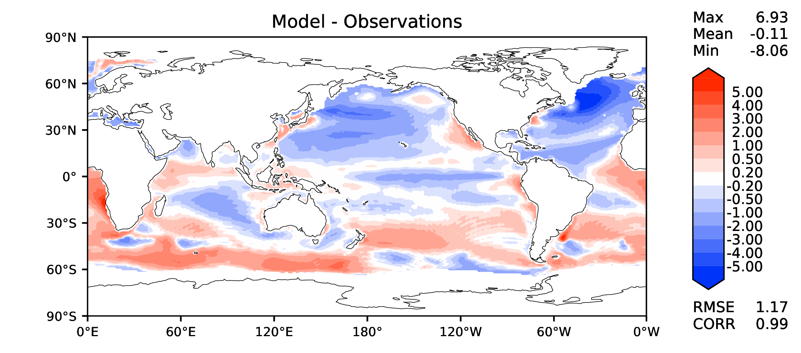
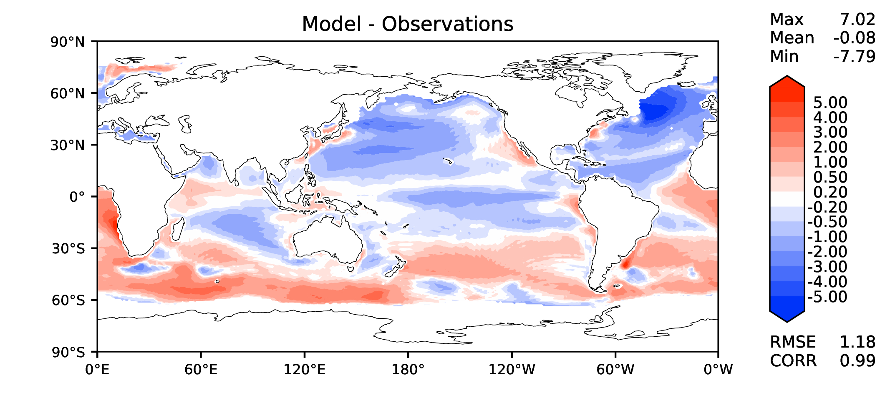
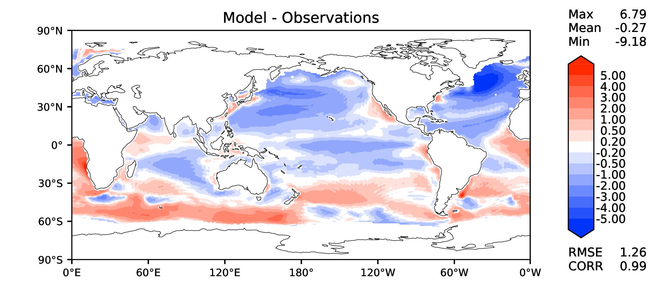
Annual SST (pre-industrial)
v2beta4
v2rc1a
v2rc1c
v2rc1d

Slide 3
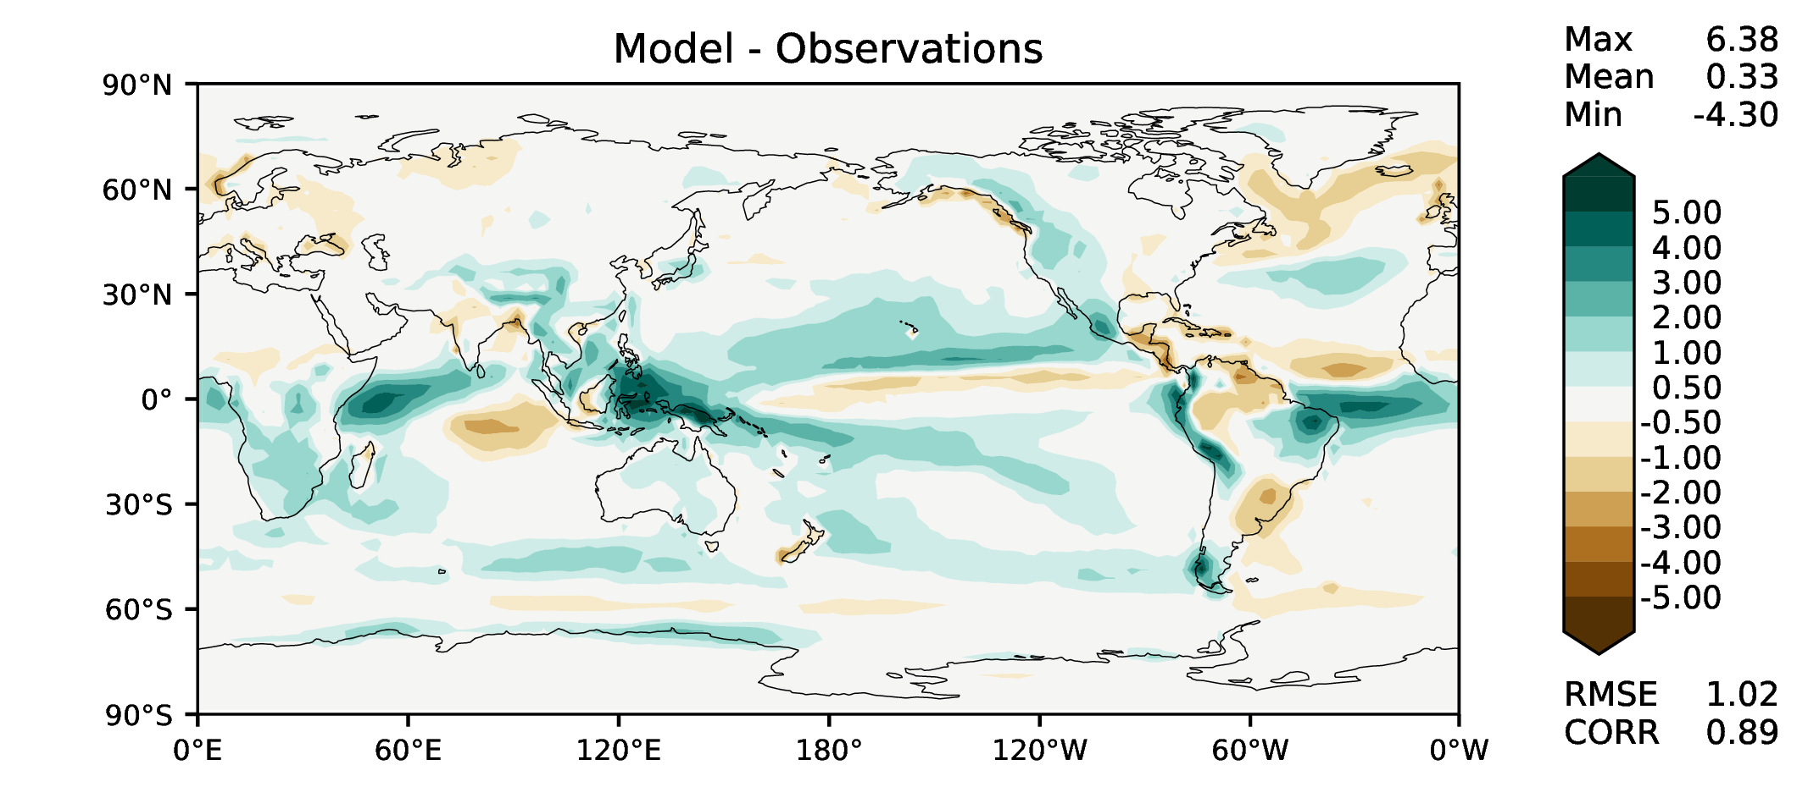
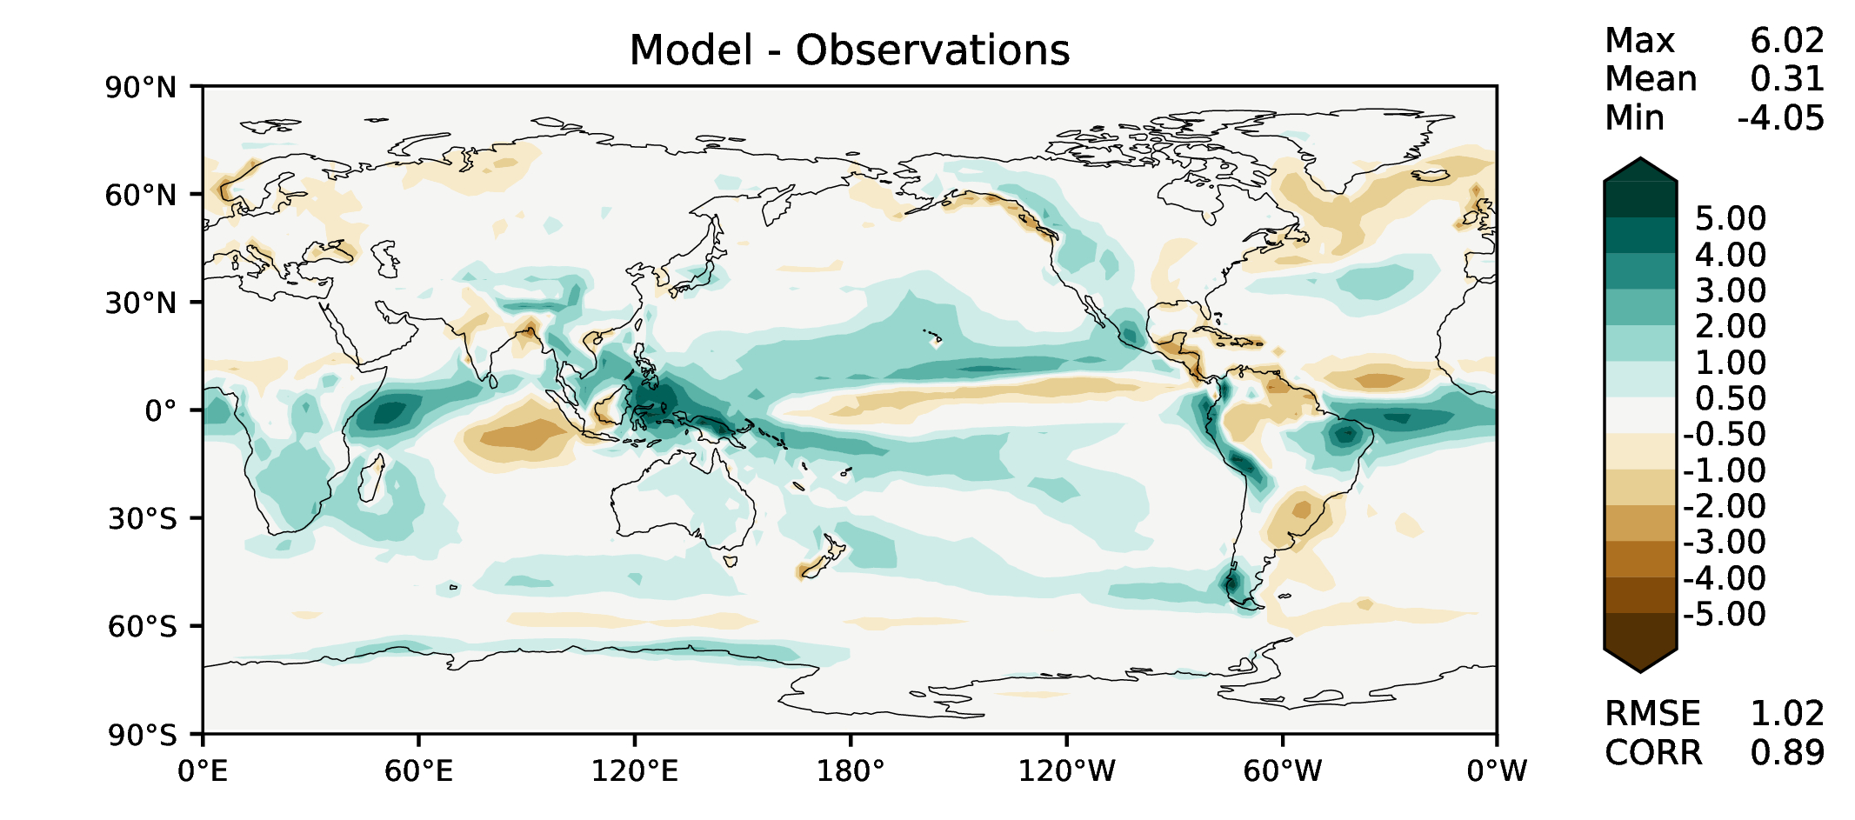
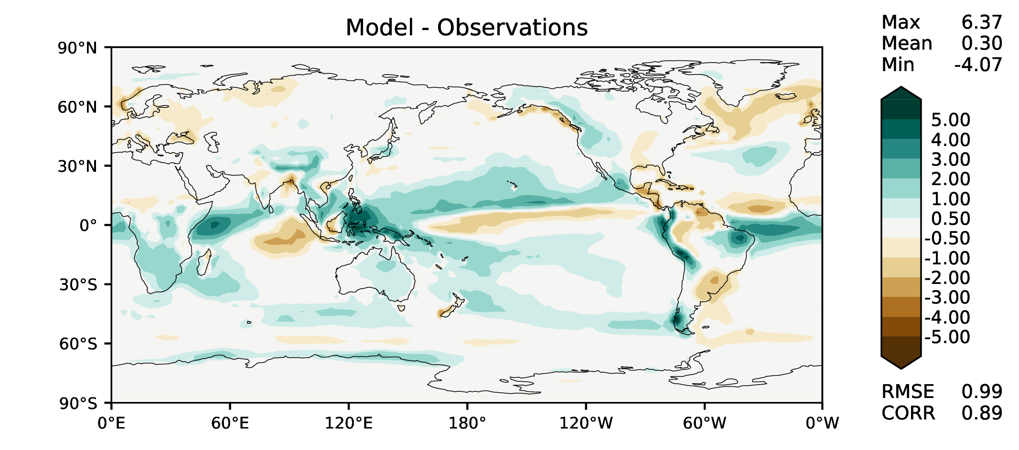
Annual total precipitation
v2beta4
v2rc1a
v2rc1c
v2rc1d

Slide 4
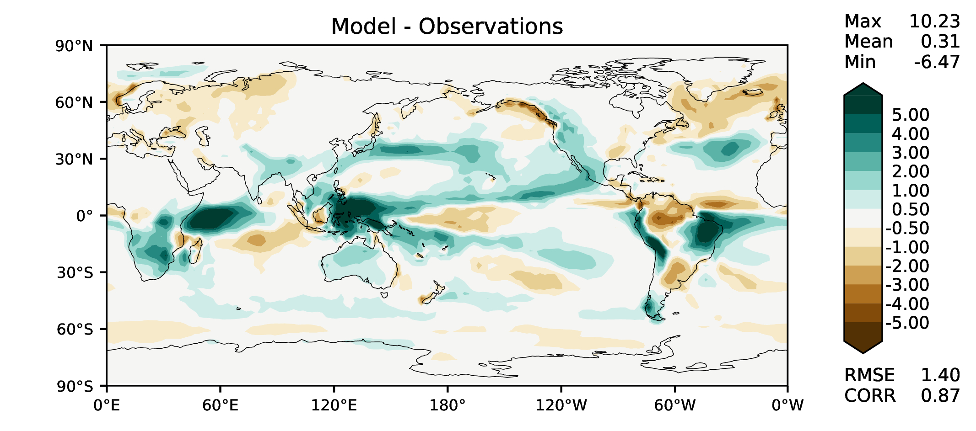
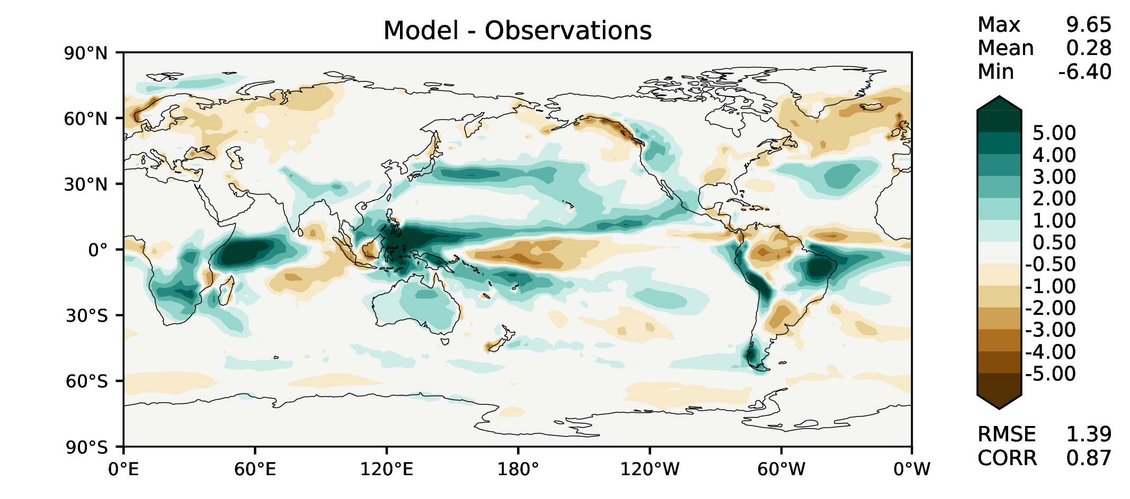
DJF total precipitation
v2beta4
v2rc1a
v2rc1c
v2rc1d

Slide 5
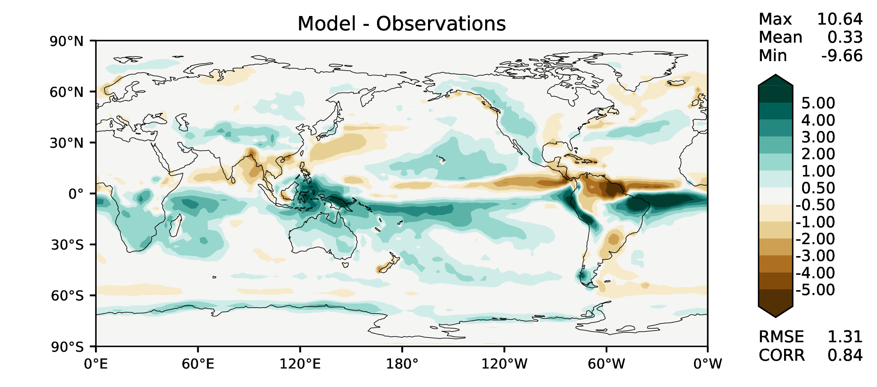
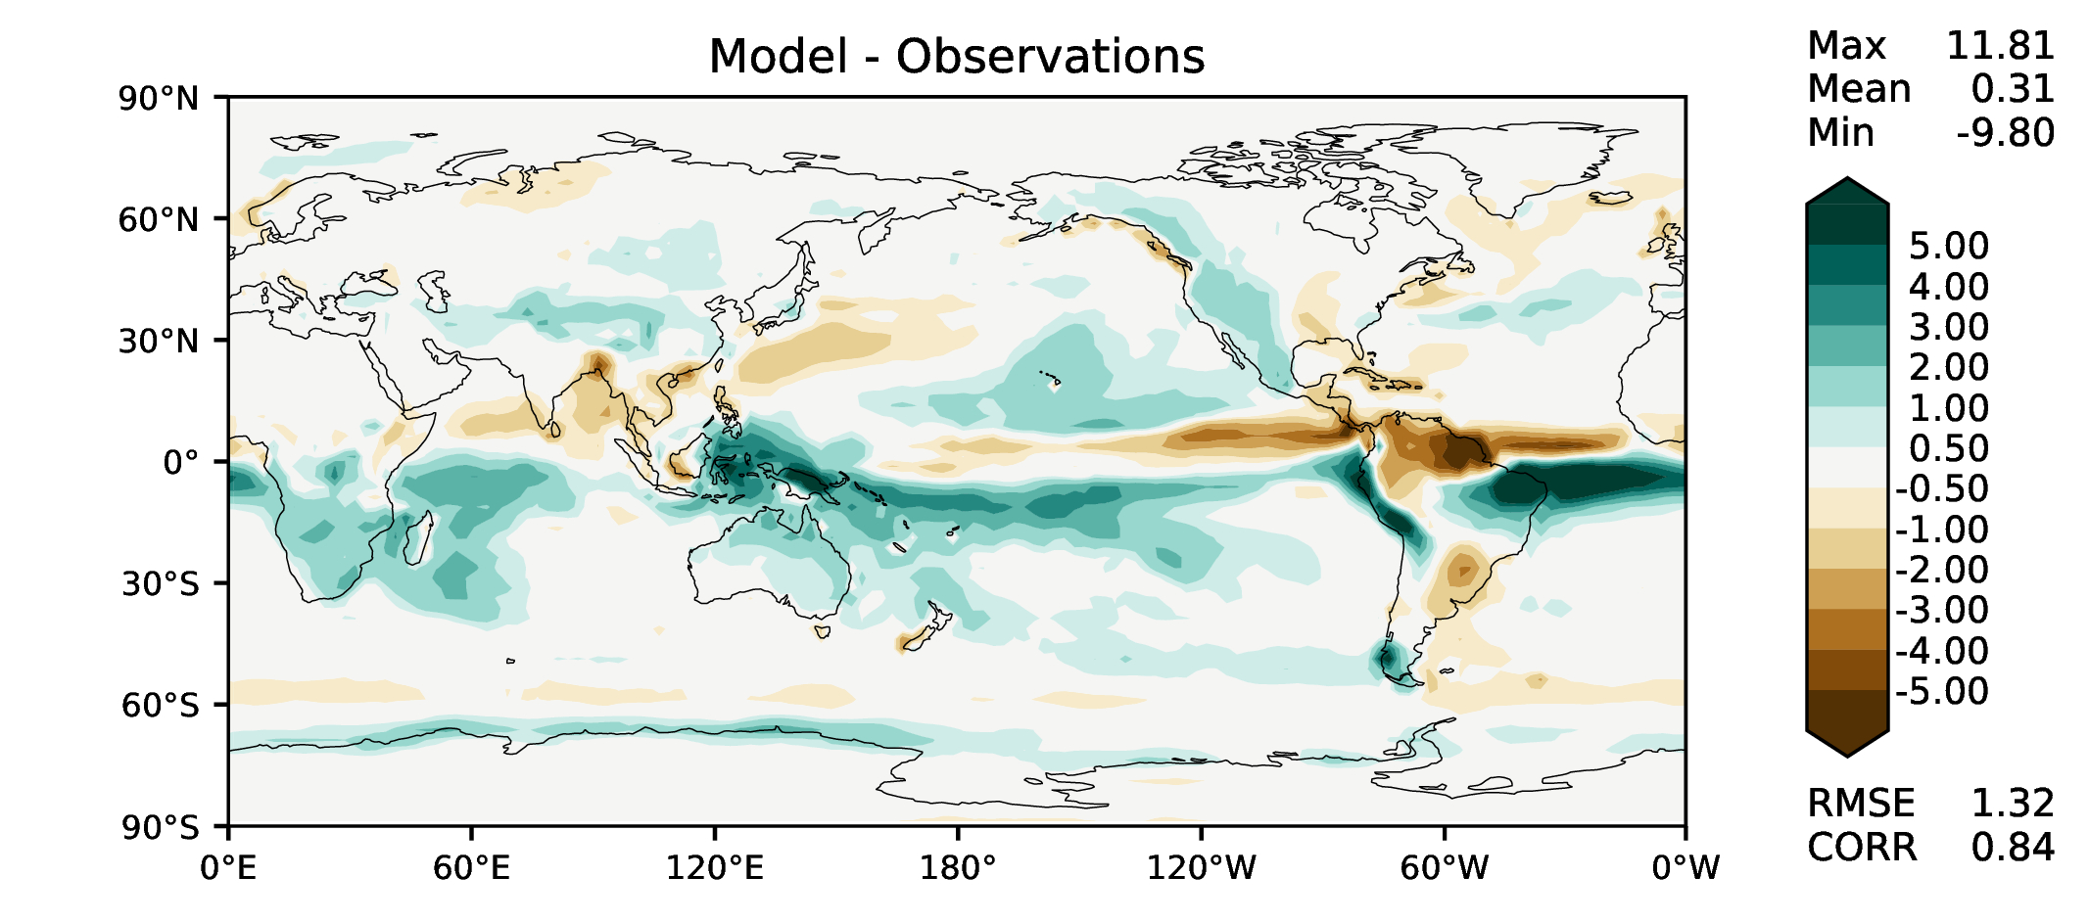
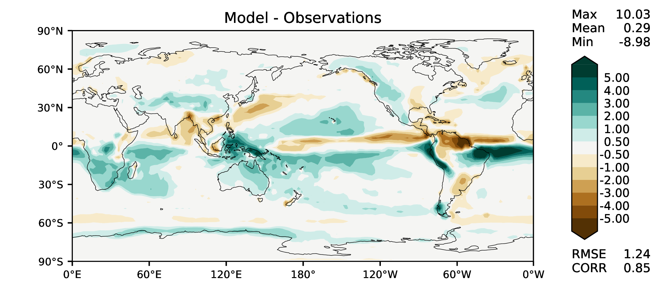
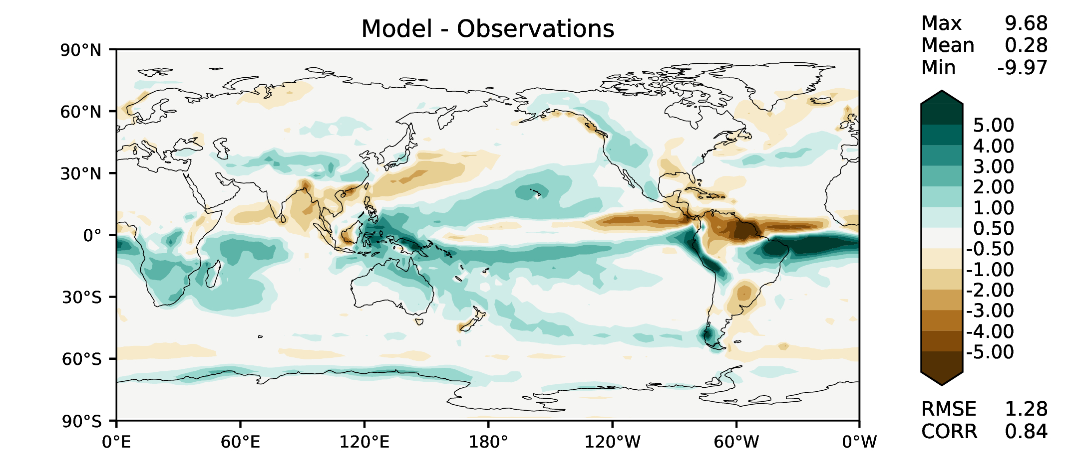
MAM total precipitation
v2beta4
v2rc1a
v2rc1c
v2rc1d

Slide 6
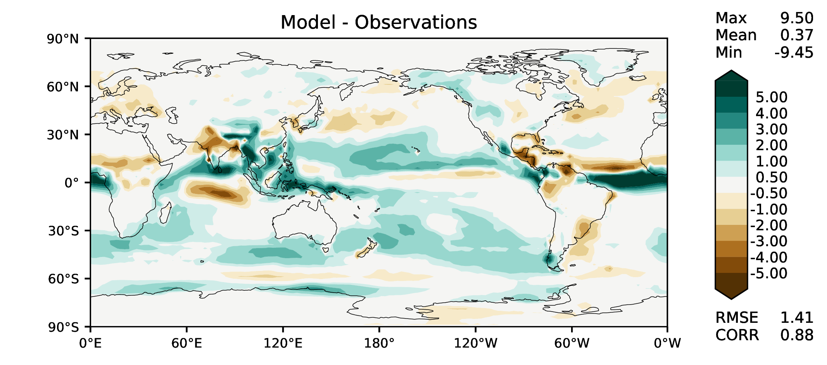
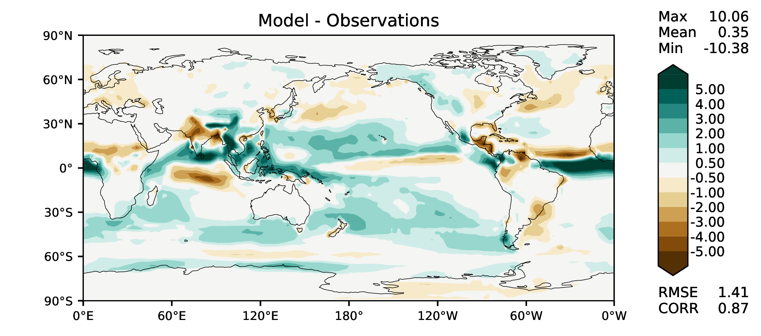
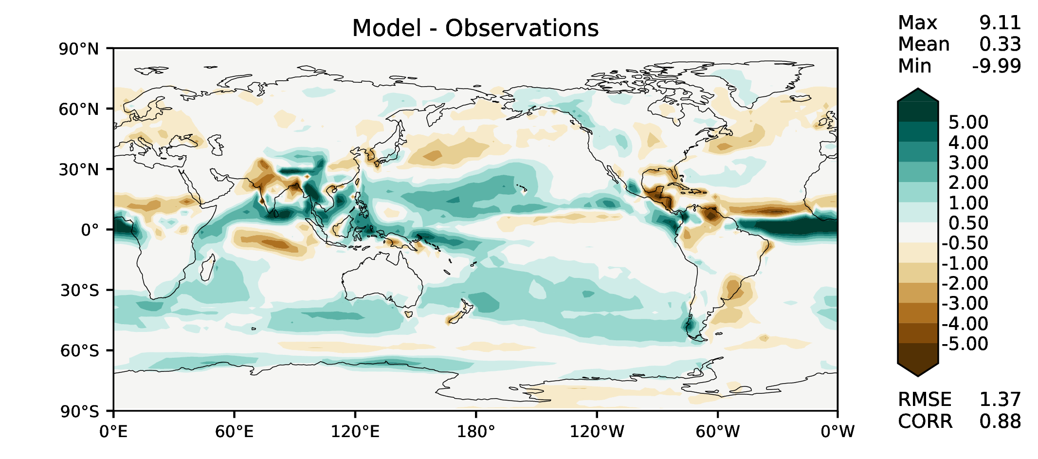
JJA total precipitation
v2beta4
v2rc1a
v2rc1c
v2rc1d

Slide 7
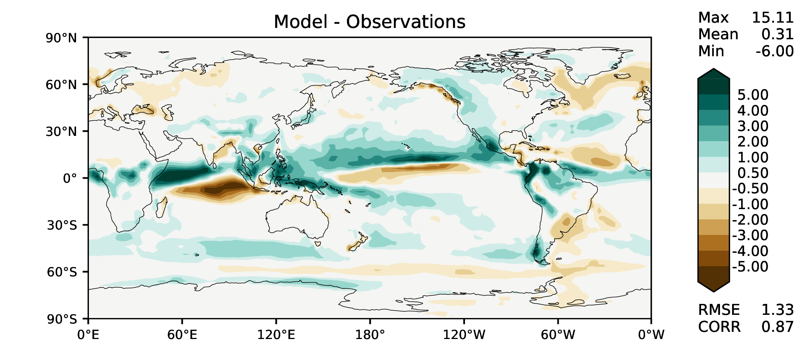
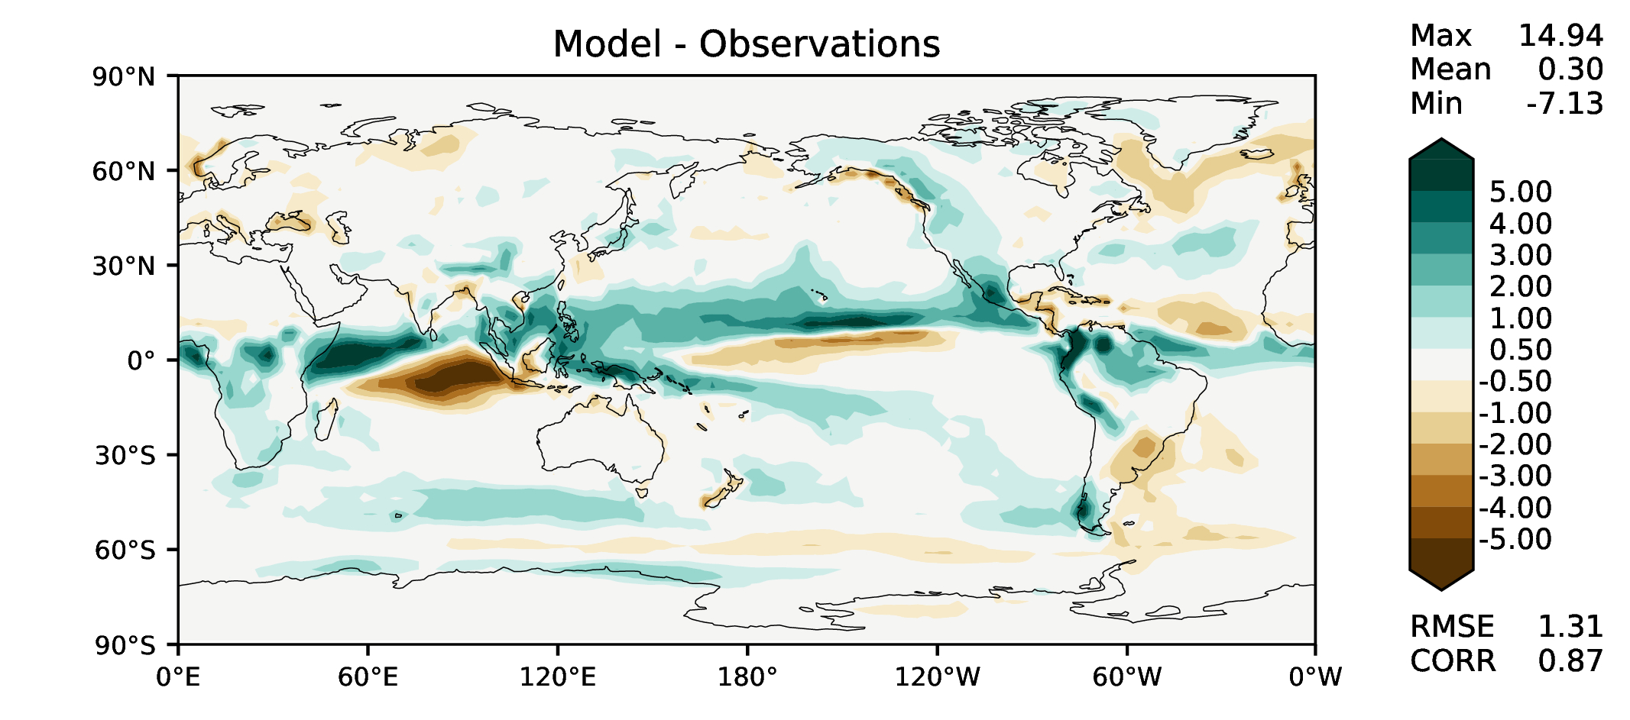
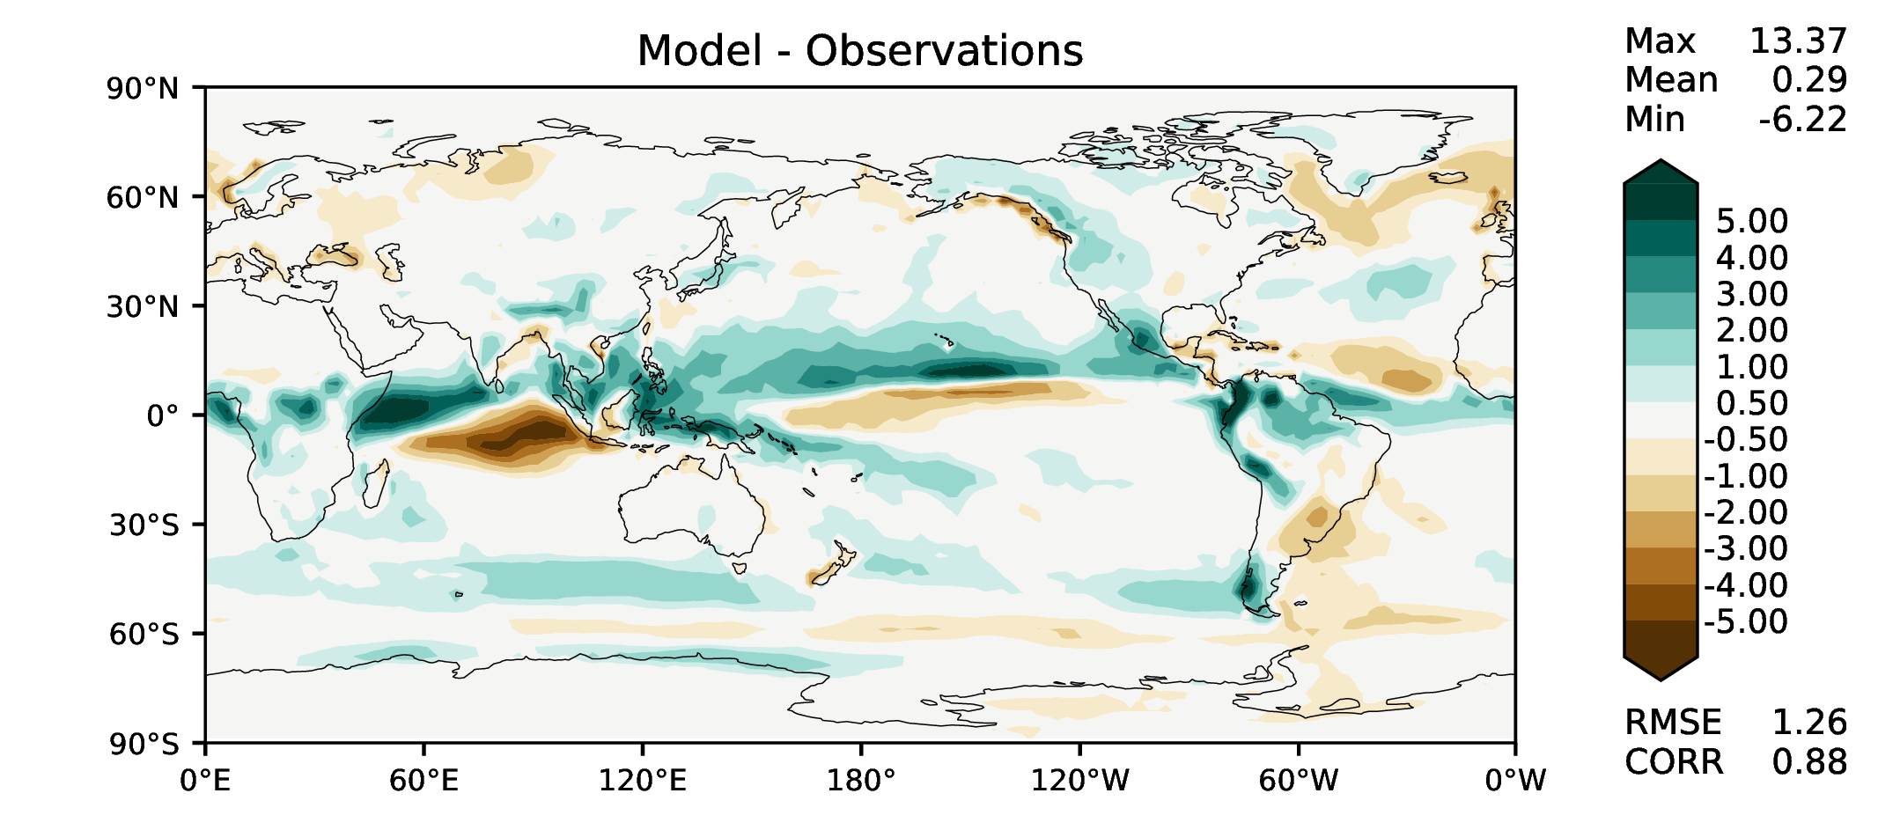
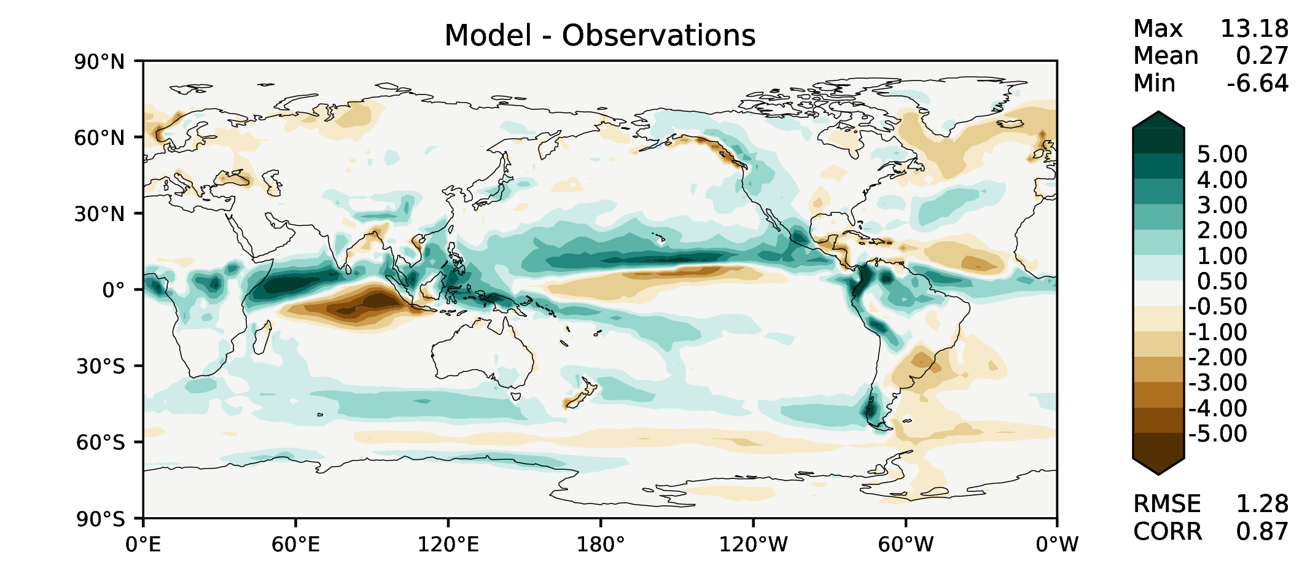
SON total precipitation
v2beta4
v2rc1a
v2rc1c
v2rc1d

Slide 8
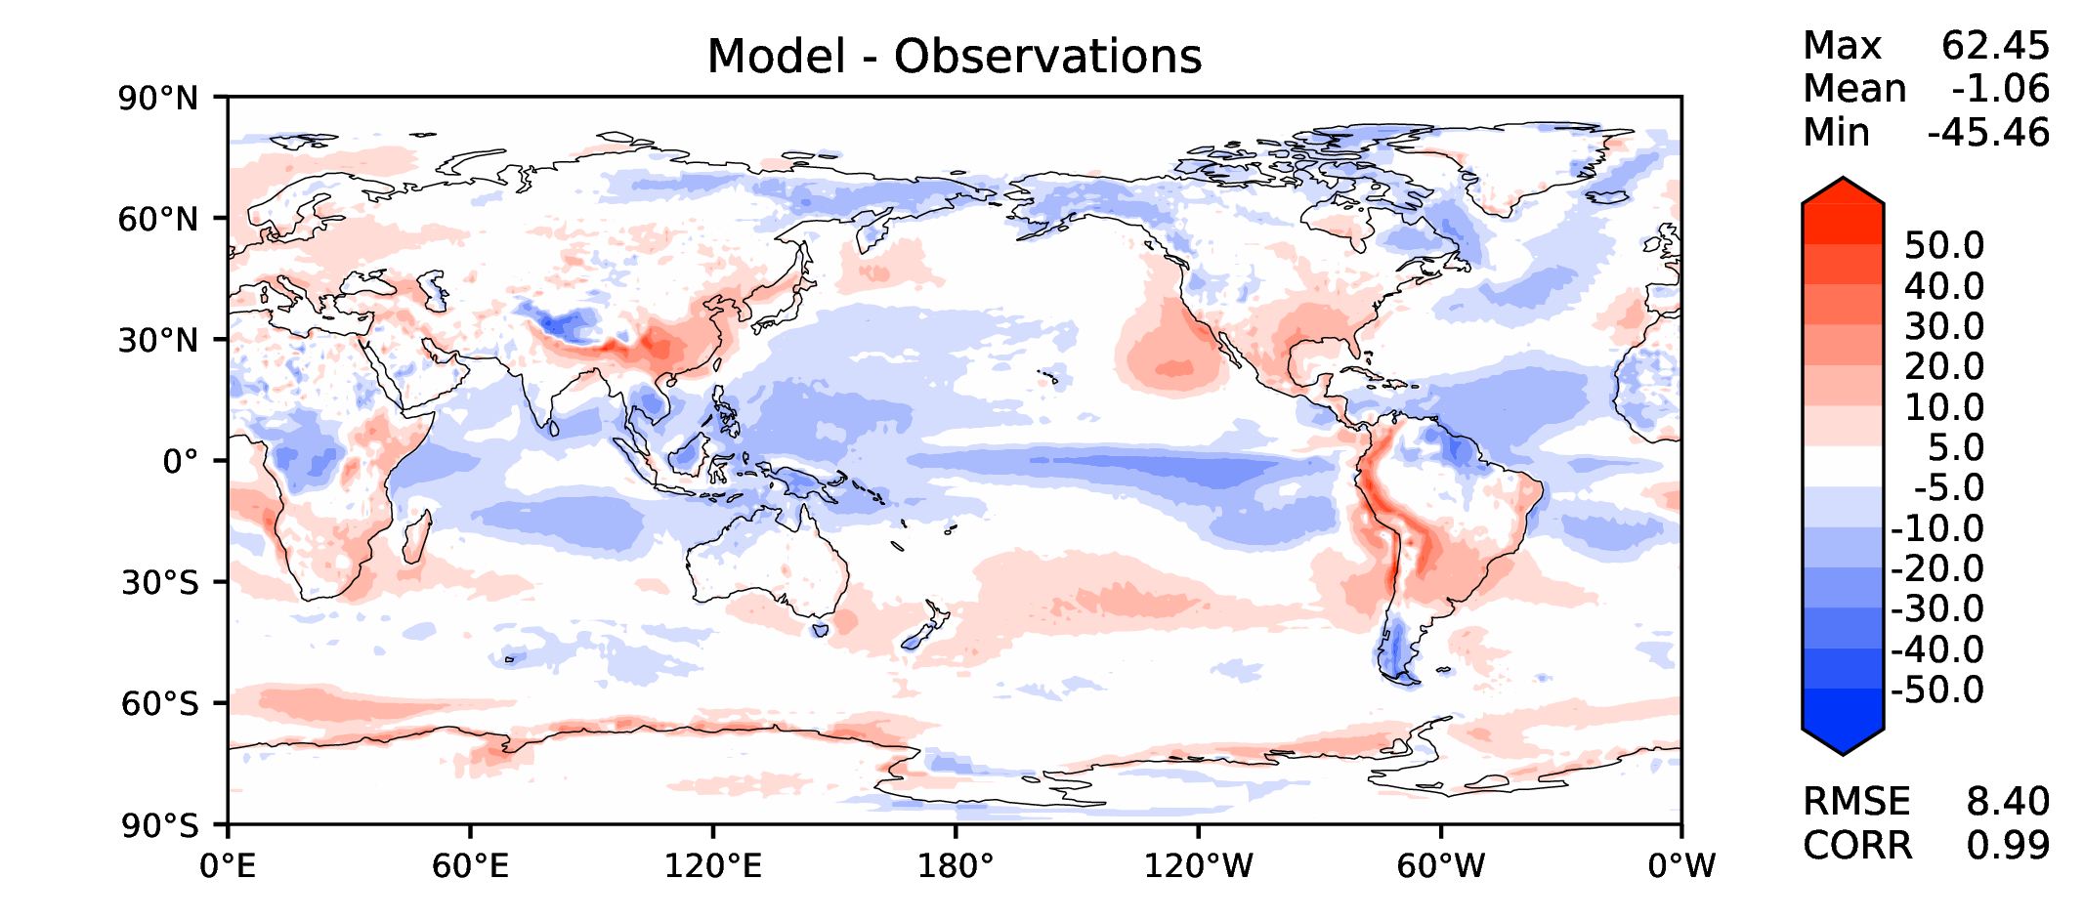
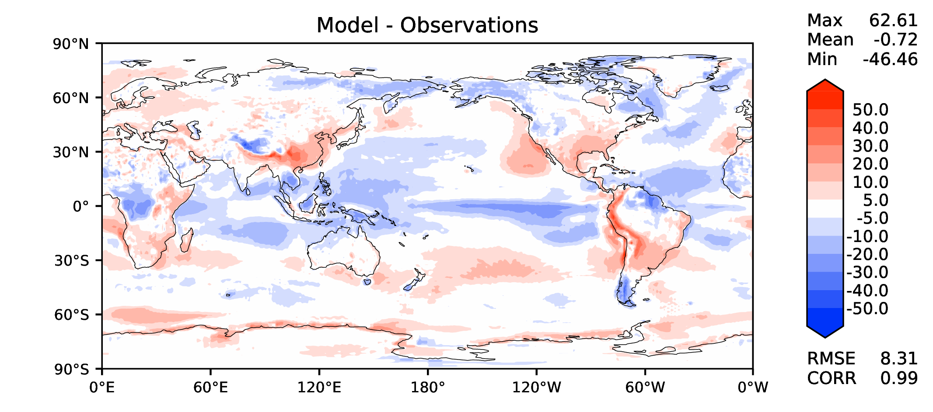
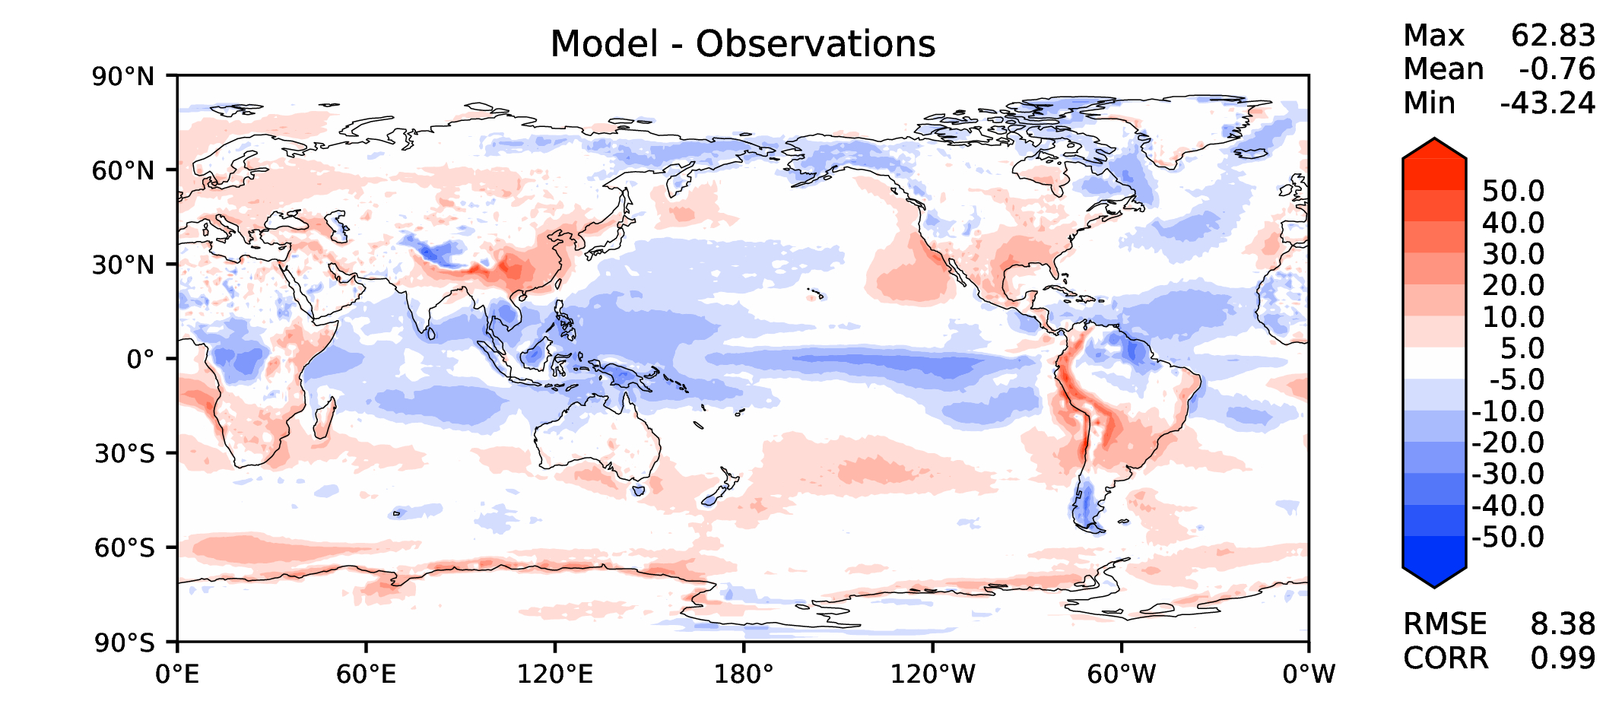
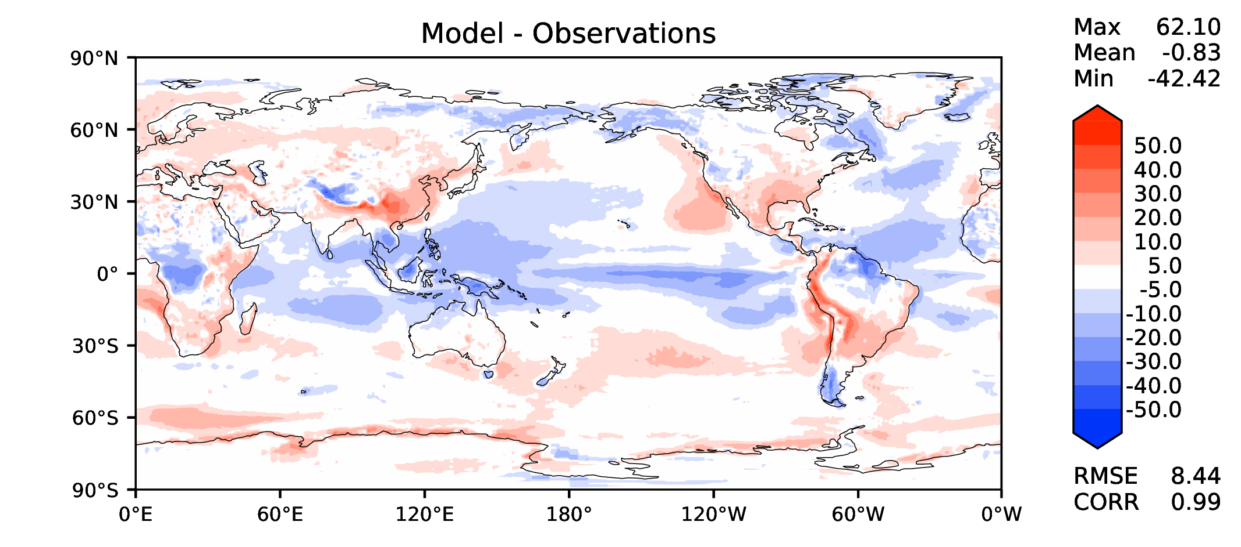
Annual TOA net radiation
v2beta4
v2rc1a
v2rc1c
v2rc1d

Slide 9
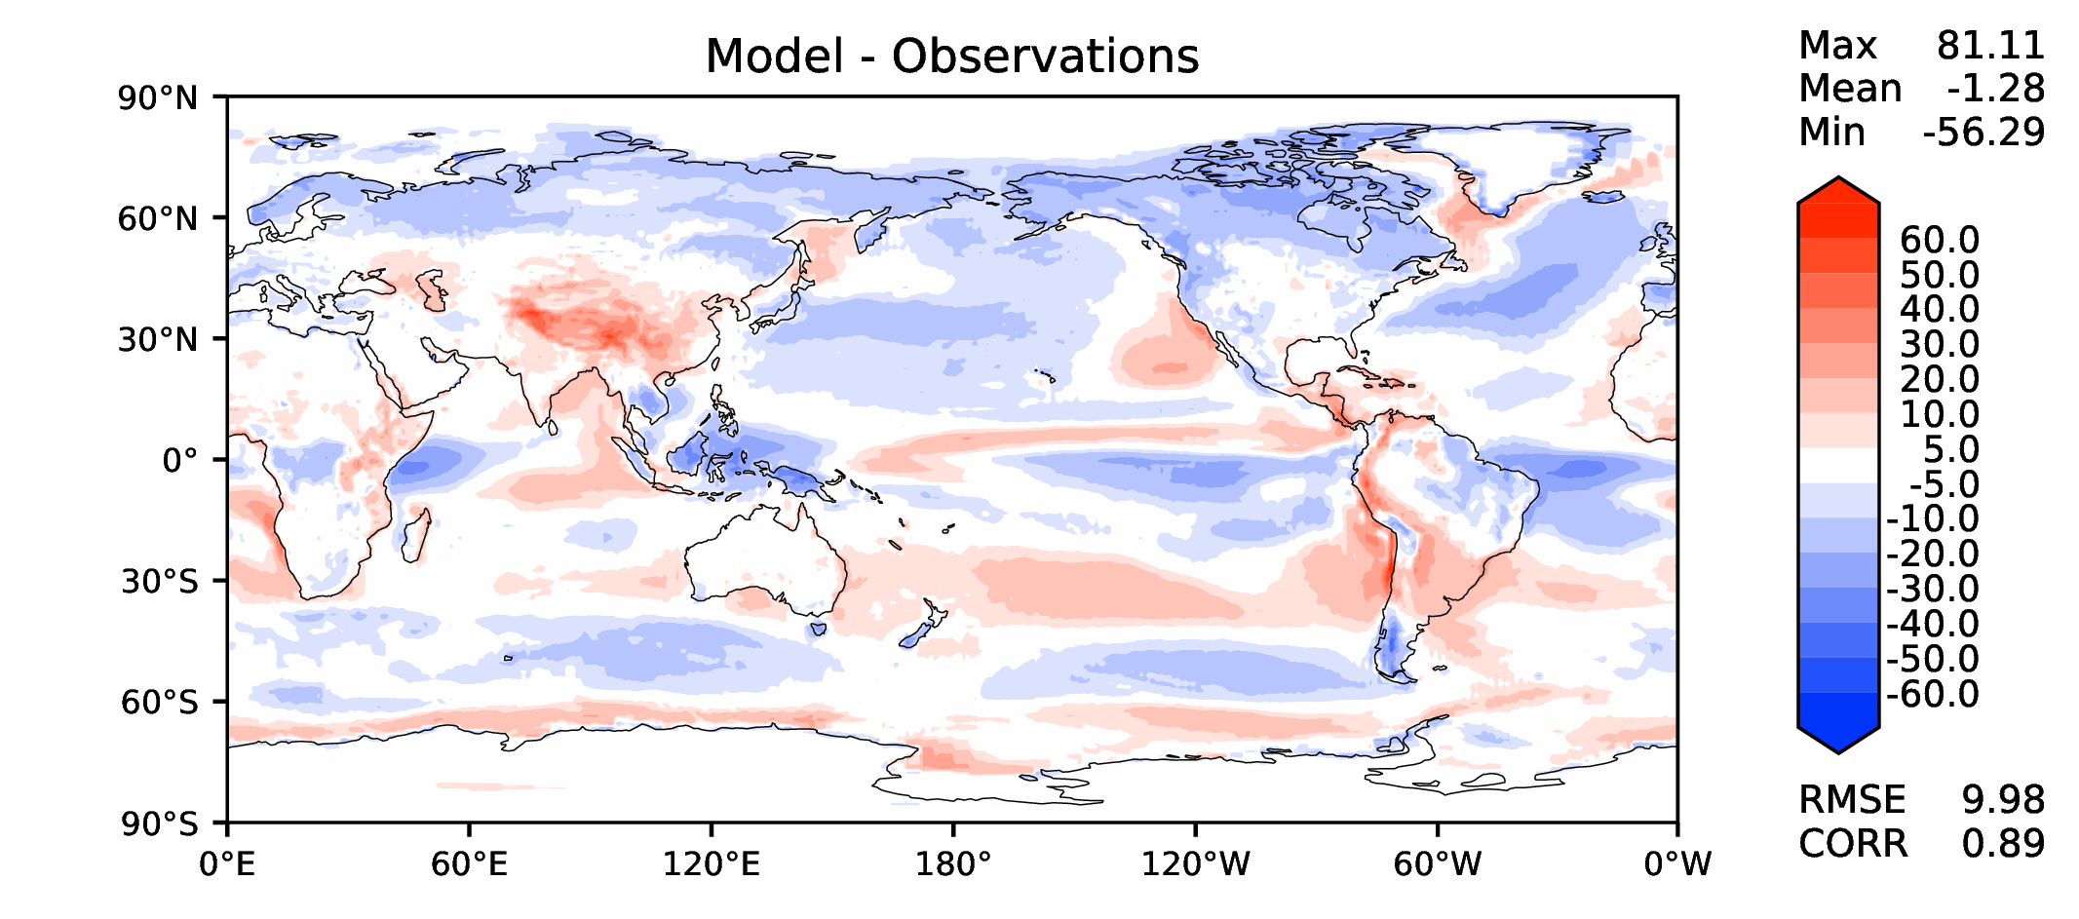
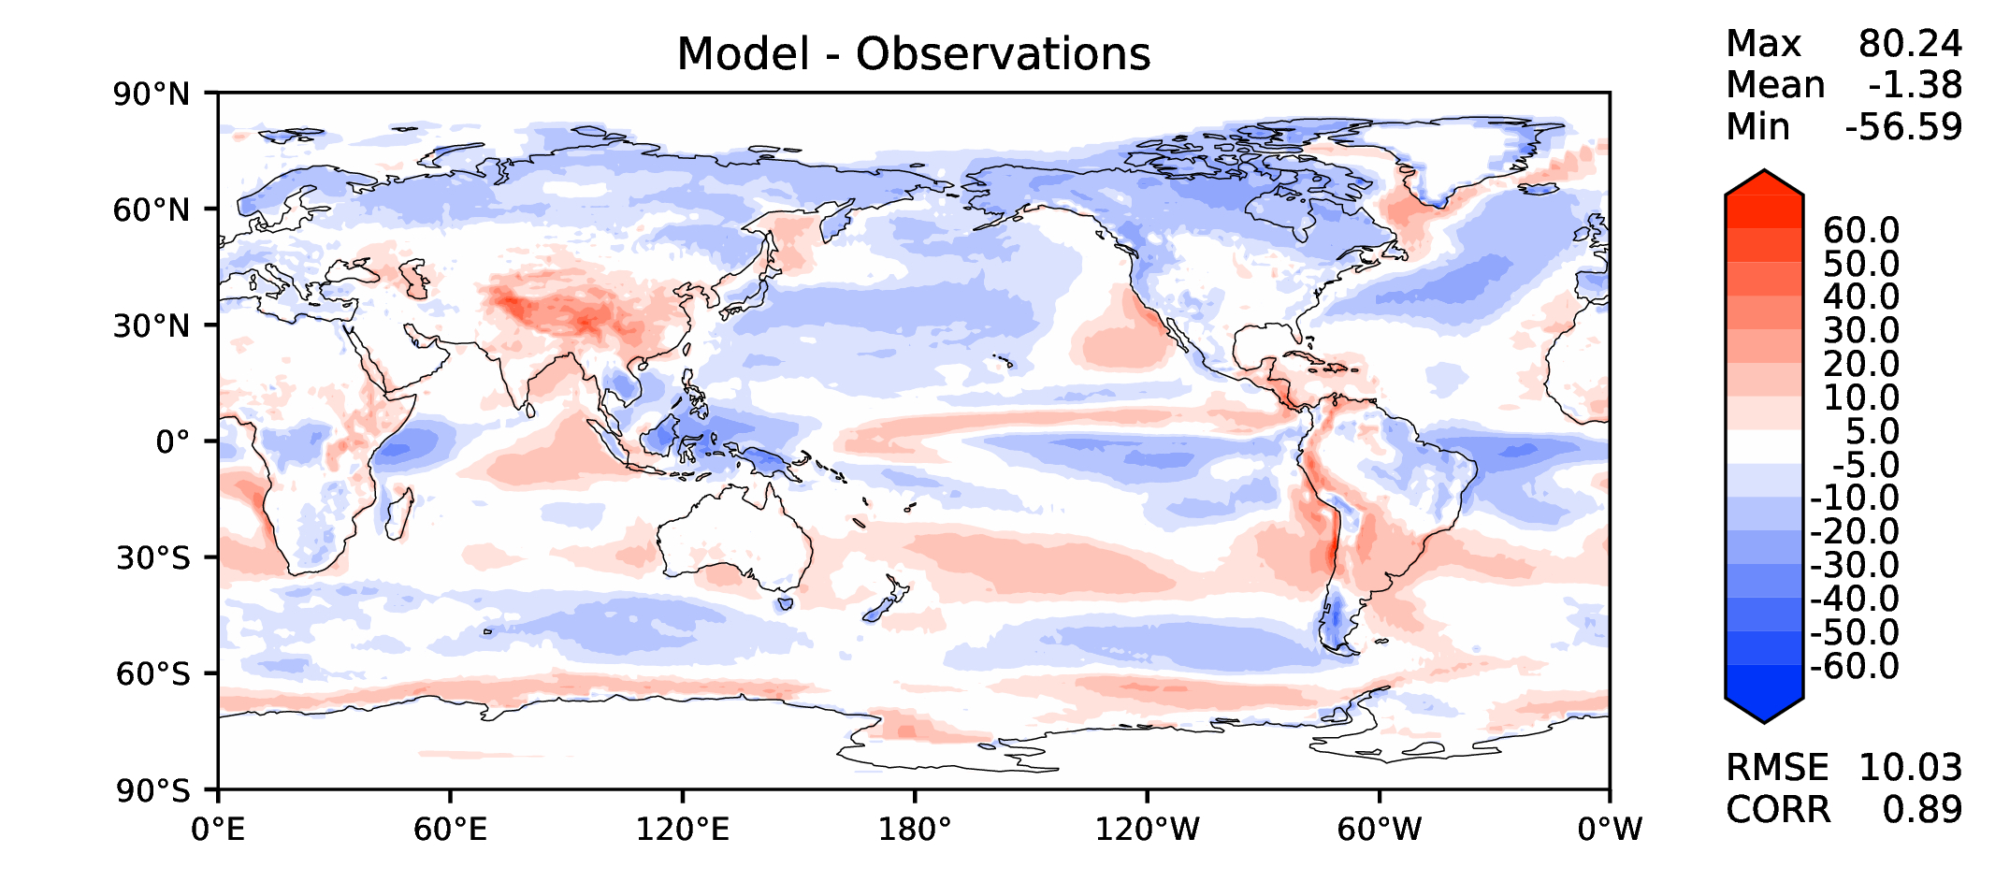
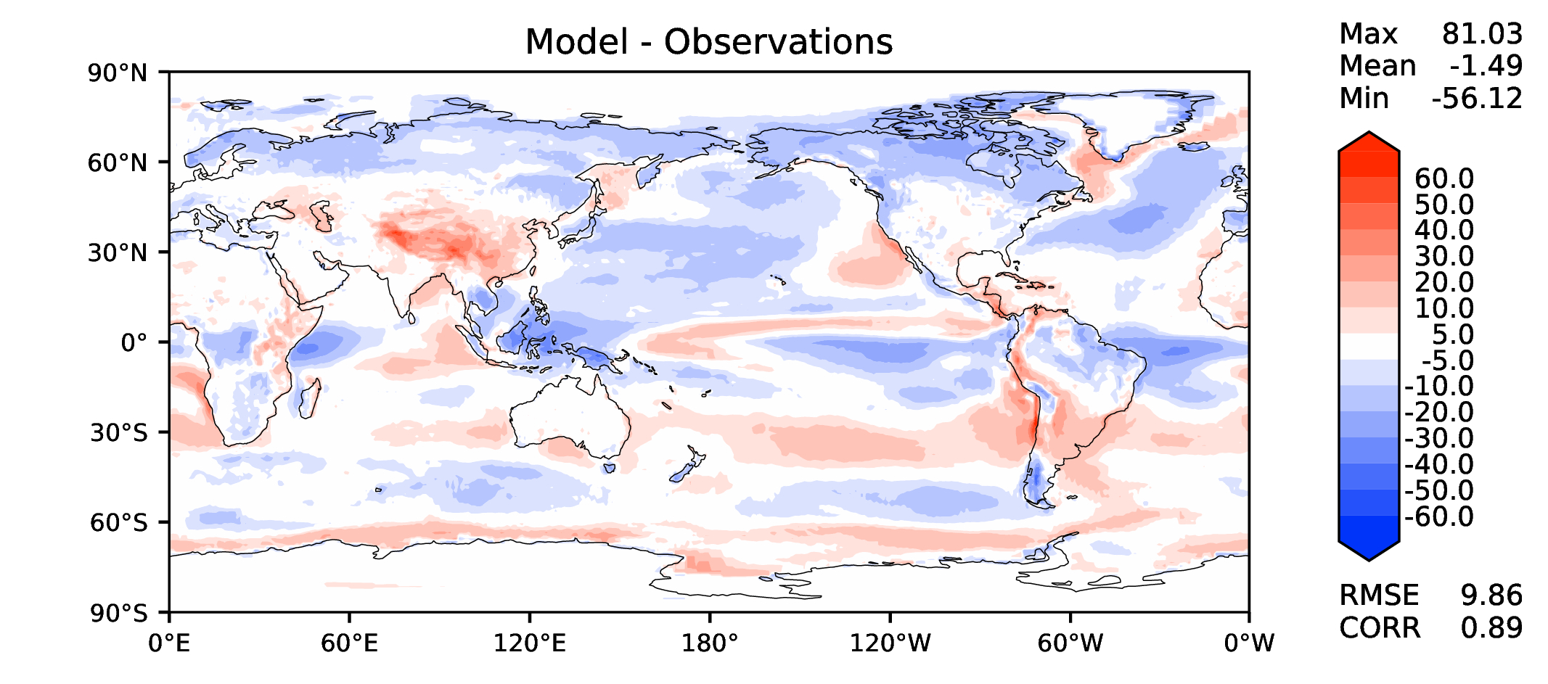
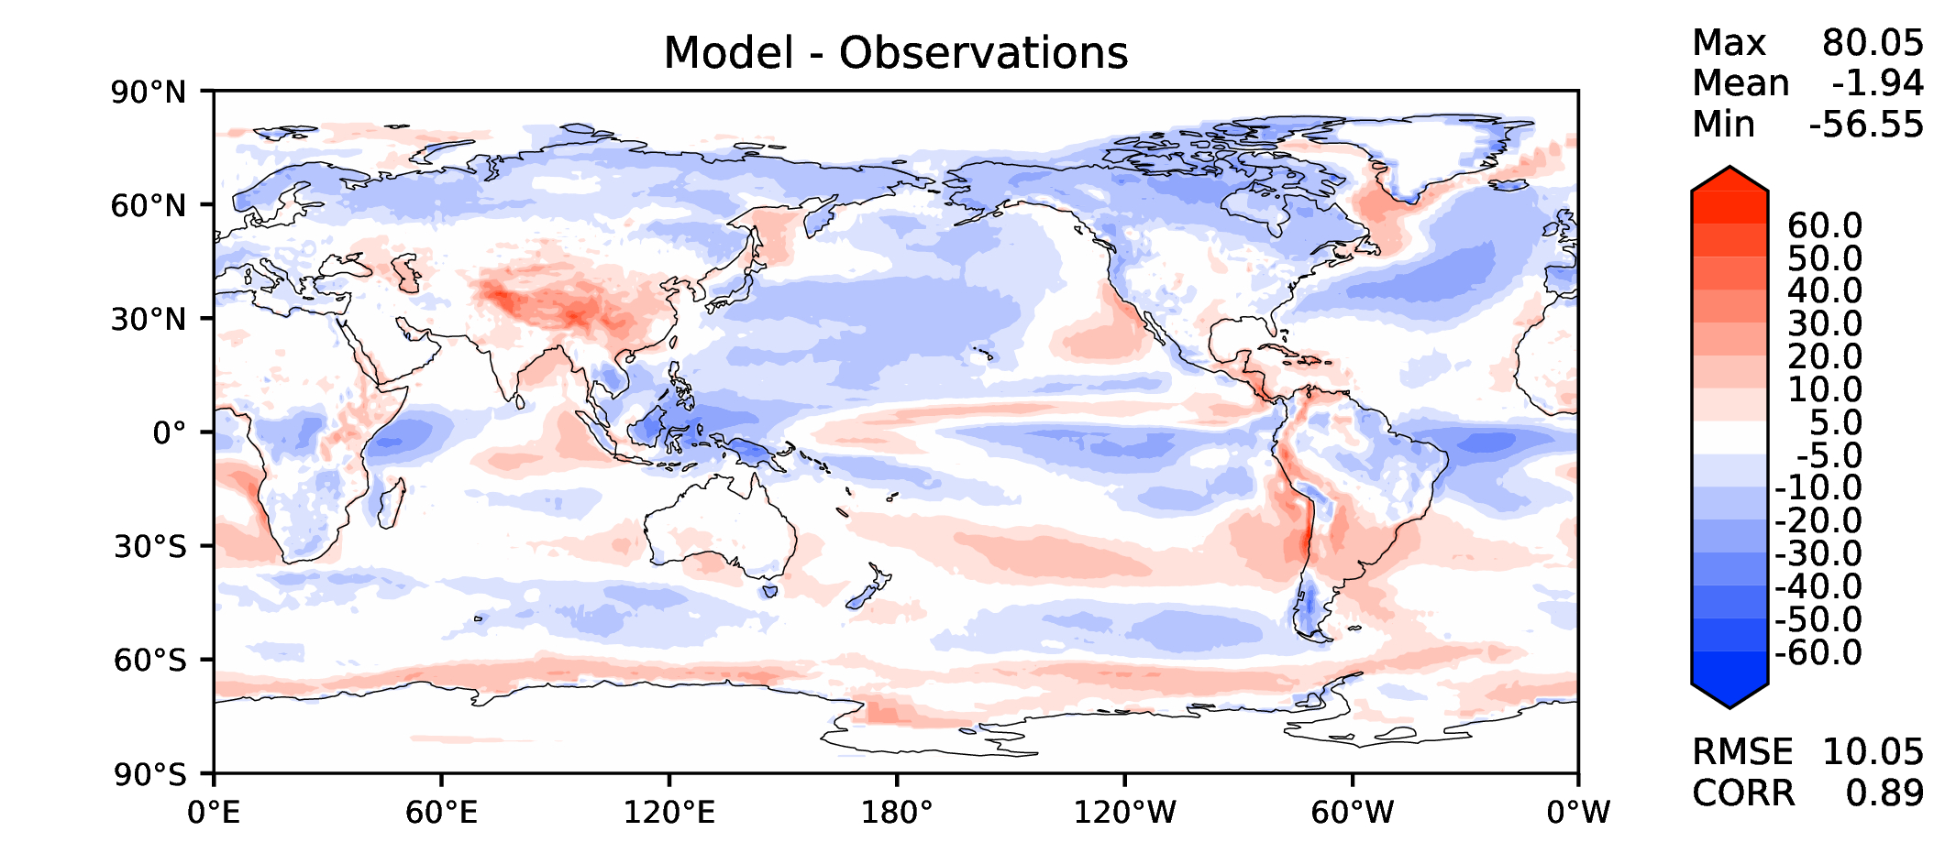
Annual TOA SW CRE
v2beta4
v2rc1a
v2rc1c
v2rc1d

Slide 10
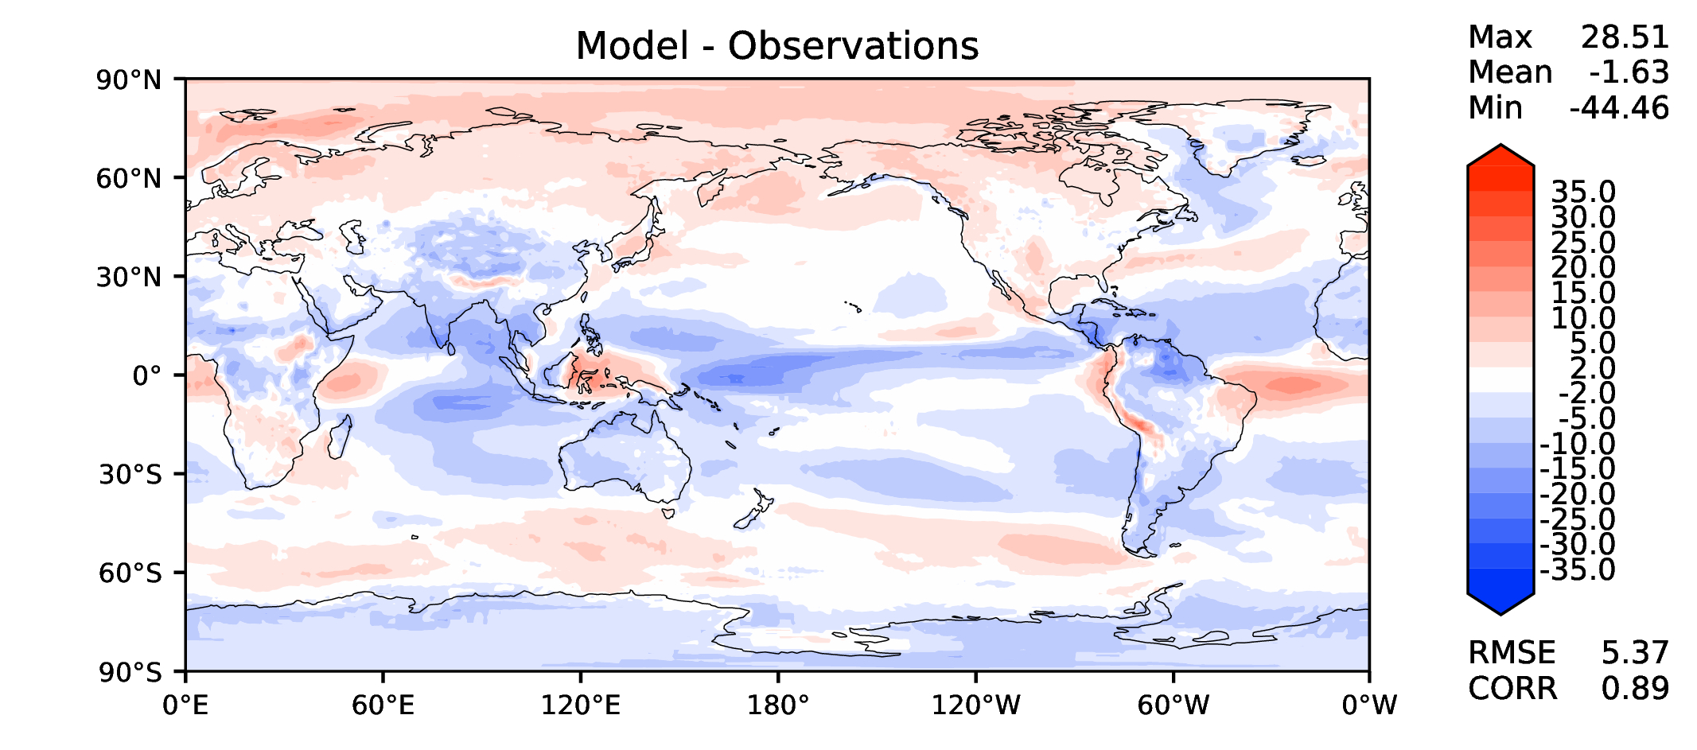
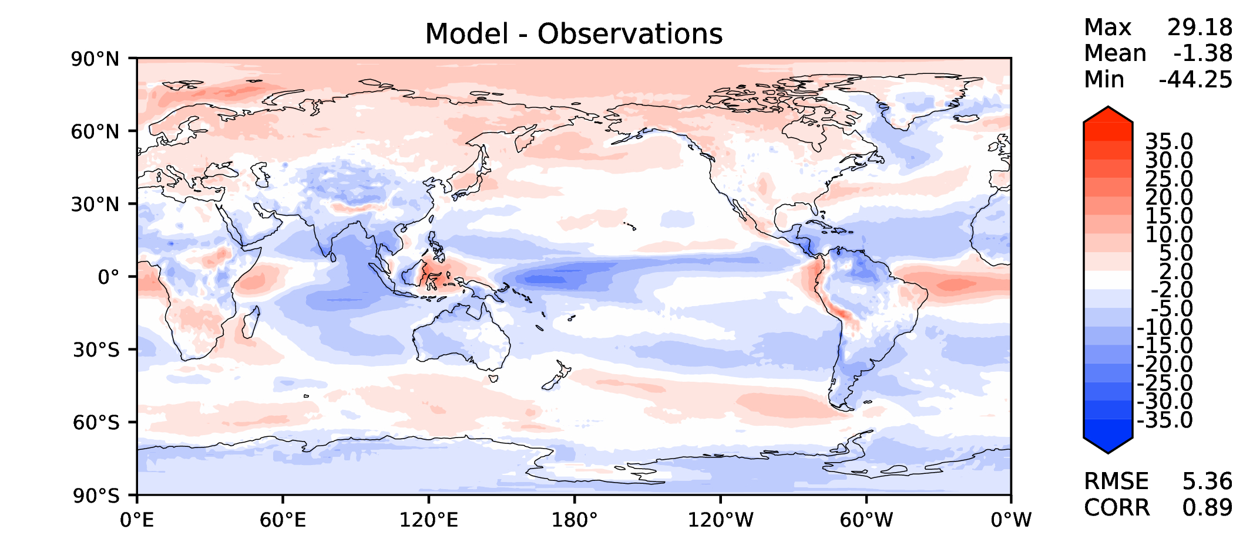
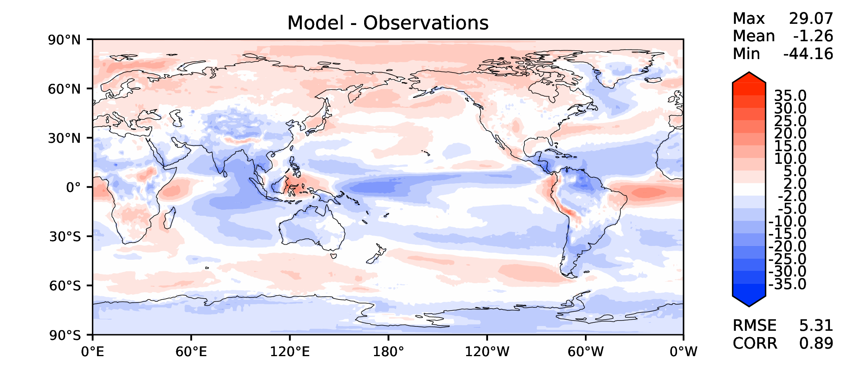
Annual TOA LW CRE
v2beta4
v2rc1a
v2rc1c
v2rc1d

Slide 11
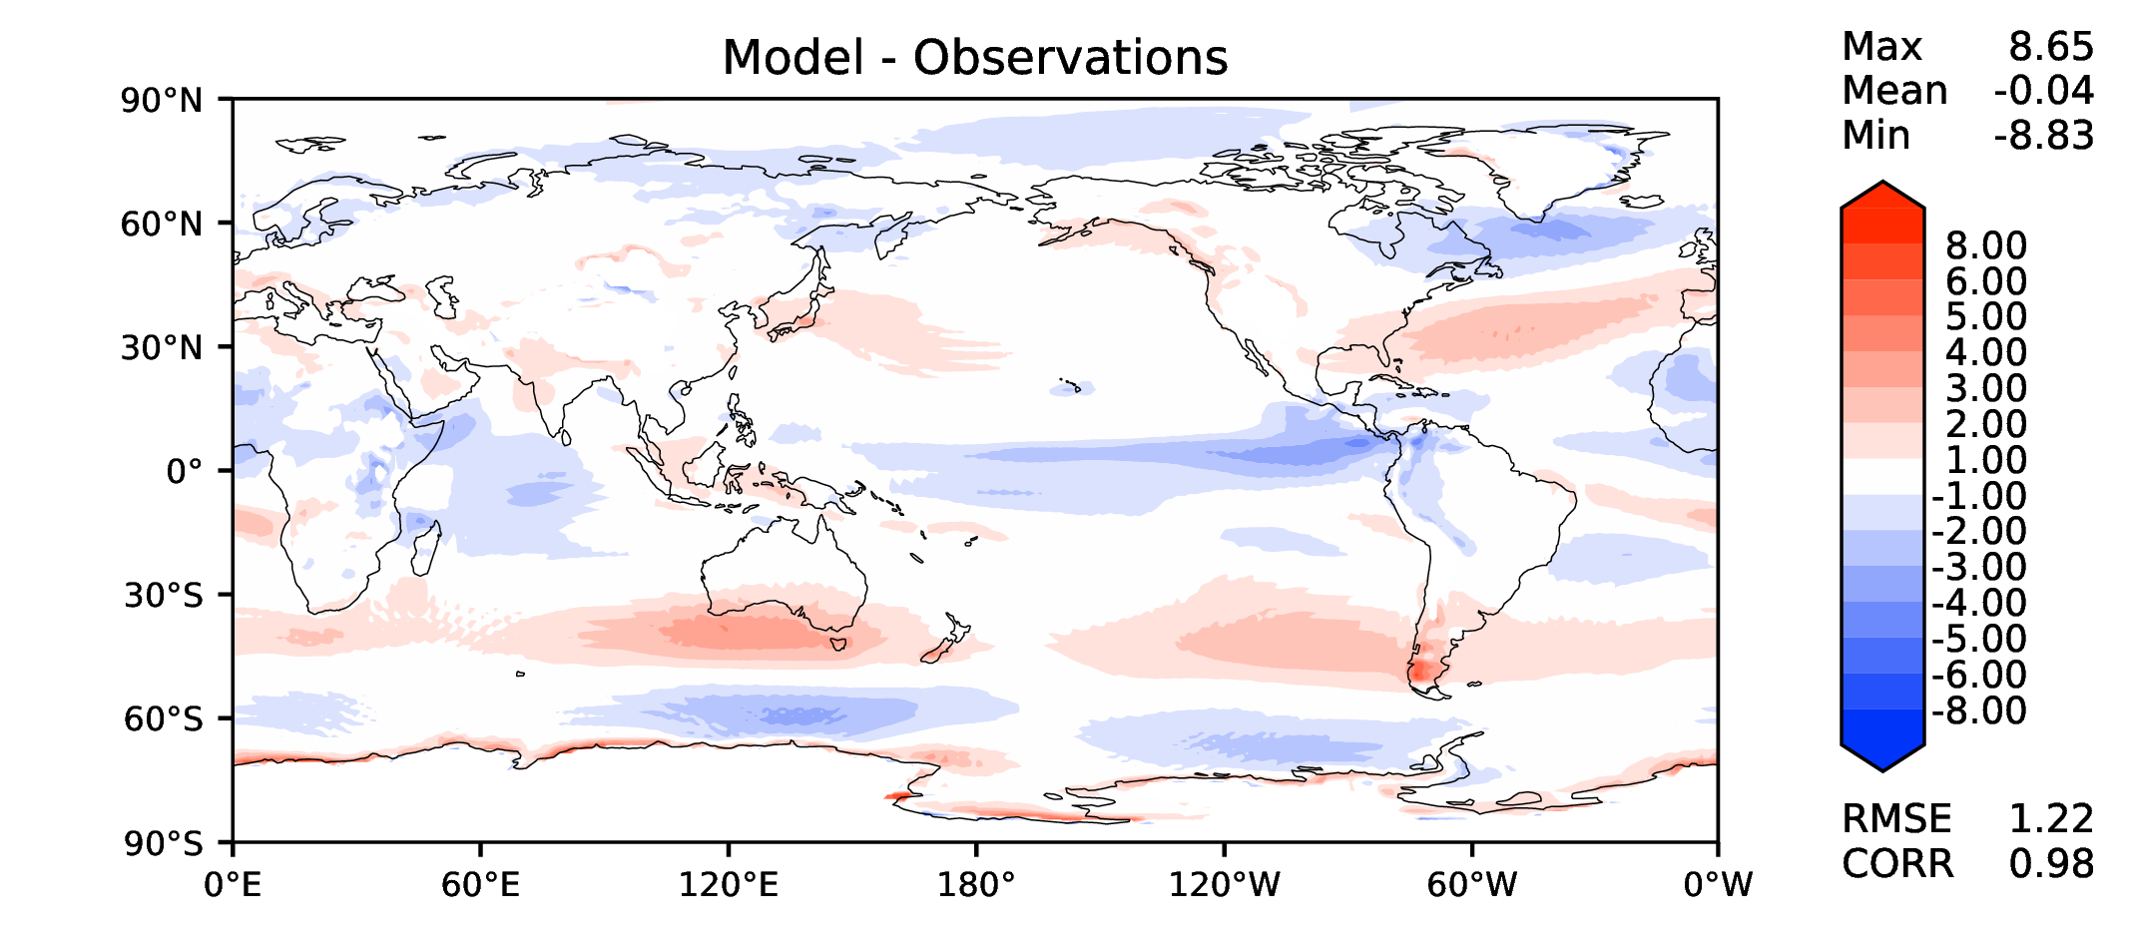
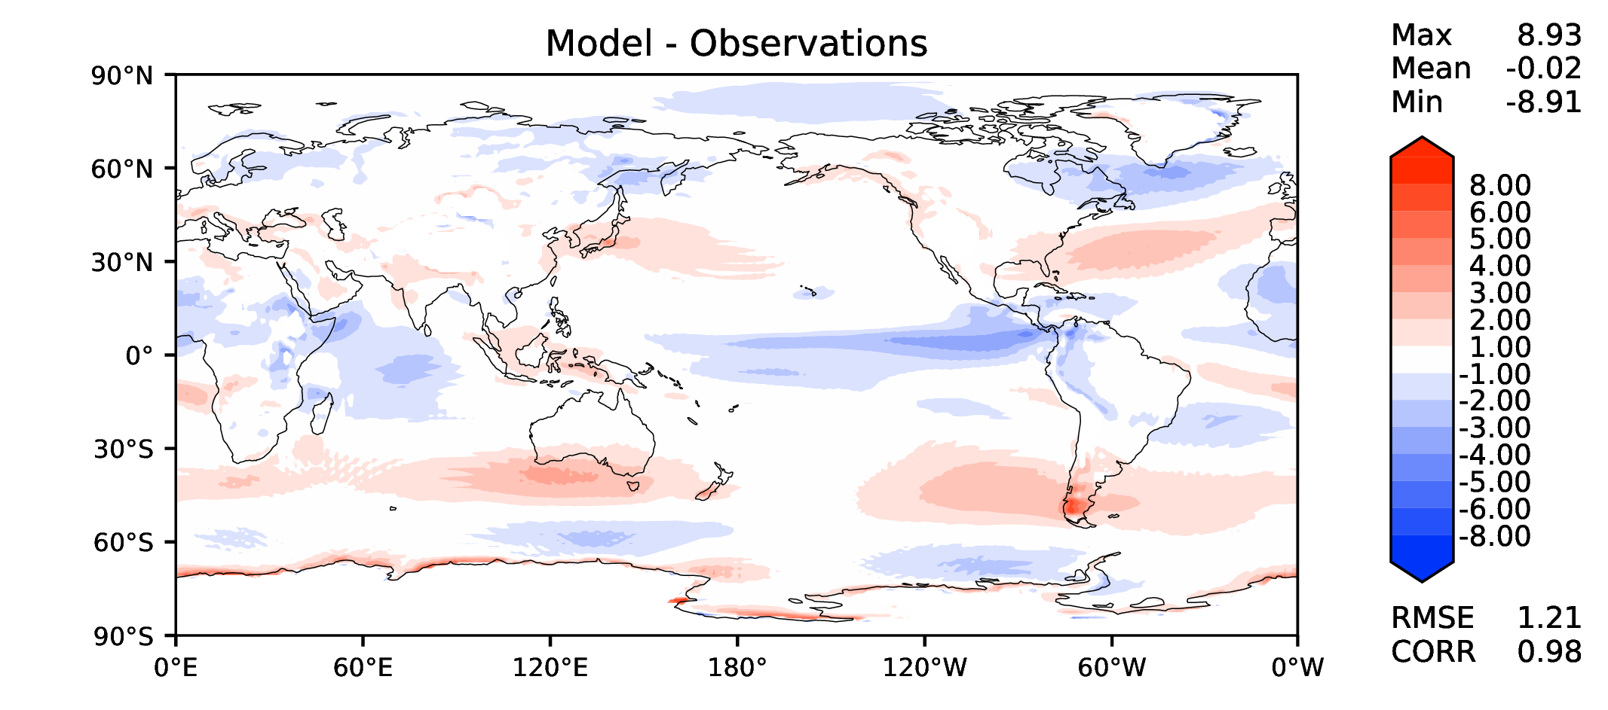
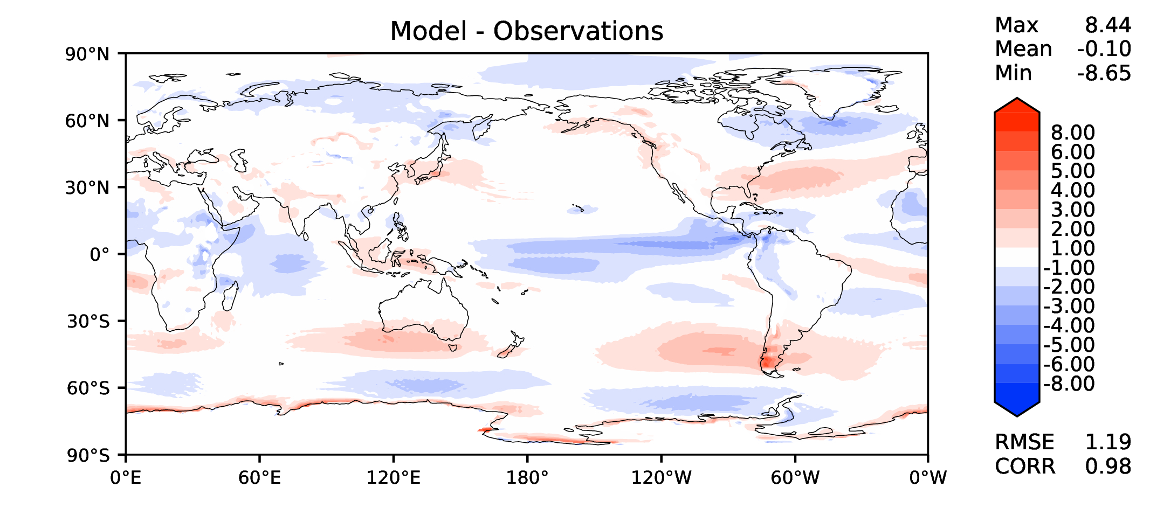
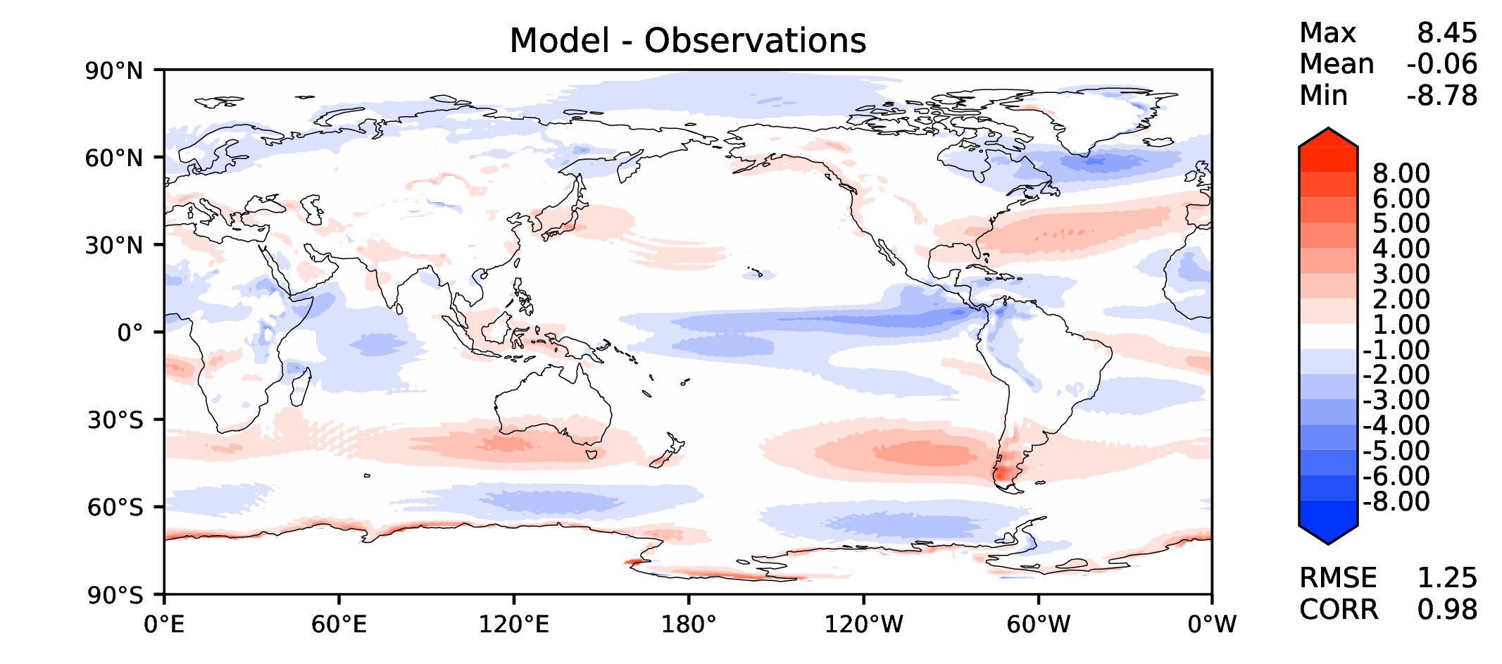
Annual u wind at 850 hPa
v2beta4
v2rc1a
v2rc1c
v2rc1d

Slide 12
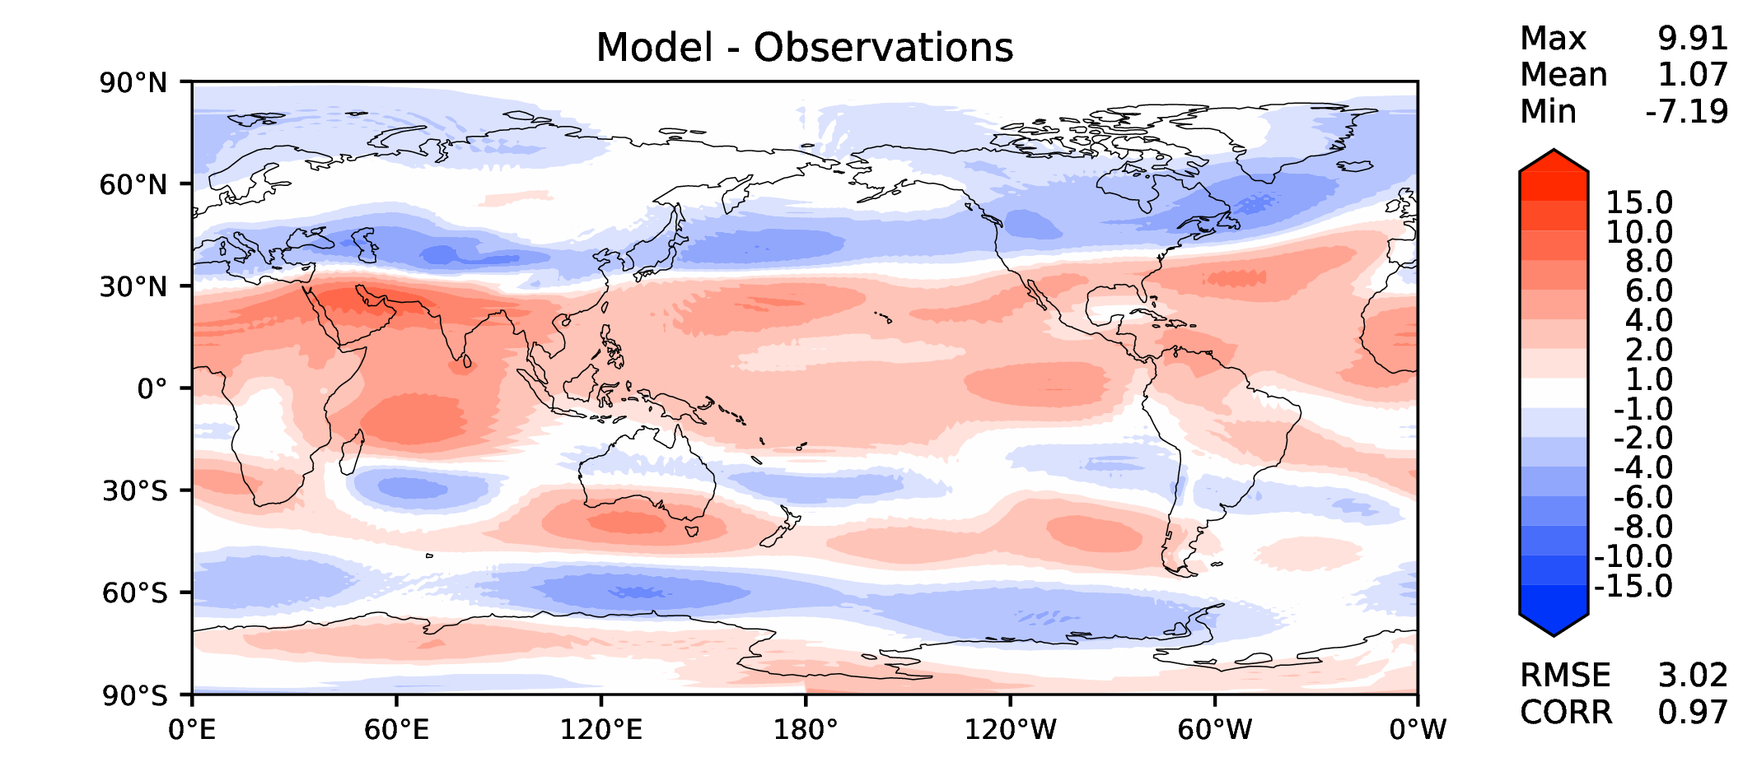
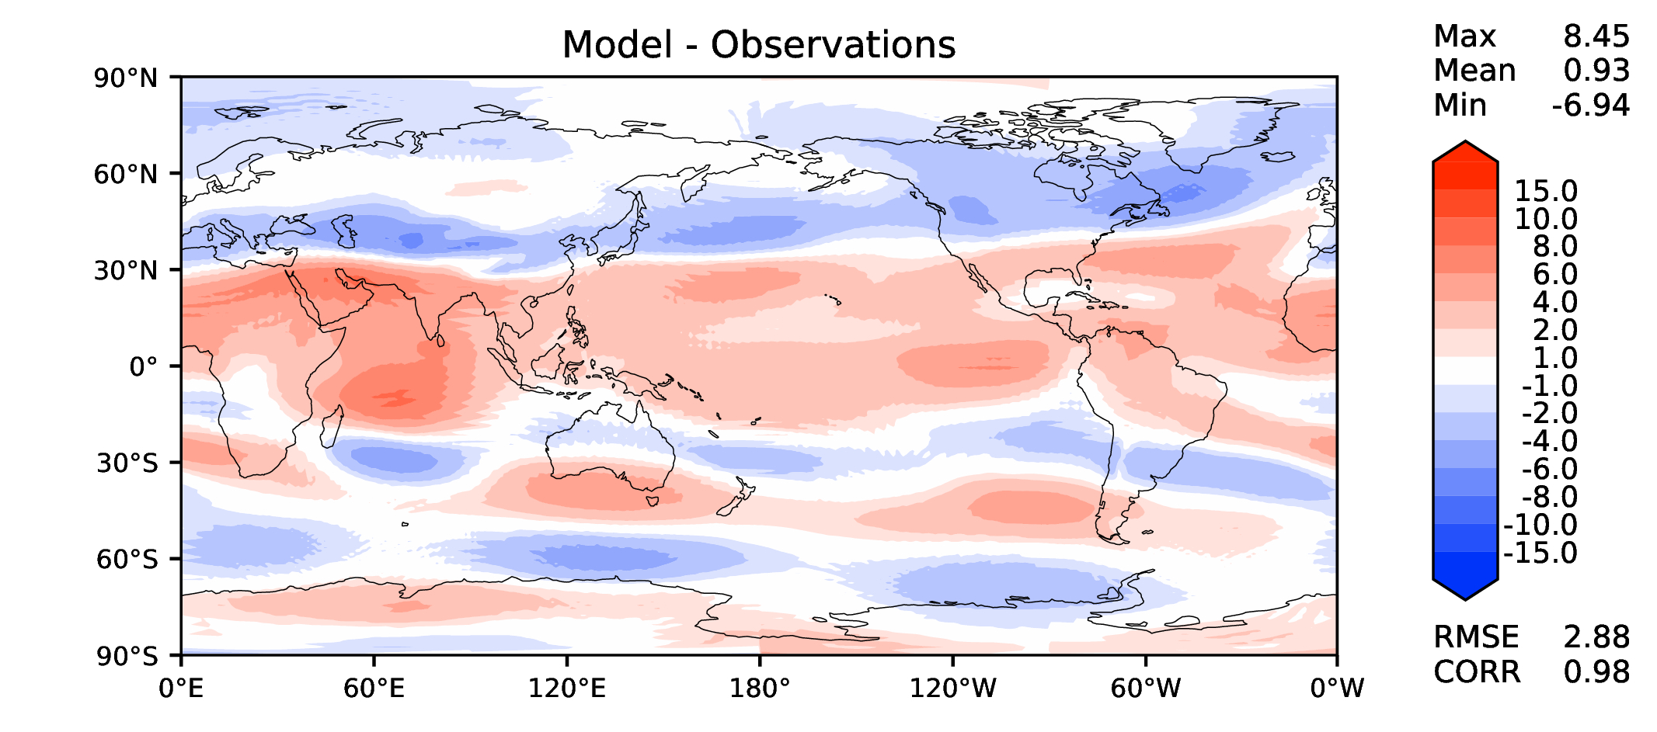
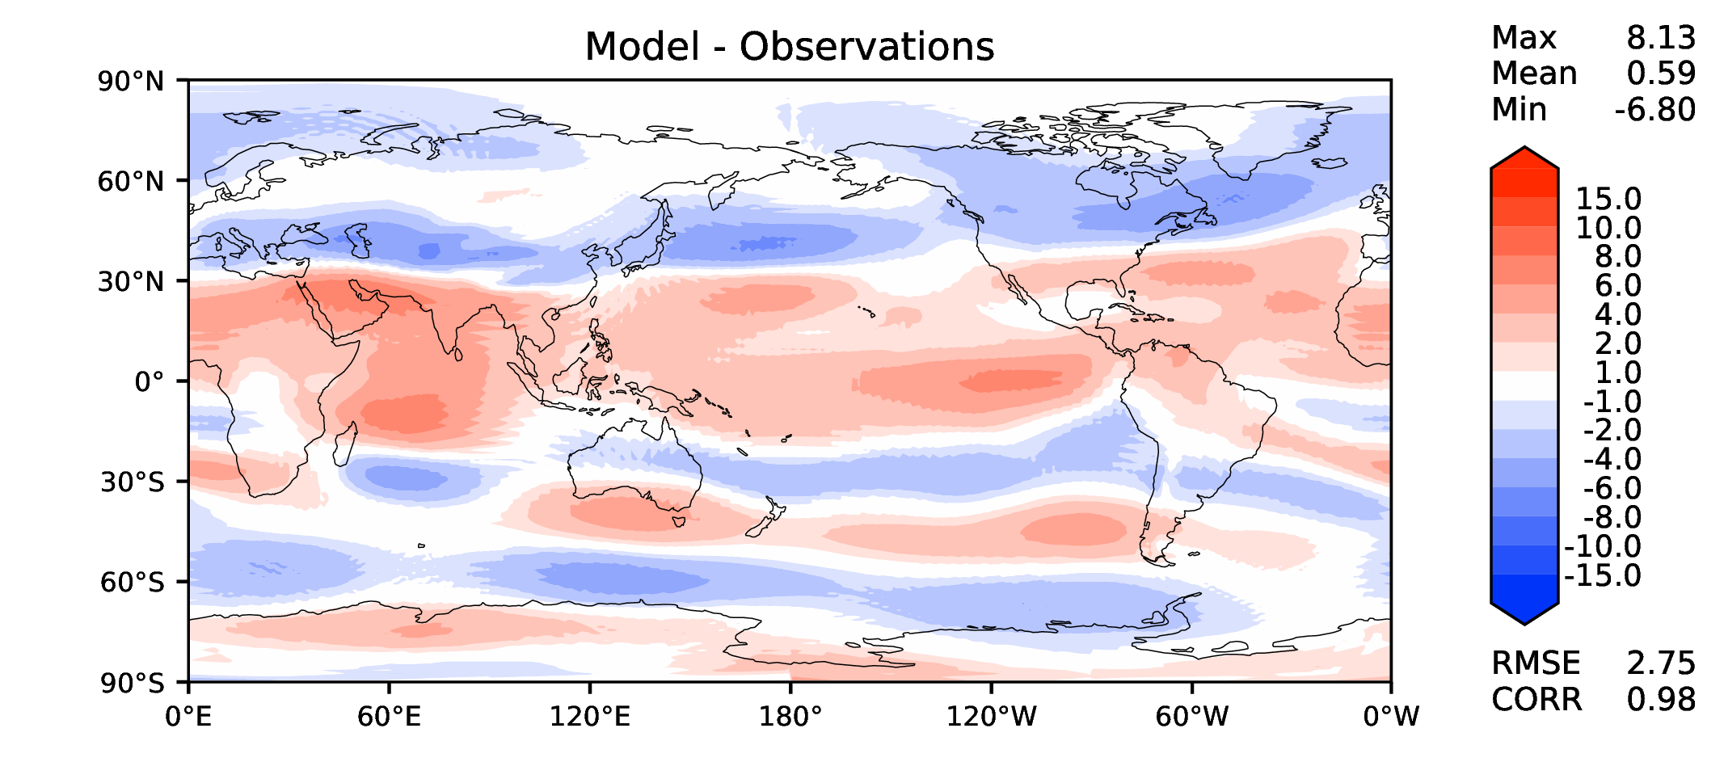
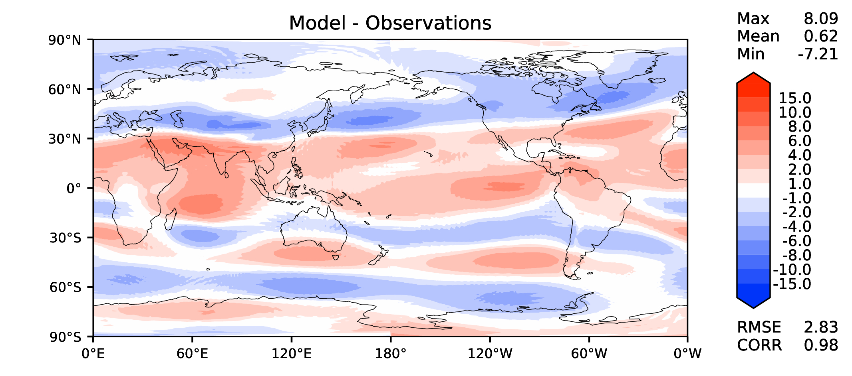
Annual u wind at 200 hPa
v2beta4
v2rc1a
v2rc1c
v2rc1d

Slide 13
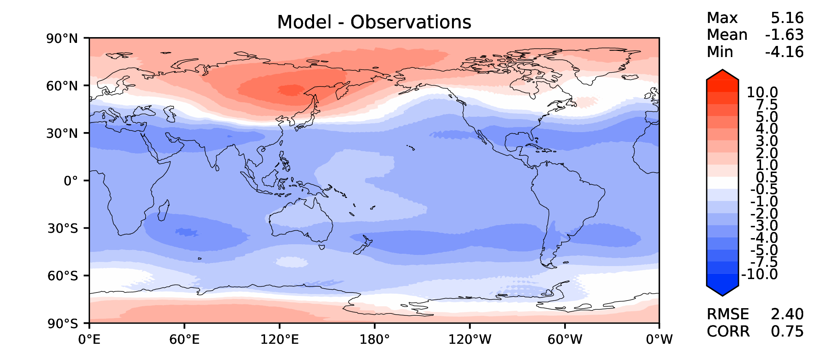
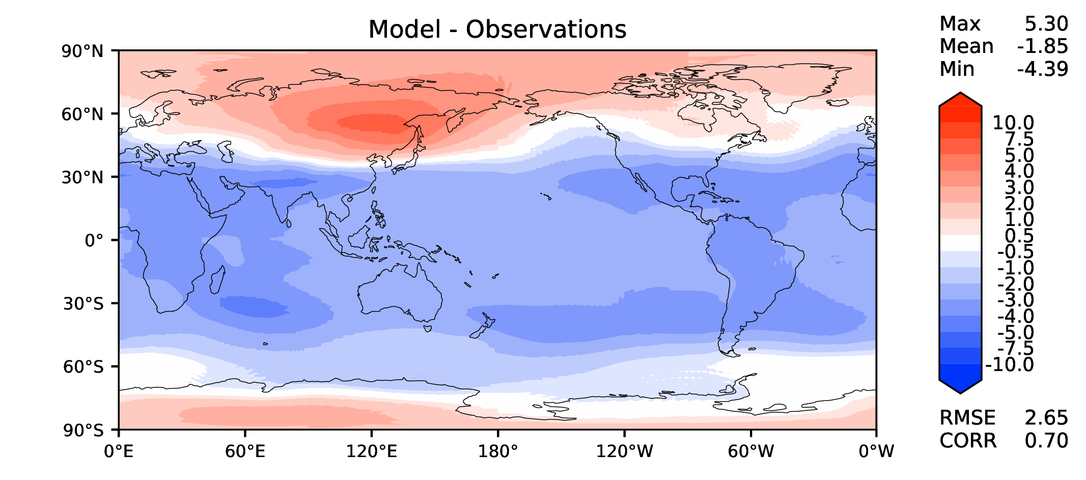
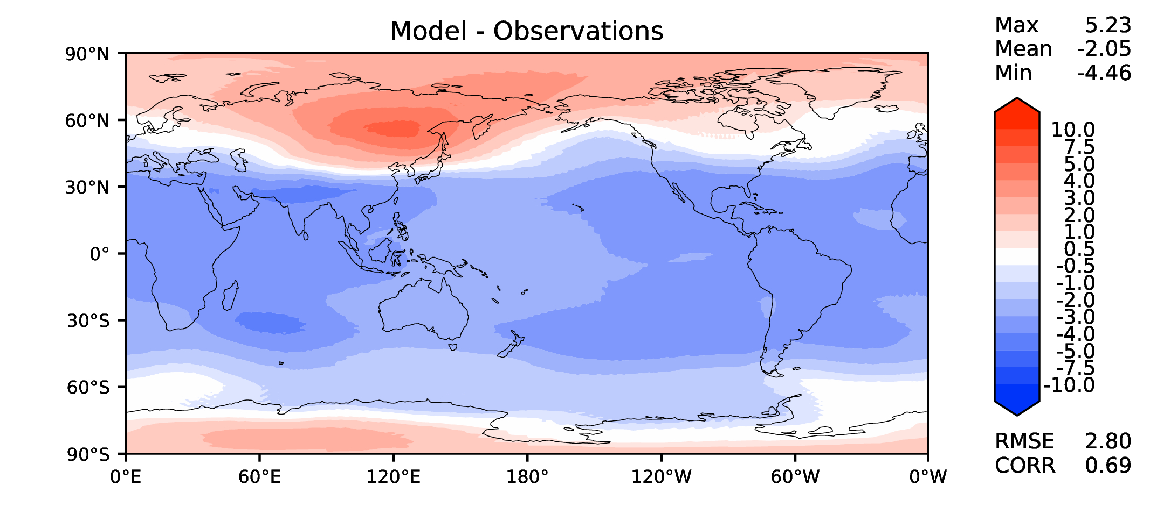
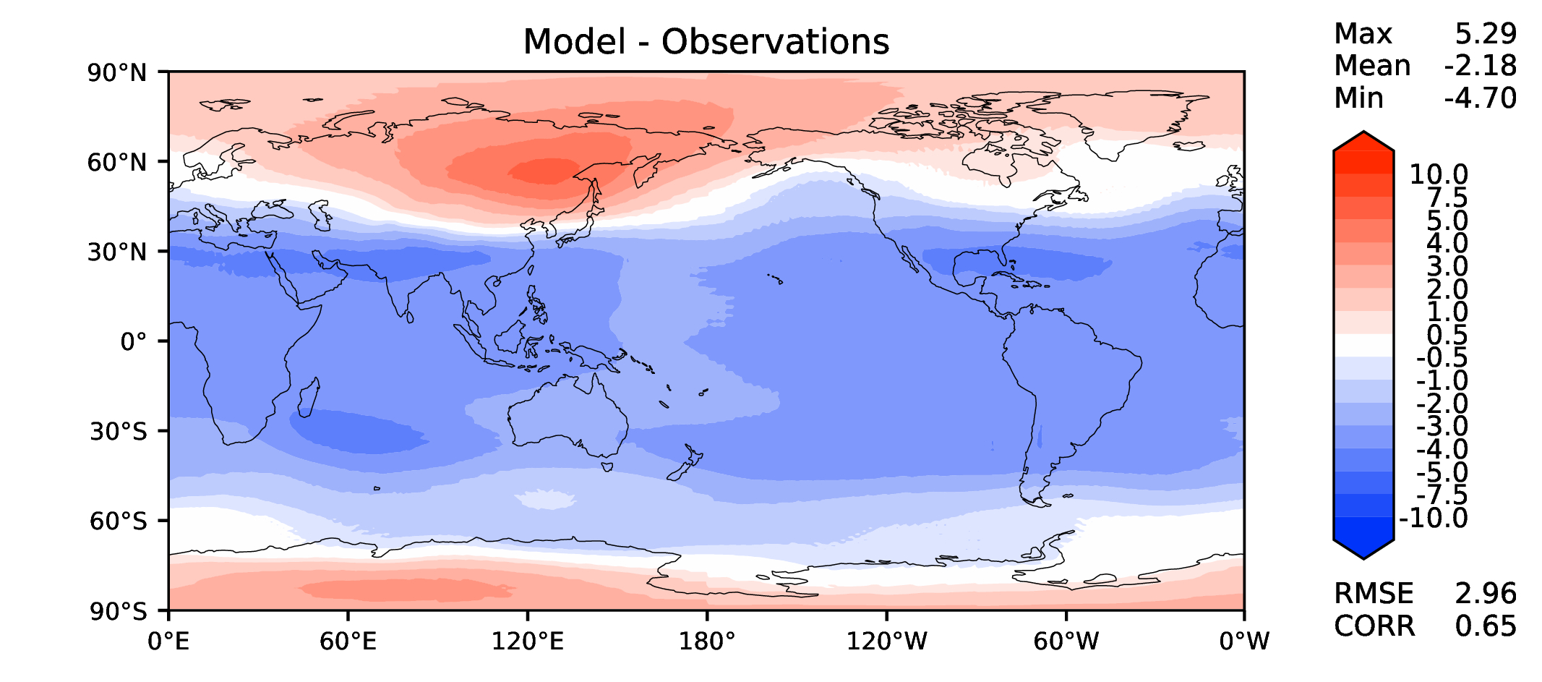
Annual T at 200 hPa
v2beta4
v2rc1a
v2rc1c
v2rc1d

Slide 14
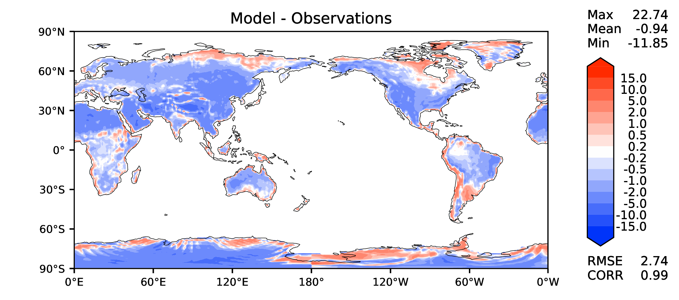
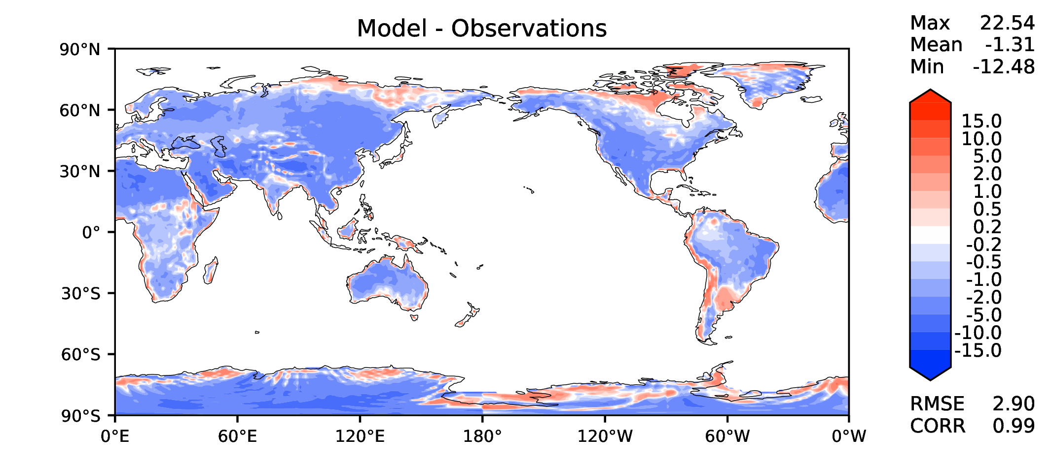
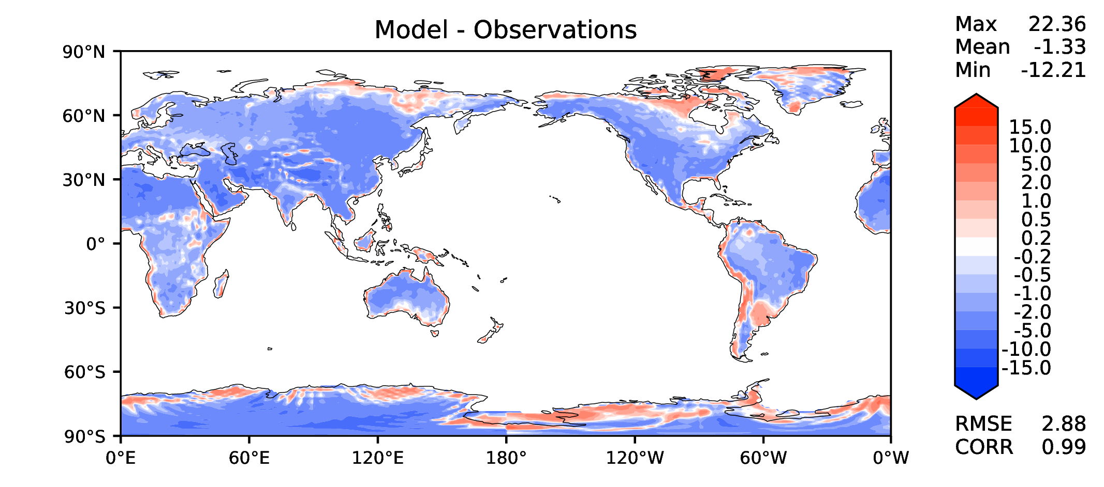
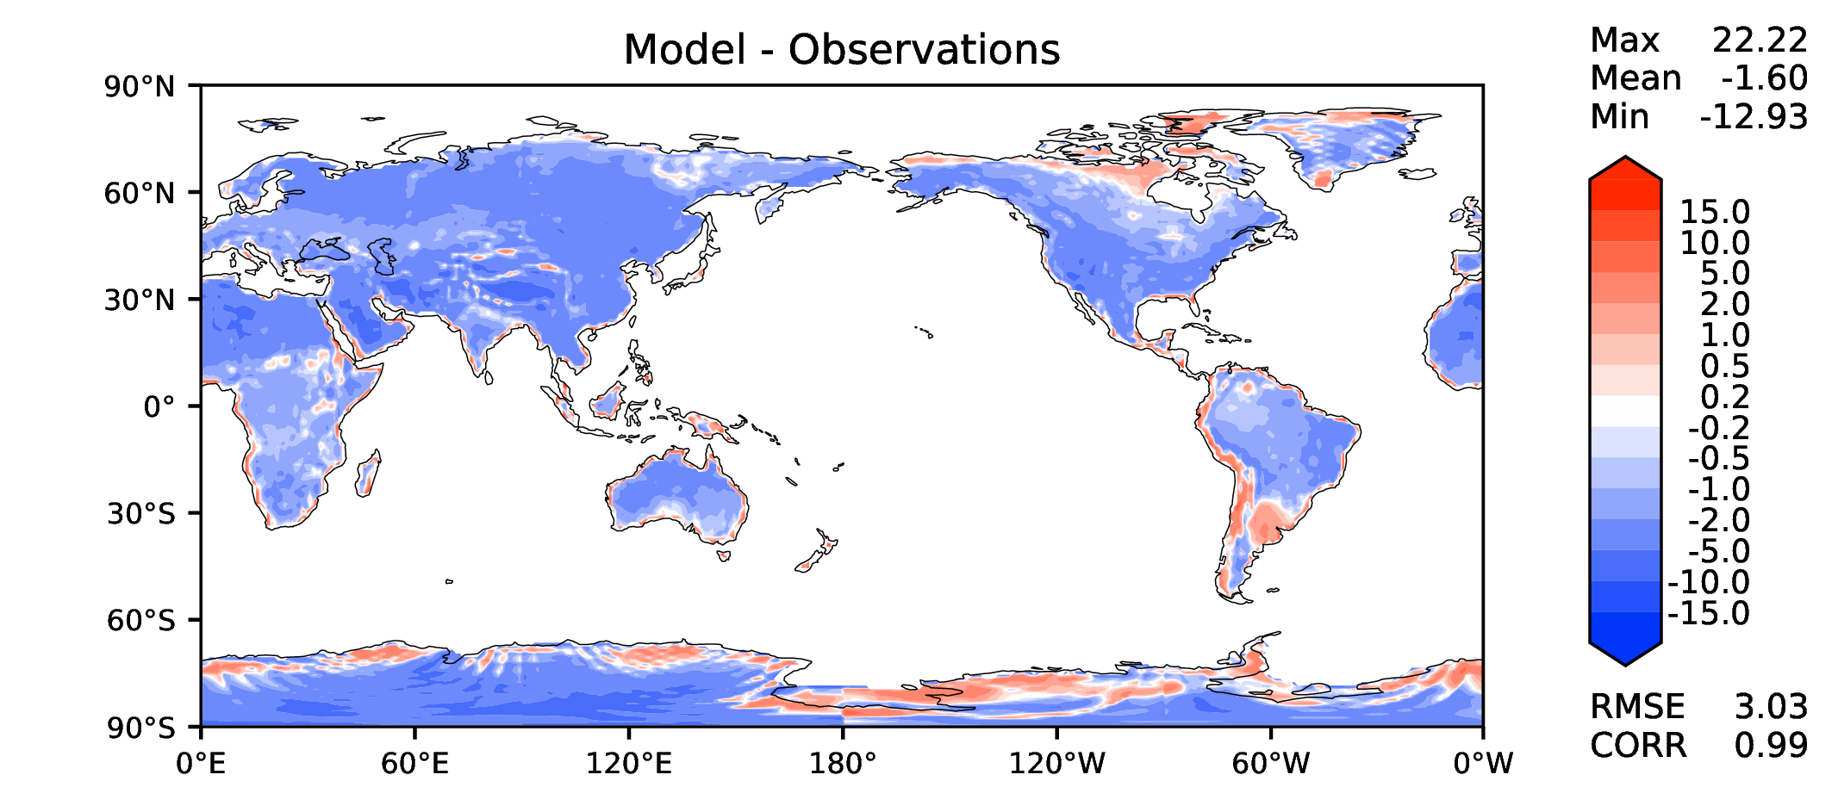
Annual surface air T (land)
v2beta4
v2rc1a
v2rc1c
v2rc1d

Slide 15
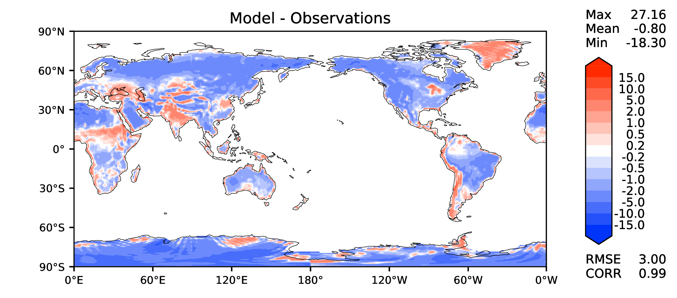
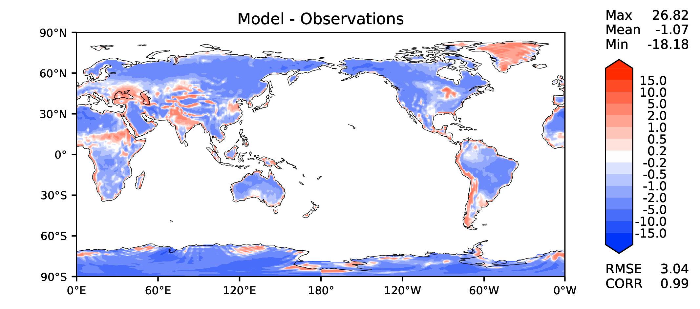
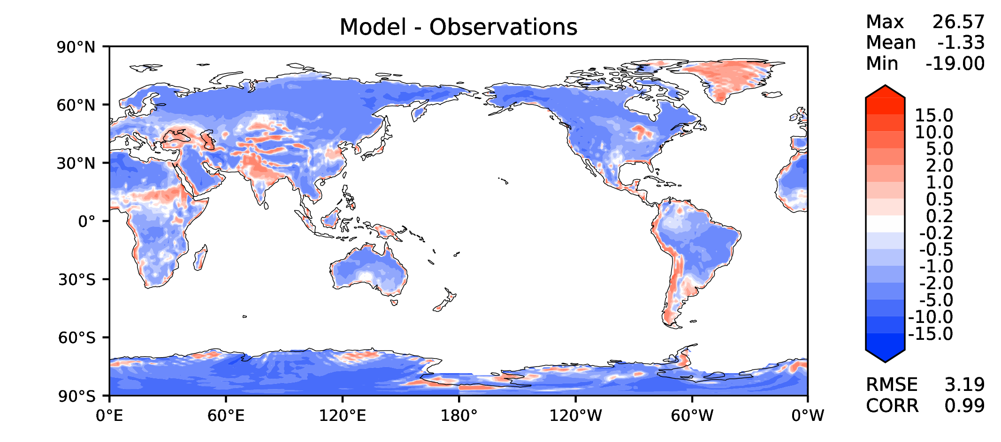
JJA surface air T (land)
v2beta4
v2rc1a
v2rc1c
v2rc1d

Slide 16
Aerosol optical depth
v2beta4
v2rc1a
v2rc1c
v2rc1d

Slide 17
TAUXY ANN ocean
v2beta4
v2rc1a
v2rc1c
v2rc1d

Slide 18
CLDLWP_OCN global SSMI
v2beta4
v2rc1a
v2rc1c
v2rc1d

