Slide 1
Summary table (RMSE vs obs)
Variable | Season | v2beta4 | v2rc1a | v2rc1c | v2rc1d
SST | ANN | 1.12 | 1.14 | 1.15 | 1.20
PRECT | ANN | 1.02 | 1.00 | 0.99 | 0.98
PRECT | DJF | 1.41 | 1.39 | 1.38 | 1.39
PRECT | MAM | 1.27 | 1.25 | 1.21 | 1.23
PRECT | JJA | 1.39 | 1.38 | 1.37 | 1.35
PRECT | SON | 1.33 | 1.30 | 1.26 | 1.24
RESTOM | ANN | 8.36 | 8.35 | 8.38 | 8.42
SWCF | ANN | 9.89 | 9.91 | 9.88 | 9.99
LWCF | ANN | 5.33 | 5.25 | 5.29 | 5.21
u850 | ANN | 1.21 | 1.20 | 1.21 | 1.23
u200 | ANN | 2.93 | 2.81 | 2.85 | 2.84
T200 | ANN | 2.42 | 2.64 | 2.82 | 2.93
TREFHT | ANN | 2.75 | 2.91 | 2.94 | 2.99
TREFHT | JJA | 3.00 | 3.17 | 3.08 | 3.16
AODVIS | ANN | 0.06 | 0.06 | 0.06 | 0.06
TAUXY | ANN | 0.02 | 0.02 | 0.02 | 0.02
CLDLWP_OCN | ANN | 39.69 | 39.68 | 43.04 | 42.48

Slide 2
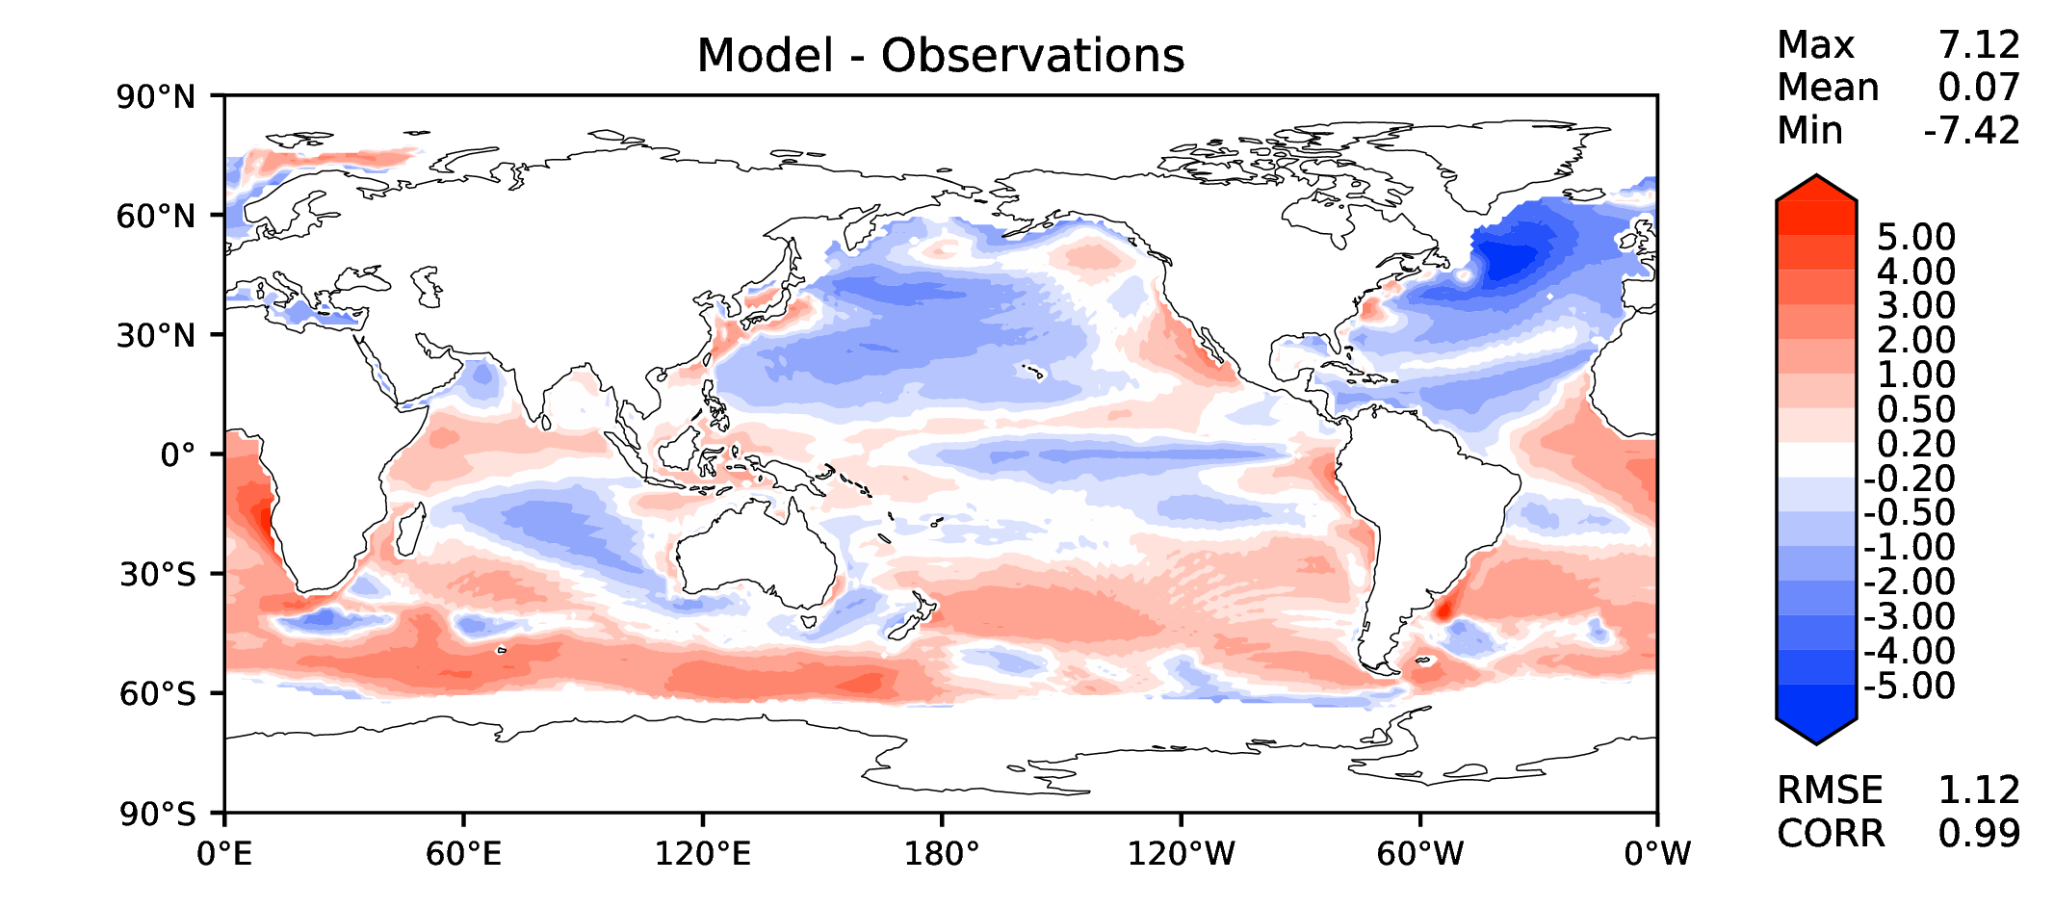
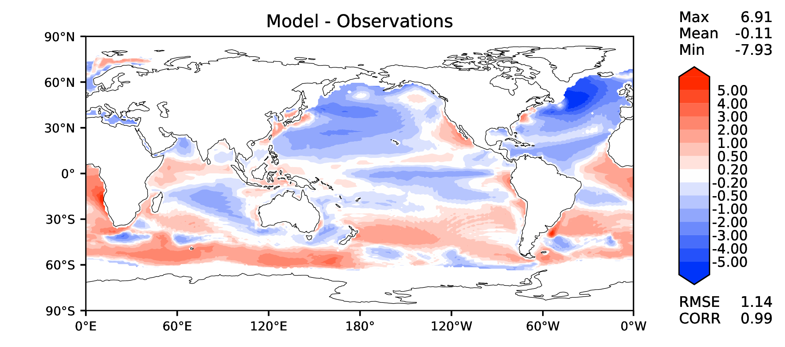
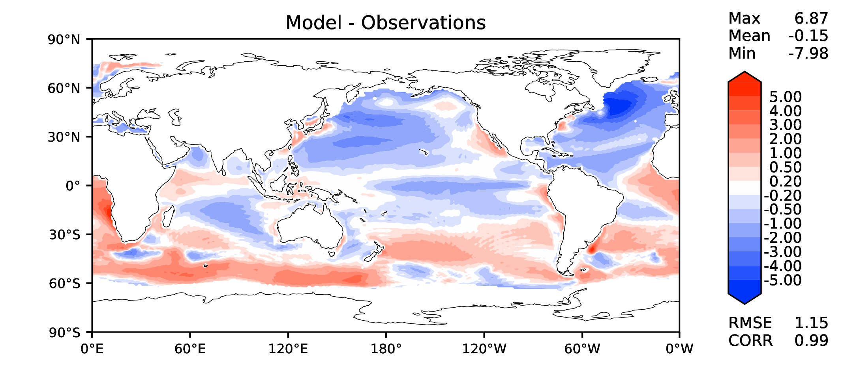
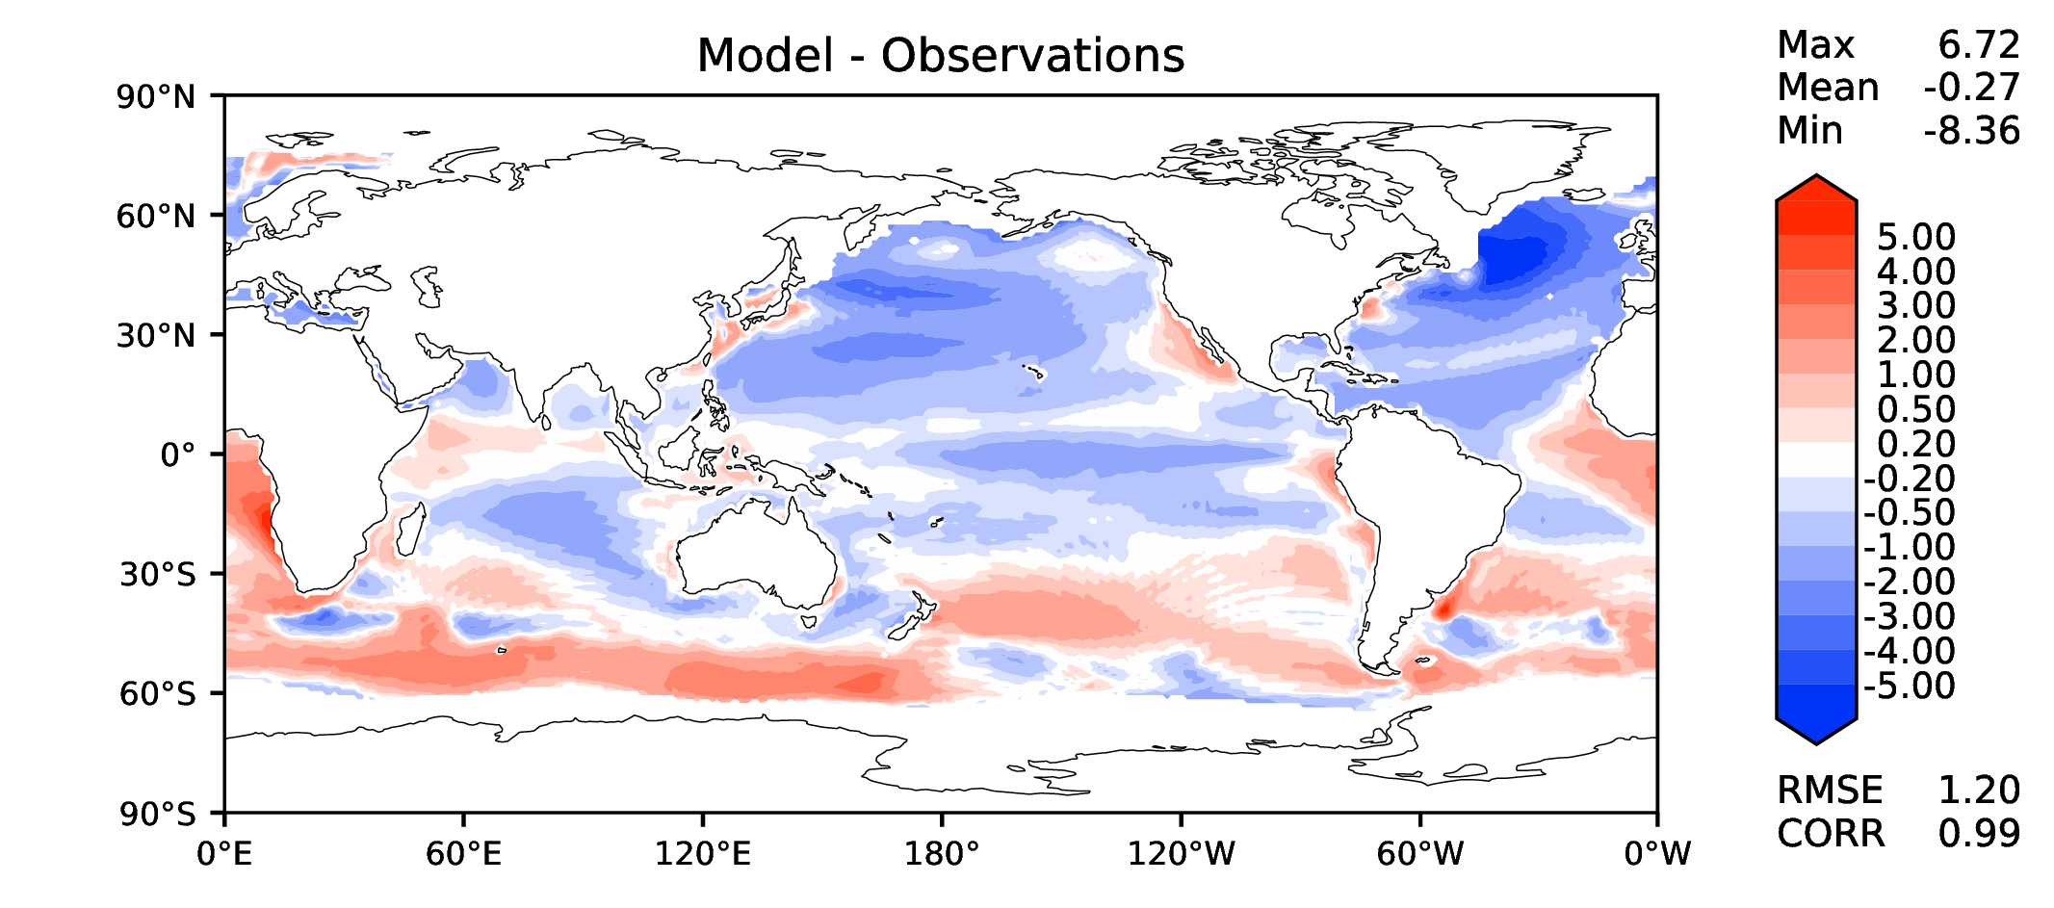
Annual SST (pre-industrial)
v2beta4
v2rc1a
v2rc1c
v2rc1d

Slide 3
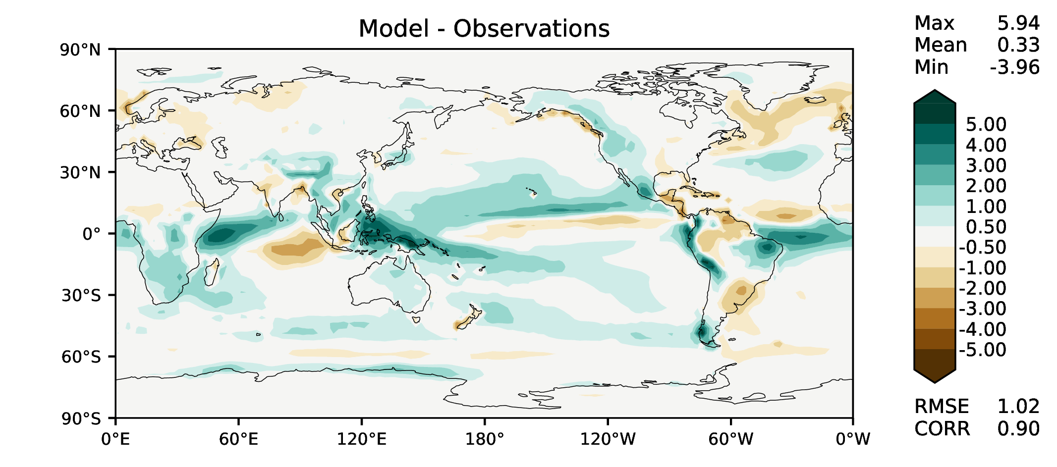
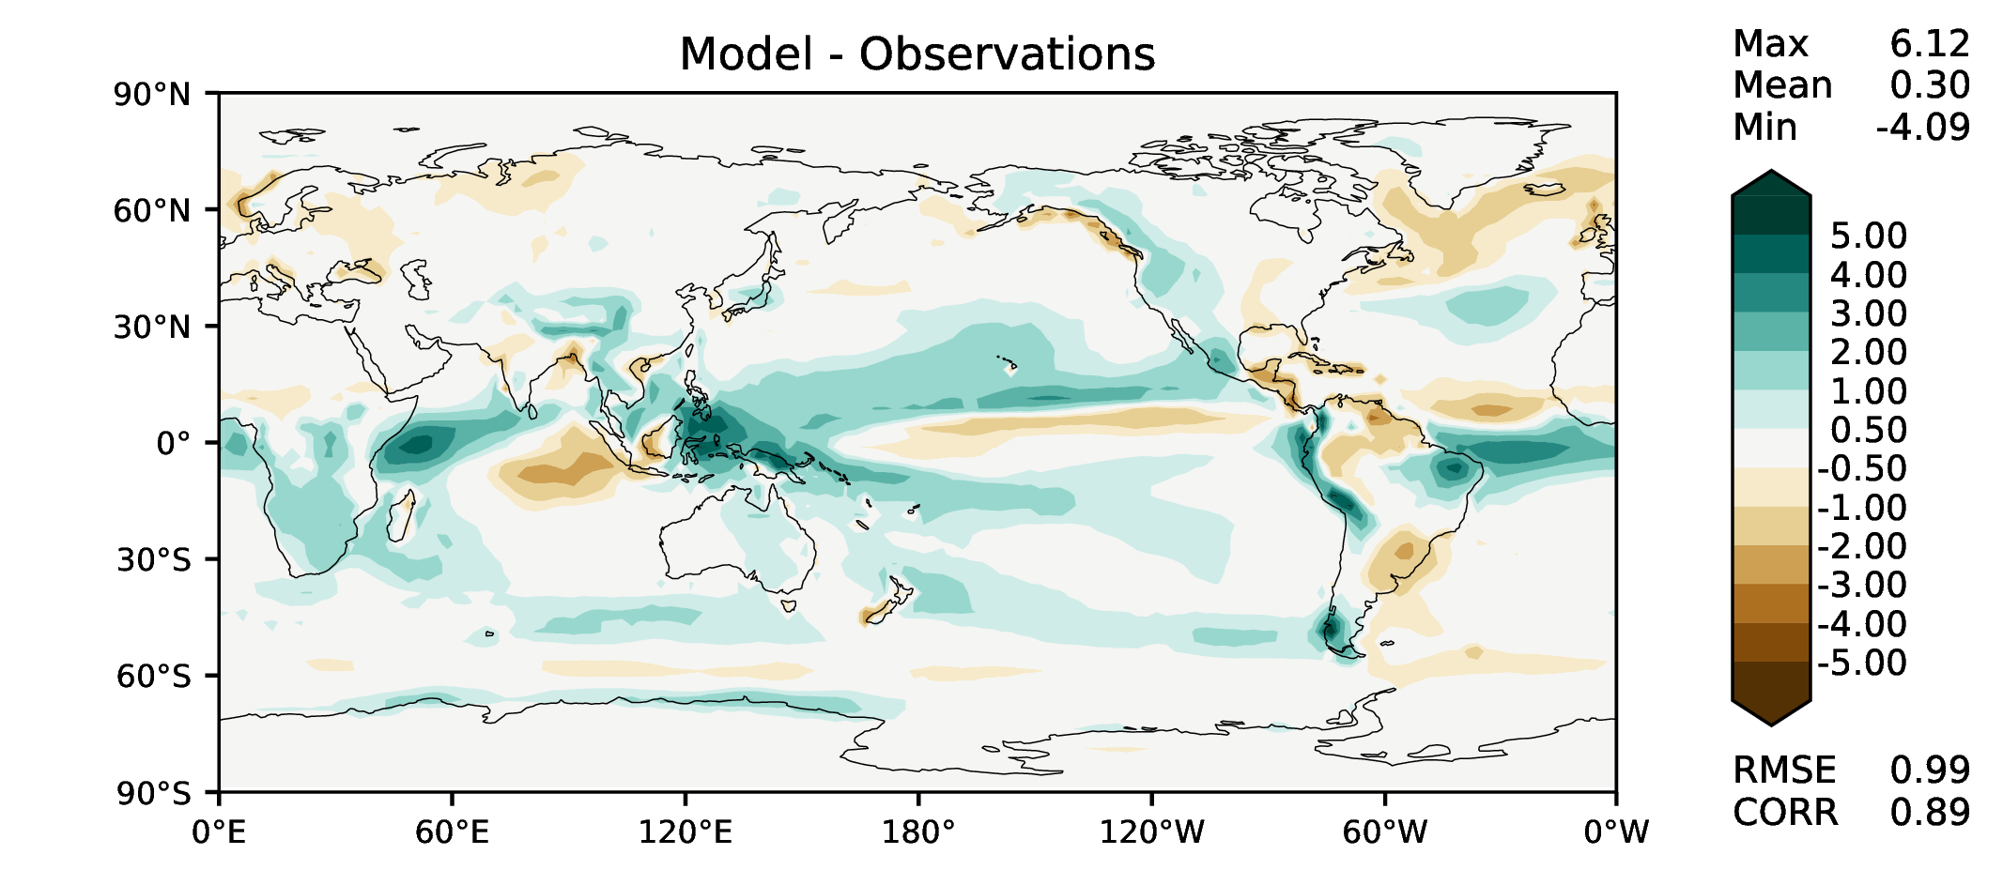
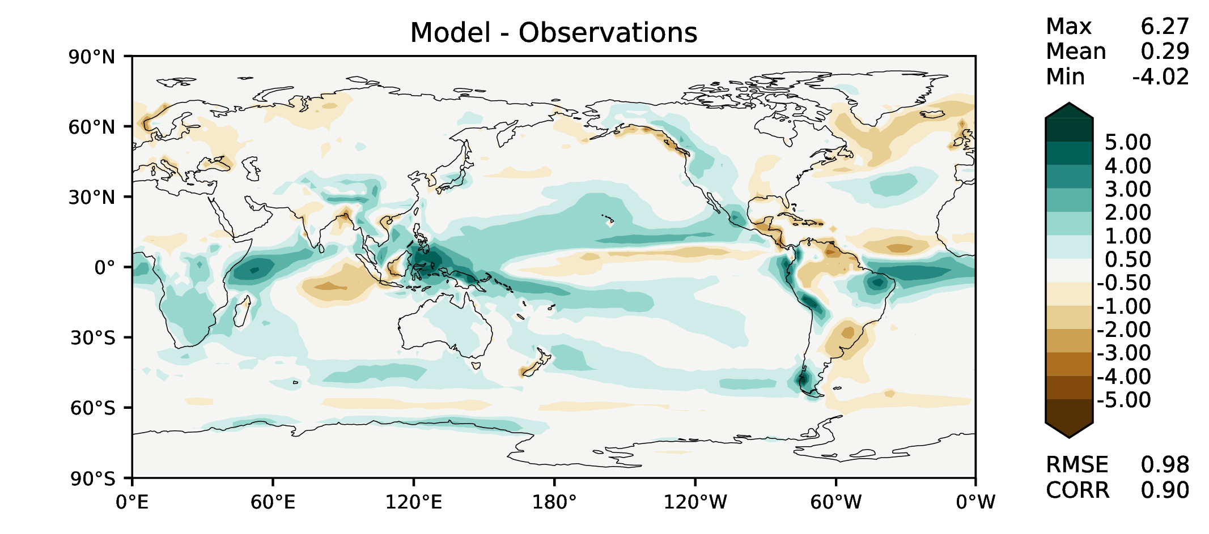
Annual total precipitation
v2beta4
v2rc1a
v2rc1c
v2rc1d

Slide 4
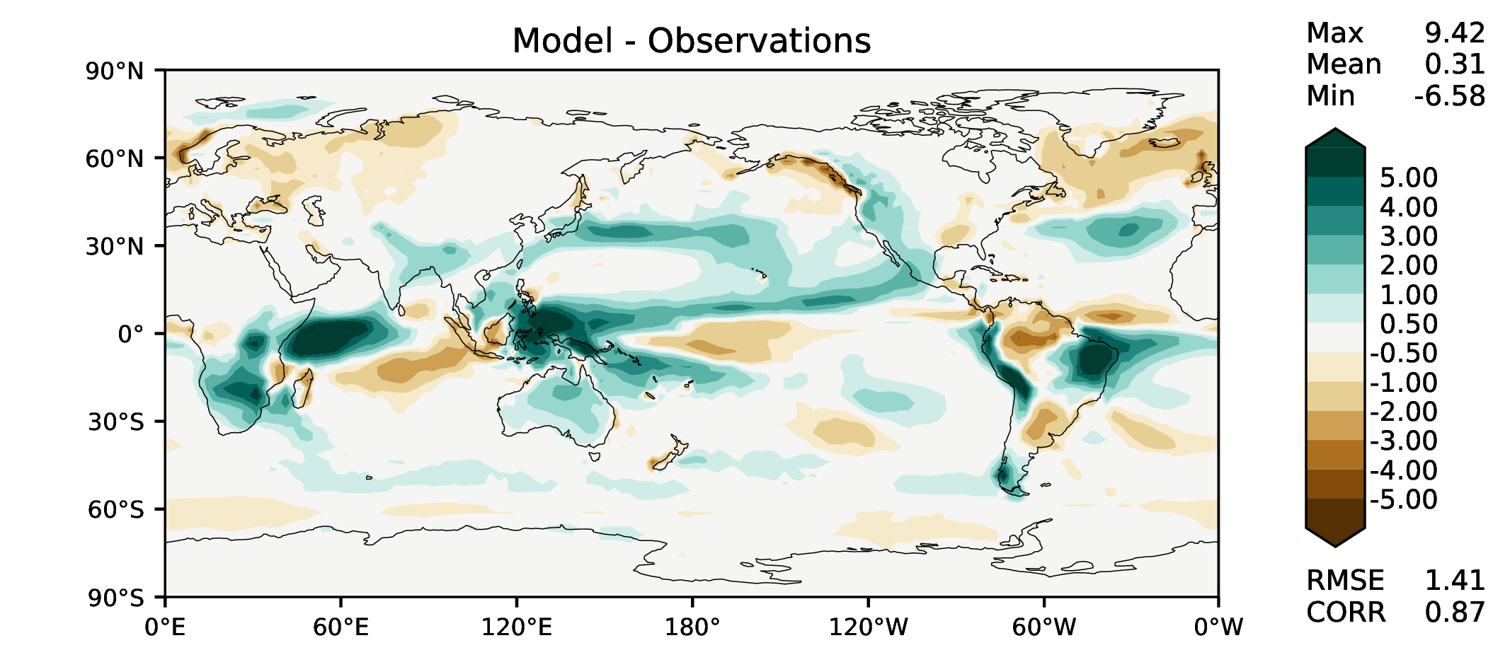
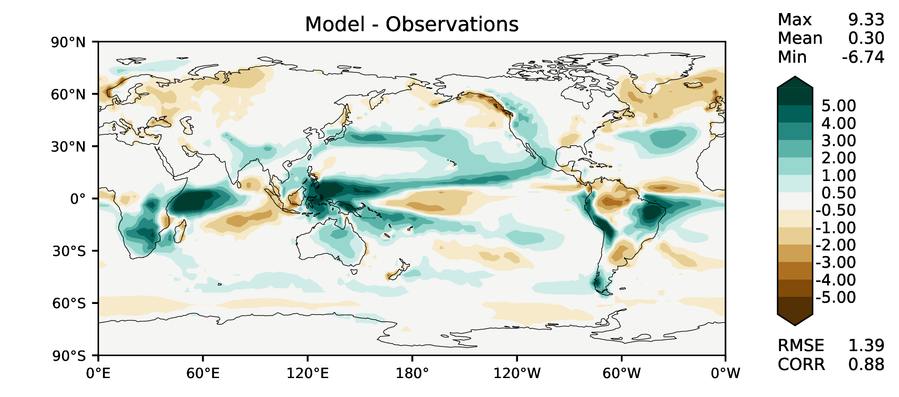
DJF total precipitation
v2beta4
v2rc1a
v2rc1c
v2rc1d

Slide 5
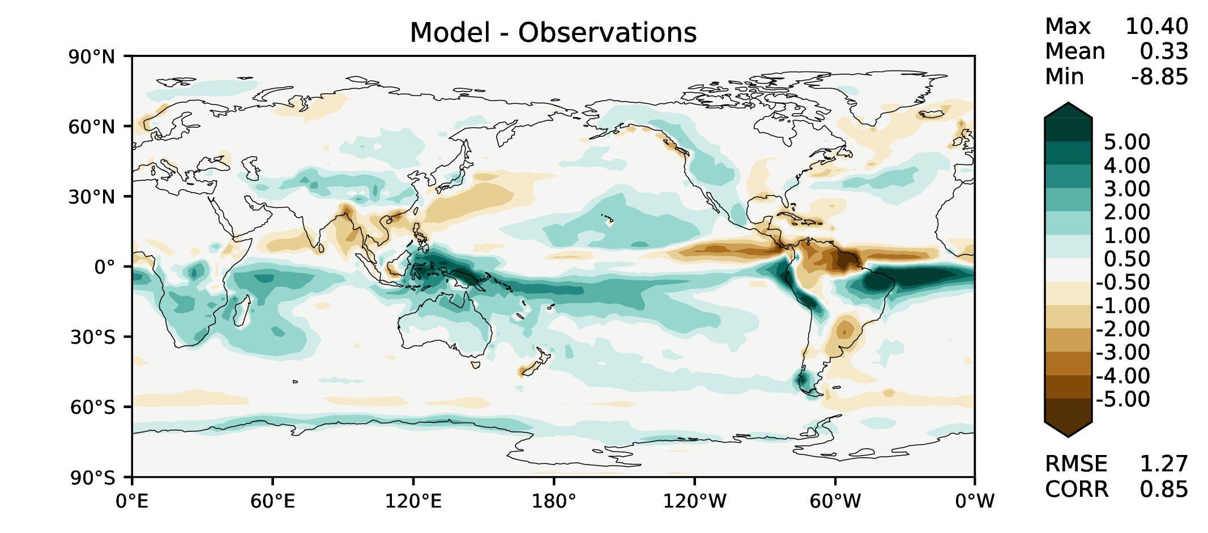
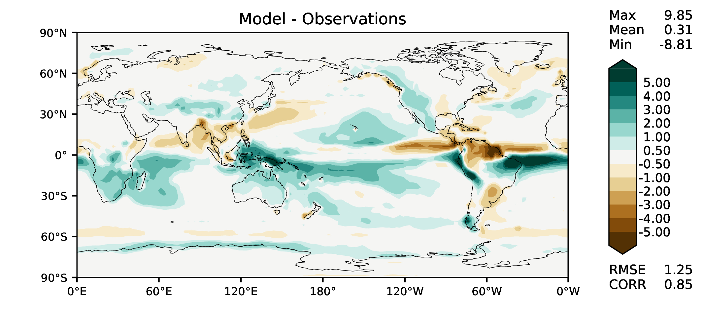
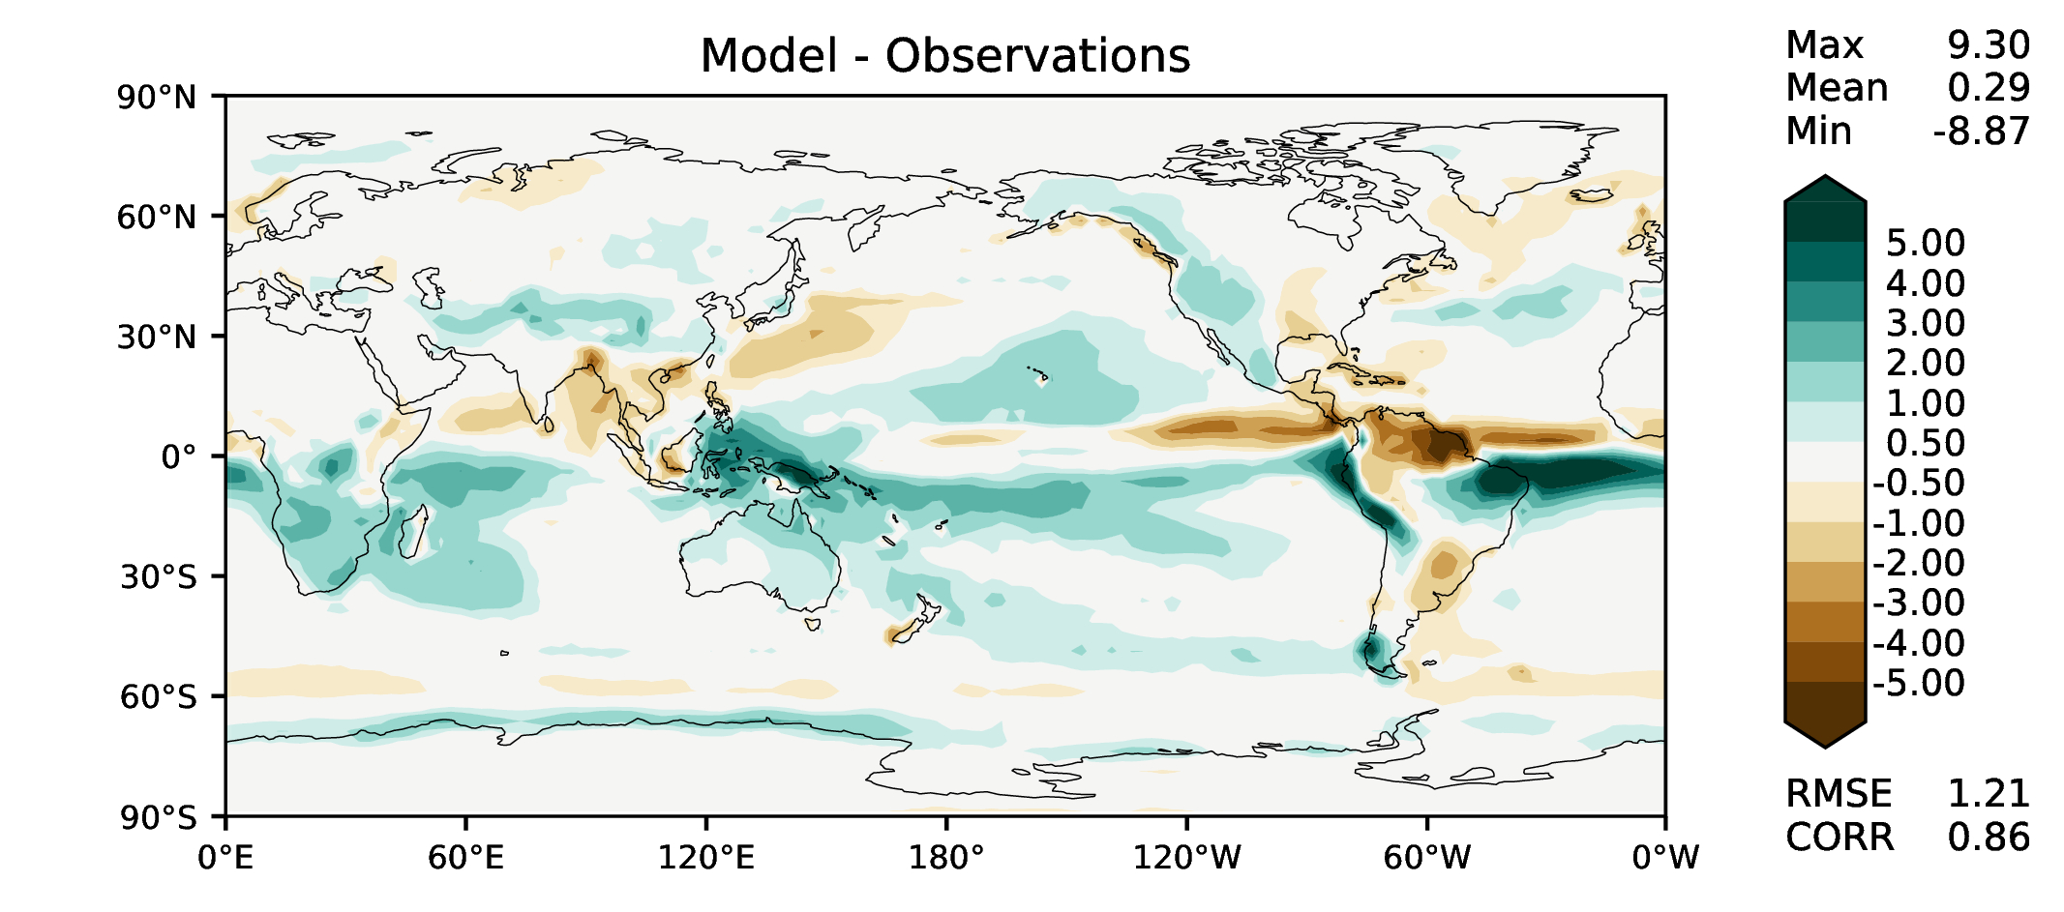
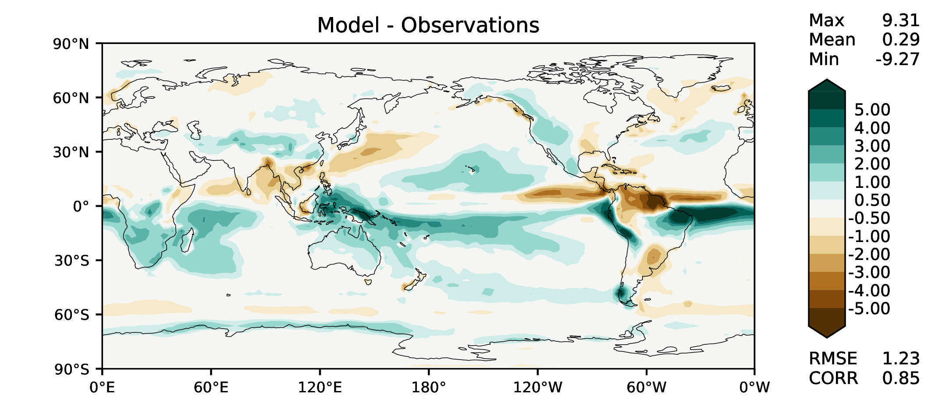
MAM total precipitation
v2beta4
v2rc1a
v2rc1c
v2rc1d

Slide 6
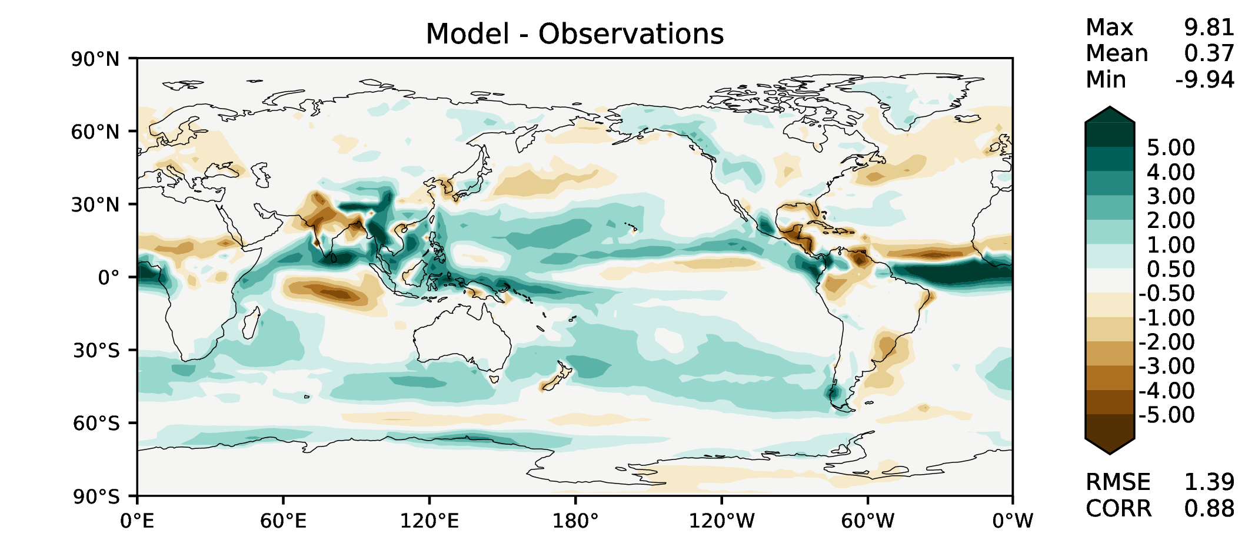
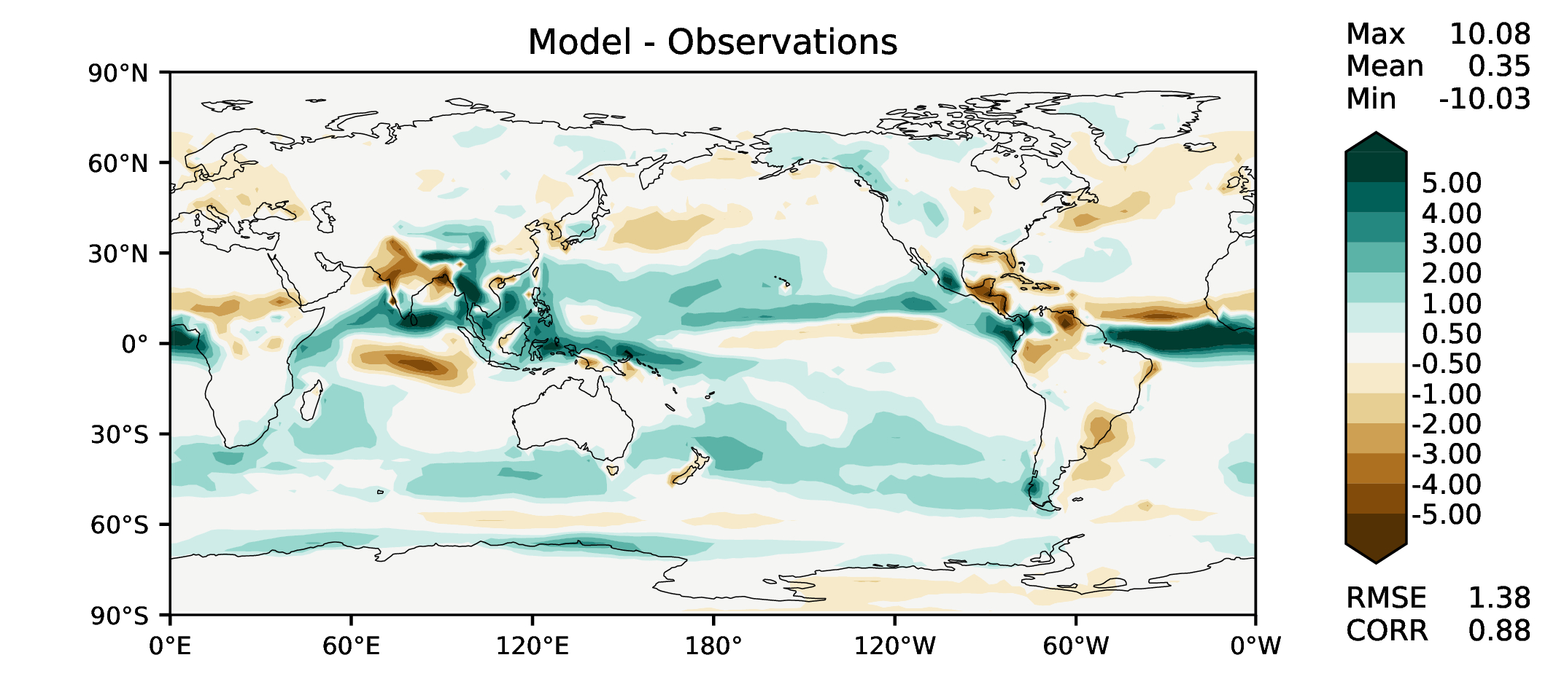
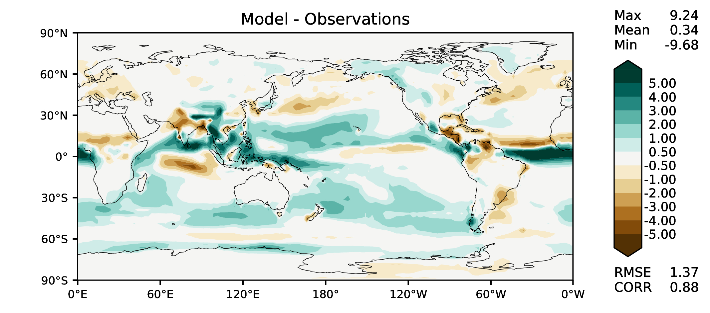
JJA total precipitation
v2beta4
v2rc1a
v2rc1c
v2rc1d

Slide 7
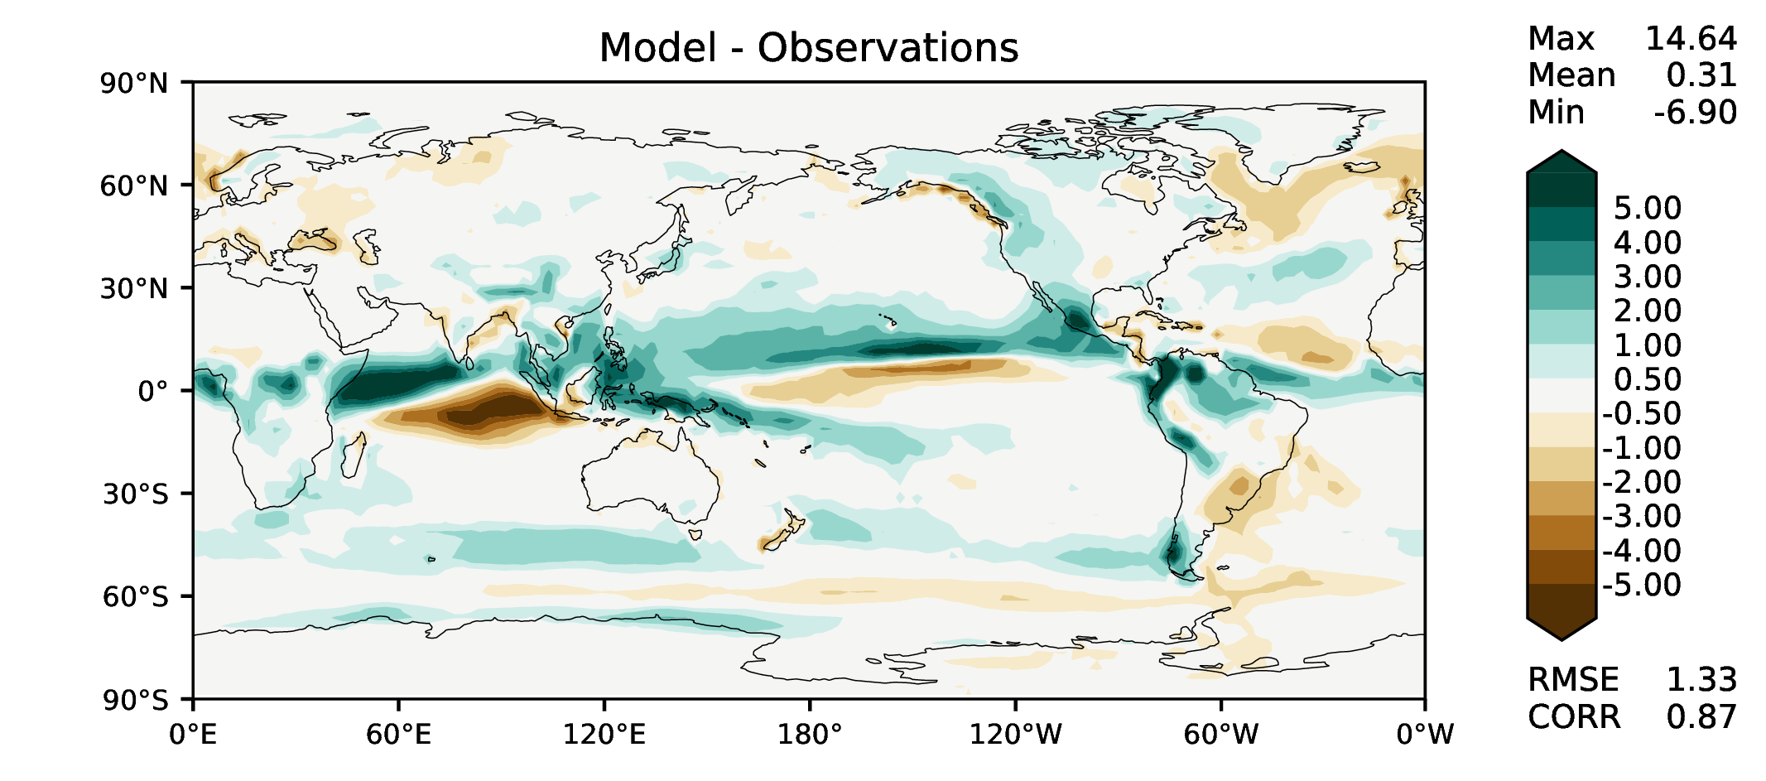
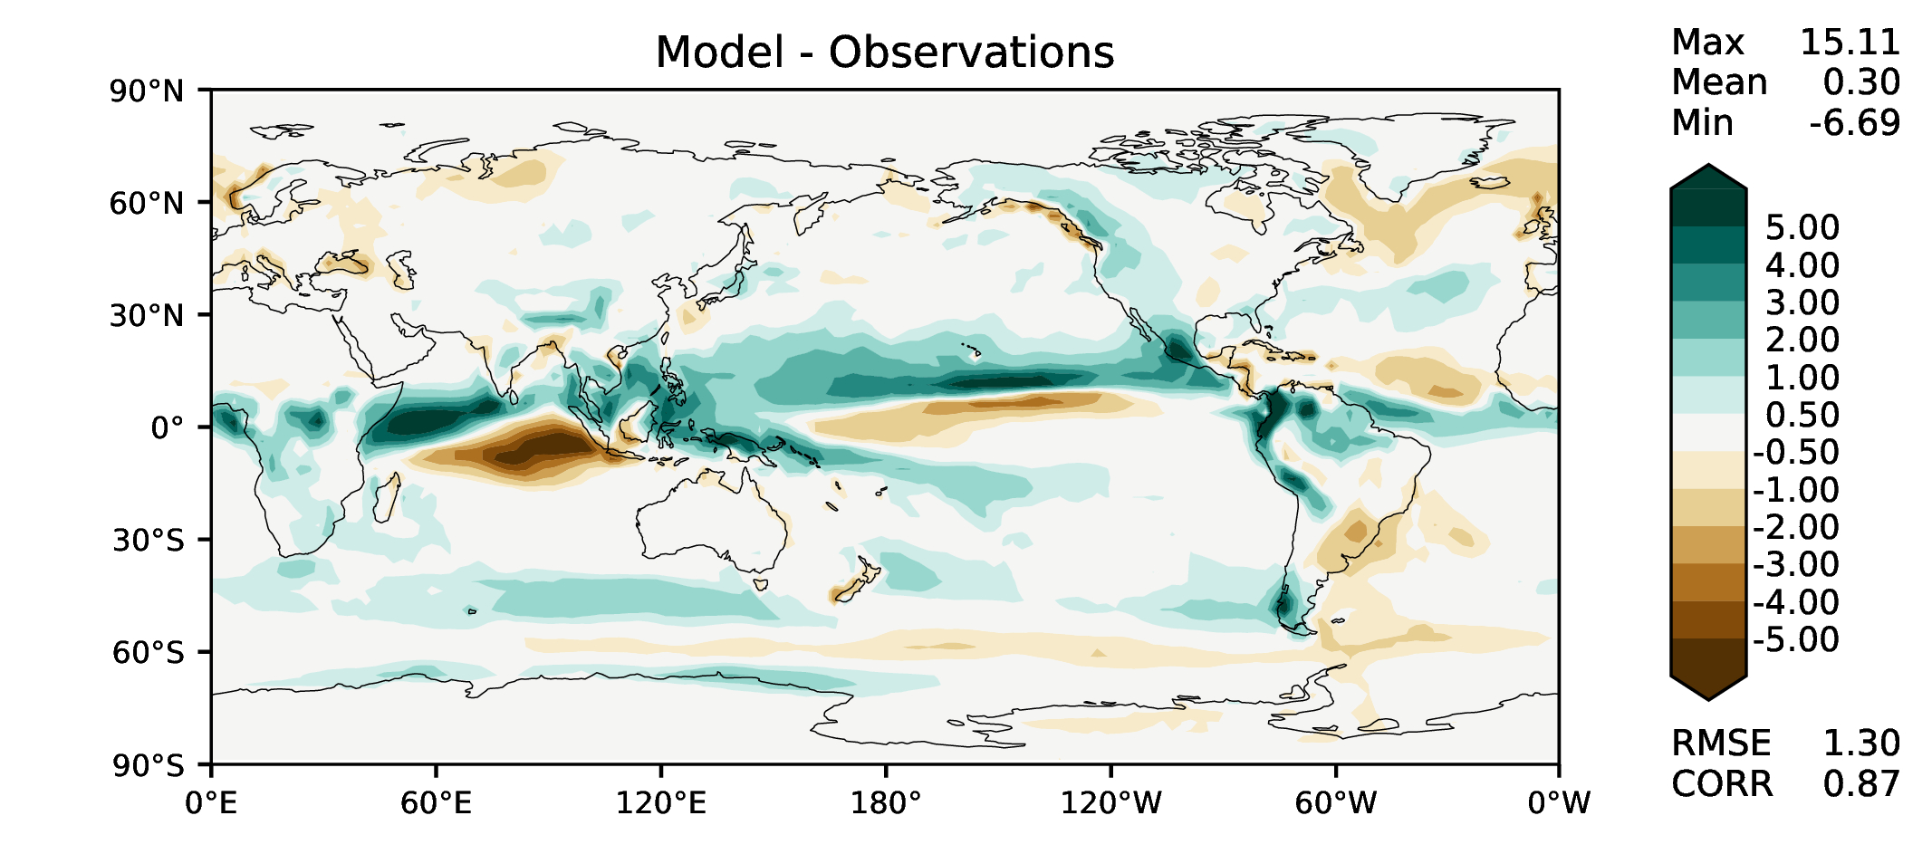
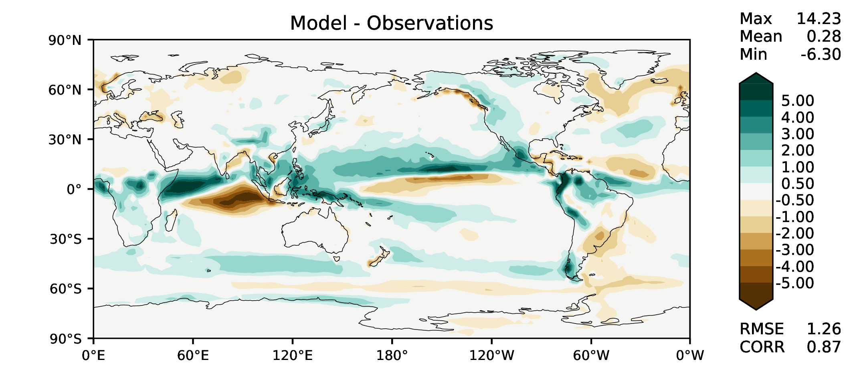
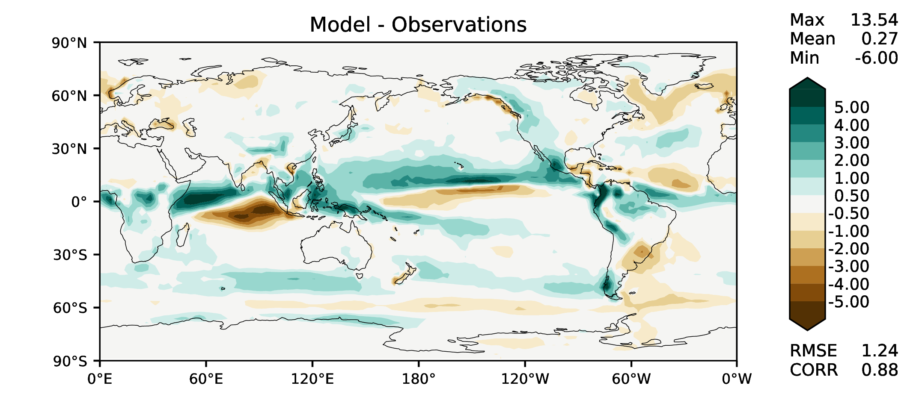
SON total precipitation
v2beta4
v2rc1a
v2rc1c
v2rc1d

Slide 8
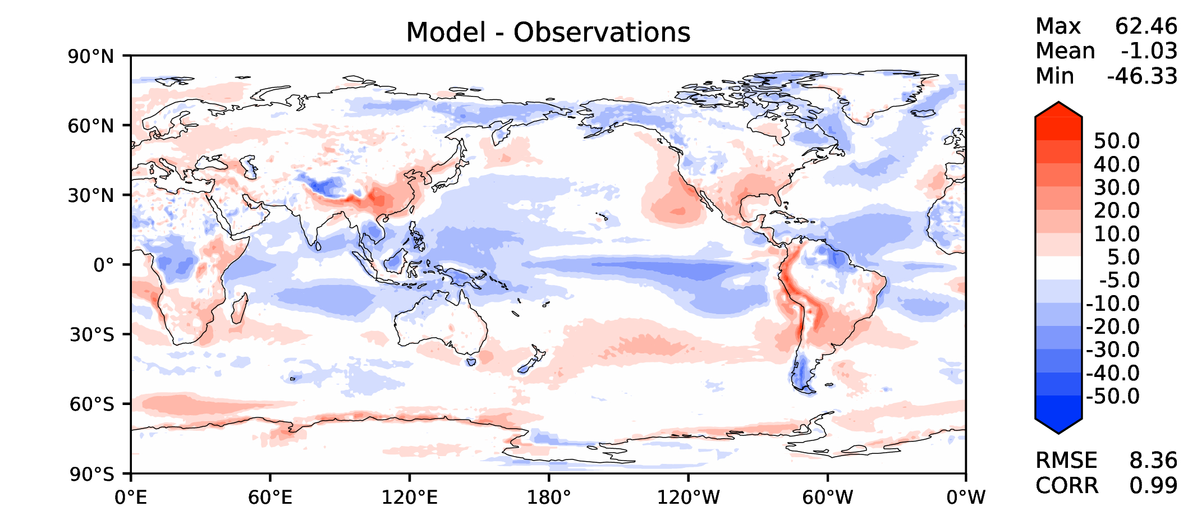
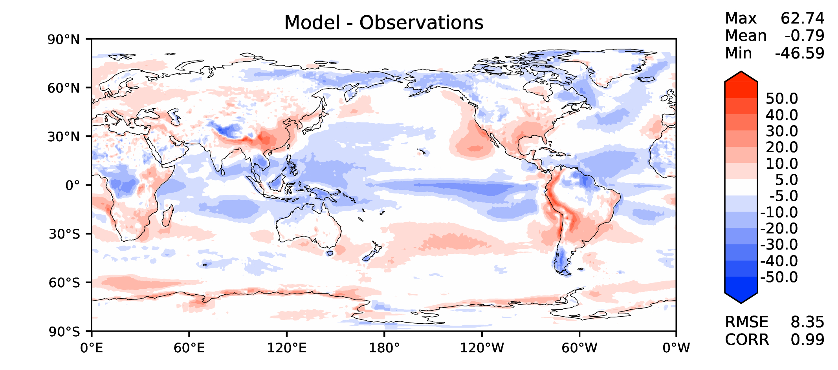
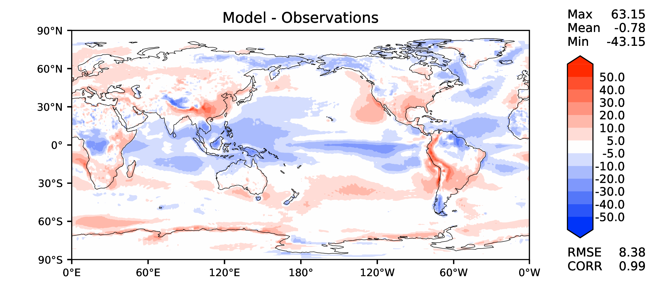
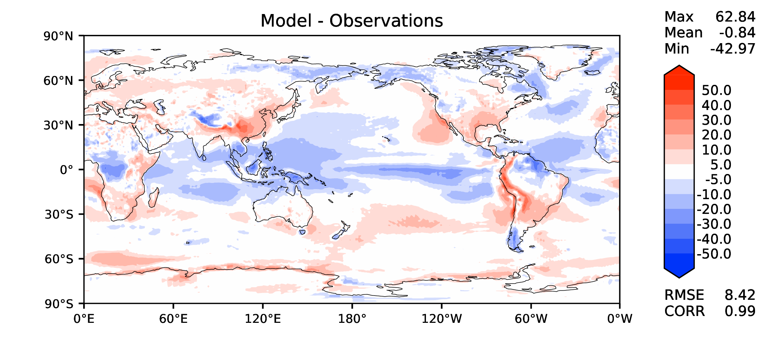
Annual TOA net radiation
v2beta4
v2rc1a
v2rc1c
v2rc1d

Slide 9
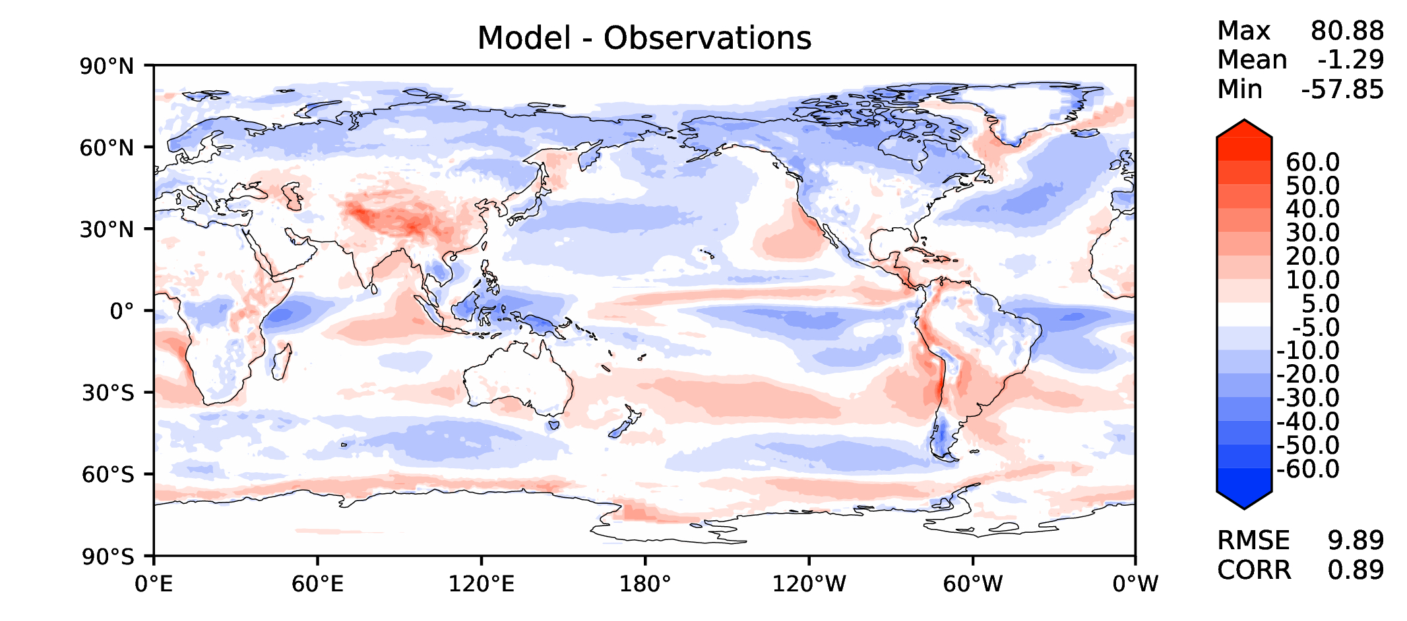
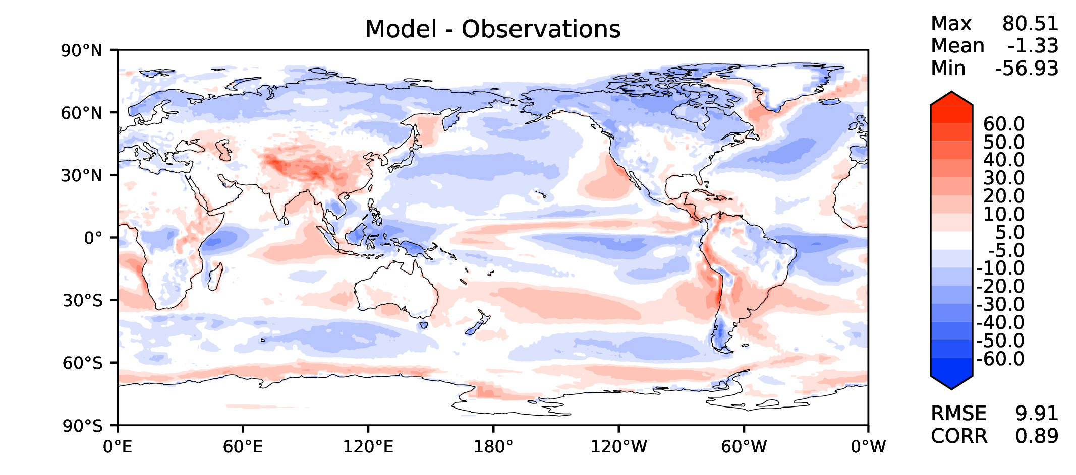
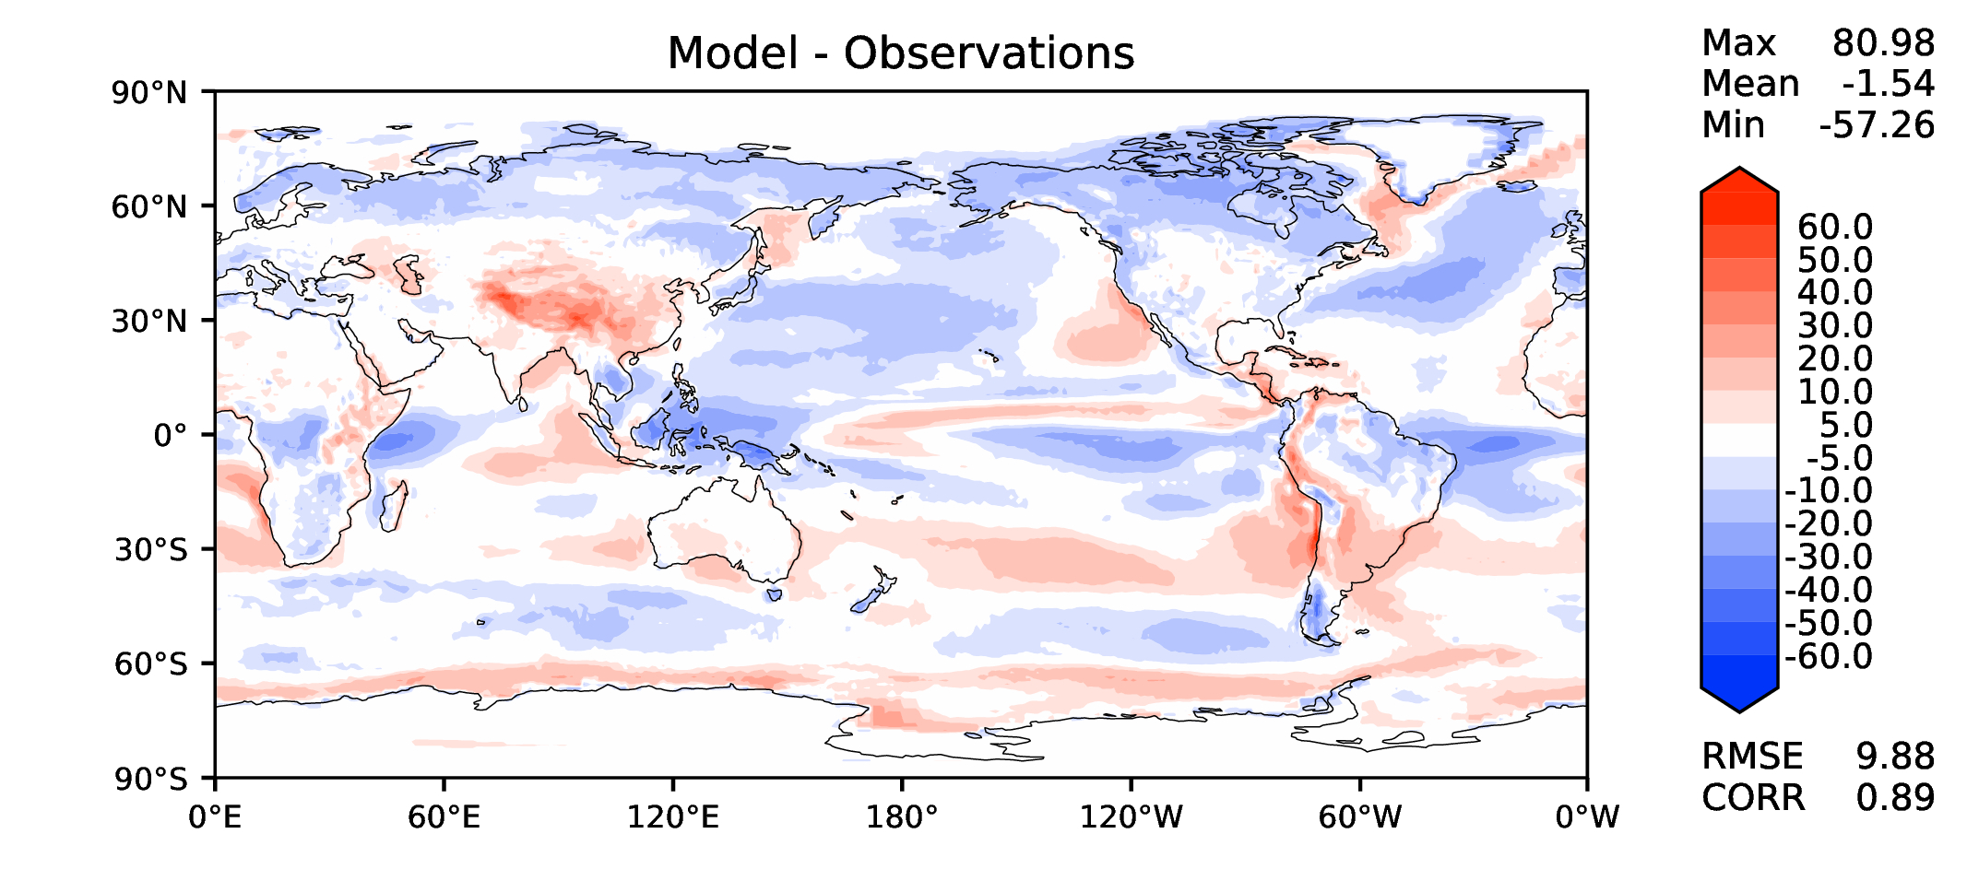
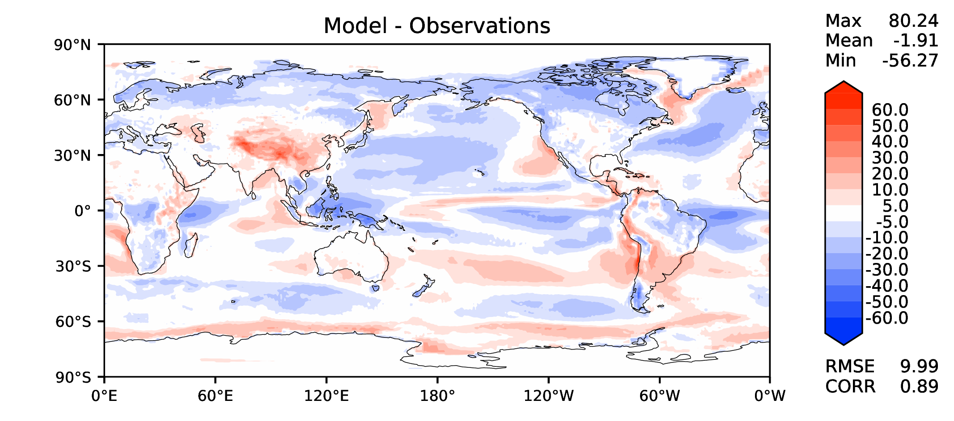
Annual TOA SW CRE
v2beta4
v2rc1a
v2rc1c
v2rc1d

Slide 10
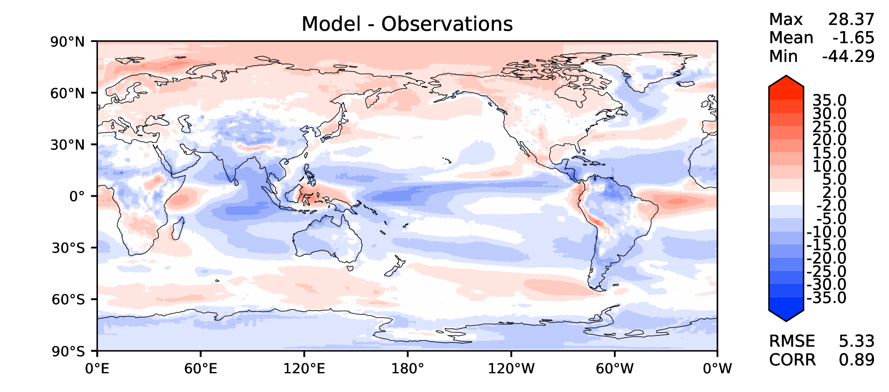
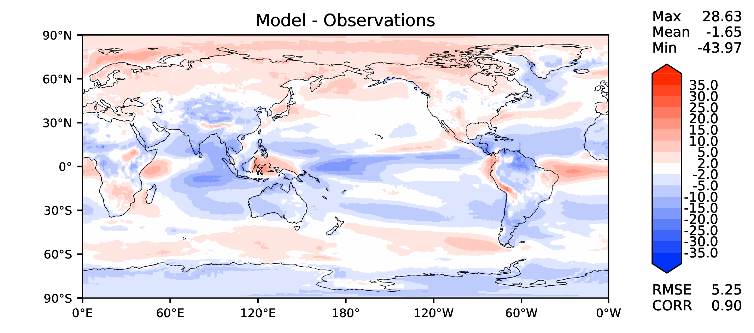
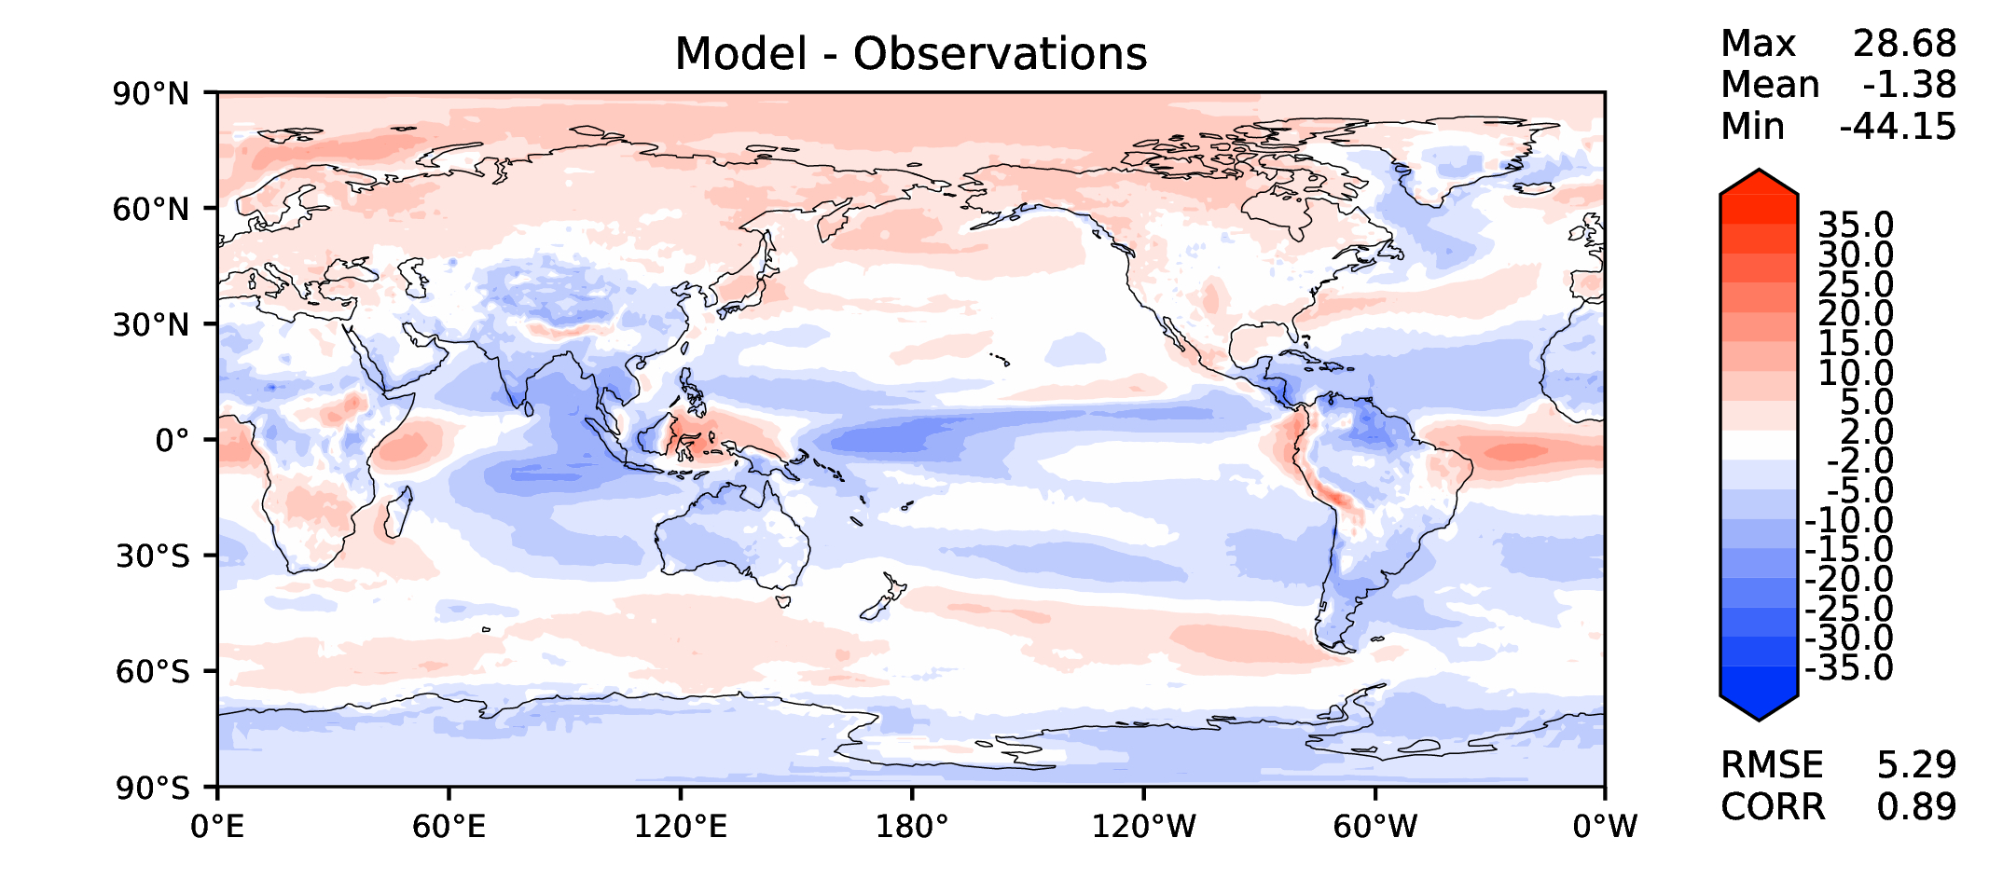
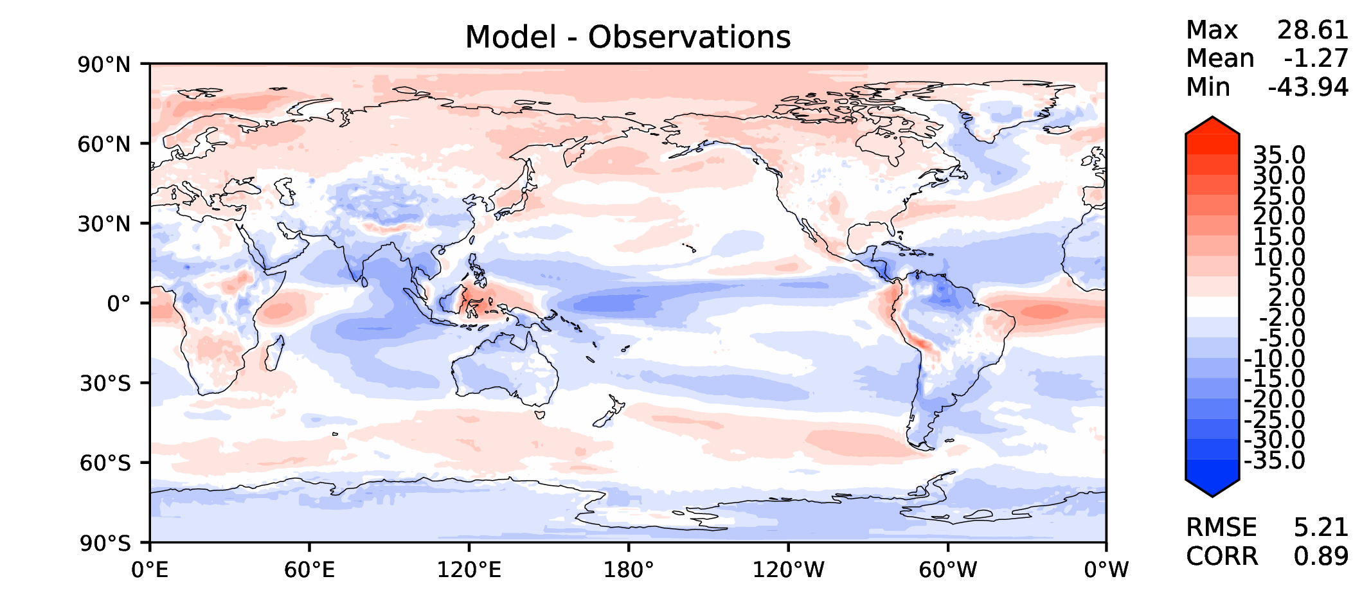
Annual TOA LW CRE
v2beta4
v2rc1a
v2rc1c
v2rc1d

Slide 11
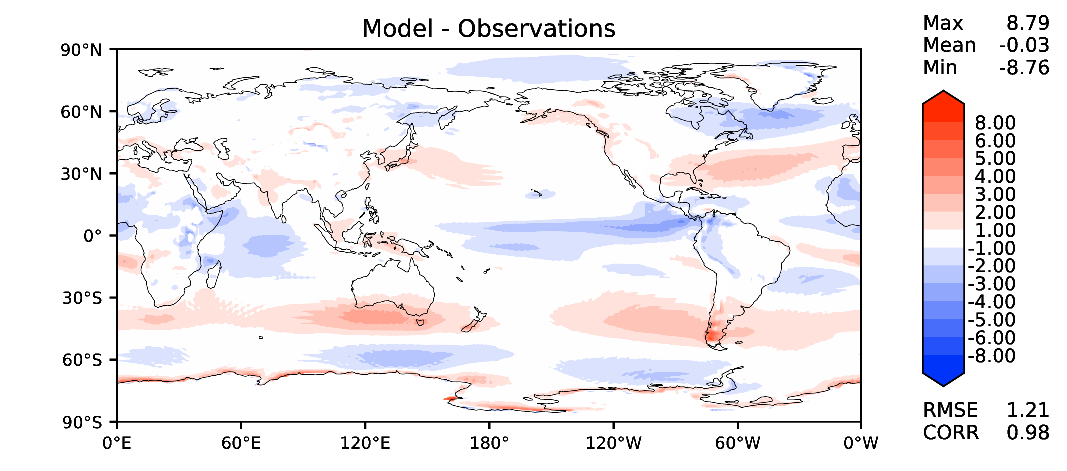
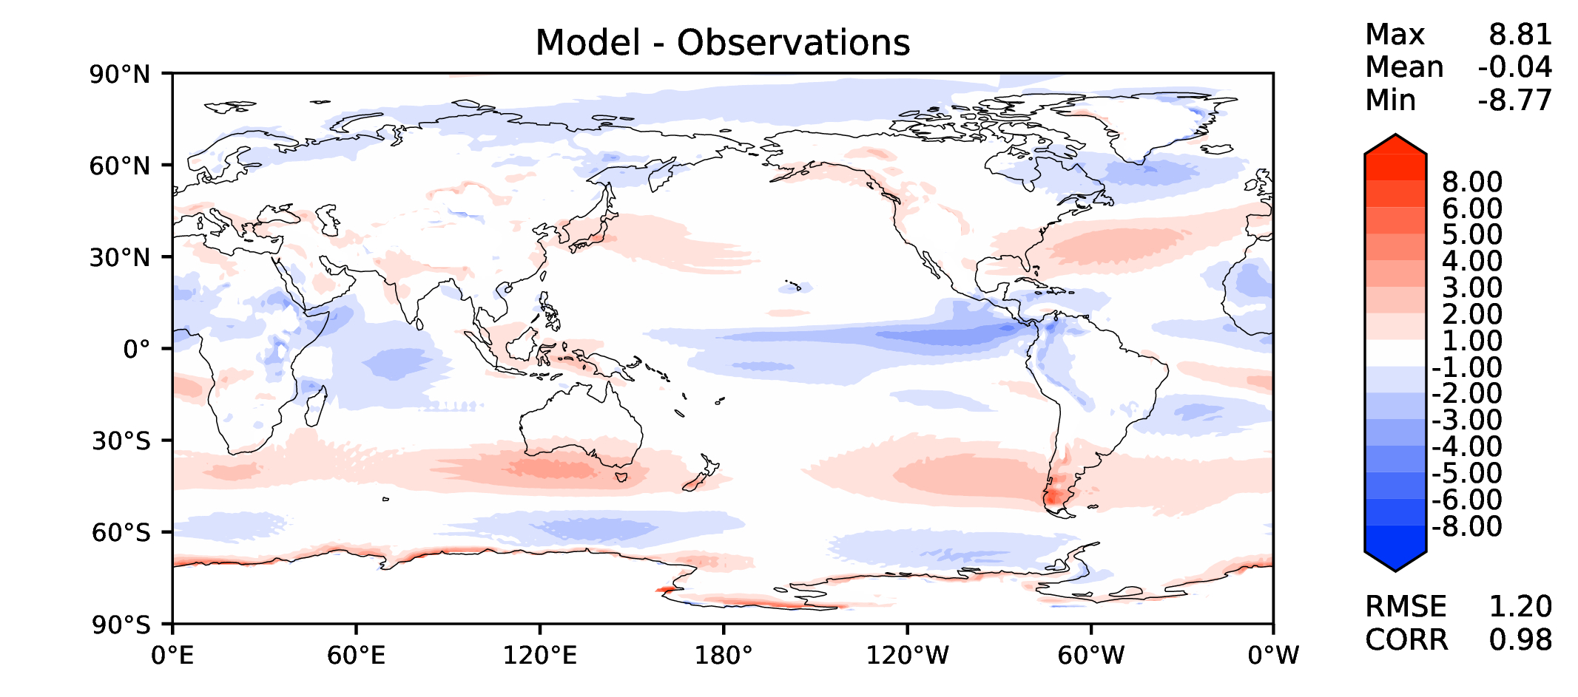
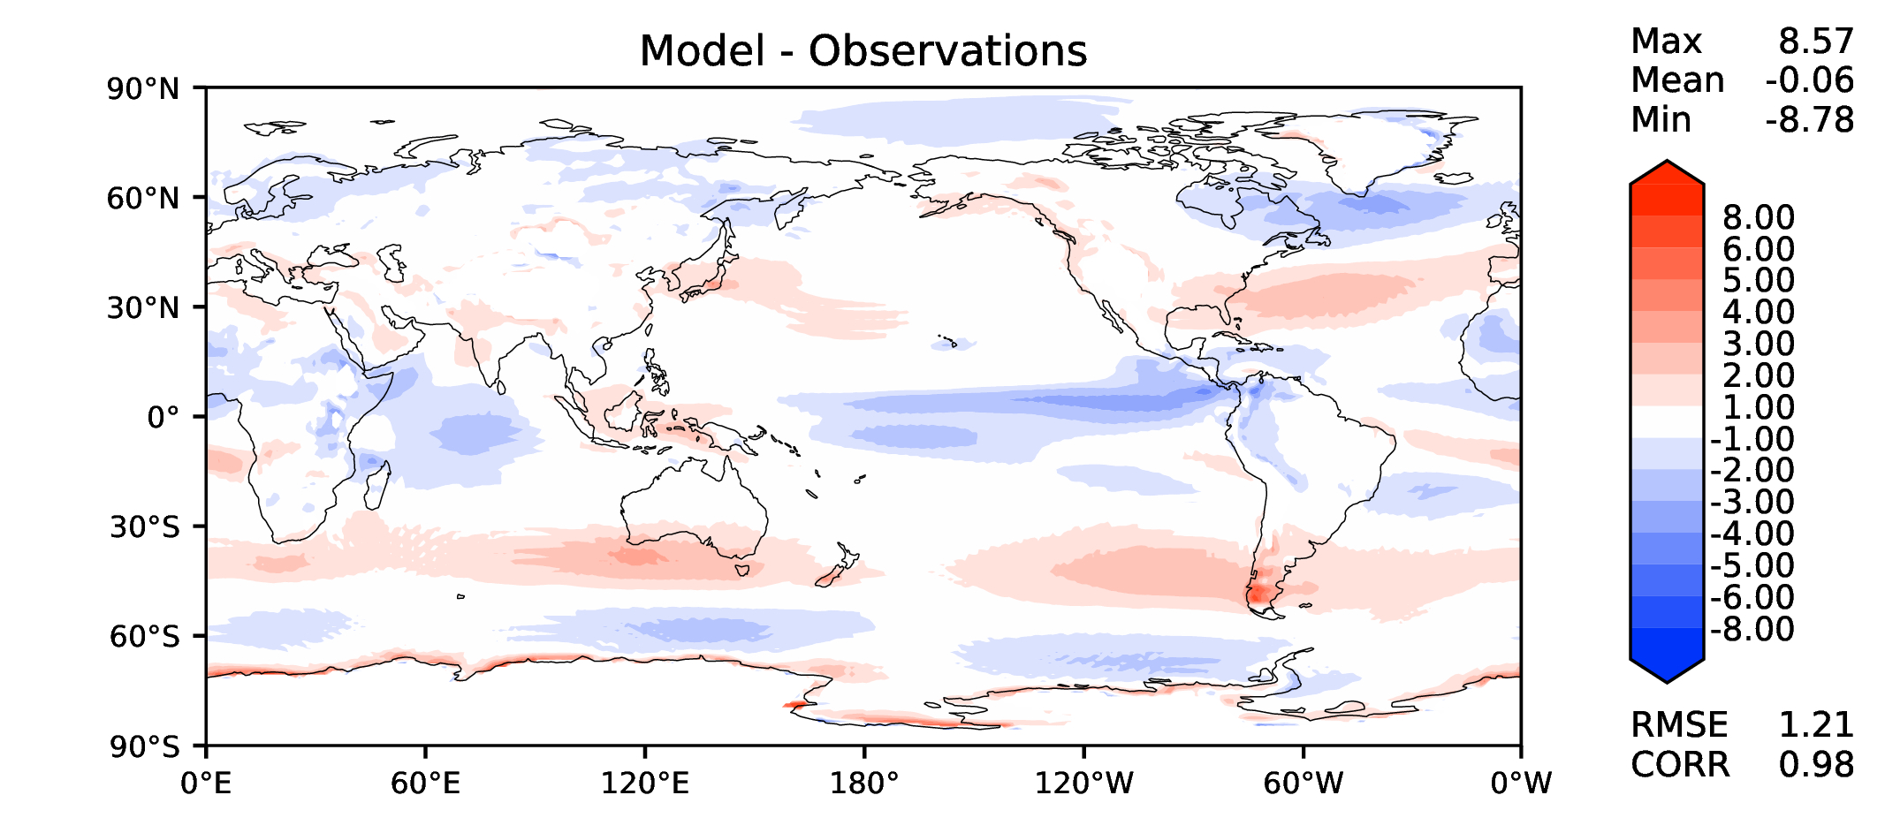
Annual u wind at 850 hPa
v2beta4
v2rc1a
v2rc1c
v2rc1d

Slide 12
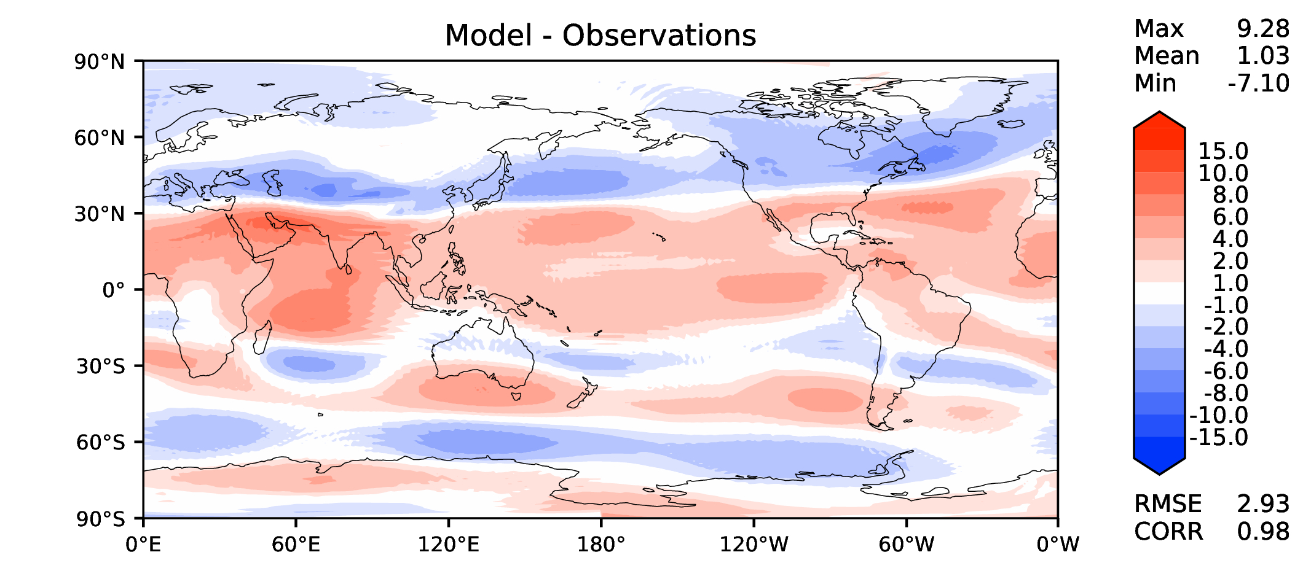
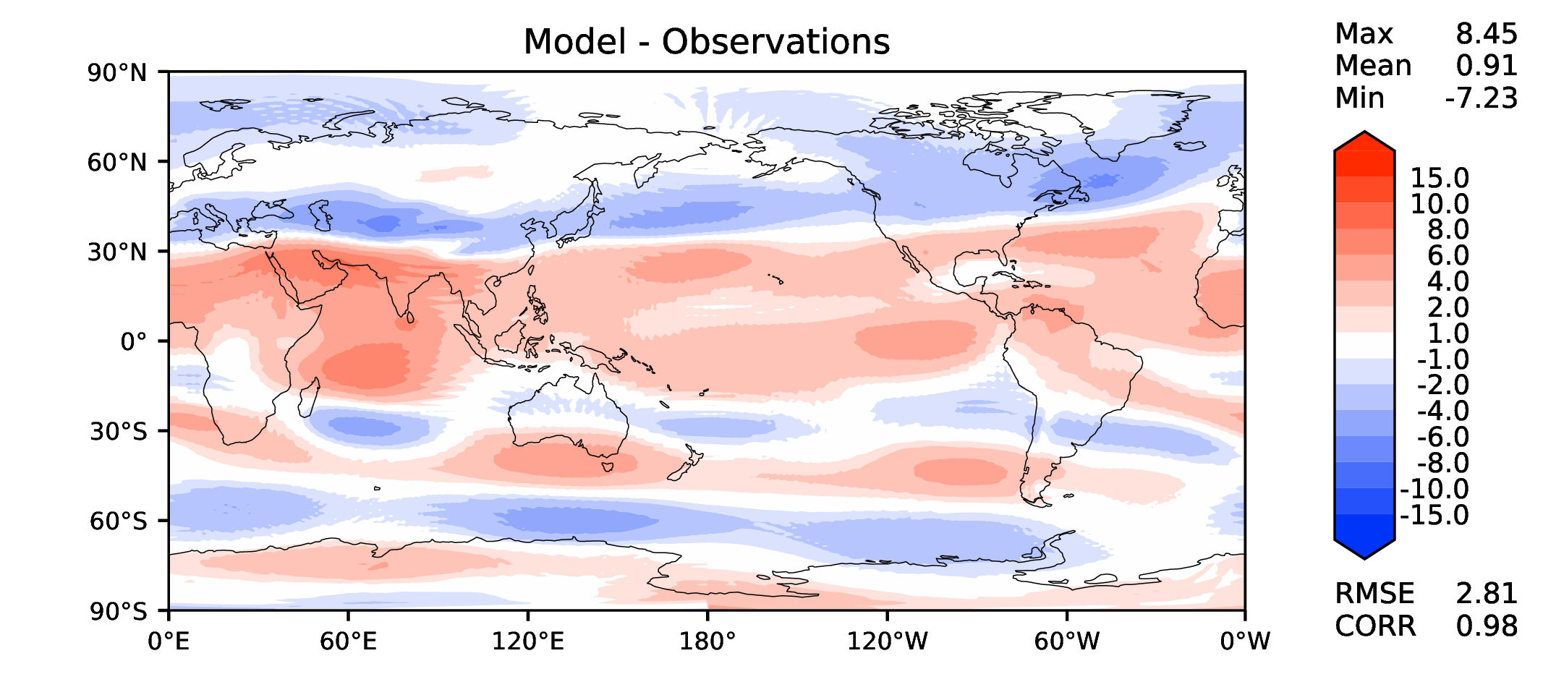
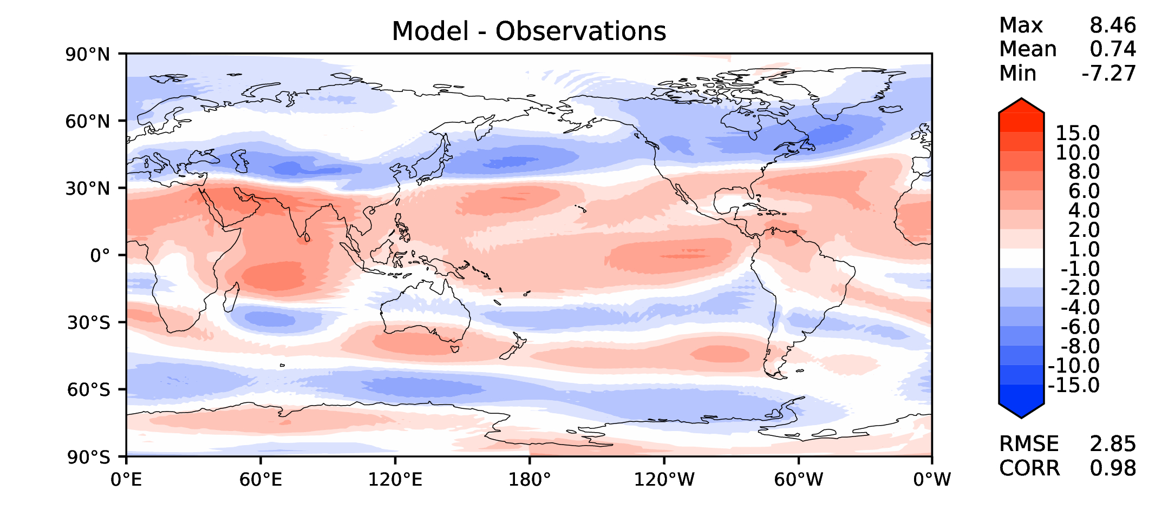
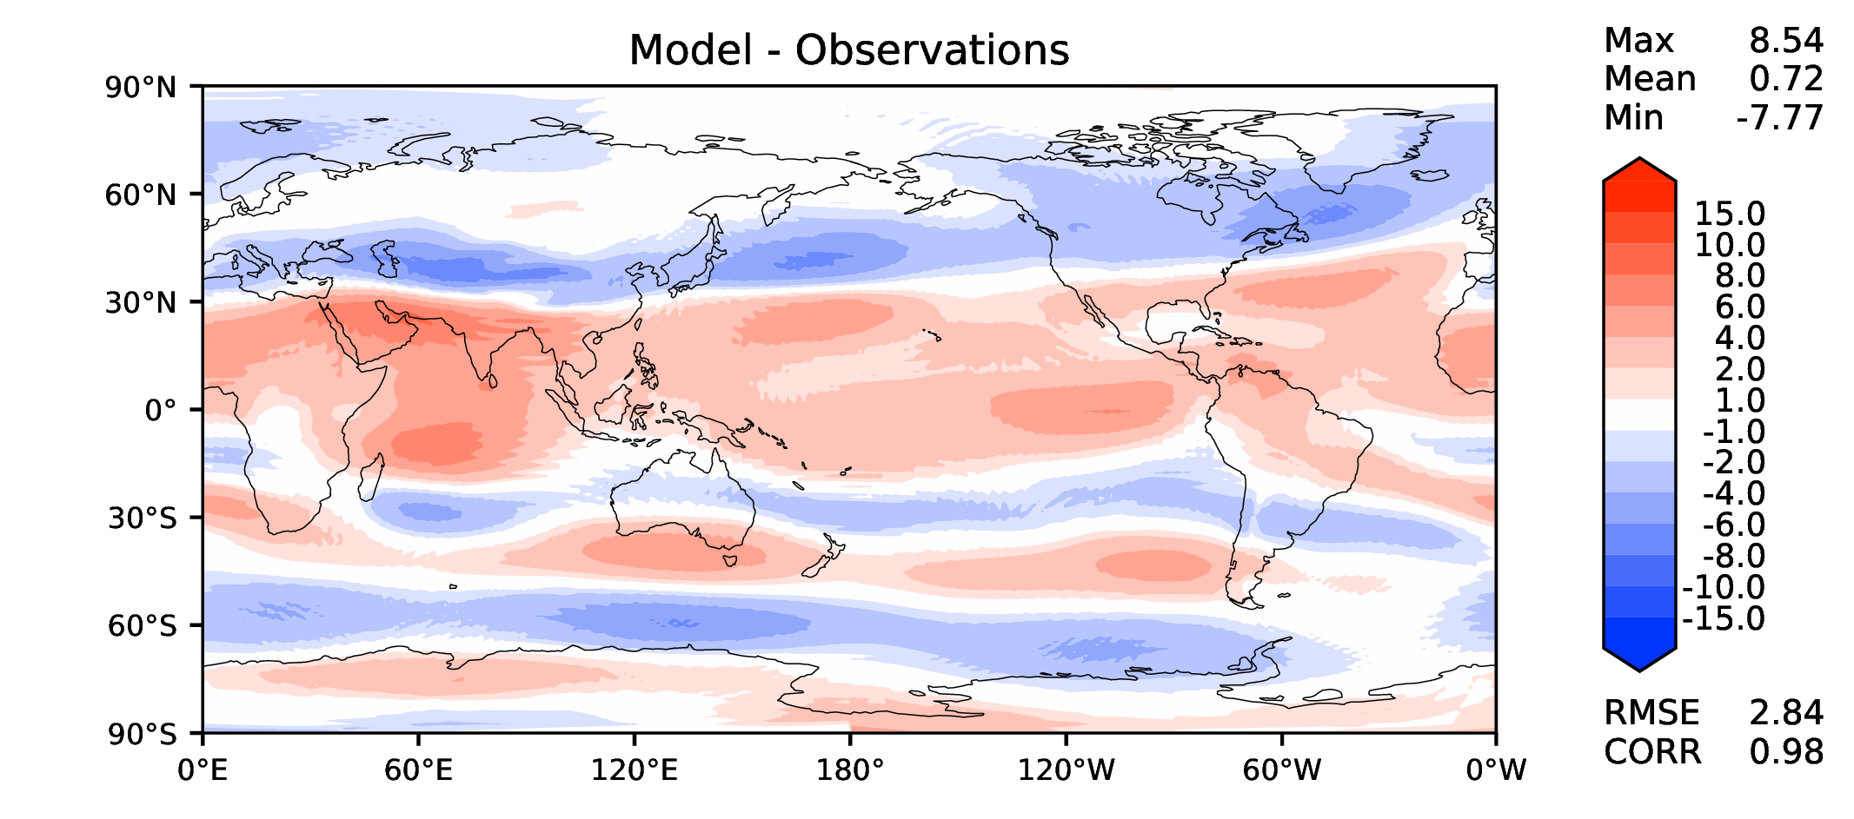
Annual u wind at 200 hPa
v2beta4
v2rc1a
v2rc1c
v2rc1d

Slide 13
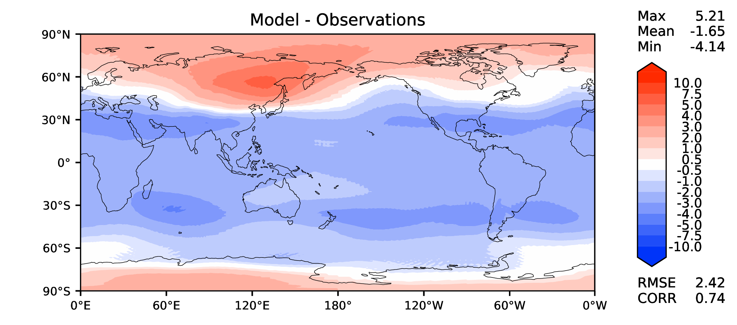
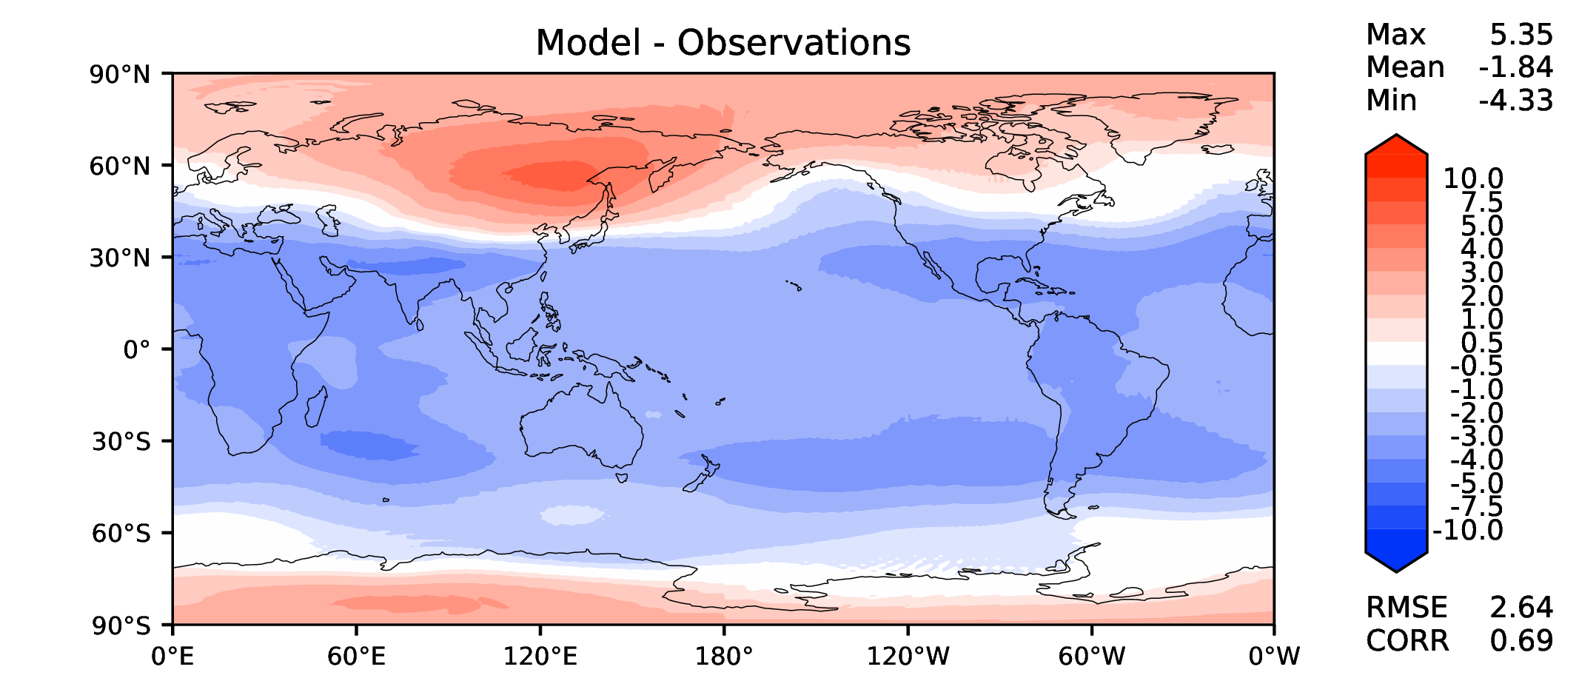
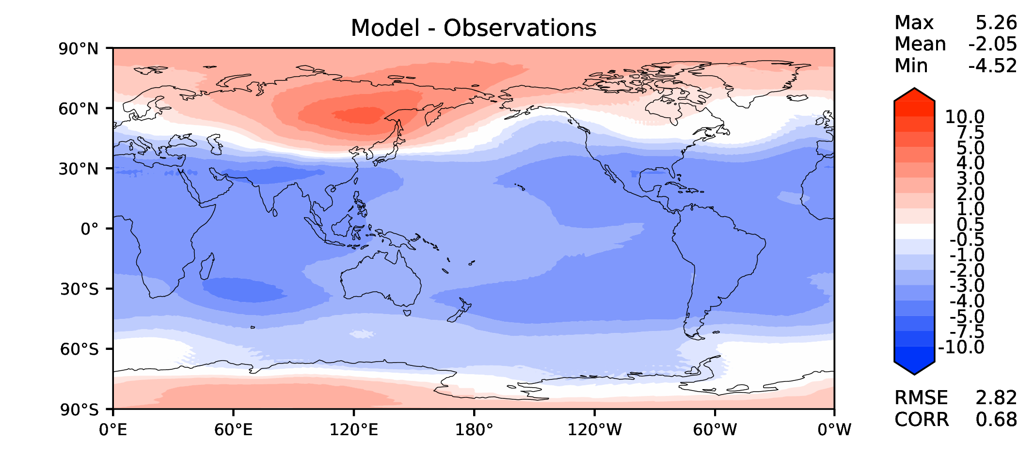
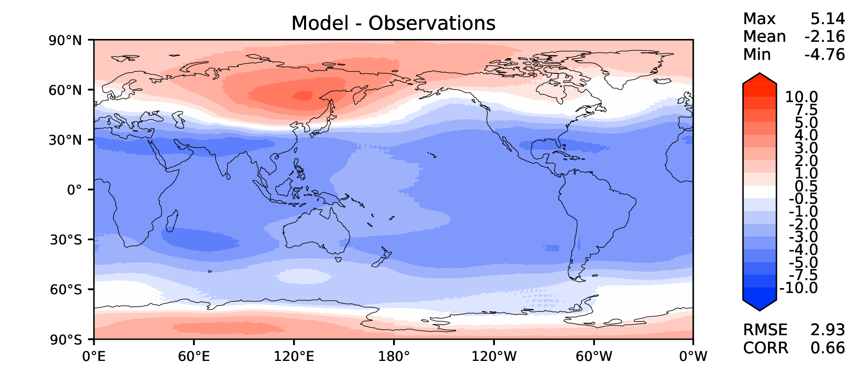
Annual T at 200 hPa
v2beta4
v2rc1a
v2rc1c
v2rc1d

Slide 14
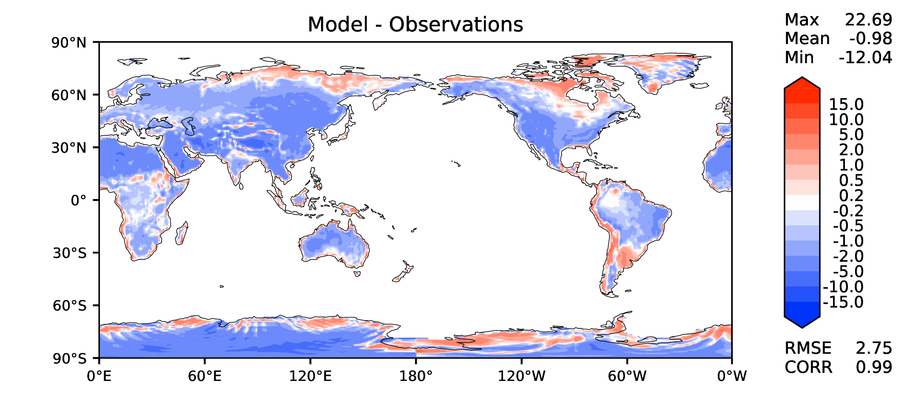
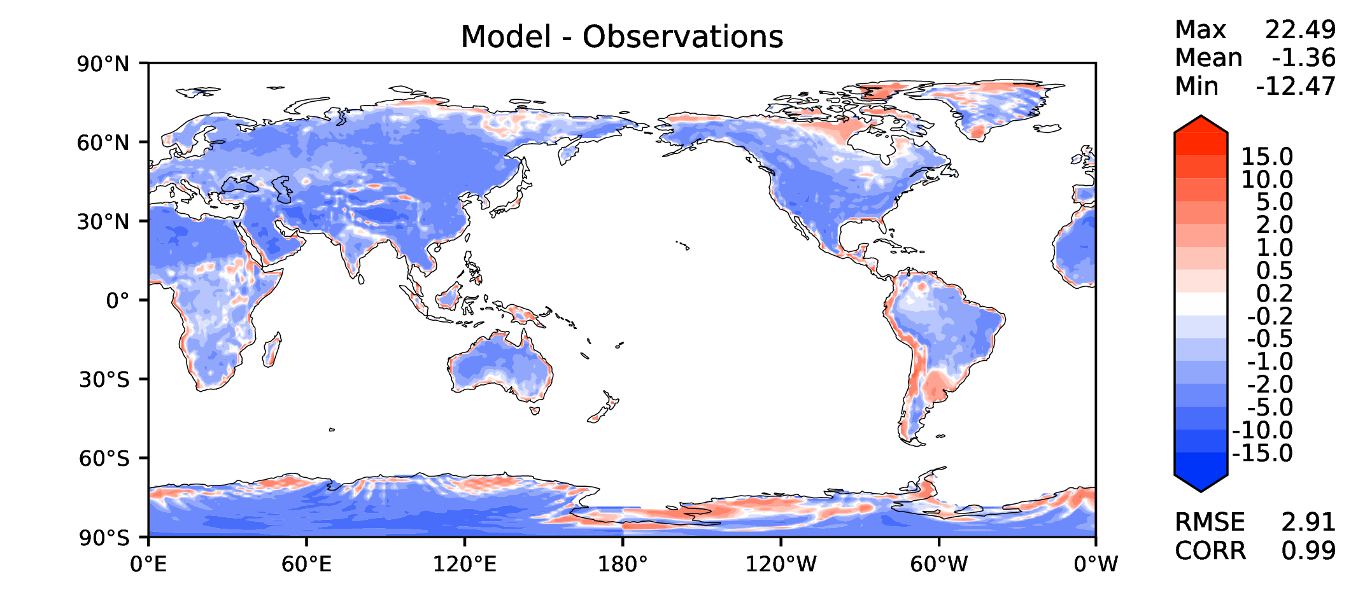
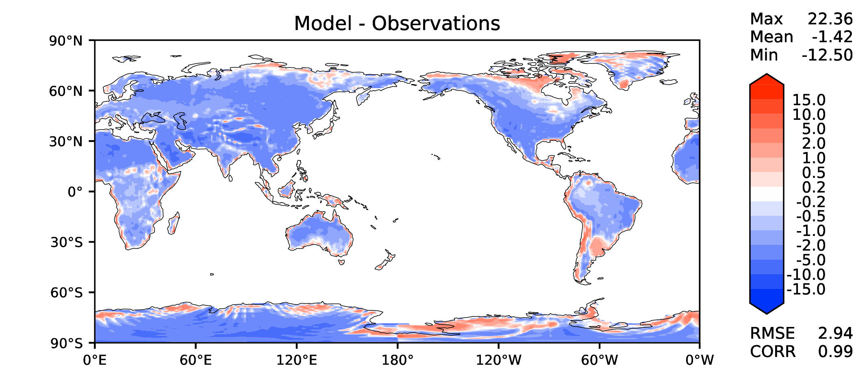
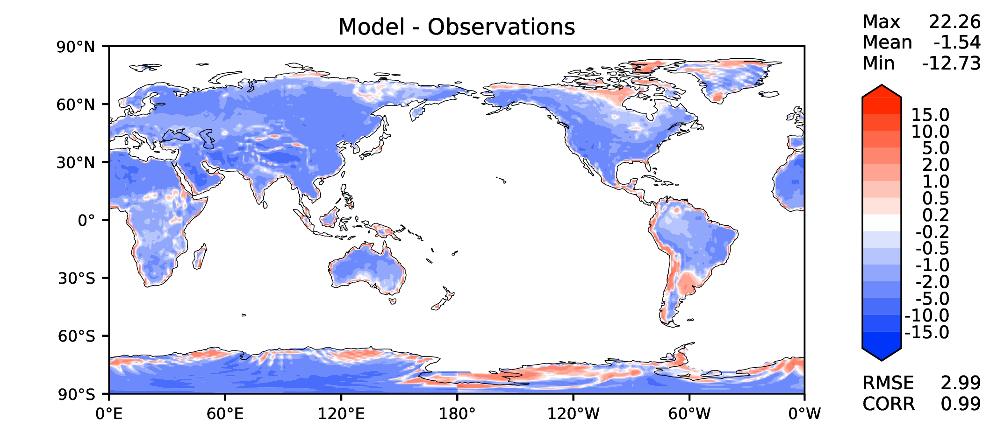
Annual surface air T (land)
v2beta4
v2rc1a
v2rc1c
v2rc1d

Slide 15
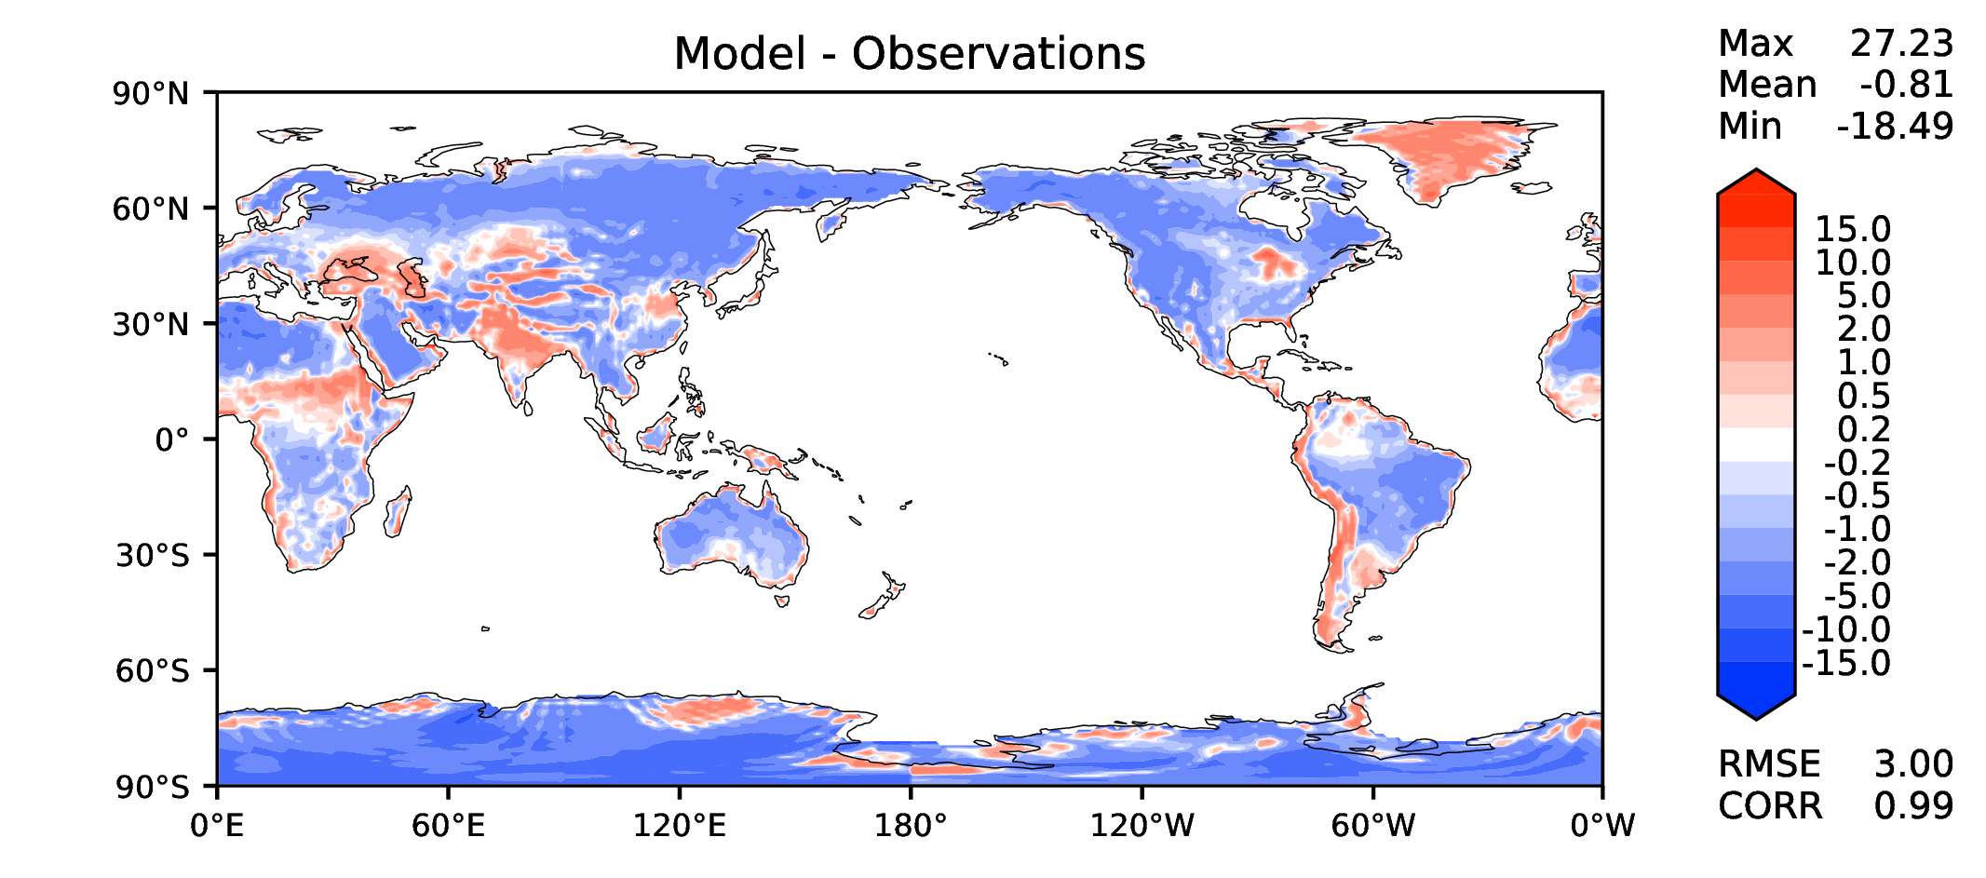
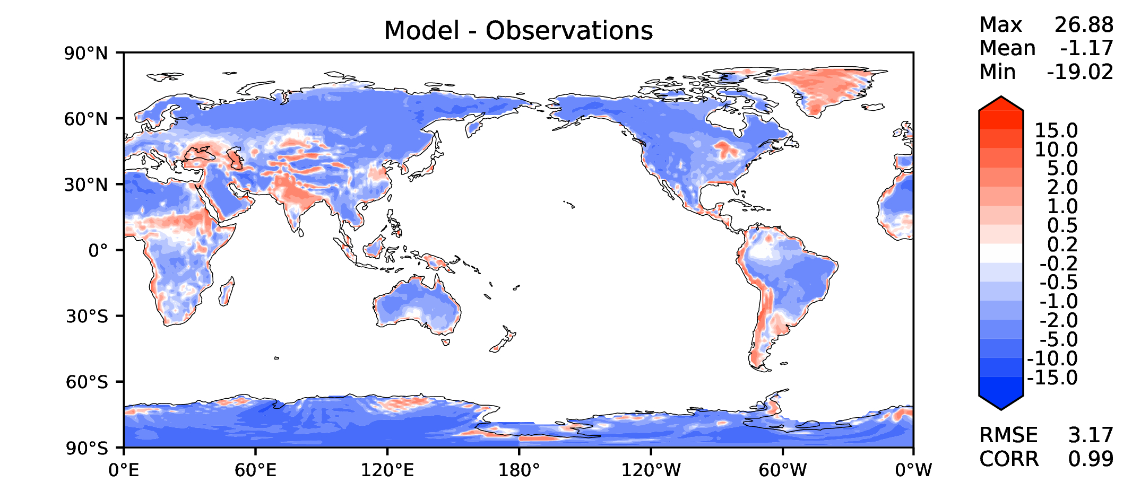
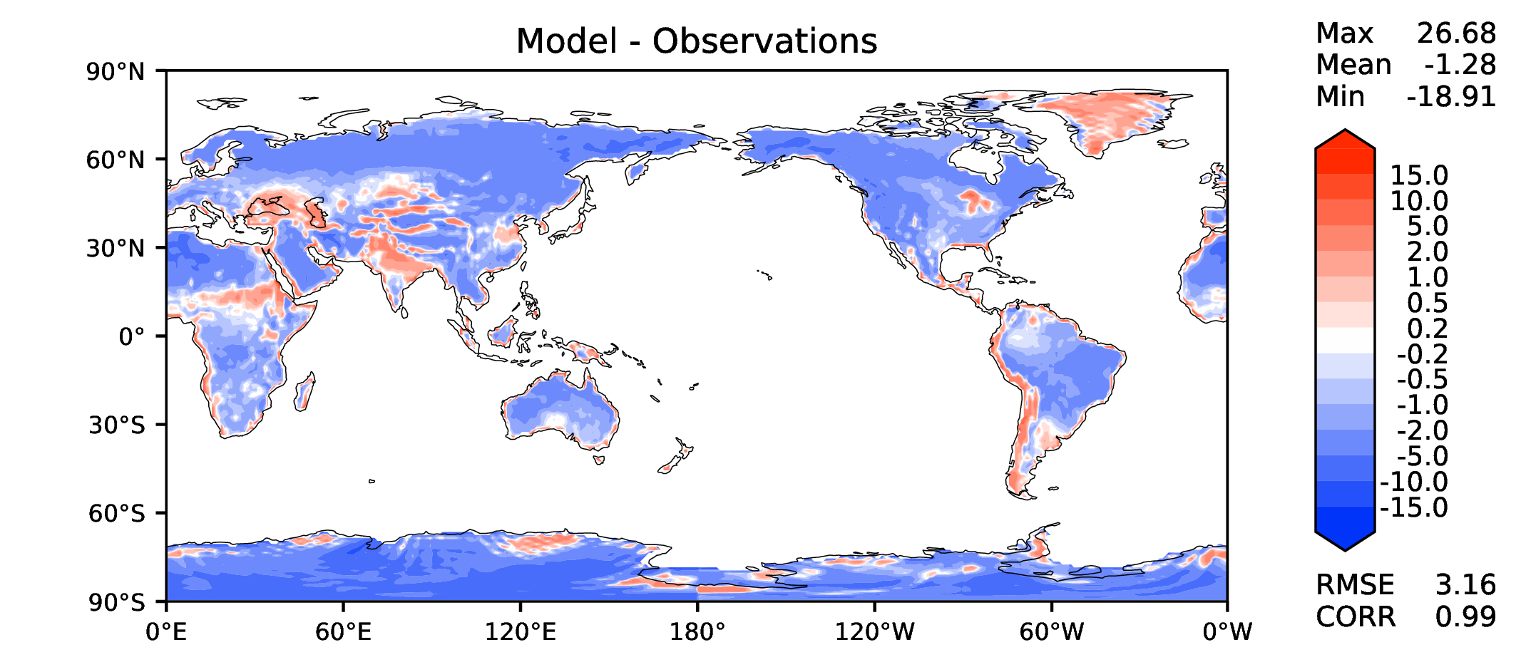
JJA surface air T (land)
v2beta4
v2rc1a
v2rc1c
v2rc1d

Slide 16
Aerosol optical depth
v2beta4
v2rc1a
v2rc1c
v2rc1d

Slide 17
TAUXY ANN ocean
v2beta4
v2rc1a
v2rc1c
v2rc1d

Slide 18
CLDLWP_OCN global SSMI
v2beta4
v2rc1a
v2rc1c
v2rc1d

