Slide 1
Summary table (RMSE vs obs)
Variable | Season | DECKv1b | v2rc1e
SST | ANN | 1.10 | 1.27
PRECT | ANN | 1.13 | 0.96
PRECT | DJF | 1.43 | 1.35
PRECT | MAM | 1.55 | 1.22
PRECT | JJA | 1.49 | 1.33
PRECT | SON | 1.28 | 1.24
RESTOM | ANN | 9.30 | 8.54
SWCF | ANN | 10.59 | 10.28
LWCF | ANN | 5.32 | 5.10
u850 | ANN | 1.30 | 1.19
u200 | ANN | 2.14 | 2.88
T200 | ANN | 2.62 | 3.13
TREFHT | ANN | 2.58 | 3.12
TREFHT | JJA | 2.82 | 3.18
AODVIS | ANN | 0.07 | 0.06
TAUXY | ANN | 0.02 | 0.02

Slide 2
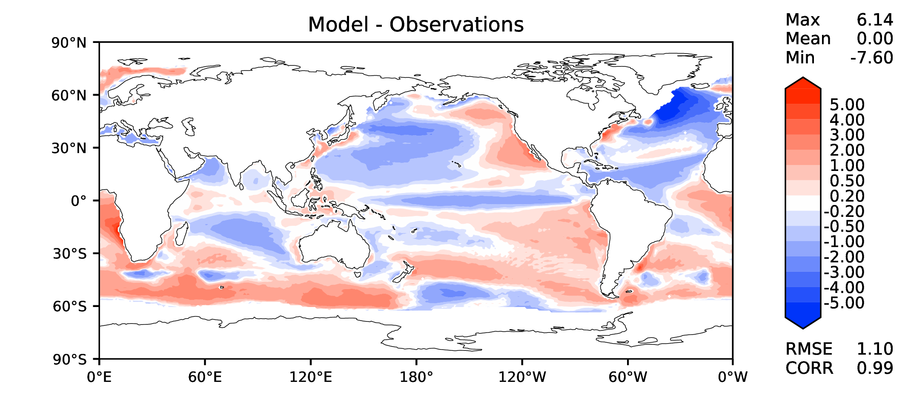
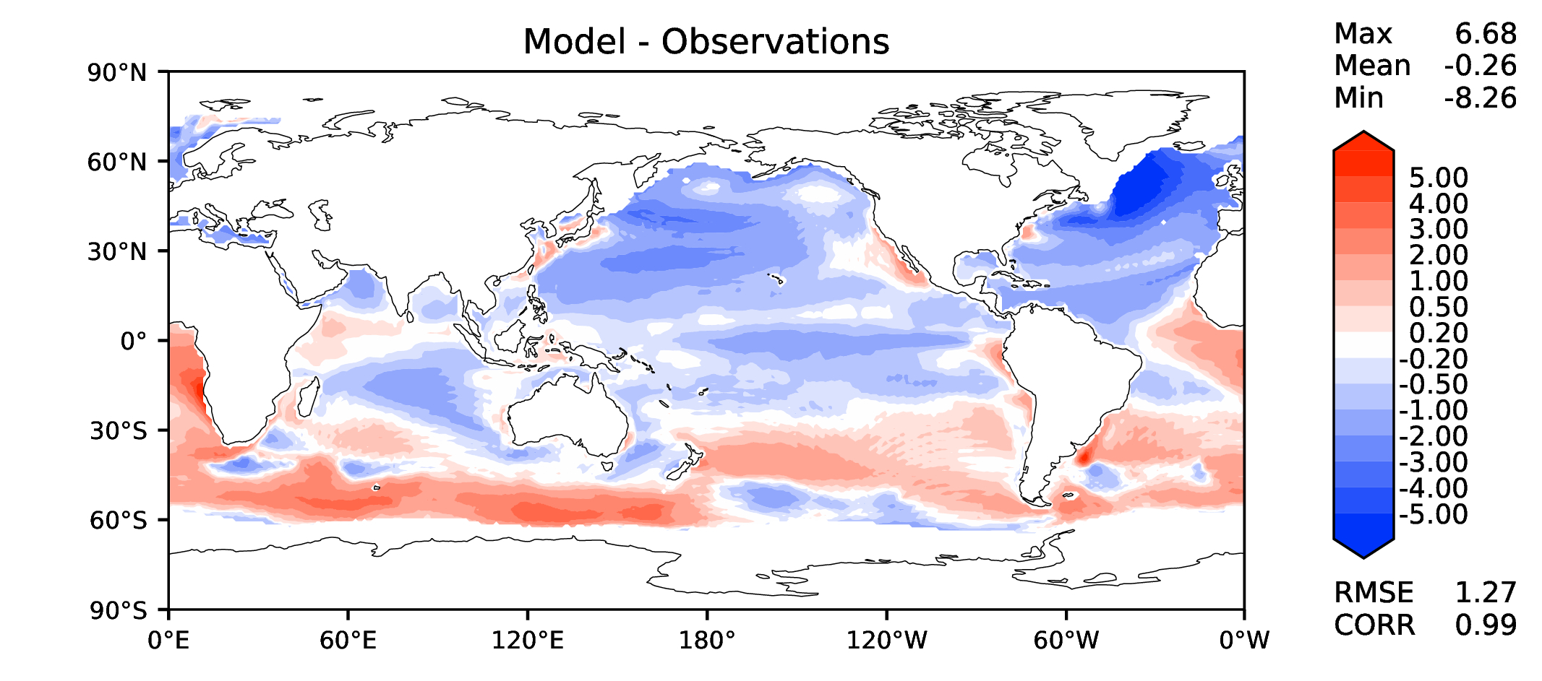
Annual SST (pre-industrial)
DECKv1b
v2rc1e

Slide 3
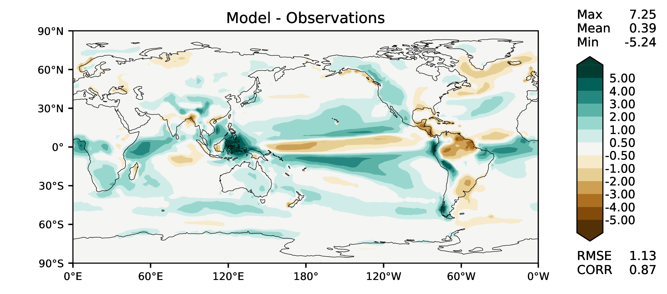
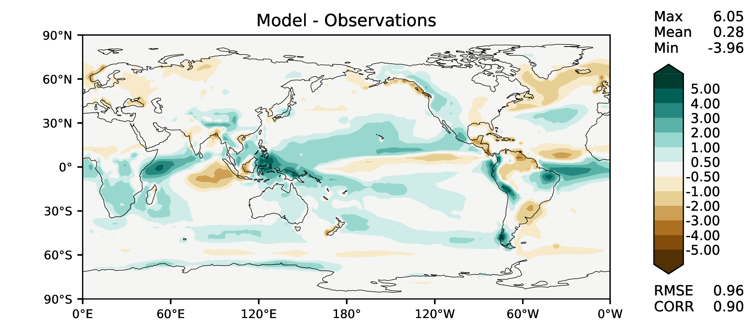
Annual total precipitation
DECKv1b
v2rc1e

Slide 4
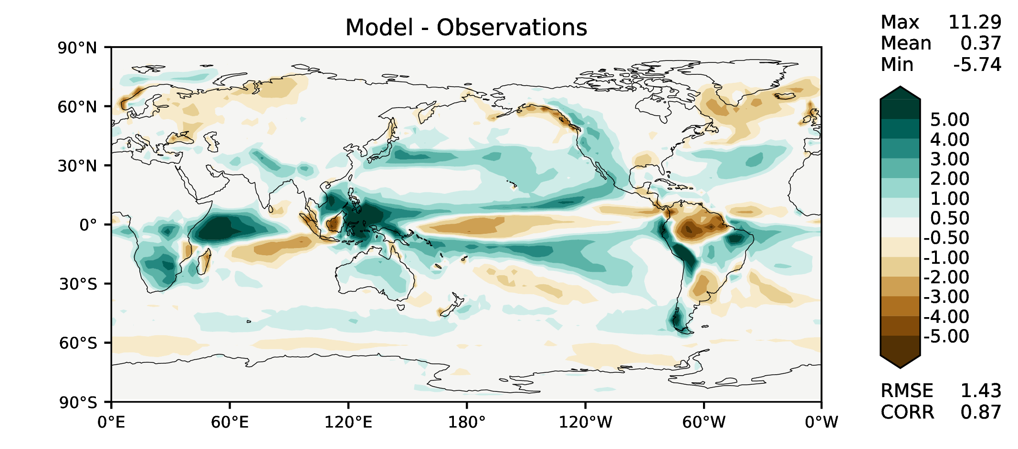
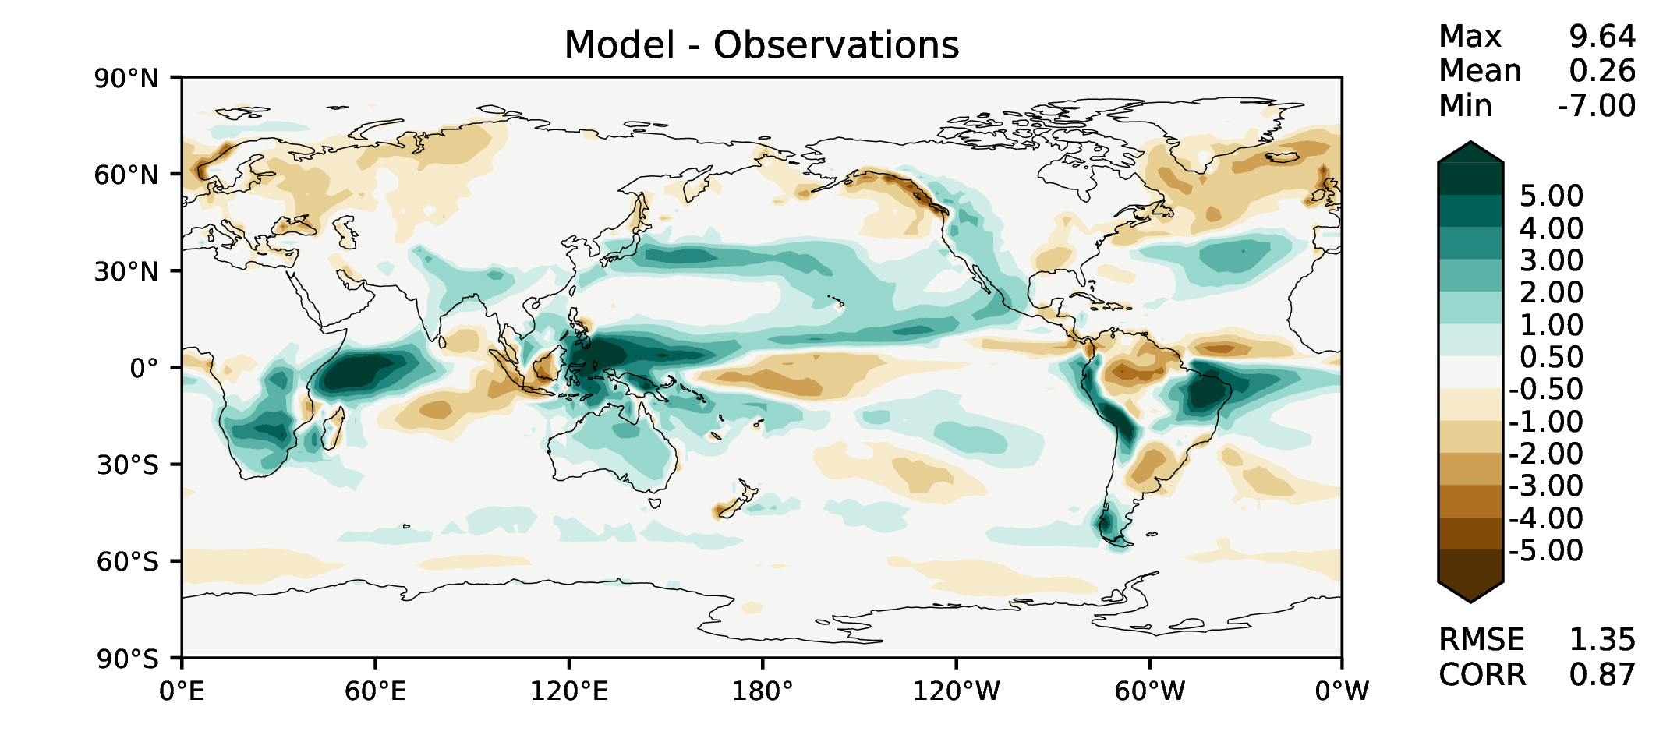
DJF total precipitation
DECKv1b
v2rc1e

Slide 5
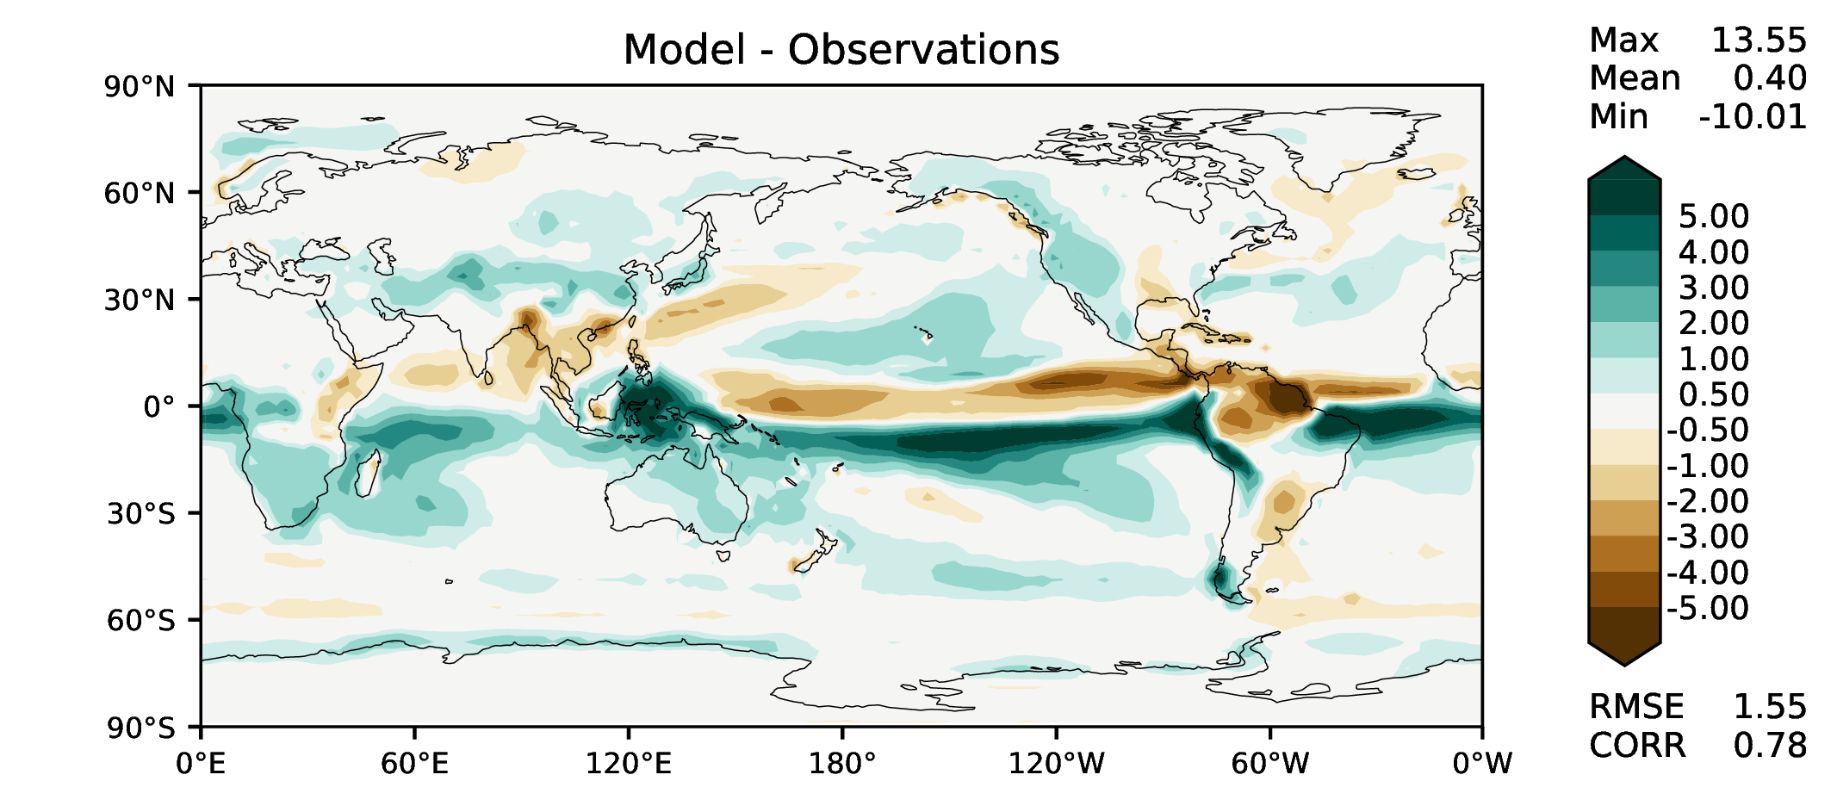
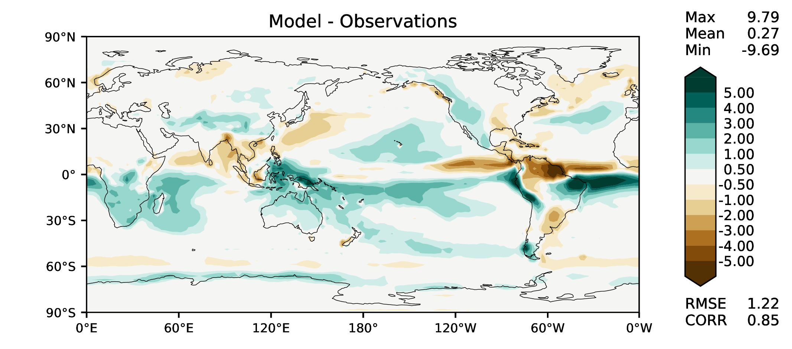
MAM total precipitation
DECKv1b
v2rc1e

Slide 6
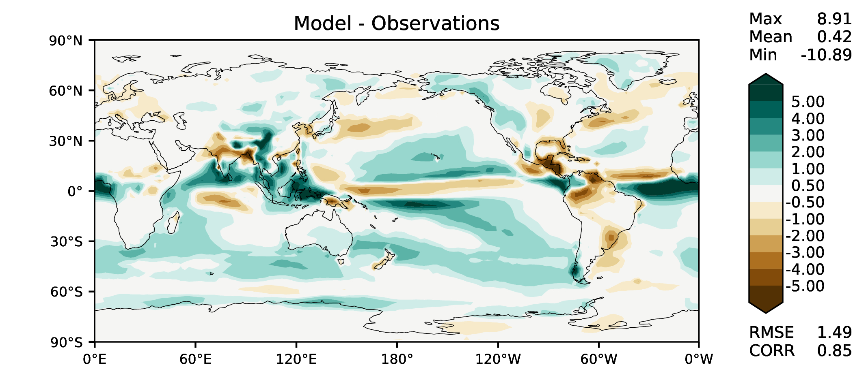
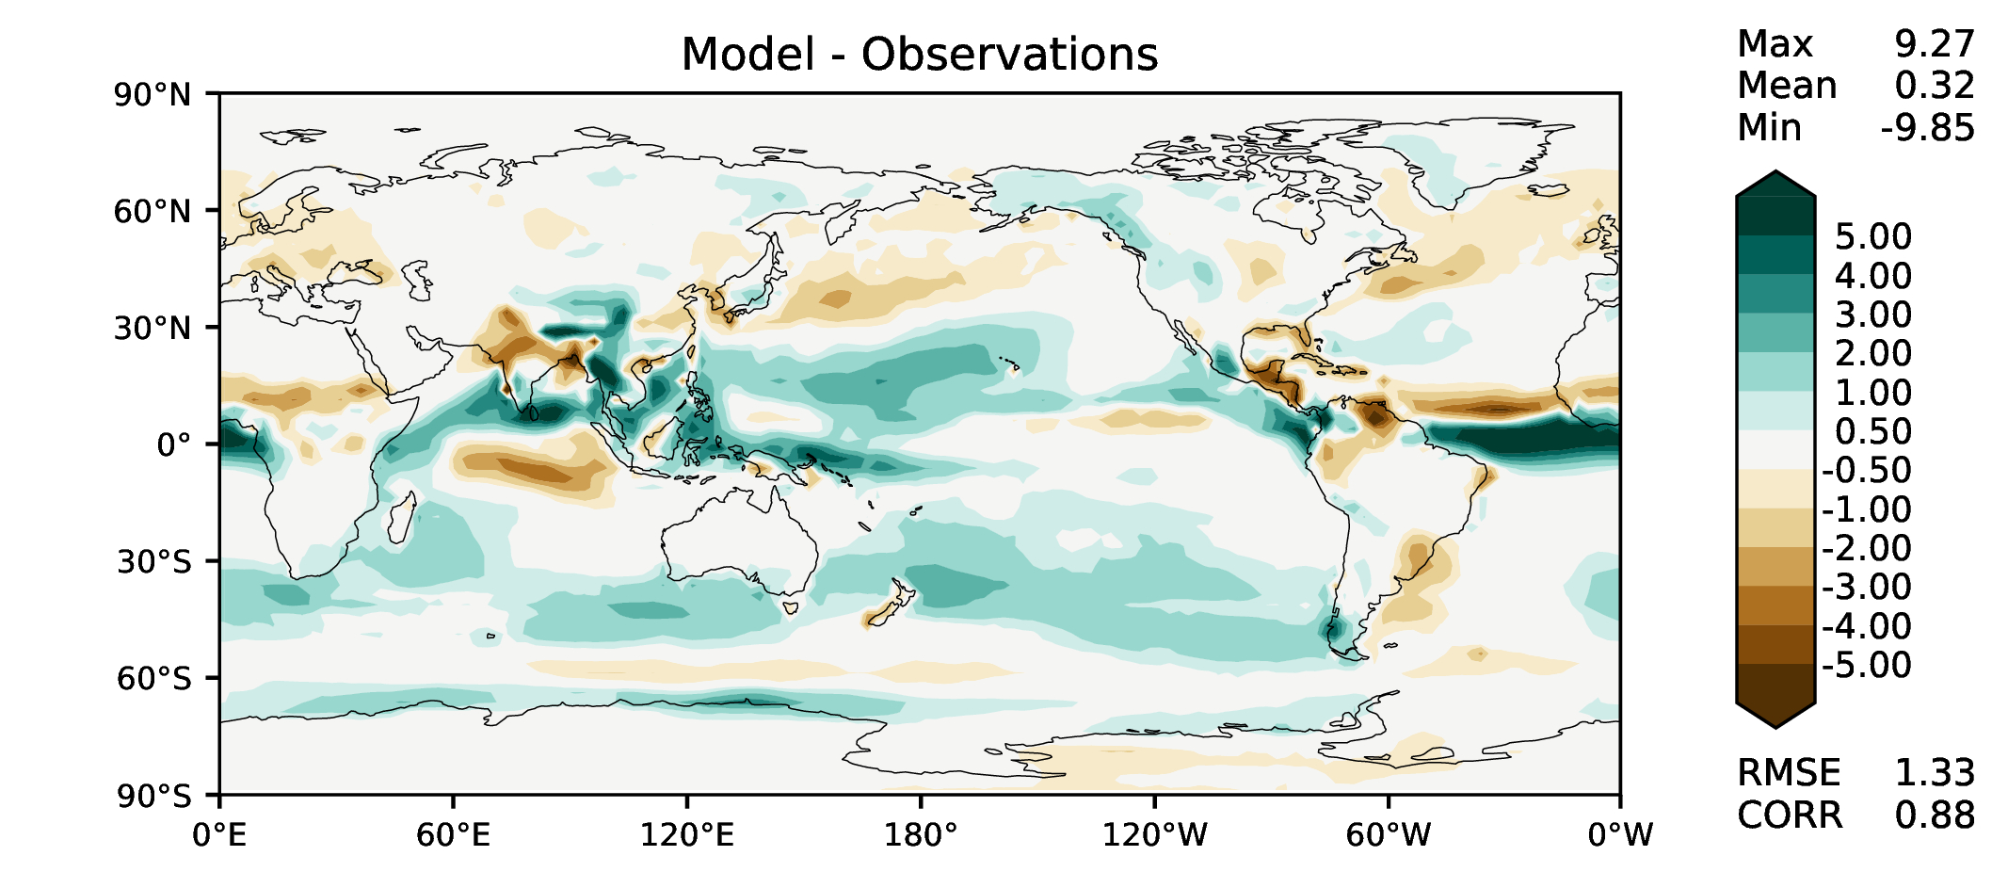
JJA total precipitation
DECKv1b
v2rc1e

Slide 7
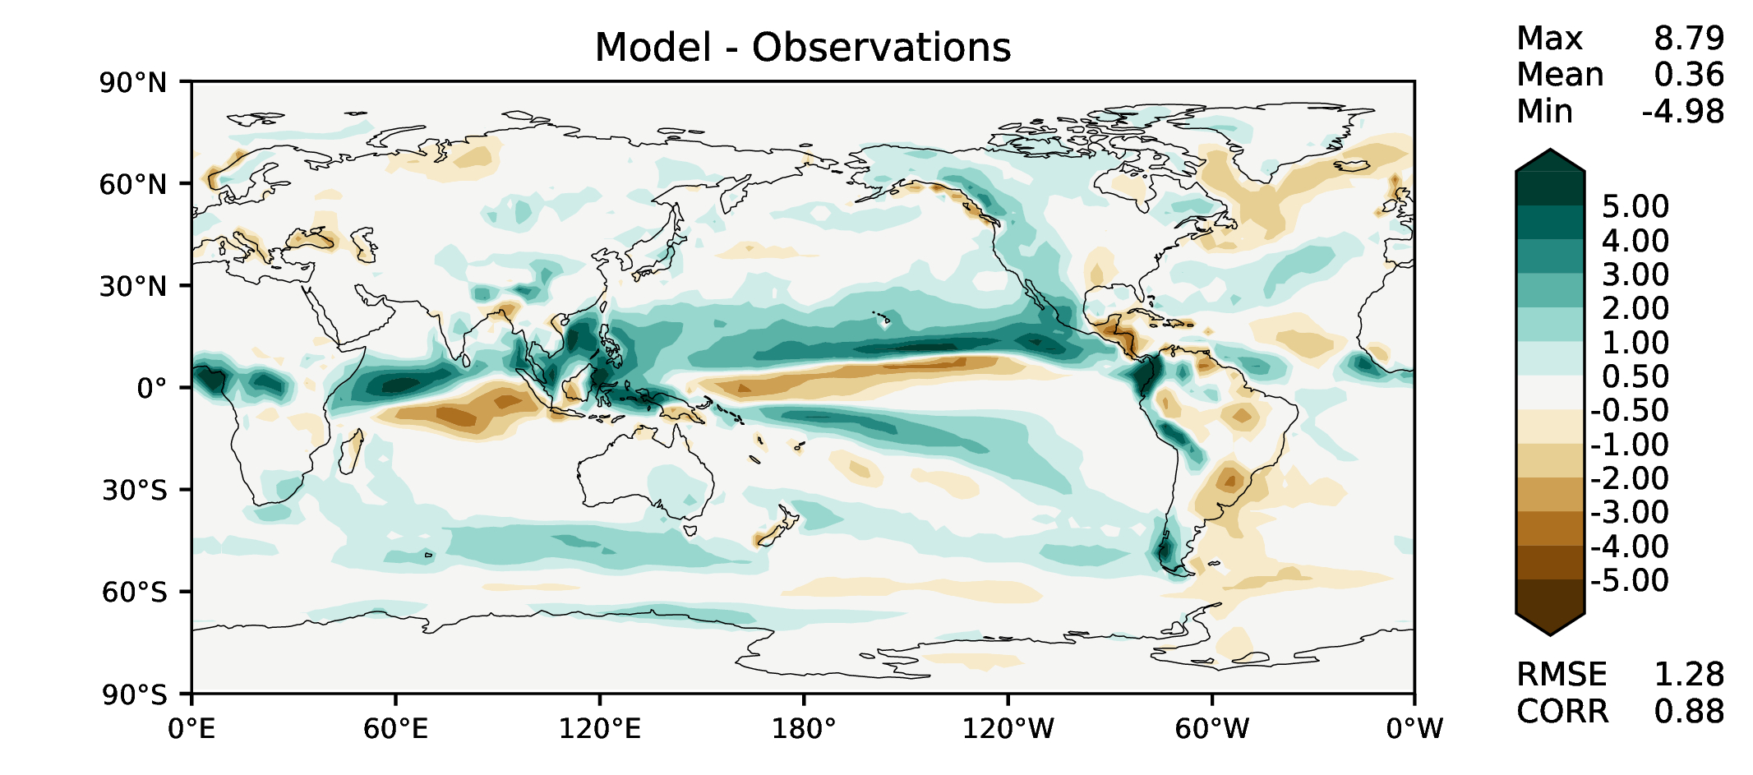
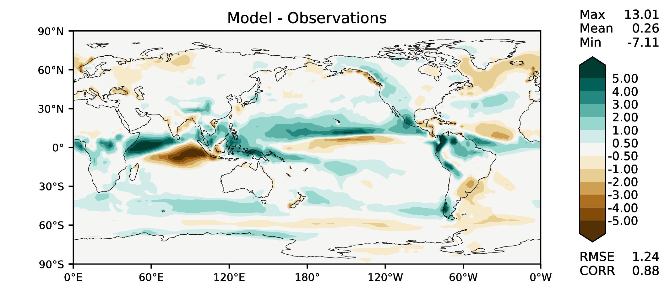
SON total precipitation
DECKv1b
v2rc1e

Slide 8
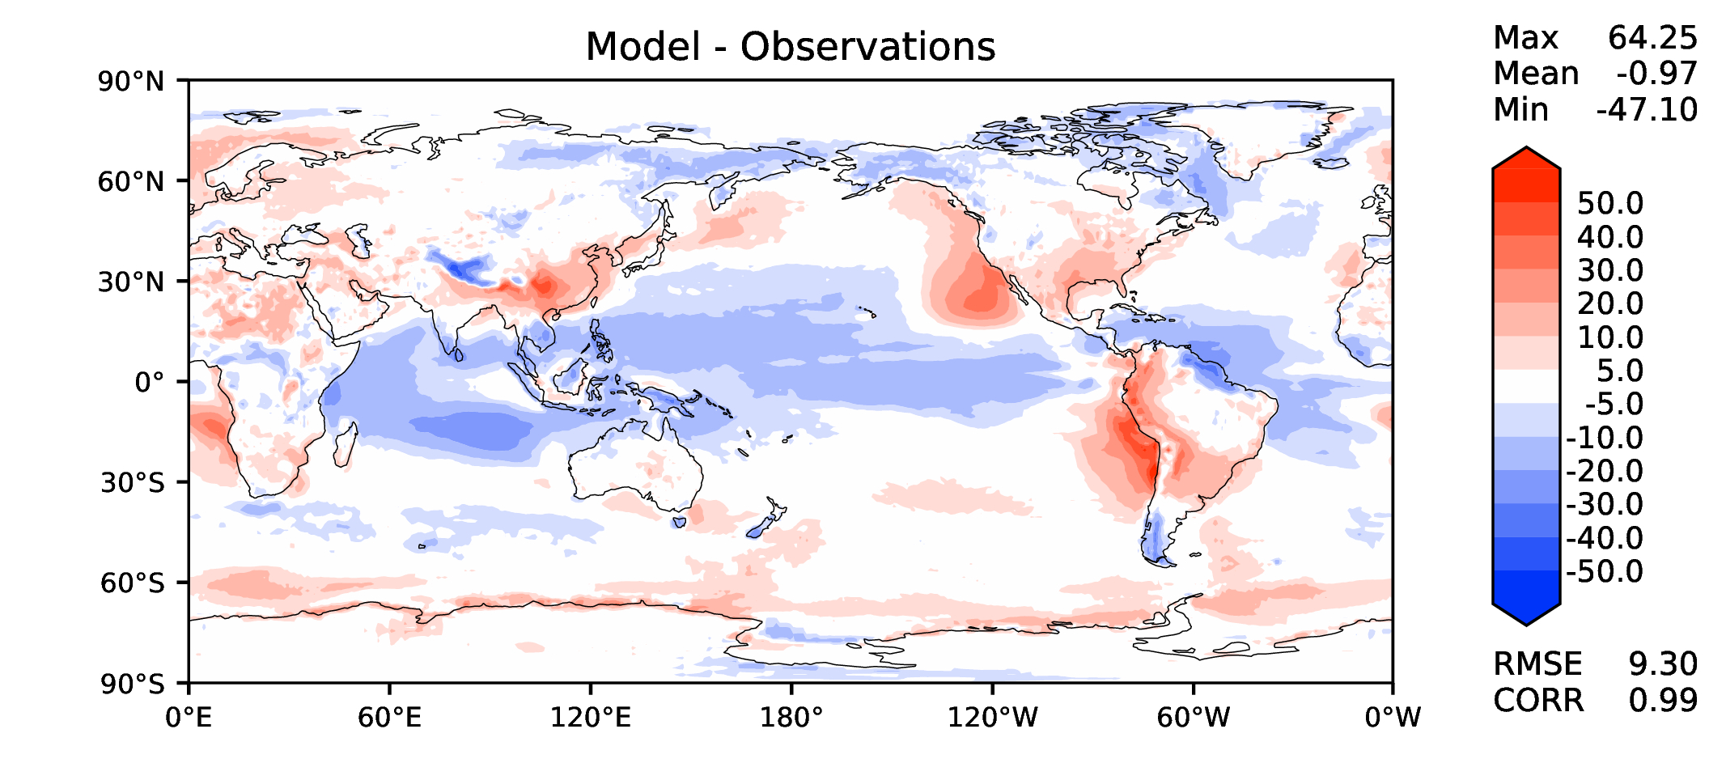
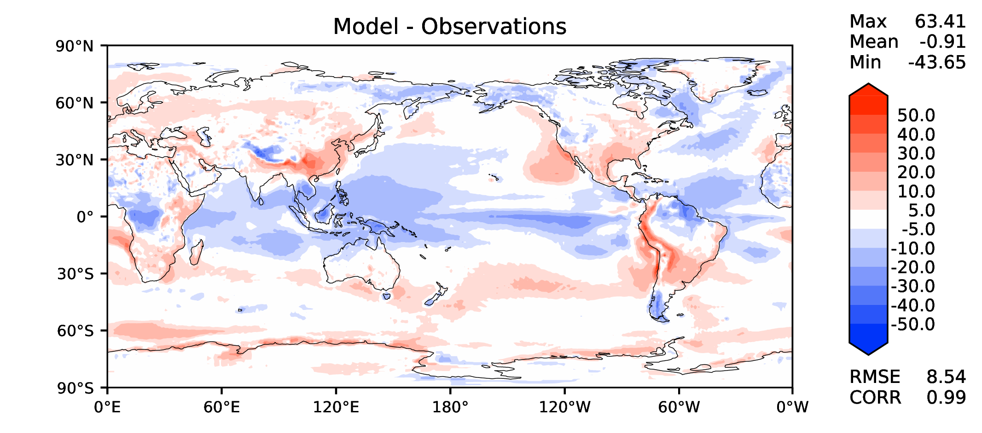
Annual TOA net radiation
DECKv1b
v2rc1e

Slide 9
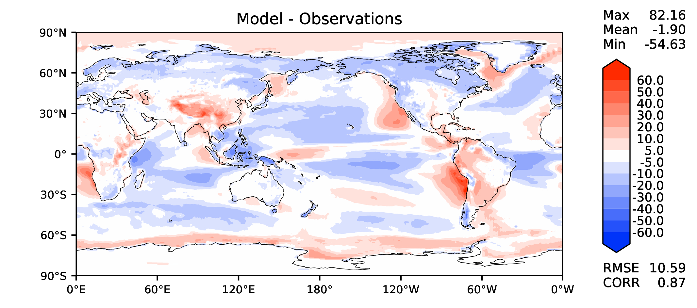
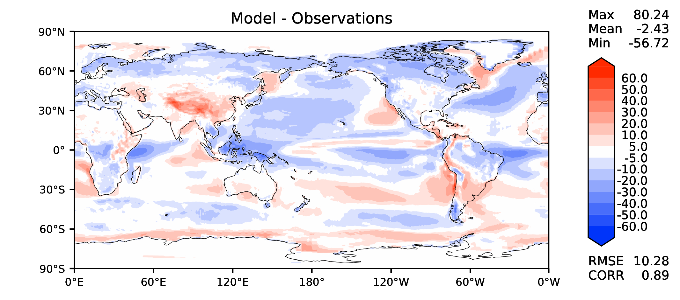
Annual TOA SW CRE
DECKv1b
v2rc1e

Slide 10
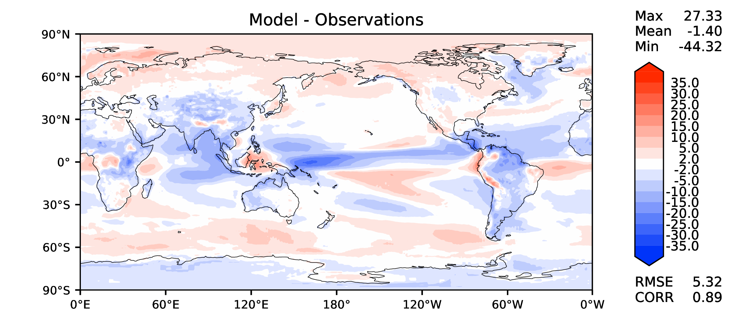
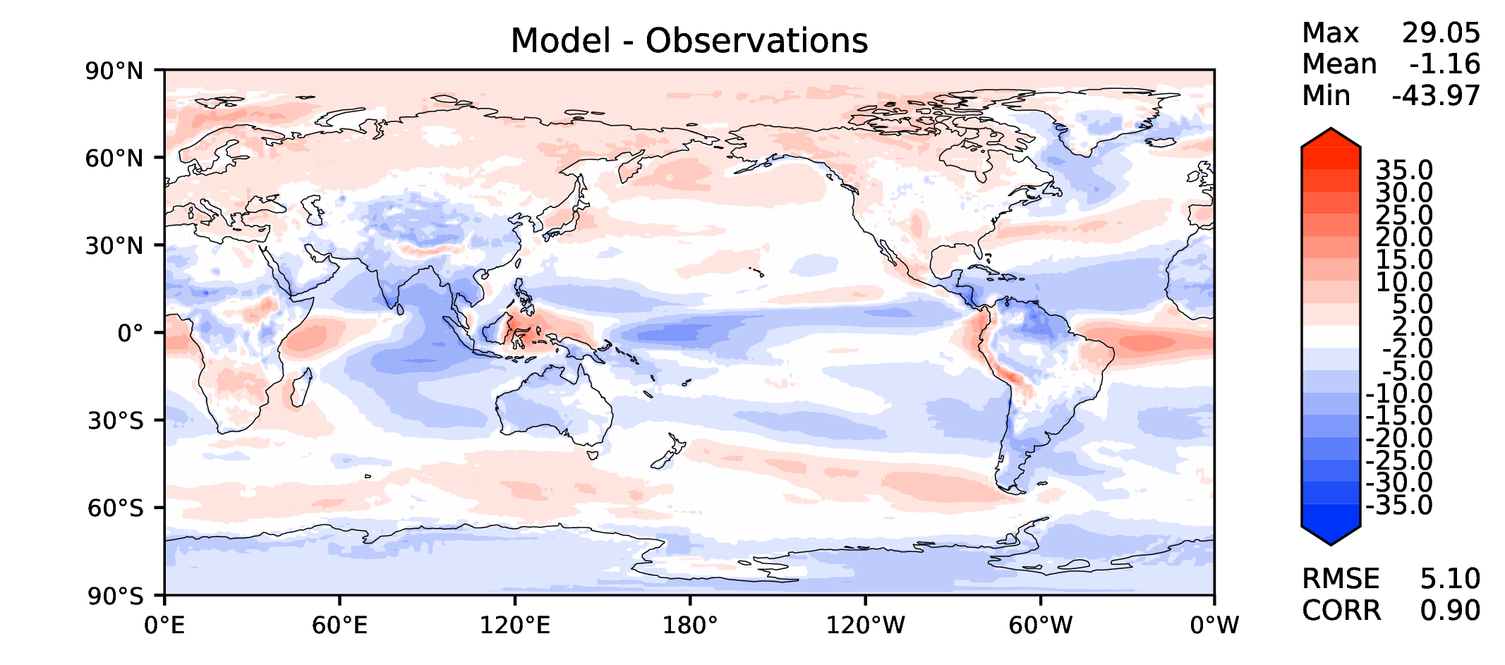
Annual TOA LW CRE
DECKv1b
v2rc1e

Slide 11
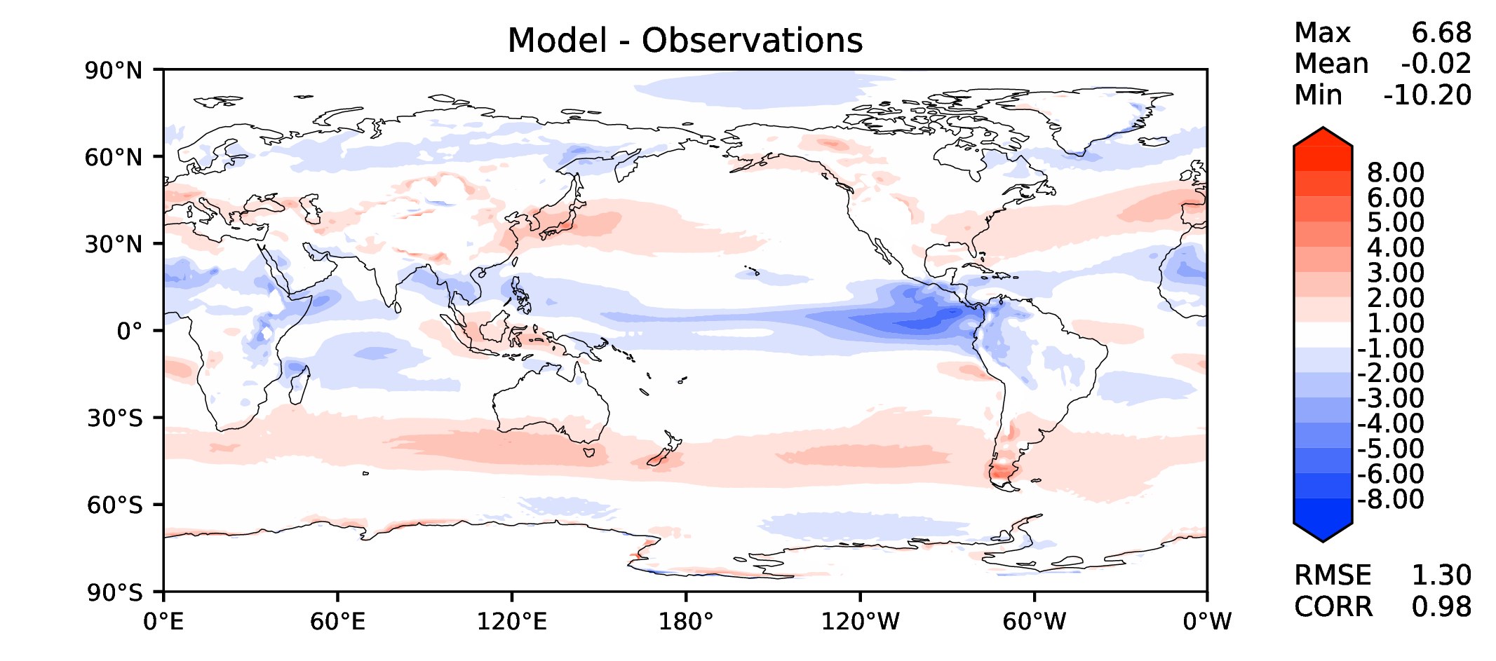
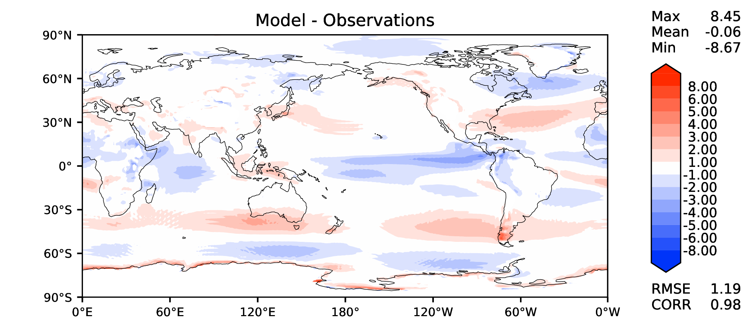
Annual u wind at 850 hPa
DECKv1b
v2rc1e

Slide 12
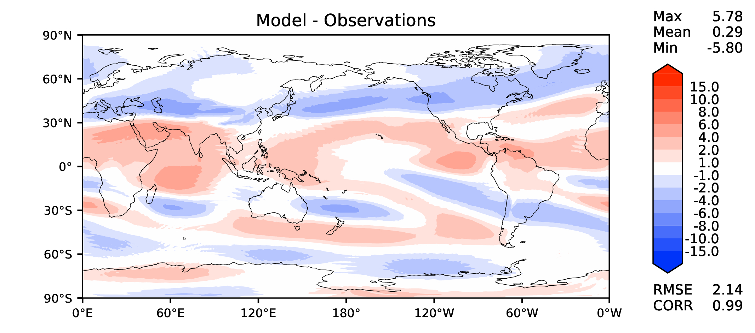
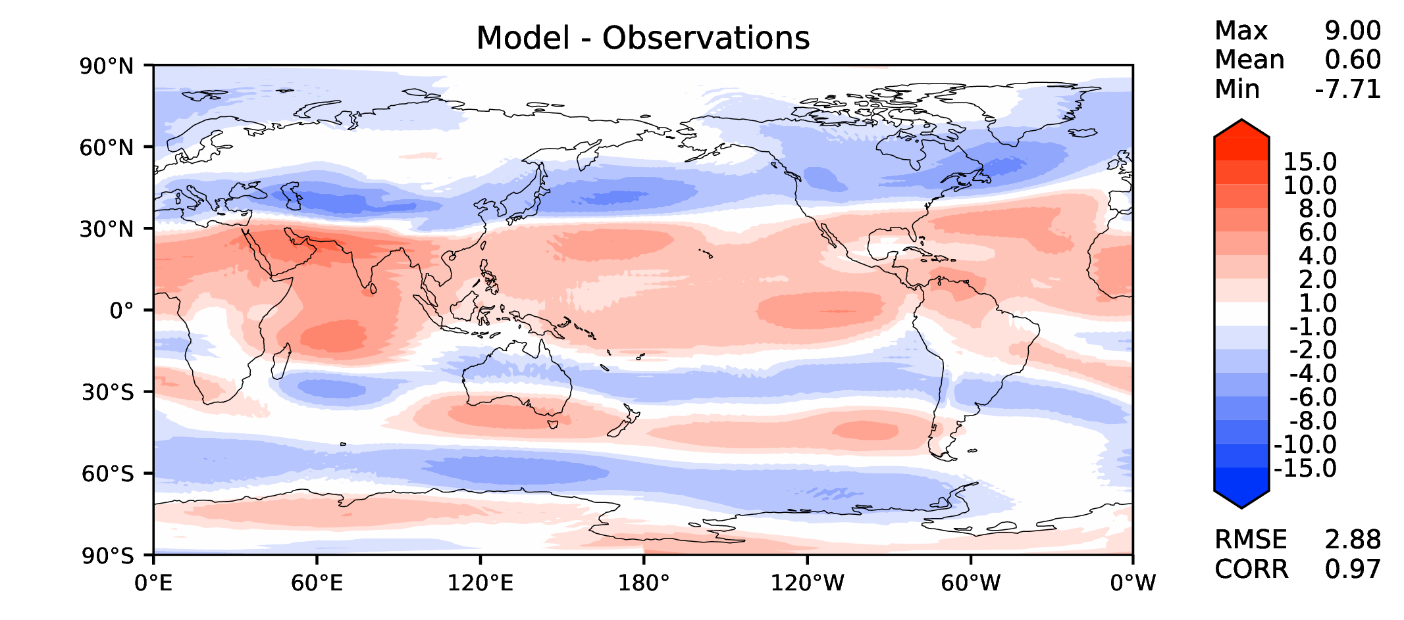
Annual u wind at 200 hPa
DECKv1b
v2rc1e

Slide 13
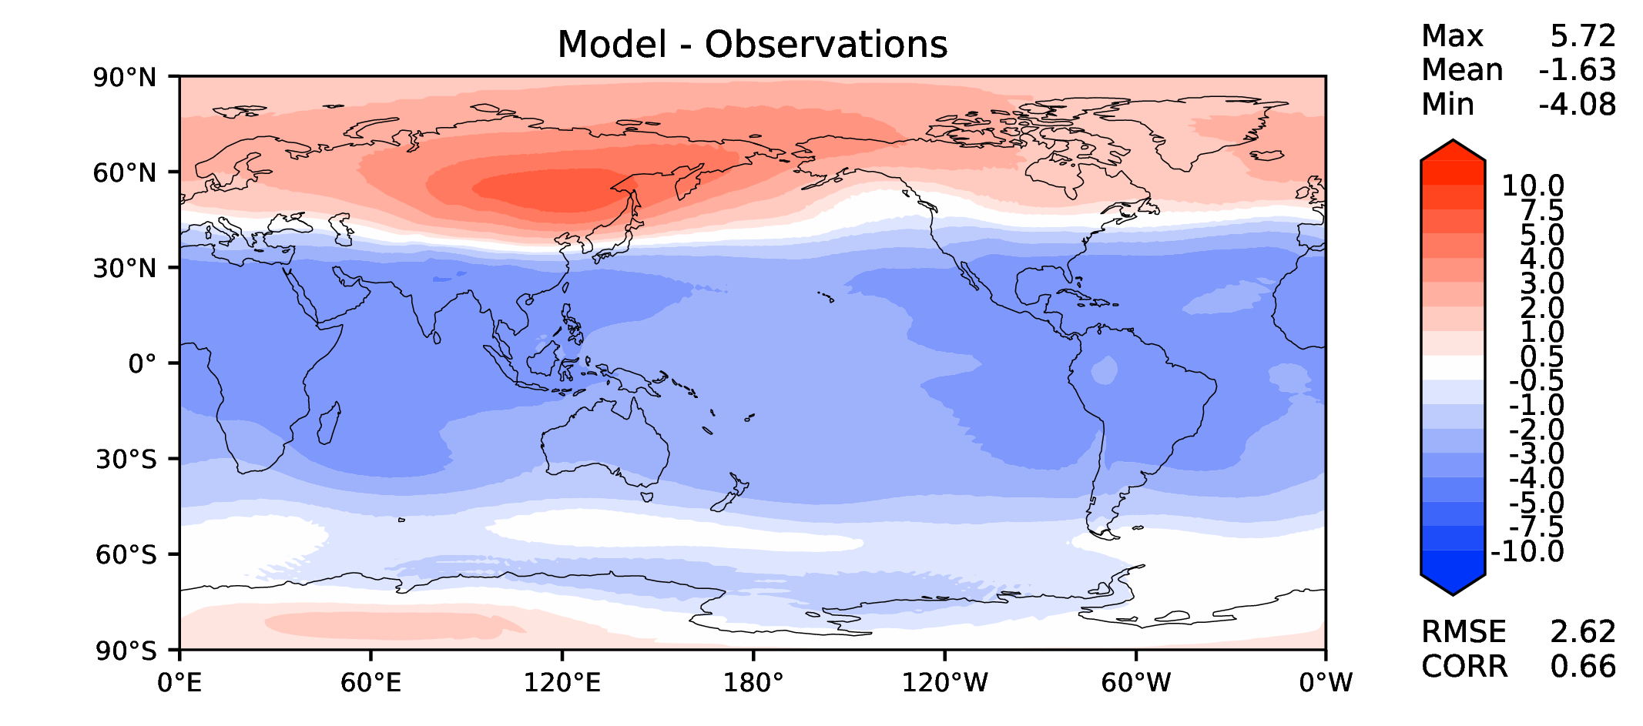
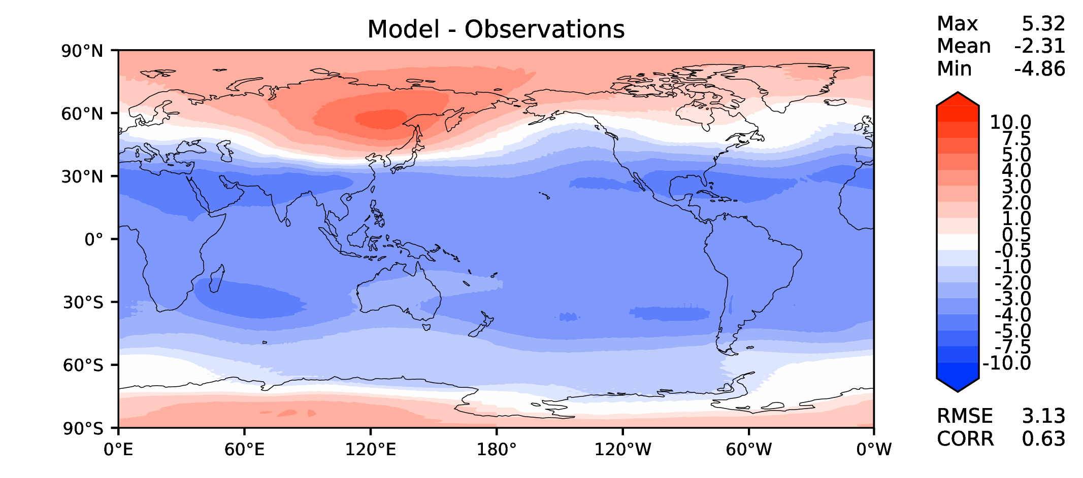
Annual T at 200 hPa
DECKv1b
v2rc1e

Slide 14
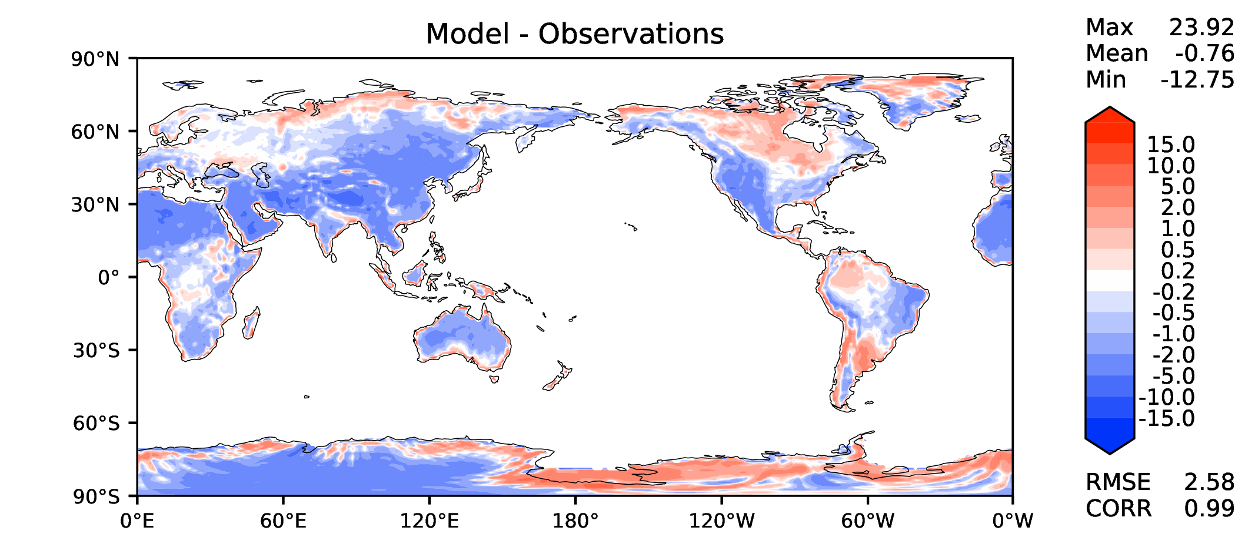
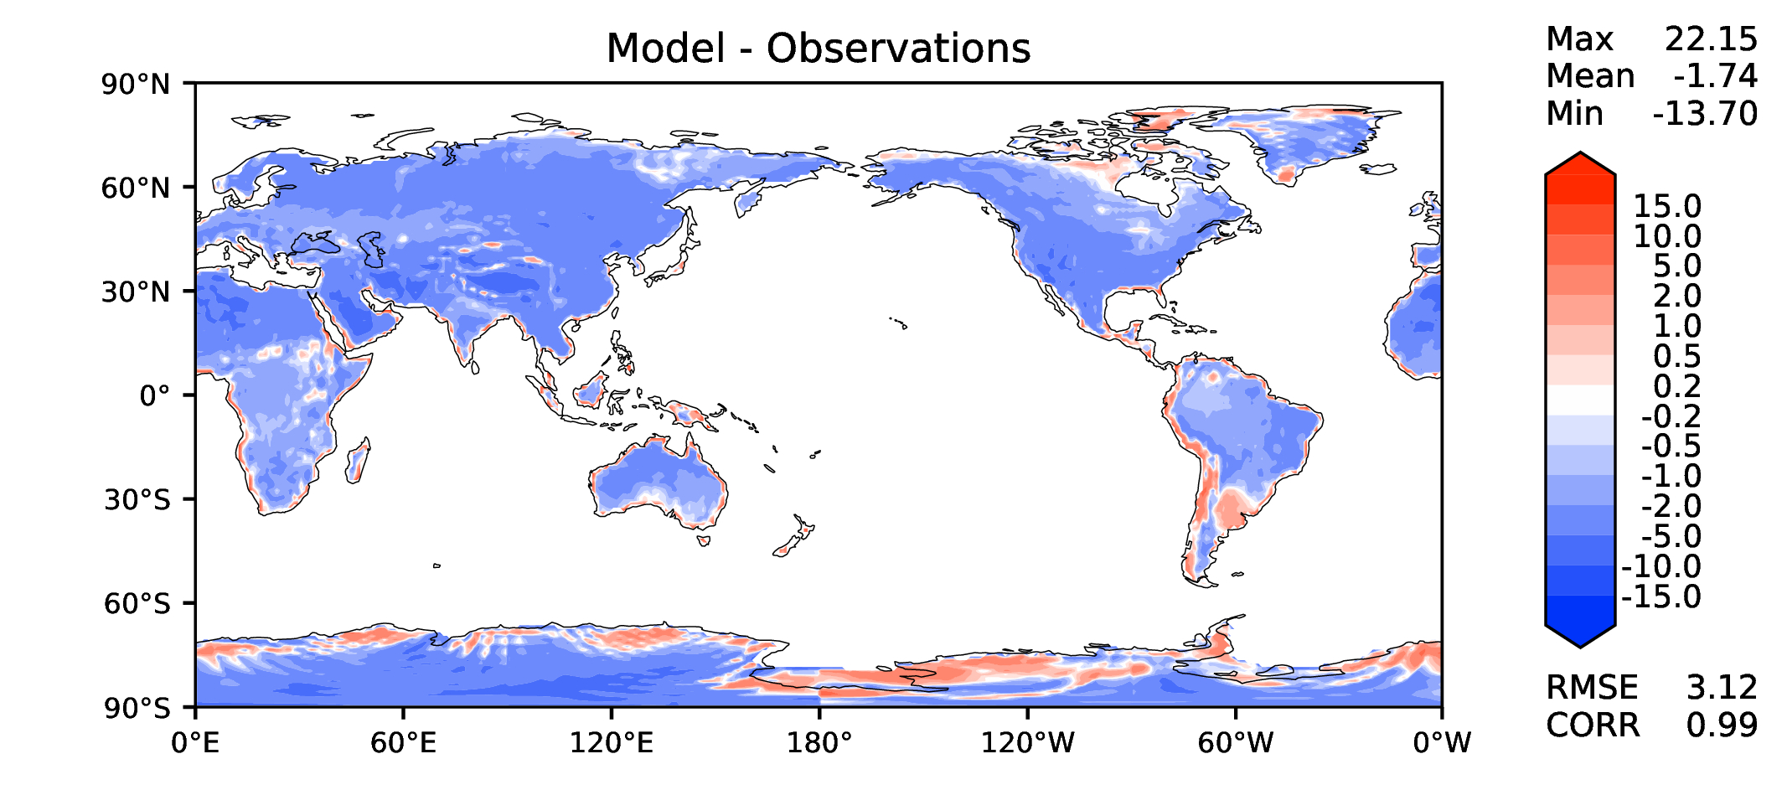
Annual surface air T (land)
DECKv1b
v2rc1e

Slide 15
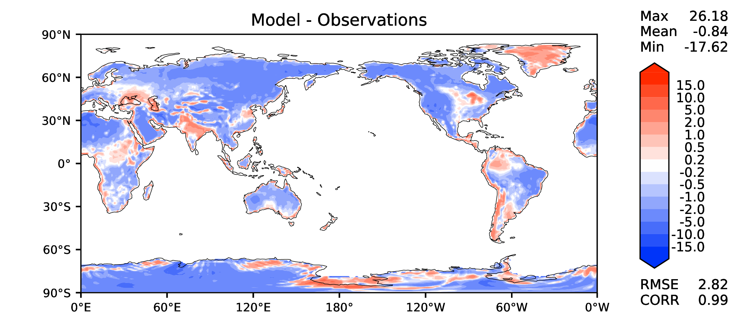
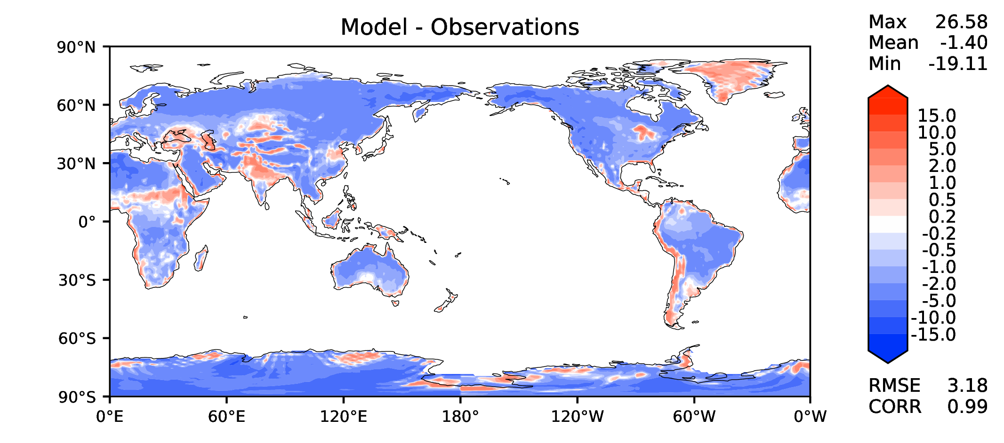
JJA surface air T (land)
DECKv1b
v2rc1e

Slide 16
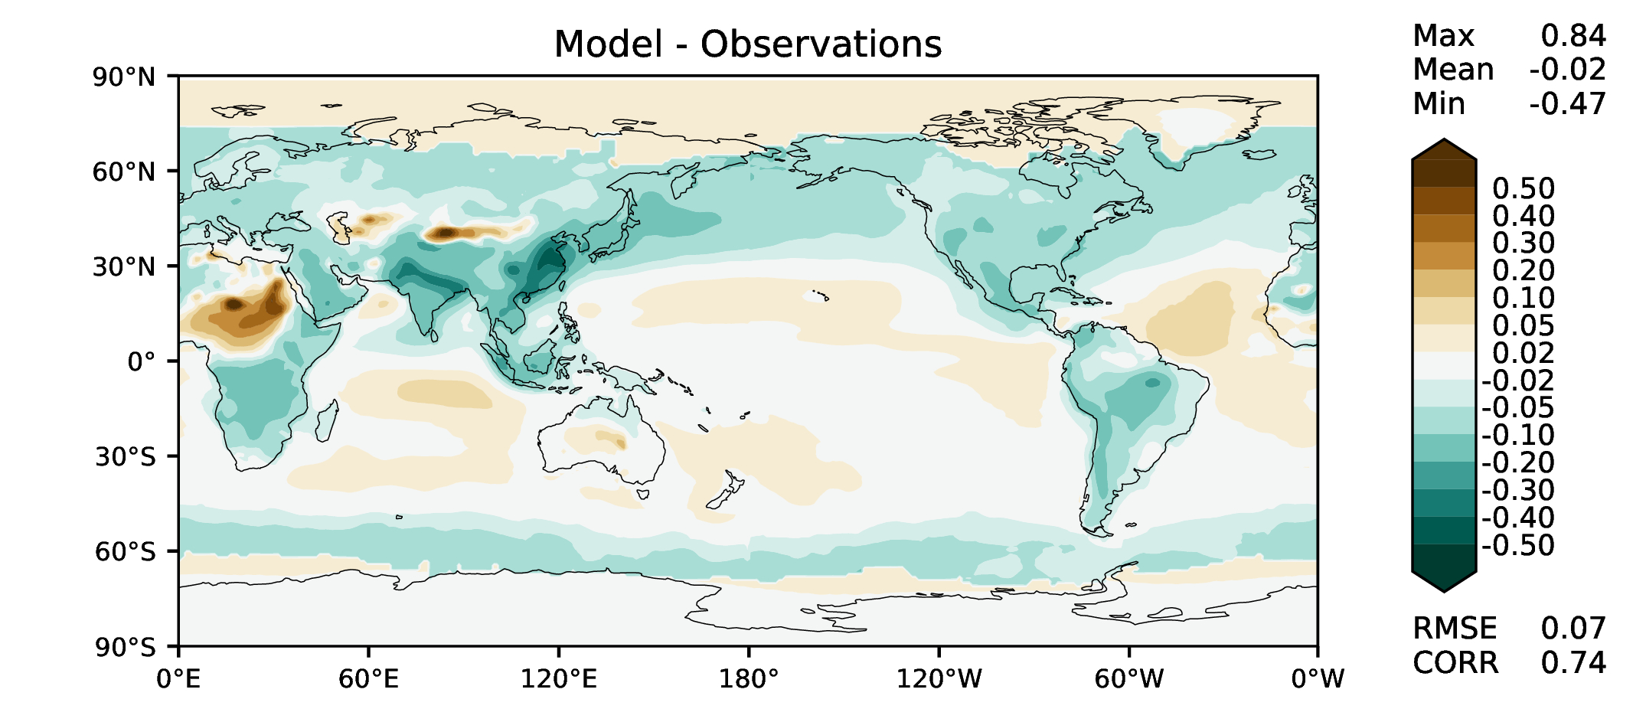
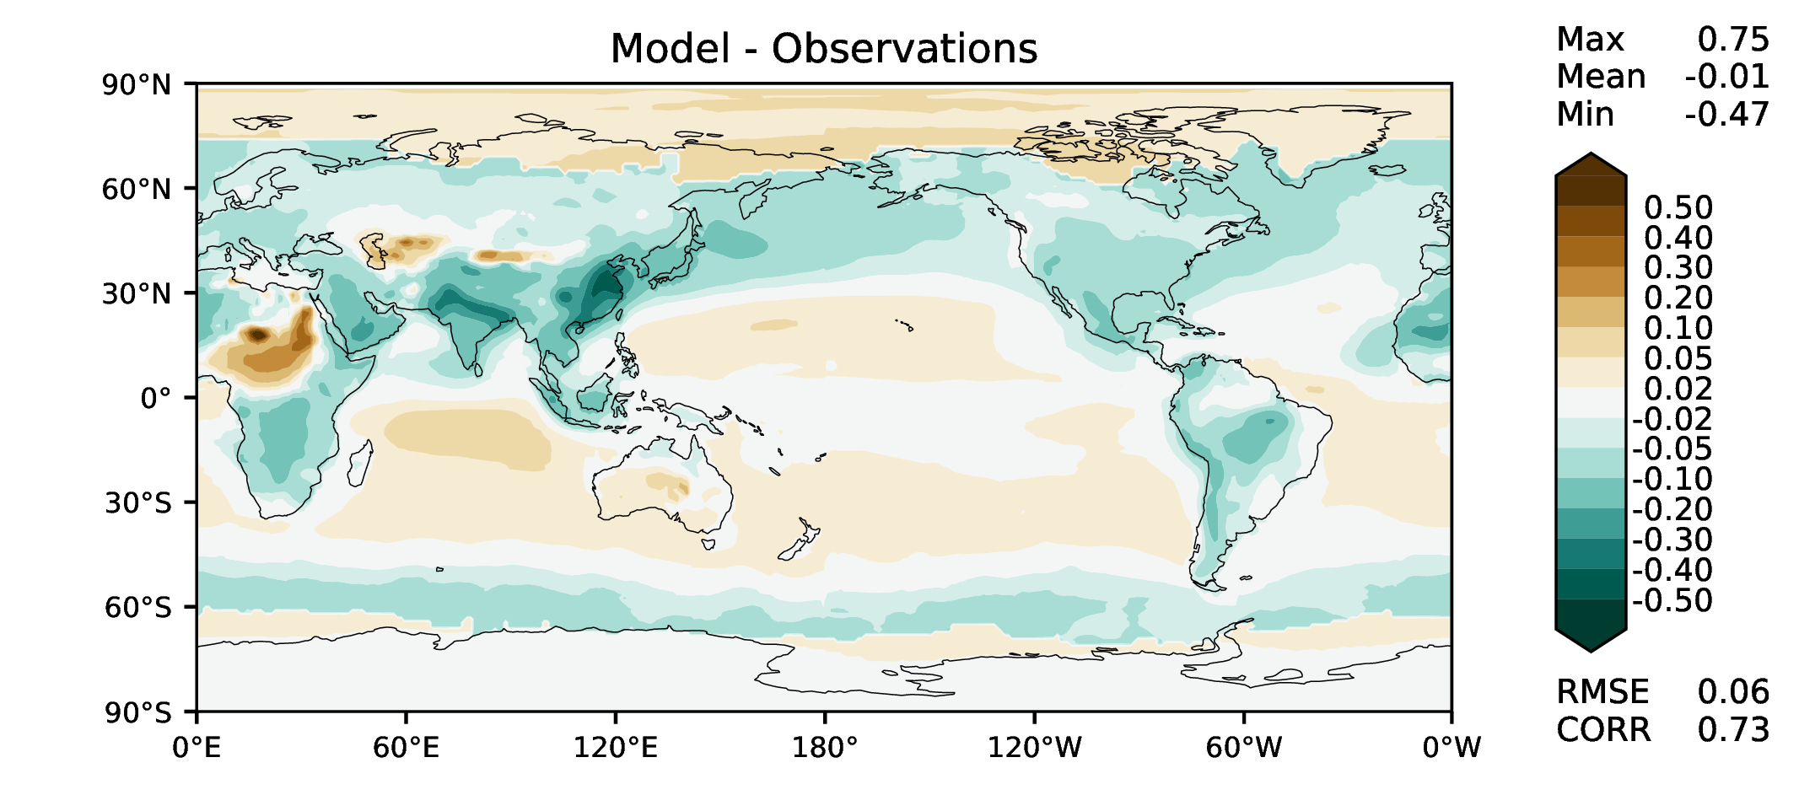
Aerosol optical depth
DECKv1b
v2rc1e

Slide 17
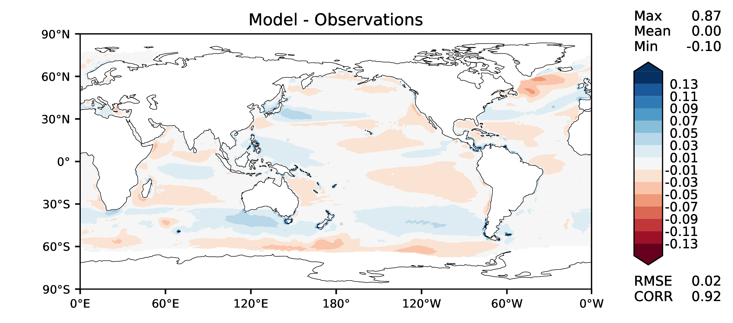
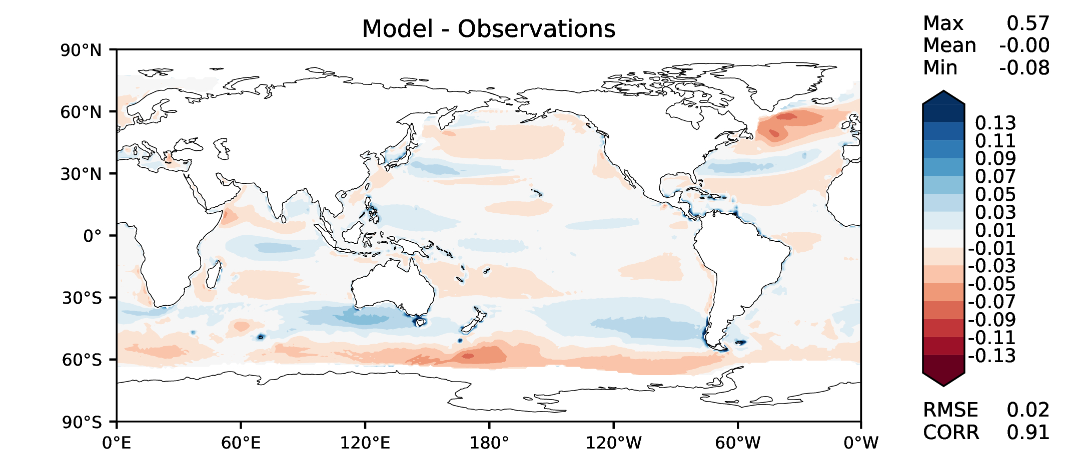
TAUXY ANN ocean
DECKv1b
v2rc1e

