Slide 1
Summary table (RMSE vs obs)
Variable | Season | DECKv1 | maint-1.0 | 20190730
SST | ANN | 1.08 | 1.05 | 1.07
PRECT | ANN | 1.11 | 1.12 | 1.13
PRECT | DJF | 1.40 | 1.41 | 1.41
PRECT | MAM | 1.52 | 1.52 | 1.51
PRECT | JJA | 1.51 | 1.50 | 1.52
PRECT | SON | 1.28 | 1.29 | 1.32
RESTOM | ANN | 9.34 | 9.28 | 9.33
SWCF | ANN | 10.56 | 10.49 | 10.70
LWCF | ANN | 5.25 | 5.28 | 5.31
u850 | ANN | 1.26 | 1.29 | 1.28
u200 | ANN | 2.22 | 2.10 | 2.22
T200 | ANN | 2.66 | 2.69 | 2.69
TREFHT | ANN | 2.61 | 2.57 | 2.62
TREFHT | JJA | 2.88 | 2.84 | 2.88
AODVIS | ANN | 0.07 | 0.07 | 0.07
TAUXY | ANN | 0.02 | 0.02 | 0.02

Slide 2
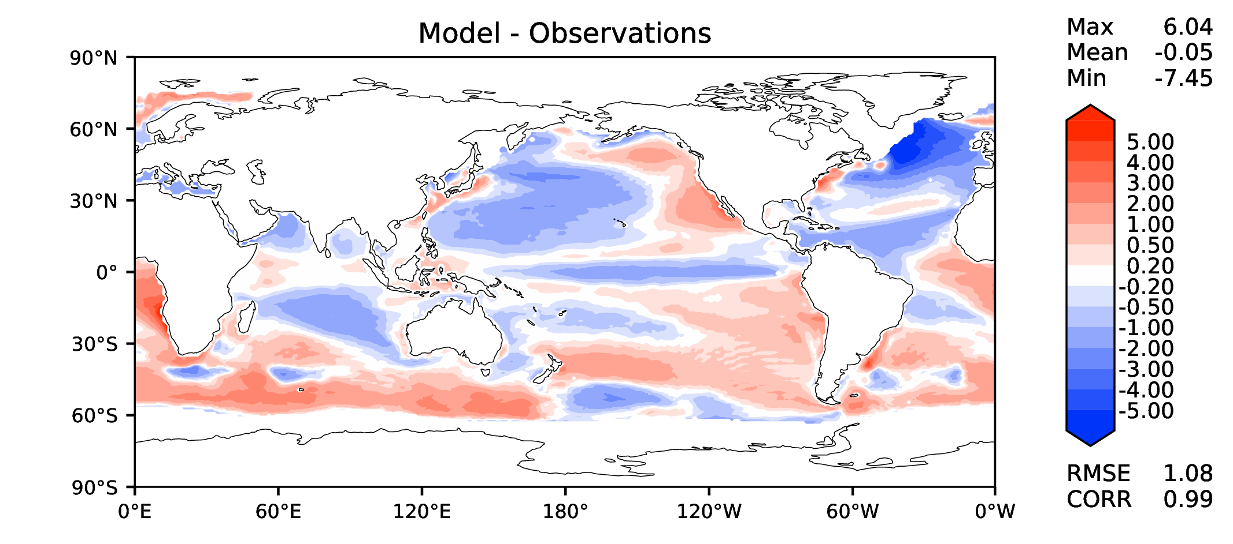
Annual SST (pre-industrial)
DECKv1
maint-1.0
20190730

Slide 3
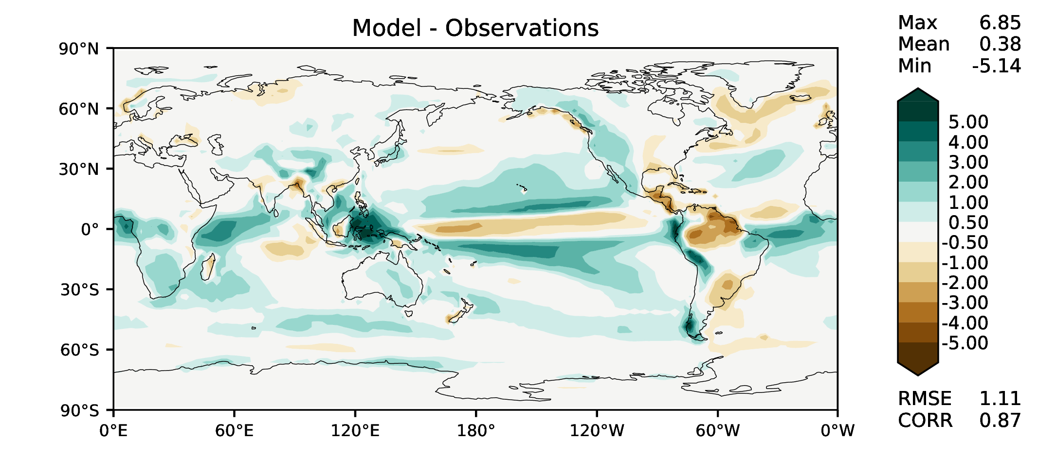
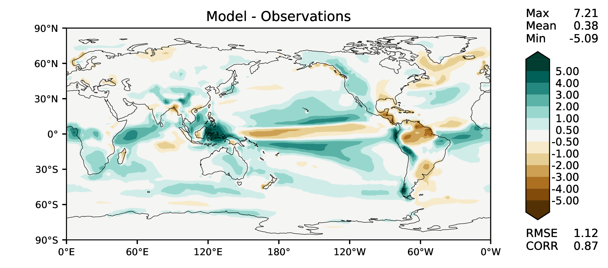
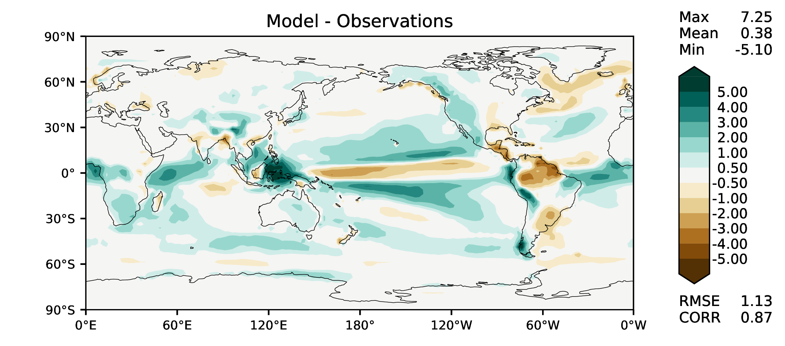
Annual total precipitation
DECKv1
maint-1.0
20190730

Slide 4
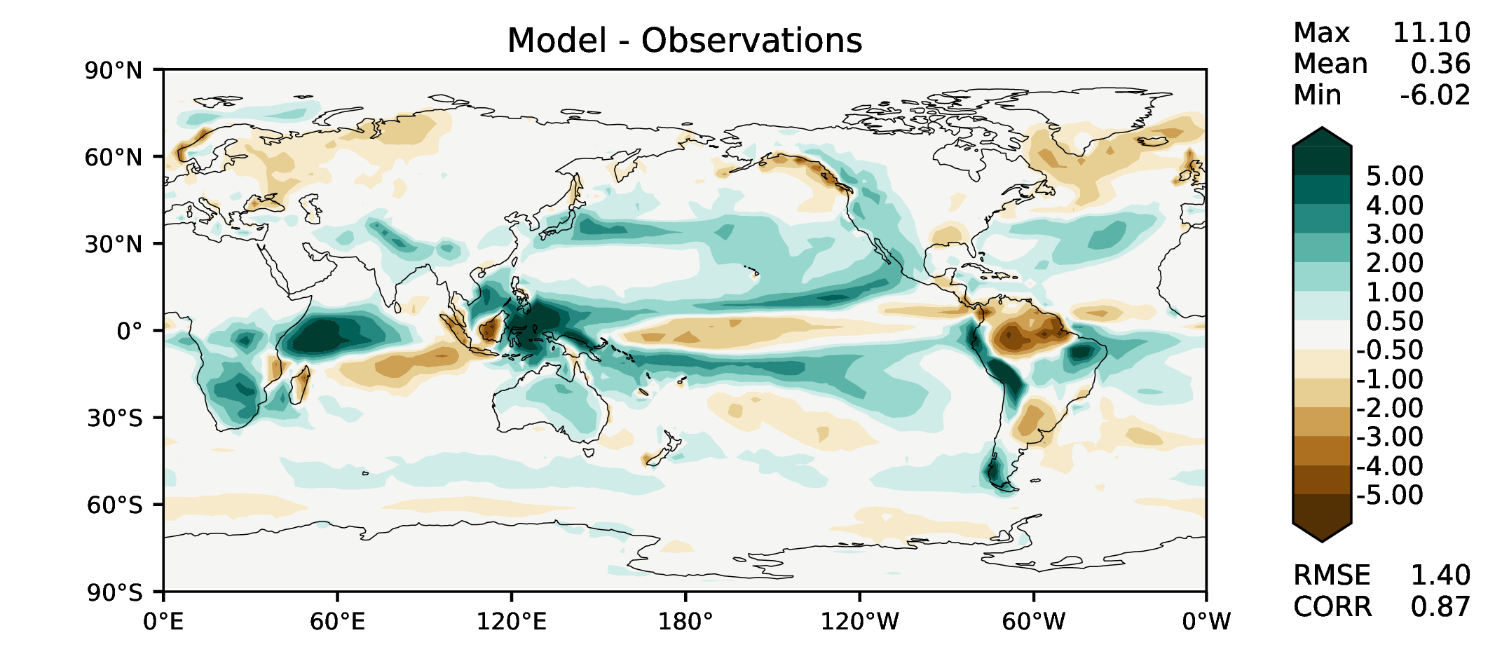
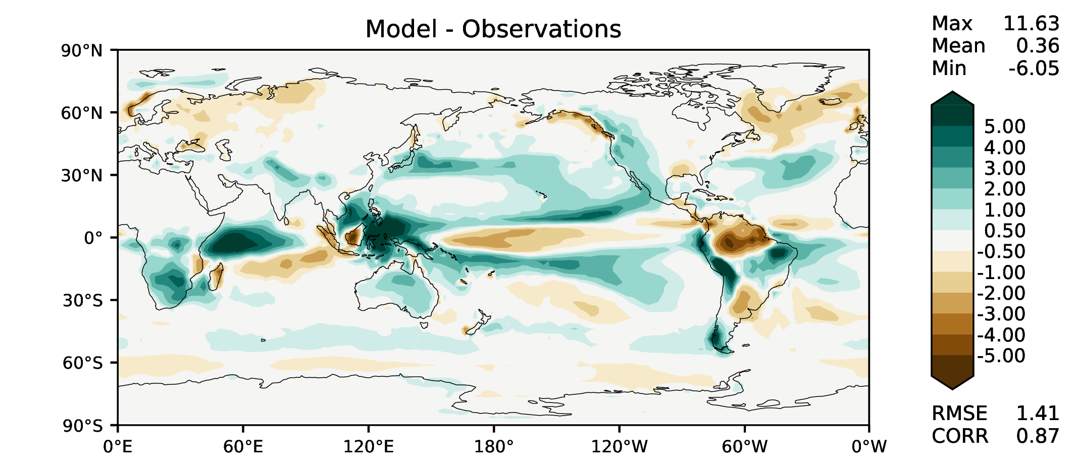
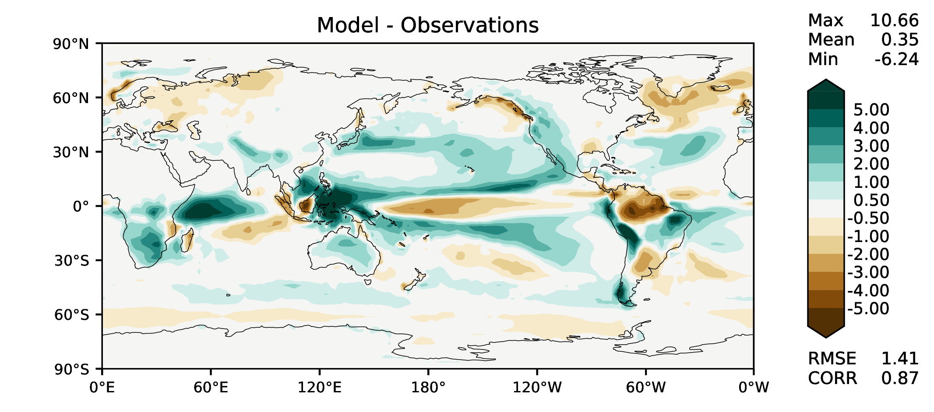
DJF total precipitation
DECKv1
maint-1.0
20190730

Slide 5
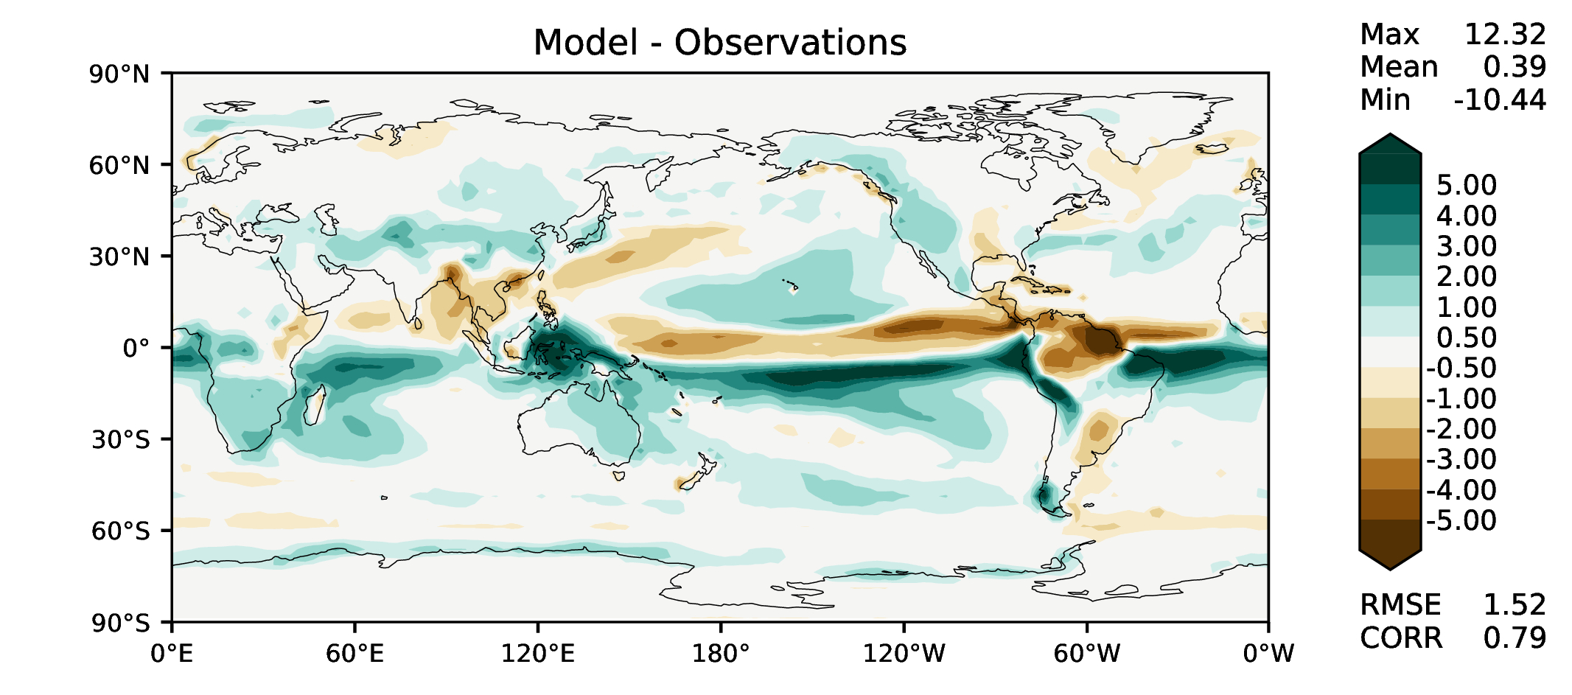
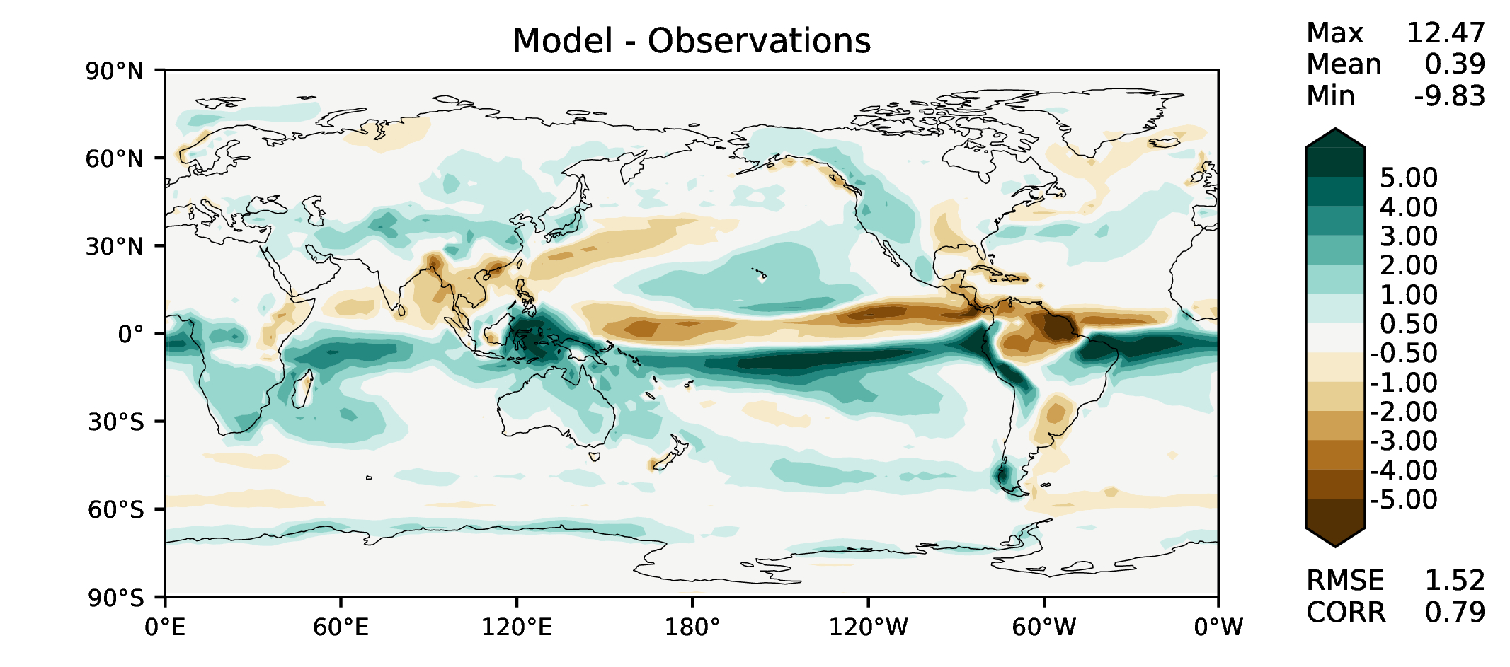
MAM total precipitation
DECKv1
maint-1.0
20190730

Slide 6
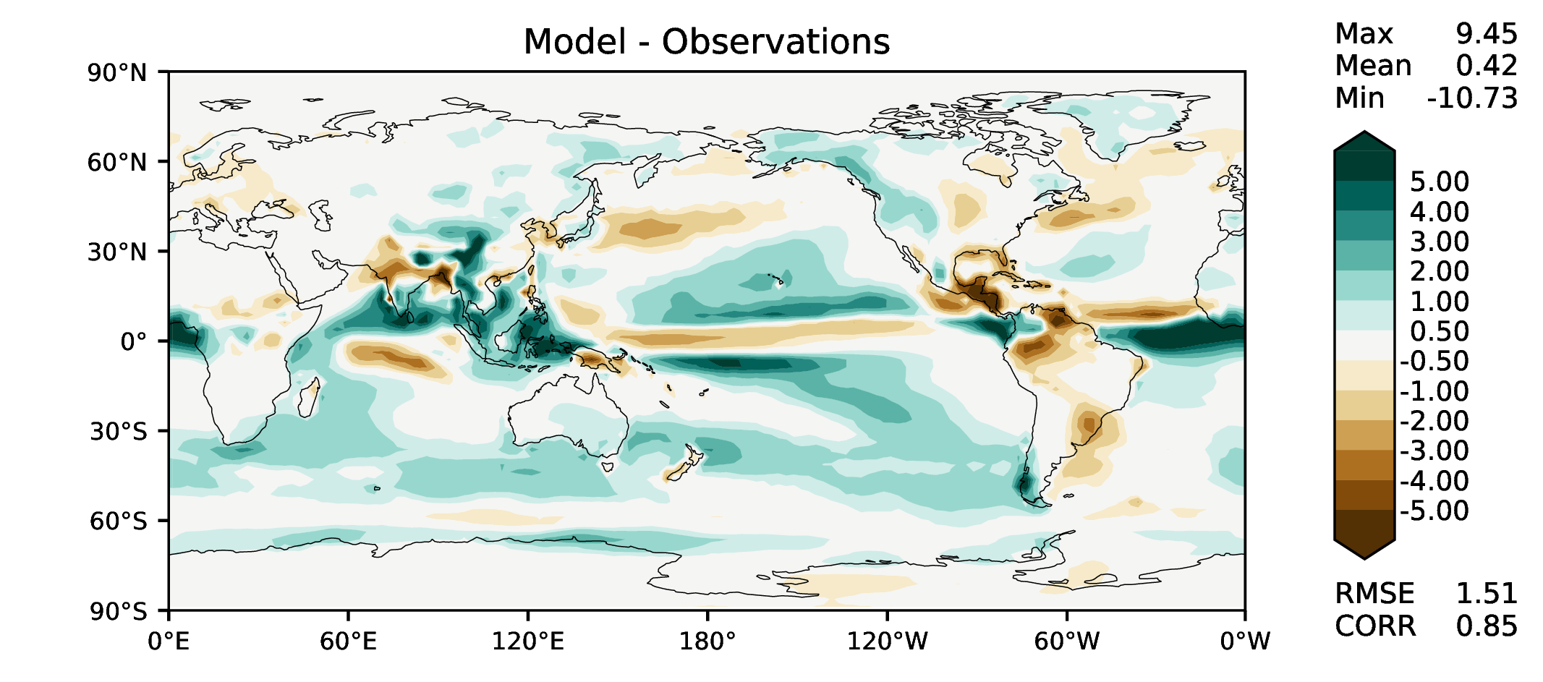
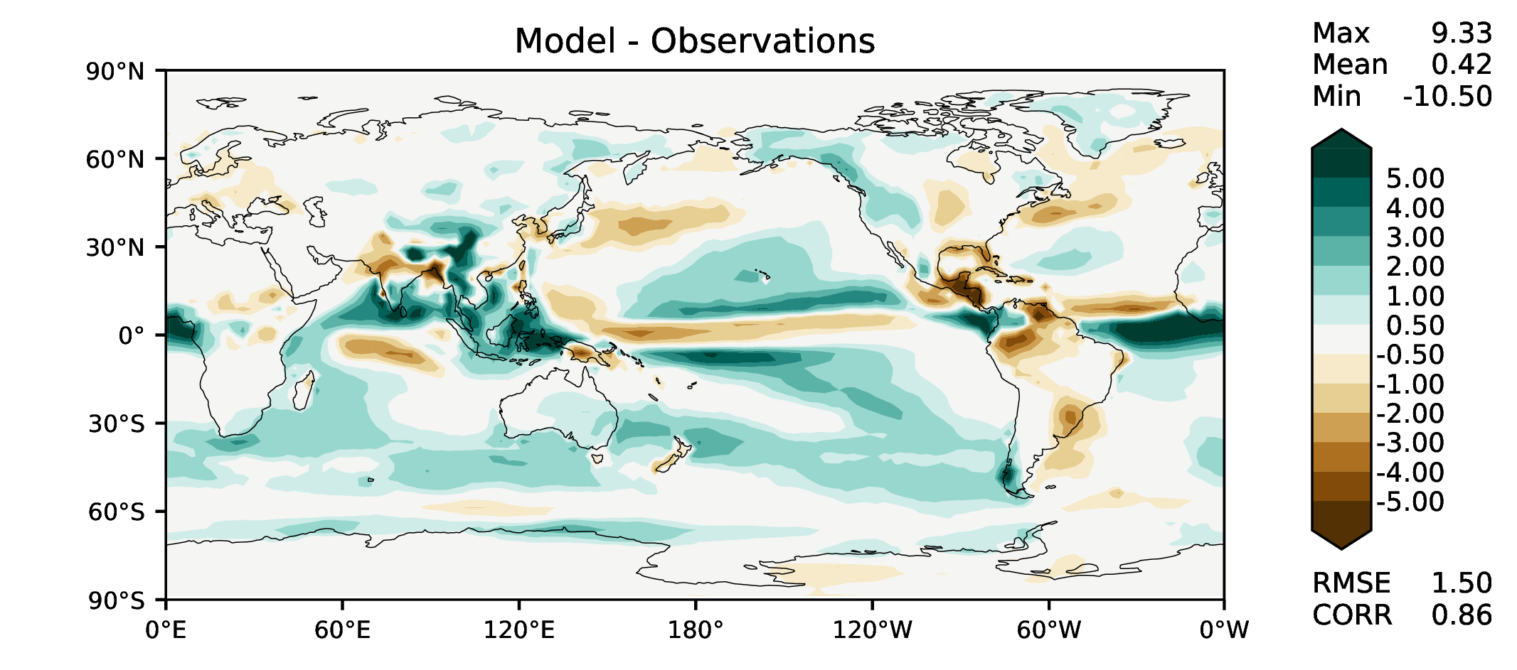
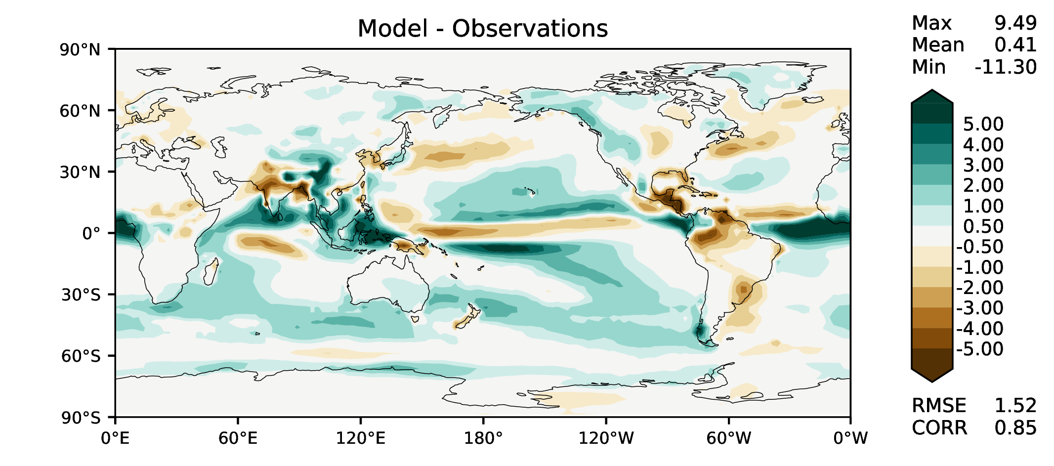
JJA total precipitation
DECKv1
maint-1.0
20190730

Slide 7
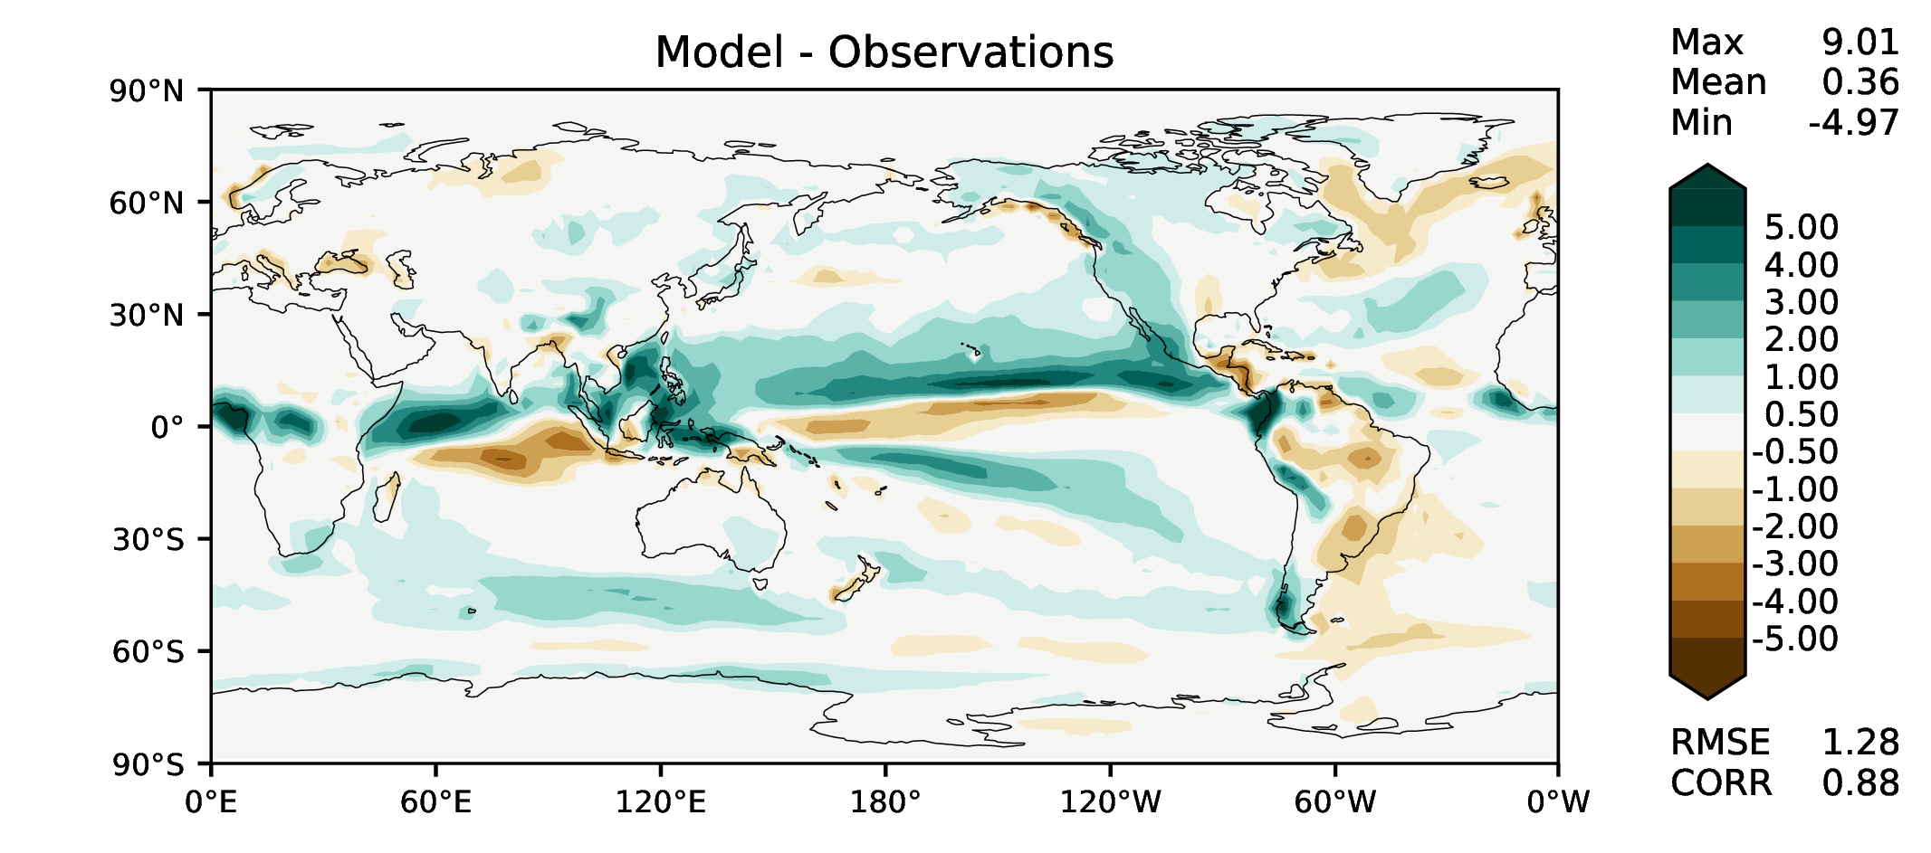
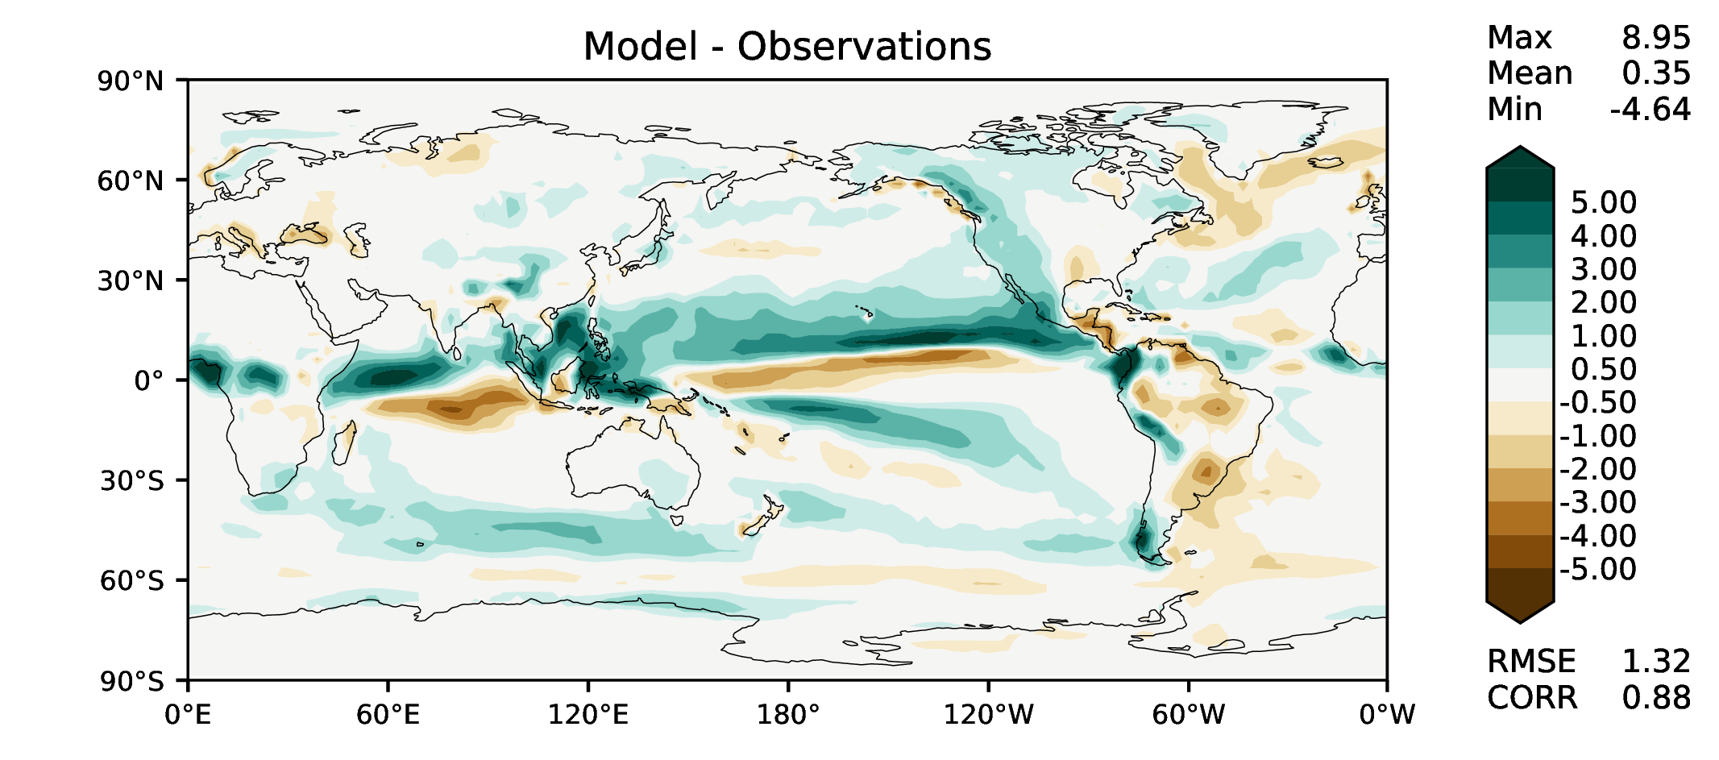
SON total precipitation
DECKv1
maint-1.0
20190730

Slide 8
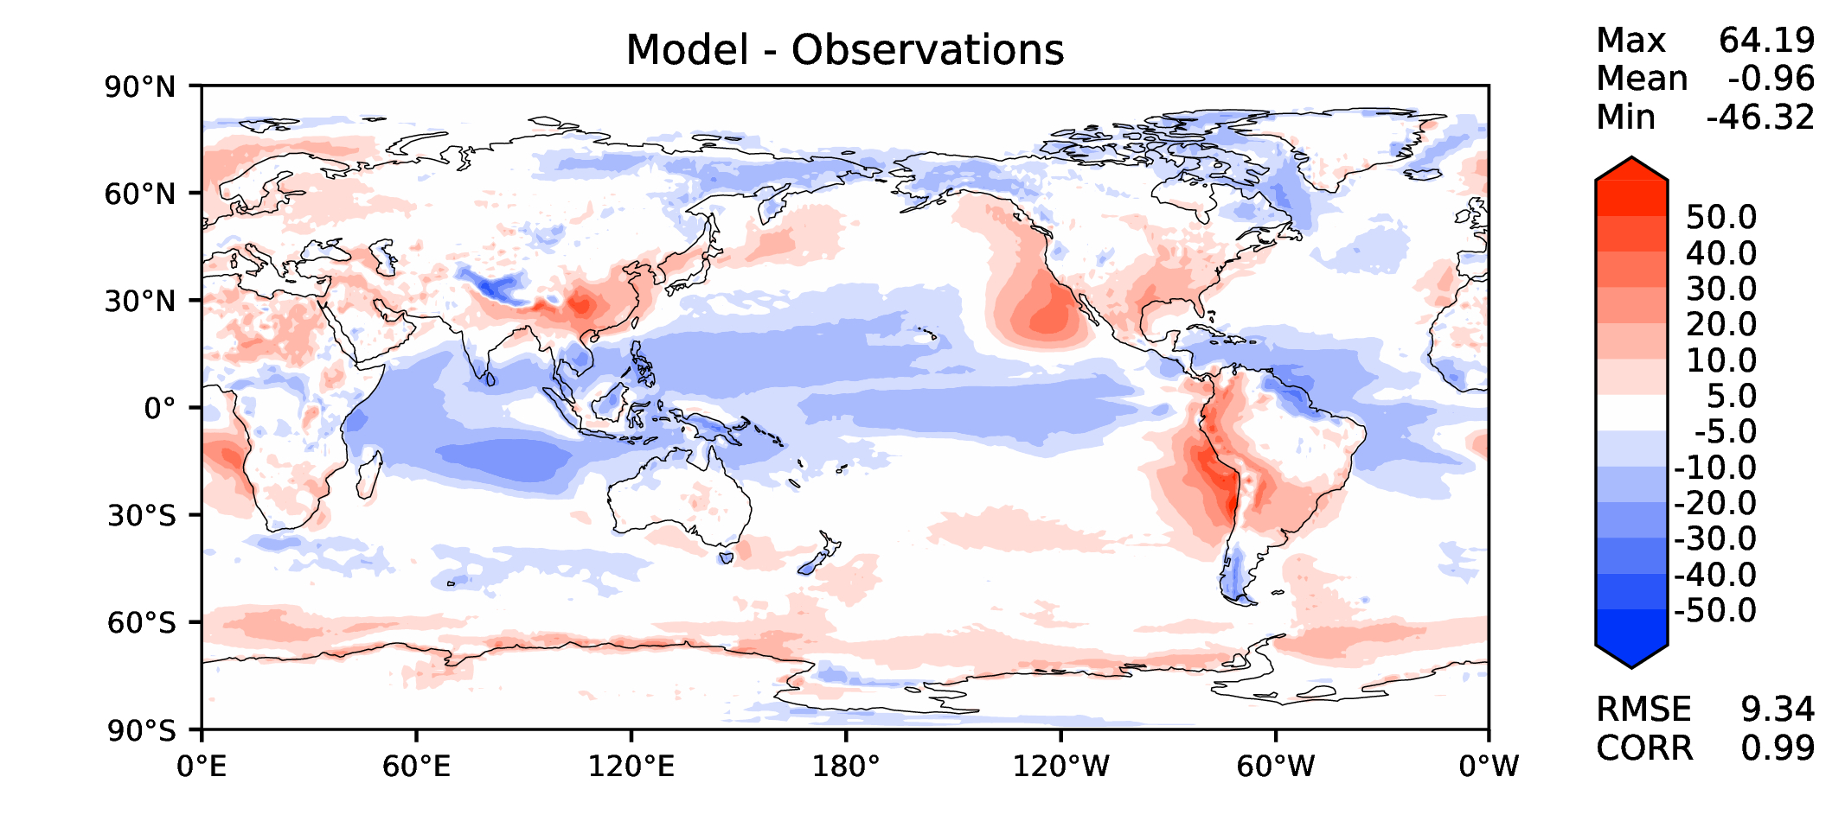
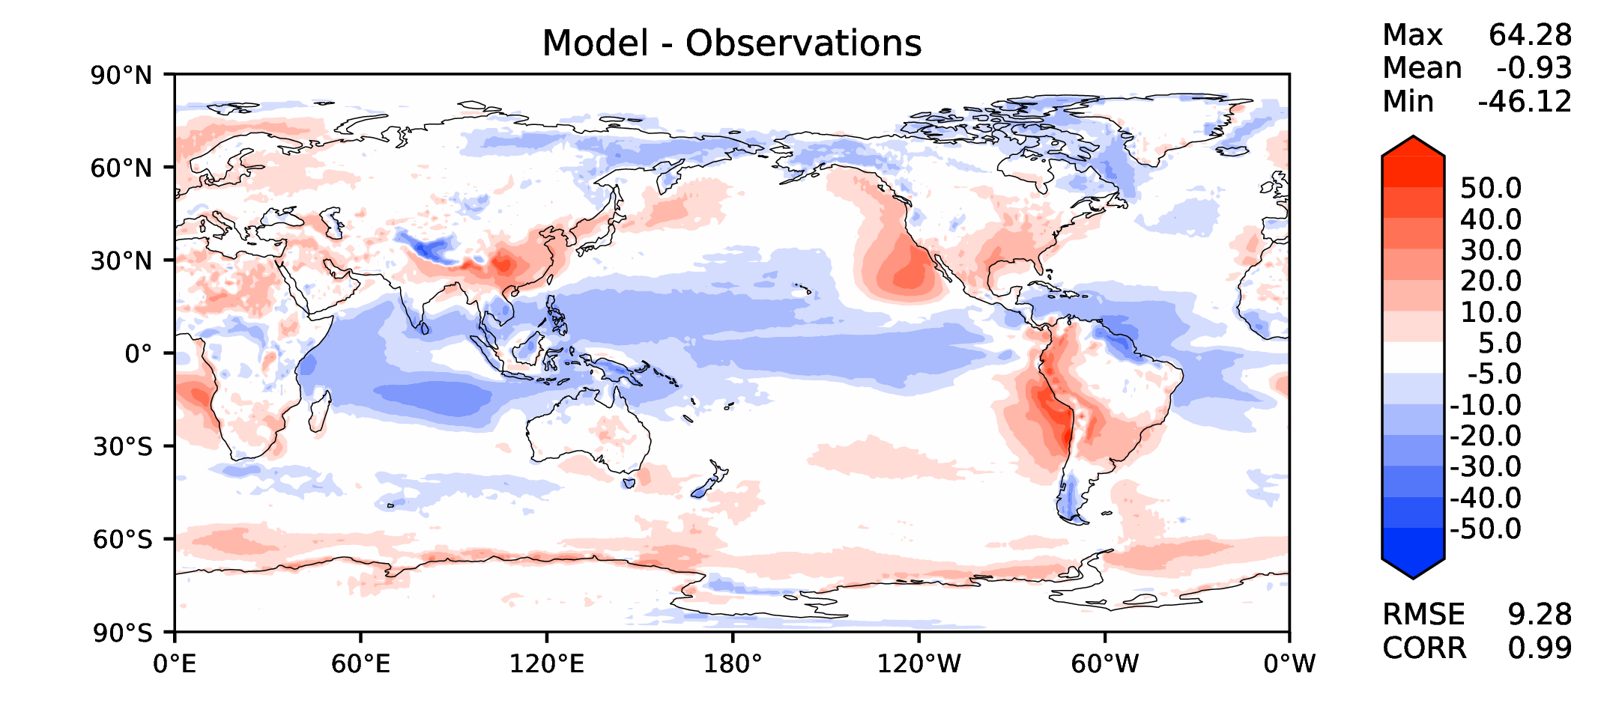
Annual TOA net radiation
DECKv1
maint-1.0
20190730

Slide 9
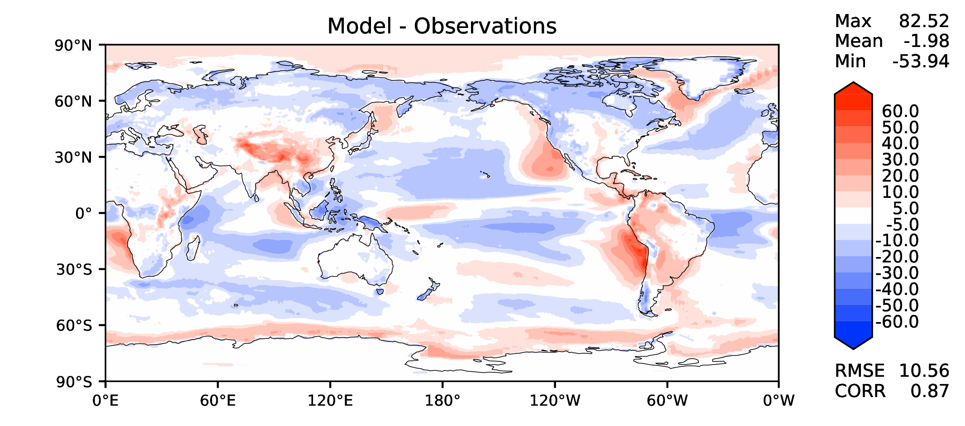
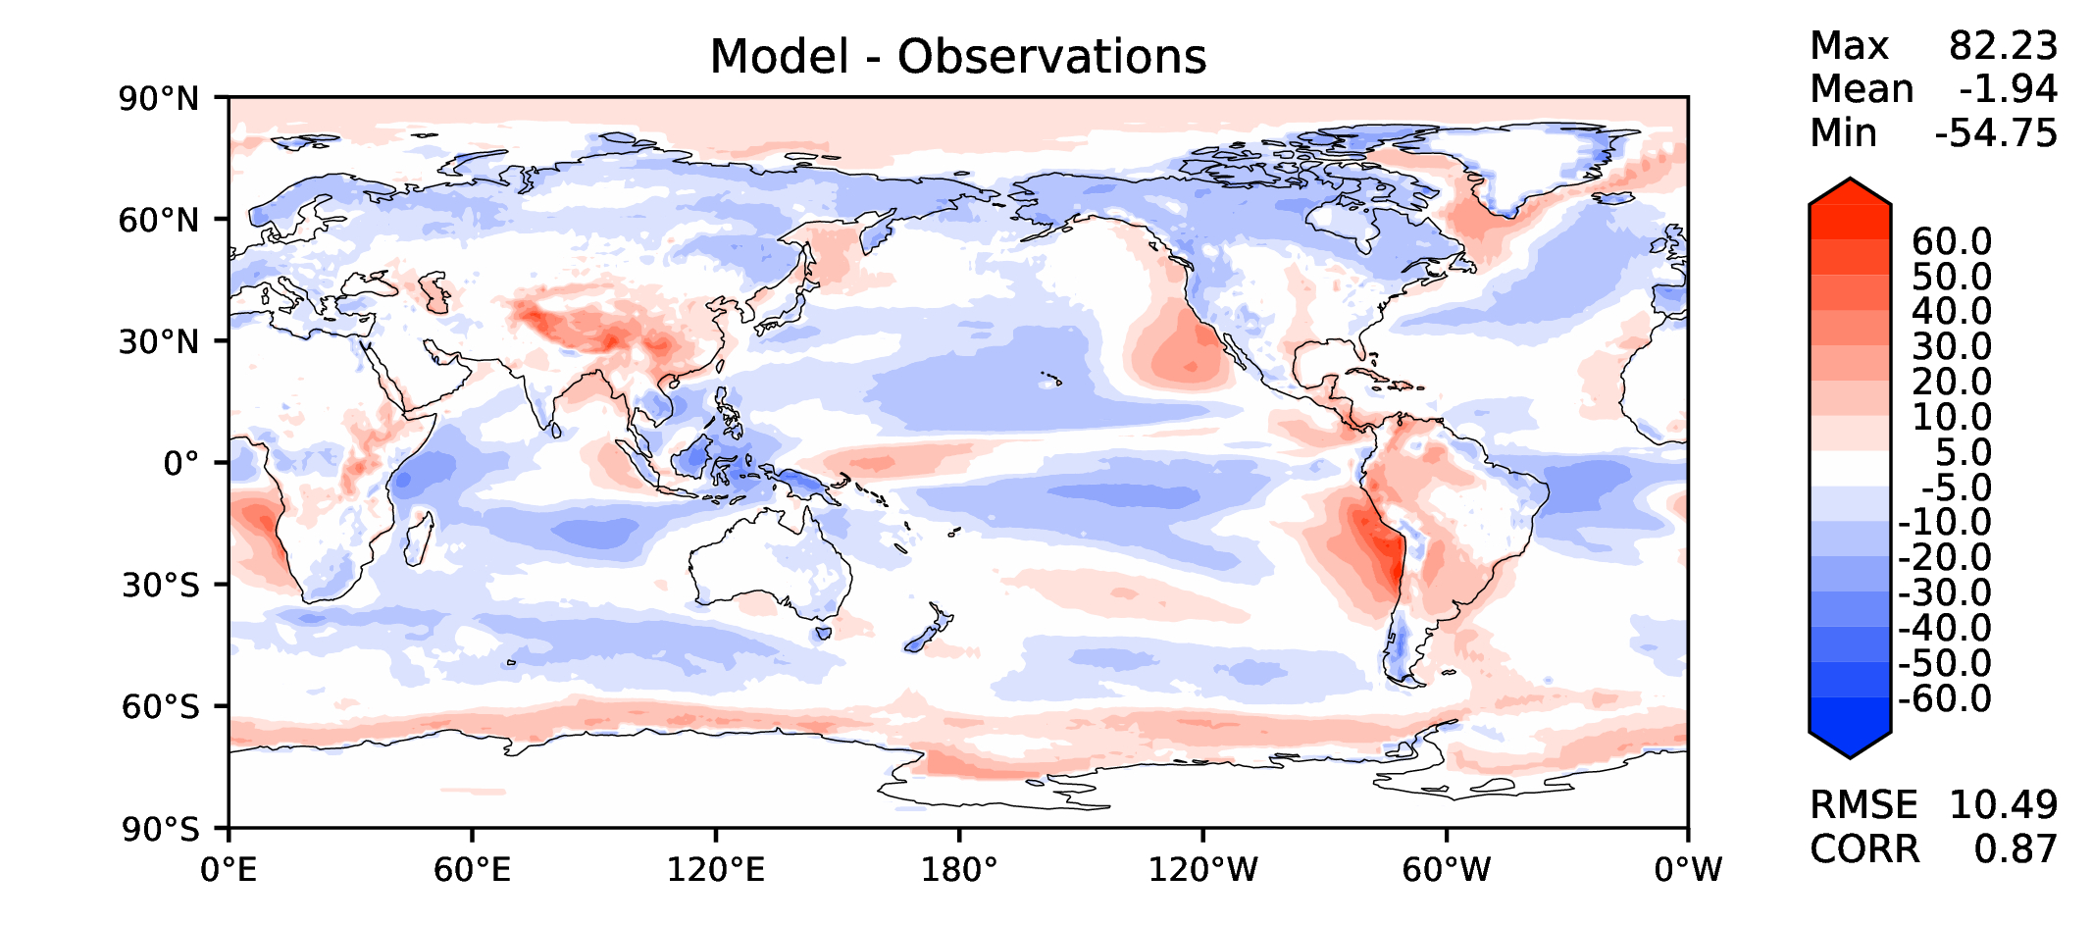
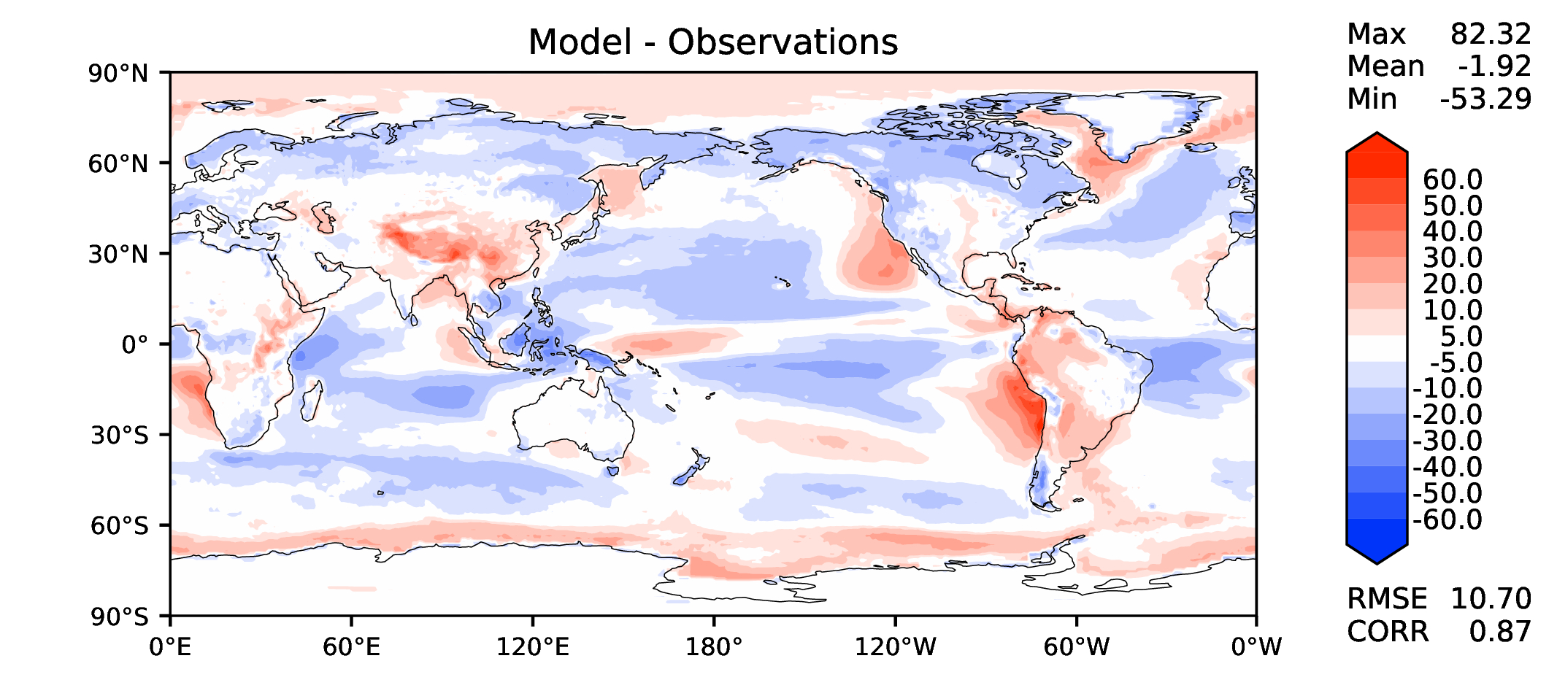
Annual TOA SW CRE
DECKv1
maint-1.0
20190730

Slide 10
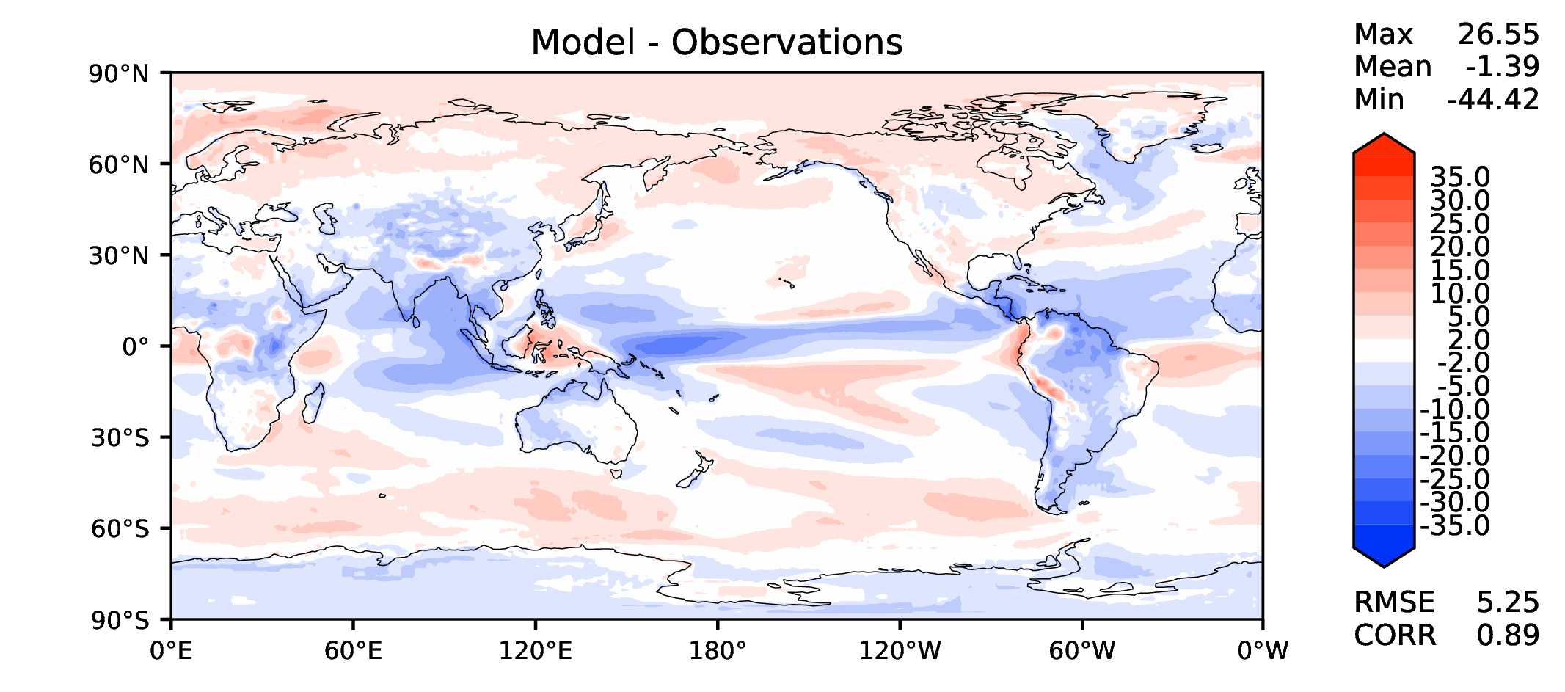
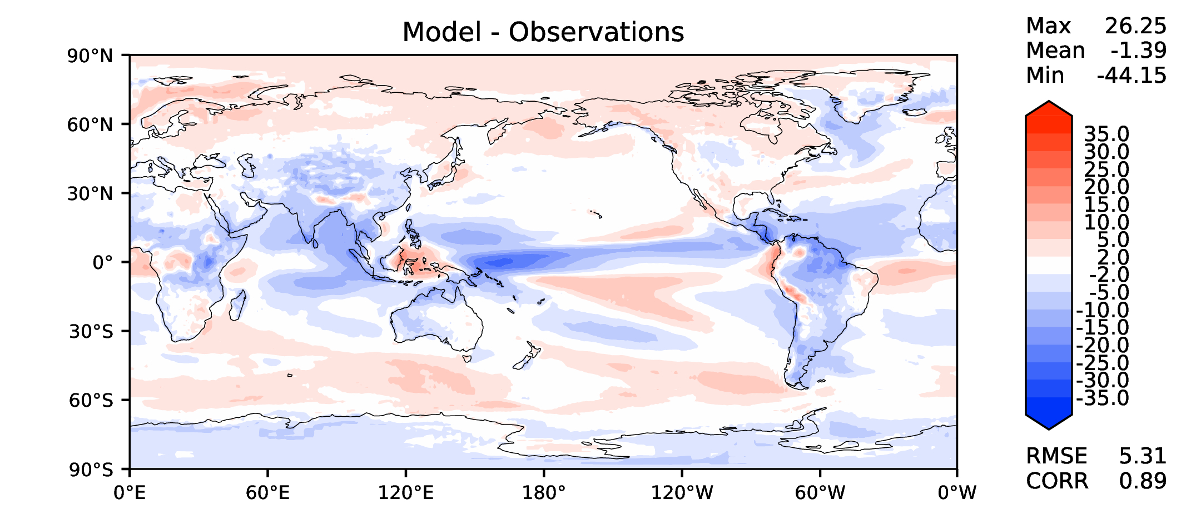
Annual TOA LW CRE
DECKv1
maint-1.0
20190730

Slide 11
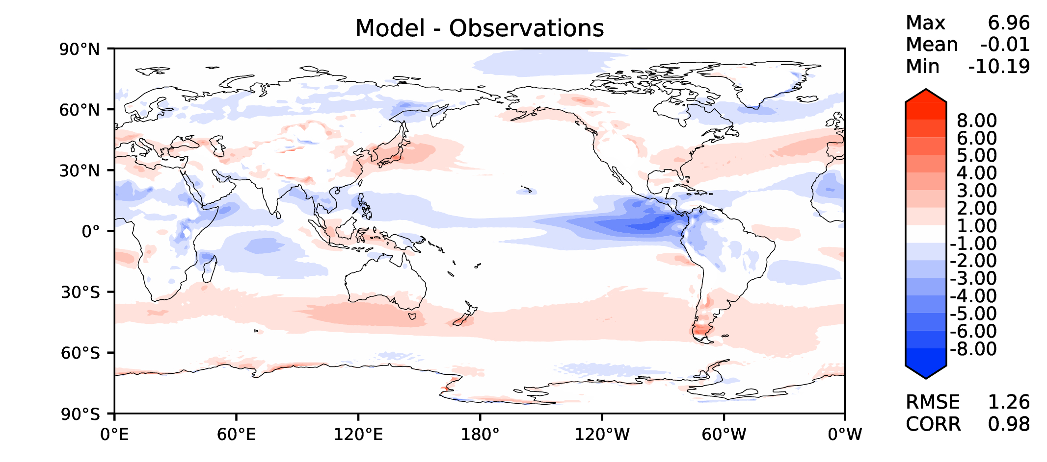
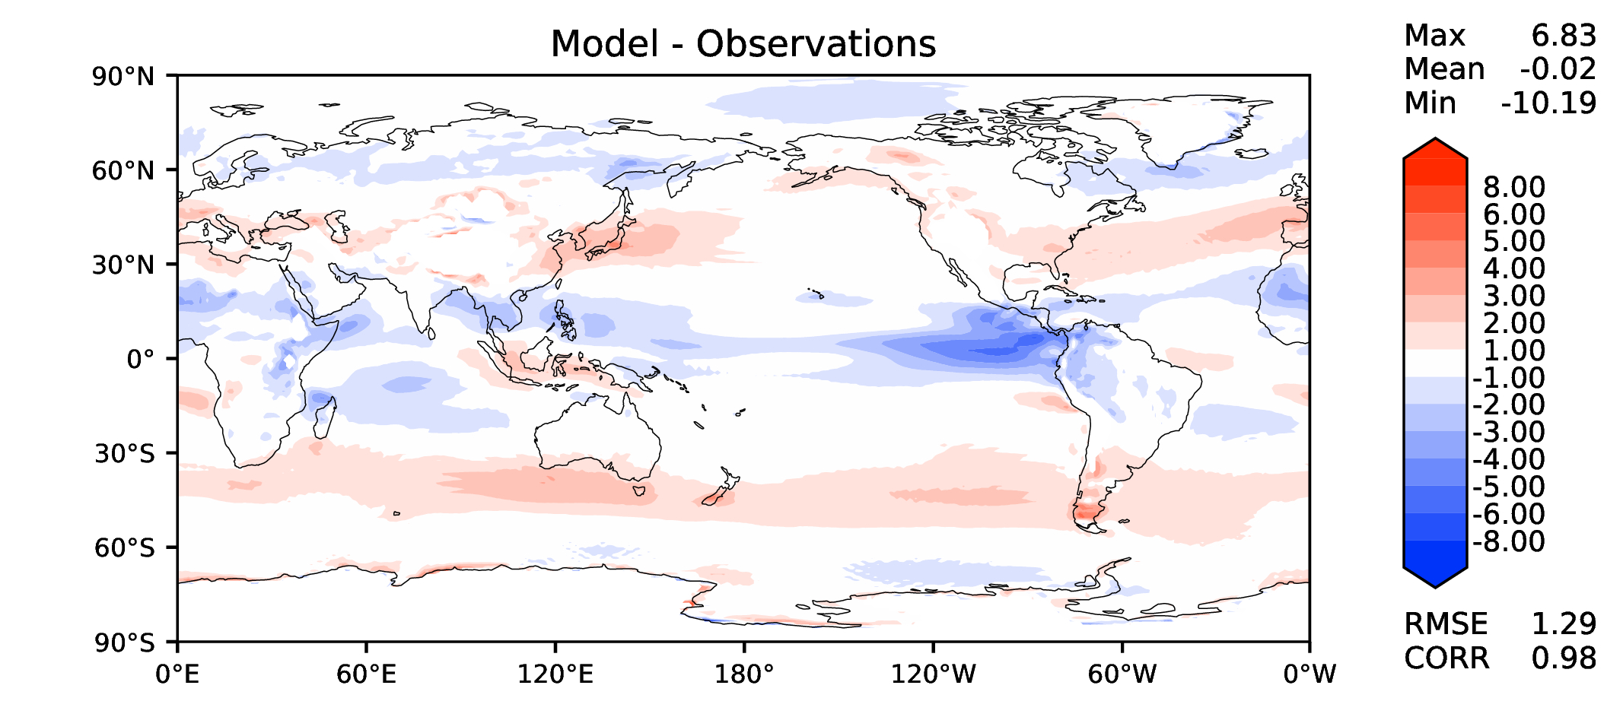
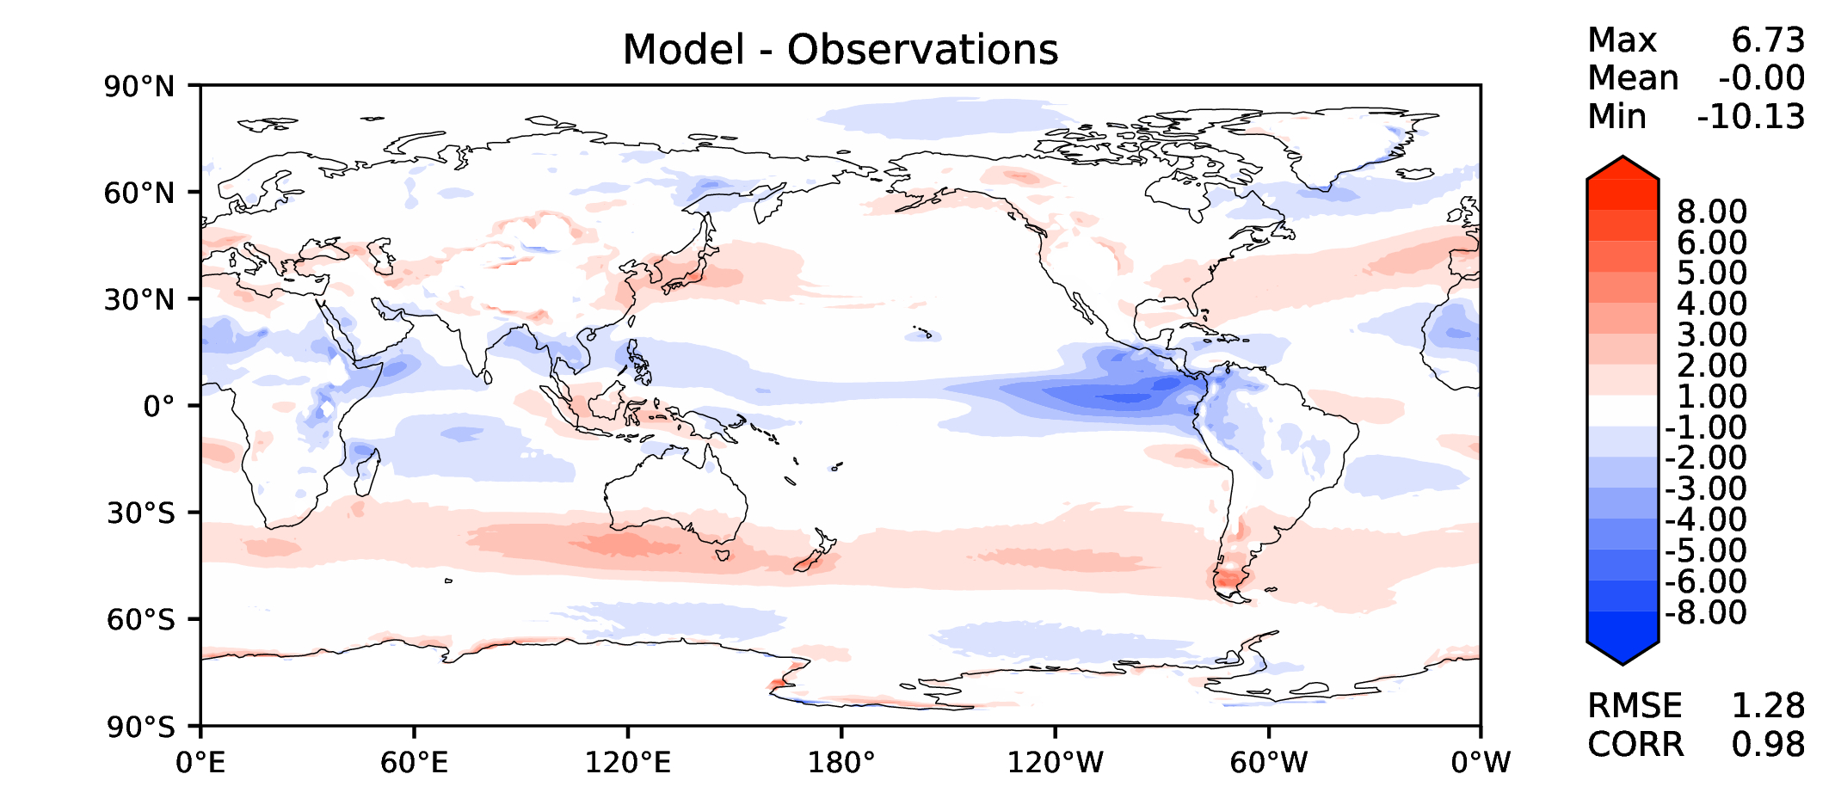
Annual u wind at 850 hPa
DECKv1
maint-1.0
20190730

Slide 12
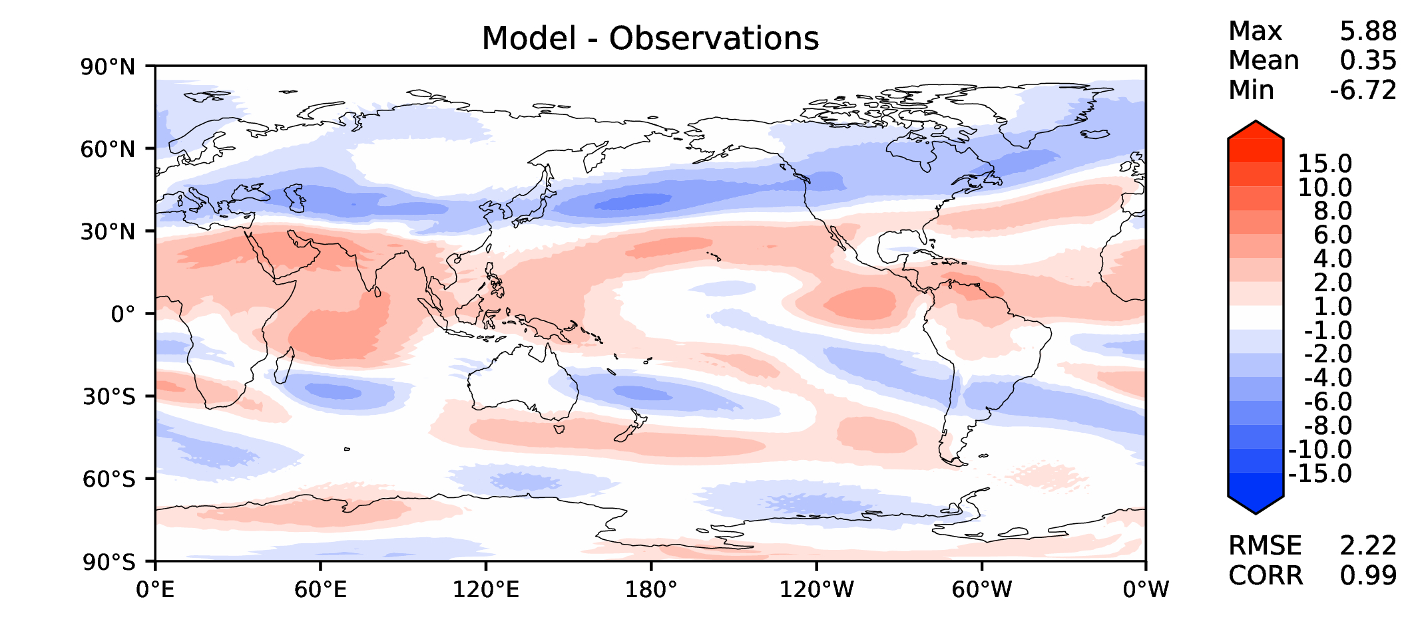
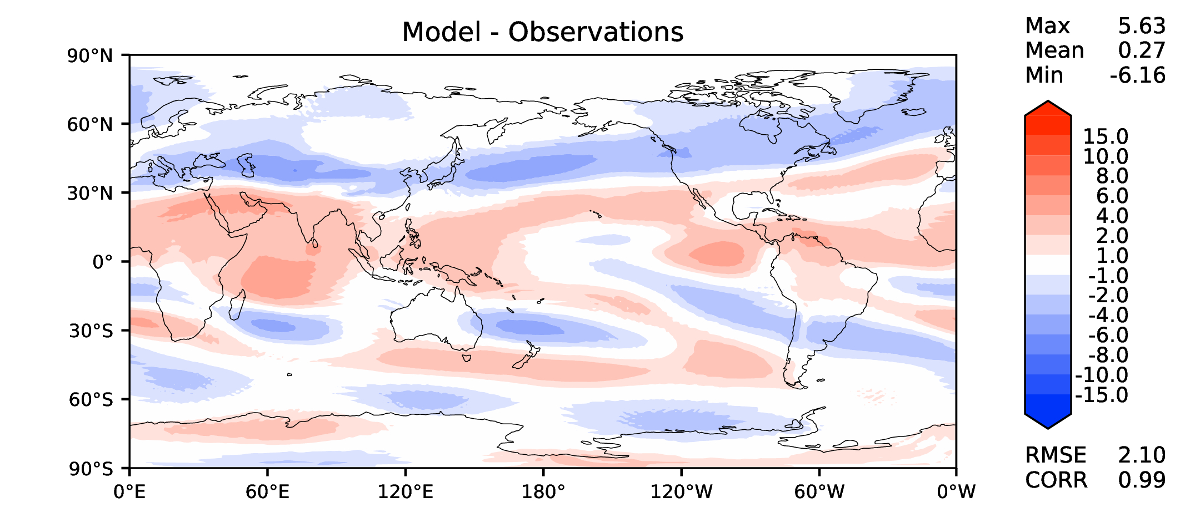
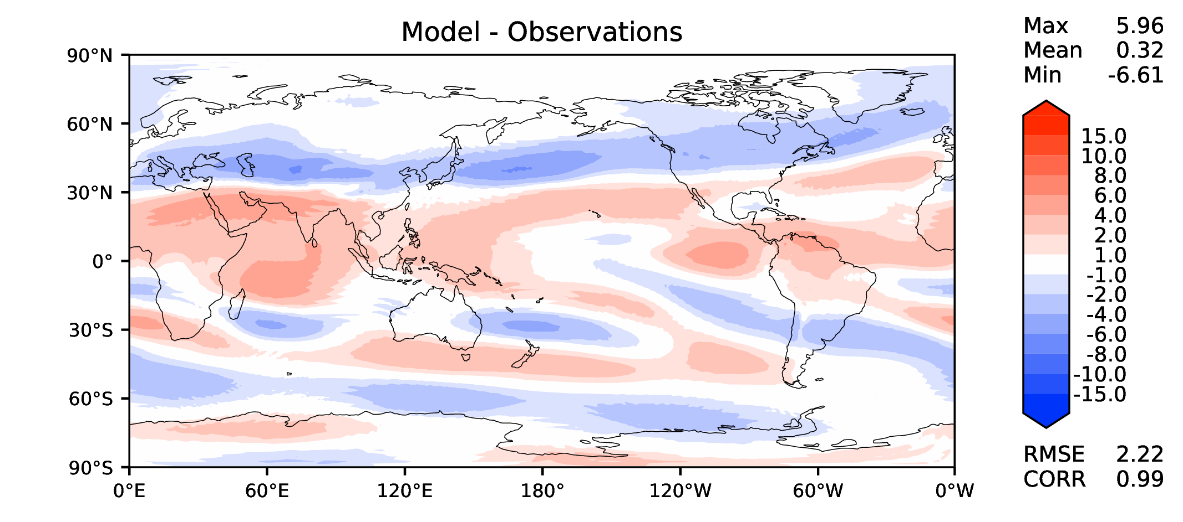
Annual u wind at 200 hPa
DECKv1
maint-1.0
20190730

Slide 13
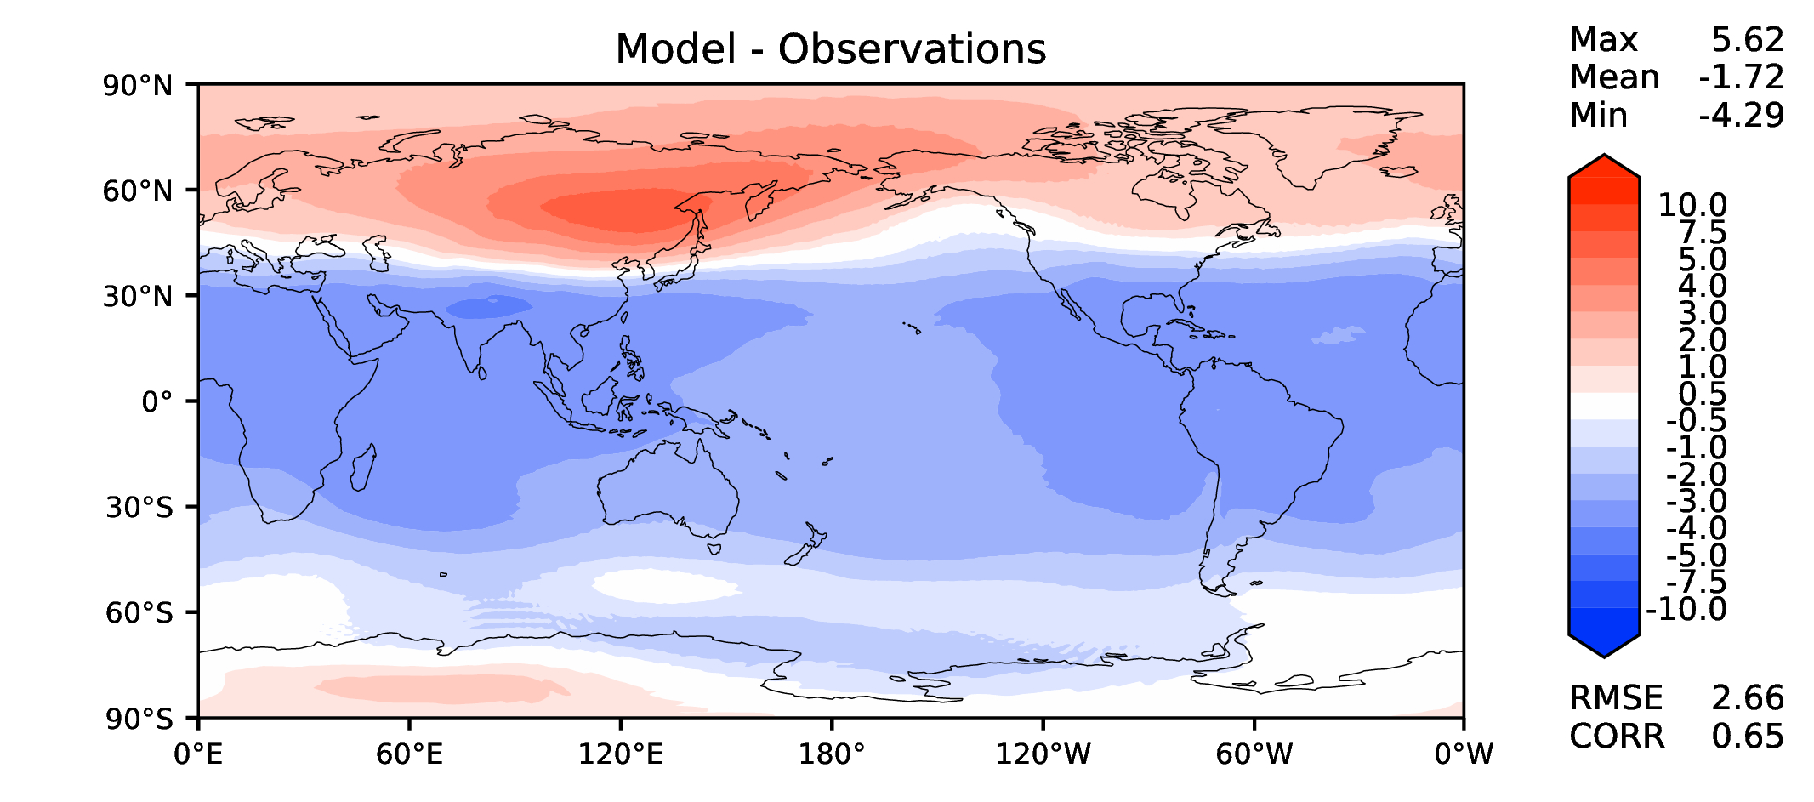
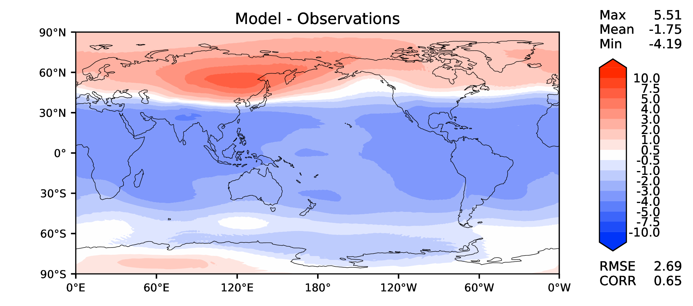
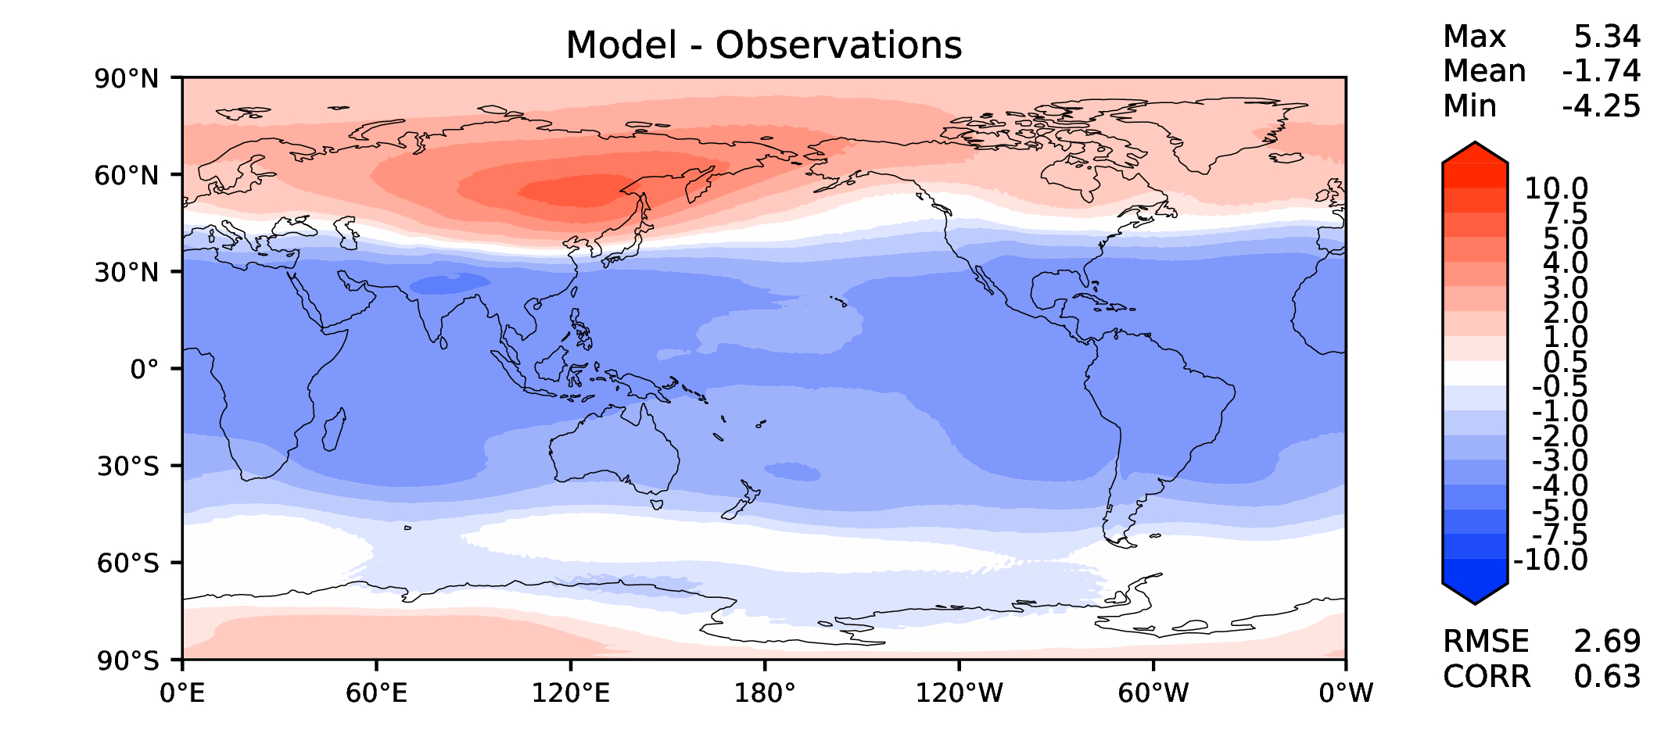
Annual T at 200 hPa
DECKv1
maint-1.0
20190730

Slide 14
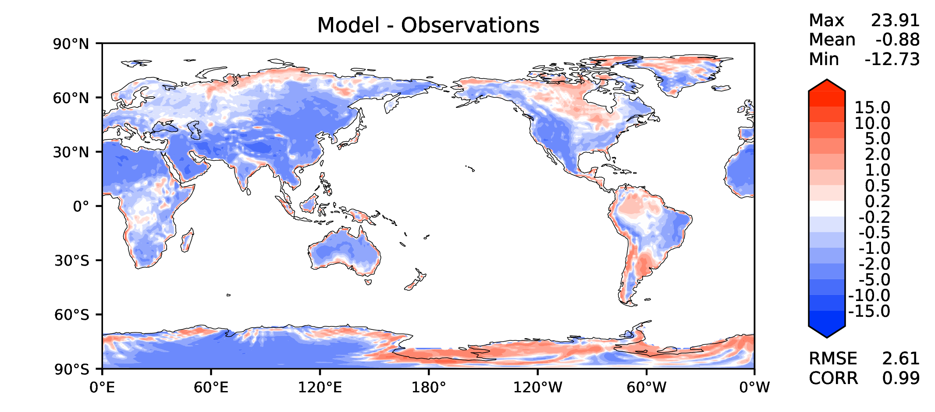
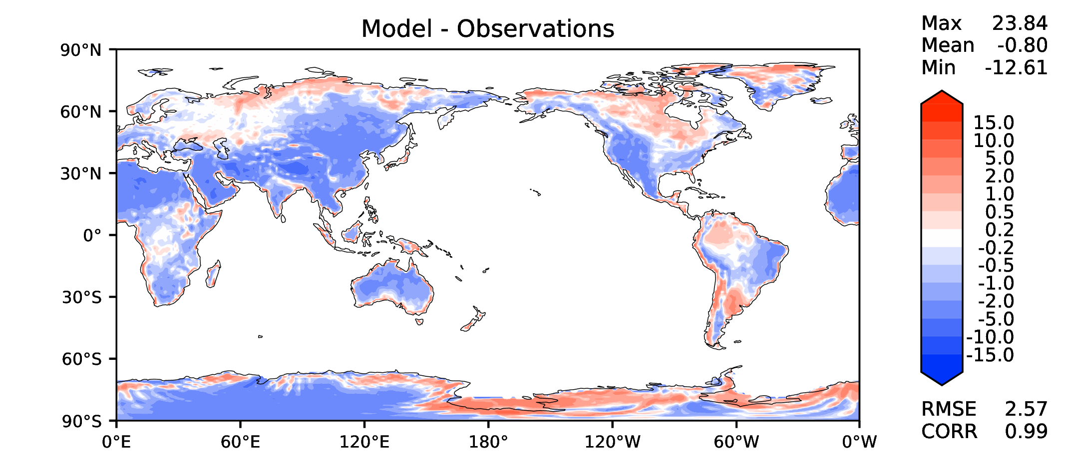
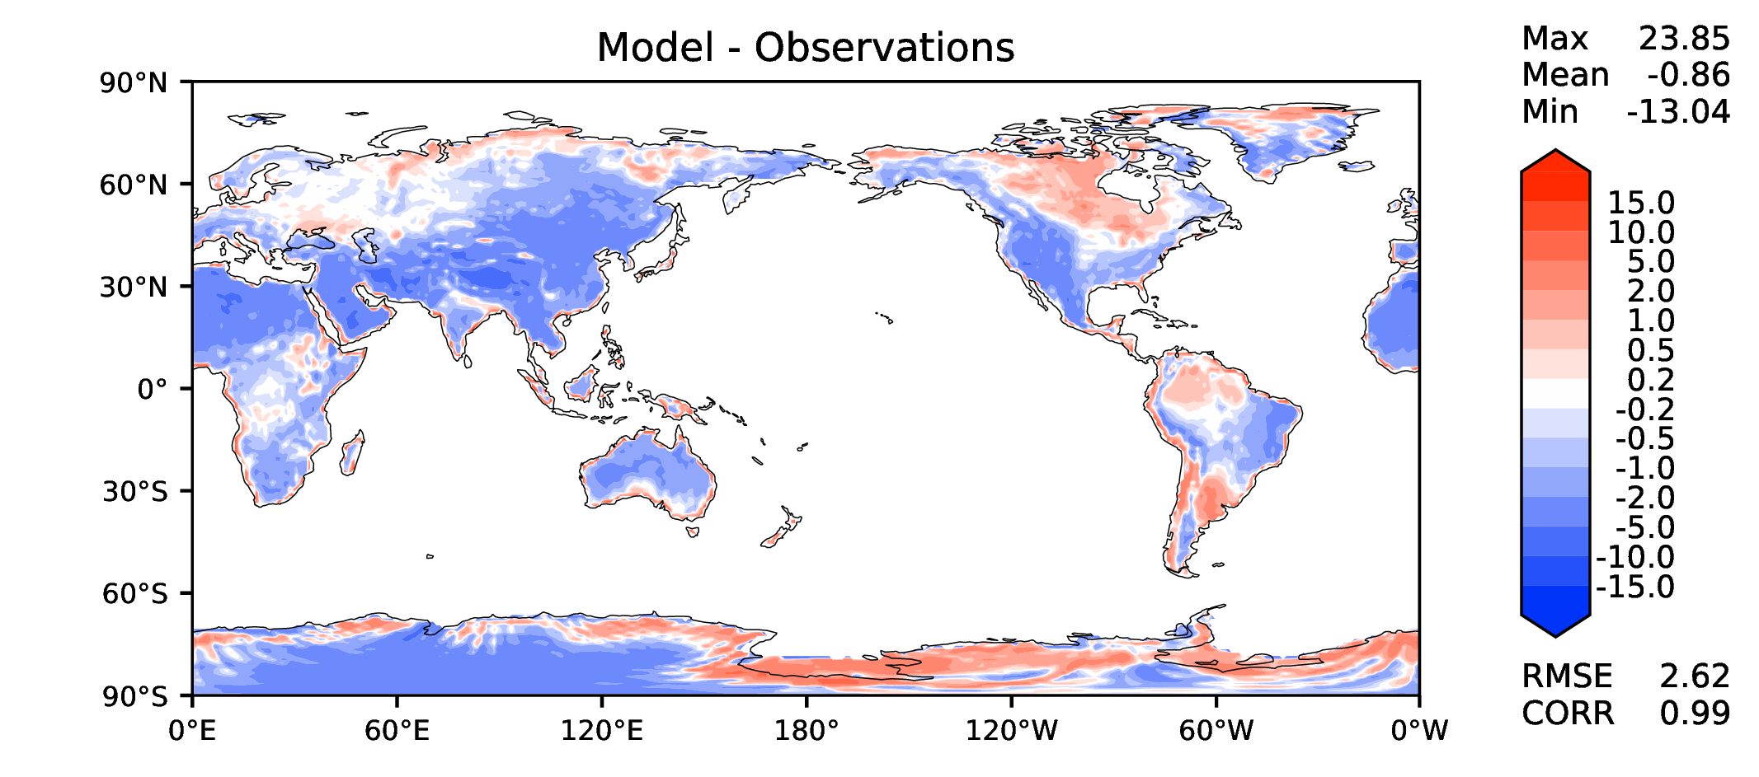
Annual surface air T (land)
DECKv1
maint-1.0
20190730

Slide 15
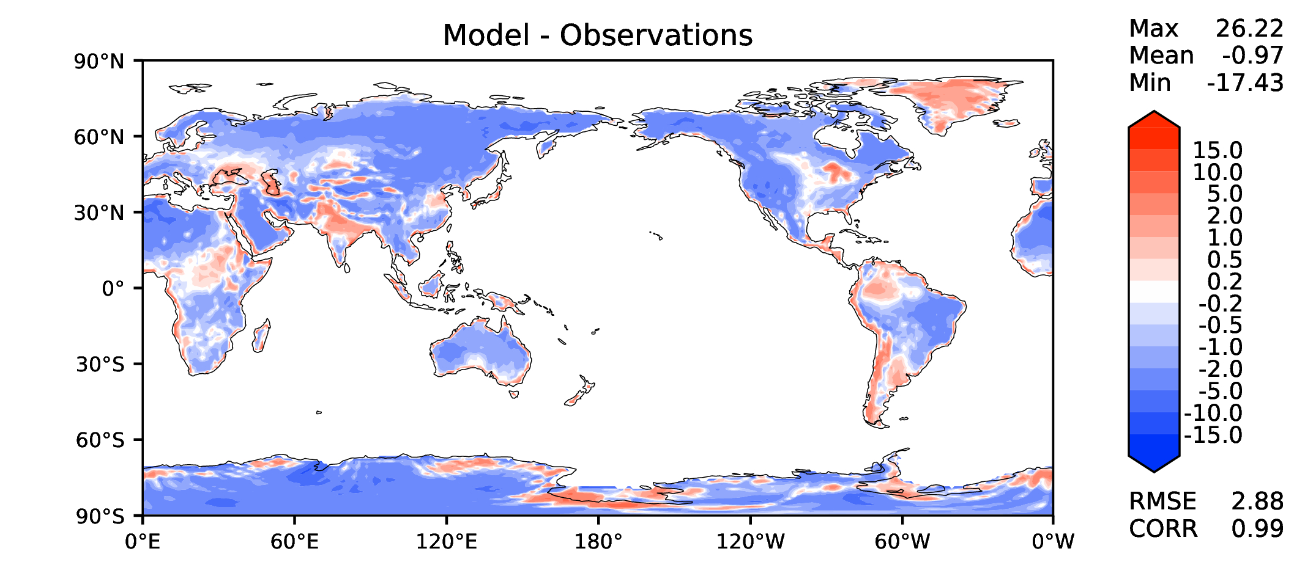
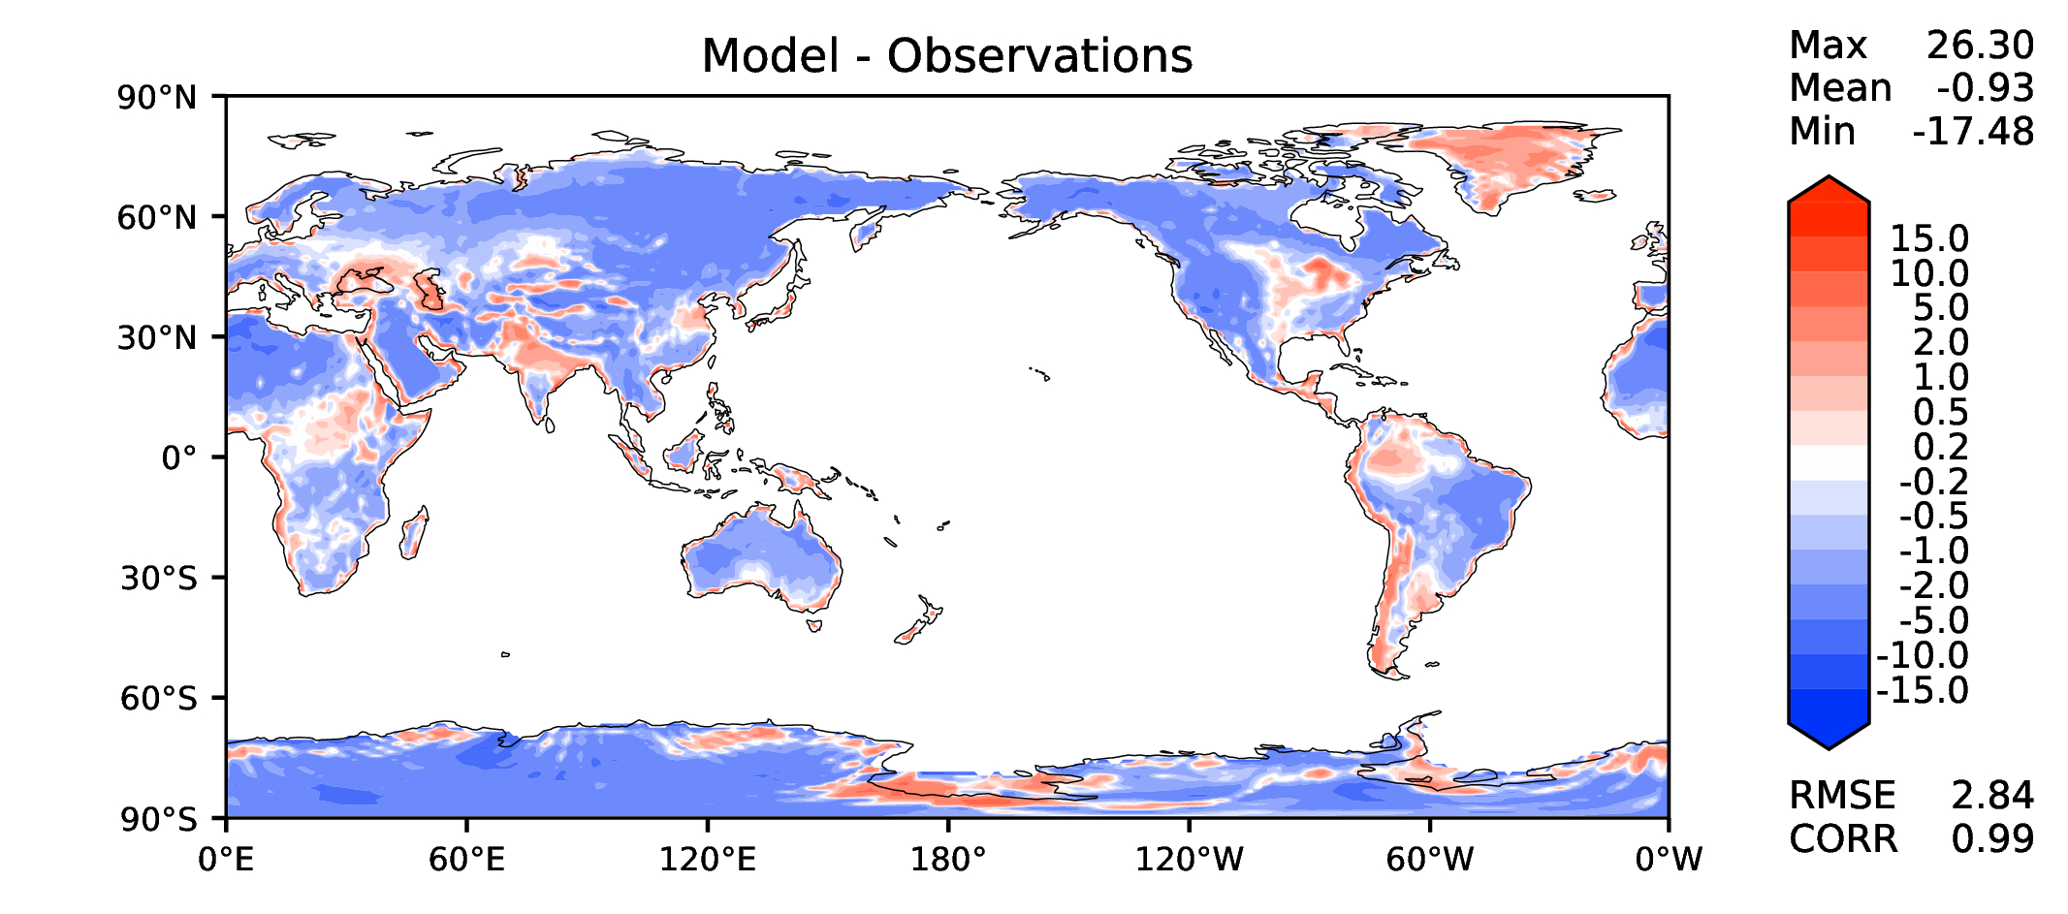
JJA surface air T (land)
DECKv1
maint-1.0
20190730

Slide 16
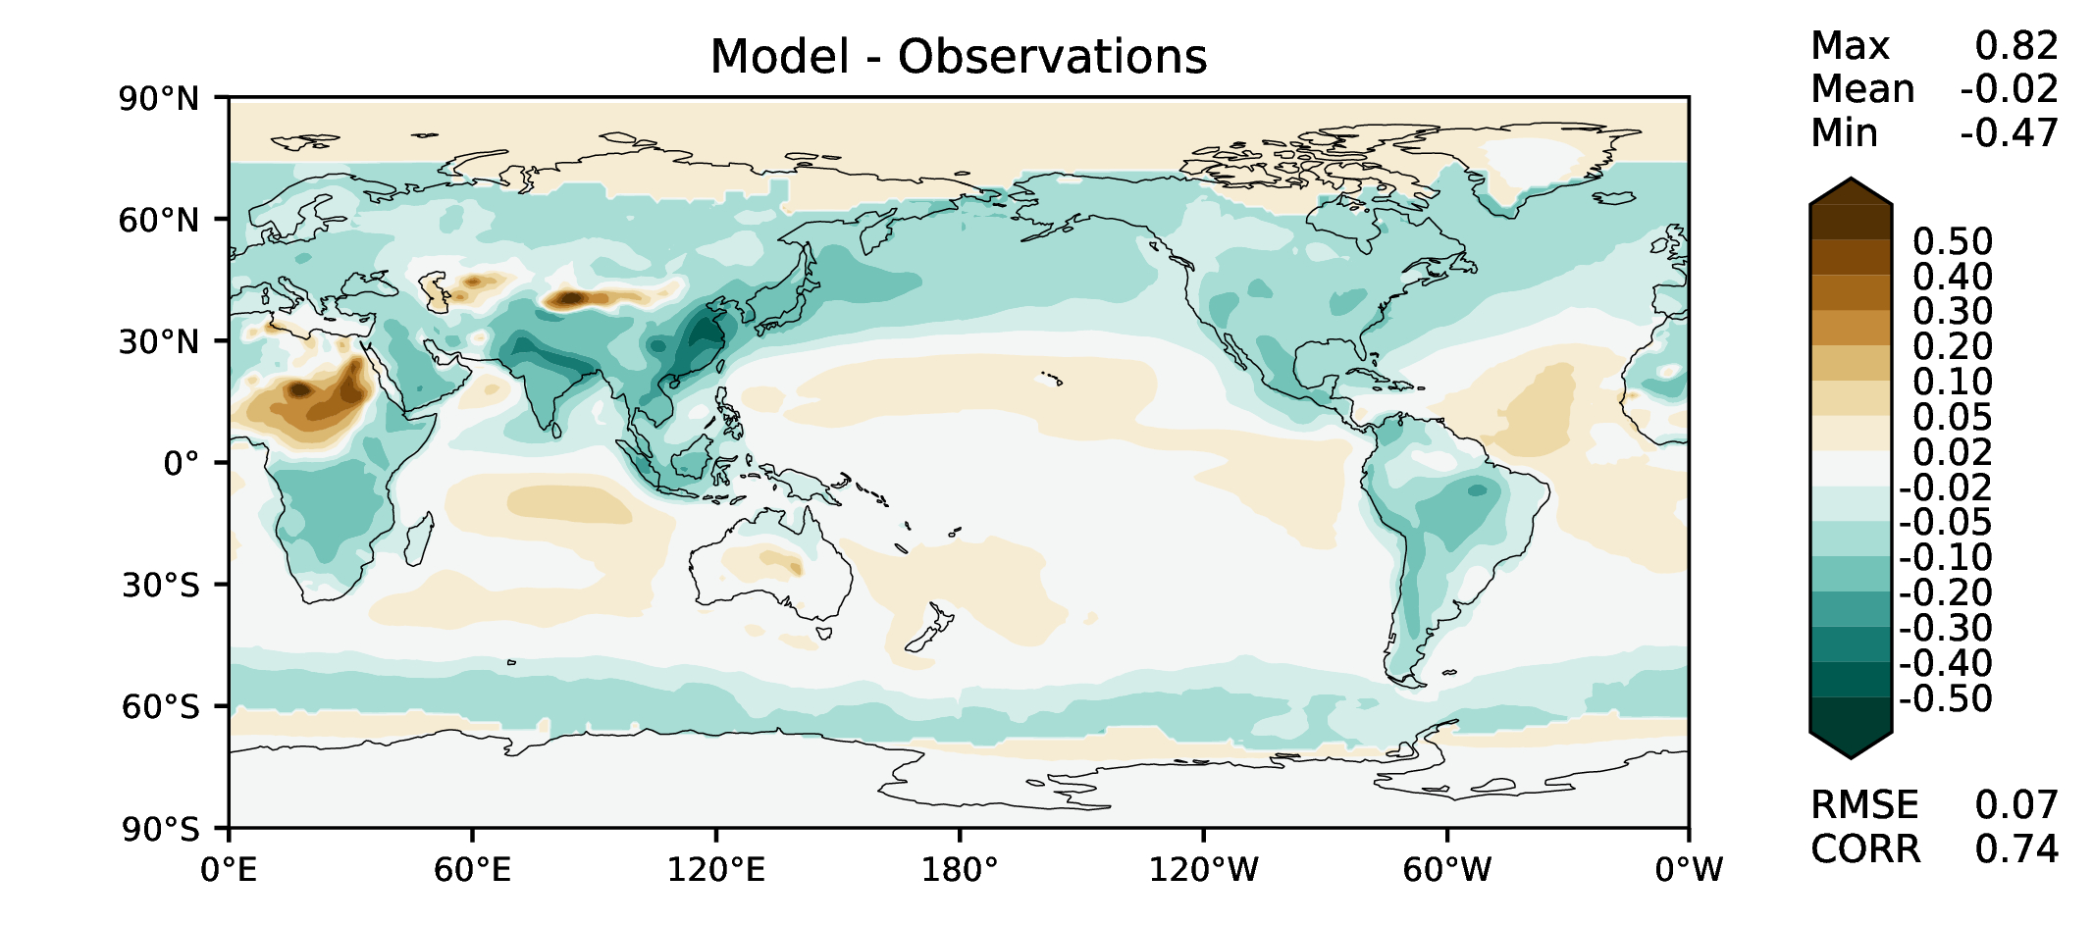
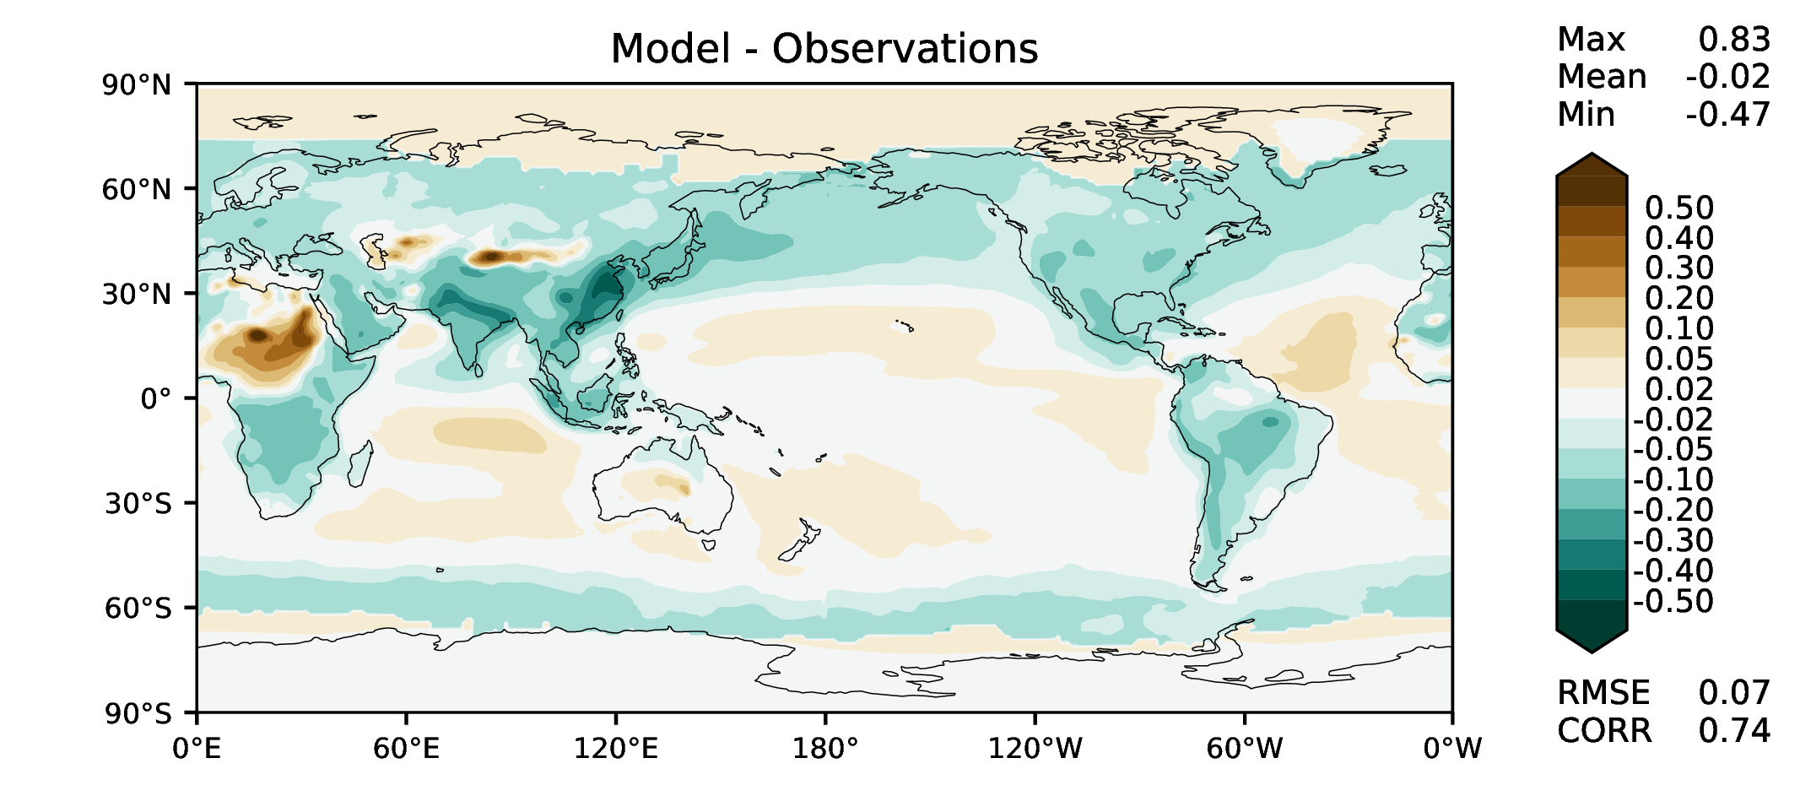
Aerosol optical depth
DECKv1
maint-1.0
20190730

Slide 17
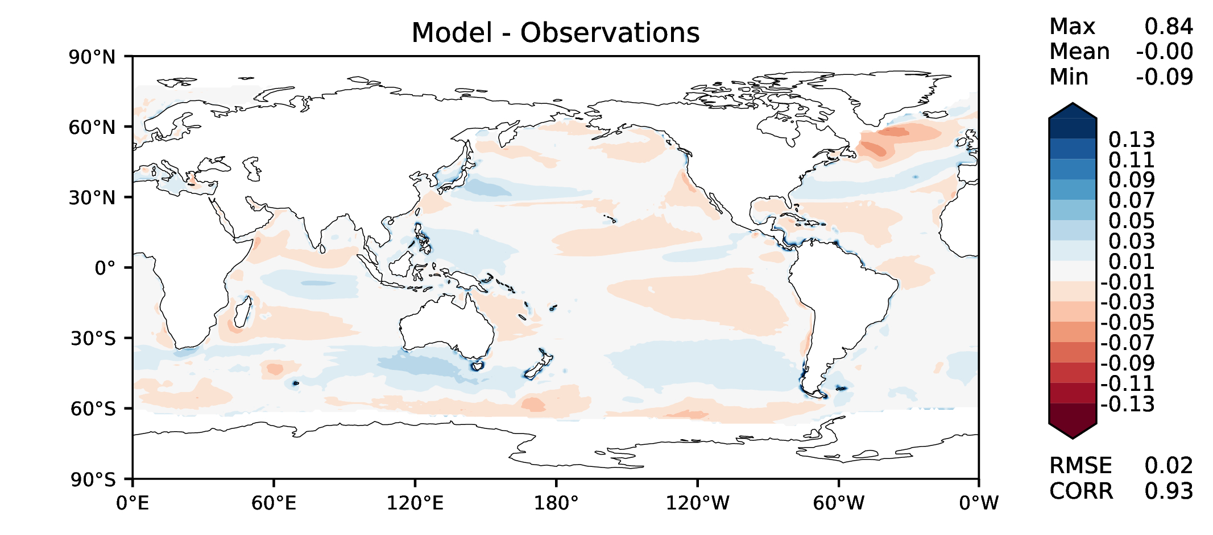
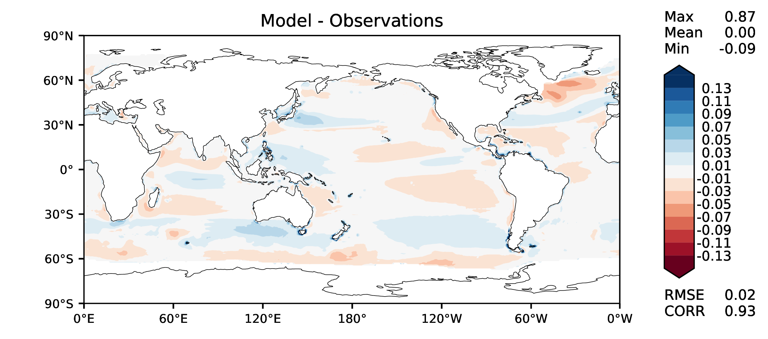
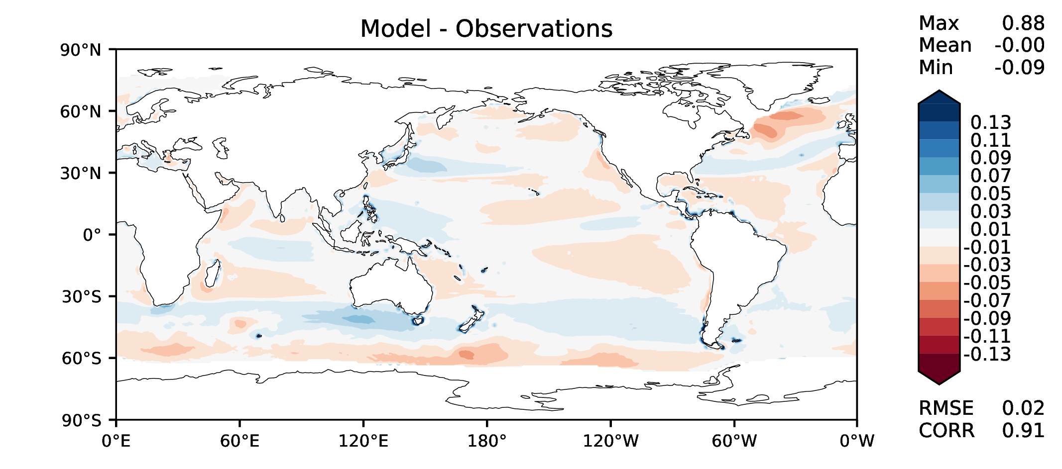
TAUXY ANN ocean
DECKv1
maint-1.0
20190730

